Slide 1
Managing Your Message With a Message Matrix
Rick Borchelt
National Cancer Institute
NIH

Slide 2
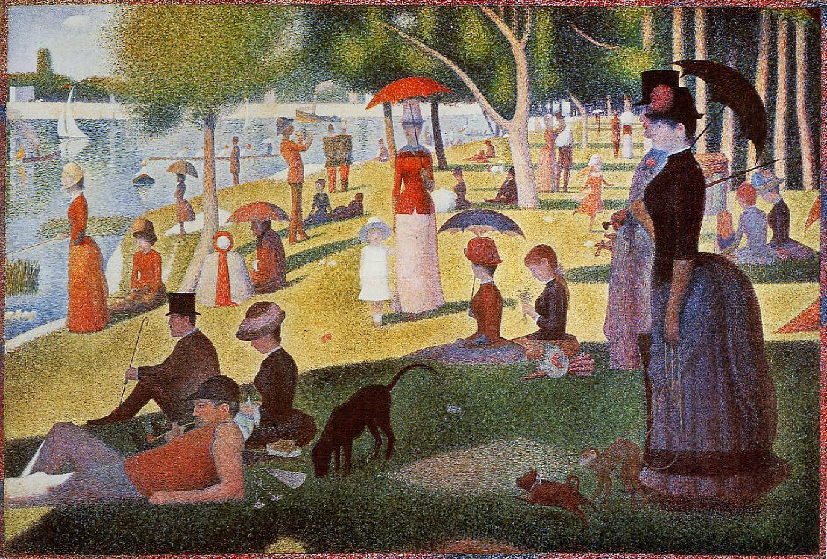

Slide 3
Message Clarity, Fidelity, and Consistency
Clarity: Is the message at the appropriate level of sophistication for the audience? Is the flow logical?
Fidelity: Is the message faithful to larger enterprise messages and to details of the scientific work?
Consistency: Is the basic message content the same over time and with diverse audiences?

Slide 4
Perceived Barriers/Disincentives
“I don’t have time to prepare for the interview (or the talk or the demo, etc.)”
“What if I leave out something important?”
“How can I make sure the reporter/audience uses all the things I say?”
“What if they ask me something I don’t know or I’m not prepared for?”

Slide 5
Constructing the Matrix
Themes: The broadest articulation and context for your conversation
Subthemes: How the theme applies in a variety of circumstances or with respect to multiple situations
Story Lines: Concrete examples that illustrate your subthemes

Slide 6
Constructing the Matrix - 2
Best if simple and uncluttered
No more than four themes (three is better)
This is a cheat sheet, not a checklist – You get to pick and choose, not necessarily get through everything in the matrix

