Slide 1
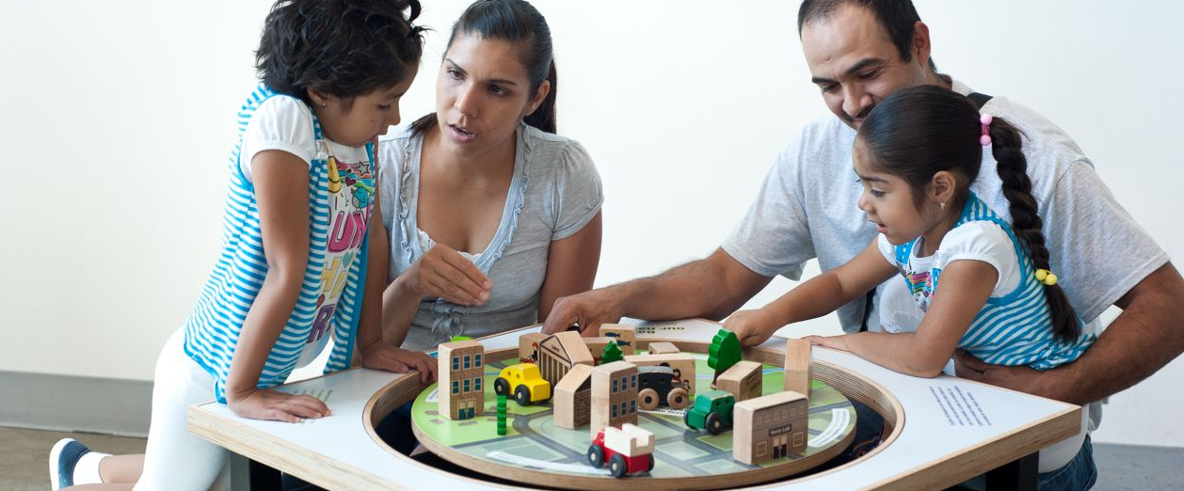
Engaging the Public in Conversations
about Nanotechnology & Society
Network-Wide Meeting
December 2012

Slide 2
Presentation Overview
Nano & Society Workshops
Visitor Conversations
Big Ideas
Improv
Program Activities
Group Discussion

Slide 3
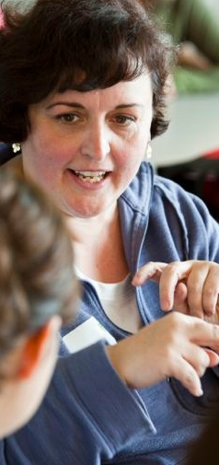
Nano & Society
Workshops

Slide 4
Network Goals for Nano & Society
Public engagement
Create a variety of educational experiences that engage a broad range of public audiences in conversations about the relevance of nanotechnology in their lives.
Professional development
Increase our capacity as a field to effectively engage public audiences in conversations about nanotechnology and society.

Slide 5
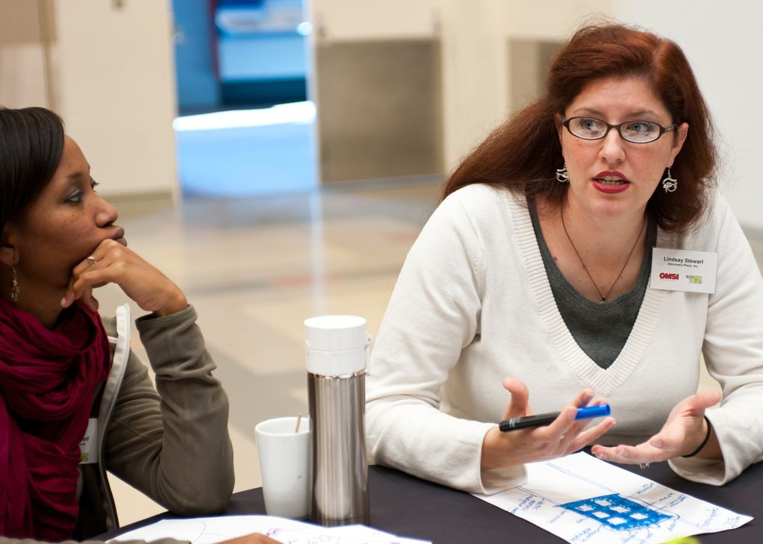
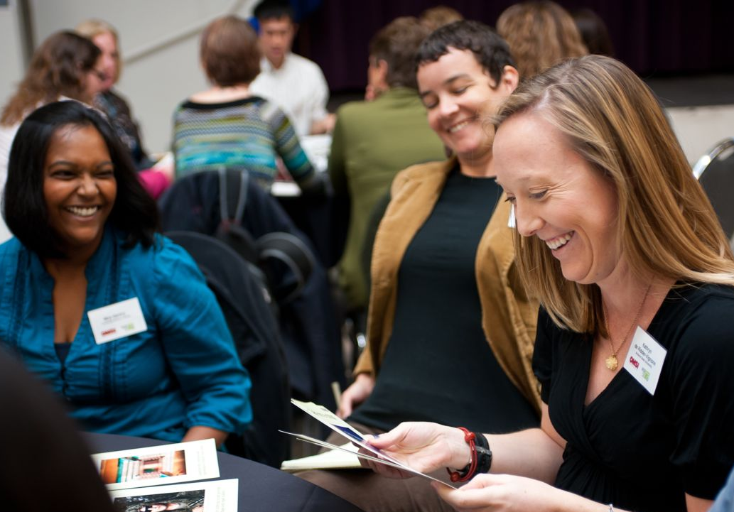
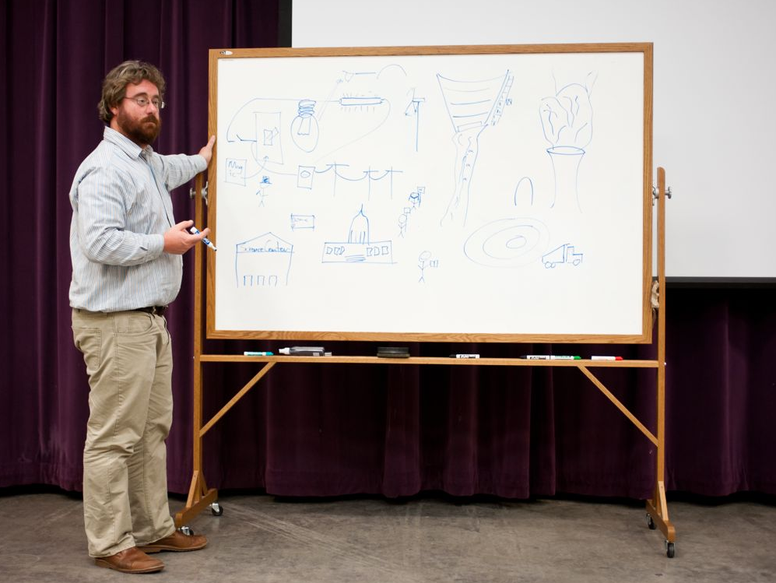
Nano & Society Workshops
Four locations, Sept-Oct 2012
50+ organizations
100+ participants

Slide 6
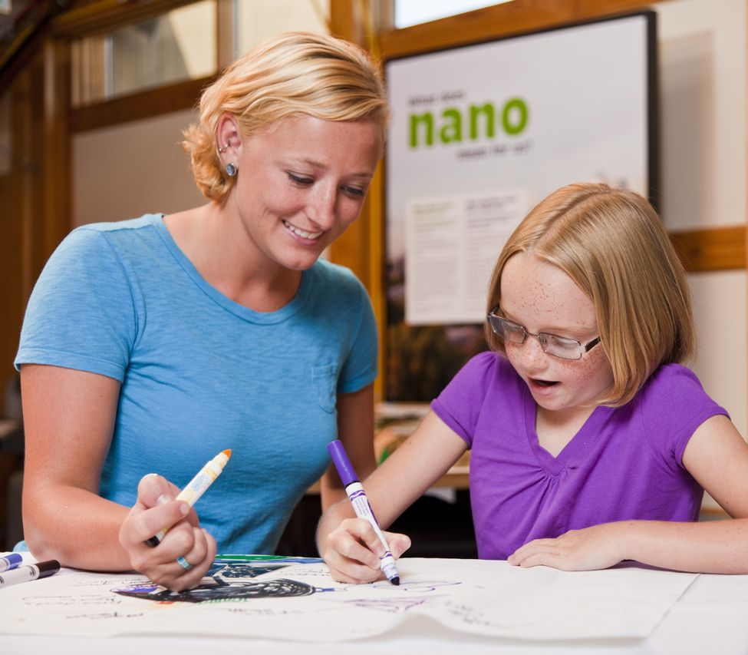
Nano & Society Workshops
Overarching goal: To empower staff and visitors to reflect on the relevance of nanotechnology in their lives.
Rationale:
Museums can bring together public audiences, educators, and scientists.
NISE Net can raise the field’s capacity to engage the public in the relevancy of emerging science and technologies to their everyday lives.
Notes:
The field is moving in this direction…
“Address key issues of significance to society locally and globally for which science understanding and public engagement are essential”
ASTC Strategic Plan, October 2008
“Children’s museums will be essential community resources where play inspires creativity and lifelong learning”
ACM Strategic Framework, 2011-2015

Slide 7
Visitor
Conversations

Slide 8
Goals for Conversations
Educators and visitors participate in open-ended, engaging conversations.
Educators and visitors have distinct, equally important roles in the conversation.
Participating in a conversation is a meaningful learning experience for visitors.
Facilitating a conversation is a valuable interpretive method for facilitators.
Notes:
Refer to handouts:
Tips for Visitor Conversations
Conversation Cheat Sheet
Big Ideas Guide
http://www.nisenet.org/community/events/other/nano_society_workshop

Slide 9
Sprinkling on Nano & Society
Courtesy Tracey Wilhelmsen, Tracey’s Culinary Adventures
Notes:
In this workshop, we’re focusing on having CONVERSATIONS with visitors about nano and society.
Let’s start with an analogy to understand this approach better. What does it mean to have a conversation with visitors about nano and society?
Let’s pretend that this cupcake is a a program about a revolutionary new nanotechnology. Now, let’s imagine you’re on the floor of your museum and you are going to deliver this cupcake program.
How are you going to have a conversation with visitors about the cupcake and why it’s so important? There are two ways you could do this.
You could talk all about the technology (that’s the cupcake) and how its made and who invented it and it what it does… and THEN on top of all that you could start talking about societal and ethical implications. That would be the “sprinkling it on” approach. The “societal and ethical implications” are the sprinkles on the cupcake.
In this approach, we place the sprinkles on top after the cupcake has been baked…or in our case we sprinkle the nano and society on top of the program. In this approach, we’re thinking about society separately from the technology. We typically don’t just sit around and eat sprinkles…just as we don’t sit around and talk about how a technology can impact our lives without understanding what the technology is in the first place.
Sometimes, by taking this approach we may already be throwing up barriers for visitors or staff. It can make talking about the connection between nano and society seem scary, or unnecessary, or just one more thing to try to add on to the interaction. We aren’t used to seeing a program with societal and ethical issues being called out intentionally. We’re not trying to call special attention to the issues by placing the sprinkles on top. In fact, the societal issues are always there, it’s just now the role of the educator to help the public see them.
As you’ll learn throughout this session, technologies are part of systems and we should be talking about them as a whole, not as any one independent thing.
So instead of using this approach, let’s try mixing the sprinkles--or the nano and society issues--into the batter.

Slide 10
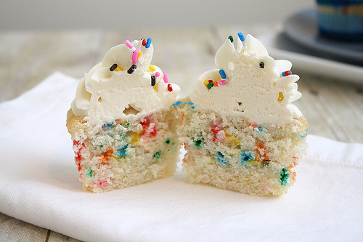
Baking in Nano & Society
Courtesy Tracey Wilhelmsen, Tracey’s Culinary Adventures
Notes:
Here is a cupcake with the sprinkles baked in. Today we’ll be focusing on some techniques teaching you how to essentially “bake” societal and ethical conversations right into your programs about nanotechnology.
Talking about the social and ethical issues surrounding certain nanotechnologies is an integral part of the whole conversation. Our goal is to integrate these issues into the conversations we’re already having with visitors, so that we can talk about the relevance of nano to their daily lives.
So, there are two ways of doing programming about nanotechnology and society: you can do them separately by sprinkling them on top or you can do them together by baking them into your conversations in an integral way.
By putting the sprinkles inside you essentially infuse the nano and society throughout the entire program.
The point is that there are two different approaches for talking about nanotechnology—and here we’ll focus on conversations, on “baking in” the nano and society.

Slide 11
How is this Different?
Demonstration
Scientist/educator has knowledge and expertise to share
Visitors discover phenomena and laws of nature
The facilitator communicates facts
Visitors ask questions and receive answers
Public understanding
Use this approach to explain the Bernoulli Principle to visitors
Conversation
Everyone has their own values and perspective to share
Visitors form opinions and explore ideas
The group considers facts and values
Facilitators and visitors ask questions and receive responses
Public engagement
Try this approach to engage visitors in nano and society
Notes:
HANDOUT the Conversational Cheat Sheet and Tips for Visitor Conversations and refer to both.
OK, here we’re going to look at both the demonstration and conversation side by side. Keep in mind, we’re not suggesting that you abandon the demo…think of them as two different approaches
These conversations are often based on questions about values. Example: What do we want the world to be like in the future? This is not something you can research and uncover the correct answer. Each visitor will have a different response and no response is wrong.
Scientists are not the experts in this topic, and neither are you or your visitors. Everyone has their own values and makes their own decisions about how a technology impacts their lives. This means you’re not on the spot to be the expert to know everything about nanotechnology and how it might affect our lives. You’re just there as a facilitator trying to get the visitor to explore and express their opinions and values. There is no right or wrong answer. There will always be things we don’t know. Science can only inform us and help us make our own decisions based on the facts.
For some educators, this might be a big change. The center of expertise shifts when you’re talking about how nano will affect individuals and society as a whole. Visitors have important expertise here: they have the best idea of how something will impact their lives. They have an equal place in the conversation, alongside educators and scientists.

Slide 12
Let’s Go Fishing!
Notes:
One of the common things visitors say as they approach is, “What do you have here?” They’re expecting you to show them something and/or give them instructions to try something, and then for you to explain it. So if you immediately turn that interaction into a question rather than showing something or providing instructions, you’re changing the dynamic and the expectation about the role of the facilitator and the visitor. At this point, your role as facilitator is to help them articulate their reasoning and work through their thought process and how they got there.
You don’t have to try to wrangle societal and ethical implications into every program you do, just be ready to let the conversation go that way if visitors are interested. One way to think of it is a fishing analogy…
And if someone’s not interested in having a conversation about nano and society, that’s fine too. Don’t force these conversations.
At what point do you set the hook? We’ll learn several techniques throughout the day that will help you fish for conversations at your museum.
Remember you don’t have to know everything about nano and society to have these conversations, you don’t have to teach a lesson in nano and society, there are a handful of things that folks could get interested in and if they seem interested, reel them in and have a conversation.
Lead with the intersections with everyday lives (the bait), build with familiarity and then expand from there.
This is a different type of engagement for us, it’s a new way of approaching our visitors. You’ll learn more throughout the day as to what to do with the visitor once you have them hooked from Jamey, Ira, Improv etc…

Slide 13
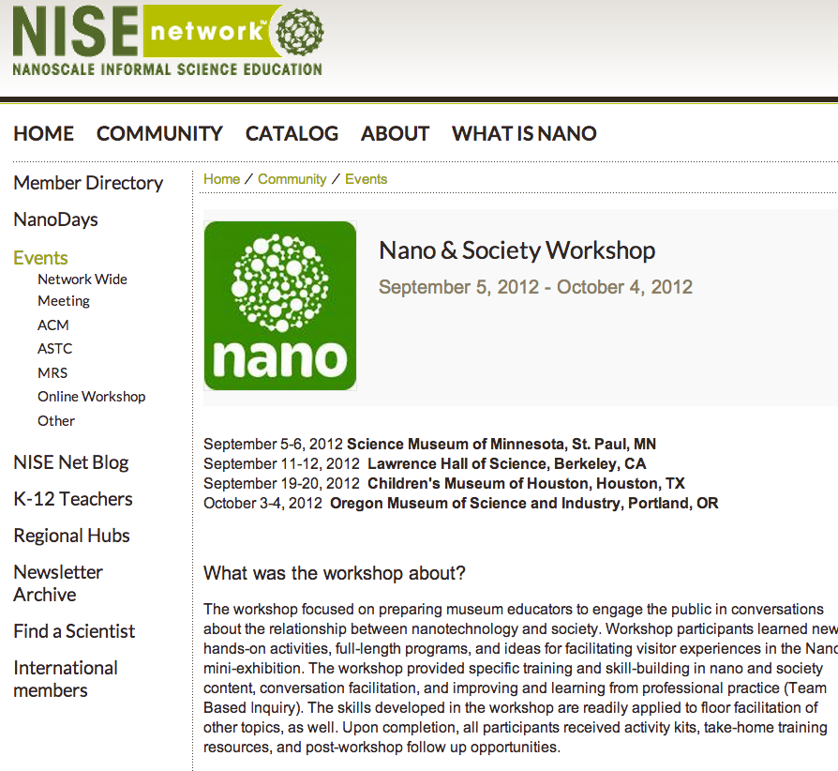
Workshop Online Resources
r
Tips for Visitor Conversations
Conversation Cheat Sheet
Big Ideas Guide
Improv Exercises
http://www.nisenet.org/community/events/other/nano_society_workshop
Notes:
http://www.nisenet.org/community/events/other/nano_society_workshop

Slide 14
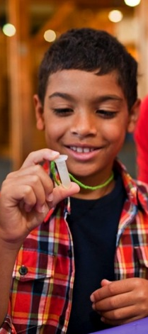
Big Ideas

Slide 15
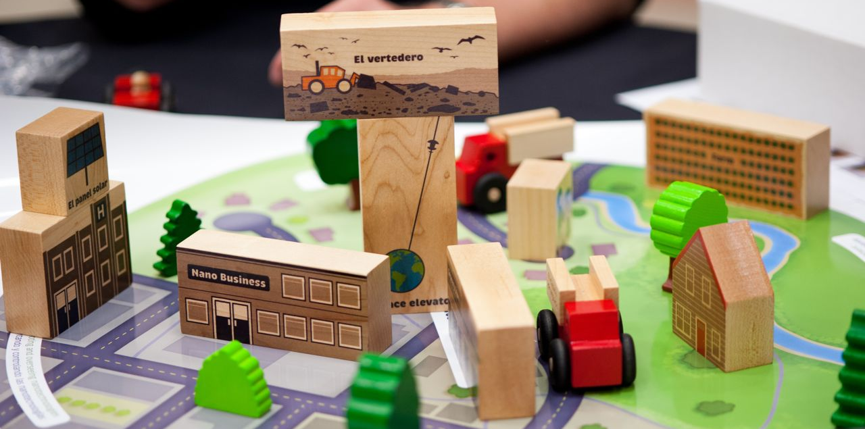
Three Big Ideas
1. Values shape technologies.
2. Technologies affect social relationships.
3. Technologies work because they’re part of systems.
Notes:
Refer to Big Ideas Handout

Slide 16
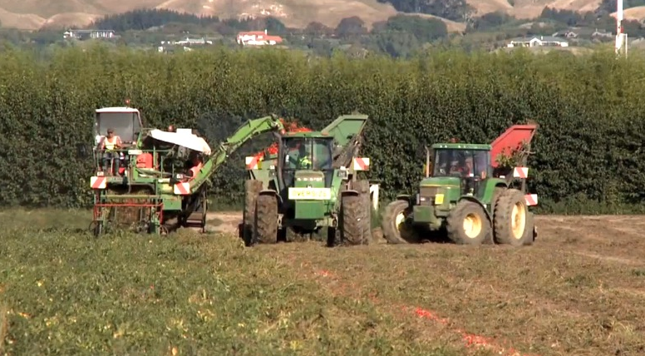
Values
Values shape how technologies are developed and adopted.

Slide 17
Relationships
Technologies affect social relationships.

Slide 18
Systems
Technologies work because they’re part of systems.

Slide 19
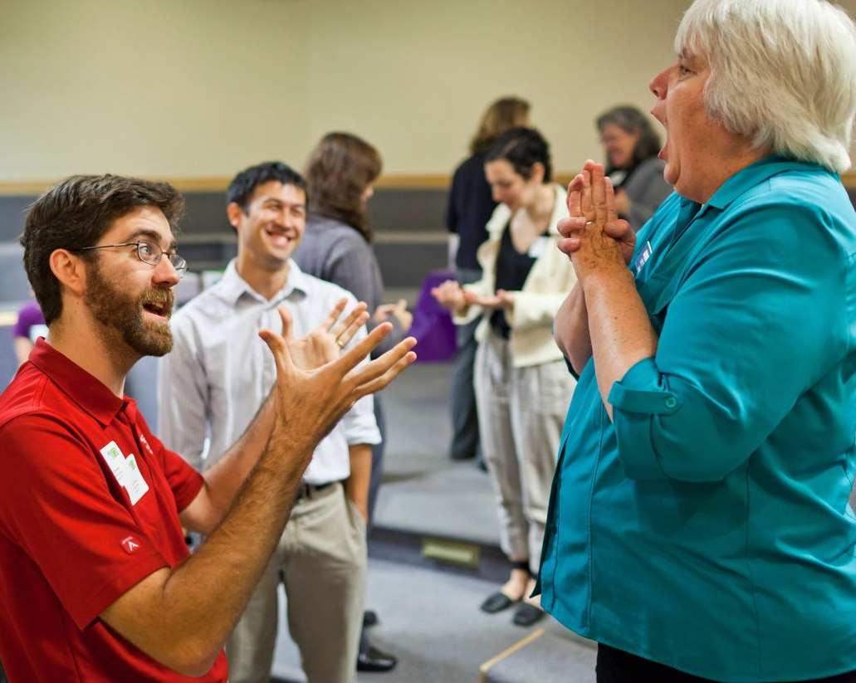
Improv

Slide 20
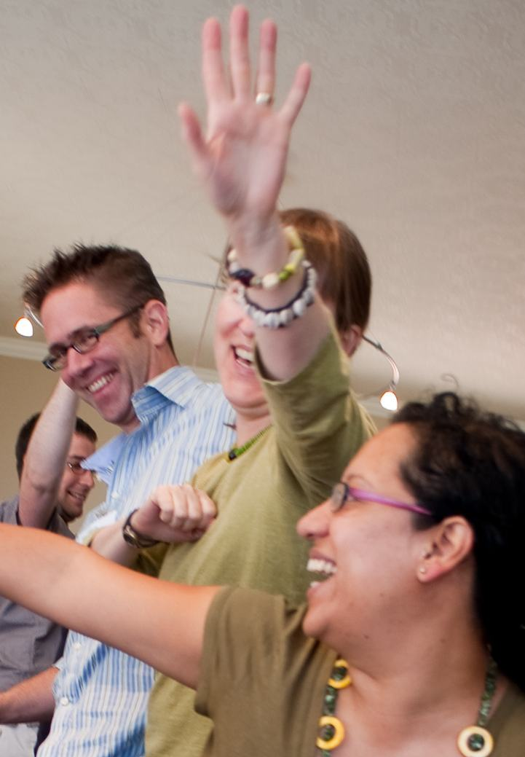
Why Do Improv Exercises?
Improvisation empowers educators to facilitate positive, learning conversations with visitors. Incorporating improv exercises into staff and volunteer training helps create a supportive and upbeat environment for educators to practice and strengthen essential skills.
Improv exercises prepare staff to:
Hold conversations with guests rather than reciting scripts.
Warm up critical skill sets for guest interactions.
Think on their feet and respond in the moment.
Integrate guest feedback into presentations.
Ask questions and tailor content based on guest responses.
Interact as equals with guests, rather than “experts.”
They also allow team leaders to:
Foster teamwork and creativity.
Generate laughter and create a fun, supportive, positive work environment.
Notes:
HANDOUT Leading Improv Exercises

Slide 21
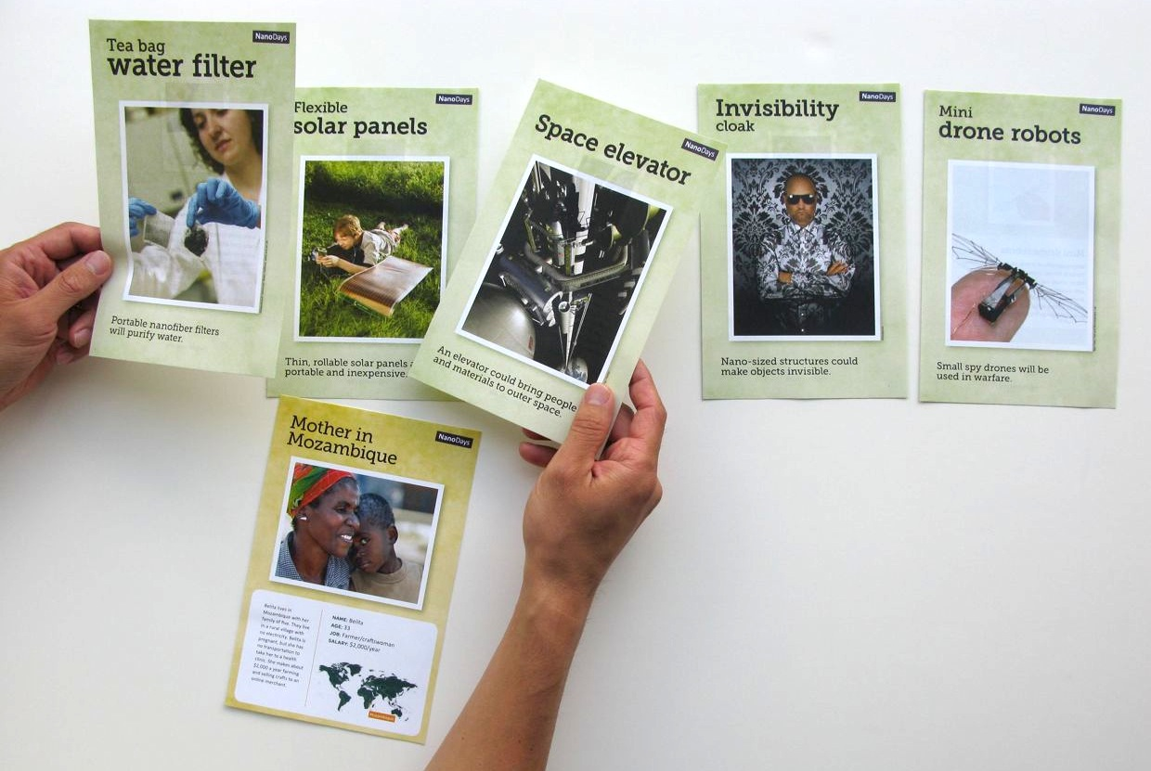
Choice of Activities
Exploring Nano & Society
Space Elevator
Exploring Nano & Society
You Decide

Slide 22
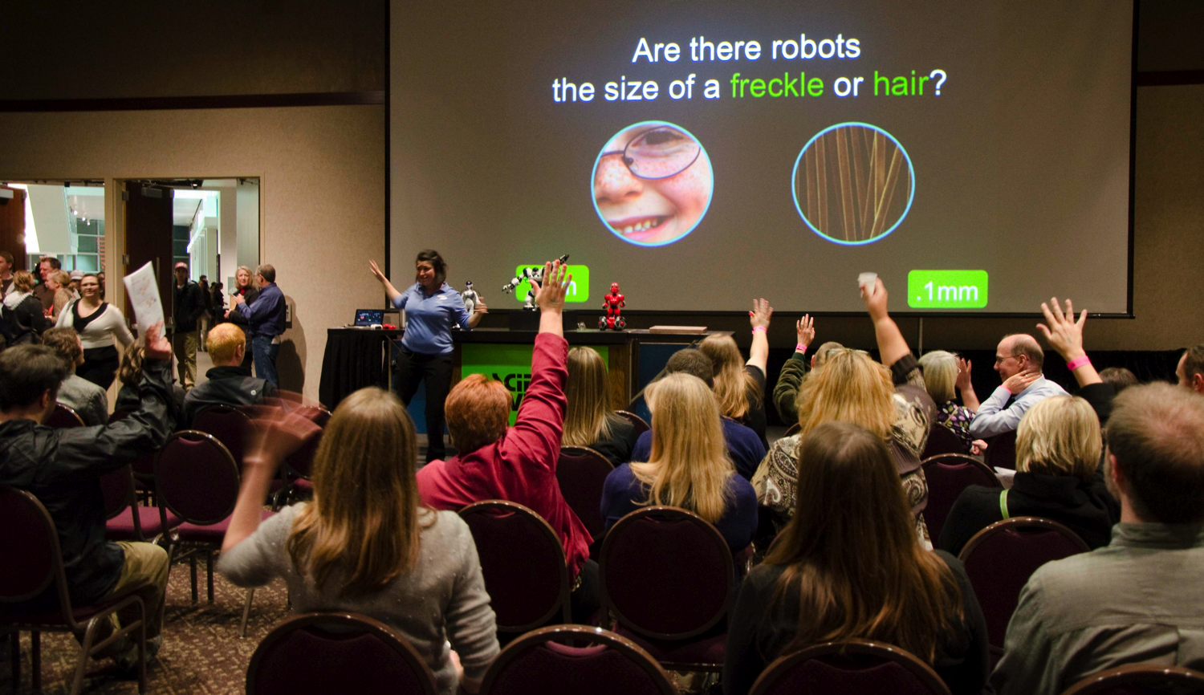
Questions and Discussion?

Slide 23
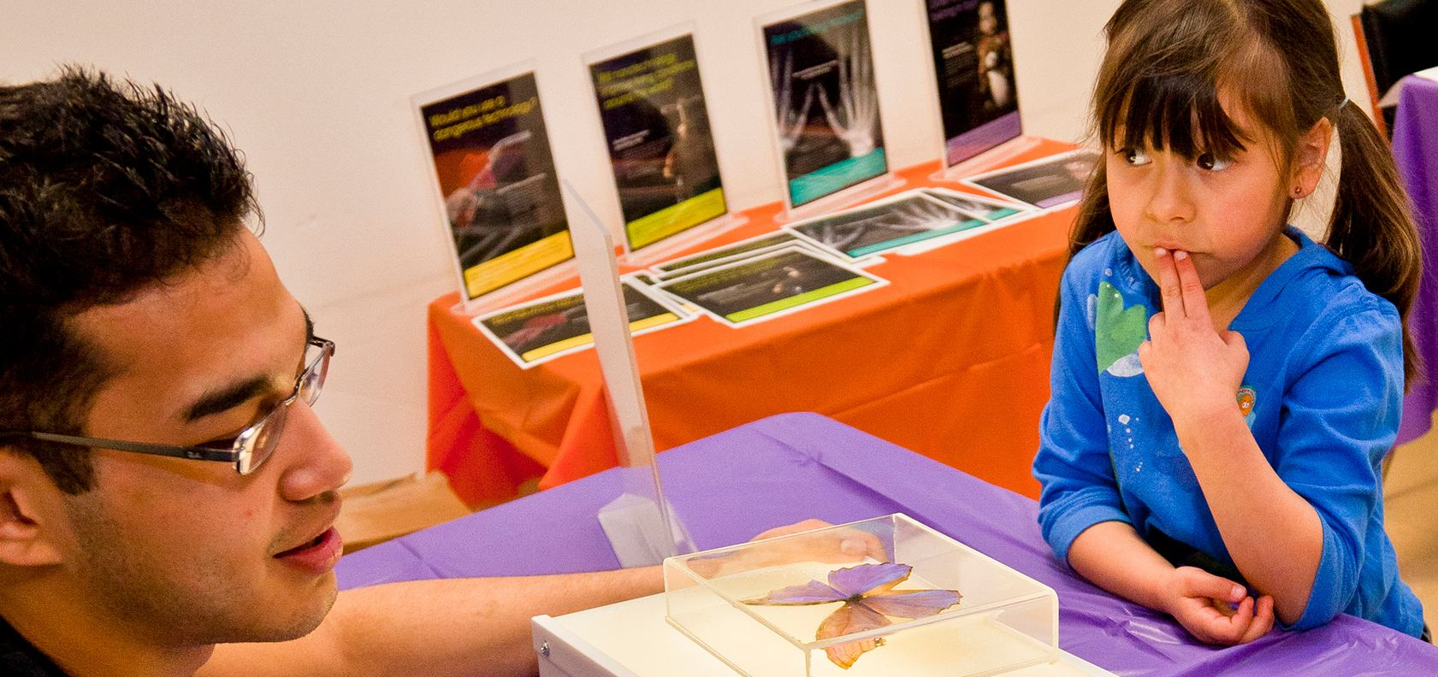
This presentation is based on work supported by the National Science Foundation under Grant No. 0940143.
Any opinions, findings, and conclusions or recommendations expressed in this presentation are those of the authors and do not necessarily reflect the views of the Foundation.

