Slide 2
???
Jonesboro
Little Rock
Hot Springs
Pine Bluff
Texarkana
Smackover
Partner Locations

Slide 3
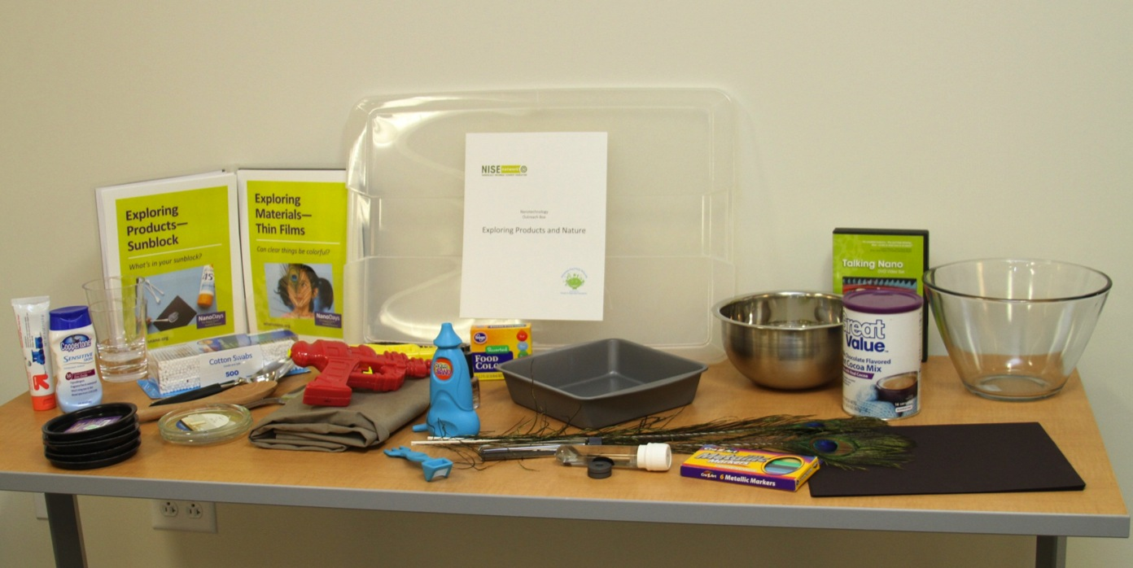
Exploring Products and Nature

Slide 4
Exploring Products and Nature
Nano Ice Cream
Sunblock
Thin Film
Nano Sand Pant and Plants
Ferrofluid

Slide 5
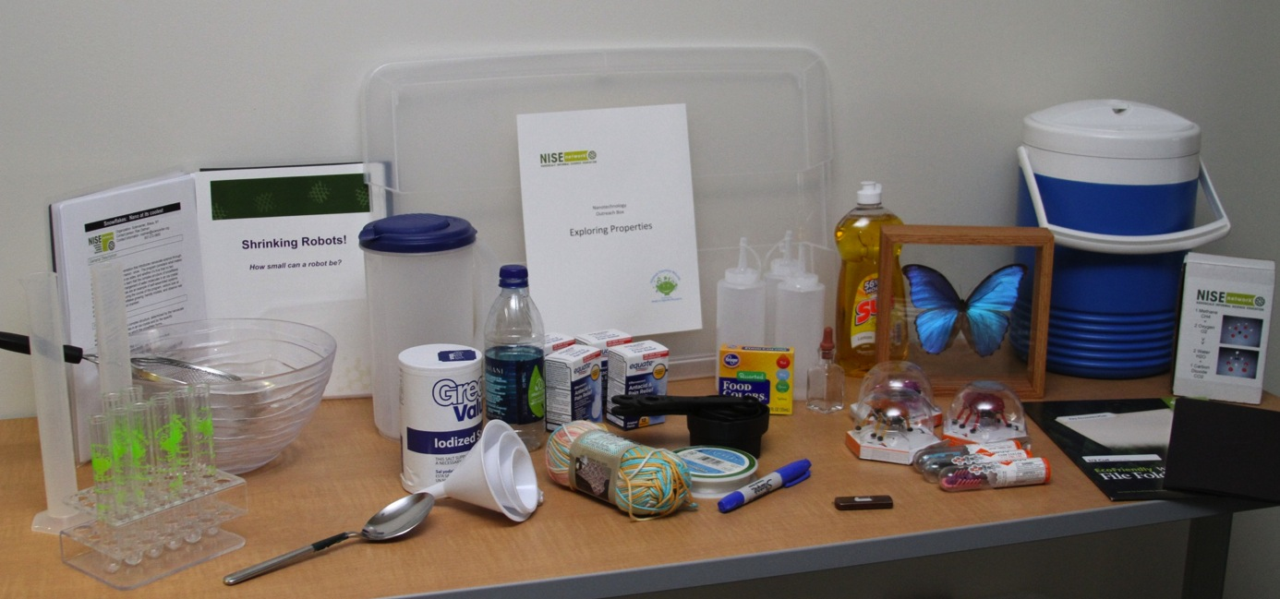
Exploring Properties

Slide 6
Exploring Properties
DNA Nanotechnology
Snowflakes: Nano at its Coolest
Shrinking Robots
Surface Area
BioBarCodes: Antibodies and Nanosensors
Blue Morpho Butterfly

Slide 7
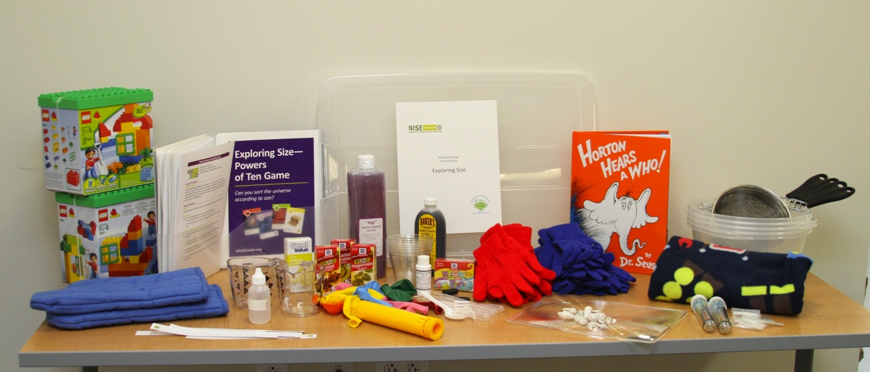
Exploring Size

Slide 8
Exploring Size
Exploring Tools-Mitten Challenge
Exploring Forces-Static Electricity
Sweet Self Assembly
Ready, Set, Self-Assemble
Horton Senses Something Small
Exploring Size-Powers of Ten Game

Slide 9
