Slide 1

Science Assets Outreach Program
Now with
Nano!

Slide 2
The Bakken Museum Science Assets Outreach Program
Originated in 2003
Served 3100 students in 2011-12
All Minneapolis Public School 4th Grades

Slide 3
Day 1
Creative Problem Solving Activities
Day 2
Science Content Lesson
Day 3
Inquiry-based experiment with a
Person of Science

Slide 4
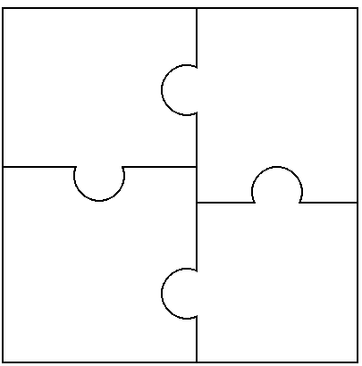
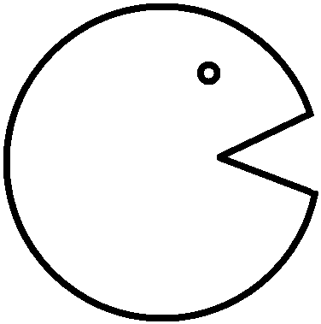
Wonder
Try
Ask questions
Observe
Make Predictions
Do an experiment
Test ideas
Be adventurous
Discover
Share
Observe
Notice what happens
What works?
What doesn’t?
Tell someone
Make a claim
Share your evidence

Slide 5
Day 2 Nano-Style
Introduce term “nanometer”
Size is Right game
Science “Magic” Trick
Wonder, Try, Discover, Share
Demonstration
Hook to Day 3
Day 3 Nano-Style
Introduce Person of Science who works in nano
Two Truths and a Lie
Inquiry-based Experiment
Nano Challenge
Bakken Museum Science Certificates

Slide 6
Wonder
Try
Does hydrogel work with other liquids?
Water
Mineral Water
Vinegar
Discover
Share
Mineral water works, but not as well
Vinegar did not work at all
We think that hydrogel only works with things are mostly water.

Slide 7
