Slide 1
Improvisation in Museums
Heather Barnes, Director Guest Experiences
Carla Thacker, Manager Guest Experiences
Notes:
Introductions
Overview:
Improv at MSI
Applications of improv
The benefits of using improvisation
Implementing improv at your institution
Participate in several exercises
Have fun!
Questions exercise
Split into small groups

Slide 2
MSI Mission and Vision:
Mission: To inspire the inventive genius in everyone
Vision: To inspire and motivate our children to achieve their full potential in the fields of science, technology, medicine and engineering
Improv is a tool we use to hire and train team members to help reach our mission and vision

Slide 3
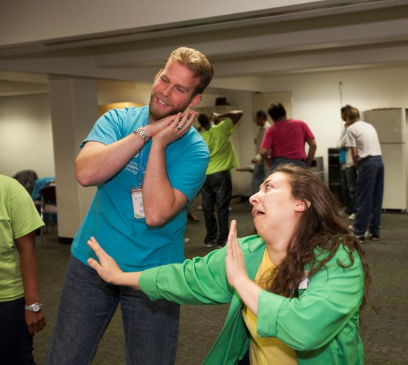
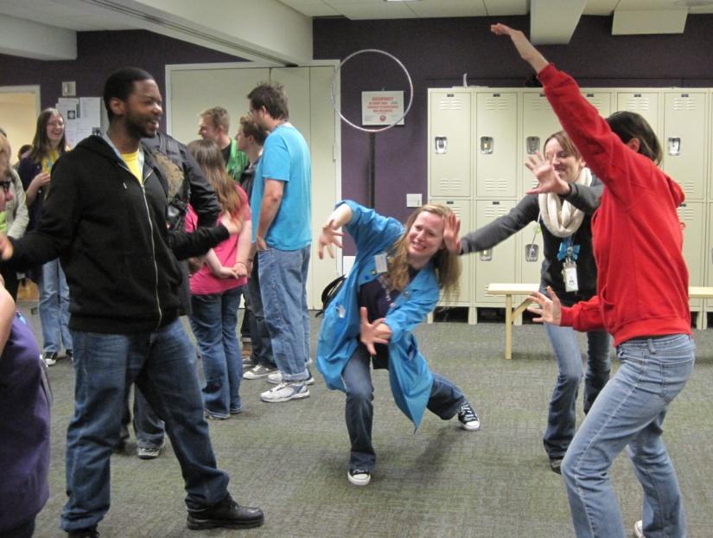
Games & Debriefs:
Notes:
Improv is one tool we use at MSI to reach our vision.
Mission: To inspire the inventive genius in everyone.
Vision: To inspire and motivate our children to achieve their full potential in the fields of science, technology, medicine and engineering.
Facilitator Role:
Provide compelling and personalized experiences throughout the Museum
Anticipate guest needs and proactively solve guest issues
Engage guests with scientific exhibit content in a positive, fun, inclusive and educational capacity
Encourage guest participation in Museum experiences with questions, games, activities, and education content related to exhibits
Guest Comments: read a few positive guest comments

Slide 4
Improv Applications:
Group Auditions
Assesses teamwork and communication skills
Morning Meetings, Leadership Meetings
Generates laughter, fun, energy, emphasizes teamwork
Trainings
Builds energy, excitement, and learning opportunities around content areas
Empowers staff to respond to guests in programs
Professional Development
Develops leaders to institute a positive work environment
Notes:
Group Auditions:
We open with an improv exercise at every group audition
Look for desirable skills, such as open body language, eye contact, effective communication, teamwork
Morning Meetings:
Generate laughter, energy, and teamwork
Start the day with a fun, positive tone
Warm-up and enhance skills required for guest interaction
Increase mental flexibility and ability to think your feet
Practice skills in a safe environment
Trainings:
Every training plan starts with an improv exercise
Builds energy and excitement
May target a skill that is needed for the new program or introduce content
Professional Development:
Send leadership to local improv classes to learn and practice improv skills

