Slide 1
NISE MINIGRANT - NANO CAMP Partnerships Increase Resources
Heather Armstrong
University of New Mexico

Slide 2
The Plan
16 week after school program - Zuni Elementary School
Students opt to join
Students would learn about nano science
NISE NanoDays kits
Every other week “specialist” visits
NSMS graduate students & Post Docs would present their research and NISE Network kits
Four UNM Laboratory tours
Final trip for parents and students to Explora
NISE funding further supported by United Way grant

Slide 3
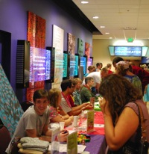
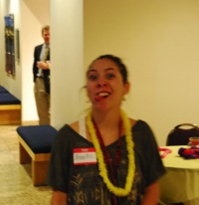
Partnerships
Each partner brings what they do best
Greater reach
Shared work
Shared financial impact
SUCCESS!

Slide 4
Who brings what?
Children’s Choice – KIDS!
Very successful not-for-profit after school program with emphasis on education
After school structure including “classes”
Interested & willing
Multiple sites for expansion
Additional funding support from United Way
NSMS at UNM – SCIENCE!
Graduate community who wants to bring science to their community
NISE Grant
NISE kits
Science toys (Laboratories)
Specialized individuals & knowledge
Other areas of interest on campus

Slide 5
NISE provided
NISE Funding Provided
Funding for Children’s Choice leader
Materials to duplicate and expand upon NISE NanoDays kits
Van rentals for visits (4) to UNM Laboratories
Van rentals for Explora! visit

Slide 6
A picture is worth a million words, right? Here are some of our pictures.

Slide 7
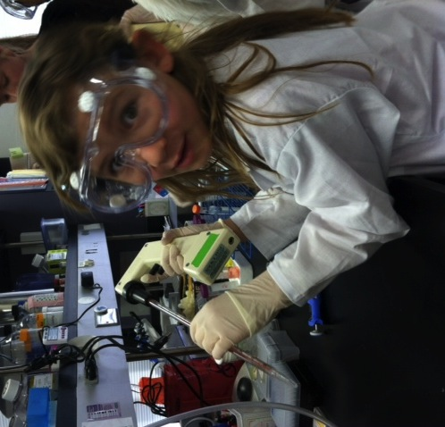
Dress for success

Slide 8
Amber – Magnetic Drug Delivery

Slide 9
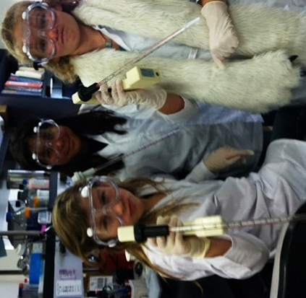
Carol – Protocell/Aerogel

Slide 10
Samantha – Imaging & Computers

Slide 11
Eric, Patrick, Harry – Tissue Growth

Slide 12
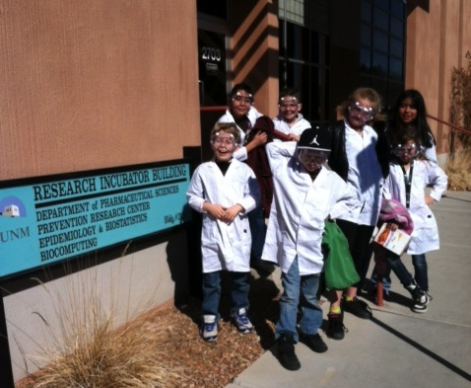
Thank you, NISE!

Slide 13
THE BEST NEWS…

Slide 14
WE ARE STILL DOING IT.
Children’s Choice is continuing to offer this after school program.

Slide 15
But wait! There’s more!

Slide 16
UNM NSMS has adopted Monte Vista Elementary.
A teacher at the school is using the minigrant plan and NISE resources to teach Nanoscience during their enrichment time.
17 activities
NISE kits
Videos
Linked websites
Specialist visits
UNM laboratory tours
Target audience
All first, second, and third grade classes.
Two lessons a week, 1.5 hours per lesson

Slide 17
