Slide 1
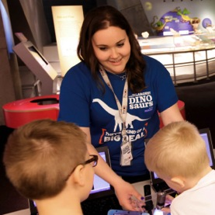
Nano is Everywhere! Nanoscience Family Science Night
Jessica Liken
Lead Educator – Physical Science
and Chemistry Programs
Perot Museum of Nature and Science
Dallas, Texas

Slide 2
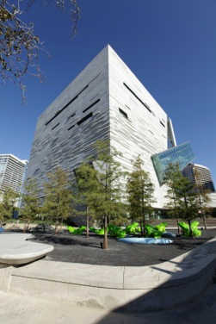
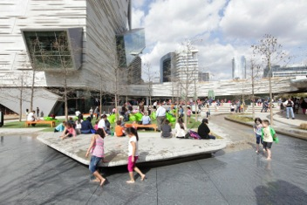
Perot Museum of Nature and Science
Opened December 1, 2012
Member of NISE Network since 2011
Use NanoDays materials in a number of programs and events
Notes:
School Programs:
26 classroom programs
5 auditorium programs
3 family science nights
6 Portable Universe programs
8 ScienceCast distance learning programs
Library
Homeschool
Public Programs:
Camps
Discovery Days
Late Nights
We do A LOT
Nano has been incorporated into almost all of these types of programs
Programs are often booked as outreaches for afterschool programs

Slide 3
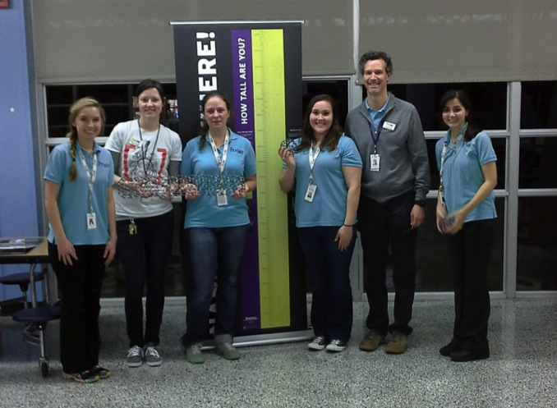
Team Nano

Slide 4
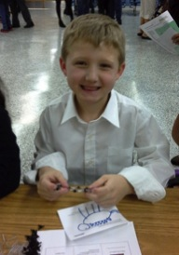
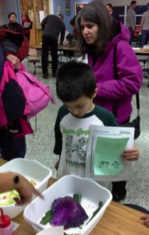
Mini-Grant Project
“Nano is Everywhere! Nanoscience Family Science Night”
Nine hands-on activity stations for students and families
Combination of new nano activities and previous NanoDays kits
Presented free of charge to eight local elementary and middle schools in under-served and under-developed communities
Notes:
Summary
Nine stations
Role of nanoscience in the world around us
Relate to biology, chemistry, physics and engineering
Offered free of charge to:
Six elementary schools (K-5)
Two intermediate schools (5-7)
How did you come up with the idea?
Other successful science nights
Reach a wide range of students and families
What audiences were you trying to reach?
Under-served communities
Elementary/middle school-aged children and their families
Did you use NISE resources? Which ones?

Slide 5
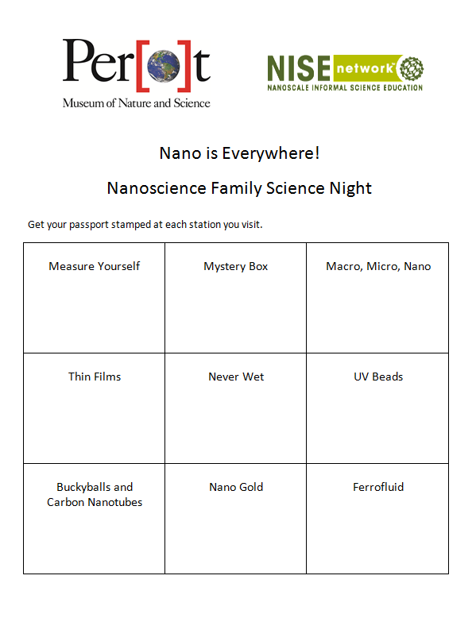
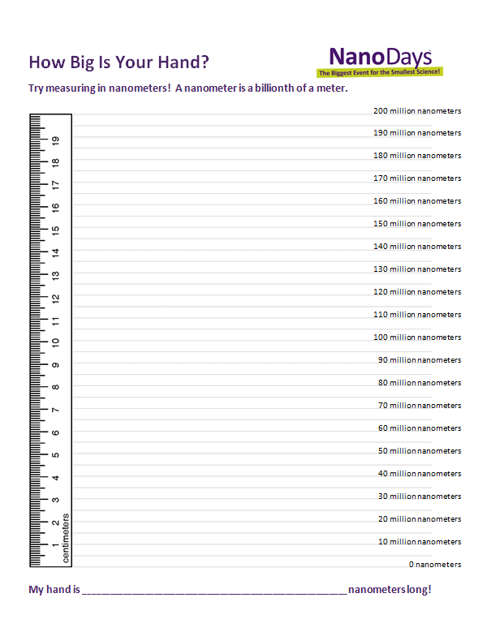
Student Passport

Slide 6
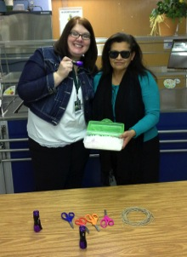
Setup and Training
Notes:
Bring materials to each school
Train parents, teachers, or older student volunteers
Monitor the stations throughout the night
All content was presented in both English and Spanish
At least one bilingual museum educator was present at each event

Slide 7
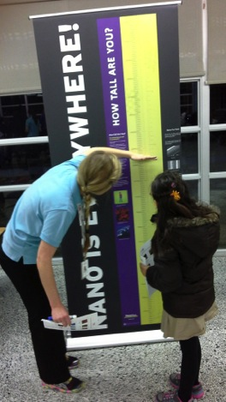
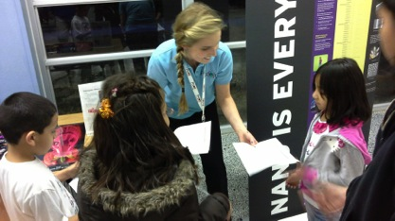
Measure Yourself

Slide 8
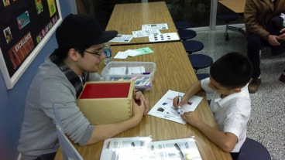
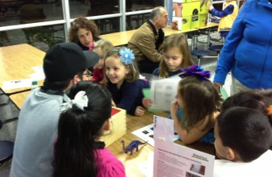
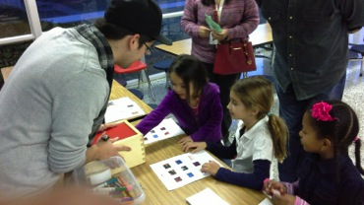
Mystery Box

Slide 9
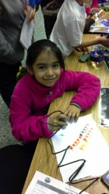
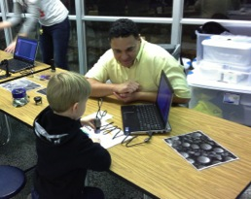
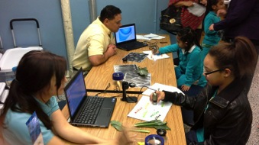
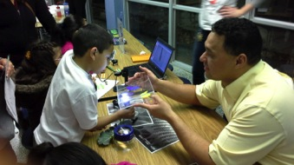
Macro, Micro, Nano

Slide 10
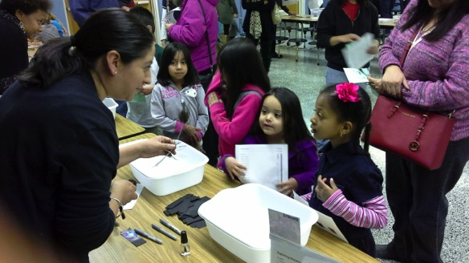
Thin Films

Slide 11
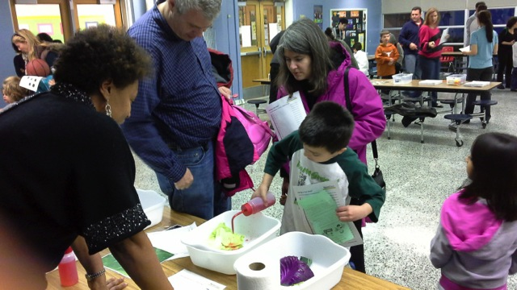
Never Wet

Slide 12
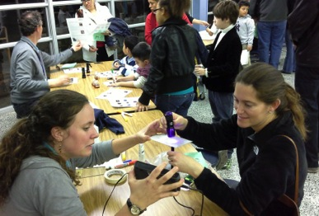
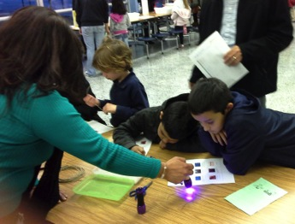
UV Beads

Slide 13
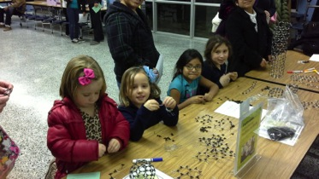
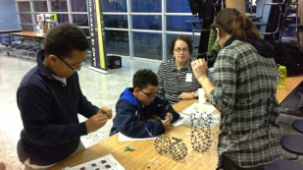
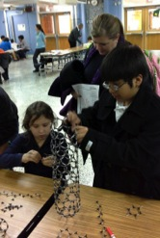
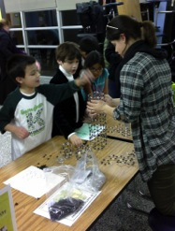
Buckyballs & Carbon Nanotubes

Slide 14
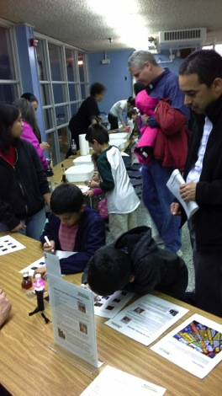
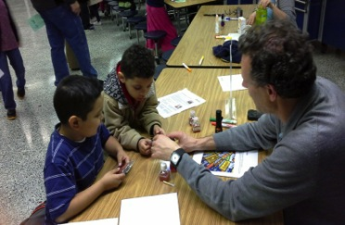
Nano Gold

Slide 15
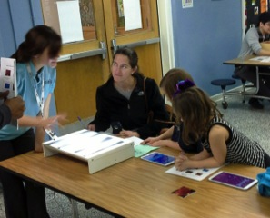
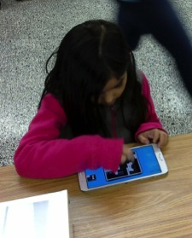
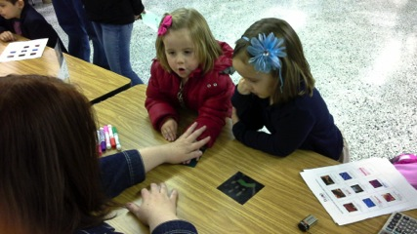
Other Stations

Slide 16
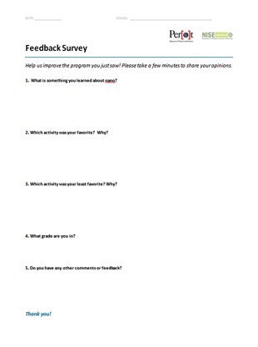
What did we learn?
Feedback surveys
Most stations were successful
Liked hands-on activities more than just looking at something cool
Schools wanted to have the program again!

Slide 17
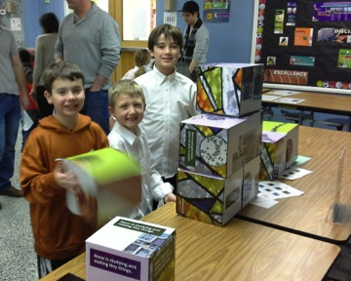
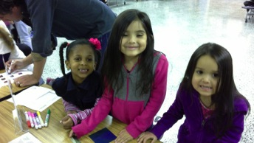
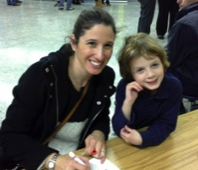
2014-2015 School Year
17 schools
3400 students

Slide 18
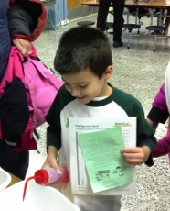
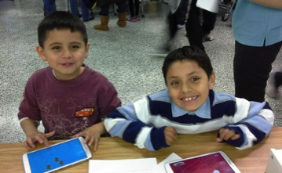
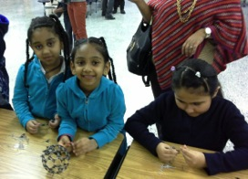
2015-2016 School Year
Rename: “Super Small: Nanotechnology Family Science Night”
New and updated stations
Combine activities
Collaboration
Notes:
Issues? (bilingual educator)
Troubleshooting?
What would you change?

Slide 19
Nano is Everywhere! Nanoscience Family Science Night
Jessica Liken
Lead Educator – Physical Science
and Chemistry Programs
Perot Museum of Nature and Science
Dallas, Texas

