Slide 1
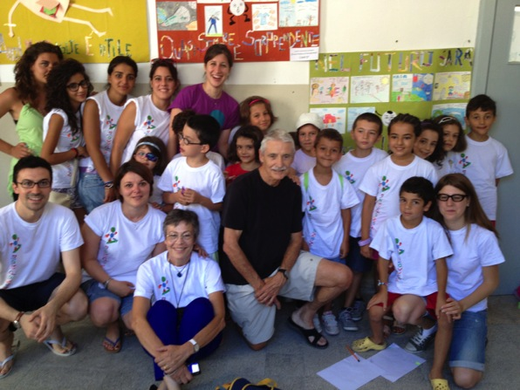
NanoPiccola, Gagliato, Italy
The summer camp of the nano… nobel prizes
JUNE 2015
NETWORK-WIDE MEETING
NISENET.ORG
Notes:
Good morning

Slide 2
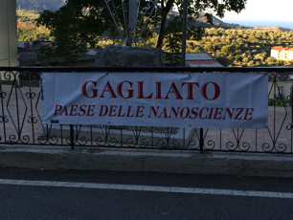
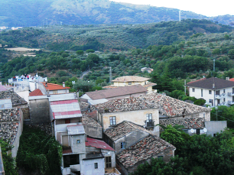
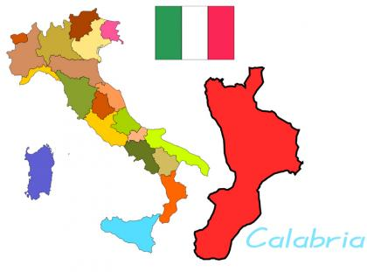
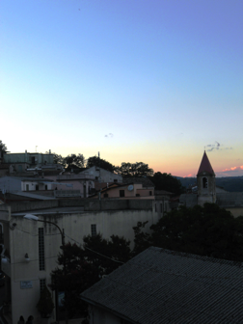
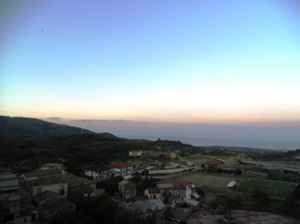
Gagliato… where is it???
Gagliato
Notes:
Qui io inserirei dati demografici su popolazione. Quanti bambini ci sono? Il tutto per evidenziare che e’ un piccolo paesino, disagiato, con poche possibilita’ economiche e di crescita

Slide 3
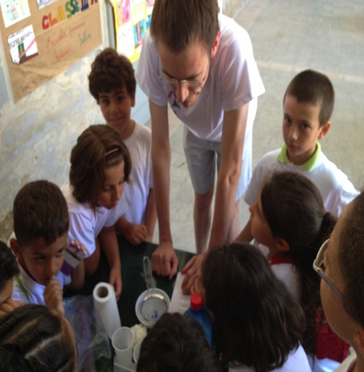
NanoPiccola, III International Conference, July 25-26, 2015
Participants:
100 Children ages 4-18 divided in age groups
Daily Schedule:
8:30-9:00am Yoga
9:00-12pm Presentations and experiments
12-1:30pm Lunch Meet the scientists
1:30-3:30pm Soccer game Teach your parents
JUNE 2015
NETWORK-WIDE MEETING
NISENET.ORG

Slide 4
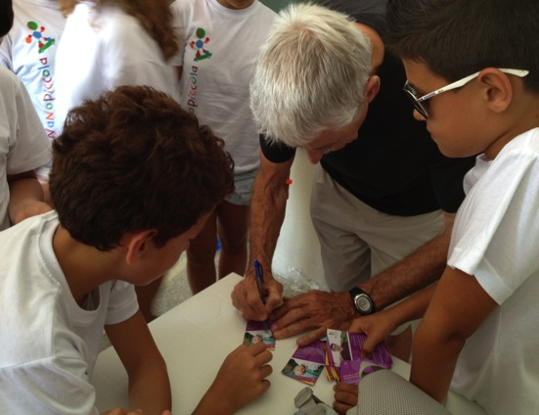
NanoPiccola, III International Conference, July 25-26, 2015
Original features:
Scientists’ Trading Cards
Gagliato Science Film Festival
Kids’ Jury for Educational Video Category
NanoPiccola presents at Public Event along with scientists
JUNE 2015
NETWORK-WIDE MEETING
NISENET.ORG

Slide 5
GAGLIATO NANOPICCOLA
NISE KIT
HOUSTON METHODIST RI
NANODAY
NANOCALABRIA
(High schools)
HORIZON 2020 ?
JUNE 2015
NETWORK-WIDE MEETING
NISENET.ORG
Notes:
Good morning

Slide 6
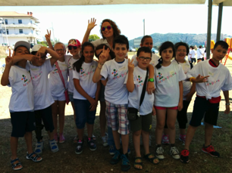
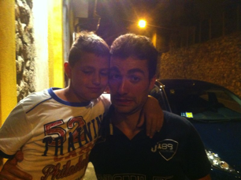
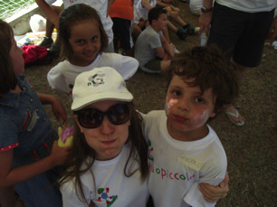
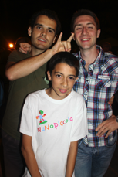
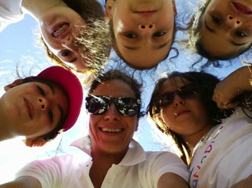
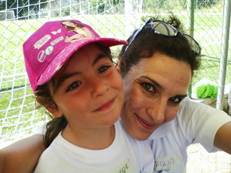
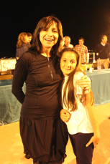
Interaction with volunteers

Slide 7
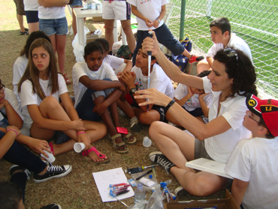
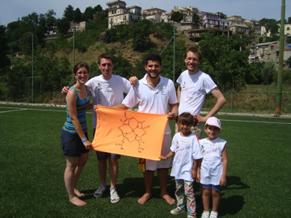
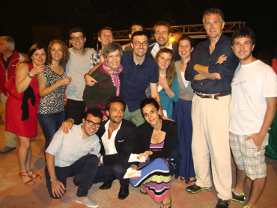
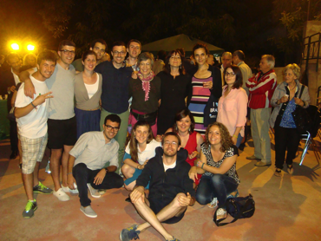
Who are the volunteers???

Slide 8
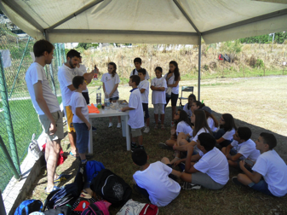
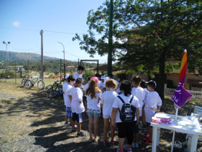
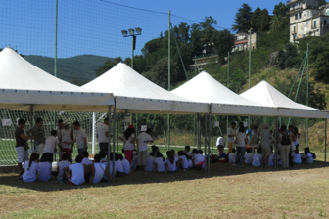
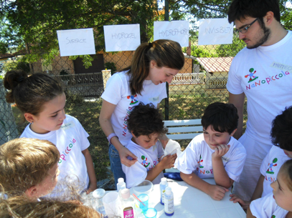
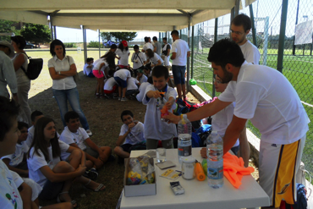
Interaction with experiments

Slide 9
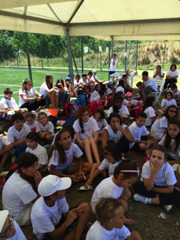
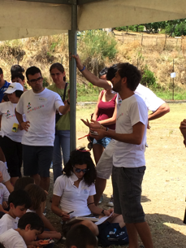
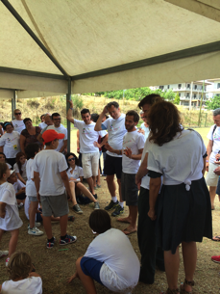
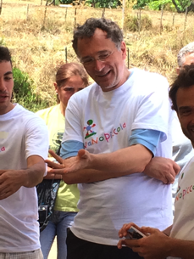
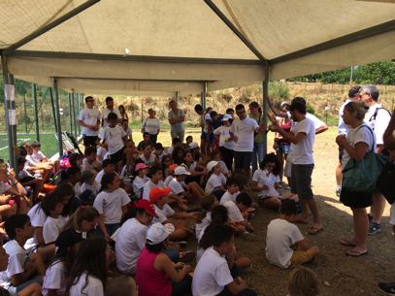
Interaction with scientists

Slide 10
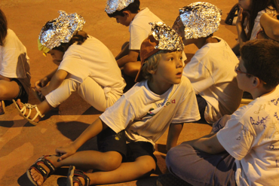
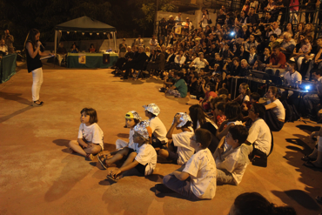
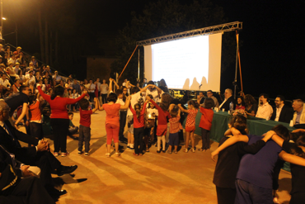
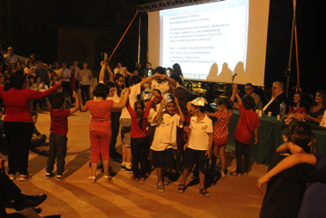
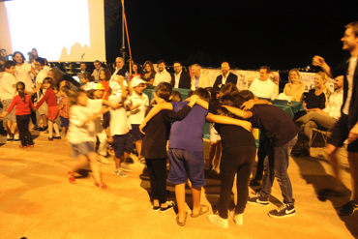
Nano… show

Slide 11
Take-home experiments
Making naked egg (egg without shell)
What do you need:
• a few eggs
• white vinegar
• a container big enough to hold the eggs and a cover for the container
• a big spoon
The aim is to explain the mechanisms of osmosis and acid-base reaction.

Slide 12
Scientific principles:
Vinegar (acetic acid) breaks apart the solid calcium carbonate (basic) crystals that make up the eggshell. The carbonate goes to make carbon dioxide—the bubbles that you see.
The naked egg will be enlarged respect to the egg shell because the water contained into the vinegar moved to it.
VINEGAR
EGG

Slide 13
Take-home experiments
Making cheese from milk
What do you need:
• Pasteurized whole milk
• white vinegar
• a container
• a strainer
• a stove to heat the milk, or a thermos for hot milk
Take-home message:
The structure of a material determines its aspect.
Material’s structure is strictly related to its functionality.

Slide 14
Scientific principles:
Milk consists of 80% Casein and 20% whey proteins. Milk, in its natural state, is negatively charged. The negative charge permits the homogeneous dispersion of casein. When milk is acidified by vinegar (acid) to pH 4.7, the isoelectric point of casein, a precipitate known as acid casein is formed, due to the neutralization of the negatively charged casein micelles.
Casein aggregates
VINEGAR
Milk
acid
Milk whey

Slide 15
Acknowledgements:
People of Gagliato
Gagliato City Hall
NG/NP volunteers
JUNE 2015
NETWORK-WIDE MEETING
NISENET.ORG

Slide 16
THANK YOU!
www.nanogagliato.org
accademia.gagliato@gmail.com
JUNE 2015
NETWORK-WIDE MEETING
NISENET.ORG

