Slide 1
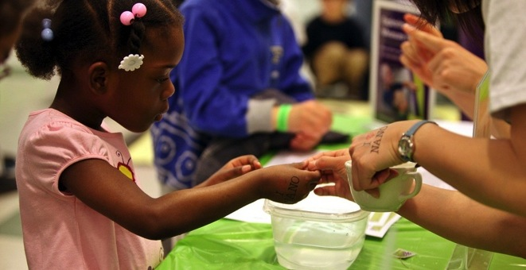
Museum and
Community Partnerships
www.nisenet.org

Slide 2
Overview
Project overview
Current thinking
Feedback and input

Slide 3
Project goals
Engage local communities more broadly in STEM learning, focusing on nanoscale science, engineering, and technology
Develop local partnerships between museums and community-based organizations, helping museums reach new audiences and helping community organizations provide high-quality STEM learning experiences for their audiences
Identify, develop, and share successful practices and models for reaching new audiences and developing successful collaborations among local organizations

Slide 4
Project outcomes
Broader reach to multiple and diverse audiences with the Network’s high-quality STEM learning opportunities
Mutually-beneficial relationships among existing NISE Network partners (including museums and universities) with community organizations
New knowledge and models for the field related to best practices for reaching new audiences and successful collaborations between museums and community organizations

Slide 5
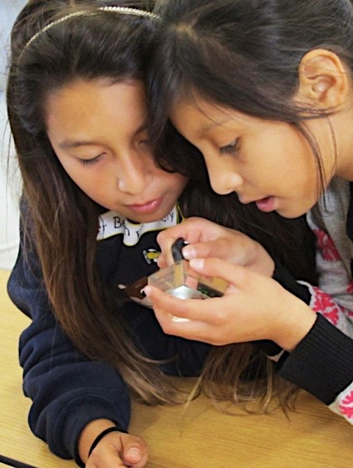
Model
Results from April workshop
Basics
Partnership planning
Public engagement products
Implementation
Reporting and evaluation

Slide 6
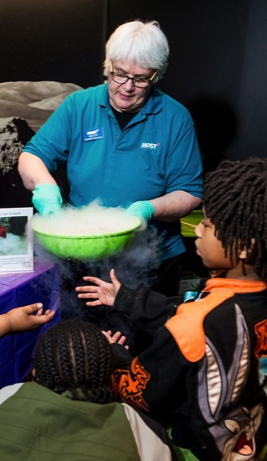
Basics
Target audience ages 8-10 (ability to stretch)
Traditionally underserved and underrepresented
Existing and new partnerships
Bringing nano to existing partnerships
Bringing new partnerships to nano
Application
NISE Net partners apply, receive, kits and report
Must identify community partner
Partnership is defined and managed locally
100 kits
Hands-on activities
Professional resources

Slide 7
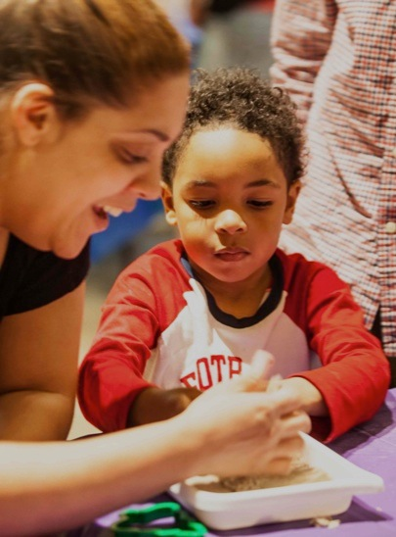
Basics
Timeline
Application due late fall 2015
Kits delivered winter 2016
Program delivery spring-summer
Report on activities summer 2016
First step
Ongoing local partnerships
Future nationwide project

Slide 8
Partnership planning
Finding a partner
Project fact sheet
Partnership video
Community org + museum fact sheets
Online workshops
Defining your partnership
Application information
Task checklist and timeline
Roles and responsibilities
Applying
Online application by NISE Net partner
Deadline late fall

Slide 9
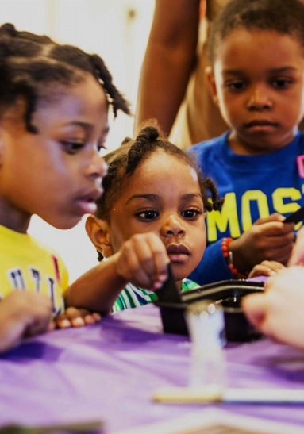
Public engagement products
Activities
Adapt NanoDays / DIY nano hands-on activity guides
Classroom set of materials
Videos sharing science and scientists
General event supplies
Frameworks
Large event + series of 45-min modules
Extensions and further learning
Connections and recommendations for other activities (beyond kit)

Slide 10
Implementation
Planning and implementation guides
Museum partners + community partners
Youth development + hands-on STEM
Info and forms for reporting and evaluation
Quick-start program prep guides
Staff training
Training guide
Sample agendas
Activity guides and frameworks
Tips sheets
Videos and guides on engaging diverse audiences + hands-on STEM and Nano 101
Notes:
LARRY

Slide 11
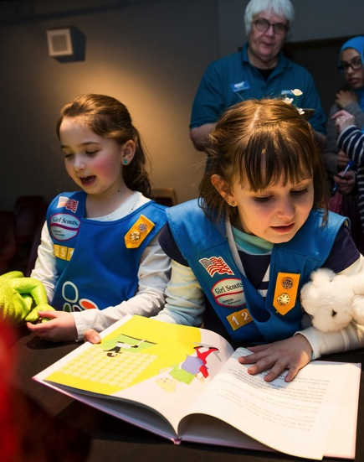
Reporting and evaluation
Overall focus
Effectiveness of this approach to reach new audiences and form new collaborations
Reporting and evaluation
Use of materials
Participation of professionals
Value of partnerships
Professional learning
Reach and demographics for public audiences
Perception of public learning and engagement

Slide 12
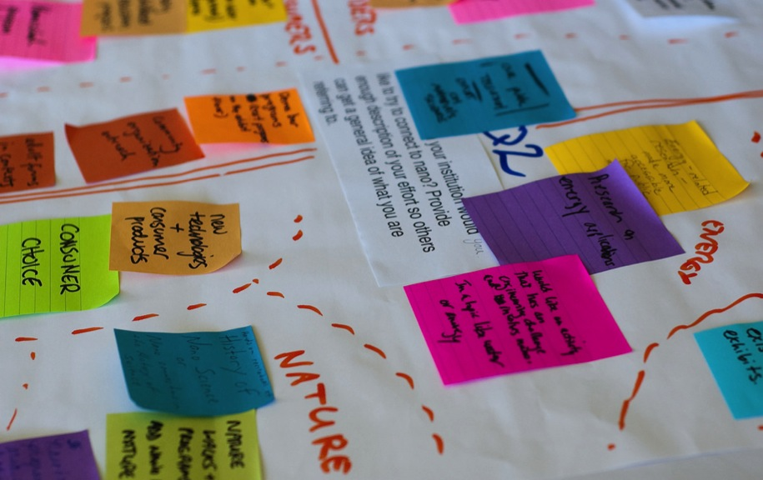
Feedback

Slide 13
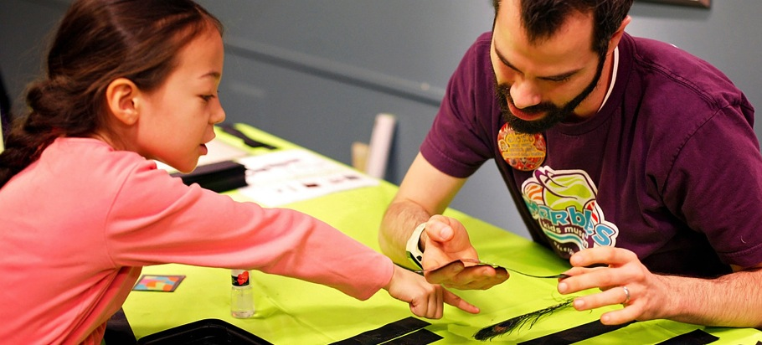
Thank you
Cynthia Needham, ICAN Productions
This presentation is based on work supported by the National Science Foundation under Grant No. 0940143. Any opinions, findings, and conclusions or recommendations expressed in this presentation are those of the authors and do not necessarily reflect the views of the Foundation.
Notes:
LARRY

