Slide 1
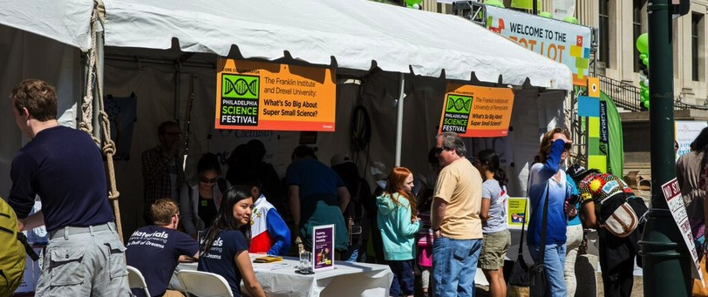


Festivals, Fairs, & Family Nights
JUNE 2015
NETWORK-WIDE MEETING
NISENET.ORG
Notes:
Good morning

Slide 2
Using Special Events to Highlight Nano Throughout the Year
Mary French, Reuben H. Fleet Science Center
Jamie Bonnett, KidsQuest Children’s Museum
Chris Weyant, Drexel University
Jayatri Das, The Franklin Institute
JUNE 2015
NETWORK-WIDE MEETING
NISENET.ORG

Slide 3
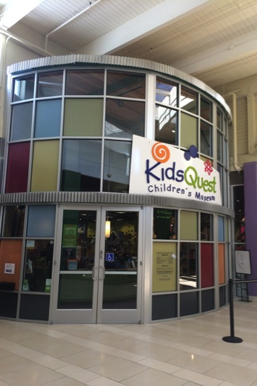

KidsQuest Children’s Museum
Where are we?
Bellevue WA
  10 miles from Seattle
Who are we?
5,600 sq feet of exhibit space
170,000 visitors served in house
10,000 visitors served in outreach

Slide 4
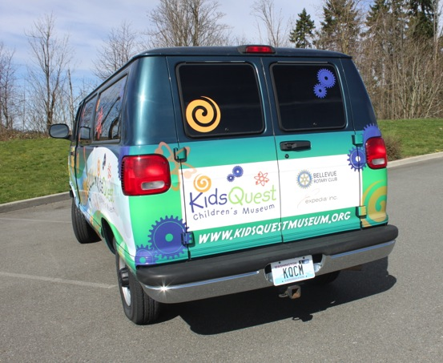
Science in the Park
NISE Net mini-grant
Science activities in public parks
“Pop- up” style
Summer months
Engage Families
Go to where the families are in the summer months.
Visit areas not “near” the museum.
Notes:
Food Truck Round Up
Soccer Games
Splash Park
Movies at the Park

Slide 5
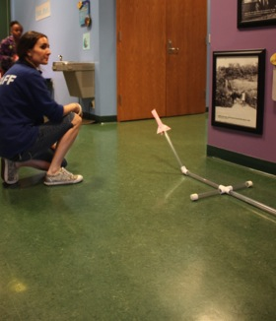
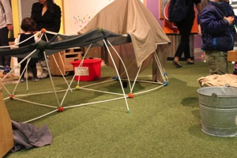
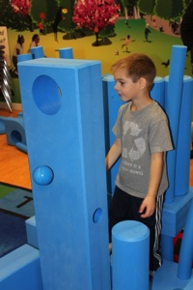
Science in the Park
Activities
June
  Moving Molecules
  Stomp Rocket
July
  Measure Yourself
  Imagination Playground
August
  Surface Tension Kit
  Building Sticks

Slide 6
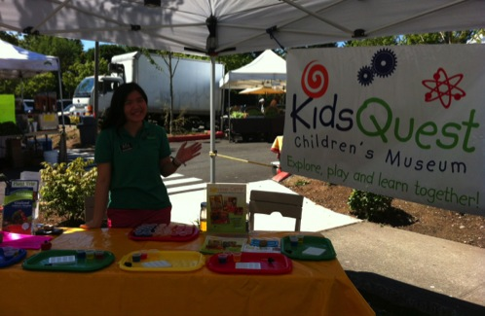
Science in the Park
Experience
Farmer’s Markets
Science Fairs
Take your child to work day
Challenges
Finding the right people to talk with at other organizations.
Finding common goals with partners.

Slide 7
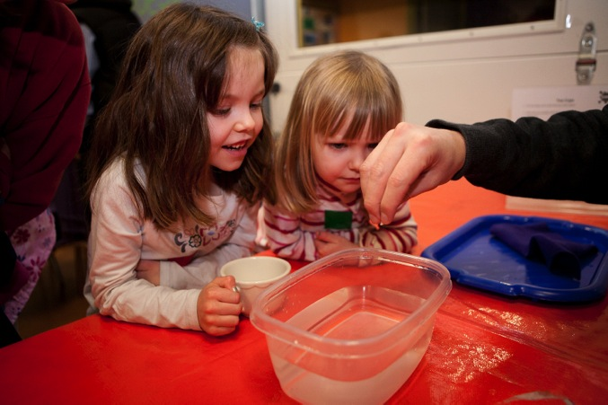

Thank you!
Jamie Bonnett
Associate Director of Education
jamie@kidsquestmuseum.org

Slide 8
Philly Materials Day:
NanoDays Kits with a Focus on Materials Science & Engineering
Christopher Weyant
Materials Science & Engineering
Drexel University

Slide 9
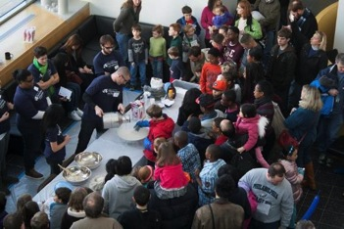
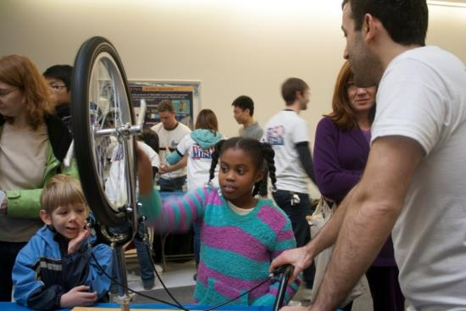
Philly Materials Day
Annual one-day (10 am-4 pm) free program open to the general public:
  Hands-on materials science & engineering-based demonstrations with half being based on NISENet kits.
  30-45 minute workshops
Partners:
  University of Pennsylvania:
    Dept. of MSE
    Laboratory for Research on the Structure of Matter
    Nano/Bio Interface Center
  The Franklin Institute
  The Academy of Natural Science

Slide 10

History
2011: To promote the PBS NOVA Making Stuff series
  NSF/DOE/WGBH/MRS
  WHYY: Local PBS station partner
Funding primarily from NSF/DOE and also local industry sponsors.

Slide 11
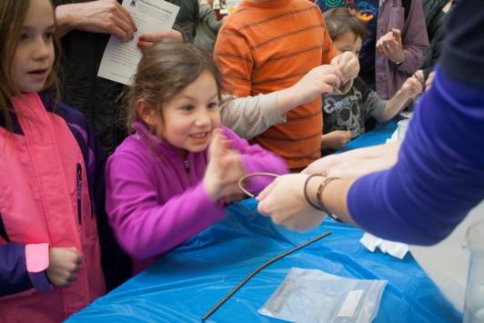
Motivation
According to Univ. Pres. John Fry, Drexel is dedicated to making our university “the most civically engaged university in the United States.”
Promote Pre-K to adult STEM outreach in a diverse urban setting
Get kids excited about science & engineering in general
Inform the general public about materials science & engineering

Slide 12
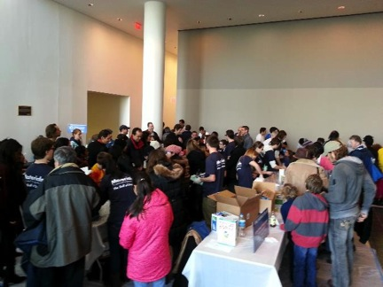
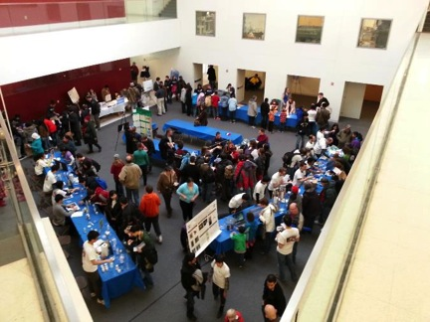
Philly Materials Day Hands-On Demos
Over 25 total hands-on demonstrations (with up to 20 occurring at one time)
  Scheduled & on-going
Two large open areas in one building

Slide 13
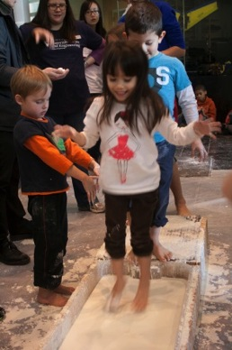
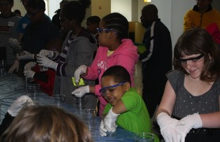
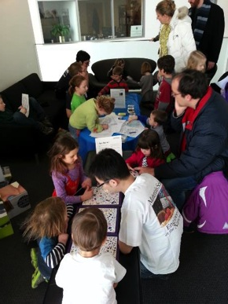
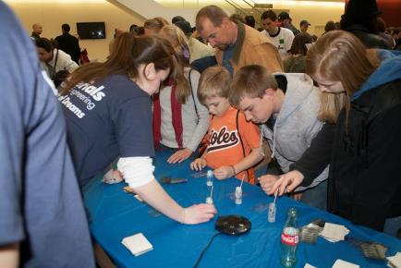
Philly Materials Day Hands-On Demos
Catering to a wide age range
Slime
Liquid Crystal
Thermometers
Ooblek
Nano-nook

Slide 14
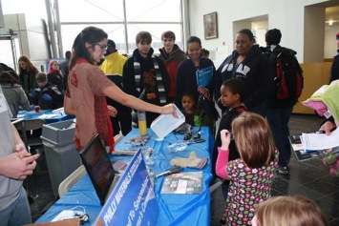
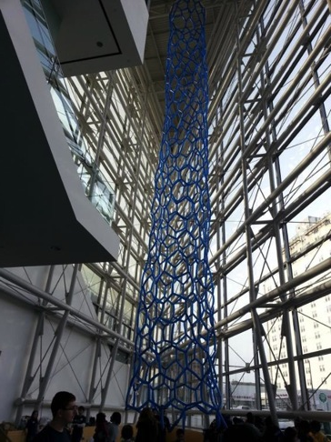
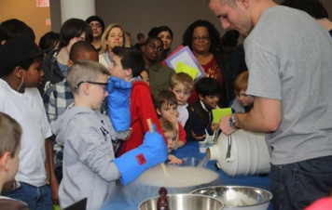
Philly Materials Day Hands-On Demos
Catering to a wide age range
Advanced Ceramics
Carbon Nanotube
Liquid Nitrogen Ice Cream

Slide 15
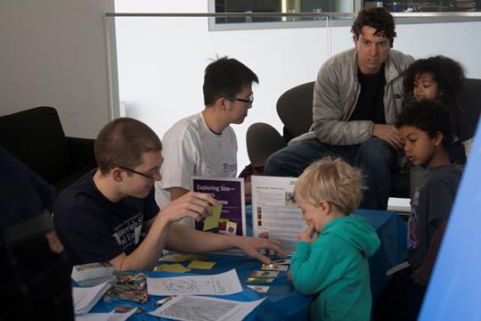
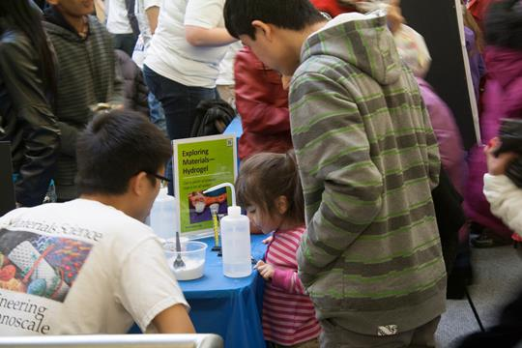
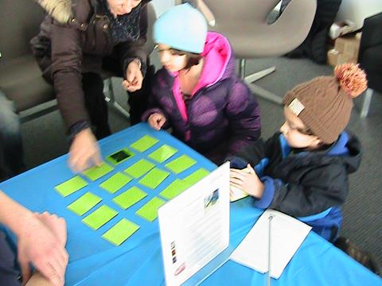
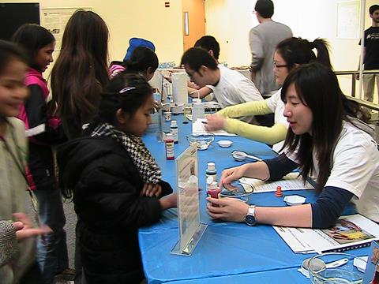
NanoDays Kits in Action
Notes:
Presenter Notes: Students don’t have to declare major until end of freshman year. Freshman Design sequence is mandatory and students will learn about different majors and disciplines.
Students will begin their major courses in their sophomore year and also go on their first co-op.
Course (Credits in parentheses)

Slide 16
Volunteers
This event would not be possible without volunteers registering visitors, interacting with the attendees and working behind the scenes.
  Drexel MSE: ~50 students, 5 staff & 4 Faculty
  U Penn Volunteers: ~40 students & 5 faculty
  TFI and ACN Volunteers
  Over 100 volunteers!
Schedule of demos led to two 3 hour shifts to keep volunteers “fresh.”

Slide 17

Feedback in 2013
List three words to describe the event:

Slide 18

Feedback in 2013
What was the most interesting or surprising thing that you learned today?

Slide 19
Feedback in 2013
What was the most interesting or surprising thing that you learned today?

Slide 20

Philadelphia Science Festival
A nine-day, community-wide celebration of science that takes place annually in April
100+ events in diverse Philadelphia neighborhoods
Over 175 organizations participated in the festival in 2015

Slide 21
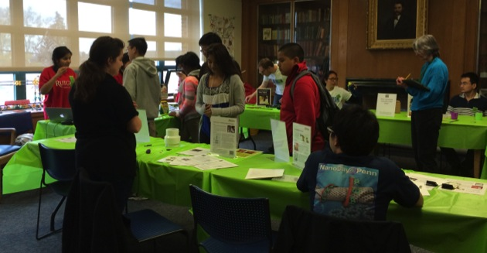


Neighborhood Science After School
PSF partners provide after-school programming in 18 neighborhood branches of the Philadelphia Free Library
Leverages TFI’s LEAP Into Science literacy program
Notes:
LEAP Into Science: https://www.fi.edu/leap
Neighborhood Science After School: http://sciencefestivals.org/resource/neighborhood-science-after-school-program/
By providing a neighborhood after school activity, partners can have their booth registration fee waived

Slide 22
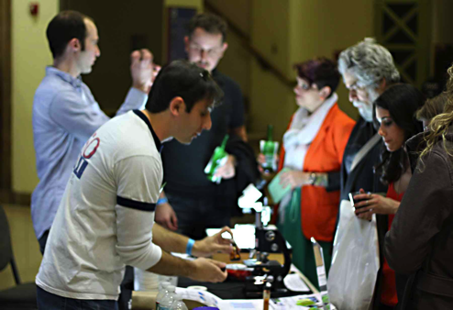



PSF Kickoff Party: 8-Bit Night
Themed, hands-on science activities & cash bar for adults 21+
In 2015, attendance ~3,000
Leverages structure of TFI’s monthly Science After Hours
Notes:
TFI Science After Hours: https://www.fi.edu/special-events/science-after-hours

Slide 23
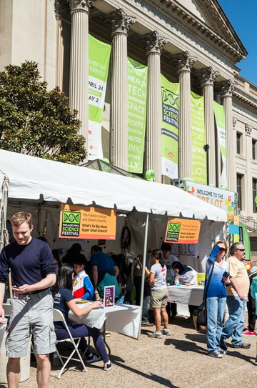




Science Carnival on the Parkway
All-day, free carnival with 175+ hands-on activities
In 2015, attendance ~50,000
Collaboration among NISE Net partners creates a stronger educational experience
Notes:
Philadelphia Science Festival: http://www.philasciencefestival.org/

Slide 24
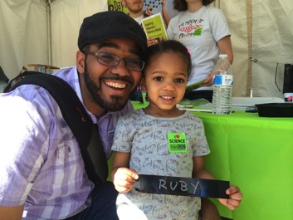
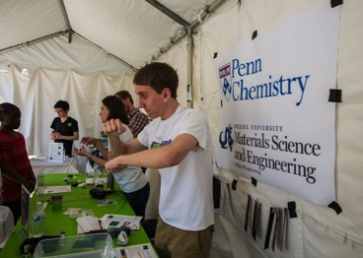
Opportunities & Challenges…
Audience
Logistics
Marketing
Staff Training
Branding
SUSTAINABILITY
Notes:
Philadelphia Science Festival: http://www.philasciencefestival.org/

Slide 25

Science Festival Alliance Resources
Notes:
Science Festival Alliance: http://sciencefestivals.org/

Slide 26
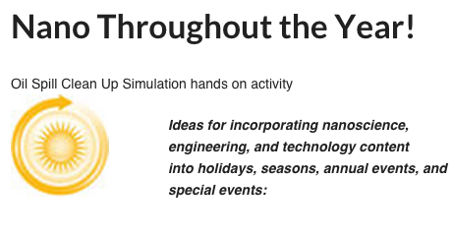

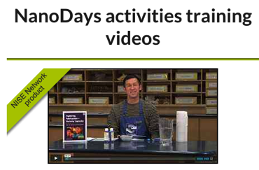
NISE Network Resources
Notes:
Nano Throughout the Year: http://nisenet.org/seasons
Planning Guide: http://nisenet.org/catalog/tools_guides/nanodays_planning_guide
Training videos: http://nisenet.org/catalog/nanodays-activities-training-videos

Slide 27



NISE Network Resources
Notes:
http://nisenet.org/catalog/online-brown-bag-beyond-nanodays-new-ideas-presenting-smallest-science-recorded
http://nisenet.org/catalog/online-brown-bag-localizing-your-nanodays-kit-adapting-kit-material-local-culture-and
http://nisenet.org/catalog/online-brown-bag-how-host-national-chemistry-week-event-recorded – theme is candy

Slide 28
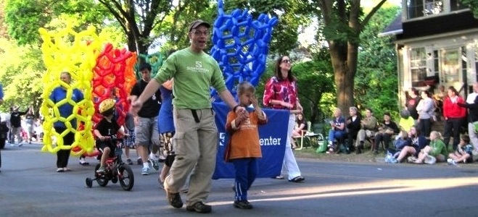


Thank you!
Cynthia Needham, ICAN Productions
This presentation is based on work supported by the National Science Foundation under Grant No. 0940143. Any opinions, findings, and conclusions or recommendations expressed in this presentation are those of the authors and do not necessarily reflect the views of the Foundation.

Slide 29
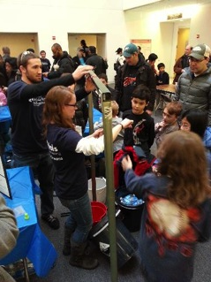
Funding
Limited industrial funding
  Ultimate goal is full industrial sponsorship
College of Engineering/Drexel University
Department Funds
  Materials Science & Engineering Summer Insitute

Slide 30
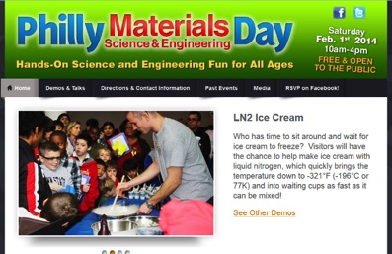
Getting the Word Out
Website
Twitter & Facebook
Facebook ads (~$1k)
Mailings to local schools (~$1k)
Local calendar listings
Email lists
Philadelphia newspapers
PECO building

Slide 31
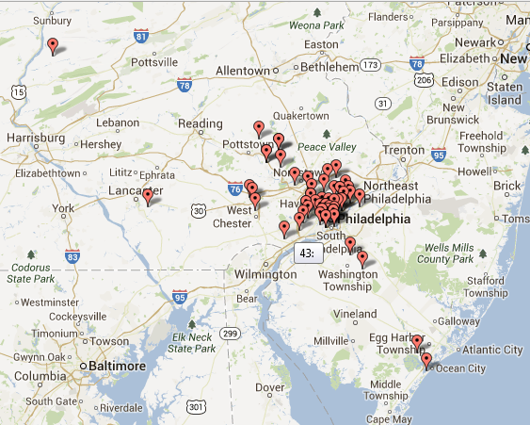
Attendance
2011: ~1000
2012: ~1300
2013: ~2000
2014: ~1500
2015: ~1200

Slide 32
Challenges
Funding (~$10k total)
Quality and quantity of volunteers
Crowd management
Safety issues

