Slide 1
Title Slide with Intro Animation

Slide 2
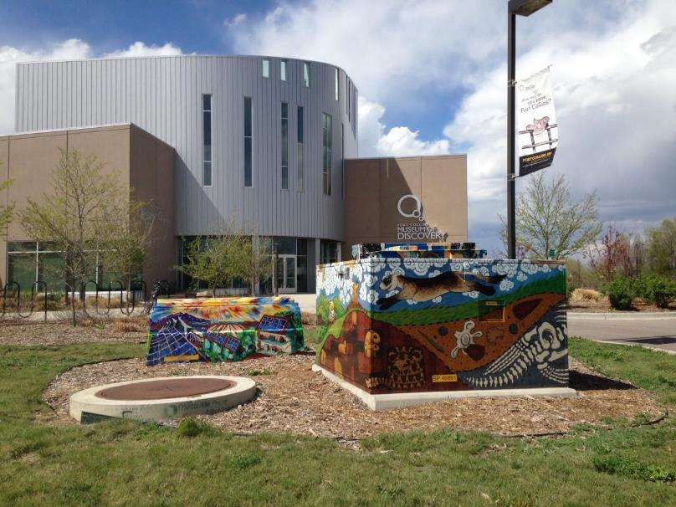
About FCMoD
The mission of the Fort Collins Museum of Discovery is to create meaningful opportunities for people to learn, reflect, and have fun through hands-on and collections-based explorations in science and culture.
Notes:
FCMoD formed in 2004 as the result of a unique public/private partnership between a local history museum and a hands-on science center.
A new 47,000 square-foot facility featuring a holistic interpretive approach blending science and history opened in 2012.
Annual visitation was 94,000 visitors in the last calendar year. Target visitation comes from a 100 mile radius and includes Denver and southern Wyoming.

Slide 3
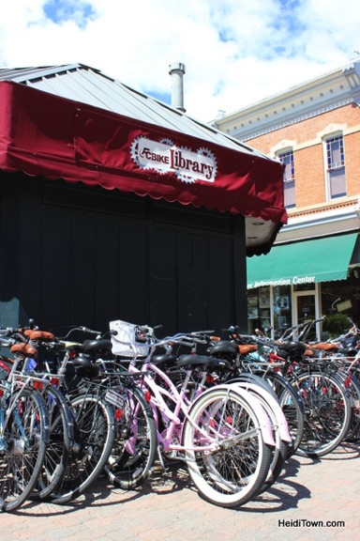
About Fort Collins: Beyond Bikes, Beer, and Bands
Demographics in Larimer County ¹
82% White
12% Hispanic or Latino of any race
3.5% Black or African American
2.4% Asian
<1% Native American
<1% Pacific Islander
Households Speaking Language other than English ²
9% , upward trending
Linguistically Isolated Households ¹
2% in 2010
80% speak Spanish, upward trending
16% Asian and Pacific Islander Languages
¹ Larimer County
² 2010 US Census
Income and Poverty
Fort Collins annual household income: $44,459 ¹
Larimer County median household income: $64,450 ²
Larimer County median family income: $89,332 ²
5.5% of families live in poverty ²
14% of population live in poverty ²
8.3% of population below age 18 live in poverty ²
Diversity
Historic context of discrimination against immigrants
International presence due to university and continued immigration
Recent immigration includes Syrian and Sudanese families
¹ Fort Collins Convention and Visitors Bureau
² Larimer County
Fort Collins is the fourth largest city in Colorado, population 151,330 ¹
1980-2010 defined 132% population growth, from 65,092 in 1980 ¹
Situated just east of the Rocky Mountain foothills and Rocky Mountain National Park
Northern end of the Front Range Urban Corridor, population 4.4 Million ²
We love beer (23 ² microbreweries and counting), bikes, bands, and dogs.
¹ 2010 US Census
² Fort Collins Convention and Visitors Bureau
Key Industries
Education: Colorado State University and Poudre School District
Breweries (23 microbreweries, plus Anheuser-Busch and New Belgium)
Technology: Hewlett-Packard, Agilent Technologies, AMD, and Avago
Manufacturing: OtterBox, Woodward Governor and Teledyne Waterpik
Alternative Energies: Advanced Energy and Vestas Wind Turbines
Oil and Gas
Notes:
McKinney-Vento: “children and youth aged birth to 21 years of age that lack a fixed, regular, and adequate nighttime residence.”
Note, PSD will account for only registered students, and will be missing a portion of under-5 not in Headstart and Early Headstart as well as dropout and graduates still 21 or under.

Slide 4
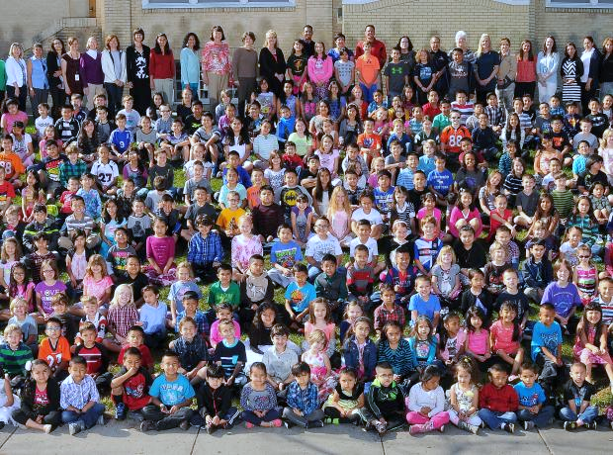
AY 14-15 Demographics of Local School District¹
Total Students: 26,038, drawn from 1,856 square miles, diverse geography
73% White
18% Hispanic or Latino of any race
3% Asian Islander
3% Two or more
1% Black or African American
0.5% American Indian or Alaskan Native
0.14% Native Hawaiian or Pacific Islander
Free and Reduced Lunch eligible
33% of all students F&R, approximately 8,592 students
ELL Students
7% total population, approximately 1,822
Elementary 10%; middle 7%; high school 4%
Homelessness (McKinney-Vento Students)
4% of students, approximately 1,181, unofficial, upward trending since 2009
¹ Statistics courtesy Poudre School District
District consolidation of programs and funding has created higher than district-wide percentages of target populations in certain schools:
2 Bilingual Education elementary schools are also Title 1 schools
75% and 70% Hispanic
55% ELL each
88% and 59% F&R eligible respectively
2 of the Title 1 elementary schools have homeless student rates of 20%
Hispanic and Latino of any race are 75% and 58%
ELL is 88% and 27%
F&R is 55% and 85%
All 6 elementary Title 1 schools also have high percentages of Hispanic and Latino of any race students; ELL students; and F&R eligible
Hispanic and Latino of any race range from 19%-75%
ELL range from 8%-55%
F&R range from 52%-88%
Notes:
Title 1 Elementary Schools (6 of 32 schools)
*75% Hispanic, 88% F&R, 55% ELL, 20% Homeless
*70% Hispanic, 59% F&R, 55% ELL
58% Hispanic, 85% F&R, 27% ELL, 20% Homeless
39% Hispanic, 64% F&R, 22% ELL
36% Hispanic, 52% F&R, 21% ELL
19% Hispanic, 64% F&R, 8% ELL
Other High ELL Elementary Schools
One Non-Title Elementary has 20% ELL (6% Hispanic, 26% F&R)
One Non-Title Elementary has 21% ELL (29% Hispanic, 38% F&R)
Title 1 Middle School
55% Hispanic, 76% F&R, 25% ELL
One Non-Title Middle has 13% ELL (28% Hispanic, 43% F&R)
No Title High Schools
16% (4,166) Hispanic or Latino of any race; 29% (1,215) F&R
3 high schools with 10% ELL populations
*Bilingual Education Model
¹Statistics Poudre School District

Slide 5
Justification for Informal Bilingual Education@FCMoD
Need
Fort Collins has a large percentage of Spanish-speaking residents and PSD students
In providing bilingual programs and content, FCMoD must also address access
Informal education aids school readiness for all children regardless of language spoken
5x5 Concept
Early language acquisition and increase vocabulary
Interest in learning increases
Confidence in ability to learn increases
Whole-family approach
Mentoring parents to support and advocate for child’s education
Awareness of unique needs of bilingual student during assessments

Slide 6
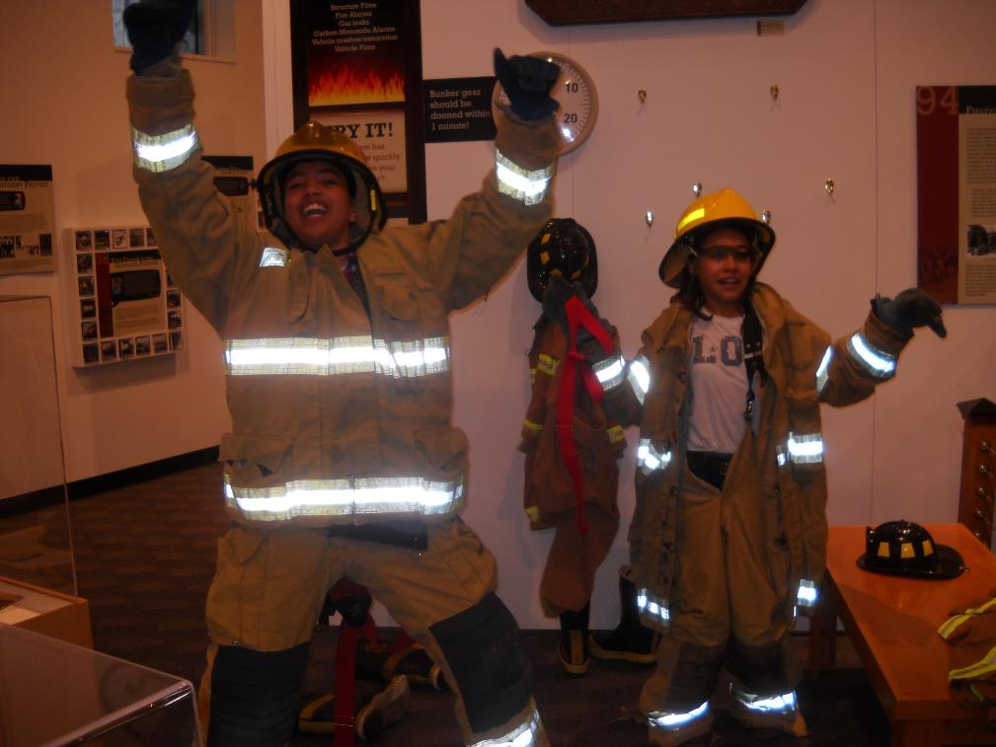
The Opportunity Program
Results, May 2014-May 2015
Opportunity Program served over 10,000 individuals
Distributed 1,148 family memberships through two school districts
Hosted 11 private events for 3,032 individuals
Provided 5,902 student field trip admission waivers for Free and Reduced Lunch eligible students
1,359 passes redeemed (for family group as defined by them, not us!)
Granted 26 scholarships for summer programs
We reserve 10% of all spaces for Opportunity Program participants
What do we provide?
Memberships to Head Start, Early Head Start, and Colorado Preschool Program families
Private events, celebrations, and parties for clients of allied agencies
Passes handed out through agencies and at events (on-site and off-site)
After first visit, families have comfort, familiarity and hopefully ownership and will utilize the passes to come back
Admission Waivers for all students (from anywhere!) who are Free and Reduced Lunch eligible
Scholarships for fee-based programs such as summer camps
We solicit local restaurants to provide lunches for children
Begun in 2003 by the Discovery Science Center
Grant Funded
Targeted Communities
Families enrolled in Head Start, Early Head Start, or the Colorado Preschool Program
Families living in poverty
Families with at-risk adolescents
Schools with high rates of students living in poverty
Non-English speaking families

Slide 7
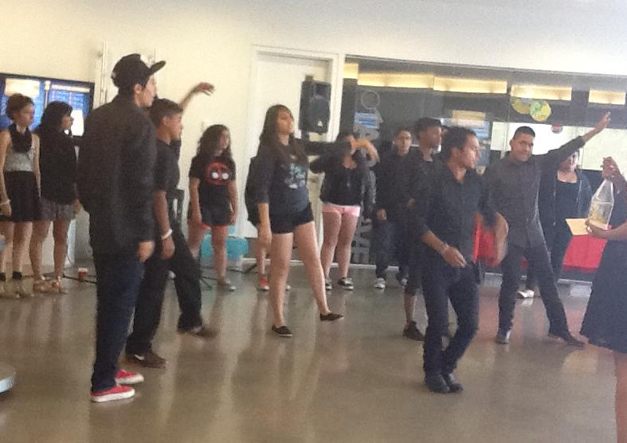
Strategies for Engaging the Spanish-Speaking Audience
We collaborate (hence the importance of demographics - know where to go!)
We have 18 formally allied service agencies that serve the target populations collaborating with us
As transportation can be a barrier to engagement, agencies will frequently provide transportation to the museum for their families!
We work directly with the schools: principals, teachers, staff, faculty, and parents
We go to them
Bilingual staff attend events and meetings with the agency staff and clients
We build trust
We speak their language: bilingual staff and volunteers visit agencies and work at the museum
We welcome them and demonstrate that the museum is a fun and safe place for their families
We respond to the needs of the families and the agencies as they express them to us
We make it about them
We host private events based on their needs (i.e. ELA Graduation Celebration; Christmas Party)
We share dinner (agencies arrange for meals)
We have bilingual interpreters in the museum

Slide 8
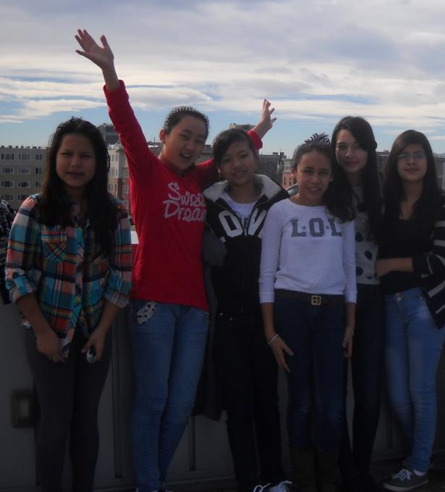
GEMS NanoCamp
Audience: Latina High School Students
While Latinas in PSD have a lower than state average dropout rate, we are on a increasing trend and saw a spike of 15% in the rate in one year
We wanted to experiment with a girls-only informal educational environment to see if the girls expressed greater confidence in their participation
We recruited through our Opportunity Program connections
Nano Content
We wanted to encourage girls to envision themselves as college students and scientists
Nano is cool, unexpected, and engaging
Role Models and Field Trips
CSU women professors of color mentored the students and hosted the girls in their labs
The project was meaningful
The girls design activities modeled after Nano Kits for use by CSU professor in outreach activities

Slide 9
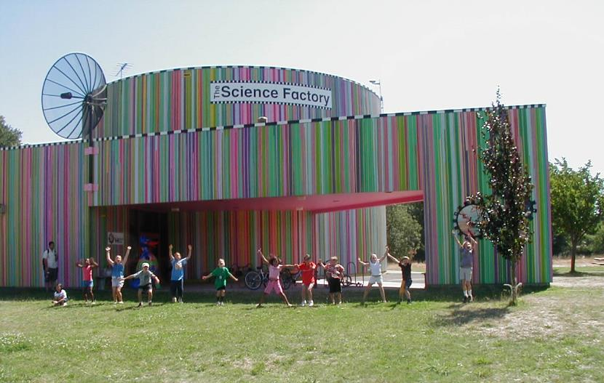

Slide 10
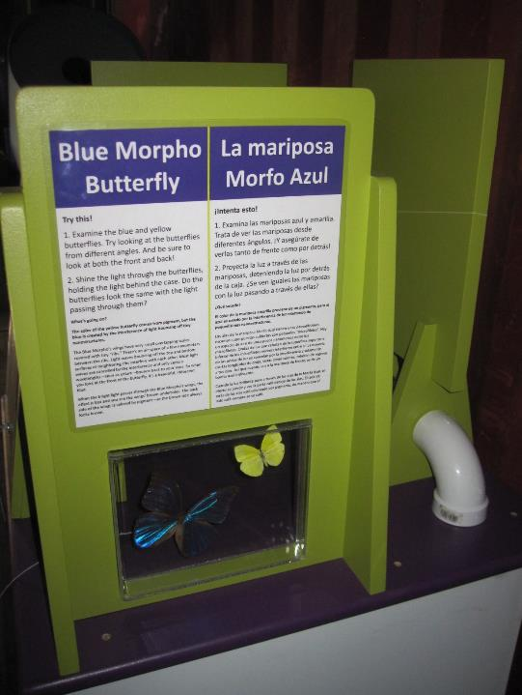

Slide 11
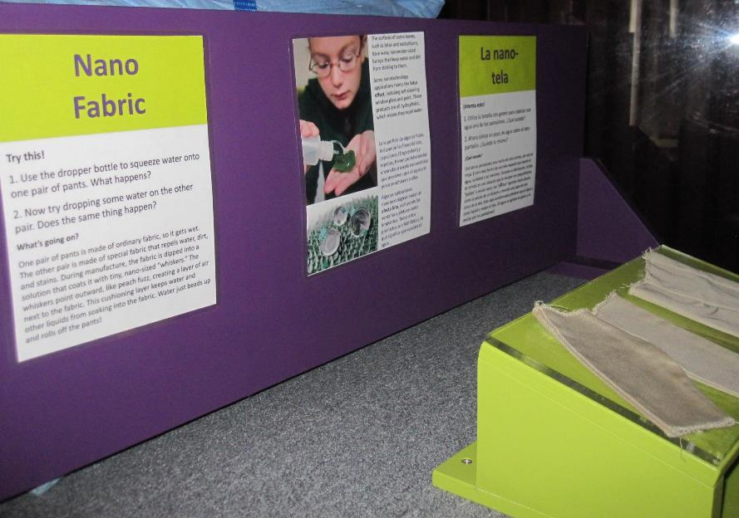

Slide 12
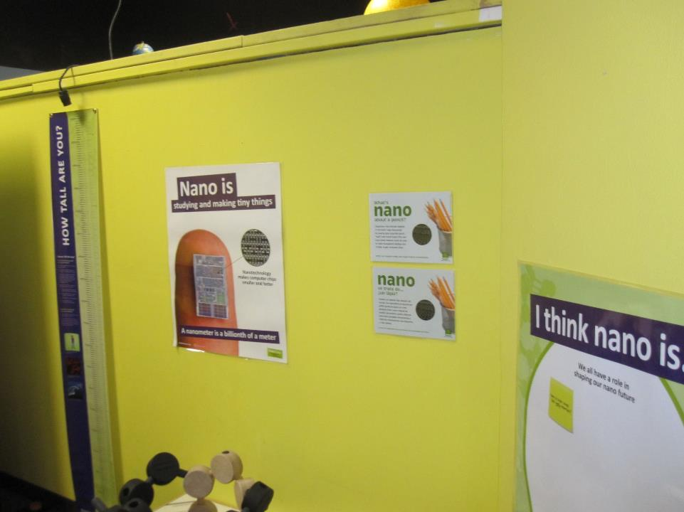

Slide 14
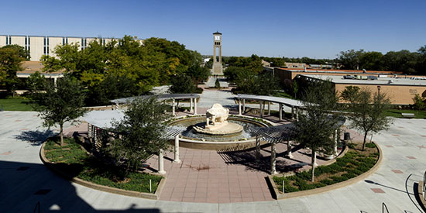
Aaron Hunt
West Texas A&M University
Canyon, TX

Slide 15
This presentation is based on work supported by the National Science Foundation under Grant No. 0940143.
Any opinions, findings, and conclusions or recommendations expressed in this presentation are those of the author(s) and do not necessarily reflect the views of the Foundation.
Notes:
And as always, thank you to NSF for supporting this project!

Slide 16
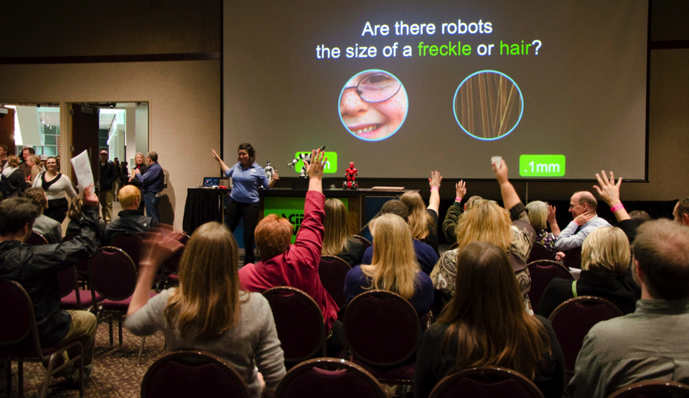
Questions and Answers

Slide 17
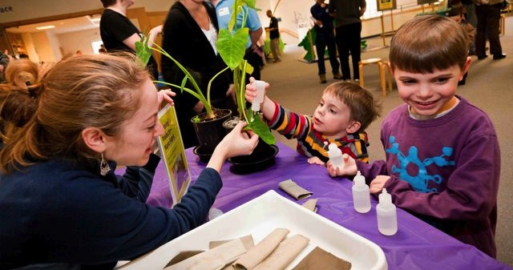
THANK YOU!!!
To all our partners, we could not do this work without you!

