Slide 1
STEM Learning Ecosystems
Generalized Example Illustration
Slides with Editable Text Labels
Illustration variations include with and without: natural context, learner pathway, and “Culture, Society, Place”
Published under a Creative Commons Attribution Noncommercial-ShareAlike license Copyright Arizona State University, November 2023
https://nisenet.org/stem-learning-ecosystems
This material is based upon work supported by NASA under cooperative agreement award number 80NSSC21M0007. Any opinions, findings, and conclusions or recommendations expressed in this material are those of the author(s) and do not necessarily reflect the view of the National Aeronautics and Space Administration (NASA).

Slide 2
STEM Learning Ecosystems
Generalized Example Illustration
Slides with Editable Text Labels
Variations
Illustration
with editable text labels
“Culture, Society, Place” with editable text labels
with learner pathway and editable text labels
learner pathway without text labels
Illustration set in a natural context
with editable text labels
“Culture, Society, Place” with editable text labels
with learner pathway and editable text labels
earner pathway without text labels

Slide 3
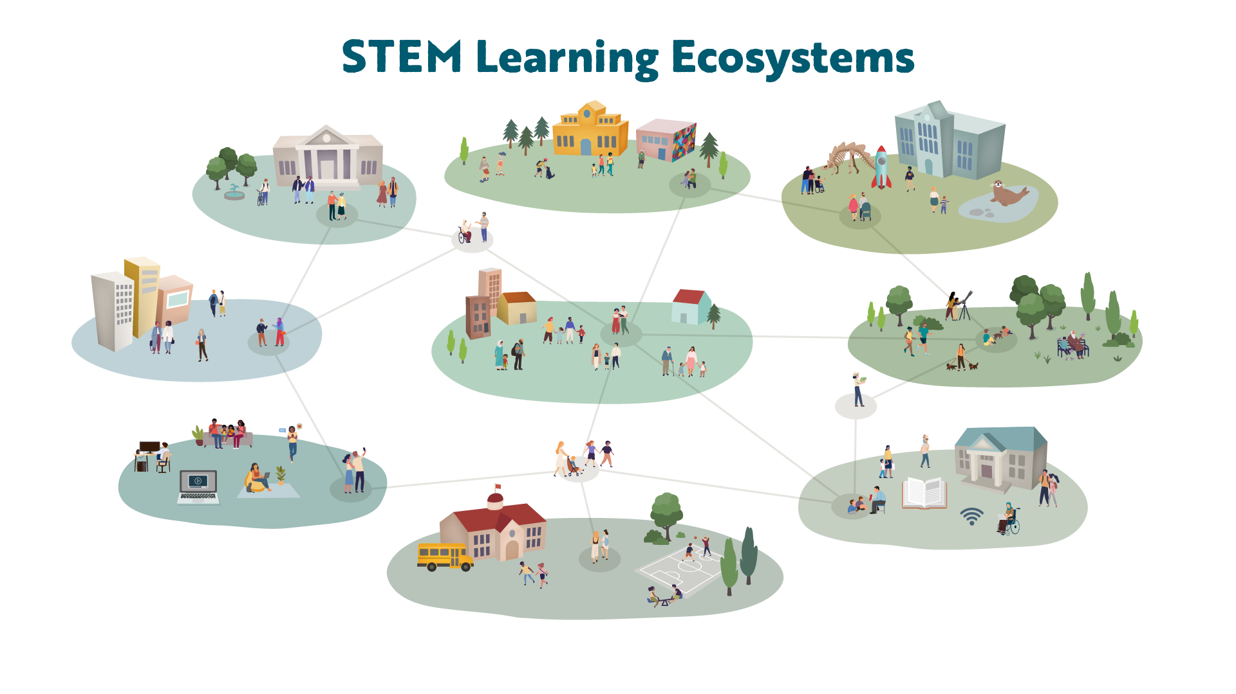
COMMUNITY + FAITH-BASED ORGANIZATIONS
GOVERNMENT
AGENCIES
MUSEUMS
ZOOS + AQUARIUMS
WORK + BUSINESS
PARKS, GARDENS + NATURE CENTERS
FAMILY, FRIENDS + NEIGHBORS
ONLINE + MEDIA
LIBRARIES
SCHOOL +
HIGHER EDUCATION

Slide 4
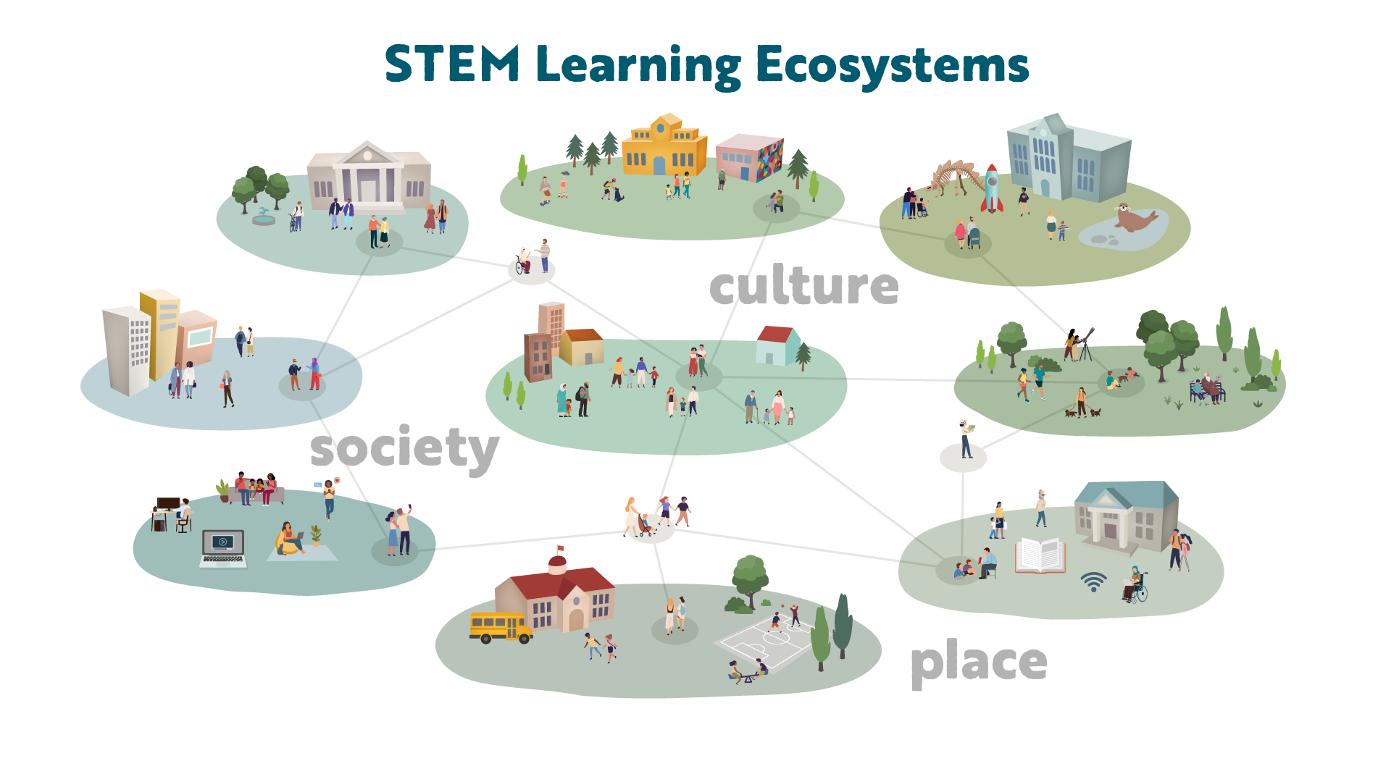
COMMUNITY + FAITH-BASED ORGANIZATIONS
GOVERNMENT
AGENCIES
MUSEUMS
ZOOS + AQUARIUMS
WORK + BUSINESS
PARKS, GARDENS + NATURE CENTERS
FAMILY, FRIENDS + NEIGHBORS
ONLINE + MEDIA
LIBRARIES
SCHOOL +
HIGHER EDUCATION

Slide 5
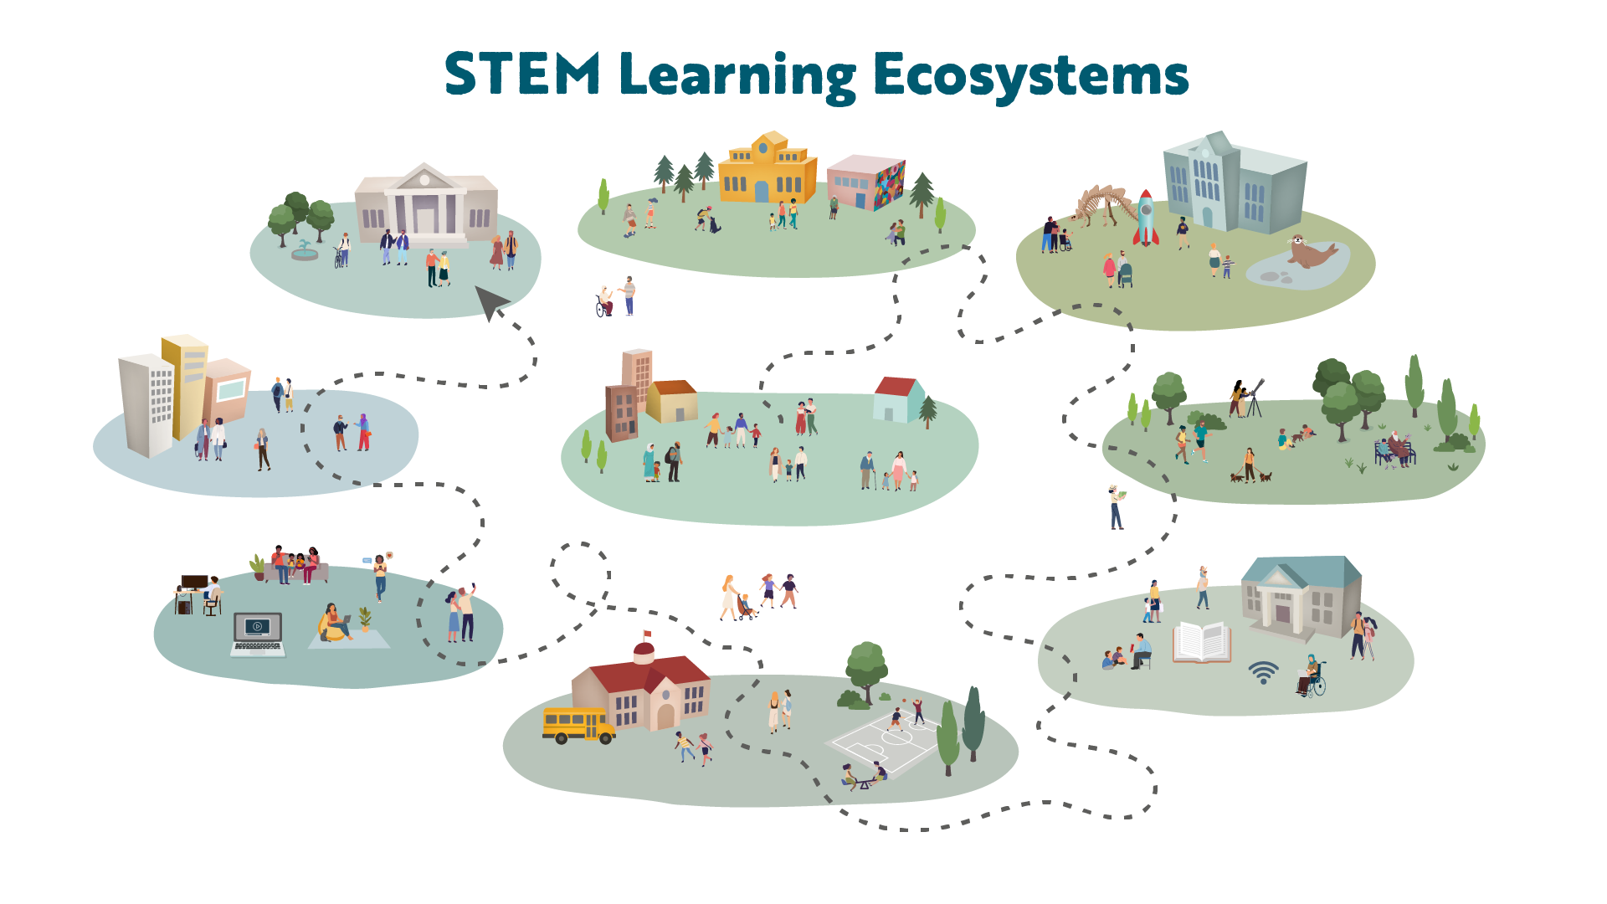
COMMUNITY + FAITH-BASED ORGANIZATIONS
GOVERNMENT
AGENCIES
MUSEUMS
ZOOS + AQUARIUMS
WORK + BUSINESS
PARKS, GARDENS + NATURE CENTERS
FAMILY, FRIENDS + NEIGHBORS
ONLINE + MEDIA
LIBRARIES
SCHOOL +
HIGHER EDUCATION

Slide 7
COMMUNITY + FAITH-BASED ORGANIZATIONS
GOVERNMENT
AGENCIES
MUSEUMS
ZOOS + AQUARIUMS
WORK + BUSINESS
FAMILY, FRIENDS + NEIGHBORS
PARKS, GARDENS + NATURE CENTERS
ONLINE + MEDIA
LIBRARIES
SCHOOL +
HIGHER EDUCATION

Slide 8
COMMUNITY + FAITH-BASED ORGANIZATIONS
GOVERNMENT
AGENCIES
MUSEUMS
ZOOS + AQUARIUMS
WORK + BUSINESS
PARKS, GARDENS + NATURE CENTERS
FAMILY, FRIENDS + NEIGHBORS
ONLINE + MEDIA
LIBRARIES
SCHOOL +
HIGHER EDUCATION

Slide 9
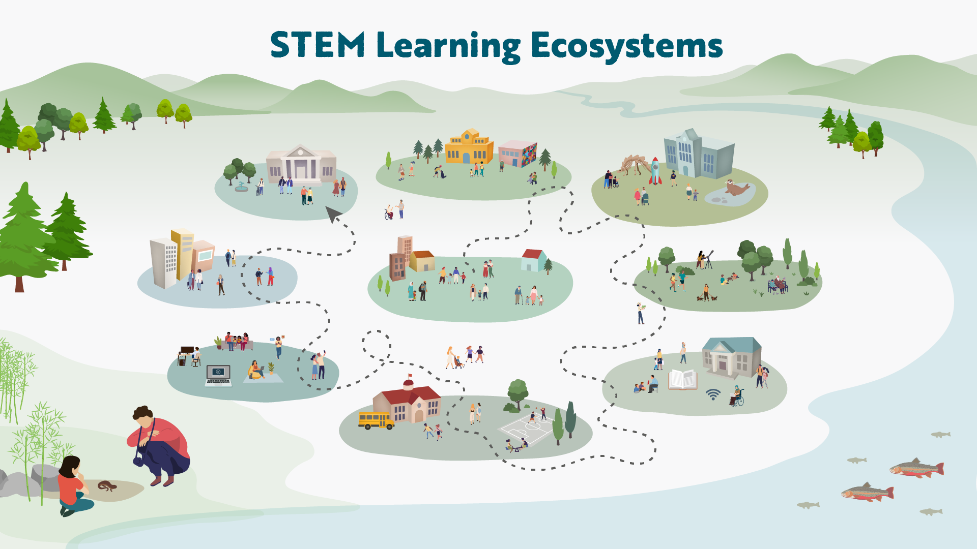
COMMUNITY + FAITH-BASED ORGANIZATIONS
GOVERNMENT
AGENCIES
MUSEUMS
ZOOS + AQUARIUMS
WORK + BUSINESS
FAMILY, FRIENDS + NEIGHBORS
PARKS, GARDENS + NATURE CENTERS
ONLINE + MEDIA
LIBRARIES
SCHOOL +
HIGHER EDUCATION

