Slide 1
Sea Level Rise
Notes:
Welcome back everyone! I hope you enjoyed your planetarium show. Thank you for returning to the room in a timely manner.
We are now going to begin with session one. We will start with a brief introduction to Kingtown.

Slide 2
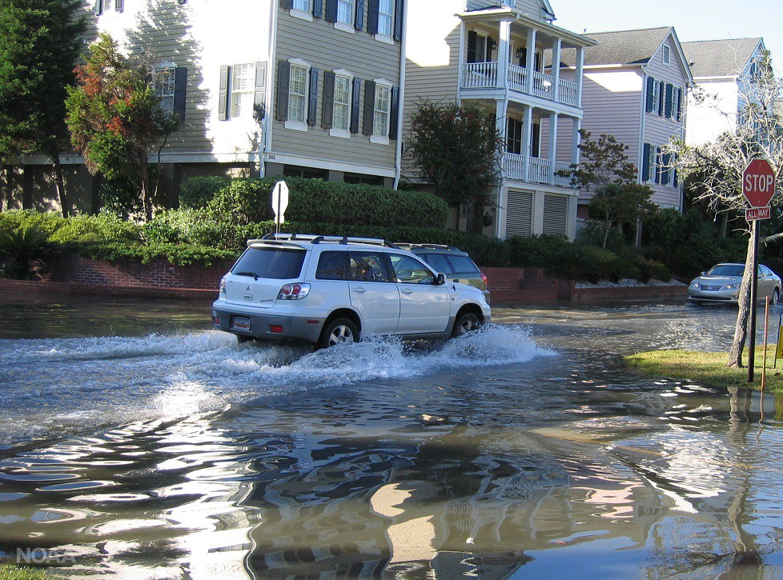
Welcome to Kingtown!
Session 1: Sea Level Rise
Notes:
I’m going to introduce you to Kingtown, which is the community we will be making a resilience plan for.
Picture: https://3c1703fe8d.site.internapcdn.net/newman/gfx/news/hires/2017/regionalseal.jpg. Image credit: NOAA

Slide 3
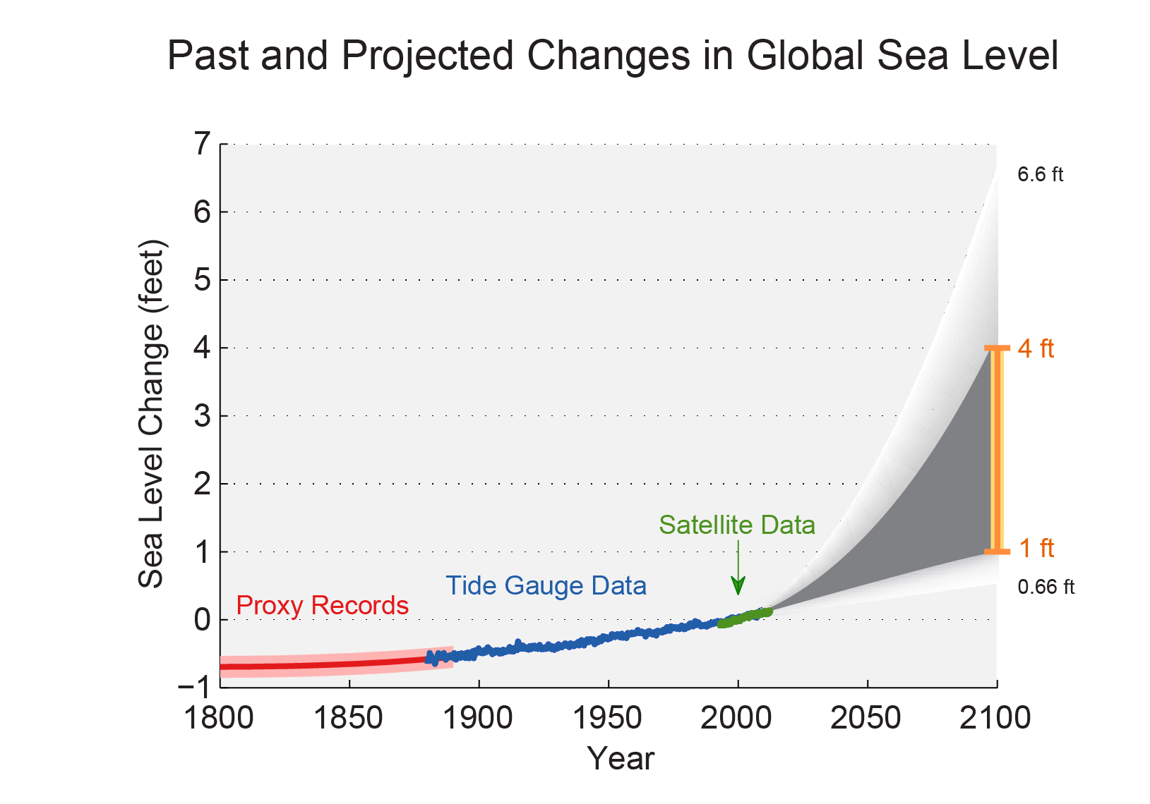
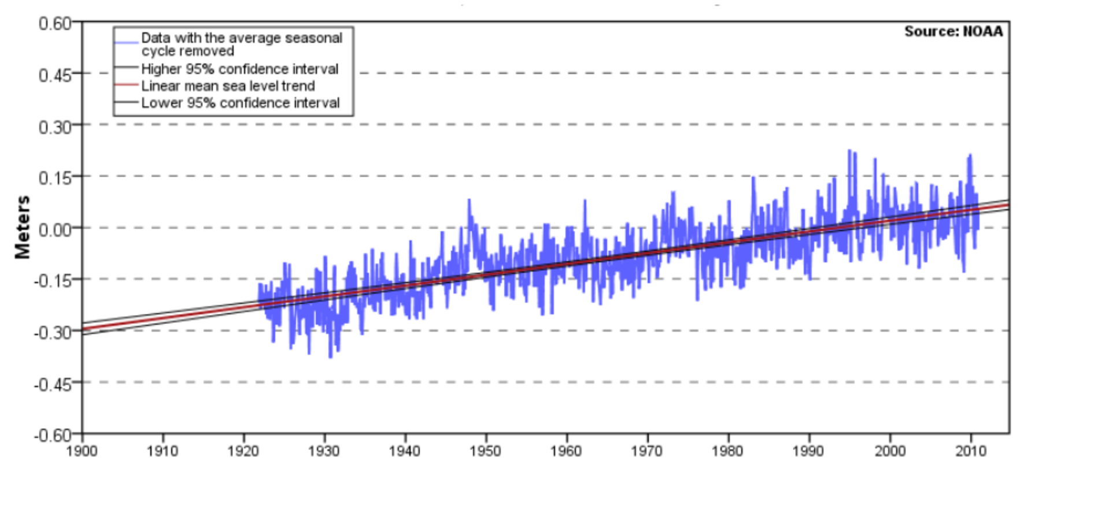
Around the world, sea levels are rising at an alarming rate.
Kingtown Sea Level Change
Global Sea Level Change
Notes:
Welcome to Kingtown! According to the National Climate Assessment, global sea level has risen by about 8 inches since reliable record keeping began in 1880. It is projected to rise another 1 to 4 feet by 2100. In Kingtown, sea levels have risen by about a foot over the last century..

Slide 4
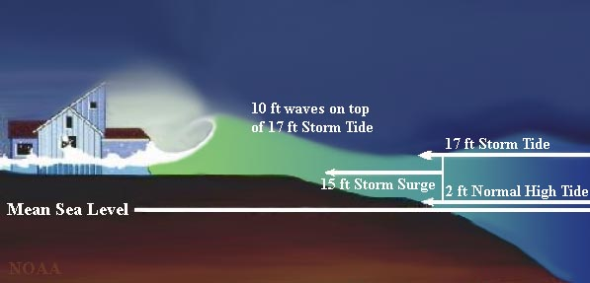
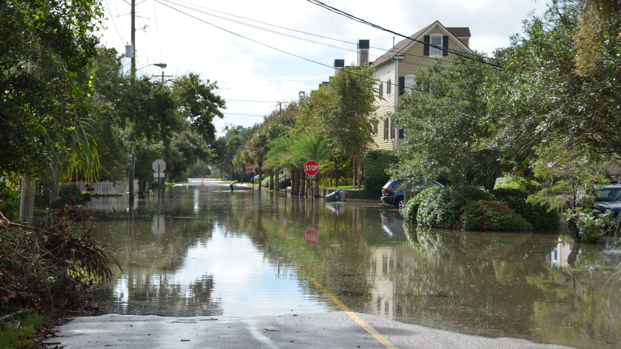
Storm surges combined with sea level rise can lead to flooding.
Notes:
Kingtown is now prone to flooding on the streets at high tides and during coastal storms. This matters because the structures we build to protect ourselves are built for the sea level people experienced a century or more ago. When we find high tide and waves from storms on top of the sea level rise we are experiencing, water washes onshore. This means Kingtown needs to become more reslient.

Slide 5
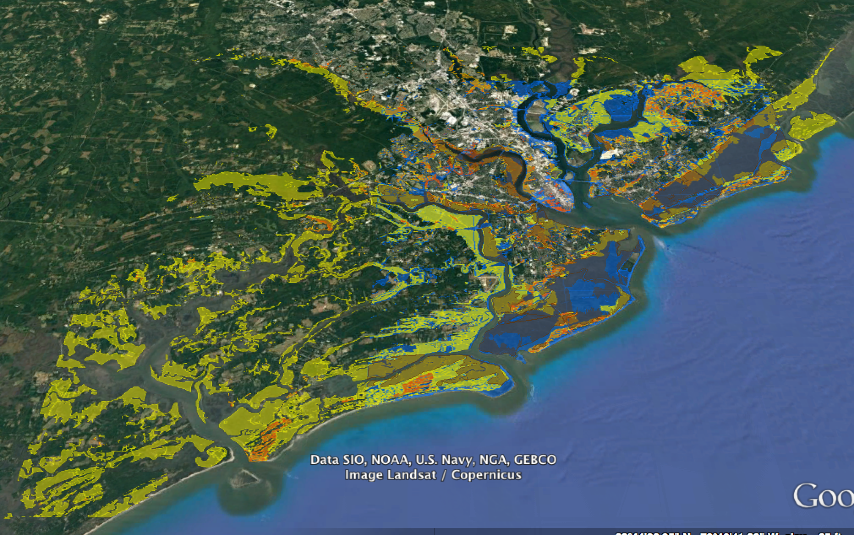
Who lives in Kingtown?
Yellow 100 - 1000 people
Orange 1,000 - 10,000 people
Red 10,000 - 100,000 people
Notes:
Population

Slide 6
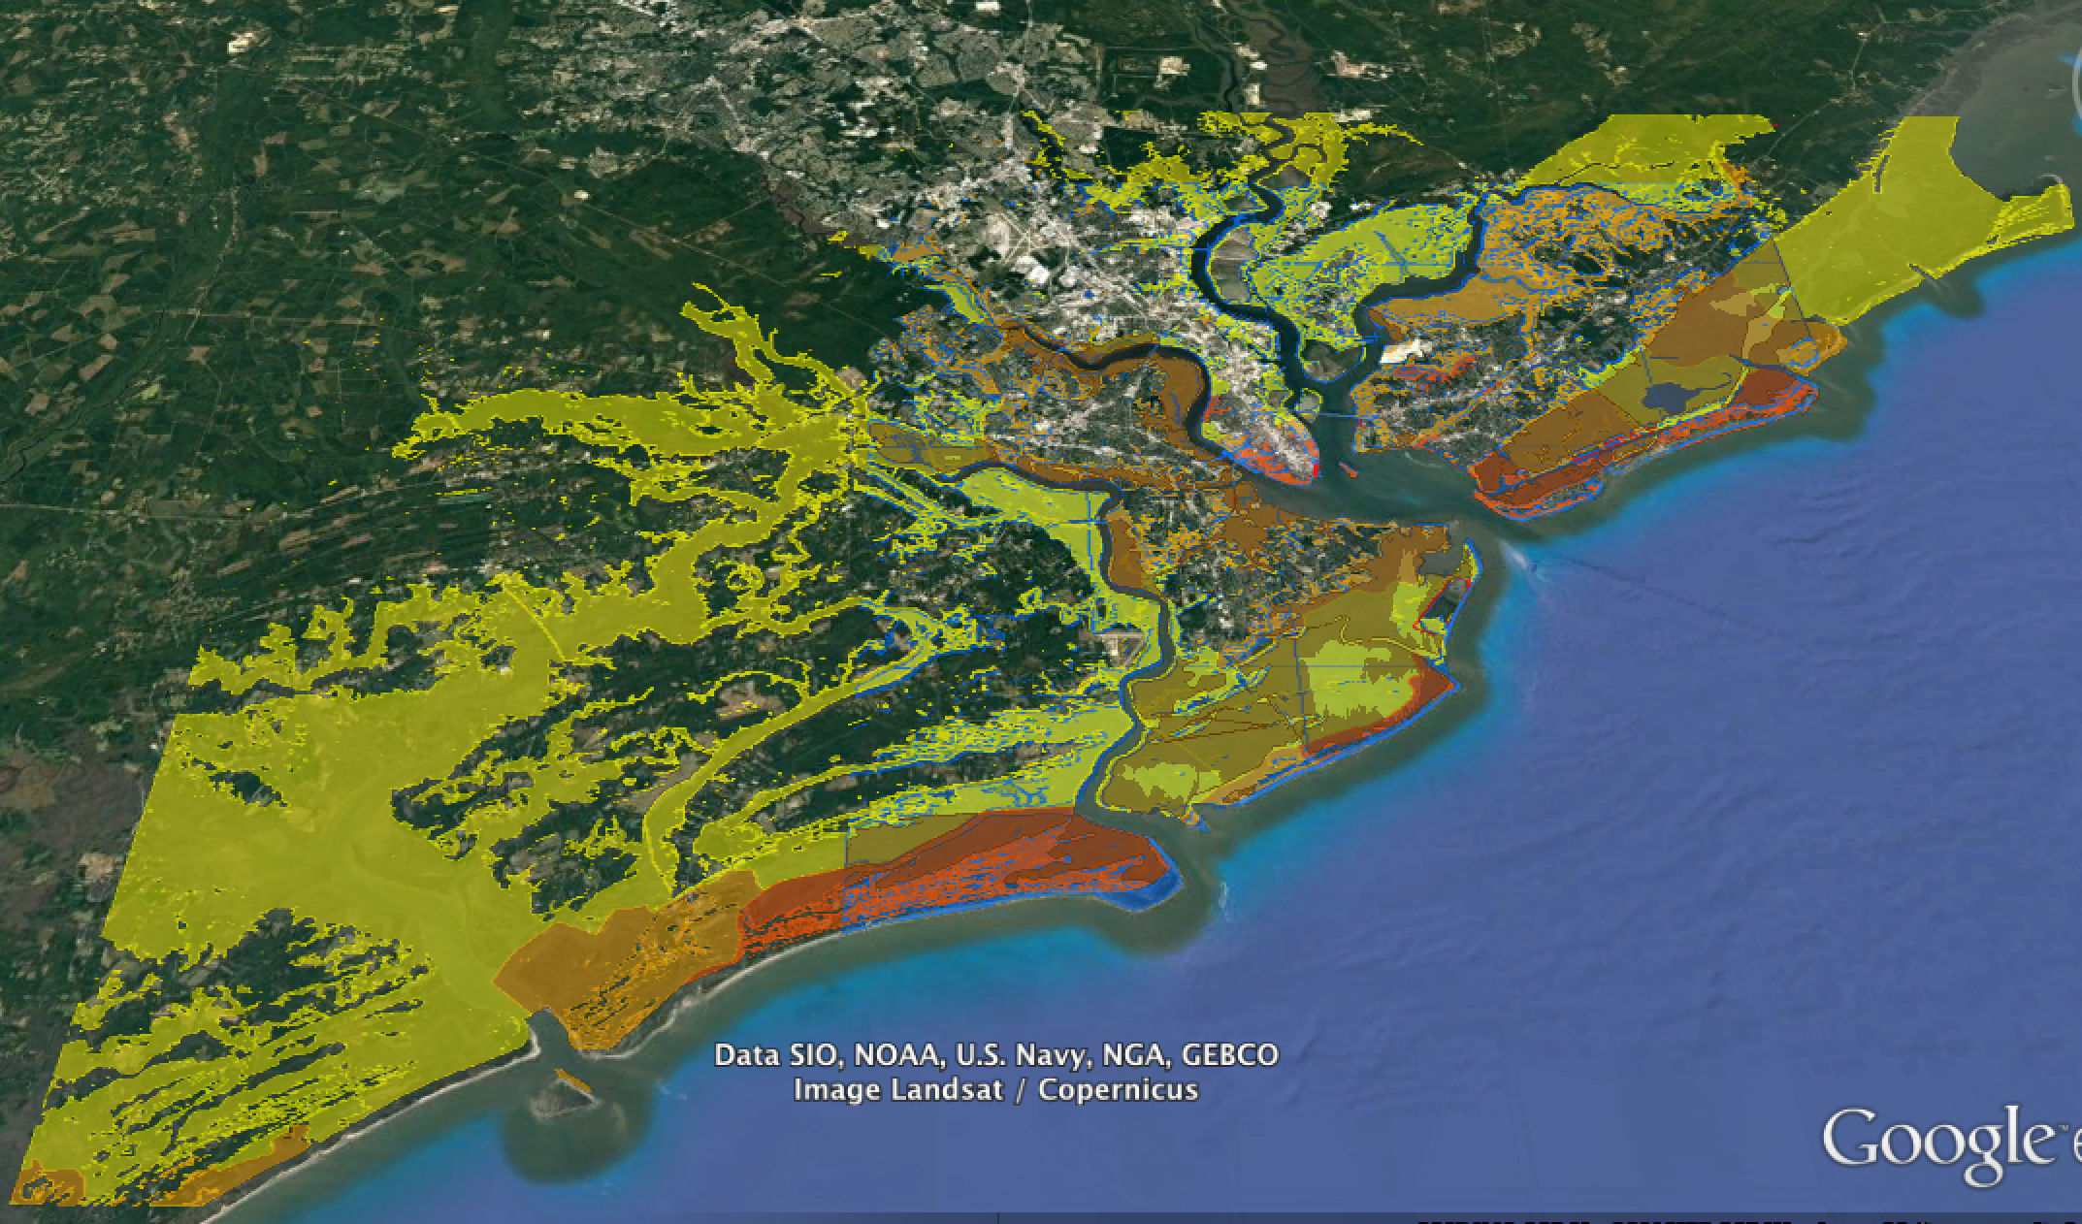
Who lives in Kingtown?
Yellow $100,000 - $1 million
Orange $1 million - $10 million
Dk. Orange $10 million - $100 million
Red $100 million +
Notes:
PROPERTY VALUE - THIS IS IN THE BACK OF THE WORKBOOKS

Slide 7
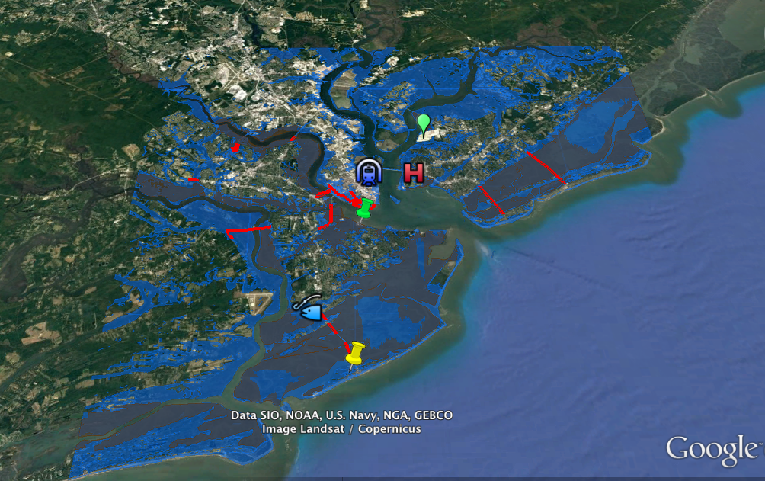
What makes Kingtown vulnerable?
Notes:
I wanted to point out that the darker areas of blue that you see here are marshes and wetlands. Even though these places are flooding as a result of sea level rise, this will not directly affect the citizens of Kingtown because no one lives there.

Slide 8
What makes Kingtown vulnerable?
Notes:
The oyster beds along South Kingtown beach have sustained oyster harvesters for generations. In recent years, farmed oysters and mussels have provided a way for fishermen to embrace more sustainable practices, while providing ways for the city to promote economic development and tourism along the coastline.

Slide 9
What makes Kingtown vulnerable?
Notes:
This neighborhood along the Eastern Sandbar is highly vulnerable to sea level rise. Property values are high here, because of the coastal views.

Slide 10
What makes Kingtown vulnerable?
Notes:
Kingtown Power Station supplies the greater Kingtown Metro region area with electricity from natural gas. The plant is about 10 years old and has a planned lifespan of at least 20 more years. The city's recent flooding vulnerability assessment named the power station as "a crucial element of infrastructure that must be protected from future flooding as sea levels rise".

Slide 11
What makes Kingtown vulnerable?
Notes:
Kingtown Central Station serves as a hub for regional railway and bus service, as well as the main connection point for the subway that serves the downtown area. If the station is flooded, it must be shut down and thus disrupts transportation throughout the Kingtown metro region.

Slide 12
What makes Kingtown vulnerable?
Notes:
Kingtown Hospital provides high-quality healthcare services and programs to city residents. The current building is about 20 years old and serves a number of low-income neighborhoods. The city's recent vulnerability assessment identified the hospital as being vulnerable to coastal flooding as sea levels rise.

Slide 13
What makes Kingtown vulnerable?
Notes:
One of the largest employers in Kingtown is AeroEng, a large international aerospace engineering firm. They recently built new corporate offices into an area in North Kingtown on the waterfront in a location that easily allows employees to get to the airport. AeroEng's leadership was originally hesitant to relocate near the water because of possible flood risks, but moved forward with the plan after the city offered tax incentives.

Slide 14
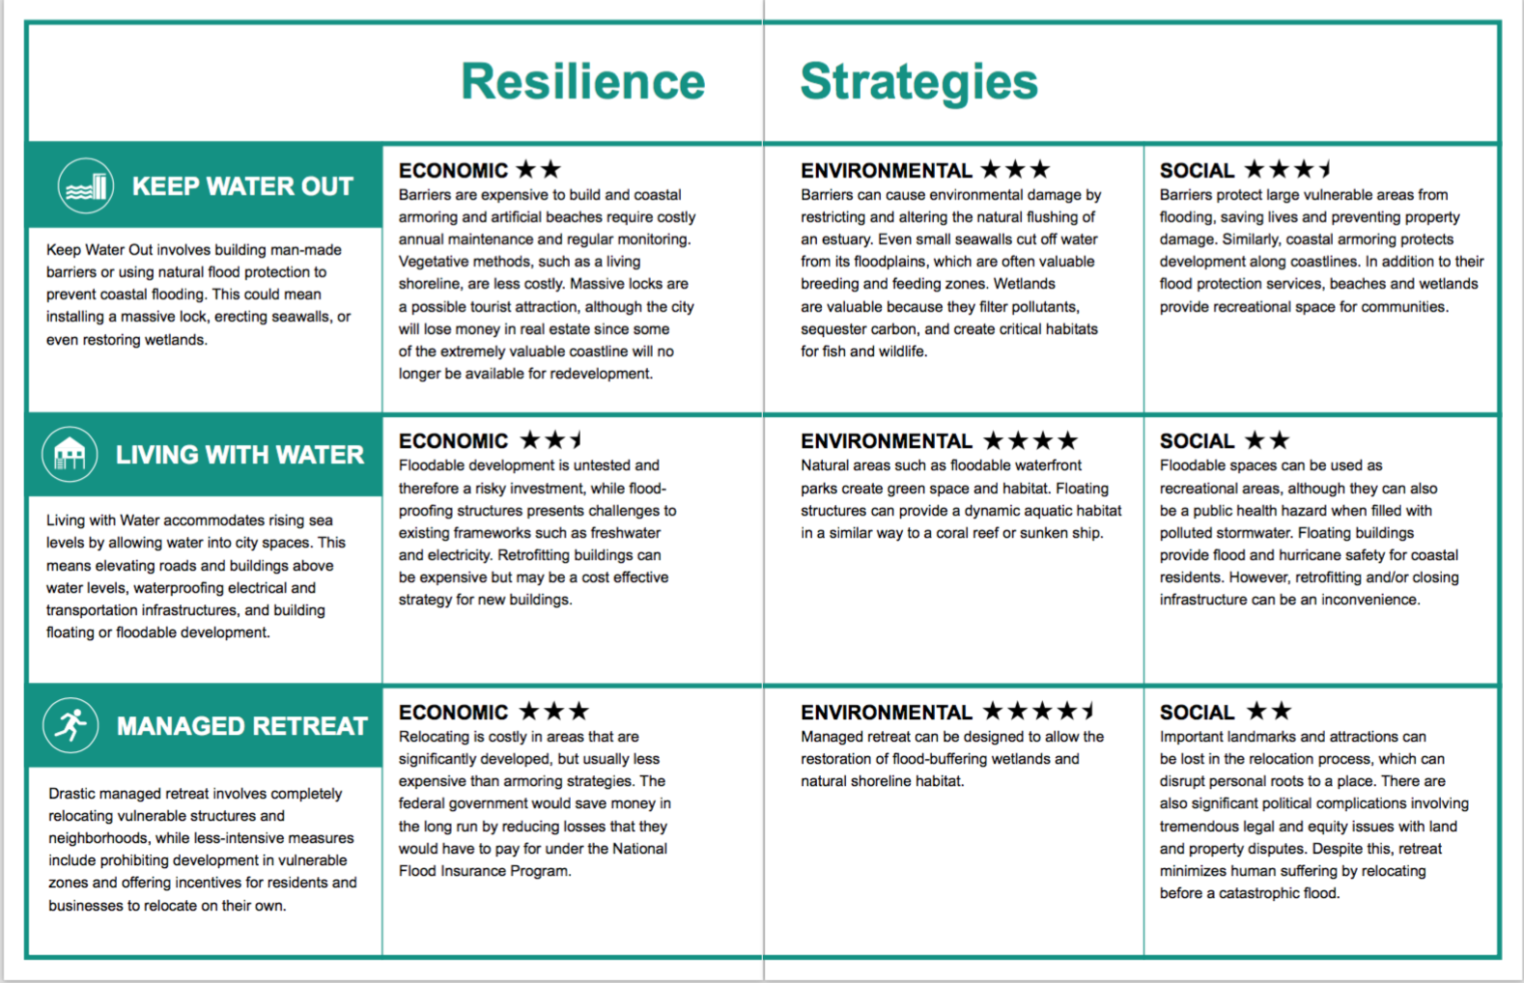
Kingtown’s Possible Resilience Strategies
Notes:
Kingtown has assembled a team of city planners planners, scientists, and engineers to come up with options for resilience. They’ve chosen three options, or resilience strategies, and have ranked them based on the economic, environmental, and social values of each strategy. The star rankings are a way to help you understand what the strategy does a bit better. You learned about these in your background packet and can refresh your memories on what these mean by looking in your workbooks for the section labeled "resilience strategies"

Slide 15
Resilience for Kingtown
Step 1: Consider Stakeholder Perspectives
Step 2: Prioritize Stakeholder Values
Step 3: Make your Resilience Plan
Step 4: Implement and Explore Your Resilience Plan
Notes:
Today you will act as the resilience planning team for the city of Kingtown. Your team’s task is to create a plan that protects Kingtown while considering the values of people who live there, the impacts on the economy and the effects on the environment of the city. Follow the steps below to create your plan, then implement and explore your plan using digital visualizations.

Slide 16
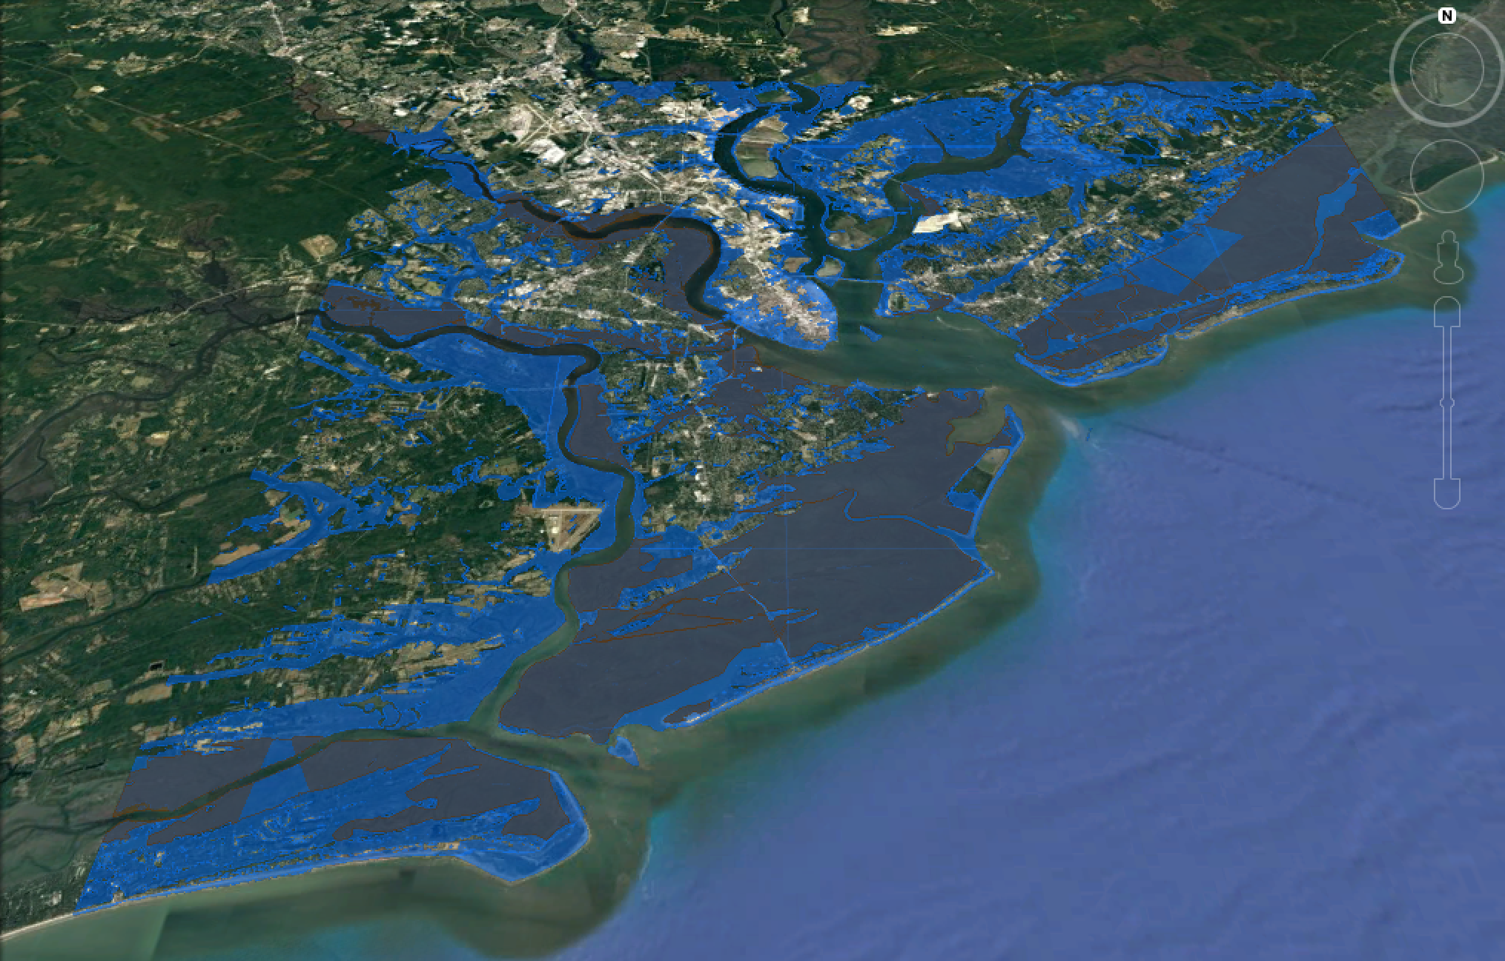
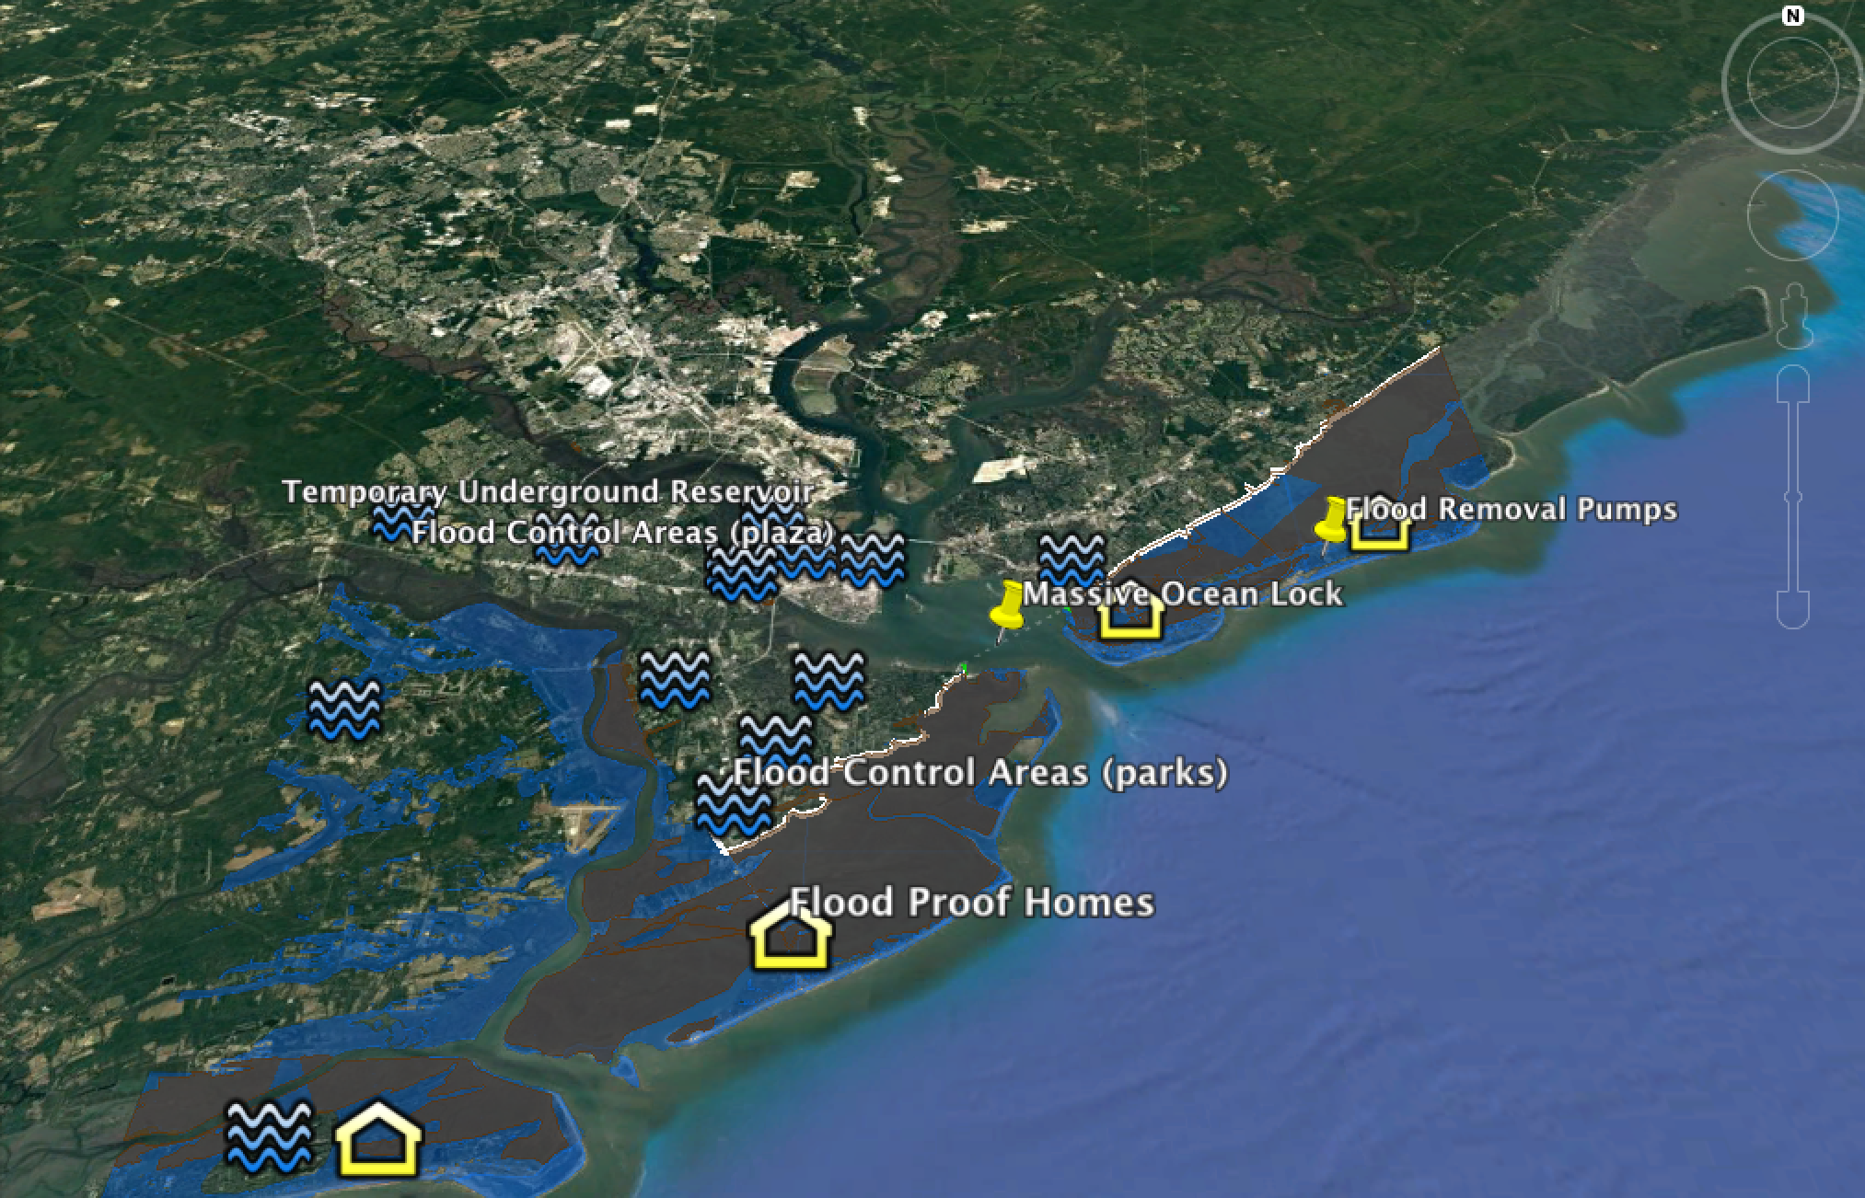
Resilience for Kingtown
Notes:
Now that you know a little bit about Kingtown, let’s start planning! You will begin by learning about the stakeholders, or people who will be affected by coastal flooding and sea level rise, and the resilience plans you will put in place, then you will discuss some options for a plan, and then finally visualize them.
Now that you know a little bit about Rivertown, let’s start planning! You will begin by learning about the stakeholders, or people who will be affected by extreme precipitation and the resilience plans you will put in place, then you will discuss some options for a plan, and then finally visualize them (hit next).
Now, your facilitators will begin section 1. You will have 15 minutes for section 1. Please keep track of time!
Participants, please remove the green Sea Level Rise Workbooks from your folders.
Facilitators please turn to page 1 of your facilitation guide and take out the stakeholder cards.
You may now begin.
Good luck!

Slide 17
Table Introductions & Overview
2
minutes
102 minutes remaining

Slide 18
Step 1: Consider Stakeholder Perspectives
15
minutes
100 minutes remaining

Slide 19
Step 1: Consider Stakeholder Perspectives
5
minutes
90 minutes remaining

Slide 20
Step 2: Prioritize Stakeholder Values
25
minutes
85 minutes remaining
Notes:
Facilitators, we are now on Section 2. You will need the stakeholder icons located in a white envelope in your folder. There are three sets of all six of the stakeholders. You will use one set per strategy on the board. Please remember to tape these down at the end of the section.

Slide 21
Step 2: Prioritize Stakeholder Values
20
minutes
80 minutes remaining

Slide 22
Step 2: Prioritize Stakeholder Values
15
minutes
75 minutes remaining

Slide 23
Step 2: Prioritize Stakeholder Values
10
minutes
70 minutes remaining

Slide 24
Step 2: Prioritize Stakeholder Values
5
minutes
65 minutes remaining

Slide 25
Step 3: Make Your Resilience Plan
20
minutes
60 minutes remaining
Notes:
Facilitators, we are now on Section 3. You will need the A & B cards and three coin chips. Participants can turn to the section in their workbooks that says Resilience Plans to follow along. Remember, only individual opinions are recorded in the workbooks. Table results are recorded on the board! What is in your workbook and on the board do not need to match!

Slide 26
Step 3: Make Your Resilience Plan
15
minutes
55 minutes remaining

Slide 27
Step 3: Make Your Resilience Plan
10
minutes
50 minutes remaining

Slide 28
Step 3: Make Your Resilience Plan
5
minutes
45 minutes remaining

Slide 29
Step 4: Implement and Explore Your Resilience Plan
10
minutes
40 minutes remaining
Notes:
Facilitators, you will now be using google earth videos and the final resilience plan cards. Remember to use the card to alert us if you need help using the google earth videos. If this is your final plan please remember to tape down the coins with what you choose.

Slide 30
Step 4: Implement and Explore Your Resilience Plan
5
minutes
35 minutes remaining

Slide 31
Step 5: Re-Evaluate Your Resilience Plan
10
minutes
30 minutes remaining
Notes:
Remember, only individual opinions are recorded in the workbooks. Table results are recorded on the board! What is in your workbook and on the board do not need to match!

Slide 32
Step 5: Re-Evaluate Your Resilience Plan
5
minutes
25 minutes remaining

Slide 33
Step 6: Explore Your New Resilience Plan
10
minutes
20 minutes remaining

Slide 34
Step 6: Explore Your New Resilience Plan
5
minutes
15 minutes remaining

Slide 35
Time’s up!
Please make sure all of your pieces are taped down on your board and that you write down your final plan in the space provided on the board.

Slide 36
Step 7: Share Your Resilience Plan
10
minutes
10 minutes remaining

Slide 37
Step 7: Share Your Resilience Plan
5
minutes
5 minutes remaining

