Slide 1
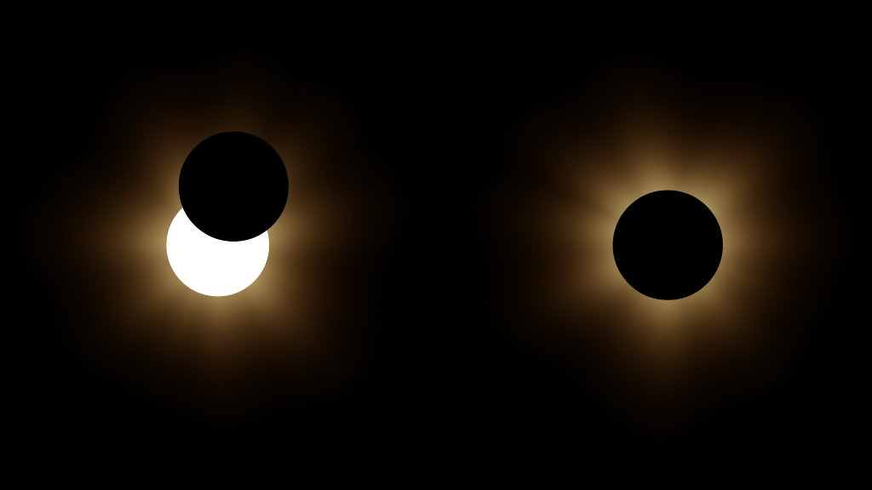
Preparing for a Solar Eclipse
Credit: NASA Goddard
Notes:
Opening slide
-----------
Image Description: Two images from the March 2015 Solar Eclipse; the left image shows a partial solar eclipse and the right shows a total solar eclipse.
Image Credit: NASA Goddard, https://images.nasa.gov/details/GSFC_20171208_Archive_e000234
-----------
This slide presentation is based on the “Preparing for a Partial Eclipse: An Event to Remember” 2017 slideshow presentation created by the NASA Night Sky Network and Astronomical Society of the Pacific.
-----------

Slide 2
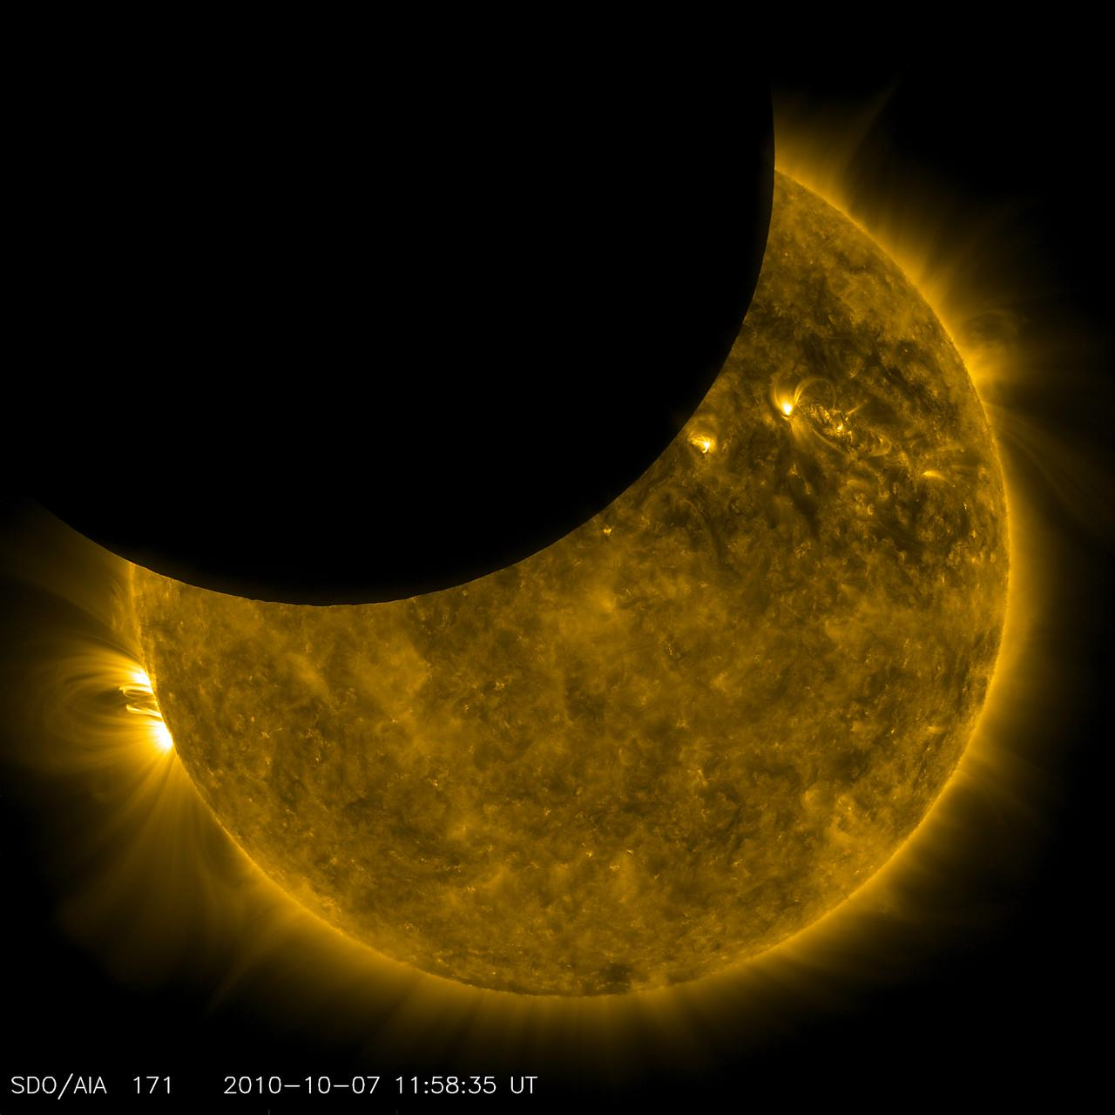
Presentation Overview
What are solar eclipses
How to enjoy a solar eclipse safely
Solar eclipse resources for everyone
Credit: NASA Goddard
Notes:
Feel free to add your own information, use only parts of this presentation, or modify as you like.
-----------
Image Description: The Solar Dynamics Observatory (SDO) observed its first lunar transit when the new Moon passed directly between the spacecraft (in its geosynchronous orbit) and the Sun. With SDO watching the Sun in a wavelength of extreme ultraviolet light, the dark Moon created a partial eclipse of the Sun.
Image Credit: NASA Goddard, https://images.nasa.gov/details/GSFC_20171208_Archive_e001976

Slide 3
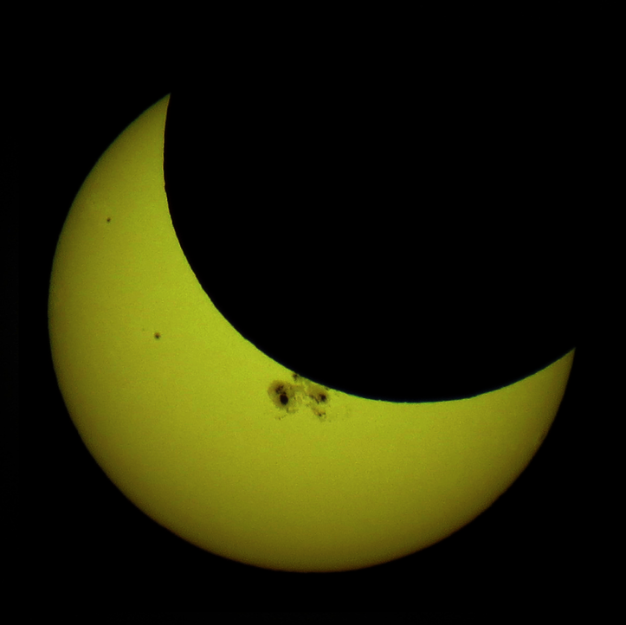
Have You Ever Seen a Solar Eclipse?
Credit: Tomruen
Notes:
Who in the room has seen a partial solar eclipse? (ask for a show of hands)
Who in the room has seen a total solar eclipse? (ask for a show of hands)
Now, has anyone has seen a lunar eclipse? (solar vs. lunar on next slide)
-----------
Image Description: Solar eclipse of October 23, 2014 from Minneapolis, Minnesota.
Image Credit: Tomruen - Own work, CC BY-SA 4.0, https://commons.wikimedia.org/w/index.php?curid=36349192

Slide 4
What is the Difference Between a Solar and Lunar Eclipse?
Illustrations not to scale
Credit: NASA Space Place
Notes:
This is a very simplified diagram showing the difference between a solar eclipse and a lunar eclipse.
During a lunar eclipse, the Earth blocks most of the sunlight that normally reaches the Moon. The Earth is between the Sun and the Moon.
This is different from a solar eclipse, when the Moon passes between the Sun and Earth and blocks all or part of the Sun.
In a solar eclipse, the Sun gets darker; in a lunar eclipse, the Moon gets darker.
Today our focus is on solar eclipses…
-----------
Solar eclipse resources: https://www.nisenet.org/solareclipse
Lunar eclipse resources: https://www.nisenet.org/lunareclipse
-----------
Image Description (Top): This is a very simplified diagram showing the difference between a solar eclipse and a lunar eclipse. In a solar eclipse, the Sun gets darker; in a lunar eclipse, the Moon gets darker.
Image Description (Bottom): This is a very simplified diagram showing the difference between a solar eclipse and a lunar eclipse. During a lunar eclipse, the Earth blocks most of the sunlight that normally reaches the Moon. The Earth is between the Sun and the Moon.
Image Credit (Both): Image credit: NASA Space Place, https://spaceplace.nasa.gov/eclipses/en/

Slide 5
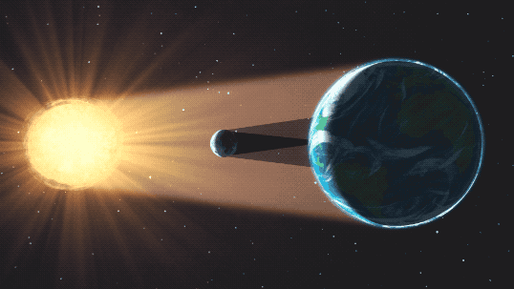
What is a Solar Eclipse?
Credit: NASA Goddard Space Flight Center
Notes:
A solar eclipse occurs when the Moon passes between the Sun and Earth. A shadow is cast over parts of Earth and blocks the face of the Sun.
During a solar eclipse, the Moon comes very close to covering the entire Sun. Earth is the only place in the whole solar system where a total solar eclipse can be observed!
-----------
Image Description: Illustration of a solar eclipse, the Moon is between the Sun and Earth; the Moon is casting its shadow over parts of Earth.
Image Credit: NASA's Goddard Space Flight Center, https://mynasadata.larc.nasa.gov/basic-page/solar-eclipses-background-information (a GIF version showing the Moon as it moves between the Sun and Earth can be found here: https://giphy.com/gifs/nasa-nasagif-solar-eclipse-3oEhn4OFaCE9mYv8aI

Slide 6
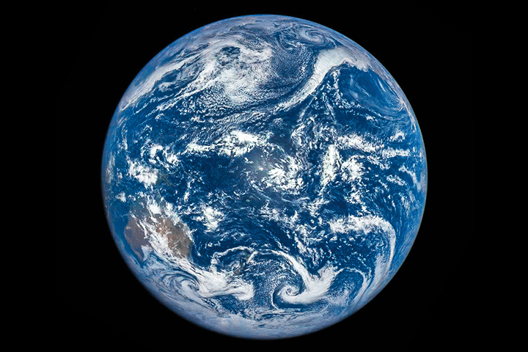
Solar Eclipse from Space: the Moon’s Shadow Moves Across Earth
Credit: NASA image courtesy of the DSCOVR EPIC team
Credit: NASA Earth Observatory animation by Joshua Stevens
Notes:
Now most of us see eclipses from here on Earth, but NASA spacecraft can see an eclipse from space. Here you can see the March 9, 2016 total solar eclipse as the Moon’s shadow travels across the Earth. The central shadow of the solar eclipse will be moving more than twice as fast as the speed of sound – at about 2,000 miles per hour.
-----------
Image Description: A GIF of the March 9, 2016 Total Solar Eclipse as seen from space; the Moon’s shadow is traveling across the Earth. The animation was assembled from images acquired by the Deep Space Climate Observatory (DSCOVR) satellite on March 9, 2016.
Image Credit: NASA Earth Observatory animation by Joshua Stevens, https://earthobservatory.nasa.gov/images/87675/an-epic-eclipse

Slide 7
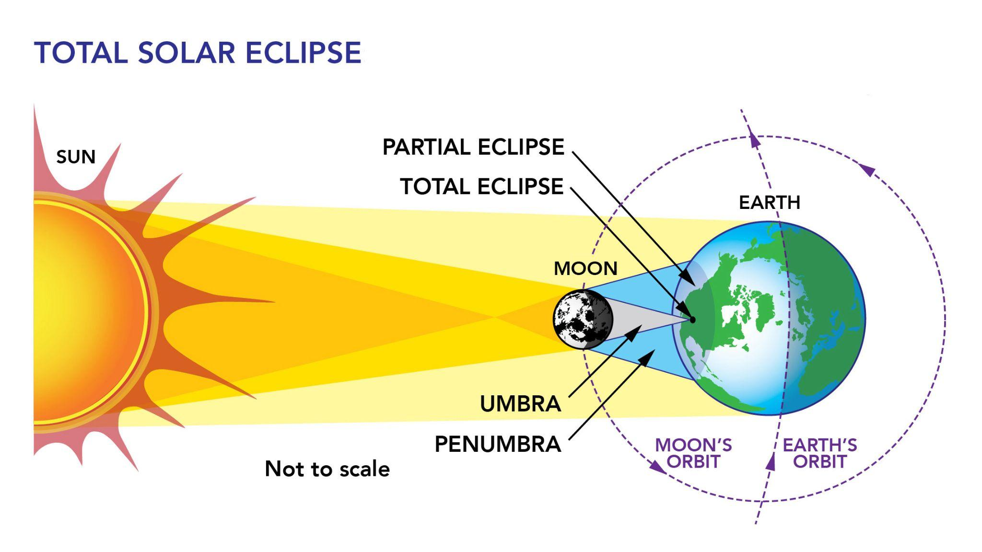
Moon’s Shadow: Umbra & Penumbra
Credit: NASA Goddard Space Flight Center
Notes:
The Moon's shadow has two parts.
The umbra is the dark inner shadow of the Moon. Total eclipses are seen from within this shadow.
The penumbra is the faint outer shadow of the Moon. Partial eclipses are seen from within this shadow.
-----------
Image Description: Solar eclipse with the Moon between the Sun and Earth casting shadows over parts of Earth with an umbra dark inner shadow and the penumbra is the faint outer shadow of the Moon.
Image Credit: NASA's Goddard Space Flight Center https://svs.gsfc.nasa.gov/12414#section_credits

Slide 8
Different Types of Solar Eclipses
Total
Annular
Partial
Credit: NASA/Bill Ingalls
Credit: NASA/MSFC/Joseph Matus
Credit: NASA/Bill Dunford
Credit: NASA/Bill Ingalls
Notes:
What are the different types of solar eclipses?
From left to right, these images show a total solar eclipse, annular solar eclipse, and partial solar eclipse. During a solar eclipse the the Moon passes between the Sun and Earth and blocks all or part of the Sun.
During a total solar eclipse, the Moon lines up perfectly to fully block the Sun. (This is happening in April 8, 2024)
During an annular eclipse, alignment is perfect but the Moon is too far away from the Earth to completely obscure the Sun. (this is happening October 14, 2023)
During a partial solar eclipse, the Moon only blocks part of the Sun.
-----------
Image Descriptions: Photo of total solar eclipse taken at totality (left); Photo of annular solar eclipse taken at maximum (center); Photo of a partial solar eclipse as the sun rises behind the Statue of Freedom atop the United States Capitol Building (right)
Image Credits: Total eclipse (left): NASA/MSFC/Joseph Matus; Annular eclipse (center): NASA/Bill Dunford; Partial eclipse (right): NASA/Bill Ingalls; https://mynasadata.larc.nasa.gov/sites/default/files/inline-images/Eclipse%20type%20images_3.png

Slide 9
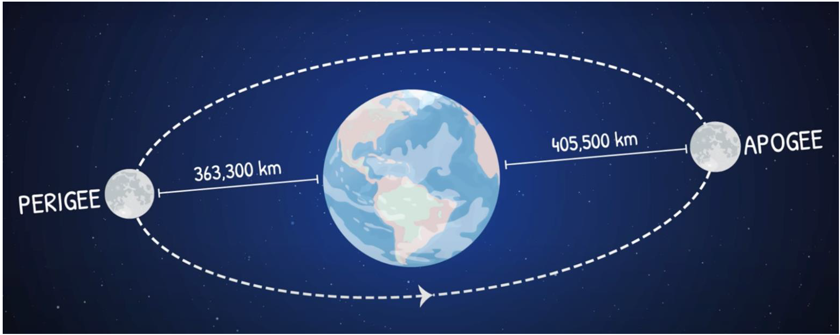
Total vs Annular Solar Eclipse? Due to the Elliptical Orbit of the Moon
Different Distance between the Moon and the Earth
Credit: NASA/JPL-Caltech
Notes:
Total vs. Annular Solar Eclipses The difference between a total and annular eclipse is the distance between the Moon and Earth. The reason that the Moon is not always the same distance from Earth is because the shape of the Moon’s orbit around Earth is in the shape of an ellipse, or an oval. During a solar eclipse, if the Moon is closer to perigee, the eclipse would be total. If the Moon is closer to apogee, the eclipse would be annular.
This graphic shows the difference between a Moon at its closest point to Earth and at its farthest. The Moon’s orbit isn’t a circle, it’s an ellipse. It’s very close to a circle but it’s enough that sometimes it’s a little closer, sometimes it’s a little farther. Which means sometimes it looks bigger and can cover the whole Sun, and sometimes smaller and can’t.
Close one eye, look at the wall across the room, and move your hand closer and farther away from your face. Your hand stays the same size, but it can cover more of what’s behind it when it’s closer.
-----------
Image Description: The Moon’s elliptical orbit is closest to Earth called perigee and at farthest at apogee.
Image Credit: NASA/JPL-Caltech, https://mynasadata.larc.nasa.gov/sites/default/files/inline-images/perogee%20and%20apogee_2.png

Slide 10
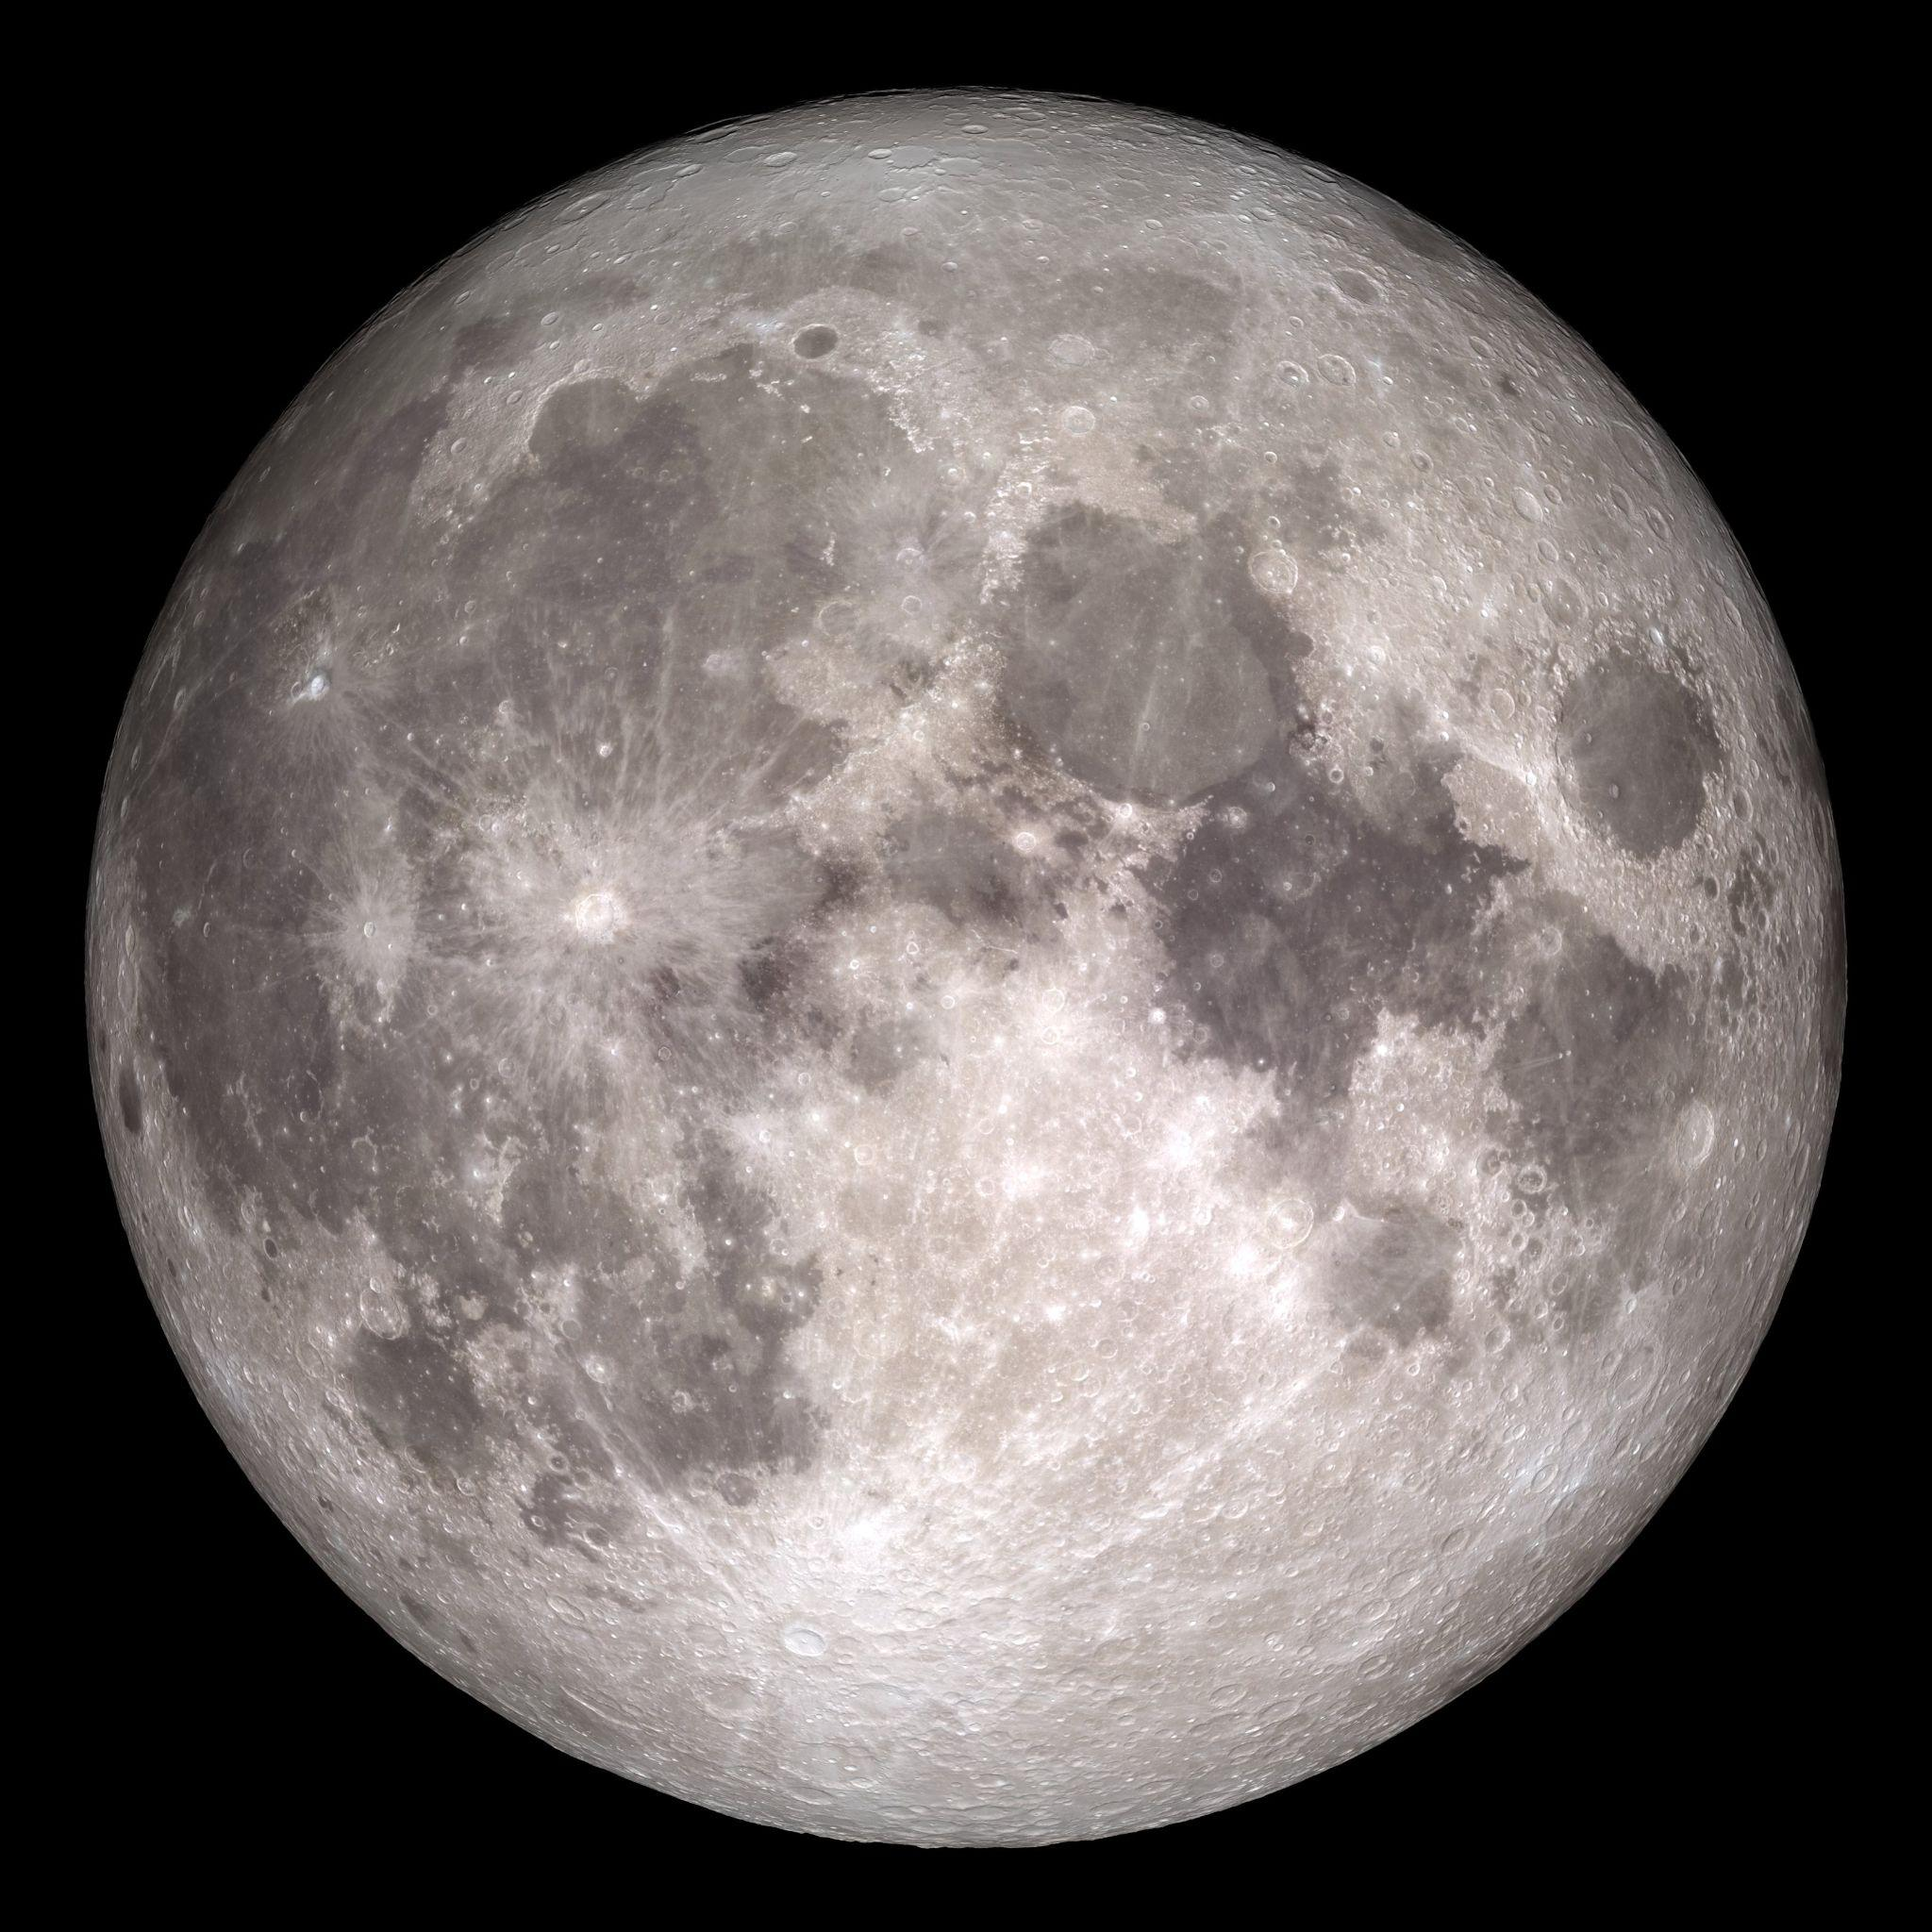
Solar eclipses are possible because the Sun and the Moon have the same apparent size in the sky.
The Sun’s diameter is about 400 times wider than that of the Moon, but the Sun is also about 400 times farther away from Earth.
Credit: NASA-GSFC-Arizona State University
Notes:
The fact that the Moon is just the right distance for eclipses is an amazing coincidence!
Solar eclipses are possible because the Sun and the Moon have the same apparent size in the sky. The Sun is actually much bigger than the Moon, but they look the same size because the Sun is much farther away. The Sun’s diameter is about 400 times wider than that of the Moon, but the Sun is also about 400 times farther away from Earth.
-----------
Image Description: The near side of the Moon, as seen by the cameras aboard NASA's Lunar Reconnaissance Orbiter spacecraft 2017.
Image credit: NASA/GSFC/Arizona State University, https://moon.nasa.gov/resources/77/the-near-side-of-the-moon/

Slide 11
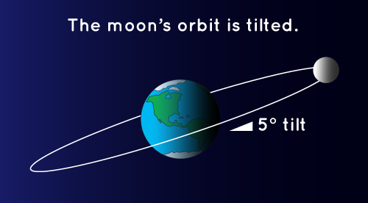
How Often Do Eclipses Happen?
How
Credit: NASA Space Place
Notes:
There are an average of 2 solar eclipses and 2 lunar eclipses every year, but they aren’t visible from everywhere on Earth.
The Moon’s shadow has to hit the Earth where you live, and the Moon’s shadow on Earth isn’t very big.
You have to be on the sunny side of the planet when it happens. You also have to be in the path of the Moon’s shadow
-----------
Why don’t we have solar eclipses every month? The Moon’s orbit is tilted just a bit (5 degrees) from the Earth-Sun orbit, so the shadow is likely to miss the Earth most of the time; the Moon’s shadow is either too high or too low.
Why don’t we have a lunar eclipse every month?
The Moon goes around Earth every month, but it doesn’t always get in Earth’s shadow. The Moon’s path around Earth is tilted compared to Earth’s orbit around the Sun.
-----------
Image Description: Moon’s orbit around Earth at a 5 degree tilt.
Image Credit: NASA Space Place, https://spaceplace.nasa.gov/eclipses/en/

Slide 12
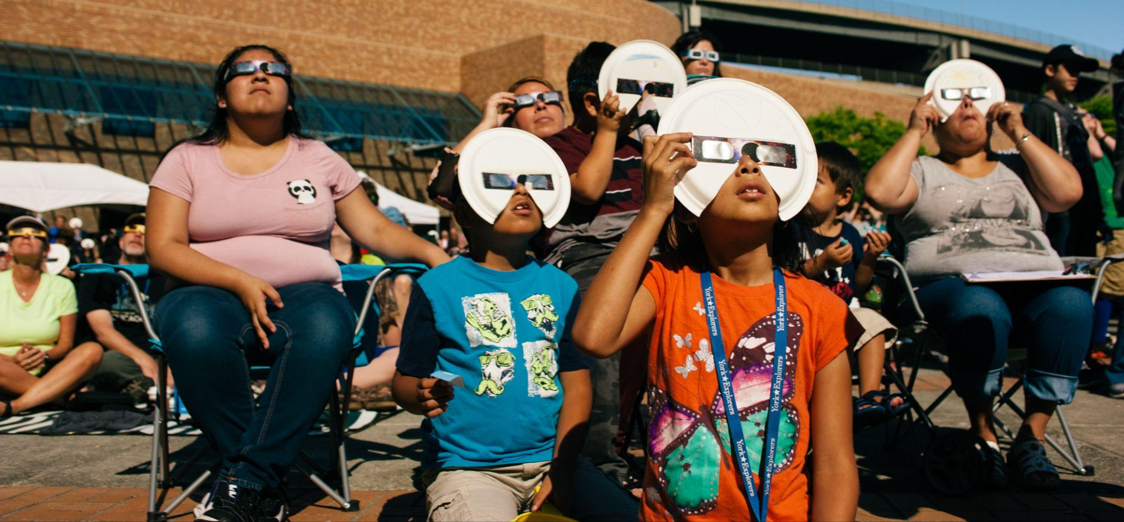
Everyone Can Participate in a Solar Eclipse!
Credits: Science Museum of Minnesota and Emily Maletz for NISE Network
Notes:
Eclipses aren’t just beautiful – they’re great for science. Experiencing an eclipse is one way that everyone can participate in NASA science, and you don’t even need a telescope! Scientists use solar eclipses to study the Sun-Earth relationship, especially how the Sun’s radiation affects the Earth’s upper atmosphere. NASA plans to use satellites, suborbital rockets, and high-altitude balloons to observe the eclipse and its effects. You can participate in citizen science projects (We’ll talk about that later.)
-----------
Image Descriptions: Photo of three young participants looking up at the sky, all wearing eclipse safety glasses (left); Photo of a mixed age group within a larger crowd, seated, wearing eclipse safety glasses, and looking up at the sky (center top), Photo of two adults and a teen viewing the sky from indoors, wearing eclipse safety glasses (center bottom), Photo of large crowd in an outdoor viewing area, a young girl has her head turned and is looking up at the sky while wearing eclipse safety glasses (right)
Image Credit: Science Museum of Minnesota (left & center bottom images); Emily Maletz for NISE Network (center top & right images)

Slide 13
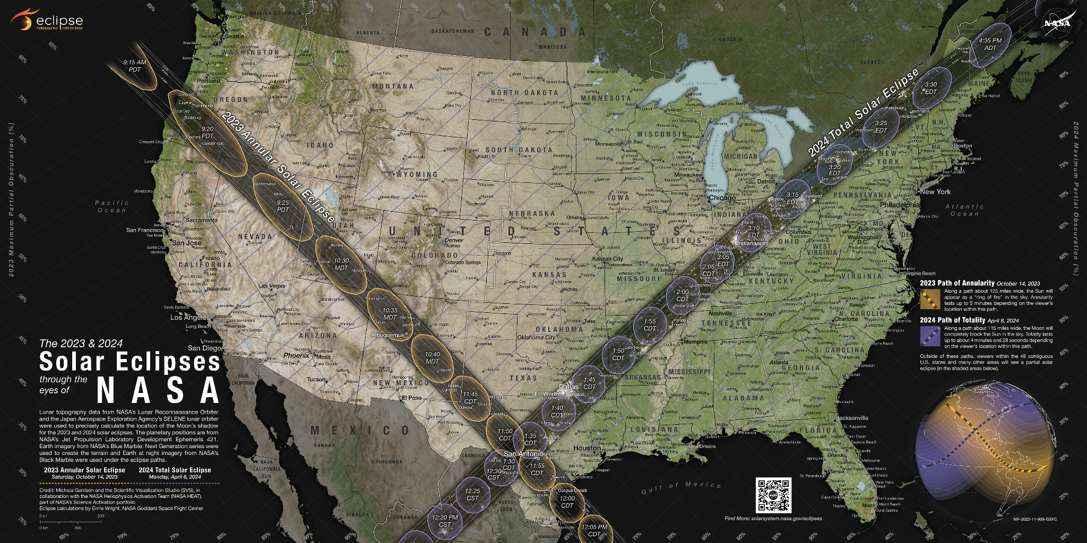
October 14, 2023 & April 8 2024 Solar Eclipses
Credit: NASA's Scientific Visualization Studio
Notes:
There are two opportunities to see an eclipse coming up very soon: October 14, 2023 and April 8, 2024.
You can see the line (from Oregon to Texas) that represents the October 14, 2023 Annular Solar Eclipse path of annularity and the other line (from Texas to Maine) that represents the April 8, 2024 Total Solar Eclipse path of totality.
Now if you are not on one of these paths, never fear. The good news is that everyone in North America (with clear skies) will be able to see at least a partial eclipse during both events.
Learn more about the map: https://www.nasa.gov/feature/goddard/2023/sun/new-nasa-map-details-2023-and-2024-solar-eclipses-in-the-us
Map: https://svs.gsfc.nasa.gov/5073
View an up-close tour of the map: https://www.youtube.com/watch?v=fmb3z--tfhM
Additional maps available at: https://www.nisenet.org/solareclipse
-----------
Image Description: NASA map of the continental United States showing a line at the left (from Oregon to Texas) that represents the October 14, 2023 Annular Solar Eclipse path of annularity, and a line on the right (from Texas to Maine) that represents the April 8, 2024 Total Solar Eclipse path of totality.
Image credit: NASA's Scientific Visualization Studio, https://svs.gsfc.nasa.gov/5073#section_credits

Slide 14
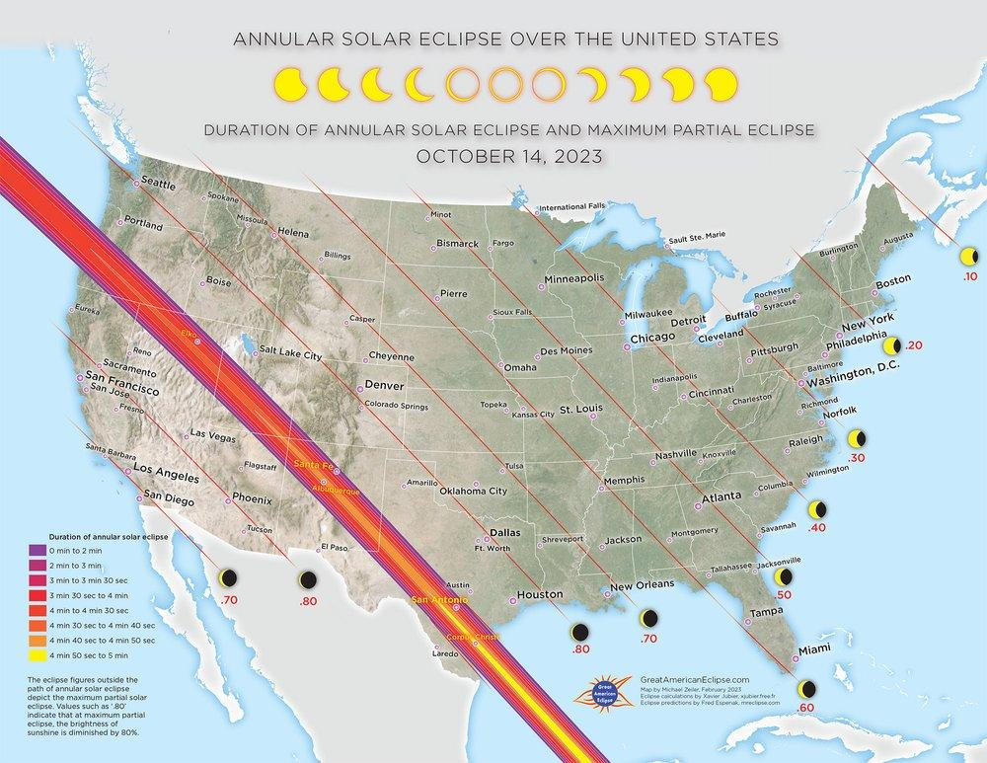
Credit:
Michael Zeiler GreatAmericanEclipse.com
Notes:
This map shows the path of annularity from Oregon to Texas for the Saturday, October 14, 2023 Annual Solar Eclipse. This annular solar eclipse will cross North, Central, and South America. All 48 contiguous states plus parts of Alaska will experience a partial solar eclipse.
During an annular solar eclipse the Moon covers the Sun, but because the Moon is farther from Earth than average, it appears smaller it doesn’t cover the Sun completely
If you are inside the path of annularity, which is about 125 miles wide and runs from Oregon to Texas, the Sun will appear as a “ring of fire” in the sky. Annularity lasts up to 5 minutes depending on the viewer’s location within this narrow path. Outside of this path, viewers within the 48 contiguous U.S. states and many other areas will see a partial solar eclipse.
It is important to remember that during an annular solar eclipse it is never safe to look directly at the Sun without proper eye protection, even on the path of annularity, since the Sun is not completely blocked.
-----------
Image Description: Map of the continental United States created by Michael Zeiler, GreatAmericanEclipse.com showing a line at the left (from Oregon to Texas) that represents the October 14, 2023 Annular Solar Eclipse path of annularity.
Image Credit: Michael Zeiler, GreatAmericanEclipse.com, https://www.greatamericaneclipse.com/2023-annular-solar-eclipse-over-the-united-states

Slide 15
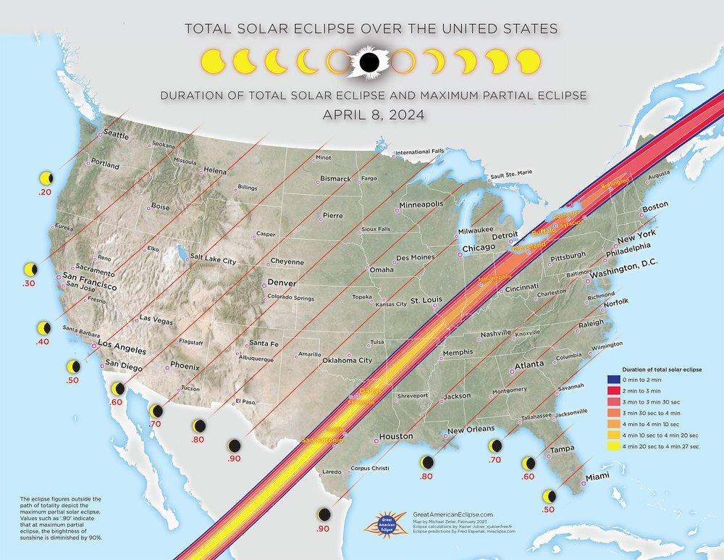
Credit:
Michael Zeiler GreatAmericanEclipse.com
Notes:
This map shows the path of totality from Texas to Maine for the Total Solar Eclipse that will take place on Monday, April 8, 2024.
During a total solar eclipse, the moon fully covers the sun for a short few minutes. In order to see this, you must be in the path of totality, which is this relatively thin path about 70 miles wide that will cross the U.S. from Southwest to Northeast. States on the path of totality include: Texas, Oklahoma, Arkansas, Missouri, Illinois, Indiana, Kentucky, Ohio, New York, Vermont, New Hampshire, and Maine.
All 48 contiguous states plus parts of Alaska will experience at least a partial solar eclipse in April 2024.
-----------
Image Description: Map of the continental United States created by Michael Zeiler, GreatAmericanEclipse.com showing a line on the right (from Texas to Maine) that represents the April 8, 2024 Total Solar Eclipse path of totality.
Image Credit: Michael Zeiler, GreatAmericanEclipse.com, https://www.greatamericaneclipse.com/2024-total-solar-eclipse-over-the-united-states

Slide 16
Everyone in North American Should
See at Least a Partial Eclipse…
If It’s Clear Out!
Credit: NASA/Aubrey Gemignani
Notes:
With clear skies, everyone in North America will be able to celebrate both spectacular events. Now if skies are not clear where you are, there are still ways to participant in the excitement. We’ll discuss those in a bit. First we need to talk about safe viewing.
You should never look directly at the Sun! So let’s go over some other methods of observing this phenomenon. Remember, whether you find yourself on the path of annularity or totality for either event, the partial eclipse will last for hours before and after totality occurs. We also want to point out that during an annular eclipse even those on the path of annularity should never, ever look directly at the sun without proper eyewear.
-----------
Image Description: The August 21, 2017 Total Solar Eclipse as seen above Madras, OR; image captures various points from start to finish of the total solar eclipse, showing the Moon as it begins to partially eclipses the Sun, as it covers the Sun completely (totality), and then as the Moon moves away and partially eclipses the Sun again.
Image Credit: NASA/Aubrey Gemignani, https://images.nasa.gov/details/NHQ201708210105

Slide 17
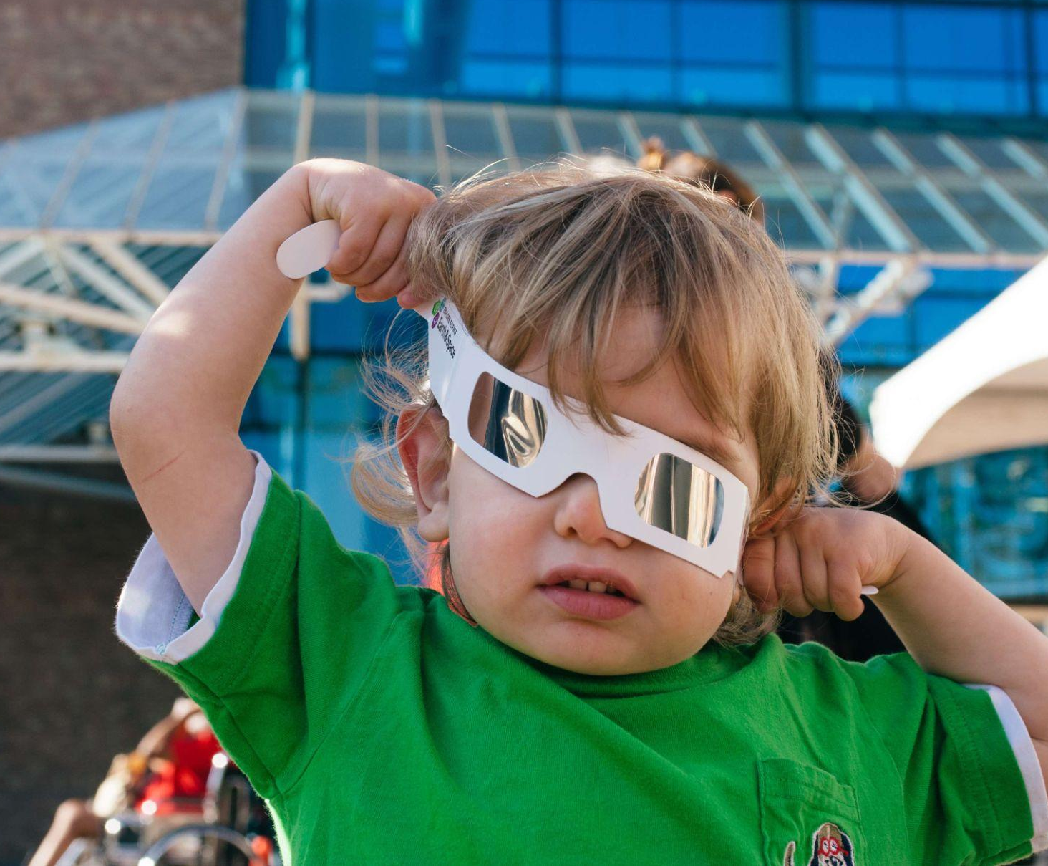
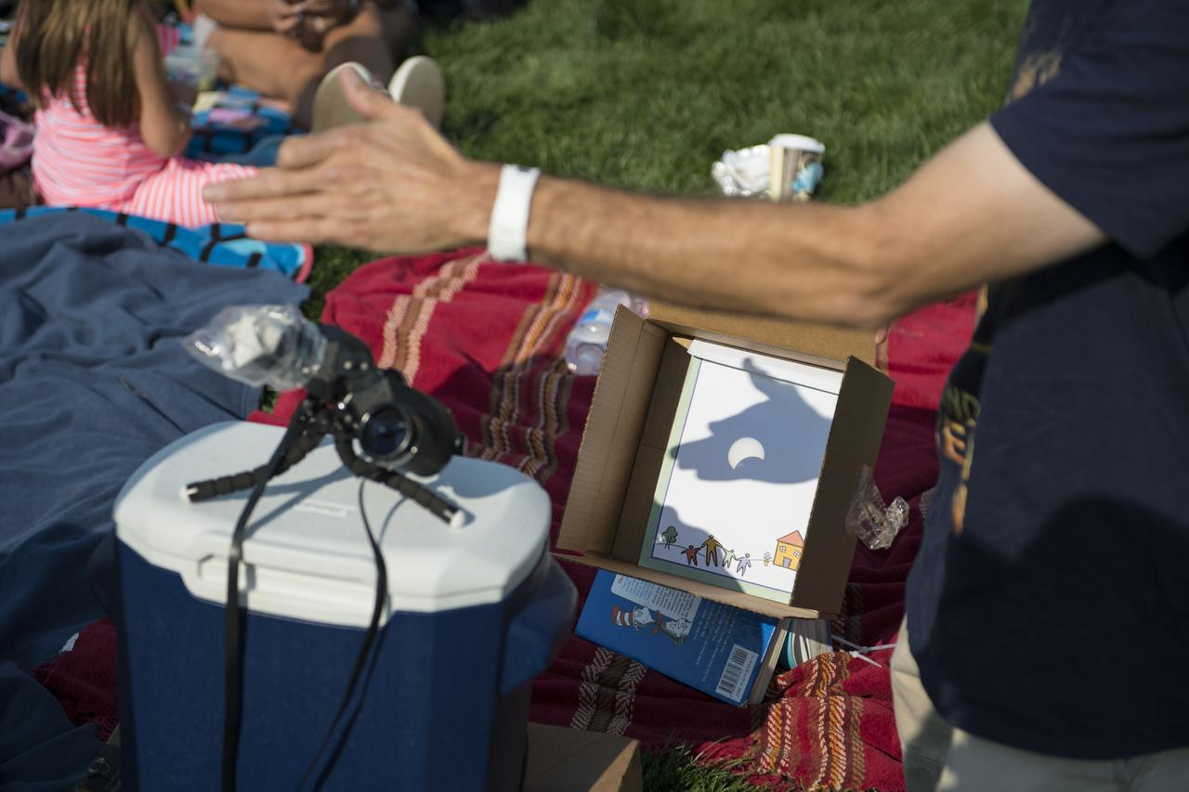
Safe Eclipse Viewing
Safety glasses
Projection of images
Shadows
Pinhole projector
-
Live streaming the event
Credits: Emily Maletz for the NISE Network and NASA/Aubrey Gemignani
Notes:
There are numerous ways to safely view an eclipse, including eclipse glasses, shadows, and pinhole projections. We’ll review these.
Do note that NASA has some great tips sheets to use as quick references for solar eclipses and safe solar viewing (links below for sharing and/or printing).
NASA solar eclipse safe viewing fact sheet handout (without dates)
https://solarsystem.nasa.gov/resources/2689/eclipse-fact-sheet/
NASA solar eclipse safe viewing fact sheet handout (October 2023 dates)
https://solarsystem.nasa.gov/resources/2782/october-14-2023-annular-eclipse-fact-sheet/
-----------
Image Description: Toddler putting on eclipse safety glasses (top left); Projection of a partial solar eclipse, projection created by using a colander to project tiny images of the partially covered Sun onto white paper (top right); Projected shadow of a partial eclipse into a box, the partially eclipsed Sun is seen on top of a shadow created by an extended hand doing a shadow puppet figure (bottom).
Image Credit: Emily Maletz for NISE Network (top two photos); NASA/Aubrey Gemignani (bottom photo), https://images.nasa.gov/details/NHQ201708210112

Slide 18
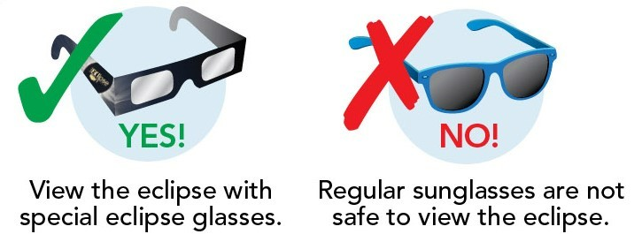
Safe Eclipse Viewing: Safety Glasses
Always use proper safety equipment to observe the Sun at any time!
Credit: NASA
Notes:
Safety glasses - it can’t be said enough, looking directly at the Sun without eye protection on any day can cause permanent eye damage! So never look directly at the Sun without the appropriate safe solar viewing equipment.
The only safe way to look directly at the un-eclipsed or partially eclipsed Sun is through special-purpose solar filters, such as eclipse glasses or handheld solar viewers. Homemade filters or ordinary sunglasses, even very dark ones, are NOT safe for looking at the Sun. Solar filters are 1000 times darker than sunglasses and block all infrared and UV light, and nearly all visible light. Even if you plan to use a telescope, binoculars, or camera (phone cameras included), to view any part of the bright Sun you need a special-purpose solar filter secured over the front of the optics to avoid severe eye injury.
Also, please remember that for an annular solar eclipse it is never safe to remove eye protection at any time, even on the path of annularity. An annular solar eclipse does not block the entire view of the Sun like a total eclipse does. Instead those on the path of annularity will see a “ring of fire” that must be viewed using proper safety equipment or else you risk severely damaging your eyes.
More from NASA on Solar Eclipse Safety: https://solarsystem.nasa.gov/eclipses/safety/
-----------
Image Description: Eclipse glasses and sunglasses, sunglasses are not safe to wear to observe a solar eclipse.
Image Credit: NASA, https://mynasadata.larc.nasa.gov/sites/default/files/inline-images/eclipse%20glasses%20and%20sunglasses_0.jpg, https://mynasadata.larc.nasa.gov/basic-page/solar-eclipses-background-information

Slide 19
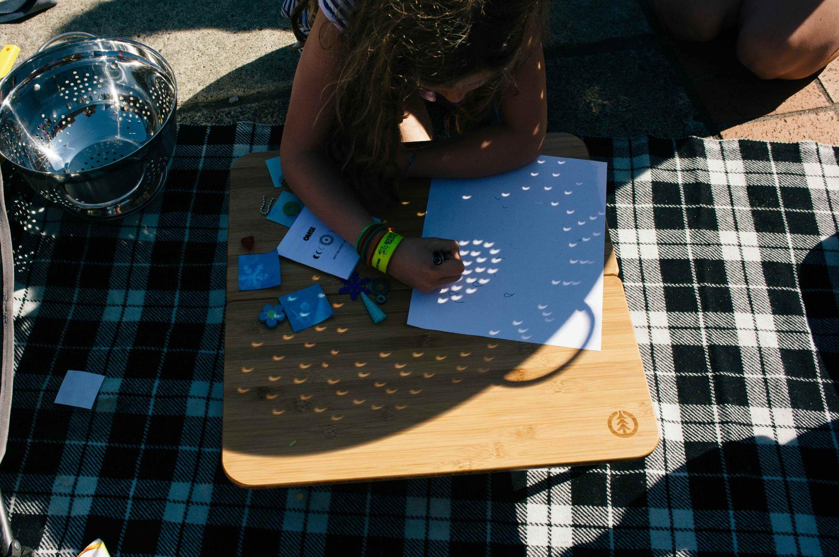
Safe Eclipse Viewing: Shadows
Credit: Emily Maletz for the NISE Network
Notes:
So now we’ll discuss some indirect ways to safely observe a solar eclipse, like using shadows.
You might not know this, but the round lights you see everyday on the ground, between the leaves of trees are actually projections of the Sun!
You can use any number of small holes like the spaces between leaves, a colander, or even your hands.
Get creative and try it out before the eclipse. You can try different shaped holes and different sizes to see what works best.
-----------
Image Description: Young participant is tracing the image of the partially eclipsed Sun on white paper, projection created by a colander.
Image Credit: Emily Maletz for the NISE Network

Slide 20
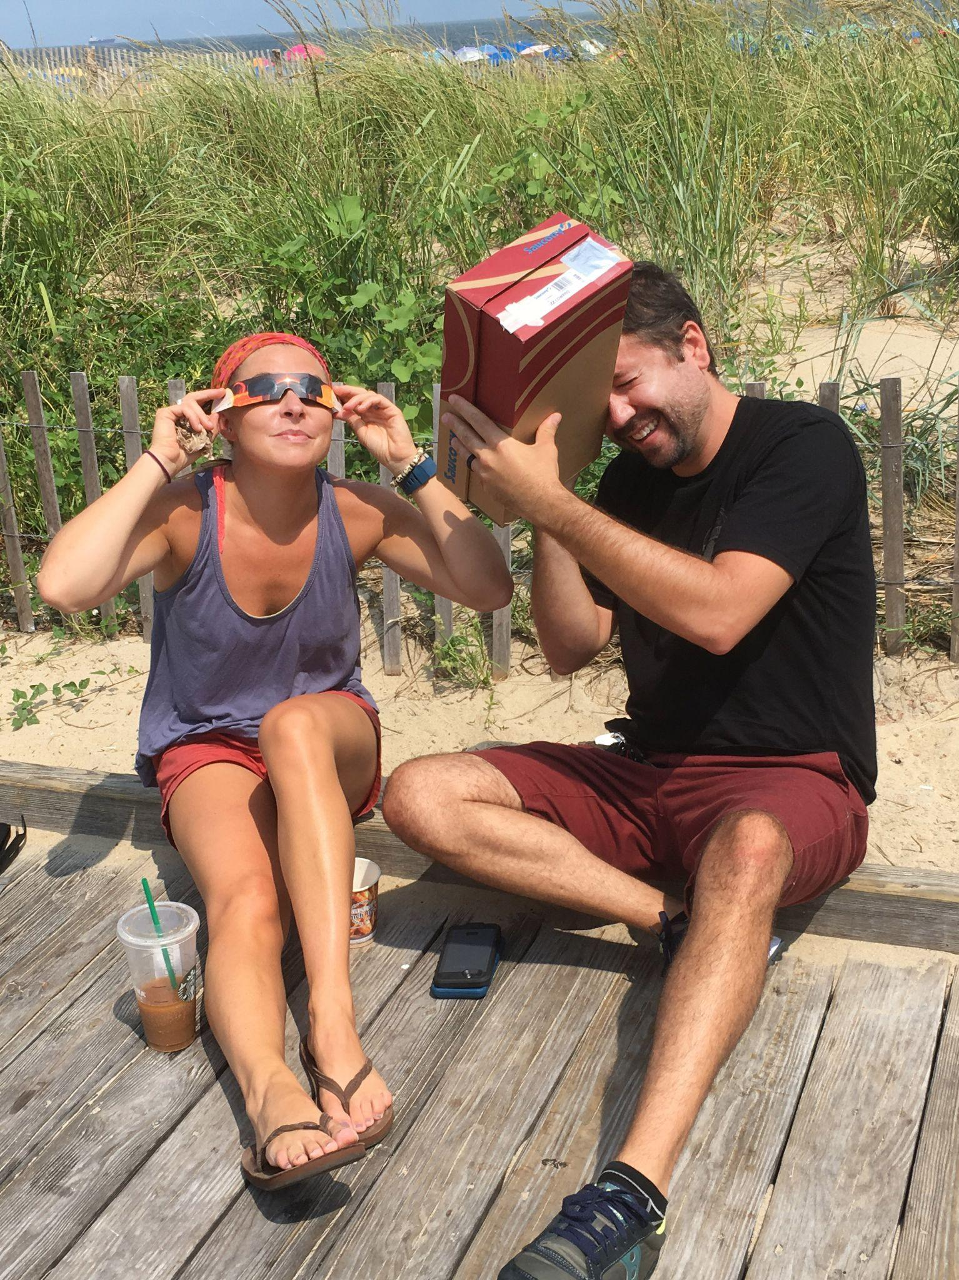
Safe Eclipse Viewing: Pinhole Viewer
Credit: NASA/Mary Pat Hrybyk-Keith
Notes:
A pinhole projector is another indirect way to safely observe a solar eclipse. Just make a small hole in a piece of cardboard or tinfoil and look at the light that shines through the hole on a flat surface a few feet away. You can also do this with a small to medium box, like a shoe box or cereal box.
It might be hard to notice here, but both of these individual have the pinhole side of their projectors aimed towards the sun while they themselves are looking at the opposite side of the box, where the image is being projected through the hole. Again, never look directly at the sun; use your pinhole projector to project onto another surface to observe.
There is also a NASA video here that shows how to make a pinhole projector out of a cereal box: https://images.nasa.gov/details/GSFC_20170621_Eclipse_m12638_PinholeProjector
-----------
Image Description: Two individuals at the Rehoboth Beach boardwalk in Delaware view the August 21, 2017 solar eclipse, one with eclipse safety glasses and the other with a pinhole viewer made from a cardboard shoebox (left); Man views the solar eclipse through his handmade cereal box pinhole projector (right)
Image Credit: NASA/Mary Pat Hrybyk-Keith, https://svs.gsfc.nasa.gov/vis/a010000/a012200/a012200/Eclipse_Rehoboth_Beach_1396.jpg, https://svs.gsfc.nasa.gov/vis/a010000/a012200/a012200/Eclipse_Rehoboth_Beach_1383.jpg, https://svs.gsfc.nasa.gov/12200/

Slide 21
Safe Eclipse Viewing: Live Streaming
Find the app and livestream info at exploratorium.edu/eclipse
Notes:
Live streaming - this is a great way to safely view totality or annularity, especially if you are not on the paths of the upcoming solar eclipses. This is also a wonderful resource for anyone who is worried about having clear skies for viewing or who just wants to be a part of the larger community celebrating the eclipse.
Since 1998, the Exploratorium and NASA have worked together to broadcast stunning images of eclipses from around the world. The Exploratorium produces multiple live streams from a few different locations that you can gain access to through their site or on the Exploratorium’s Total Solar Eclipse app for iOS and Android, which works great for outdoor viewers!
Find the app and livestream information at https://www.exploratorium.edu/eclipse
Links to more info about the live streams for both the October 2023 and April 2024 solar eclipse events can also be found here: https://www.exploratorium.edu/eclipse/viewing
-----------
Image Description: Exploratorium logo with added Solar Eclipse project branding.
Image Credit: Exploratorium

Slide 22
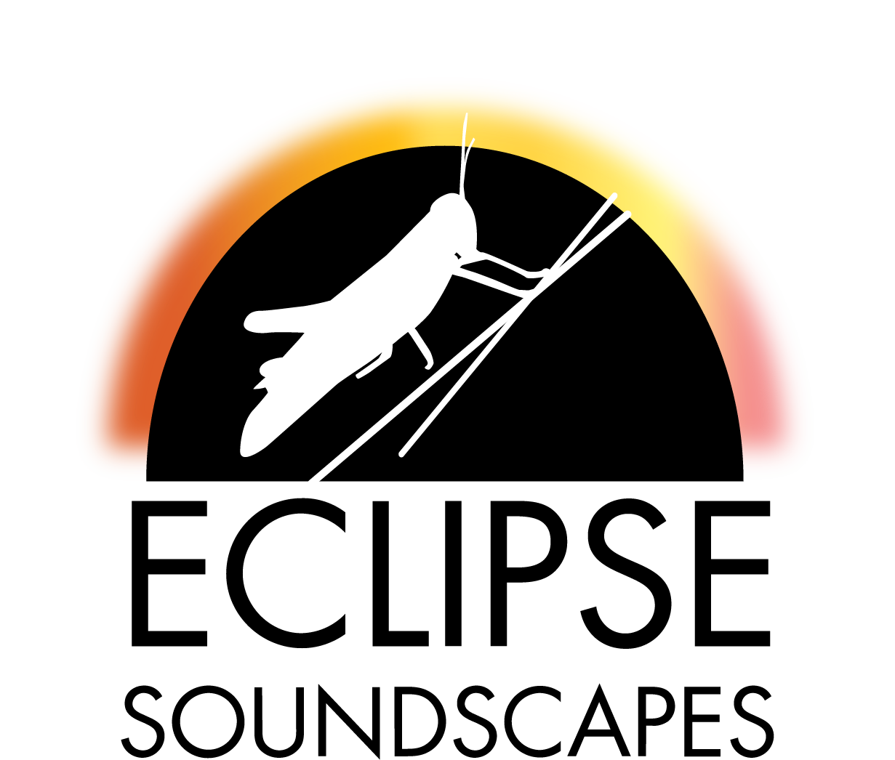
Resources: Citizen Science Projects
Eclipse Soundscapes
What are the effects of a solar eclipse on animals, insects, and other living creatures on Earth?
Find more info at EclipseSoundscapes.org
Notes:
So now let’s talk more about some other resources you can use during both upcoming solar eclipses. As we mentioned earlier, experiencing an eclipse is one way that everyone can participate in NASA science. There are a number of citizen science projects that study eclipses’ effects on animals, insects, and the environment, and on the Earth’s outer atmosphere.
The Eclipse Soundscapes: Citizen Science Project is studying how eclipses affect life on Earth. Eclipse Soundscapes citizen scientists will help collect and analyze observations and sound data from the October 14, 2023, annular eclipse and the April 8, 2024, total solar eclipse. There are many different ways that people can participate in the Eclipse Soundscapes: Citizen Science Project and support its scientists. The observations and sound data collected will help us understand the impact of the 2023 and 2024 solar eclipses on various U.S. ecosystems.
More information can be found at https://eclipsesoundscapes.org/
-----------
Image Description: Eclipse Soundscapes logo, grasshopper on plant stem with the text Eclipse Soundscapes.
Image Credit: Eclipse Soundscapes

Slide 23
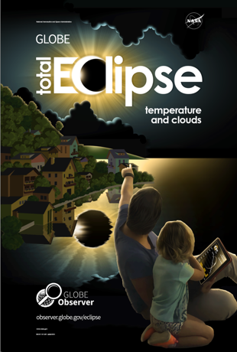
Resources: Citizen Science Projects
GLOBE Observer
What happens on Earth to temperature, clouds, and wind, when the Sun is blocked by the Moon during an eclipse?
Find the app & info at observer.globe.gov/eclipse
Credit: NASA GLOBE Observer
Notes:
The GLOBE Observer app is another great was to contribute to a citizen science database used by scientists and students to study the effects of eclipses on the atmosphere. Volunteer scientists are able to observe how the eclipse changes atmospheric conditions near you by reporting on clouds and air temperature.
Learn more at: https://observer.globe.gov/eclipse
-----------
Image Description: GlOBE Eclipse logo, GLOVE Observer cover of Total Eclipse guide, with child and caregiver viewing a total eclipse while reviewing the guide.
Image Credit: NASA GLOBE Observer

Slide 24
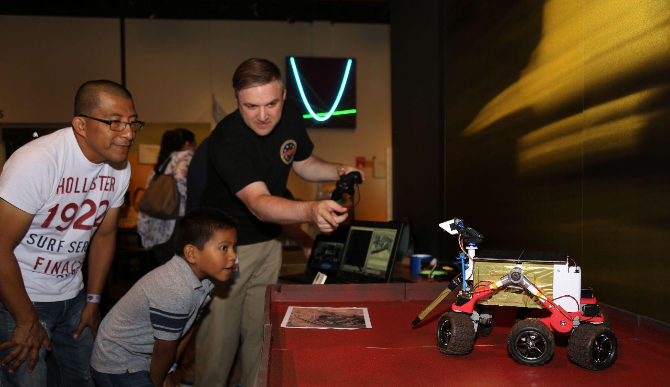
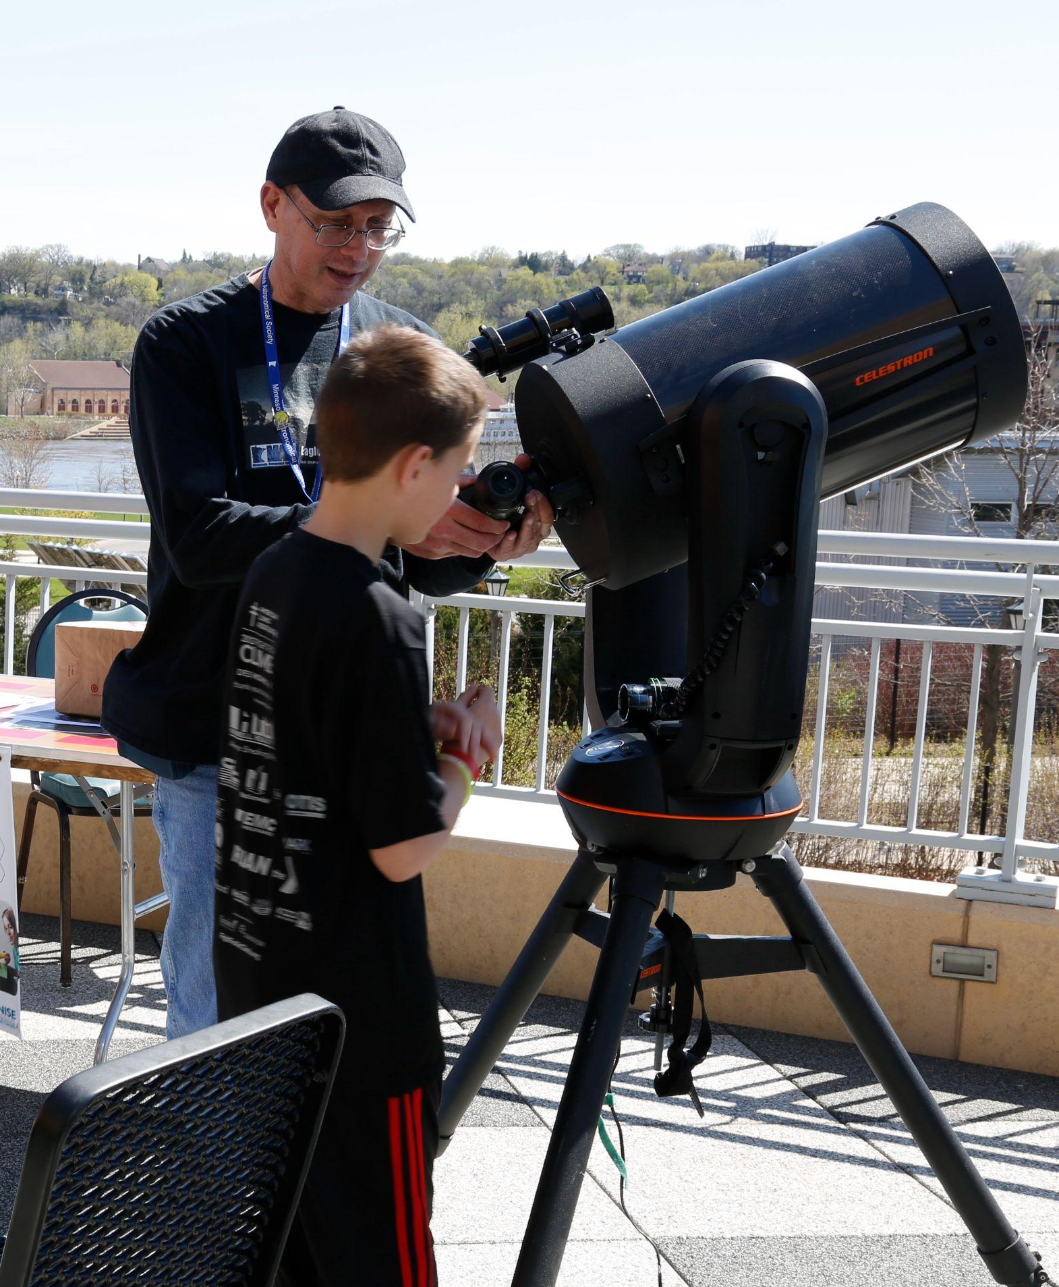
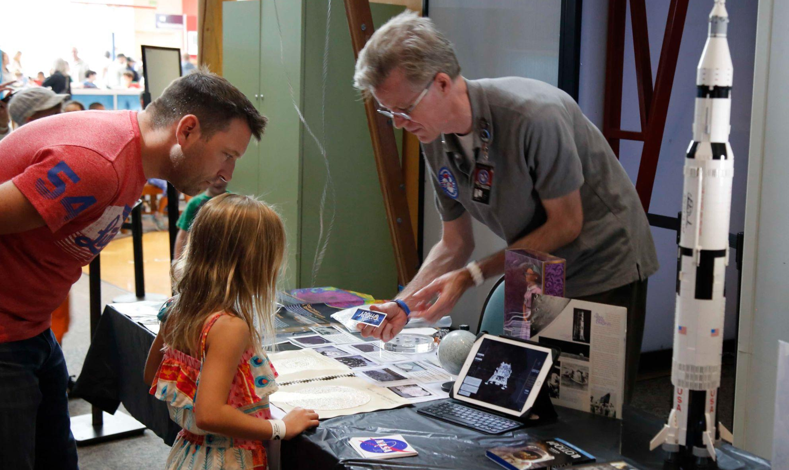
Resources: Local Expertise
Credit: Science Museum of Minnesota for NISE Network
Notes:
Again, eclipses are great ways to engage your whole community and you can also integrate local expertise into your event.
The Night Sky Network can connect you to your local amateur astronomy club: https://nightsky.jpl.nasa.gov/index.cfm
Eclipse Ambassadors will engage their local communities, providing solar viewing glasses as well as context for underserved communities off the central paths: https://astrosociety.org/education-outreach/amateur-astronomers/eclipse-ambassadors/program.html
The Solar System Ambassadors program trains volunteers from across the US to communicate the science and excitement of NASA's space exploration missions and discoveries. https://solarsystem.nasa.gov/solar-system-ambassadors/events/
Finally, the NISE Network has a guide with more information, strategies for recruitment, and ideas for places where you can find experts in your community. This includes Indigenous, Black and African American, Hispanic and Latinx, and Asian and Pacific Islander storytellers, elders, and experts who can share local and historical knowledge as well as their experiences and traditions, particularly as they reflect on the night sky, our Earth, and solar eclipses. https://www.nisenet.org/working-with-experts
-----------
Image Description: Two young participants speaking with a Solar System Ambassador while doing a table top coloring activity (left); Child and caregiver watching a small table top rover demonstration led by a Solar System Ambassador (center top), Child and caregiver speaking to a Solar System Ambassador who has multiple table top demonstrations including an iPad app and a Lego model rocket (center bottom); Child looking up at the sky with a telescope with an amateur astronomer nearby offering guidance and information (right)
Image Credits: Science Museum of Minnesota for NISE Network

Slide 25
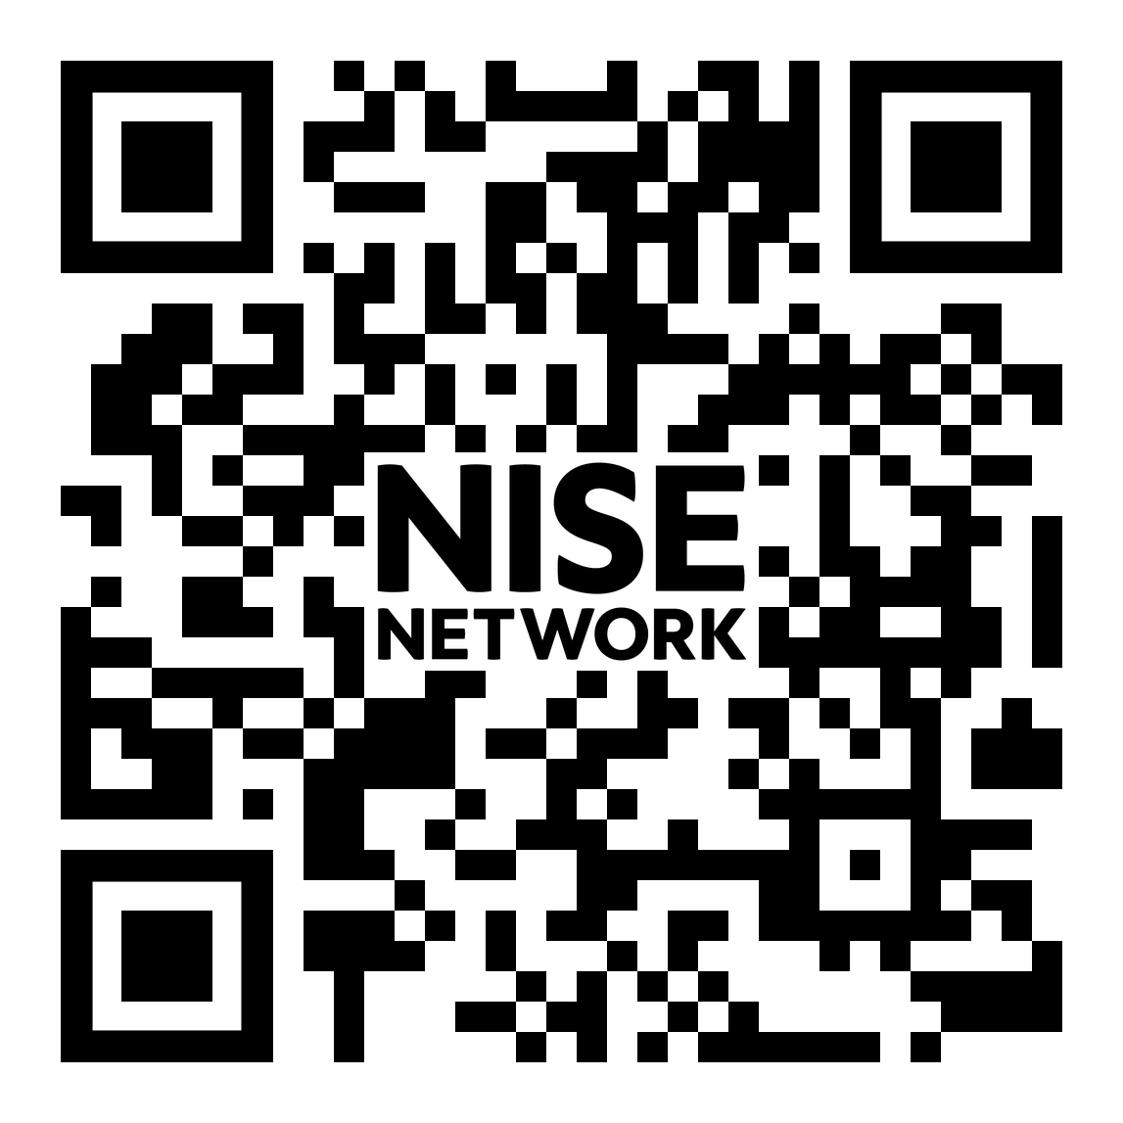
Resources: Event Planning
Compilation of Solar Eclipse public engagement resources:
Hands-on activities
Maps and images
Safe viewing
NASA’s Solar Eclipse Tactile book
Cultural connections and more!
nisenet.org/solareclipse
Notes:
The NISE Network has a compilation of solar eclipse resources. https://www.nisenet.org/solareclipse
This include more information about planning an event, hands-on activities and other resources to engage the public, as well as links to all of NASA’s updated resources for preparing audiences for this big event. With that, NASA has updated its Solar Eclipse Tactile Book, “Getting a Feel for Eclipses,” which explains the details surrounding the October 14, 2023 and April 8, 2024 eclipses for visually impaired audiences. https://sservi.nasa.gov/books/eclipses.html (a copy is included in the NISE Network Voyage through the Solar System 2023 kit; NASA has many other wonderful tactile book resources)
-----------
Image Description: QR code for nisenet.org/solareclipse

Slide 26
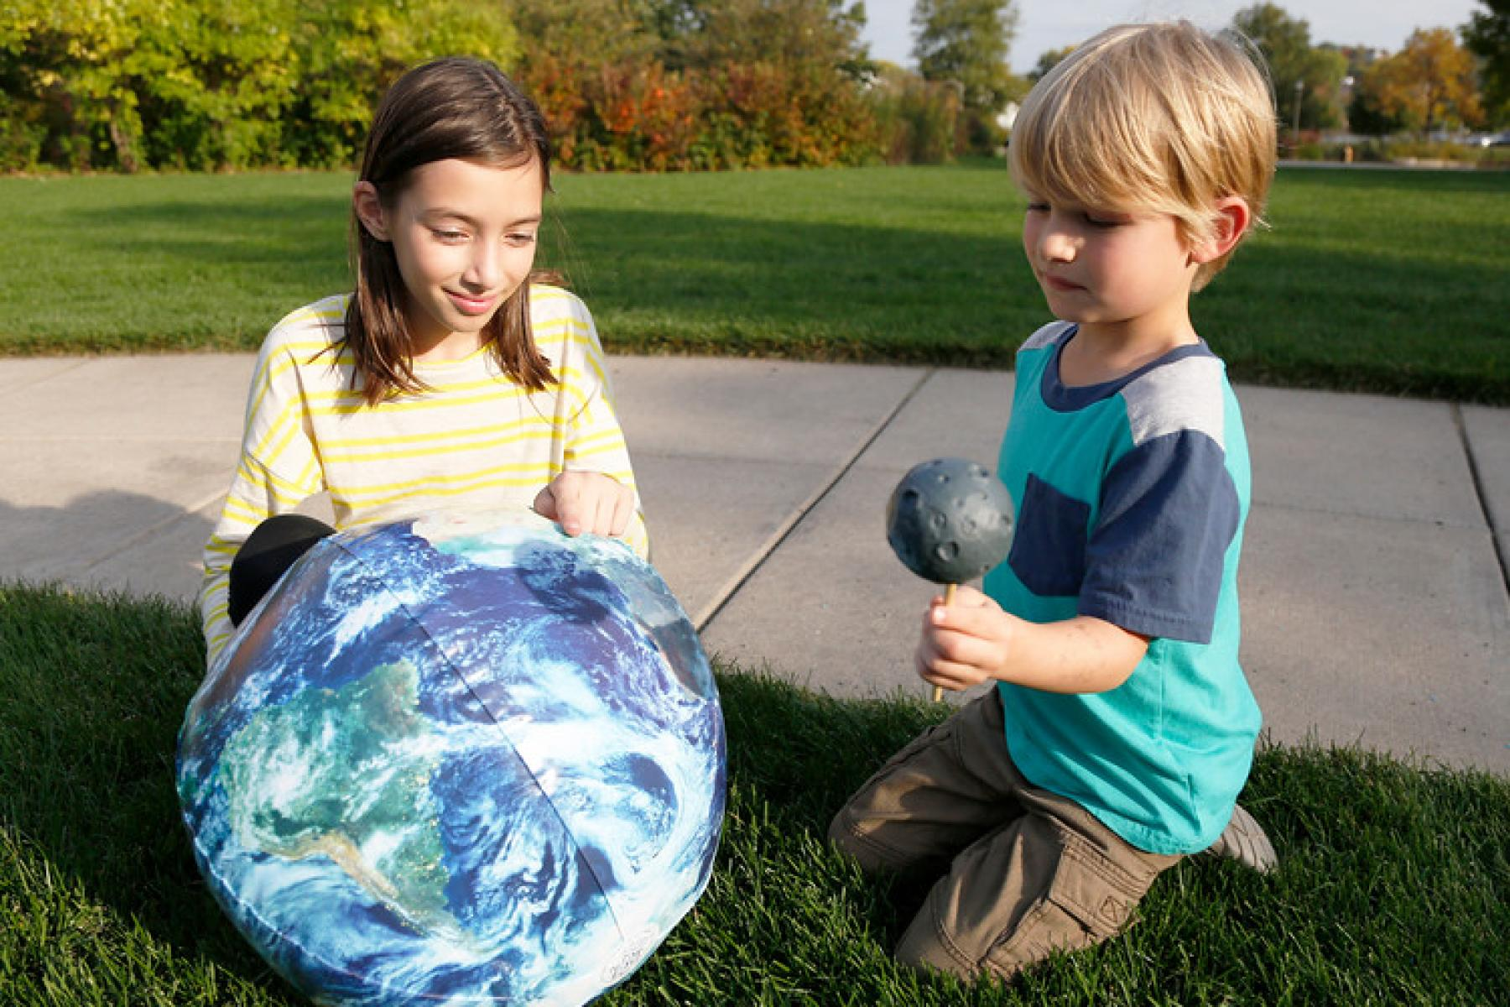
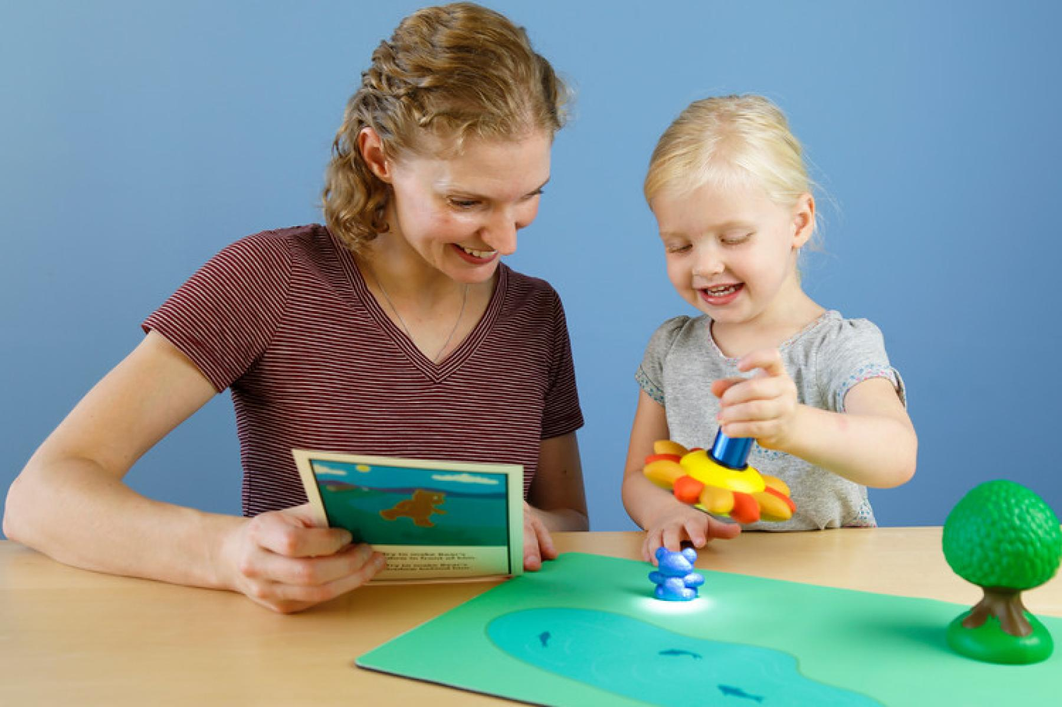
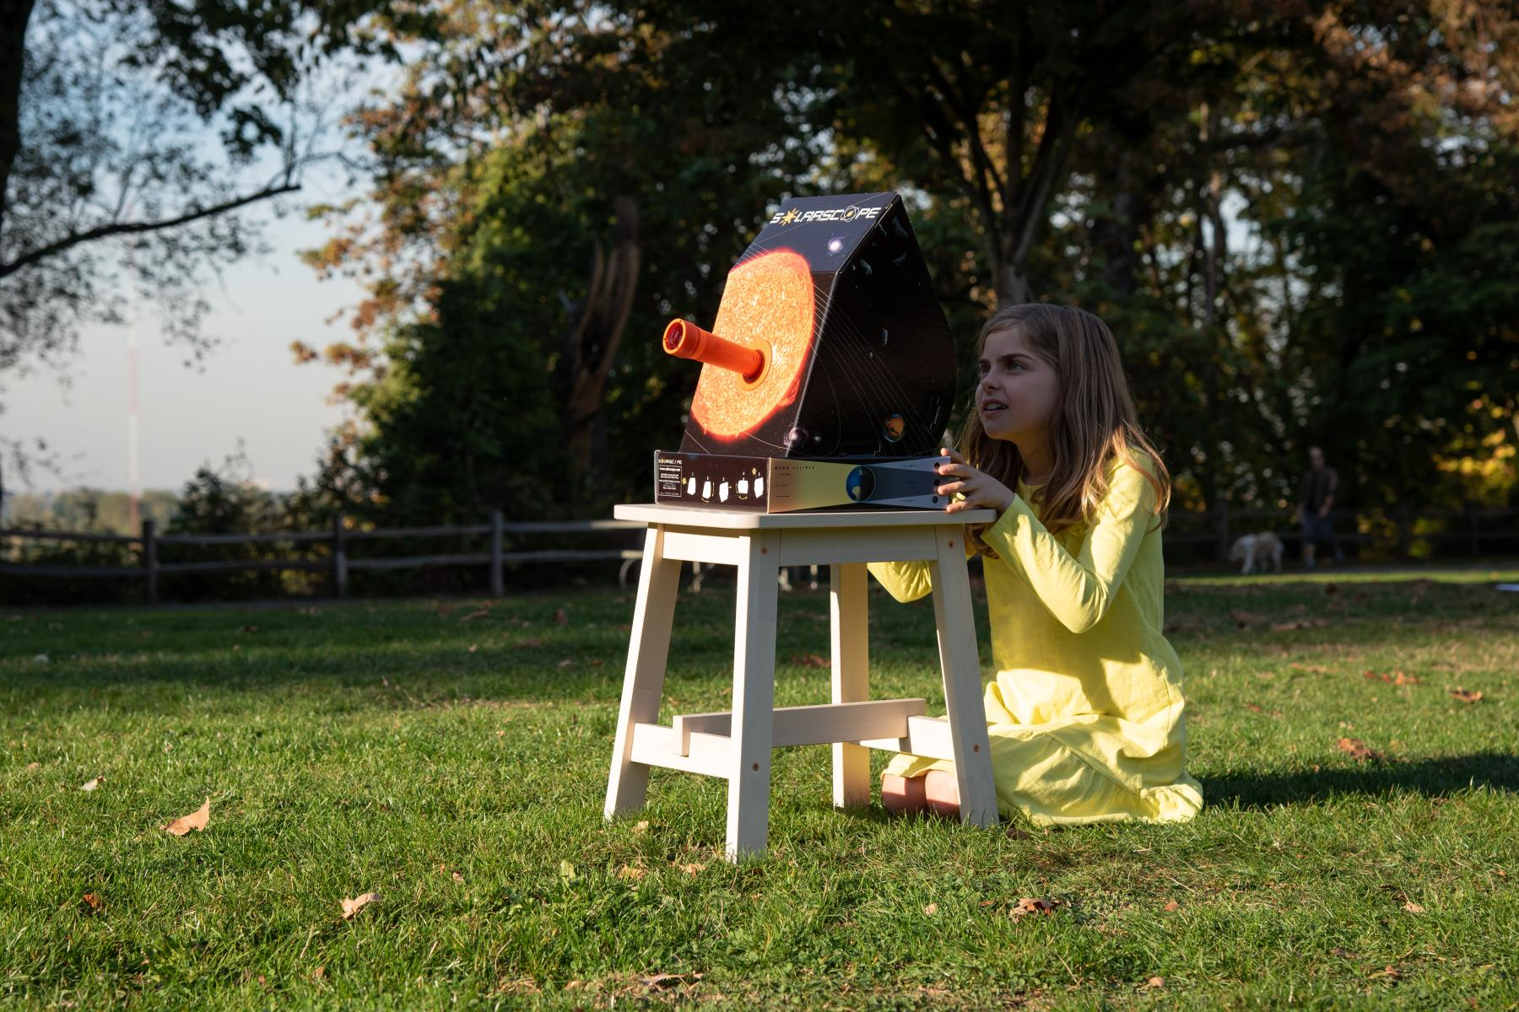
NISE Network Solar Eclipse Activities
Exploring the Solar System: Solar Eclipse
Exploring the Solar System: Big Sun,
Small Moon
Exploring
Earth:
Bear’s Shadow
Exploring the Solar System: Observe the Sun
Credits: Science Museum of Minnesota for the NISE Network; Emily Maletz for the NISE Network
Notes:
Hands-on activities are a great way to engage your community in advance of an eclipse, and on the day of the eclipse.
NISE Network hands-on eclipse activities with downloadable guides and training videos include:
Exploring the Solar System: Big Sun, Small Moon https://www.nisenet.org/catalog/exploring-solar-system-big-sun-small-moon
Exploring the Solar System: Solar Eclipse https://www.nisenet.org/catalog/exploring-solar-system-solar-eclipse
Exploring the Solar System: Observe the Sun https://www.nisenet.org/catalog/exploring-solar-system-observe-sun
Exploring Earth: Bear’s Shadow https://www.nisenet.org/catalog/exploring-earth-bears-shadow
More: https://www.nisenet.org/solareclipse
More: https://www.nisenet.org/astronomy
-----------
Image Description: Two children using familiar objects (a tennis ball and a beach ball) to compare the size of the Sun and Moon in the Big Sun, Small Moon activity (top left); Two children using an inflatable Earth beach ball and a small Moon ball to compare the size of the Sun and the Moon and mimic an eclipse in the Exploring the Solar System: Solar Eclipse hands-on activity (top right); A mother and young child using a flashlight and toy bear and tree to explore the Sun’s shadows in the Exploring Earth: Bear’s Shadow activity (bottom left); A young learner in a grassy field safely observes an image of the Sun being projected on a solarscope using the Exploring the Solar System: Observe the Sun activity (bottom right)
Image Credits: Science Museum of Minnesota for the NISE Network top left (bottom left, top right); Emily Maletz for the NISE Network (bottom right)

Slide 27
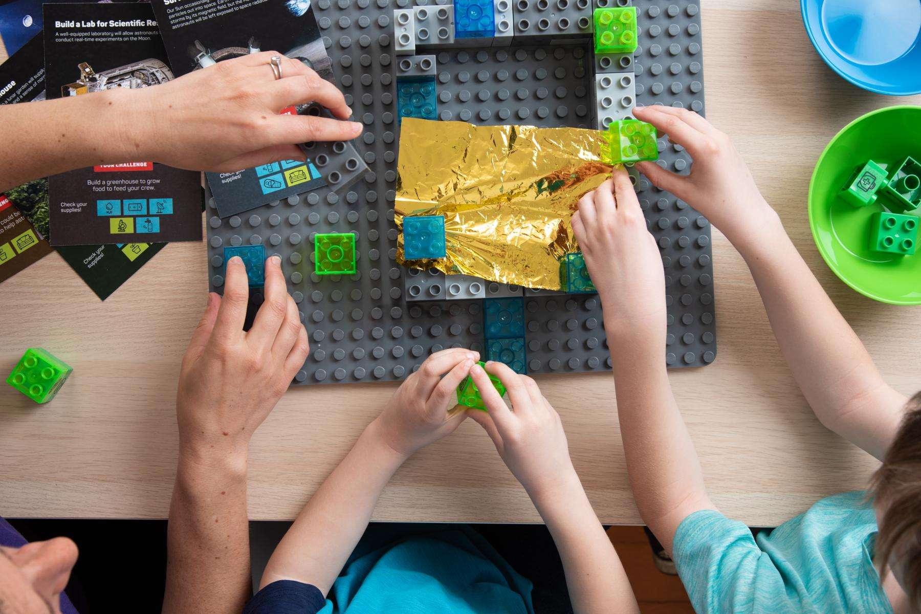
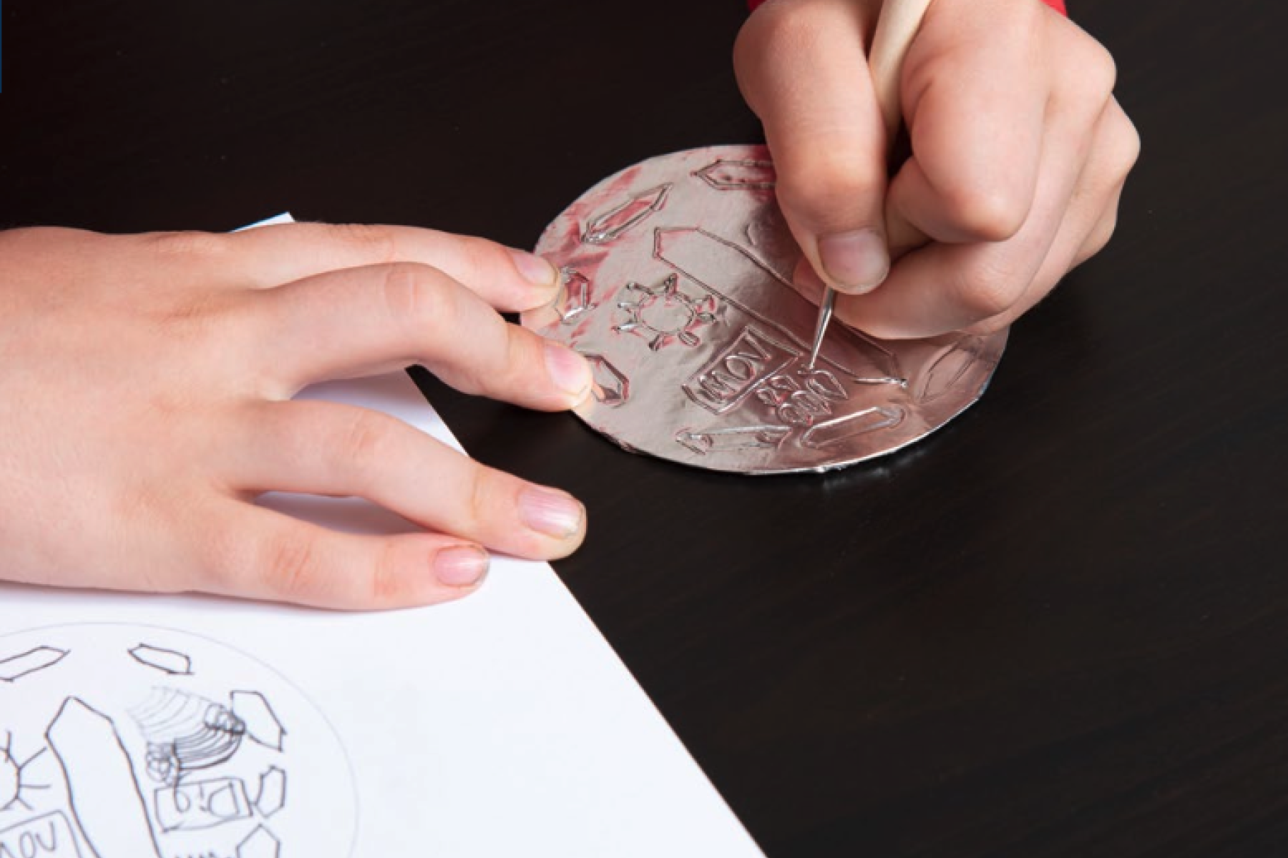
Explore Science: Voyage through the Solar System Activities
Build a Moon Base
Space Souvenir
Breath of Fresh Air
nisenet.org/solarsystem-kit
Credit: Emily Maletz for the NISE Network
Notes:
If you received the Explore Science: Voyage through the Solar System kit, include this slide for staff and volunteers.
In addition, the NISE Network’s new resources from the Explore Science: Voyage through the Solar System kit are great for hands-on engagement with eclipse audiences. These new activities and professional resources focus on NASA's ongoing efforts to send future astronauts to the Moon, Mars, and beyond. These materials are designed to help connect participants to solar system discoveries, imagine possible space futures, and consider the ways that human needs and values intersect with space exploration.
https://www.nisenet.org/solarsystem-kit
The hands-on activities include:
Build a Moon Base: In this activity, learners use building blocks to design and construct a base on the moon that allows explorers to survive and thrive!
Space Souvenir: In this activity, learners make their own mission medallion with foil and cardboard!
Breath of Fresh Air: In this activity, learners do an experiment that demonstrates some of the science concepts involved in keeping breathable air available on the International Space Station.
-----------
Image Description: Photo of three sets of hands manipulating building blocks and golden foil as part of the Build a Moon Base activity (left); Photo of one set of hands using a wooden stylus to etch a design onto foil wrapped around a circle of cardboard as part of the Space Souvenir activity (center); Photo of three young women using small test tubes filled halfway with water as part of the Breath of Fresh Air activity (right)
Image Credit: Emily Maletz for the NISE Network

Slide 28
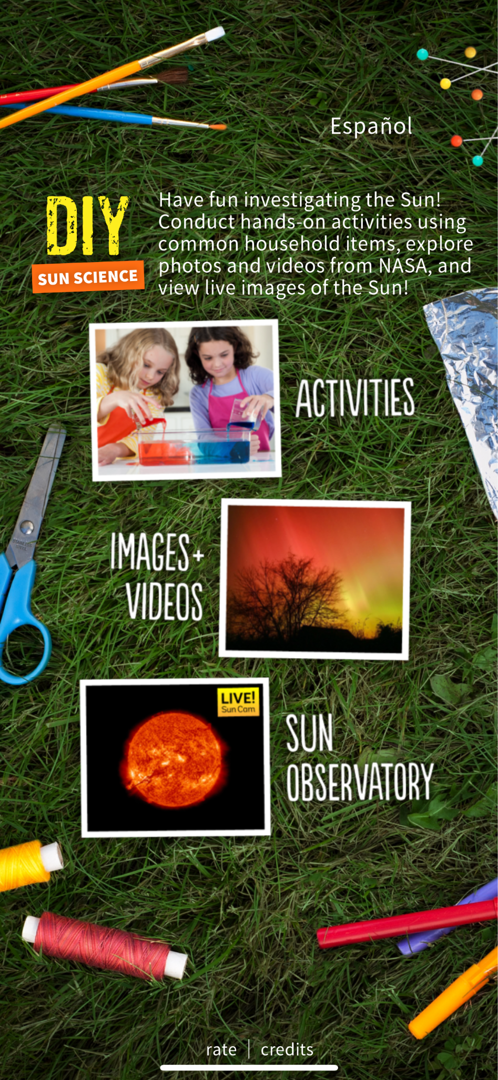
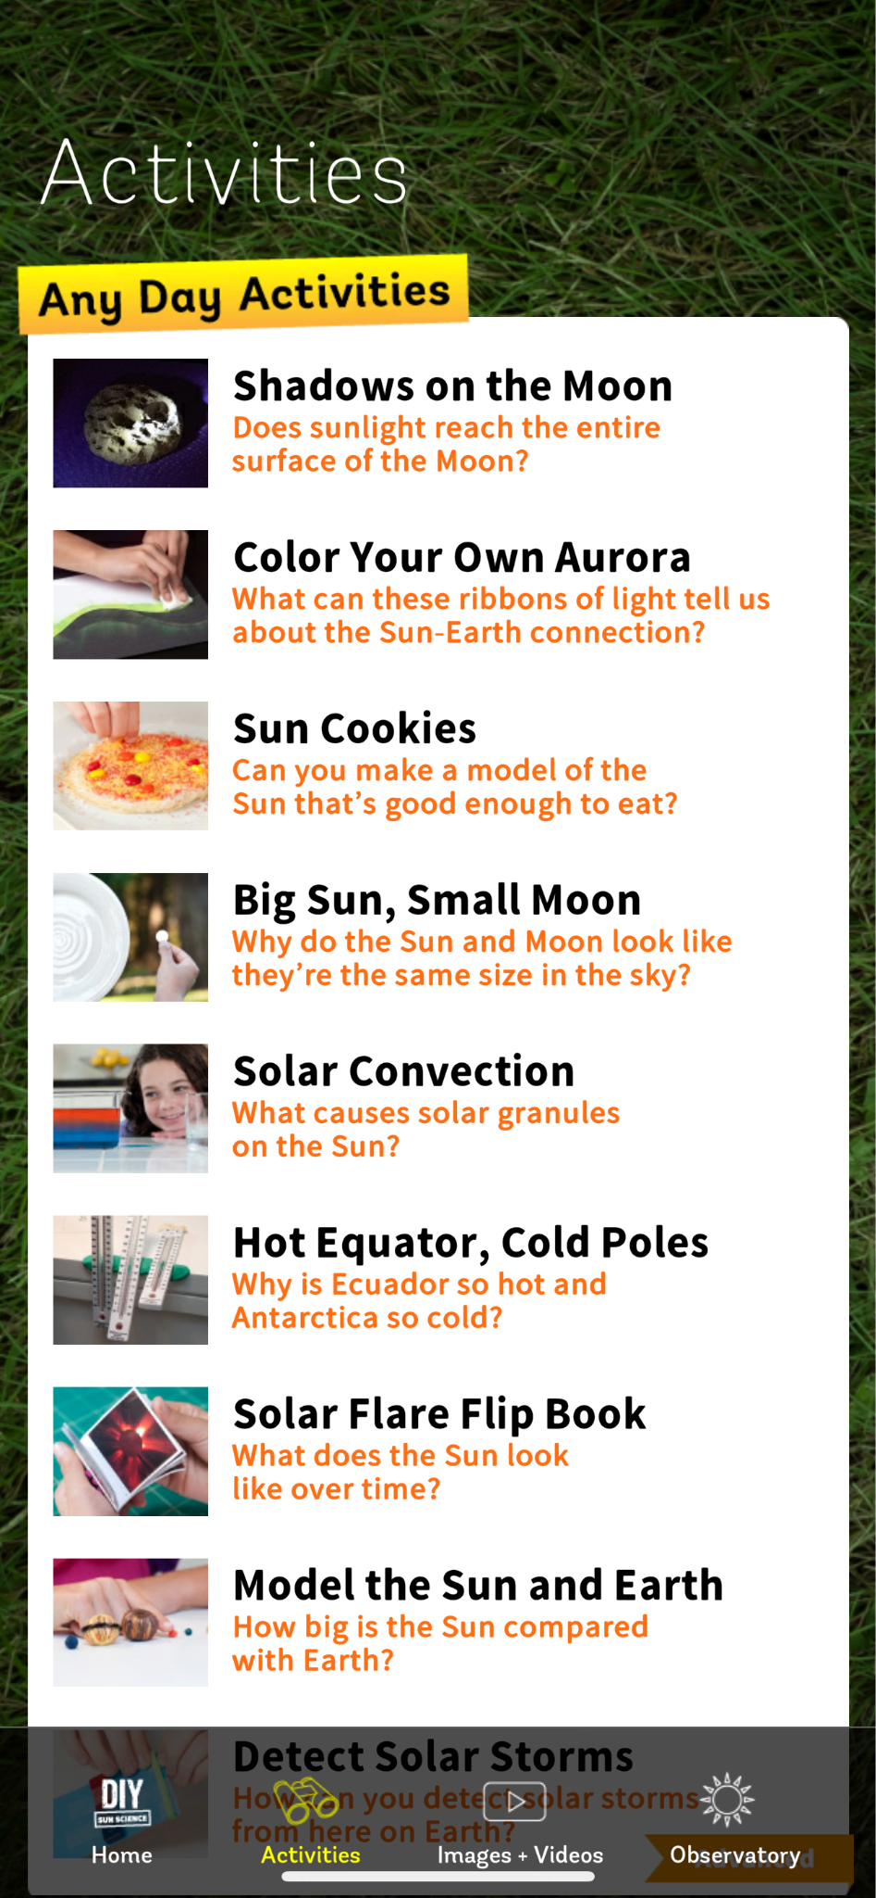
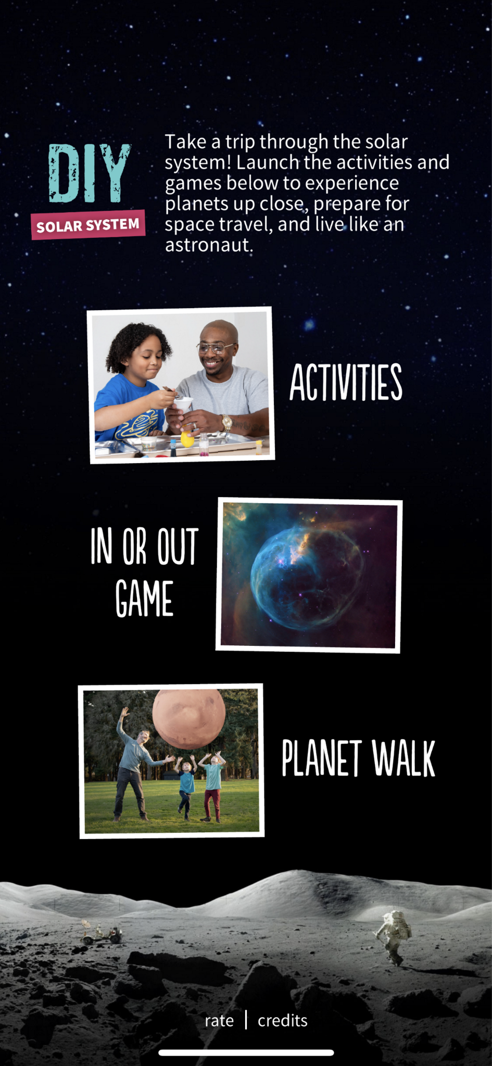
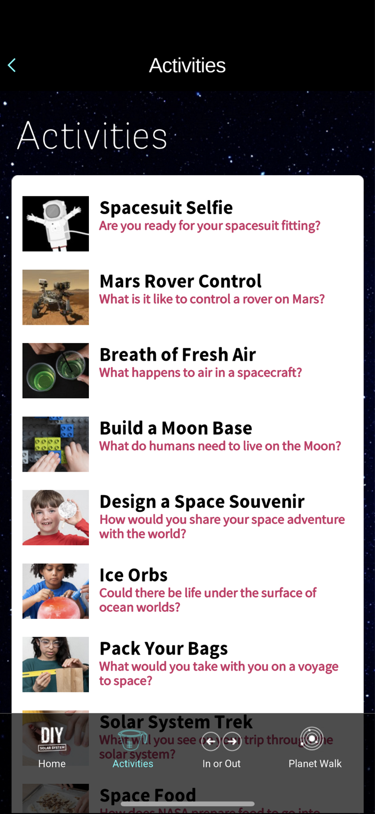
DIY Sun Science
DIY Solar System
Companion Apps with Hands-on Activities
Download from the App Store!
Notes:
In addition, there are two apps that anyone can use to continue their exploration of the sun and solar system.
DIY Sun Science is designed to make it easy for families and educators to learn about the Sun anywhere, anytime. https://www.nisenet.org/diy-sun-science-app
DIY Solar System makes it easy for families and educators to explore the solar system; the app even includes a Planet Walk feature where users can walk through a scale model of our solar system from right outside their home! https://www.nisenet.org/diy-solar-system-app
Both apps include beautiful NASA imagery and hands-on activities; both are available for iPhones and iPads from the App Store.
DIY Sun Science is currently available in English and Spanish, as well as for Android devices; DIY Solar System will be available for Android and include a Spanish translation soon.
-----------
Image description: Select screenshots from the DIY Sun Science app. Select screenshots from both the DIY Solar System app.

Slide 29
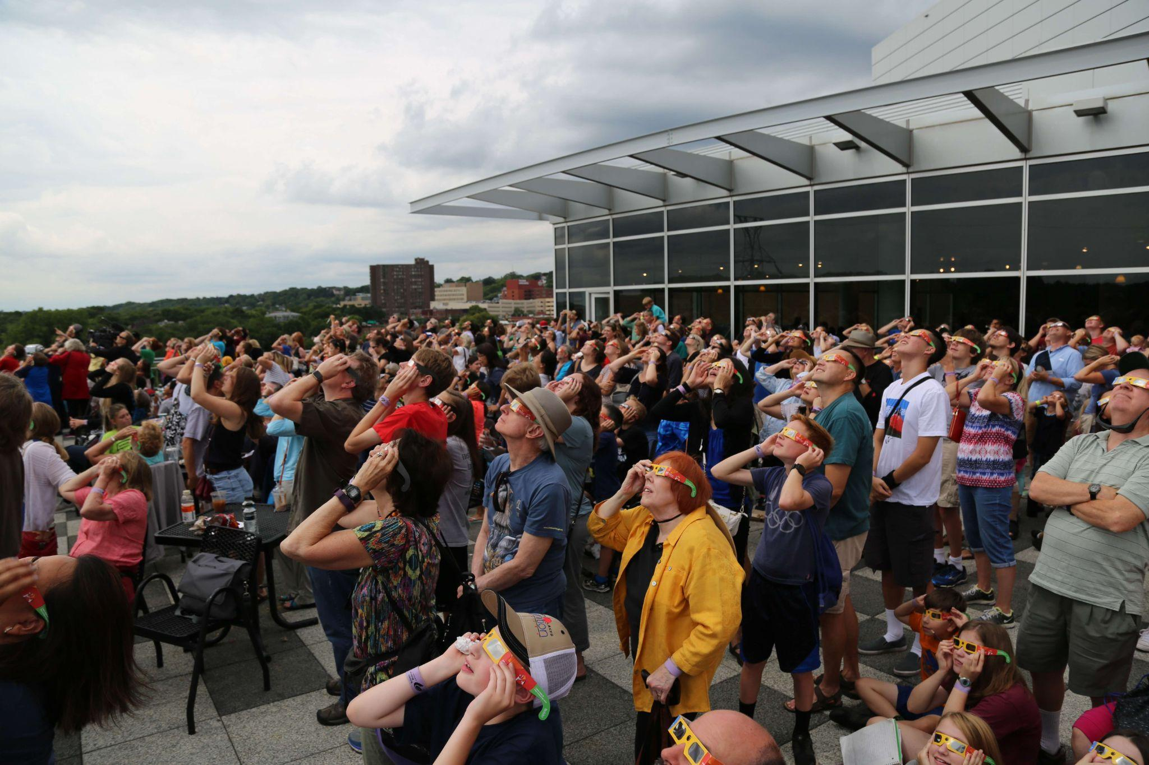
Tips for Hosting Solar Eclipse Events
Plan ahead!
Spacious location
Staff and volunteers
Safe viewing
Live stream
Hands-on Activities
Credit: Science Museum of Minnesota
Notes:
Tips for hosting a solar eclipse viewing event
If possible, plan this many months in advance - especially if you are on the path of annularity or totality!
A spacious location outside with horizon lines that will allow viewing (e.g. field or parking lot rather than forested area), can accommodate large crowds, and have necessary amenities for visitors; again nisenet.org/solareclipse includes links to guides to help you consider all the logistics
Staff and volunteers to support the event by answering questions, facilitating activities, and demonstrating safe viewing; this can include those local experts from the community
Viewing equipment like solar eclipse safety glasses, projection methods as discussed earlier (pinhole projectors, colanders, etc.), and special filters for cameras and telescopes - next we’re going to talk tips for taking photos
Live stream in case it’s cloudy– or even if it’s not– have a live stream set up!
Hands-on activities
-----------
Image Description: Huge crowd wearing eclipse safety glasses stands looking up at the sky from a balcony.
Image Credit: Science Museum of Minnesota

Slide 30
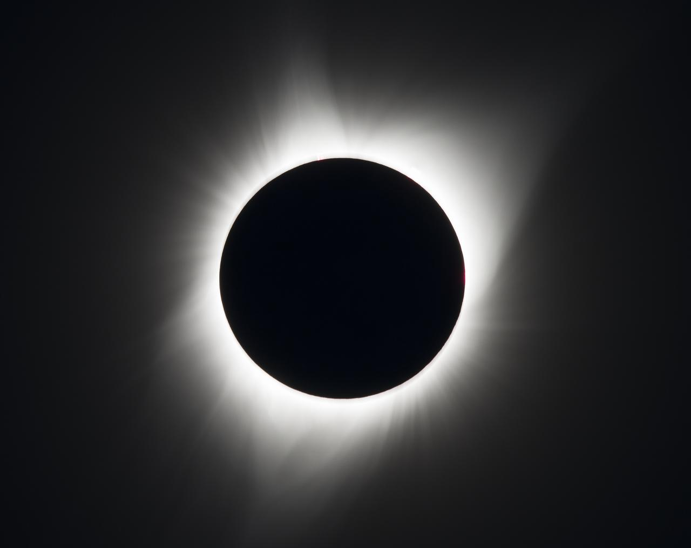
Tips for Taking Photos
Treat your camera like your eyes - use safe solar viewing practices!
Use the right solar filter for your specific model of camera
If it is cloudy, you can still get some great photos of the event by just observing the people and environment around you.
More advice: https://eclipse.aas.org/imaging-video/images-videos
Credits: NASA/Aubrey Gemignani
Notes:
Tips for taking photos - The best advice is to simply treat your camera like your eyes and cover the lens with a solar filter during the moments before and after totality when the sunlight is still blindingly bright. Though NASA offers many resources that include tips for taking great photos and video during a solar eclipse (links below), there are no official recommendations for safety equipment because of the inherent risk involved with looking directly at the Sun and the huge number of optical filter and camera models that may be used (and often misused). If you are unsure, seek expert advice from an astronomer before using a solar filter with cameras, telescopes, binoculars, or any other optical devices, and do NOT just use eclipse glasses or handheld viewers as they are many different types of solar filters and using the wrong one can damage your eyes and equipment.
Now most of us will likely just be using the camera on our smartphone to capture shots. NASA has a list of tips as well as a PDF with more info on how to take the best camera phone pictures during a solar eclipse. Again, just be sure to use the right filter for your phone’s camera: https://eclipse2017.nasa.gov/smartphone-photography-eclipse
Also remember, especially if it is cloudy, you can still get some great photos of the event by just observing the people and environment around you.
More tips for photographing a solar eclipse:
https://eclipse.aas.org/imaging-video/images-videos
https://eclipse2017.nasa.gov/smartphone-photography-eclipse
https://www.nasa.gov/feature/goddard/2017/five-tips-from-nasa-for-photographing-the-total-solar-eclipse-on-aug-21
https://eclipse.gsfc.nasa.gov/SEhelp/eclipsePhoto.html
https://solarsystem.nasa.gov/eclipses/safety/
-----------
Image Description: The 2017 Total Solar Eclipse is seen on Monday, August 21, 2017 above Madras, Oregon during totality.
Image Credit: NASA/Aubrey Gemignani, https://images.nasa.gov/details/NHQ201708210100

Slide 31
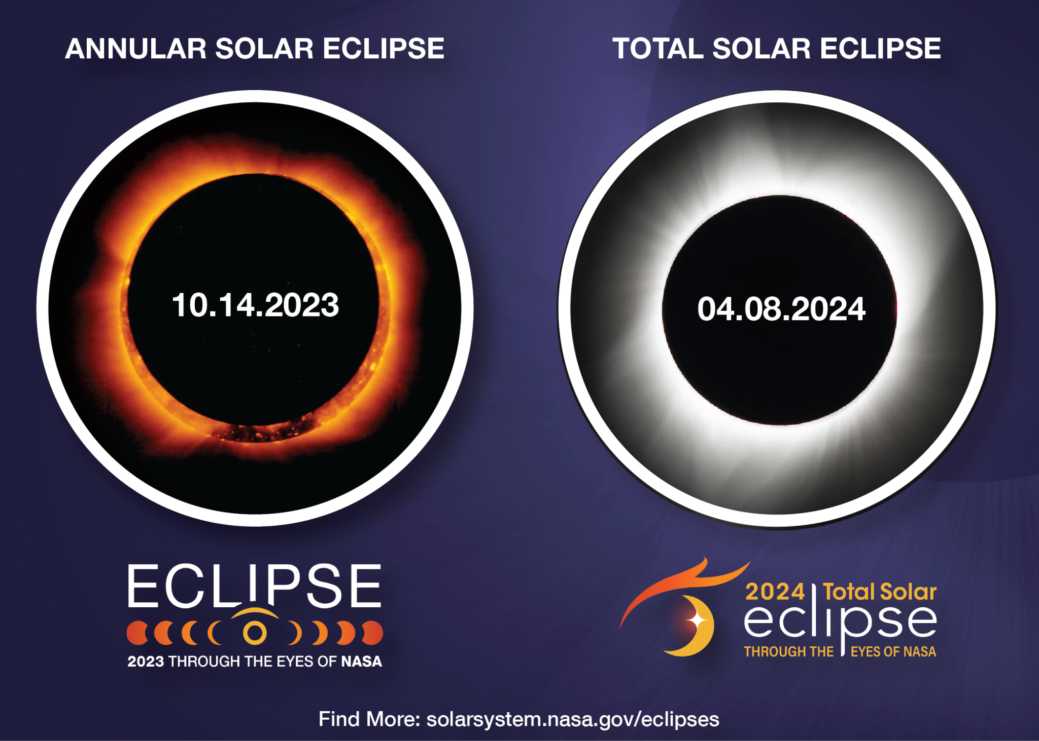
Questions?
Notes:
Any questions?
-----------
Image Description: Save the Date Postcard for the 2023 and 2024 Solar Eclipses from NASA HEAT.
Image Credit: NASA HEAT, https://solarsystem.nasa.gov/resources/2940/save-the-date-postcard-upcoming-us-solar-eclipses/?total_eclipse

Slide 32
Thank you!
This presentation includes content from:
American Astronomical Society: https://eclipse.aas.org
Astronomical Society of the Pacific: astrosociety.org
Eclipse Soundscapes: https://eclipsesoundscapes.org/
Exploratorium: exploratorium.edu/eclipse
Great American Eclipse: greatamericaneclipse.com/
NASA: solarsystem.nasa.gov/eclipses
NASA Eclipse Ambassadors: eclipseambassadors.org
NASA GLOBE Observer: observer.globe.gov/eclipse
NASA Night Sky Network: nightskynetwork.org
NASA Science Activation: science.nasa.gov/learners
Space Science Institute: spacescience.org
STAR Net Solar Eclipse Activities for Libraries (SEAL): starnetlibraries.org/about/our-projects/solar-eclipse-activities-libraries-seal/
Notes:
Thank you for your time and to all the institutions and individuals who made this presentation possible!
American Astronomical Society: https://eclipse.aas.org
Astronomical Society of the Pacific: https://astrosociety.org
Eclipse Soundscapes: https://eclipsesoundscapes.org/
Exploratorium: https://www.exploratorium.edu/eclipse
Great American Eclipse: https://www.greatamericaneclipse.com/
NASA: https://solarsystem.nasa.gov/eclipses/home/
NASA Eclipse Ambassadors: https://astrosociety.org/education-outreach/amateur-astronomers/eclipse-ambassadors/program.html
NASA GLOBE Observer: https://observer.globe.gov/eclipse
NASA Night Sky Network: https://nightskynetwork.org
NASA Science Activation: https://science.nasa.gov/learners
Space Science Institute: https://www.spacescience.org/
STAR Net Solar Eclipse Activities for Libraries (SEAL): https://www.starnetlibraries.org/about/our-projects/solar-eclipse-activities-libraries-seal/

Slide 33
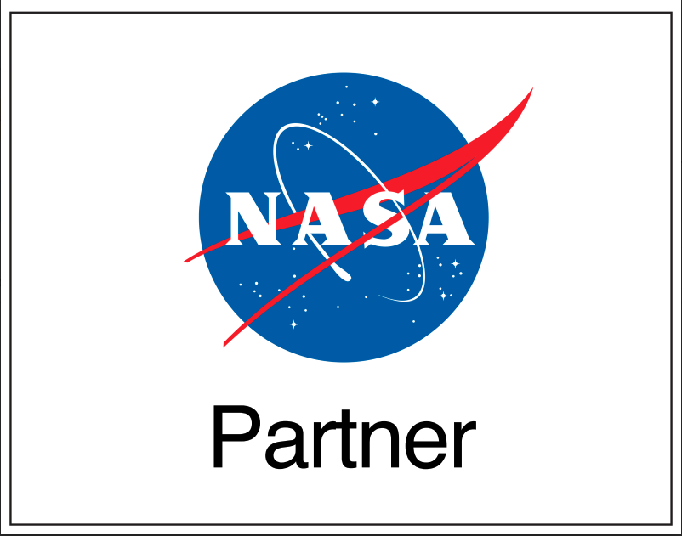
This material is based upon work supported by NASA under award number 80NSSC21M0082 and cooperative agreement award numbers NNX16AC67A and 80NSSC18M0061. Any opinions, findings, and conclusions or recommendations expressed in this material are those of the author(s) and do not necessarily reflect the view of the National Aeronautics and Space Administration (NASA).
Creative Commons Attribution Non-Commercial Share Alike 3.0 United States (CC BY-NC-SA 3.0 US).
Notes:
Acknowledgements
-----------
Image Descriptions: National Informal STEM Education Network (NISE Network) logo, Explore Science: Voyage through the Solar System logo, Explore Science: Earth & Space logo, NASA Partner logo, Creative Commons Attribution Non-Commercial Share Alike logo.

