Slide 1

WELCOME!
ASTC Breakfast | 2022

Slide 2
Overview
Introduction to the NISE Network
Opportunities to get involved and stay connected
Discussion and activity
Notes:
We are so glad to have you all join us today on the last day of the conference

Slide 3

The NISE Network brings people together to engage in STEM, understand our world, and build a better future for everyone.

Slide 4
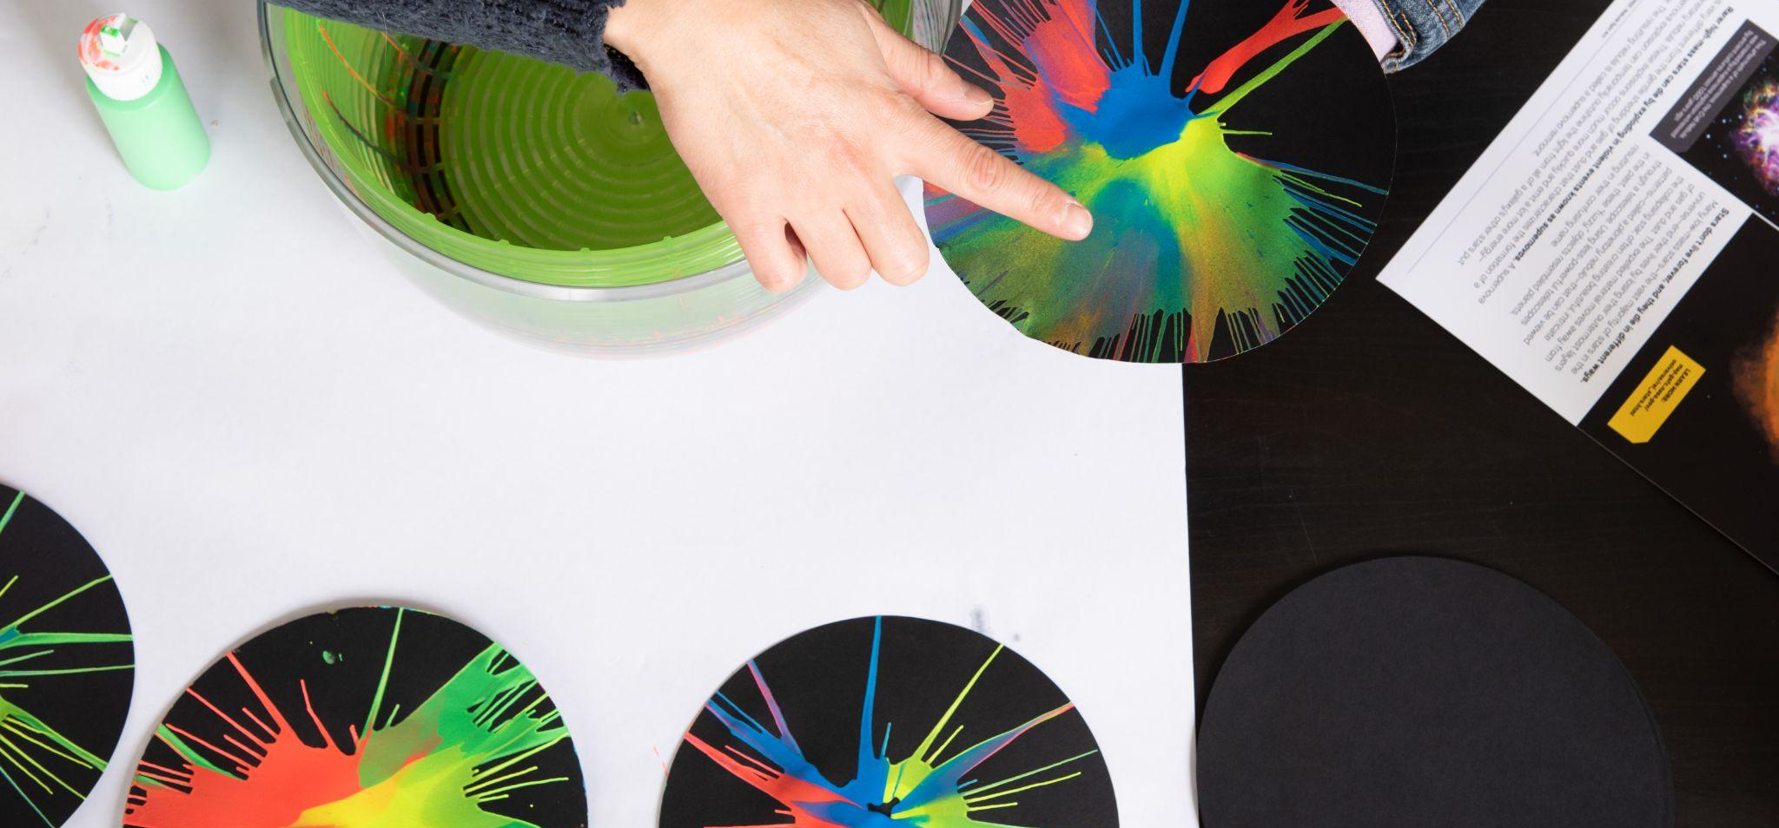
We create and share products, practices, and materials with partner organizations across the country.
Our resources
are available to everyone for free download from nisenet.org.

Slide 5
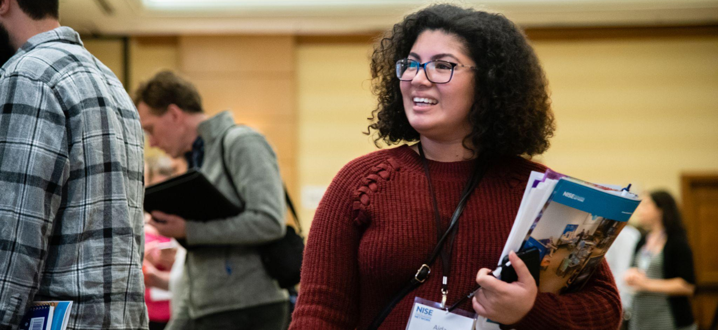
Hundreds of organizations participate in the NISE Network, including museums and universities.
Our community
includes educators, researcher/evaluators,
and scientists.

Slide 6
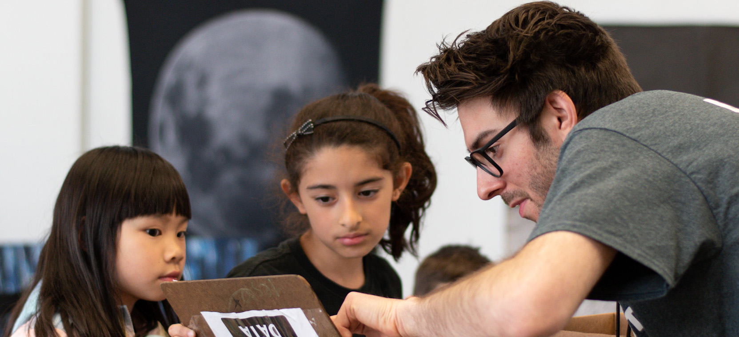
Partner organizations use Network resources to engage learners in their communities.
Local use
brings people together to share and learn from each other.

Slide 7
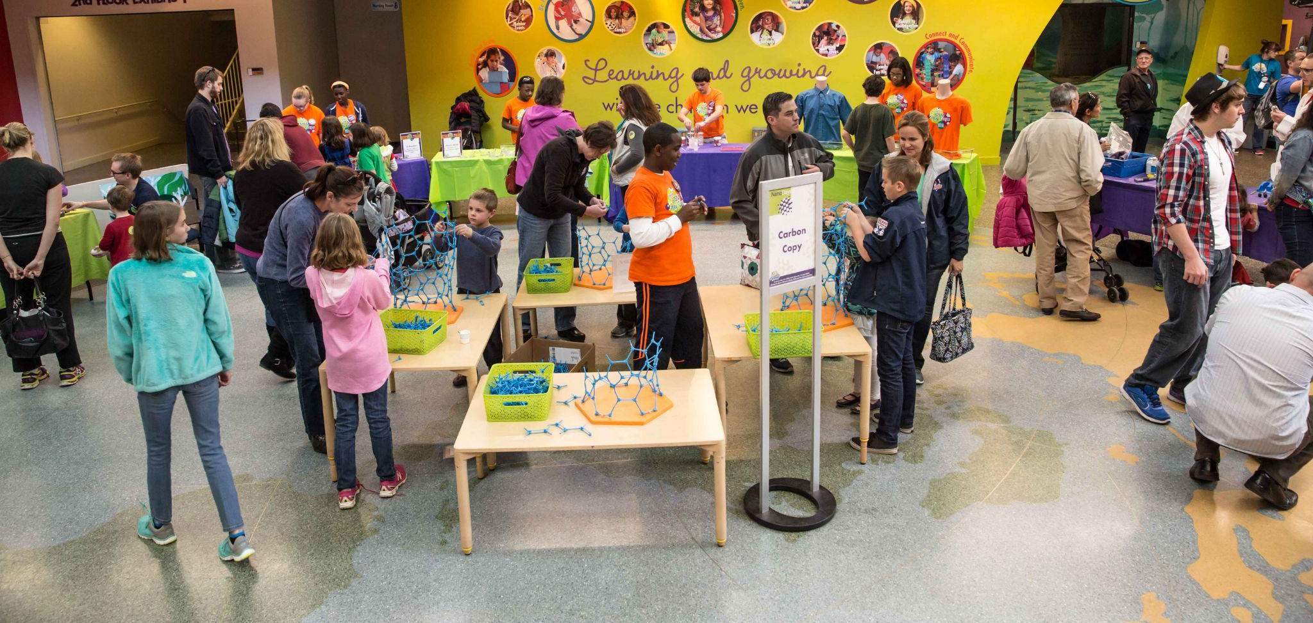
Together we reach millions of people each year!
Our impact
grows through the efforts of our partner organizations.

Slide 8
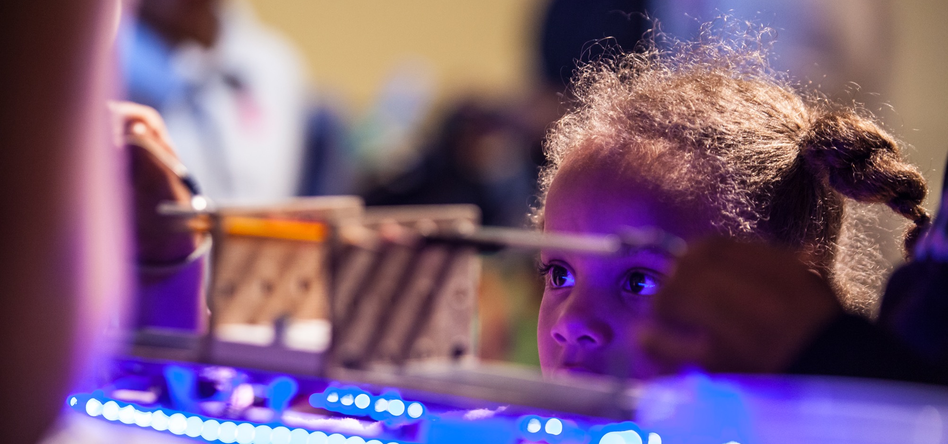
We are committed to diversity, equity, accessibility, inclusion, and belonging (DEIAB).
Strategies include prioritizing DEAIB through leadership; using best practices in our projects and products; and supporting network partners’ efforts through professional development.

Slide 9
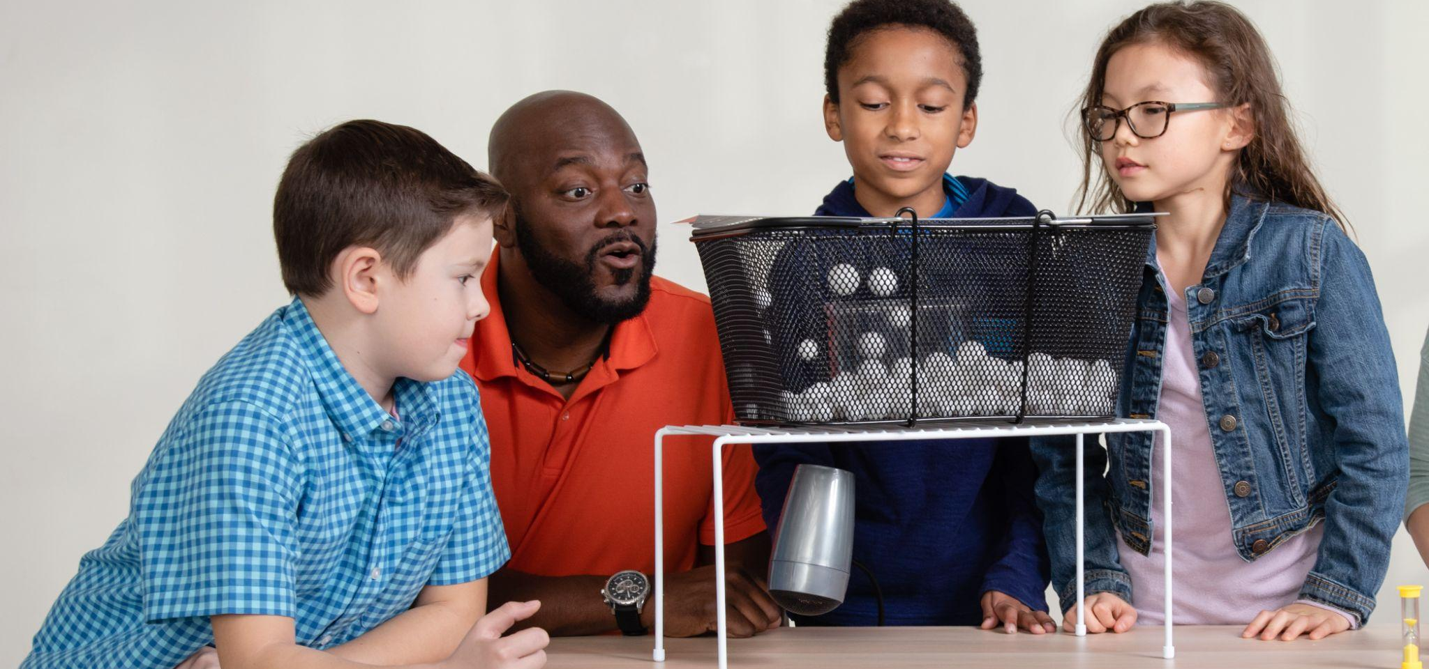
Network projects tackle challenging problems and develop knowledge, tools, and practices.
Relationships,
knowledge, and infrastructure support all our activities.

Slide 10
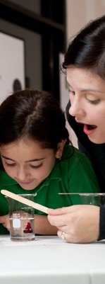
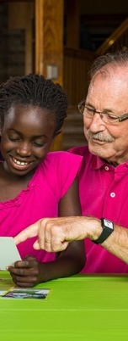
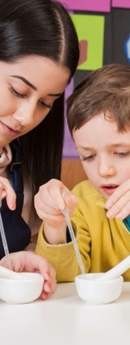
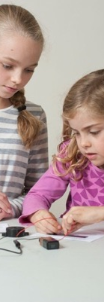
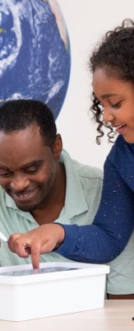
Our projects focus on many areas of STEM.
Nanotechnology
2005-2017
Synthetic biology
2014-2018
Chemistry
2016-2019
Responsible innovation
2015-2019
Sustainability
2016-2017, 2019-2022

Slide 11
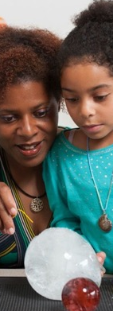
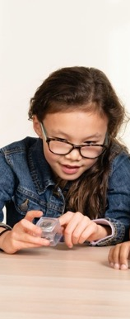
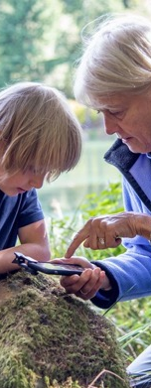
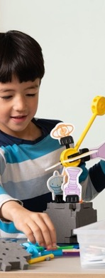
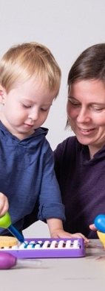
Projects provide opportunities to get involved.
Earth and space
2016-2023, 2022-2025, 2019-2022, 2020-2023, 2022-2024, 2022-2025
Changing brains
2018-2020, 2021-2023
Climate resilience
2020-2022
Radio waves
2020-2024
Learning
ecosystems
2021-2025

Slide 12
Opportunities to get involved

Slide 13
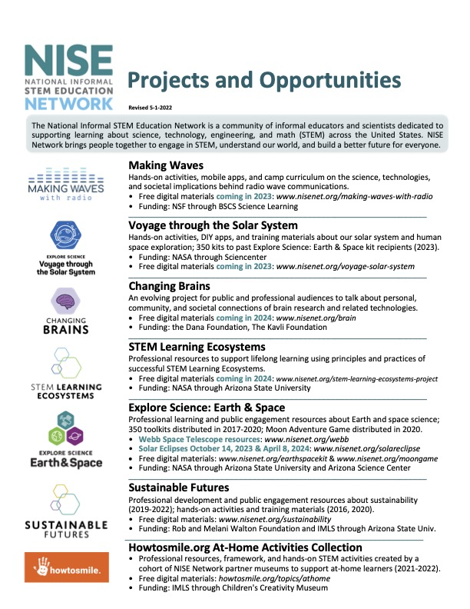
How to get involved
Take one home!
Use our resources
STEM public engagement materials
Professional learning resources
Connect with us
Online
In person
Notes:
Updates on opportunities and new resources from NISE Network and the informal science education field
Flyers on the table also list current and upcoming opportunities
Please sign in on the sheets on your table (even if you already receive the newsletter, please sign in on the sheets on your table)

Slide 14
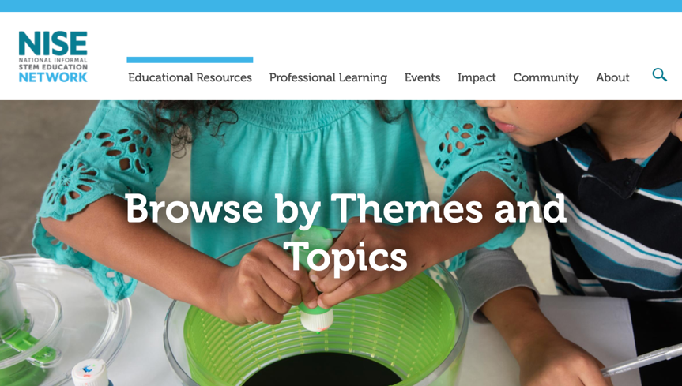
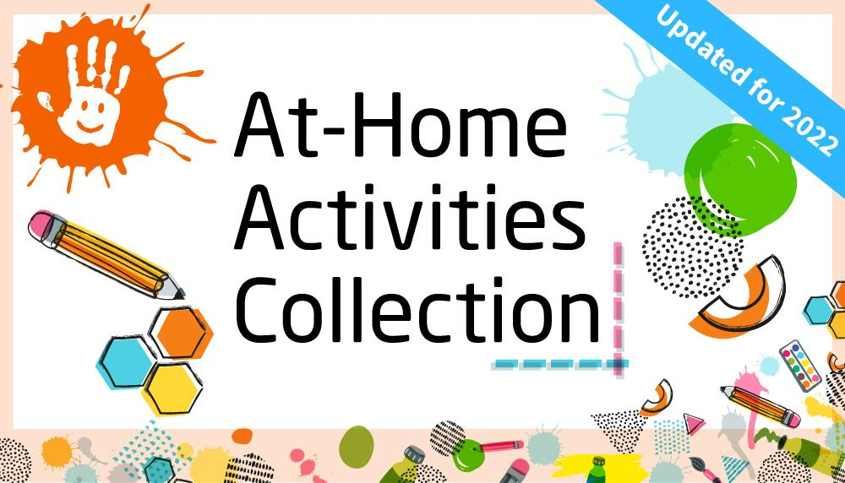
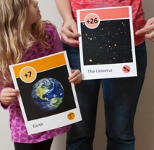
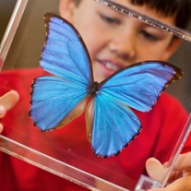
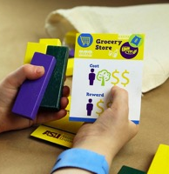
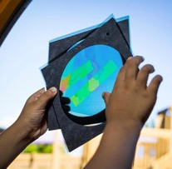
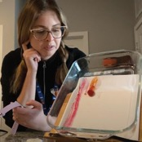
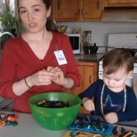
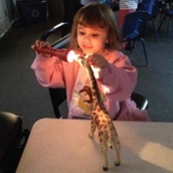
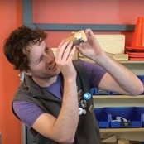
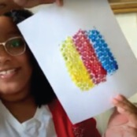
Use our free resources on nisenet.org and howtosmile.org
nisenet.org/browse-topic
howtosmile.org/topics/athome
Notes:
Brows topic – great way to look for things like Halloween activities or National Chemistry Week

Slide 15
Recent
Public Engagement and Professional Learning Resources

Slide 16
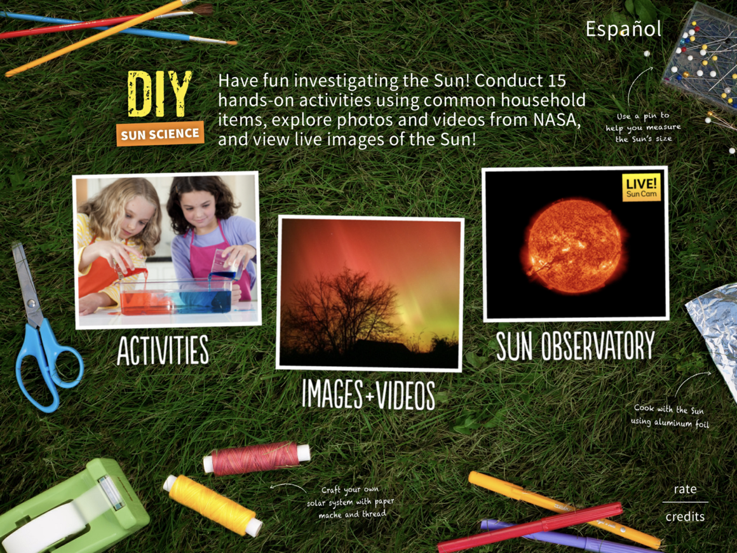
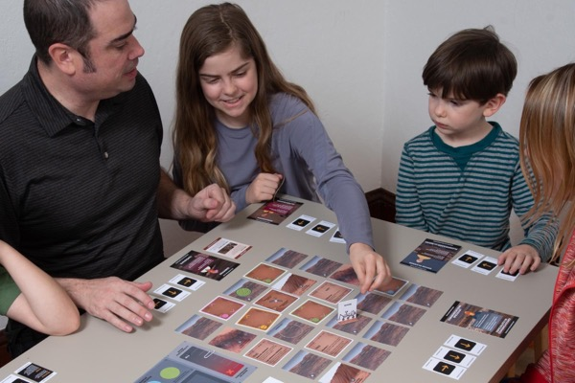
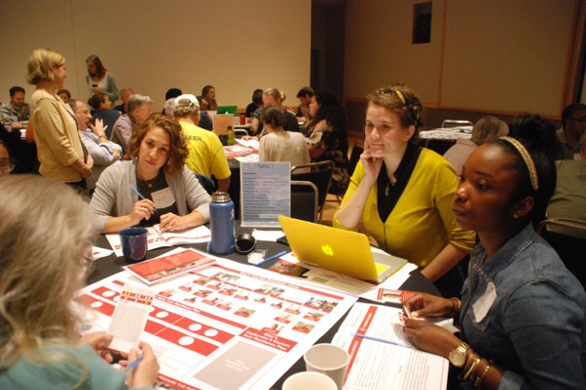
Featured STEM engagement resources on nisenet.org
nisenet.org/explore-mars-rover-game
nisenet.org/forums
nisenet.org/diy-sun-science-app
nisenet.org/forums
Notes:
DIY Sun Science – iOS for iphone and ipad – on Apple app store. Activity printouts on nisenet.org
Rover game – strategy board game – print your own
Climate hazard resilience forums: drought, extreme heat, extreme precipitation, sea level rise

Slide 17
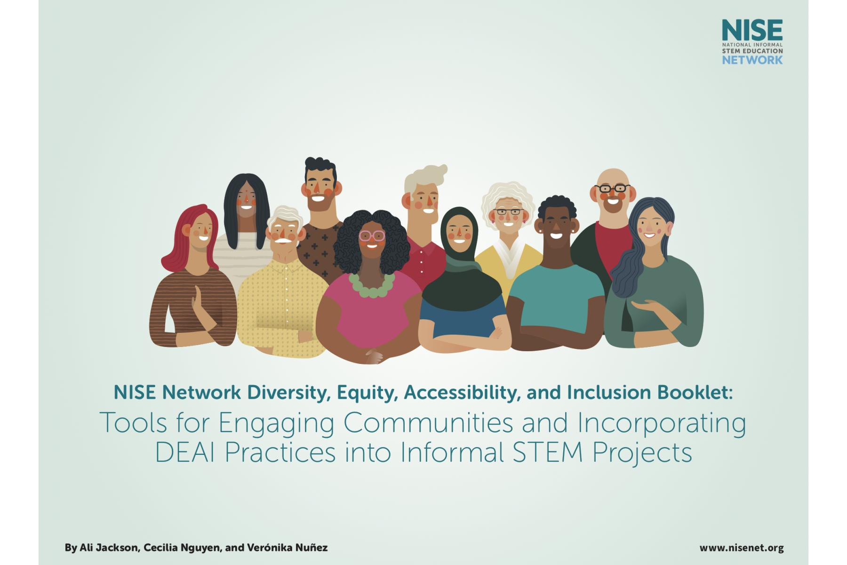
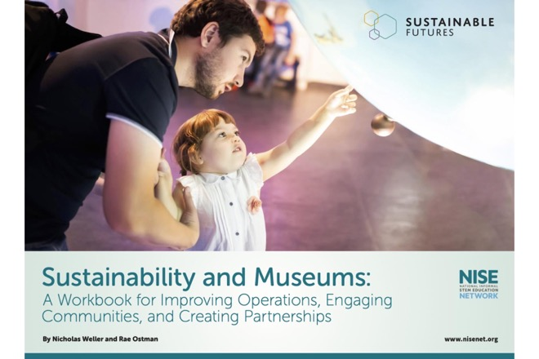
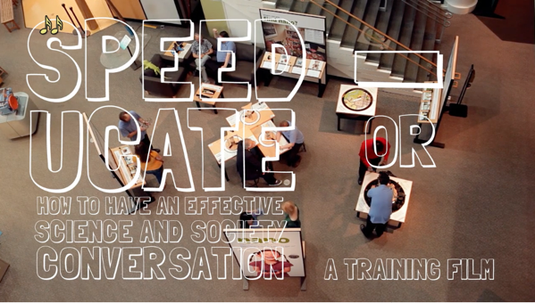
Featured professional learning resources on nisenet.org
nisenet.org/ sustainability
nisenet.org/making-relevant-inclusive
https://www.nisenet.org/pd/training-videos
Notes:
Professional learning resources based on the NISE Network’s Earth & Space Project-Based Professional Learning Community.
Written materials, slides, and videos presented during this virtual online learning community to explore at your own pace.
Designed to help museums and science centers make their E&S learning experiences more relevant and inclusive for local communities.
We also have many PD resources for Sustainability
And Science and society

Slide 18
Upcoming Projects

Slide 19


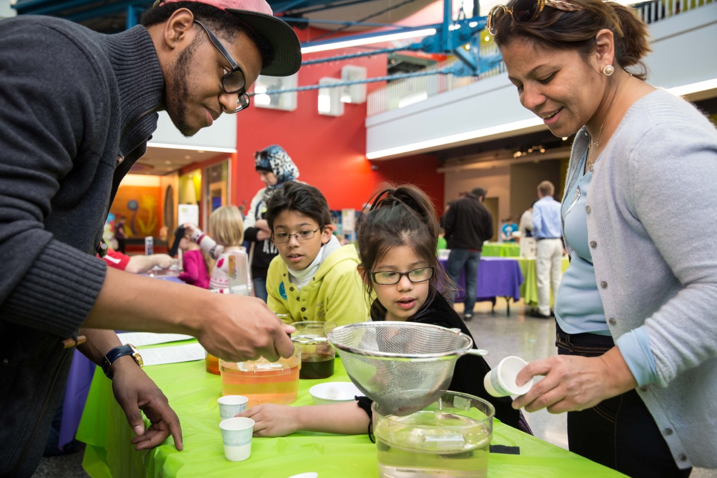

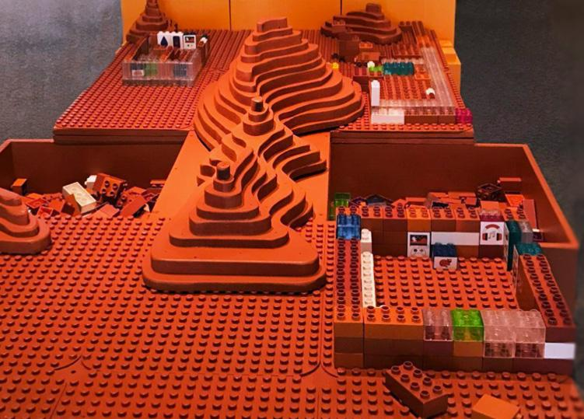
Earth & Space
Voyage through the Solar System
New activities and app 2023 & 2024
Sparking Interest in STEM + Engaging Hispanic communities
New activities and exhibition in 2024-2025
Mars Habitat exhibit component
Sun, Earth, Universe exhibition in 2023
Notes:
Sparking Interest in STEM will co-develop a set of bilingual hands-on activities to complement NASA’s existing Spanish-language resources and provide professional development to support NISE Network partners in using them. (Museum of Life and Science, NASA)
Engaging Hispanic Communities in NASA Science will co-develop multiple copies of a small-footprint exhibition for use in museums in the southwestern US and a suite of programmatic materials for use nationwide. It will also provide professional development for implementing partners. (Arizona State University, NASA)
Voyage through the Solar System (aka Explore Science: Moon, Mars, and Beyond) is creating a set of bilingual hands-on activities and a DIY app focused on human exploration in our Solar System. It also includes a rebuild and relaunch of the DIY Sun Science app with two new activities and complete translation into Spanish. (Sciencenter, NASA)
Build a Mars Habitat will distribute a new component for the Sun, Earth, Universe exhibition that explores NASA’s plans for human exploration of Mars. (Science Museum of Minnesota, NASA)
– QUESTIONS? Paul Martin for Engaging Hispanic Communities and Max Cawley on Sparking Interest and Ali Jackson for Voyage through the Solar System

Slide 20

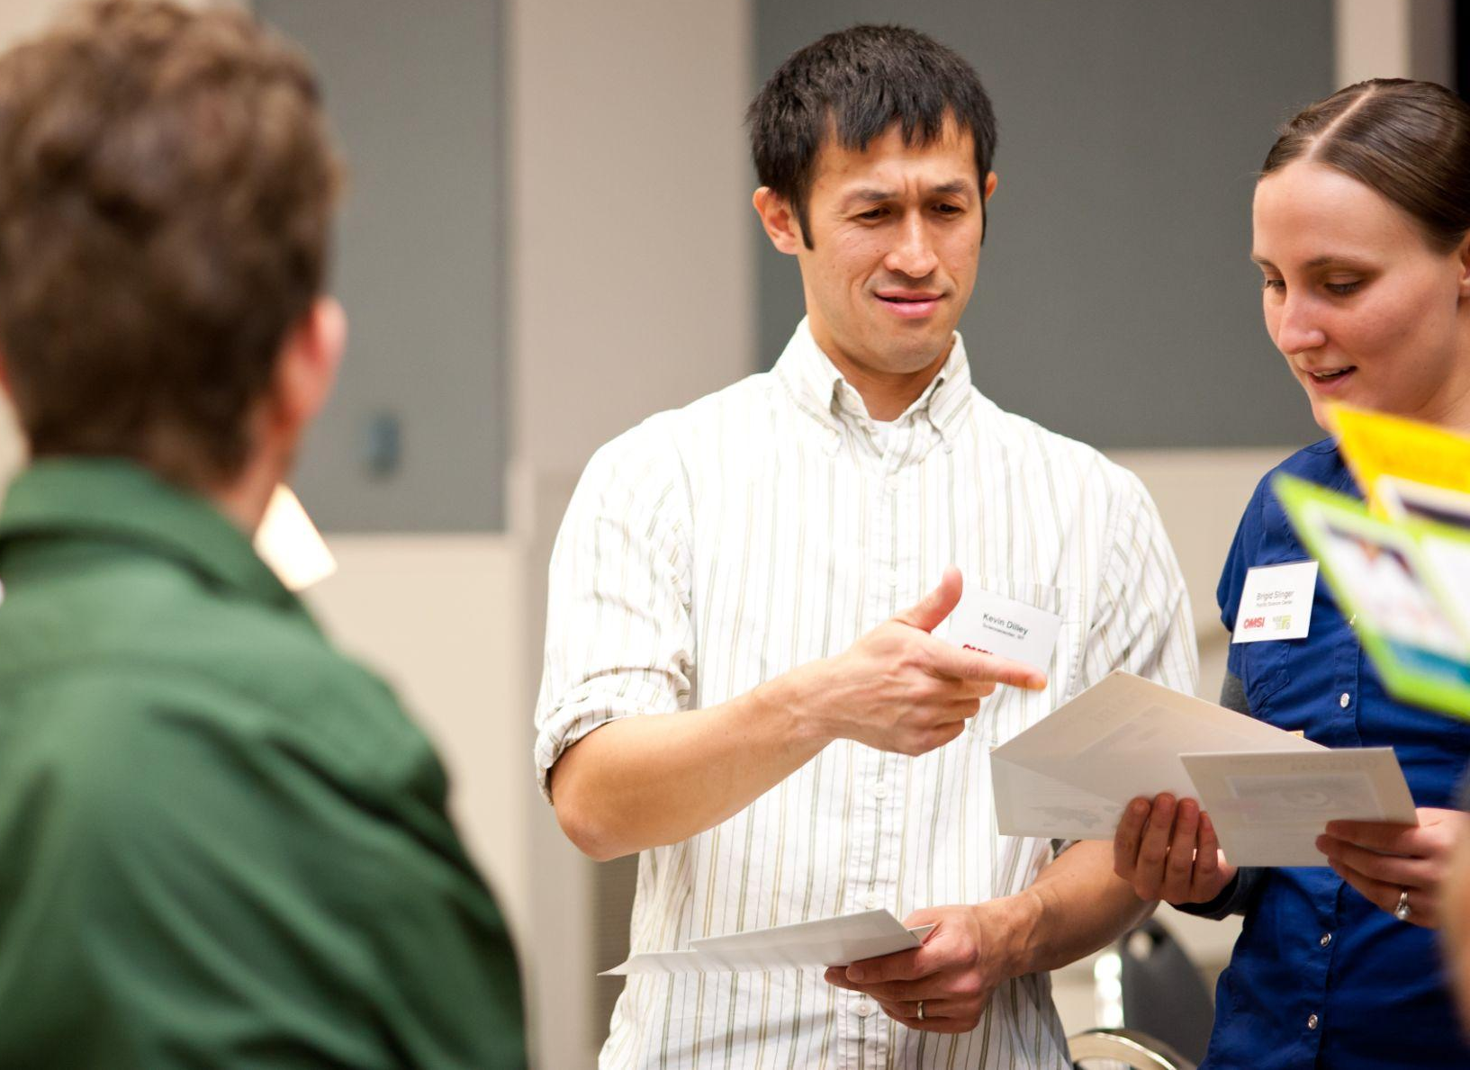
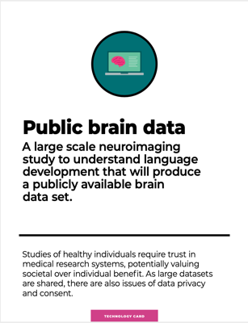


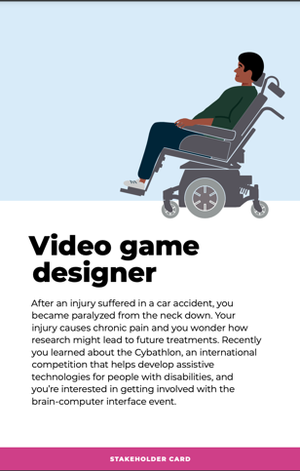
Changing brains
Neuroscience, ethics, and technologies
Hands-on activities in 2023
Notes:
Changing Brains is developing a plan for nationwide engagement in learning about neuroscience, ethics, and technologies. This work includes developing and evaluating a handful of pilot activities. (Arizona State University, Dana Foundation)
Hands-on activities in 2023
Questions – see Darrell Porcello, Jayatri Das, Claire Weichselbaum

Slide 21
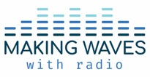
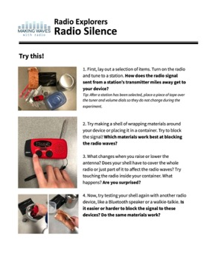
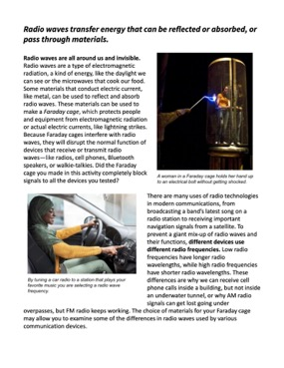
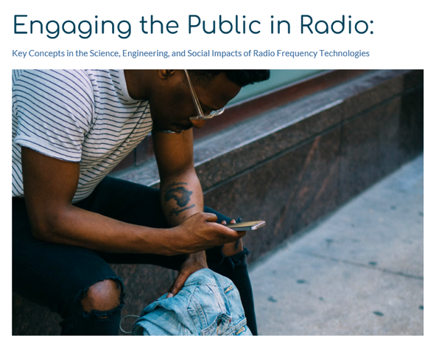
Making Waves with Radio
Learner resources
Craft-based toolkit and digital apps in 2023
Professional resources
Online PD and activity guides in 2023
Notes:
Making Waves is creating digital apps, a craft-based toolkit, activity guides, and mobile online professional learning, all designed to engage youth and the public about radio frequency communications. (BSCS Science Learning, NSF)
Craft-based toolkit and digital apps in 2023
Online PD and activity guides in 2023
Questions – Darrell Porcello

Slide 22
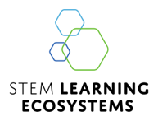
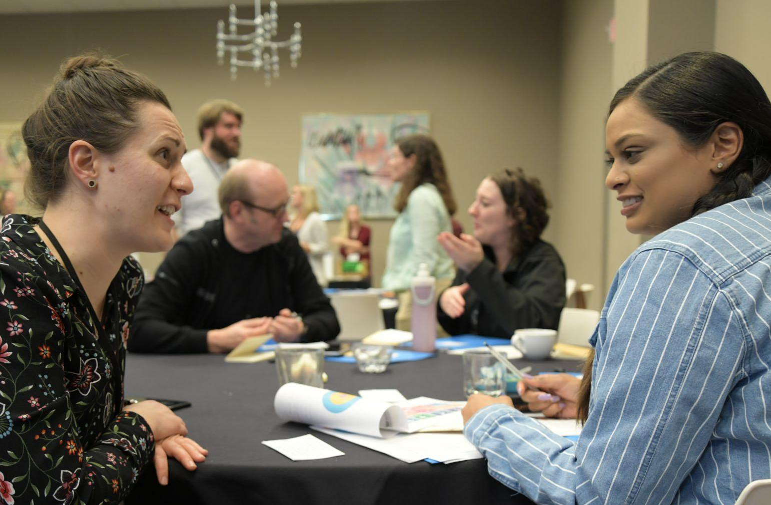
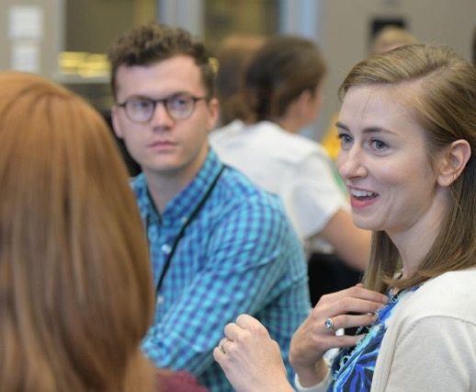
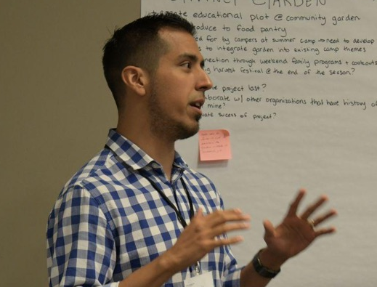
STEM learning ecosystems
Principles and practices of community-wide learning ecosystems
Professional development in 2024
Notes:
SciAct STEM Ecosystems is identifying principles and practices that enable learning ecosystems to broaden participation in authentic STEM learning. It includes resources and professional development for NASA’s Science Activation community and the wider STEM engagement field. (Arizona State University, NASA)
Professional development in 2024
Questions? Rae Ostman, Liz Kollmann, Allison Anderson,

Slide 23
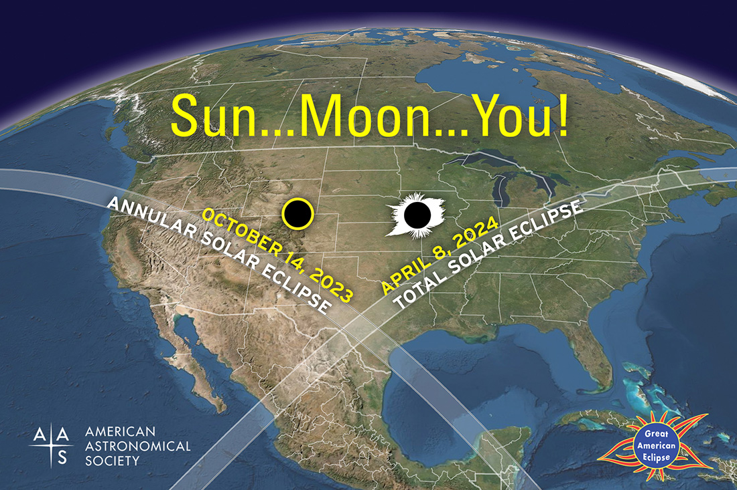
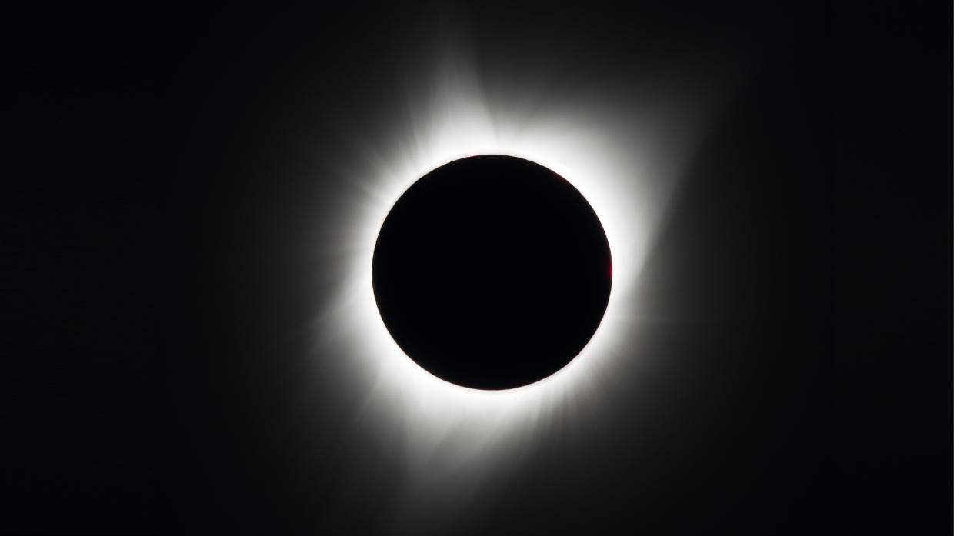
Solar Eclipses
October 14, 2023
And
April 8, 2024
Online workshop in October
nisenet.org/events
nisenet.org/solareclipse
Map courtesy Michael Zeiler of GreatAmericanEclipse.com

Slide 24
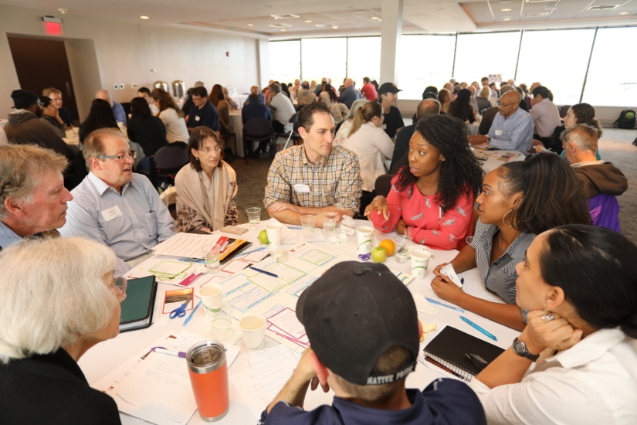
Opportunity from the Museum of Science in Boston
Co-creation community discussions on a community driven topic
Examples of projects have included affordable housing and mental health
Stipend of $8,000 plus travel support
Apply by November 1, 2022
publicengagementwithscience.org
Questions? see Susan Heilman & David Sittenfeld

Slide 25

Opportunity from the Arizona Science Center
Moon Adventure Game training
Today at 9:30am
Westin Hotel, Butler Room (down hall)
participants will receive a $200 materials stipend in the form of an Amazon Gift Card. Limit one gift card per institution.
Questions? see Sari Custer

Slide 26







How to stay in touch
Learn more and access online
digital resources:
nisenet.org
Subscribe to the
monthly newsletter:
nisenet.org/newsletter
Follow NISE Net on social media
nisenet.org/social
Notes:
Updates on opportunities and new resources from NISE Network and the field
Flyers on the table also list current and upcoming opportunities
Please sign in on the sheets on your table (even if we have your email already)

Slide 27






Thank you
Support from the National Science Foundation: Nanoscale Informal Science Education Network (#0532536, #0940143), Multi-Site Public Engagement in Science (#1421179), Increasing Learning and Efficacy about Emerging Technologies (#1516684), ChemAttitudes (#1612482), Wireless Radio Communications (#2005784), Co-Created Public Engagement with Science (#1811118). Any opinions, findings, and conclusions or recommendations expressed in this presentation are those of the authors and do not necessarily reflect the views of the Foundation.
Support from NASA: Space and Earth Informal STEM Education (#NNX16AC67A, #80NSSC18M0061), Moon and Beyond (#80NSSC18K1219), Build a Mars Habitat (#80NSSC20M0030), SciAct STEM Ecosystems (#), Destination Moon (#80NSSC21M0082), and Engaging Hispanic Communities. Any opinions, findings, and conclusions or recommendations expressed in this material are those of the author(s) and do not necessarily reflect the view of the National Aeronautics and Space Administration (NASA).
Support from NOAA: Citizen Science, Civics, and Resilient Communities (#NA18SEC0080008)
Support from IMLS: Sustainable Museums (#MG-245910-OMS-20) and How to Smile (#CAGML-246996-OMLS-20).
Support from Rob and Melani Walton Foundation: Sustainability in Science and Technology Museums.
Support from The Kavli Foundation: Changing Brains.
Support from Dana Foundation: Barbara Gill Civic Science Fellowship.
Notes:
A sincere thanks to all of our project funders, none of this would be possible without them!

Slide 28
Discussion and activity

Slide 29
Discuss with others at your table
Do you have ideas for future online workshops?
Write them down on the index cards at your table
What does belonging mean to you?
As a professional
As a learner and community member
As a group or organization

Slide 30
Stand up
Improv games
Staff and volunteer skill building
Meeting icebreakers and stretch breaks
Team and relationship building
Let’s play Red Ball!

