Slide 2
Agenda
Welcome 10 minutes
(Speaker/Video) (10-15 mins)
Step 1: Intros and Malaria Profile 5 minutes
Step 2: Eng. Mosquito Profile 10 minutes
Step 3: Gene Drive Profiles 8 minutes
Step 4: Release Options 2 minutes
Step 5: Personal Profiles 10 minutes
Step 6: Discussion and Plan 30 minutes
Step 7: Report Out 10 minutes

Slide 3
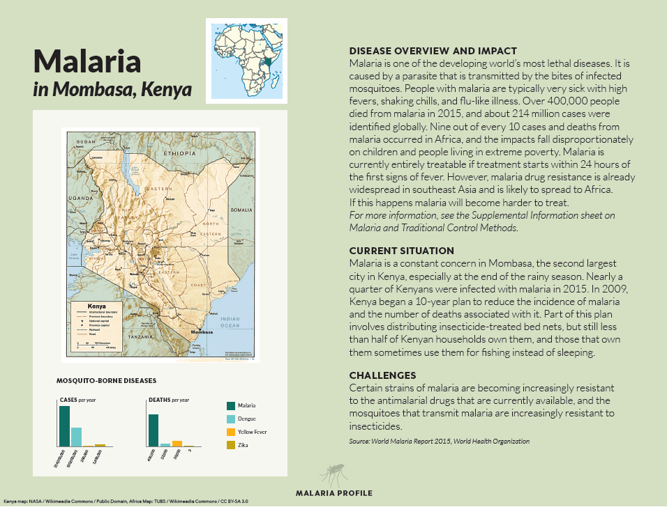
Step 1: Malaria Profile 1 card, 5 minutes
5
minutes remaining
60 minutes until report out

Slide 4
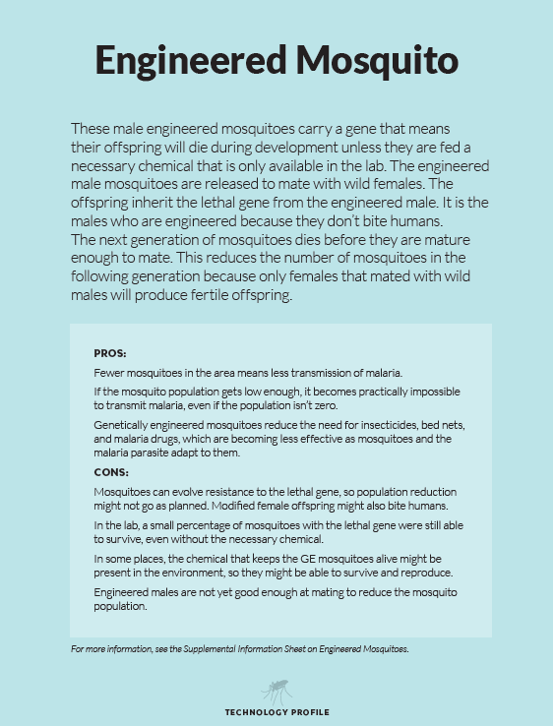
Step 2: Eng. Mosquito Profile 1 card, 5 minutes
5
minutes remaining
55 minutes until report out

Slide 5
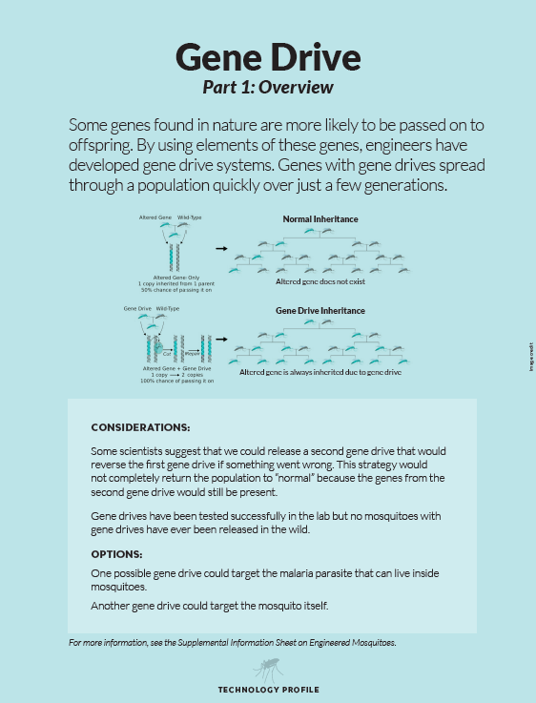
Step 3: Gene Drive Profiles 2 cards, 8 minutes
8
minutes remaining
50 minutes until report out

Slide 6
Step 3: Gene Drive Profiles 2 cards, 8 minutes
3
minutes remaining
45 minutes until report out

Slide 7
Step 4: Release Options 1 card, 2 minutes
2
minutes remaining
42 minutes until report out

Slide 8
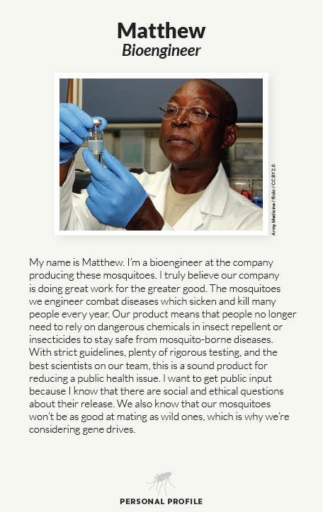
Step 5: Personal Profiles 5 cards, 10 minutes
10
minutes remaining
40 minutes until report out

Slide 9
Step 5: Personal Profiles 5 cards, 10 minutes
5
minutes remaining
35 minutes until report out

Slide 10
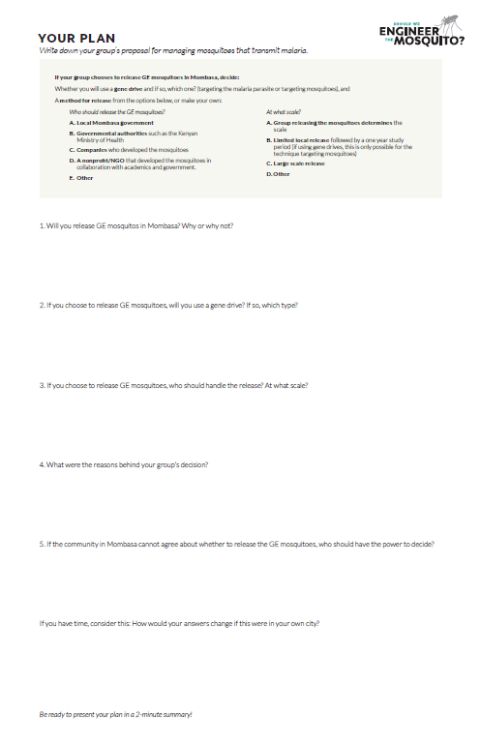
Step 6: Discuss and Make a Plan 30 minutes
30
minutes remaining
30 minutes until report out

Slide 11
Step 6: Discuss and Make a Plan 30 minutes
25
minutes remaining
25 minutes until report out

Slide 12
Step 6: Discuss and Make a Plan 30 minutes
20
minutes remaining
20 minutes until report out

Slide 13
Step 6: Discuss and Make a Plan 30 minutes
15
minutes remaining
15 minutes until report out

Slide 14
Step 6: Discuss and Make a Plan 30 minutes
10
minutes remaining
10 minutes until report out

Slide 15
Step 6: Discuss and Make a Plan 30 minutes
5
minutes remaining
5 minutes until report out

Slide 16
Step 6: Discuss and Make a Plan 30 minutes
1
minute remaining
1 minute until report out

Slide 17
Time is up!

Slide 18
Step 7: Report Out 10 minutes

