Slide 1
Science Centers and Community Partners
Working Together for People and the Planet
ASTC 2020

Slide 2
WELCOME
SUSTAINABLE FUTURES
Session 1

Slide 3
Introductions
Your name
Your organization and its location
A value that resonates with you and your hopes for sustainability at your organization or in your community

Slide 4
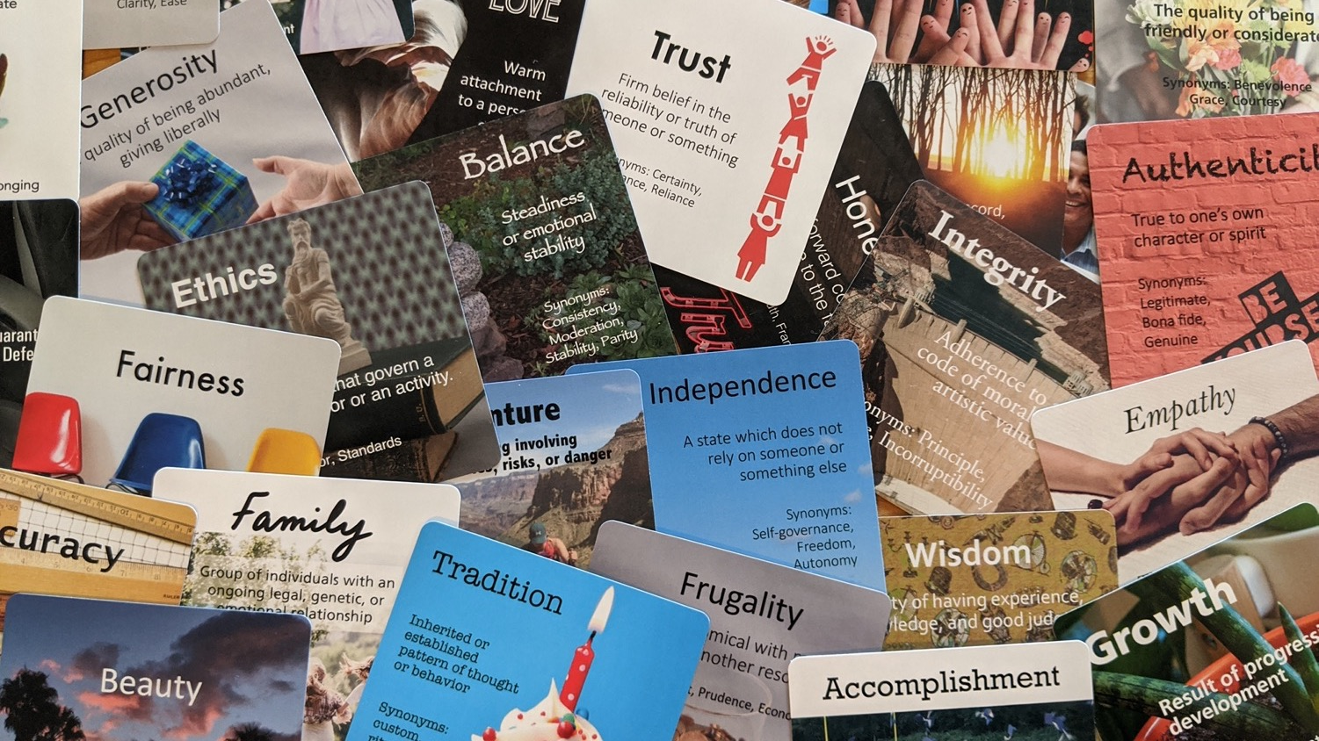
Ethics
Growth
Generosity
Kindness
Logic
Knowledge
Authenticity
Trust
Independence
Love
Accuracy
Inclusion
Tradition
Integrity
Honesty
Humility
Adventure
Community
Individuality
Family
Strength
Beauty
Accomplishment
Creativity
Wisdom
Empathy
Balance
Fun
Optimism
Respect
Structure
Resilience
Fairness
Choose a value that resonates with you and your hopes for sustainability at your organization or in your community.

Slide 5
Raise your hand
How much experience do you have with sustainability?
A little
Some
A lot

Slide 6
WORKSHOP OVERVIEW

Slide 7
Workshop goals
Learn and share key concepts in sustainability science, education, and practices for science centers and museums
Develop ideas for sustainability priorities at your own organization, and identify possible project ideas and next steps
Become aware of available tools and resources related to sustainability in science centers and museums

Slide 8
Workshop agenda
SESSION 1
Introduction to sustainability
Break
Sustainability and science centers
Sustainability @ OMSI
Homework
Final thoughts
SESSION 2
Brainstorming activity
Sustainability @ MOTE
Sustainability @ NC Museum of Natural Sciences
Break
Sustainability project ideas
Resources and future opportunities
Priorities, next steps, and reflections

Slide 9
INTRODUCTION TO SUSTAINABILITY

Slide 10
Breakout rooms – What is sustainability?
What are some definitions of sustainability you’ve heard or used?

Slide 11
Share – What is sustainability?
What definitions did you come up with?
What aspects of sustainability felt important to your group?

Slide 12
Sustainability
“meets the needs of the present without compromising the ability of future generations to meet their own needs”
Needs – include food, water, shelter, work, happiness, and respect.
Future – people in the future will also have needs. How will our actions affect them?
Present – people all over the world have needs that are equally important and must be met.
United Nations. Our common future, Brundtland Report, (1987).

Slide 13
Sustainability
Economy
Society
Society
Economy
Environment
Environment

Slide 14
Sustainability means healthy people, communities, and environments now and in the future

Slide 15
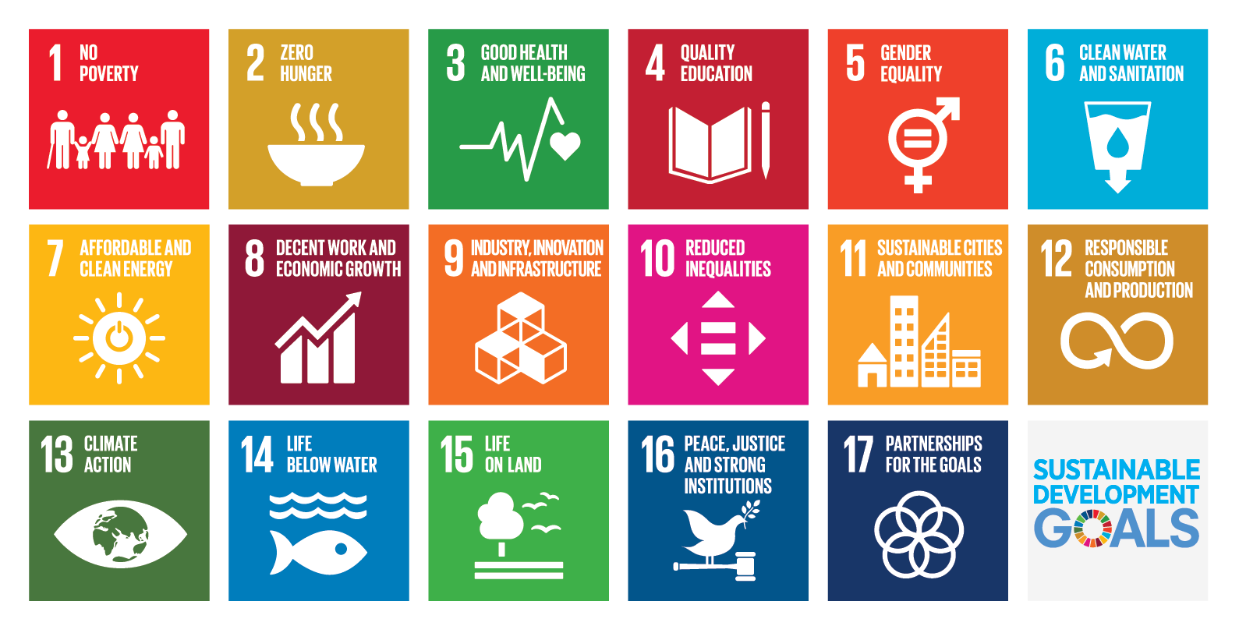
United Nations

Slide 16
Education for sustainability
“cultivates individual and collective potential … to increase the possibility that humans and other life can flourish on Earth now and into the future”
Individual – empowering learners
Future – making a difference as an organization
Collective – connecting with our communities
Cloud, ed. Education for a sustainable future: Benchmarks for individual and social learning,
Journal of Sustainability Education, (2017).

Slide 17
Break + Sustainability scavenger hunt
Find objects (or take pictures) that make you think of:
… hunger
… the climate
… oceans
… equality
… healthier cities
… learning or teaching
Bring two (or more) items to share after the break (15 minutes)

Slide 18
Share – Sustainability scavenger hunt
Share objects (or pictures) that make you think of:
… hunger
… the climate
… oceans
… equality
… healthier cities
… learning or teaching

Slide 19
Nich Weller,
Arizona State University

Slide 20
SUSTAINABILITY & MUSEUMS

Slide 21
Sustainability means healthy people, communities, and environments now and in the future What does this mean in museums?

Slide 22
Share – Role of science centers
What role do you think science centers (and similar organizations) can play in creating a sustainable future?

Slide 23
Science centers for sustainability
What role can we play?
Science centers are trusted organizations
Science centers support lifelong learning
Science centers foster social learning
Science centers engage diverse public audiences
Science centers can serve as conveners in a community
Science centers can model sustainable practices

Slide 24
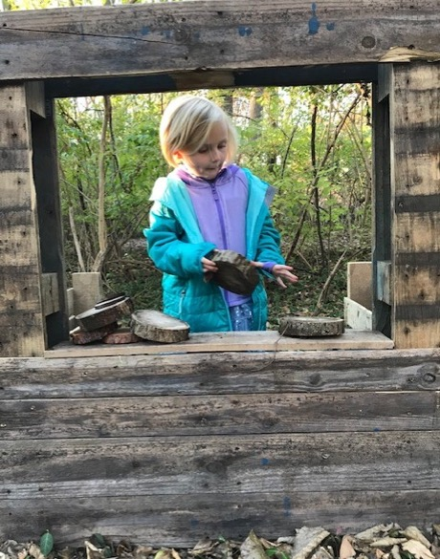
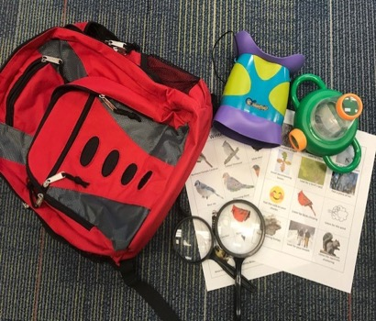
How to navigate sustainability
Make sustainability relevant to your community
Highlight local natural features or issues important to the community
Build partnerships with your community
Avoid “blame”
Sustainability is about more than nature
Photos from Robin Ramsey, Boonshoft Museum of Discovery
Notes:
Niles Parker at the Maine Discovery Museum worked with local conservation groups to create podcasts and other digital content about local conservation issues.
Darcie Cook of the Cape Fear Museum developed online programming that emphasized positive behaviors people could take towards a plastic free July
Robin Ramsey (Boonshoft Museum of Discovery) updated her museum’s outdoor space to get more visitors outside and made a backpack check out program with activities to help kids learn about the natural environment.
Sustainability is about more than nature.
Reaching underserved audiences
Building community
Concept of sustainability can help link a variety of activities
Sustainability can be about more than nature. Many fellows used the UN SDGs to guide their projects and include ‘social’ considerations.
One of our presenters today will share their activity about screen time.
Even food drives to support local families in need can be part of sustainability activities at your museum.
“Not everything has to be a sustainability project. But sustainability as a concept can be a helpful idea for planning a variety of efforts.”
------
Research finding:
Interpretation of sustainability varied with:
Small vs. large and type of museum
Surrounding communities
Small vs large museum: Small, two-person staff museum I interviewed spoke of needing more community collaborations to support any sustainability efforts.
One participating museum professional in Seattle invited activist organizations to their sustainability event, which was a film festival pictured here. Others in fossil fuel areas (Texas, Oklahoma., West Virginia) used less direct ways to talk about climate change, such as introducing guests to smaller ‘pieces’ of the climate change problem as entry points into the conversation.

Slide 25
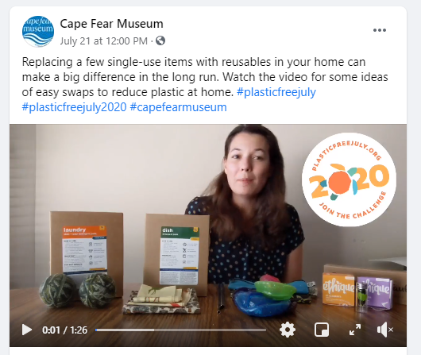
How to navigate sustainability
Make sustainability relevant to your community
Highlight local natural features or issues important to the community
Build partnerships with your community
Avoid “blame”
Sustainability is about more than nature.
Post by Darcie Cook, Cape Fear Museum
Notes:
Niles Parker at the Maine Discovery Museum worked with local conservation groups to create podcasts and other digital content about local conservation issues.
Darcie Cook of the Cape Fear Museum developed online programming that emphasized positive behaviors people could take towards a plastic free July
Robin Ramsey (Boonshoft Museum of Discovery) updated her museum’s outdoor space to get more visitors outside and made a backpack check out program with activities to help kids learn about the natural environment.
Sustainability is about more than nature.
Reaching underserved audiences
Building community
Concept of sustainability can help link a variety of activities
Sustainability can be about more than nature. Many fellows used the UN SDGs to guide their projects and include ‘social’ considerations.
One of our presenters today will share their activity about screen time.
Even food drives to support local families in need can be part of sustainability activities at your museum.
“Not everything has to be a sustainability project. But sustainability as a concept can be a helpful idea for planning a variety of efforts.”
------
Research finding:
Interpretation of sustainability varied with:
Small vs. large and type of museum
Surrounding communities
Small vs large museum: Small, two-person staff museum I interviewed spoke of needing more community collaborations to support any sustainability efforts.
One participating museum professional in Seattle invited activist organizations to their sustainability event, which was a film festival pictured here. Others in fossil fuel areas (Texas, Oklahoma., West Virginia) used less direct ways to talk about climate change, such as introducing guests to smaller ‘pieces’ of the climate change problem as entry points into the conversation.

Slide 26
What’s the role of museums in sustainability?

Slide 27
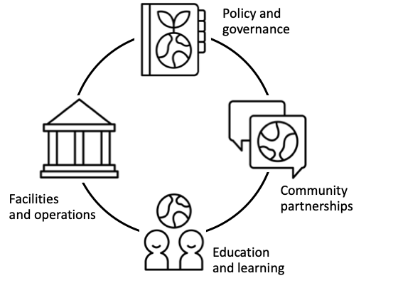
Whole institution approach

Slide 28
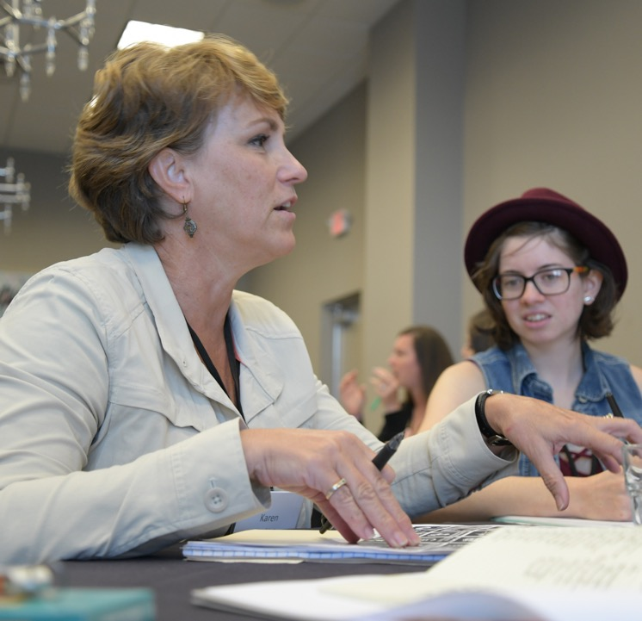
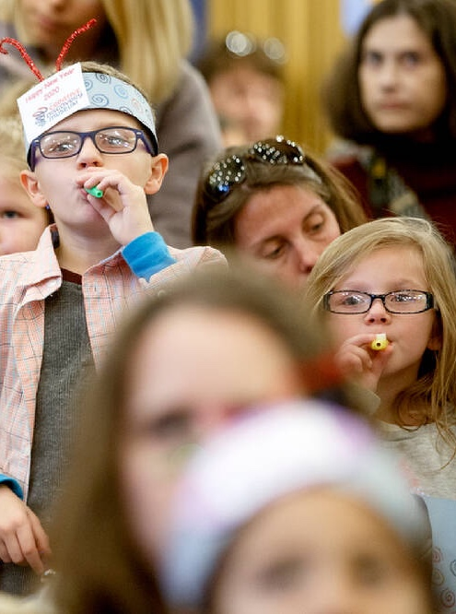
Karen Dewhirst, Creative Discovery Museum
(Chattanooga, TN)
Governance, policy, and capacity building
“We have really changed the mindset in just a couple of months. This program has made an amazing shift in the focus of the staff people and I’m just thrilled that in such a short period of time we’ve seen such a change in attitude.”

Slide 29
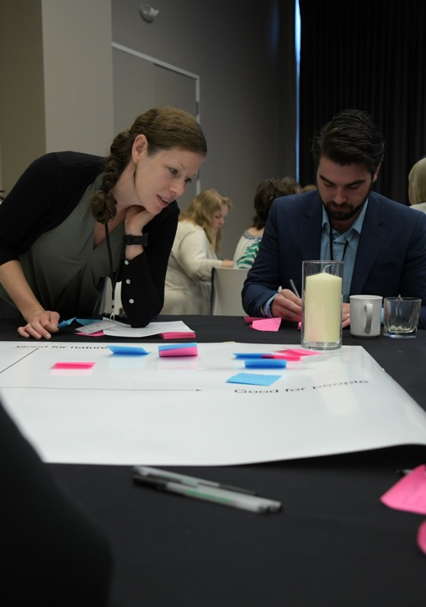
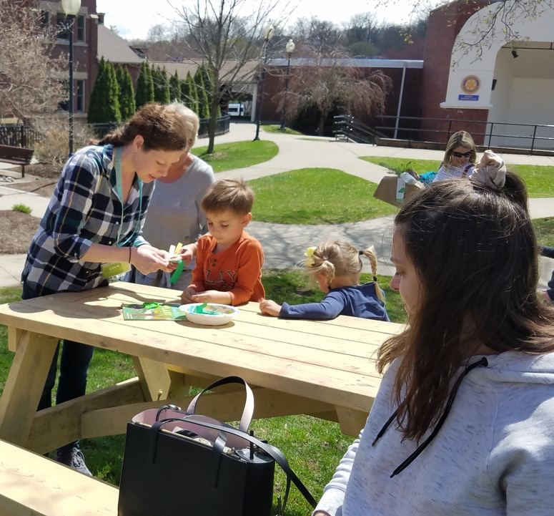
Colie Haahr, Children’s Museum of New Hampshire
(Dover, NH)
Community partnerships and relationships
“We have made great connections, and also showed that the museum is committed to sustainability, and our goals align with many other community institutions and groups. Every group we have connected with has been eager to try to collaborate whether now or in the future.”

Slide 30
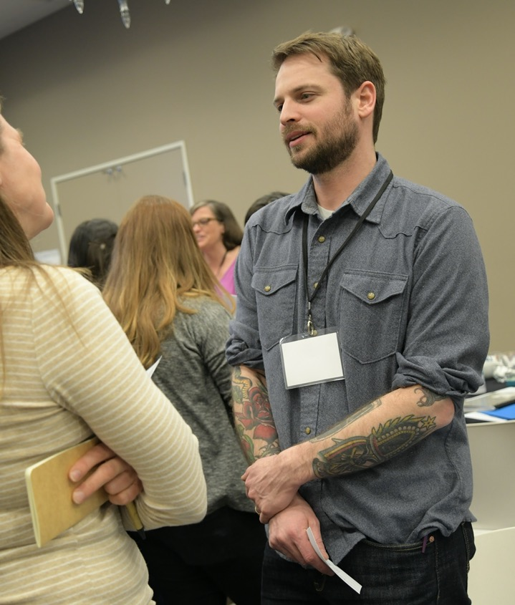
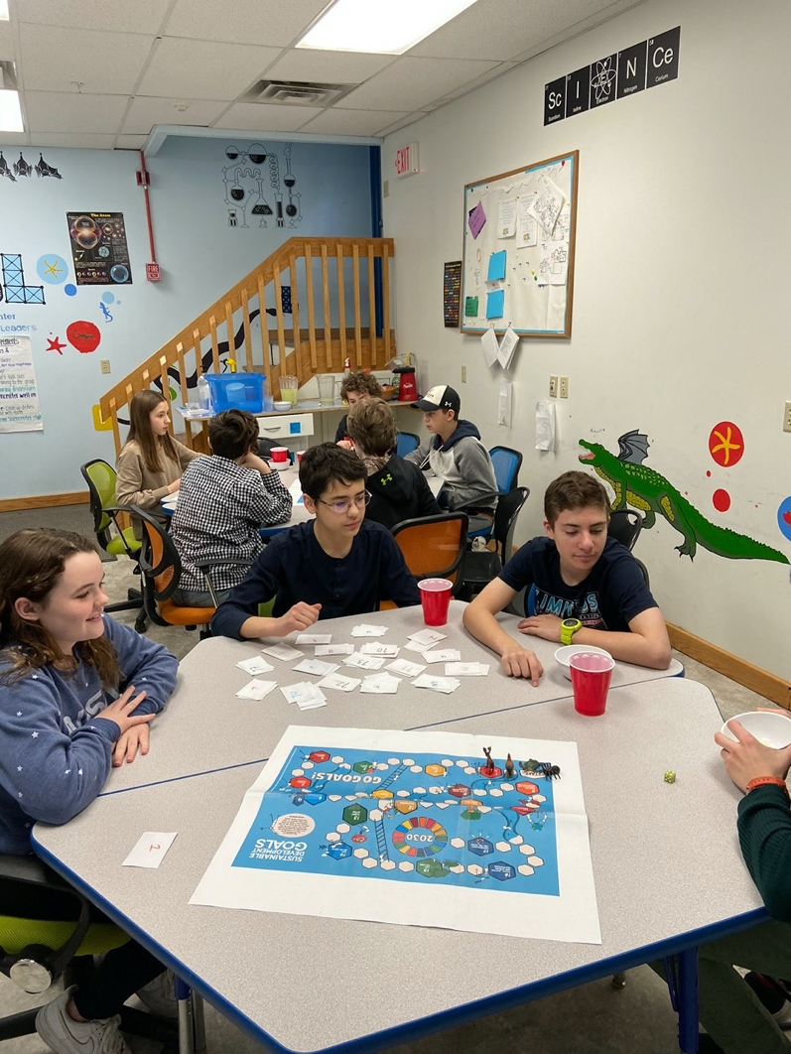
Peter Leipzig, Sciencenter
(Ithaca, NY)
Education and Learning
“[Students] were able to explore the social aspects of the SDGs...I also expect that they will feel ownership and expertise in the area when they communicate with the public. Finally, I hope that museum visitors will find the subject more approachable when it’s presented in the form of a game.”

Slide 31
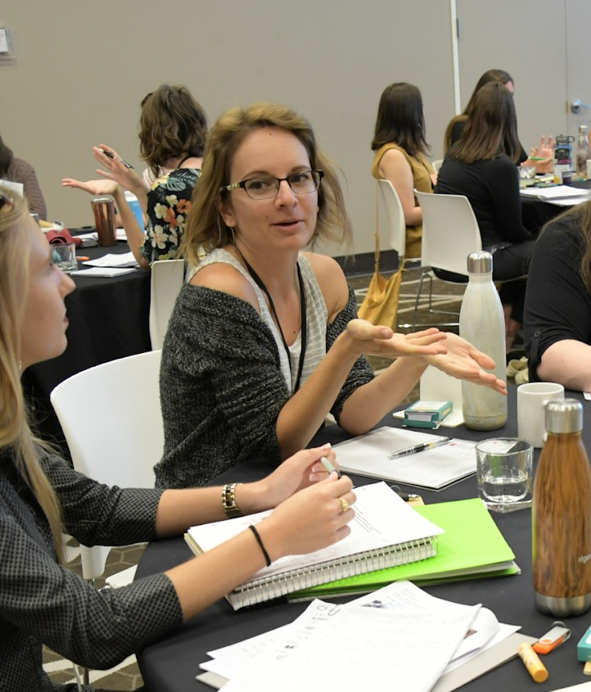
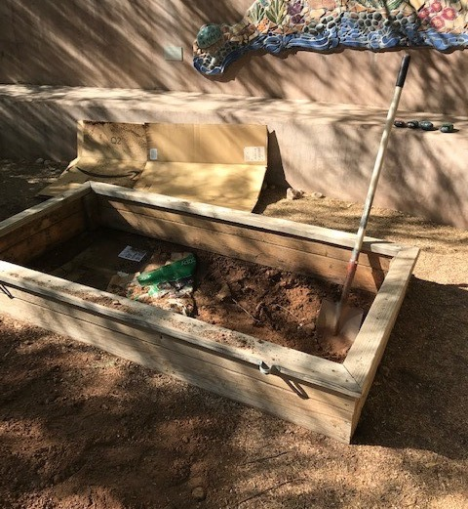
Lauren Marks, Desert Botanical Garden
(Phoenix, AZ)
Facilities and operations
“[Other staff were] WAY excited and have already donated more compost material than we can store and the worms can eat at once. This excitement is helping lead the way for more sustainable solutions and services offered and [assisted our] certification with City of Phoenix Green Business program”

Slide 32
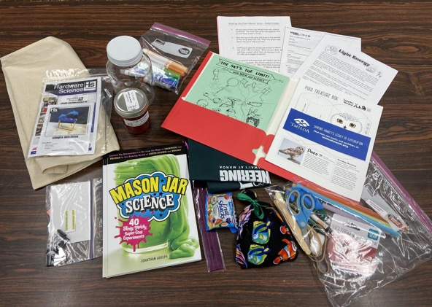
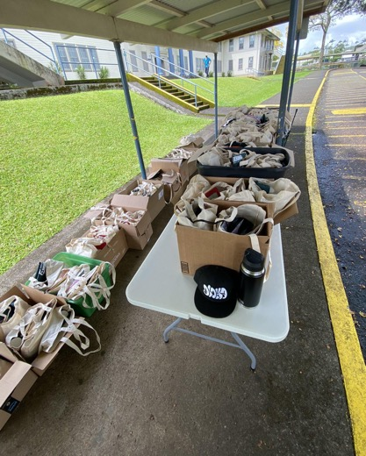
Whole institution approach in practice...
Sustainability fellows sought to
Educate and build awareness
Model behaviors, big and small
Create collaborations and community
Start conversations with their community and visitors
Photos from Christian Wong, Hawai’i Science and Technology Museum
Notes:
Educate and build awareness – Christian Wong, for example, distributed at home gardening and cooking kits to 800 students, helping students learn about hawai’i’s ecosystems and building community.
Model behaviors, big and small – For example, removing disposable items from activities
Creating collaborations and community –
Starting conversations with their community and visitors –

Slide 33
What enables success?

Slide 34
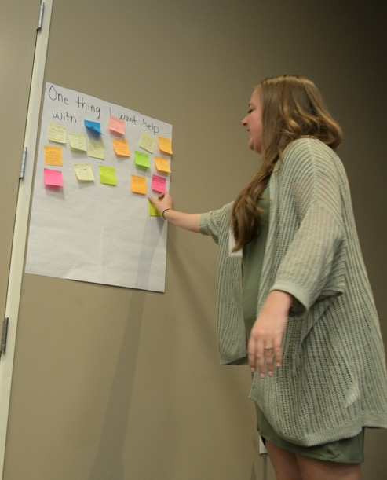
Tips and tricks from museum professionals
Find small ways to start
Share successes, learning, and inspiration with others
“What others are doing” – Use other institutions’ successes to your advantage
Develop flexible ways to communicate sustainability
Notes:
Find small ways to start
- Even just experimenting with an existing program about sustainability is a good way to get the ball rolling. Dean will share some programs you can try at the end of today’s session.
Share successes, learning, and inspiration with others
Time, resources, etc are all a challenge. Find a few other people at your museum or in your network to brainstorm and share with.
“What others are doing” -- Use other institutions’ successes to your advantage.
- Having trouble building support in your museum for sustainability projects? Many children’s museums are already taking on sustainability. Pointing to actions at other museums can help win over skeptics. ACM itself has highlighted the importance of sustainability issues, like climate change, in their own efforts.
Develop flexible ways to communicate sustainability.
- Sustainability is a big topic. Keep it local and interesting to help others understand it.

Slide 35
Dave Laubenthal,
OMSI

Slide 36
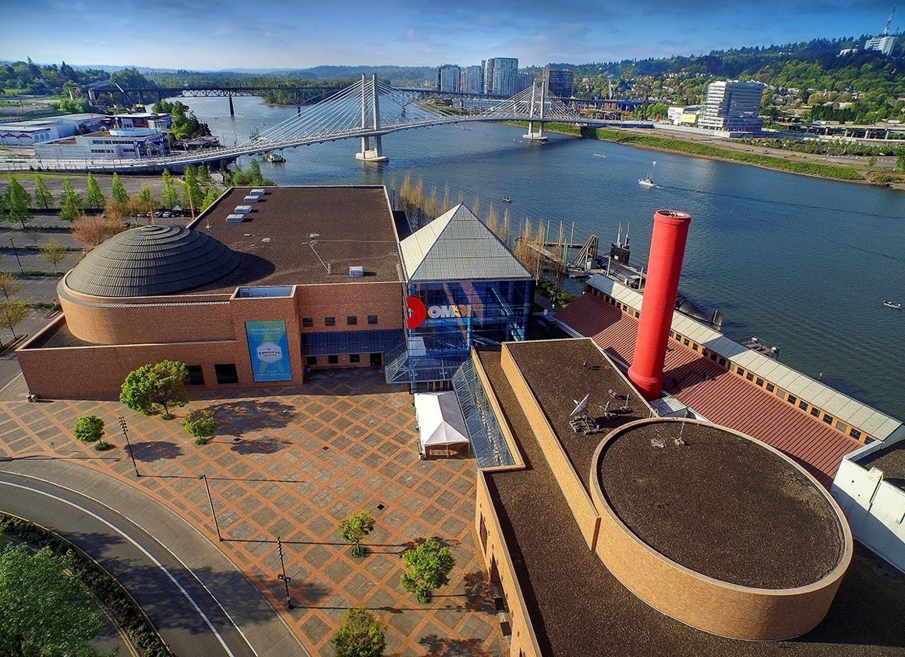
Dave Laubenthal
Creative Director
Oregon Museum of
Science and Industry
dlaubenthal@omsi.edu

Slide 37
How sustainability and the considerations of society, economy and environment are being integrated at OMSI into:
Exhibits, Projects and Explorations
Exhibits Operations
OMSI Strategic Plan and focus on Sustainability (organizationally)
Agenda

Slide 38
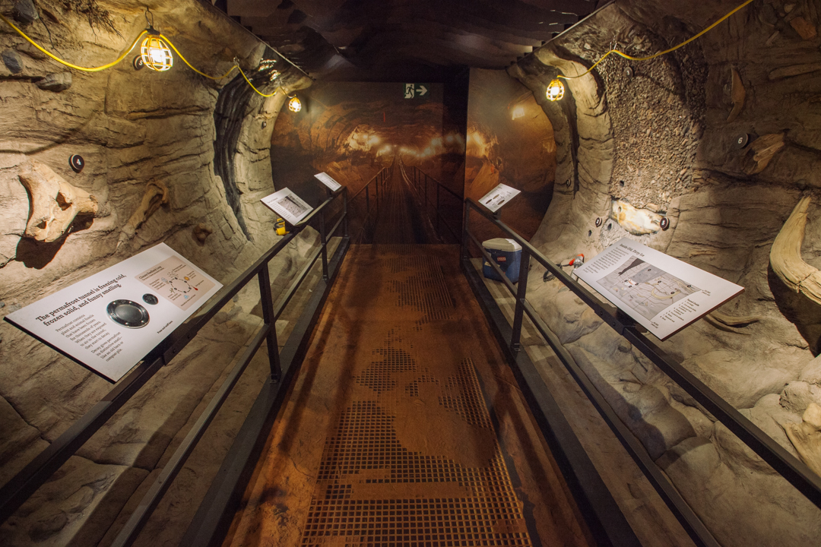
Exhibit:
Under The Arctic -Digging into Permafrost

Slide 39
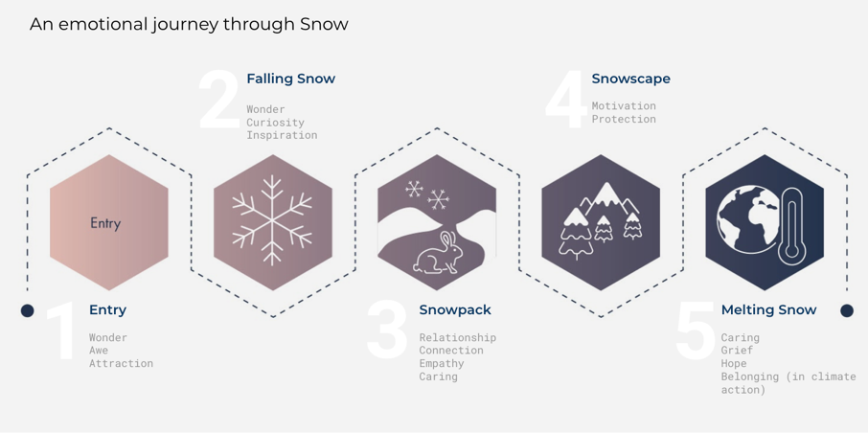
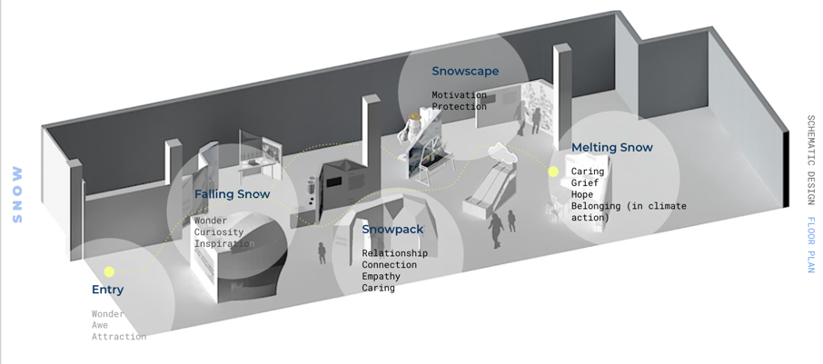
Exhibits on deck:
Snow

Slide 40
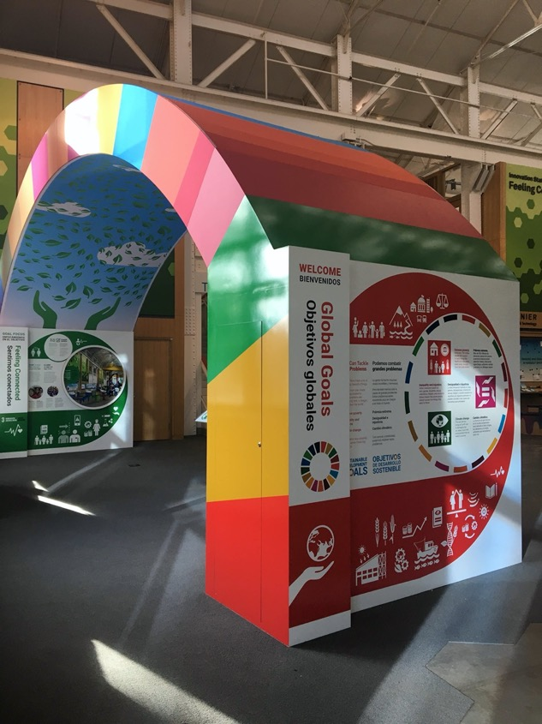
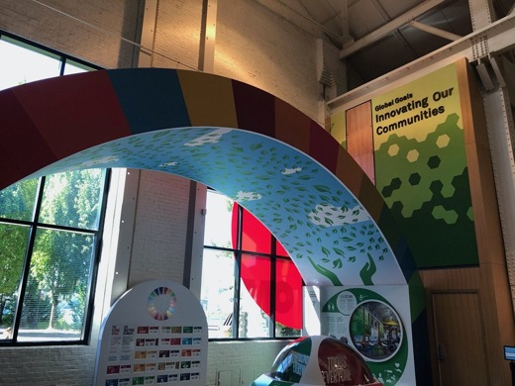
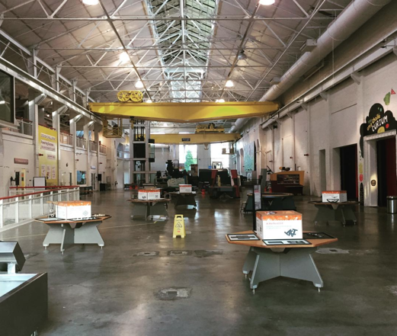
Exhibits on deck:
Global Goals Hub

Slide 41
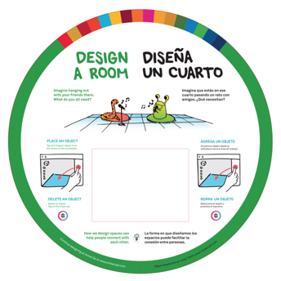
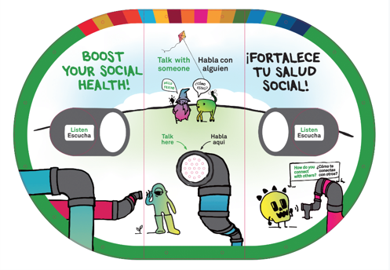
Exhibits on deck:
Innovation Station 1

Slide 42
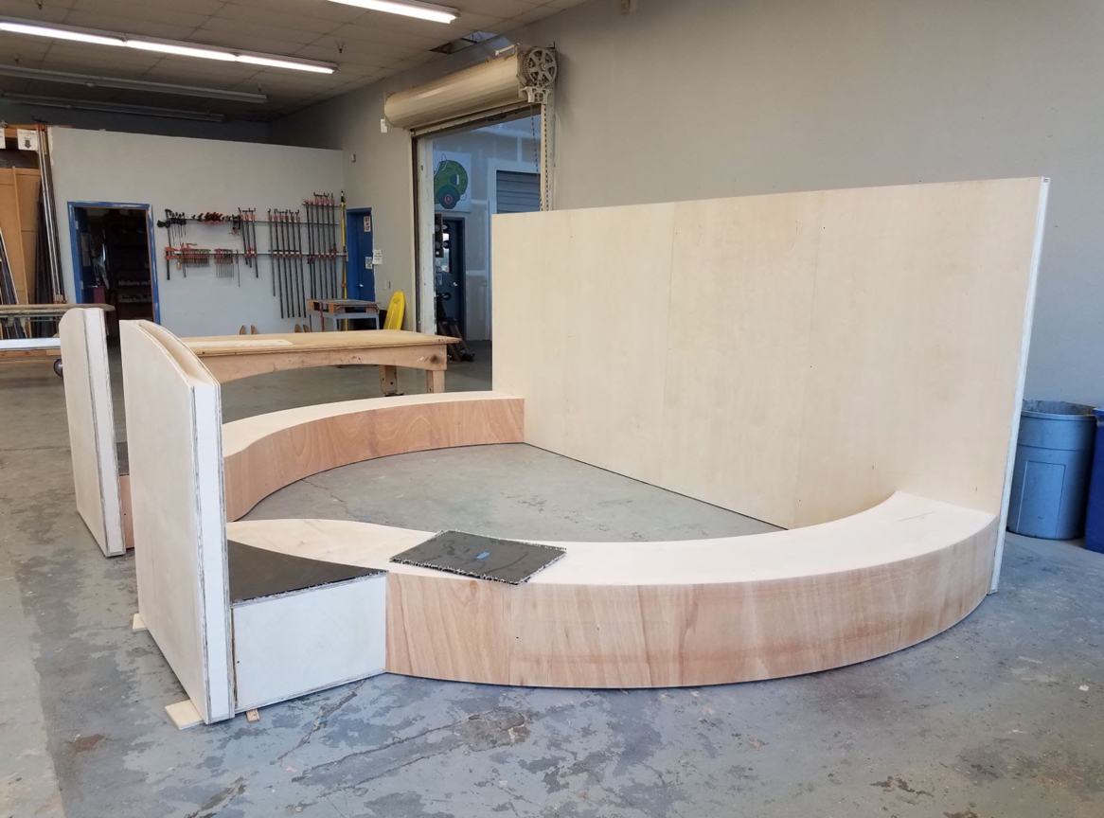
Exhibits Operations:
Green Exhibits
Checklist

Slide 43
Exhibits Operations:
Green Exhibits
Checklist

Slide 44
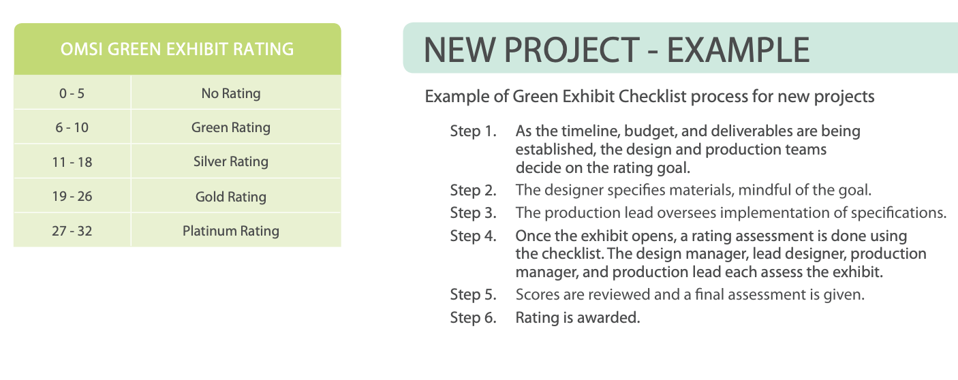
Exhibits Operations:
Green Exhibits
Checklist

Slide 45
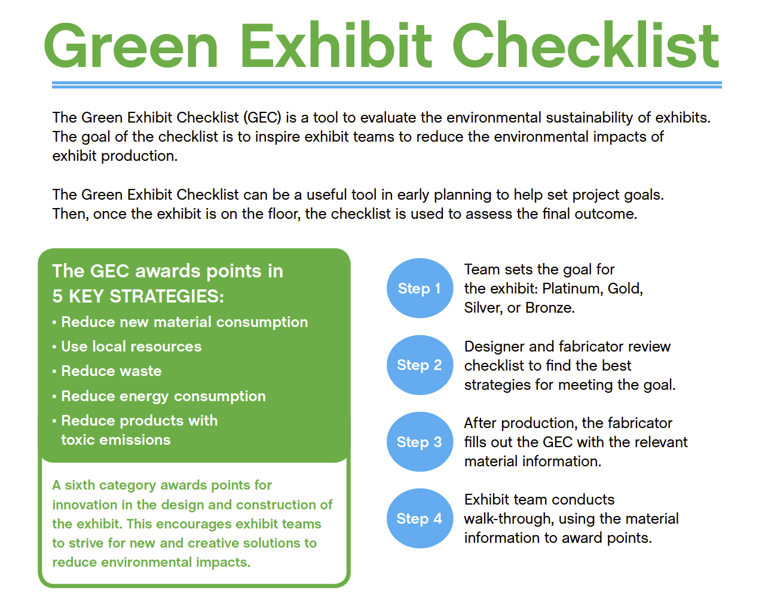
Exhibits Operations:
Green Exhibits
Checklist

Slide 46
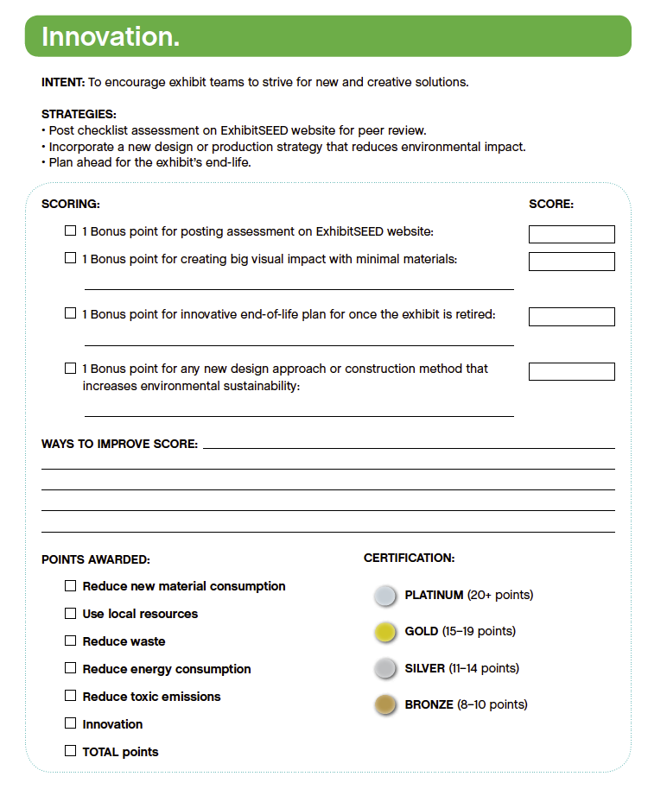
Exhibits Operations:
Green Exhibits
Checklist

Slide 47
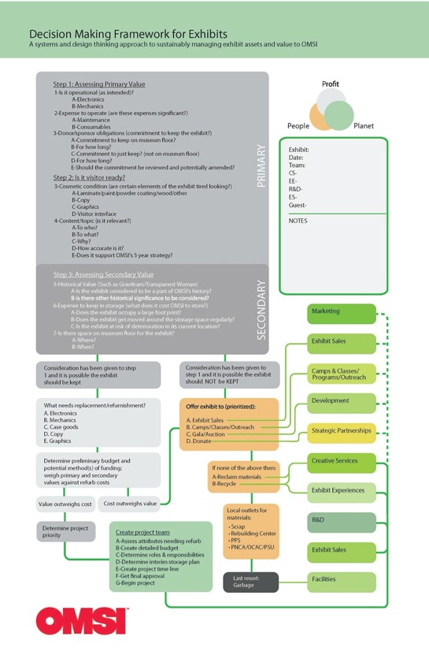
Exhibits Operations:
Decision Making
Framework for
EOL exhibits

Slide 48
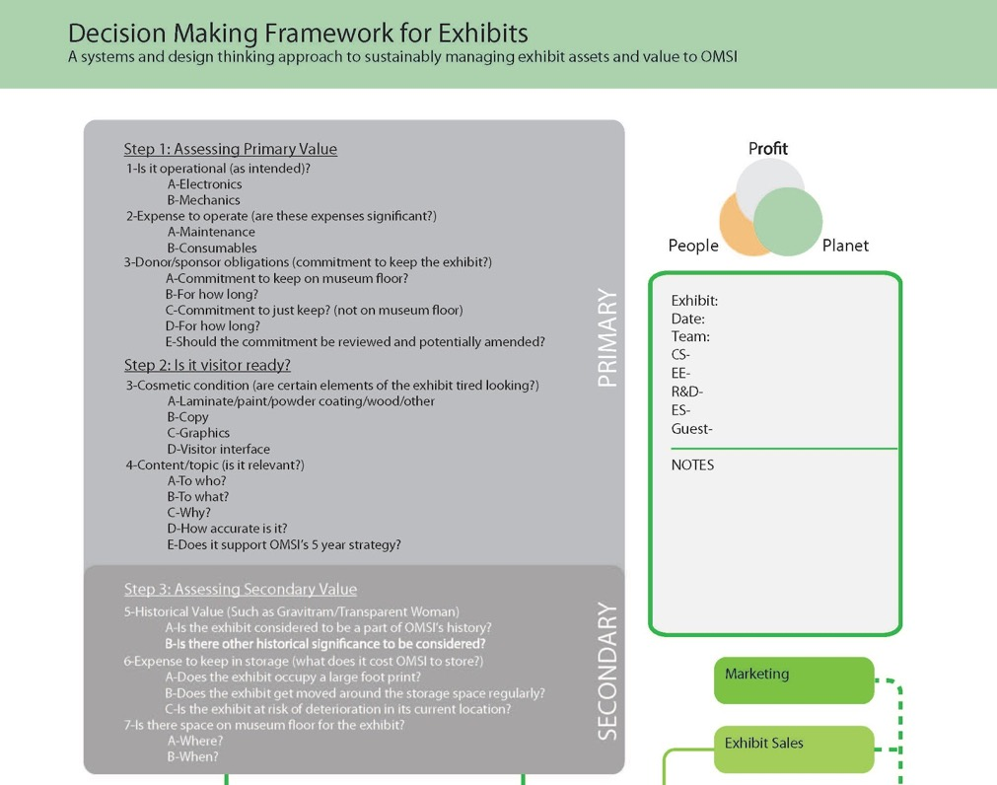
Exhibits Operations:
Decision Making
Framework for
EOL exhibits

Slide 49
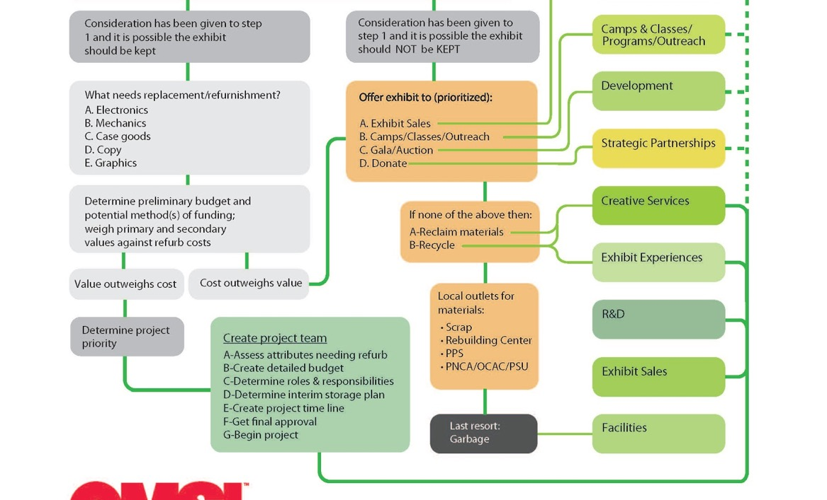
Exhibits Operations:
Decision Making
Framework for
EOL exhibits

Slide 50
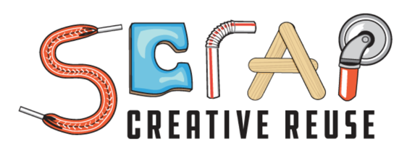
Exhibits Operations:
Decision Making
Framework for
EOL exhibits

Slide 51
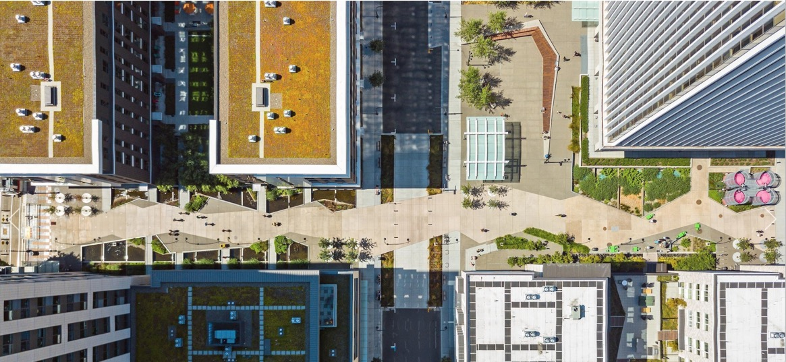
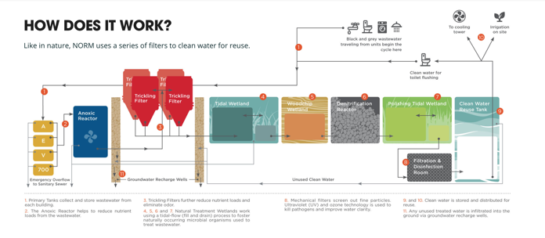
Strategic + Exhibits on deck:
NORM
Natural Organic Recycling Machine

Slide 52
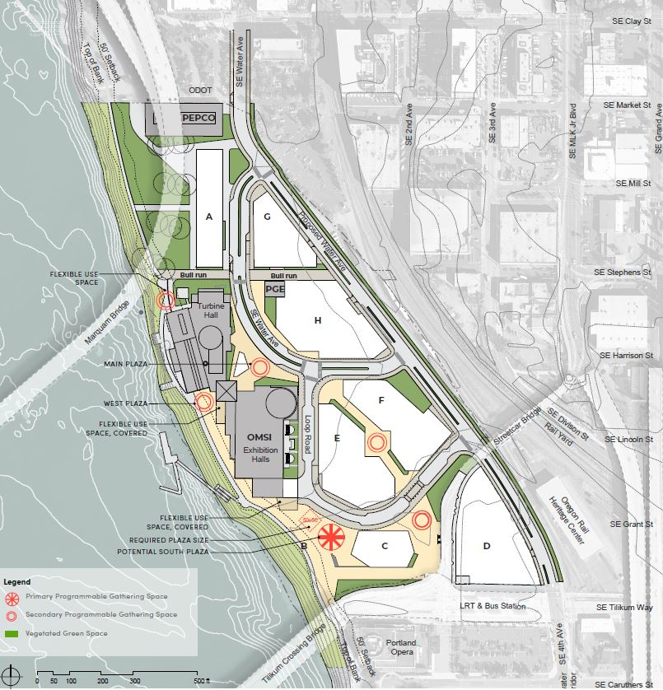
Transit Station
Waterfront
Neighborhood
Public Space
Retail
Hotel
Housing
Strategic + Exhibits on deck:
OMSI District

Slide 53
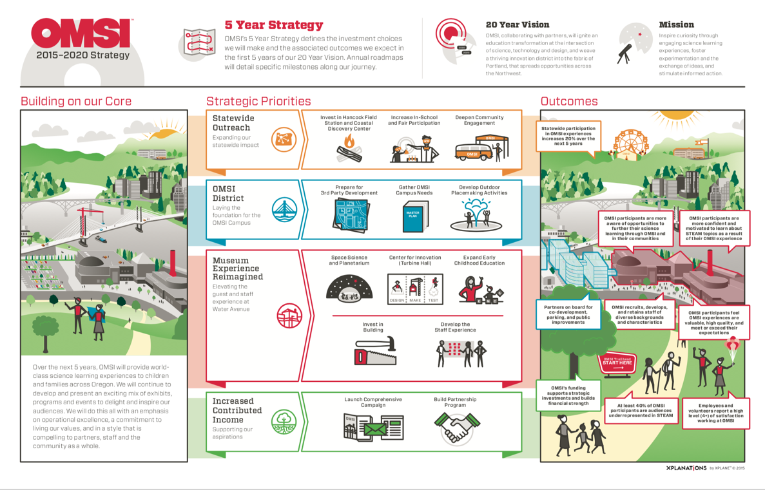
Strategic (Org.):
OMSI 5-year Strategy

Slide 54
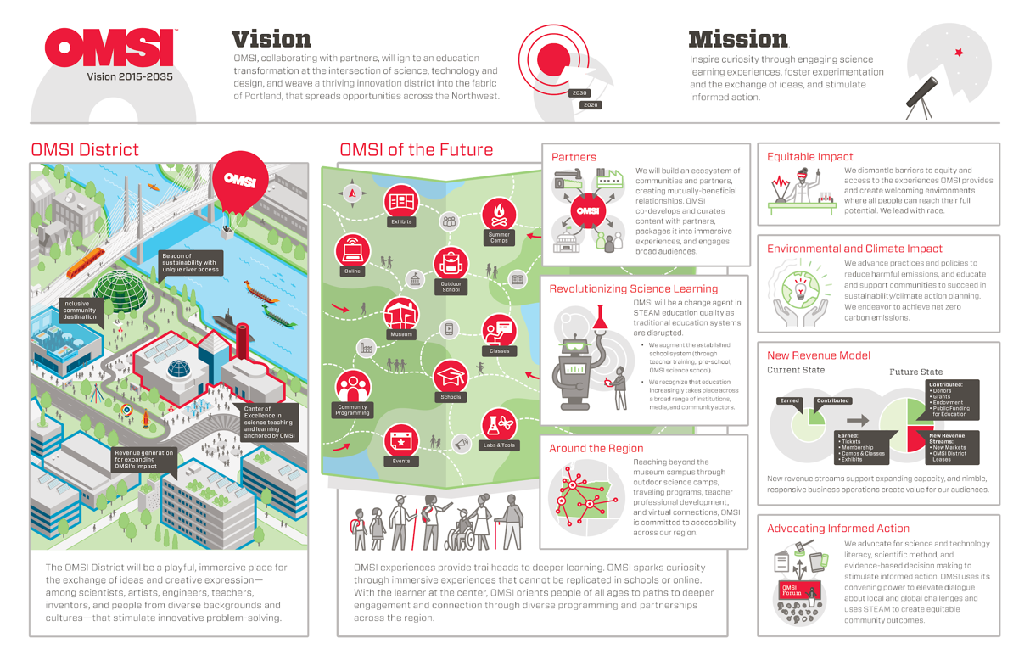
Strategic (Org.):
OMSI 20-year
Vision

Slide 55
Strategic (Org.):
OMSI Strategic
Vision & Mission

Slide 56
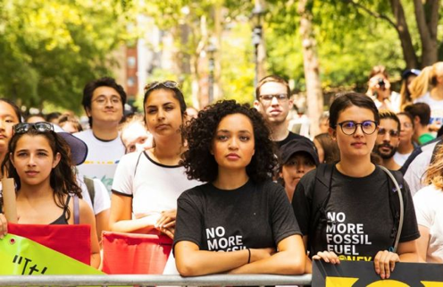
The Climate Action Team will champion, unify, and bring visibility to climate action efforts at OMSI aligned with OMSI’s 20-year vision and 5-year plan, including:
Practices and policies to reduce harmful emissions and accelerate energy efficiency and clean energy;
Learning opportunities across OMSI programs about climate justice and action and climate resiliency;
Professional development and resources for OMSI staff, volunteers, and other educators;
Strong community partnerships and a point of contact for climate action efforts at OMSI.
Strategic (Org.):
Climate Action Team and Youth Lead the Way

Slide 57
OMSI:
As an anchor

Slide 58
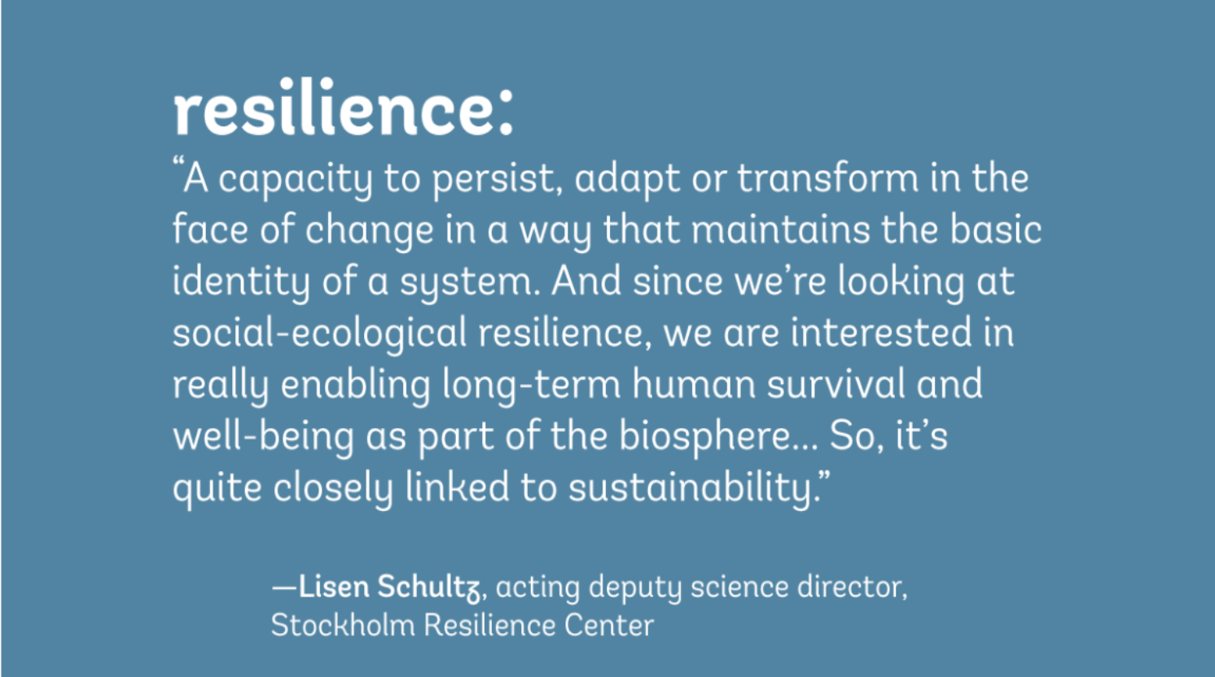

Slide 59
Thank You!
Dave Laubenthal
dlaubenthal@omsi.edu

Slide 60
HOMEWORK

Slide 61
Get familiar with the SDGs
Watch a short video:
https://www.youtube.com/watch?v=3WODX8fyRHA
Look through background information:
https://www.un.org/sustainabledevelopment/sustainable-development-goals/

Slide 62
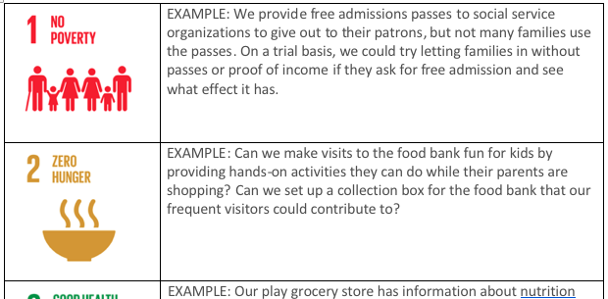
Do a brainstorming activity
Feel free to self-organize and work with others!
Consider which of the UN’s sustainable development goals your organization addresses now or is positioned to address in the future
Identify other organizations in your community that address the SDGs
Feel free to self-organize and work with others

Slide 63
Share – Final thoughts for the day
Something about sustainability that’s new or inspiring to me
or
Something I’m wondering about related to sustainability

Slide 64
ADJOURN
See you tomorrow!

Slide 65
The Rob and Melani Walton Sustainability in Science and Technology Museums program is supported through funding from The Rob and Melani Walton Foundation.
Sustainable Museums: Professional Development to Support Fieldwide Capacity in Practice, Partnerships, and Education for Sustainability is made possible in part by the Institute of Museum and Library Services
The Sustainable Development Goals (SDGs) logo, color wheel, and icons are used according to the United Nations guidelines: https://www.un.org/sustainabledevelopment/wp-content/uploads/2019/01/SDG_Guidelines_AUG_2019_Final.pdf

