Slide 1
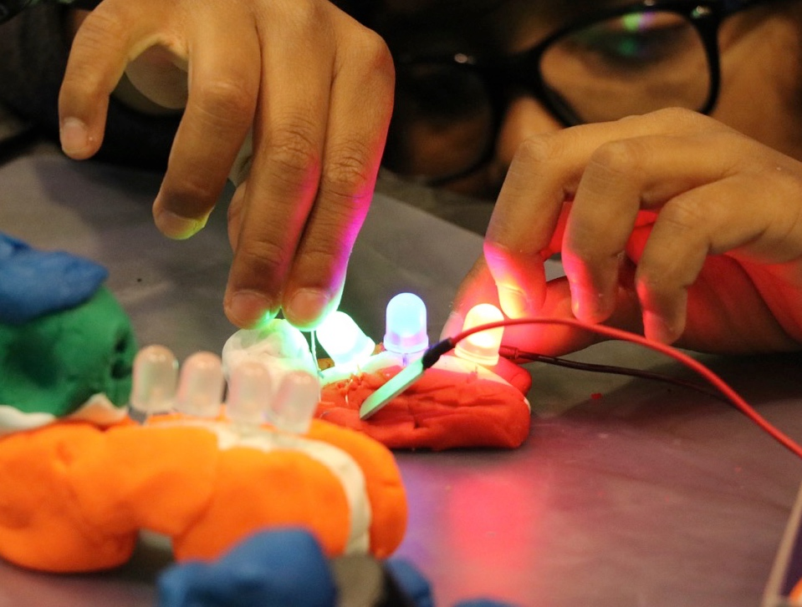
Museum and library partnerships:
Hands­on STEM learning for everyone
ASTC 2018

Slide 2
Overview
INTRODUCTION – COLLABORATION
  Rae Ostman, Arizona State University
PRESENTATIONS – PARTNERSHIP PROJECTS
  Keliann LaConte, Space Science Institute
  Dawn La Valle, Connecticut State Library
  Tara Cox, The Franklin Institute
  Anna Hurst, Astronomical Society of the Pacific
  Jeannie Colton, Arizona State University
  Darlene Cavalier, Arizona State University
  Cheri Grinnell, Kentucky Science Center
QUESTIONS
RESOURCES & DISCUSSION

Slide 3
Why collaborate?
To achieve something
you can’t do on your own!
Share resources, expertise, and connections
Build upon existing strengths
Reach new audiences

Slide 4
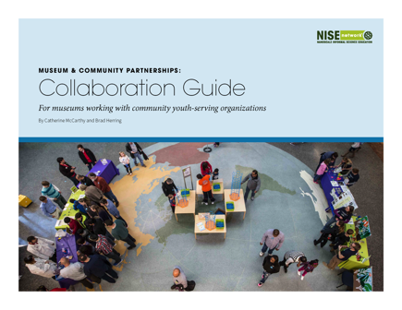

Resources
  Available at www.nisenet.org/collaboration-guide

Slide 5
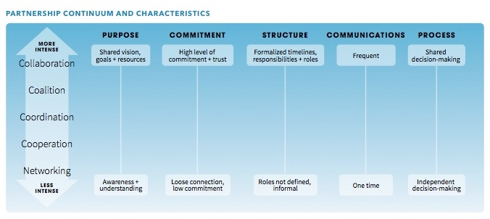
Levels of partnership

Slide 6
Collaboration tips
Be patient! Collaboration takes time.
Be clear about your goals and expectations.
Get to know each other. Each partner has a lot to offer.
Talk about how things are going. Communication is critical.
Stay focused on your goals, and don’t forget to celebrate your successes!

Slide 7

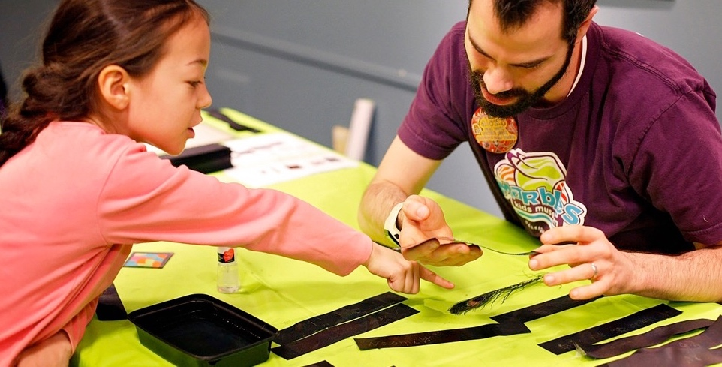
Thank you
The Nanoscale informal Science Education Network was supported by the National Science Foundation under award number 0940143. Any opinions, findings, and conclusions or recommendations expressed in this presentation are those of the authors and do not necessarily reflect the views of the Foundation.

Slide 8
Keliann LaConte

Slide 9

Libraries & STEM:
A National Perspective

Slide 10
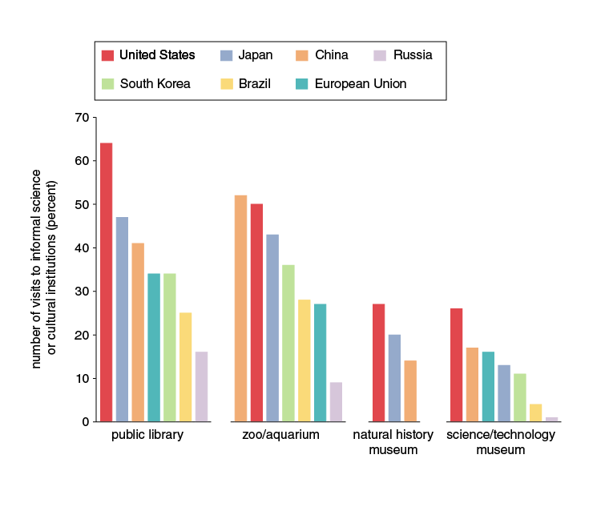
Use of Informal Science Venues
From Falk & Dierking, 2010, courtesy of American Scientist.
Notes:
https://www.americanscientist.org/article/the-95-percent-solution
Falk, John & Dierking, Lynn. (2010). The 95 percent solution: School is
not where most Americans learn most of their science. American Scientist.
98. 486-493. 10.1511/2010.87.486.
Used with permission.

Slide 11
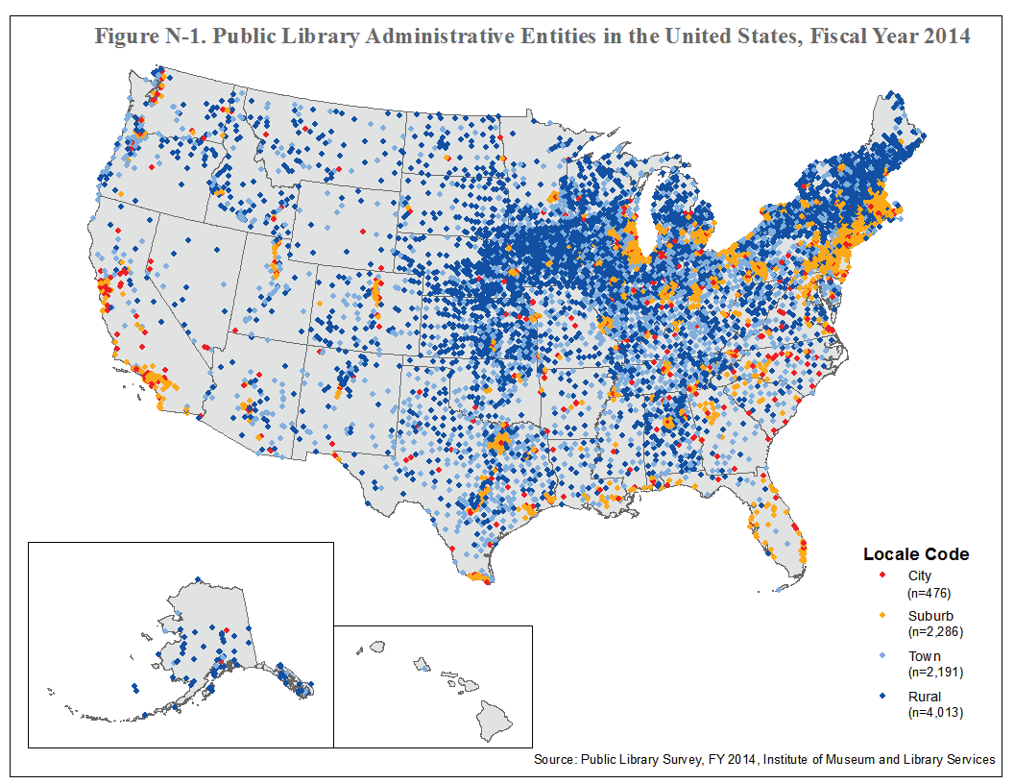
Notes:
Public domain image. SOURCE: Institute of Museum and Library Services, Public Libraries Survey, Fiscal Year 2014.
https://www.imls.gov/sites/default/files/publications/documents/plsfy2014.pdf

Slide 12
U.S. Libraries: Quick Facts
16,000 library locations
1.5 billion visits per year
Latinx Use: 72%
African-American Use: 69%
Notes:
Institute of Museum and Library Services (IMLS). (2016). Public Libraries in the United States Survey: Fiscal Year 2013. Institute of Museum and Library Services. Retrieved from https://www.imls.gov/research-evaluation.
Zickuhr, K., Rainie, L., Purcell, K., & Duggan, M. (2013). How Americans value public libraries in their communities. Pew Internet and American Life Project. Retrieved from http://libr aries.pewinternet.org/2013/12/11 /libraries-in-communities.

Slide 13
STAR Net Project Stats
Over 1.5 million patrons have visited STAR Net exhibitions
Over 200,000 patrons have attended STAR Net programs
Over 8,000 members have joined the STAR Net Online Community

Slide 14
Survey of U.S. Libraries

Slide 15
STEM Programming in Libraries
STEM programming is offered somewhat frequently, often integrated into existing literacy and arts programming like hands-on investigations, art-based STEM projects, and STEM-related storytimes (Hakala et al., 2016; n=455)
Notes:
Hakala, J.S., MacCarthy, K., Dewaele, C., Wells, M., Dusenbery, P., & LaConte, K. (2016). “STEM in Public Libraries: National Survey Results.” Boulder, CO: University of Colorado.
http://www.nc4il.org/images/papers/FINAL_STEM_LibrarySurveyReport.pdf

Slide 16

Type of STEM Programming (2017)
n=717
Note. Item was ‘check all that apply’ - percentages are out of those providing a response.
16% provided a written programming type (‘other’ response)
Notes:
Recent preliminary results, not yet published. Presented at the 2018 American Library Association Midwinter Meeting, https://www.eventscribe.com/2018/ALA-Midwinter/fsPopup.asp?Mode=presInfo&PresentationID=348819.

Slide 17


Children aged Pre-K through middle school are the most common target audience (Hakala et al., 2016; n=455).
www.starnetlibraries.org
Notes:
Hakala, J.S., MacCarthy, K., Dewaele, C., Wells, M., Dusenbery, P., & LaConte, K. (2016). “STEM in Public Libraries: National Survey Results.” Boulder, CO: University of Colorado.
http://www.nc4il.org/images/papers/FINAL_STEM_LibrarySurveyReport.pdf

Slide 18
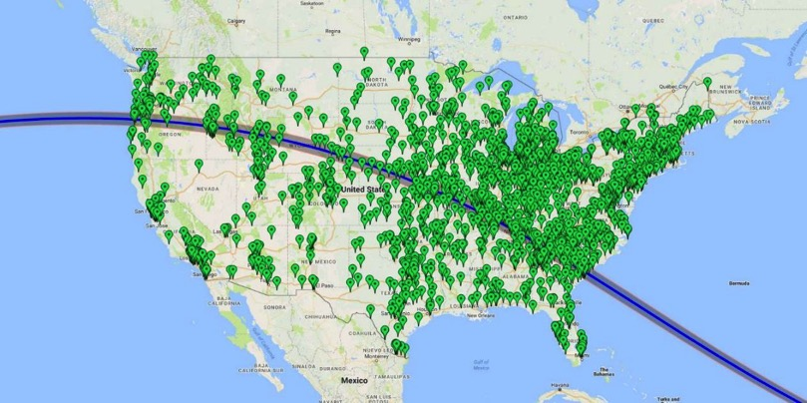


2017 Solar Eclipse Event

Slide 19
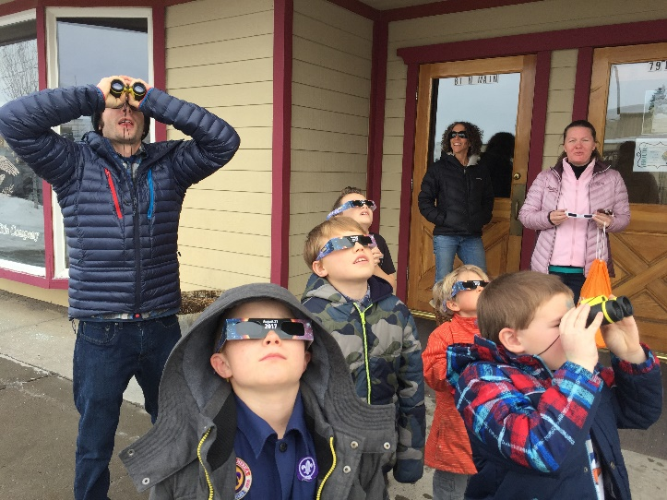
Photo courtesy of Grand Tetons Public Library

Slide 20
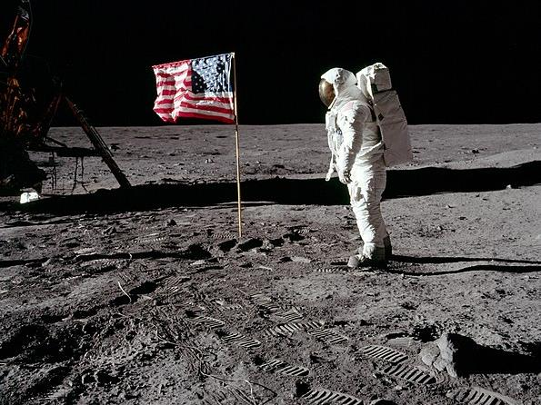
Universe of Stories
June-August 2019
What’s Next?
STAR Net
starnetlibraries.org
Collaborative Summer Library Program
cslpreads.org
Notes:
The Next Eclipse Level Public Engagement Event: The 2019 summer learning theme for U.S. public libraries nationwide is Space Exploration (“Universe of Stories”). NASA@ My Library and STAR Net are partnering with the Collaborative Summer Library Program to support 16,000 libraries.

Slide 21
STEM Resources for Library Staff

Slide 22
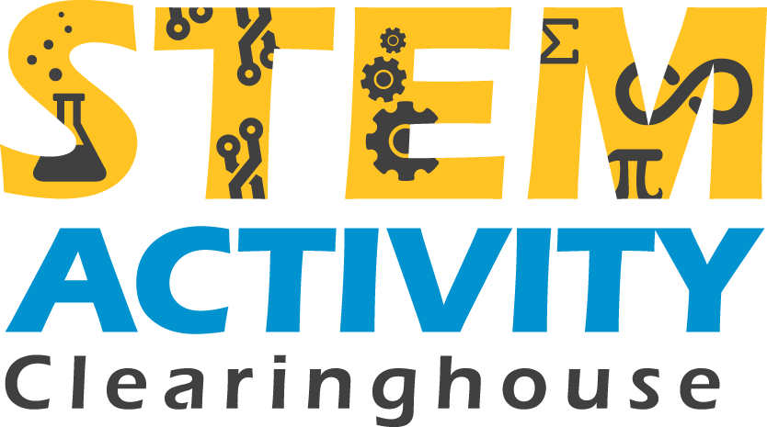
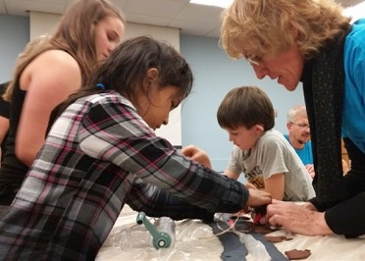
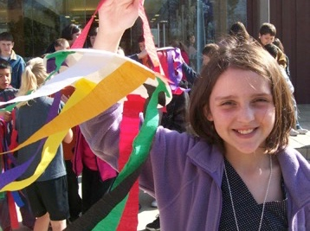
http://clearinghouse.starnetlibraries.org
Searchable
Hands-on
Free
Curated
Trusted
Credit: T.L.L. Temple Memorial Library
Notes:
http://clearinghouse.starnetlibraries.org/

Slide 23
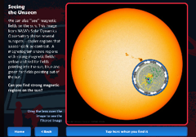
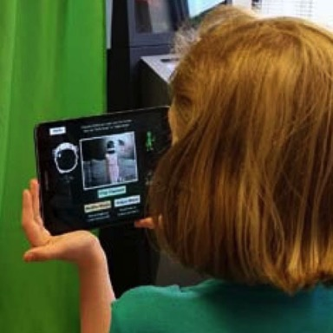
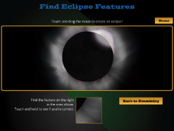
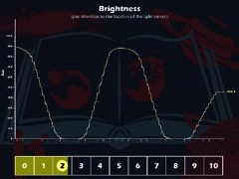
Apps
www.scigames.org
Notes:
http://www.scigames.org/

Slide 24
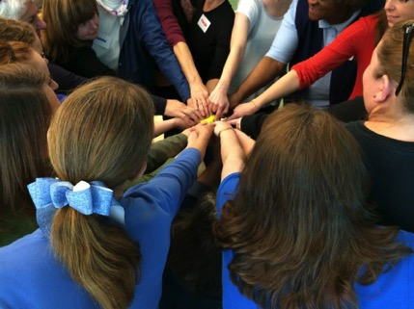

Join us!
Credit: St. Tammany Parish Library
www.starnetlibraries.org

Slide 25
Dawn La Valle

Slide 26
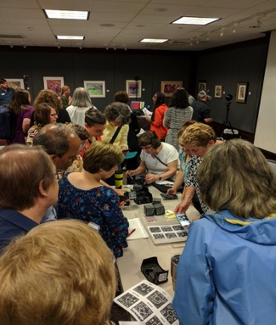
State Libraries Empower Libraries to Engage in
STEM Activities through Statewide Services
Research and development; beta testing new concepts, technologies, equipment
Professional Development Workshops
Experiential learning
Tech Sand Boxes; Collections
Resource Sharing
Consulting
Statewide Strategic Partnerships
IMLS/LSTA Grant Opportunities

Slide 27
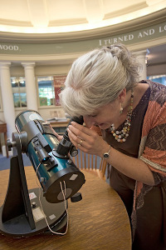
State Library Agencies (SLAs) Leading the Way to Engaging Libraries in STEM
Maine State Library awarded IMLS National Leadership grant with the goal to enable the nation’s State Library Agencies to have a field-tested, replicable science literacy methods that the can use to enable their public libraries to become skilled STEM facilitators.
Empowering public libraries to build their science literacy capacity to enable libraries and librarians to connect with their communities and to engage their communities in meaningful informal science and technology experiences
Project capitalizes on decade long strategic partnership between the Maine State library and Cornerstones of Science
https://www.maine.gov/msl/libs/grant_projects/imls_leadership_grant.shtml

Slide 28
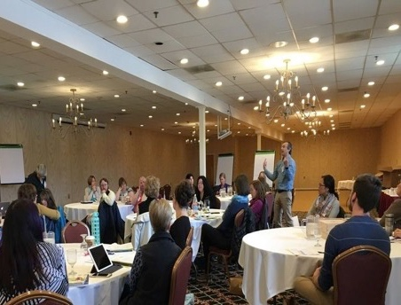
SLAs Leading the Way with STEM
Professional Development for Librarians
VELI-STEM a partnership between the Vermont Department of Libraries and the Vermont Center for the Book, focusing on early literacy through inquiry into science, technology, engineering and math.
Project sequence allows for three years of progressive development for librarians to understand what it means to engage children in inquiry-based experiences, the nature of facilitation and guidance that adults can offer in order to challenge, and engage children and to strengthen content knowledge.
www.veli-stem.weebly.com
Creating community collaborations with a focus on STEM Education: https://www.slideshare.net/1amariposa/libraries-museumsstem

Slide 29
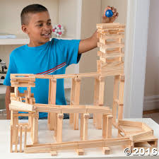
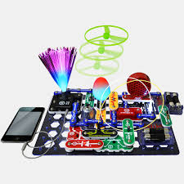
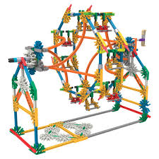
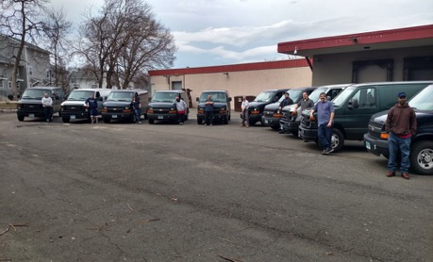
Statewide Resource Sharing:
Providing Libraries with Stem Kits

Slide 30


SLAs Uniquely Positioned to Foster Strategic Partnerships
IMLS – Institute for Museums and Library Services offers Talking Points: Museums, Libraries and Makerspaces.
SLAs foster strategic partnerships with Depts of Economic Develop; Arts and Culture; Museums, higher education, private sector and other key stakeholder groups
SLAs collaborate amongst themselves on national initiatives sharing professional development, resource sharing and partnering opportunities to benefit their library communities
Library community – YouMedia Centers (Hartford CT), Meteorology Maker’s Club (Norman, OK), Makelabs (Chicago, IL), Anythink Places (Thornton, CO)
For more information contact:
Dawn La Valle |Director, Division of Library Development | Dawn.lavalle@ct.gov | Office: (860) 757-6665
http://libguides.ctstatelibrary.org/dld/home |
231 Capitol Ave. Hartford CT 06106 | Fax: (860) 757-6503

Slide 31
Tara Cox

Slide 32


Cultivating a National Network for Informal Science and Literacy

Slide 33

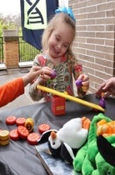

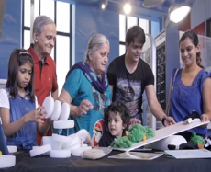
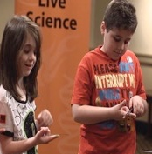

What is Leap into Science?
Preschool
Ages 3-5
Structured Activities
Family
All Ages
Mix of structured & station-based
Elementary
Ages 6-10
Structured Activities

Slide 34
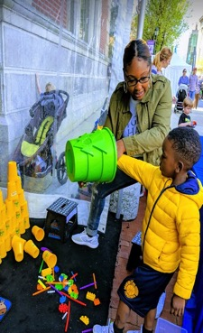
Goals for Children & Caregivers
Have fun learning together
Think scientifically
Build positive attitudes towards science
Caregivers are learners themselves, and facilitators for their children’s learning

Slide 35

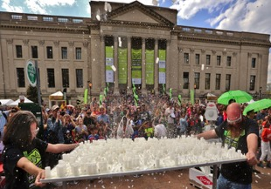

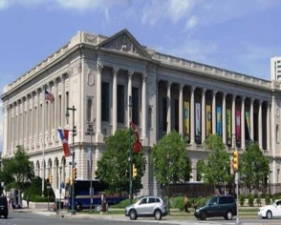


Program Origins
2007-2010
Developed and piloted resources with The Free Library of Philadelphia and early literacy partners
2010-2017
Piloted in 11 cities around the US to refine curriculum and training resources

Slide 36
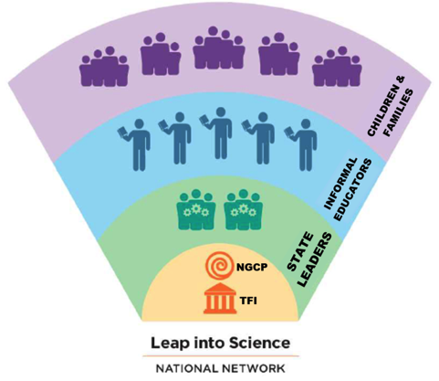

National Scale-up
  Network of informal educators committed to engaging underserved communities in science & literacy
  State-level interdisciplinary partnerships between museums, libraries, and OST organizations
  Aiming for a sustainable train-the-trainer model

Slide 37



Who leads the National Network?
STEM & PD expertise
Tested resources
National strategy
Network & collaboration expertise
National partnerships
Gender equity
Research expertise
Depth in understanding of informal family STEM learning
Impacts on scale-up

Slide 38
State Leadership Teams
OST
Afterschool Networks
Non-profit Girl Scouts, 4H, YMCS
Literacy
Libraries
Head Starts
Science
Museums
Universities
All state leaders must be committed to statewide outreach
Trainers must have experience leading trainings
State leaders must facilitate access to informal educators in rural and urban areas

Slide 39
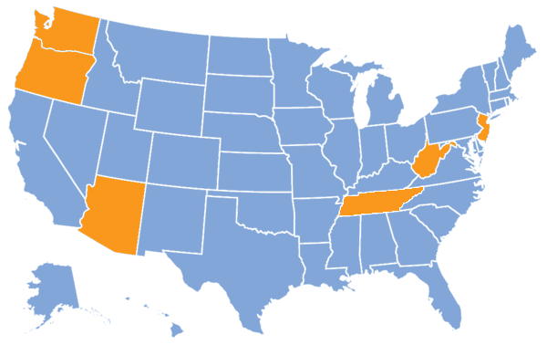
Goal by 2021
15 states will have disseminated Leap into Science programming to over 2000+ educators in rural and urban communities.

Slide 40
For more information please visit Leap.fi.edu

Slide 41
Anna Hurst

Slide 42

www.astrosociety.org
Anna Hurst: ahurst@astrosociety.org
Notes:
The Astronomical Society of the Pacific was founded in 1889. We are a nonprofit organization based in San Francisco, offering programs that are national and sometimes international in scope.

Slide 43
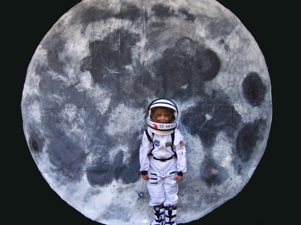
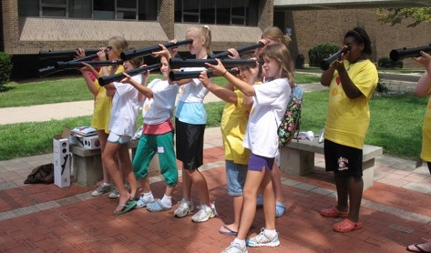
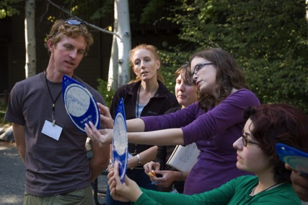
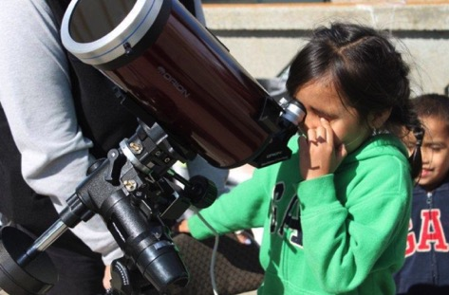
Notes:
Our main focus is on astronomy and space science education and public outreach, providing materials and training to teachers, museum educators, park rangers, librarians, professional and amateur astronomers, afterschool providers, Girl Scout leaders; enabling them to communicate the excitement of astronomy to their audiences.
We’ve been offering resources targeted specifically at museums and parks for 14 years.

Slide 44
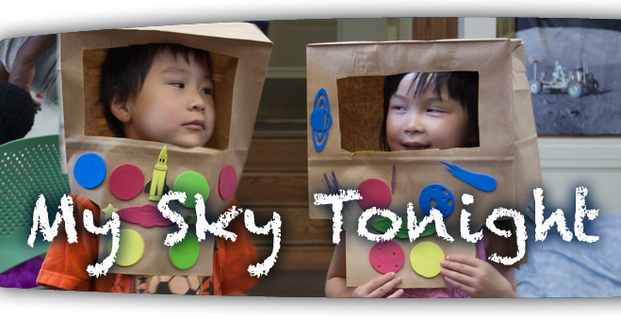


A Program from the Astronomical Society of the Pacific
www.astrosociety.org/MySkyTonight
My Sky Tonight is based upon work supported by the Division of Research On Learning (DRL) of the National Science Foundation under Grant no. AISL #1217441. Any opinions, findings, and conclusions or recommendations expressed in this material are those of the authors and do not necessarily reflect the views of the National Science Foundation.
Notes:
We heard again and again from educators in museums and parks that, while they were enthusiastic about these materials, they were also unsure how to engage with very young children. To fill this gap, astronomy educators at the ASP teamed up with developmental psychology researchers for the NSF-funded My Sky Tonight project.

Slide 45
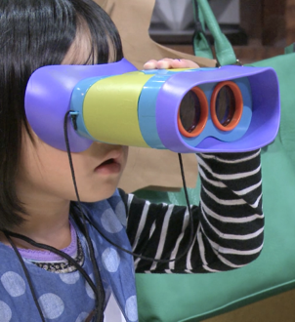
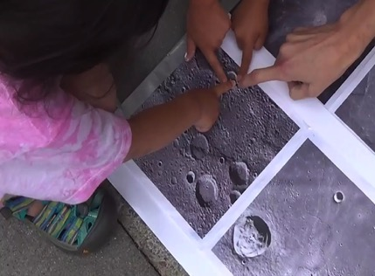
Engage young children in developmentally appropriate astronomy activities
Engage young children in science practices as they investigate astronomy
Notes:
Overarching goals of My Sky Tonight

Slide 46
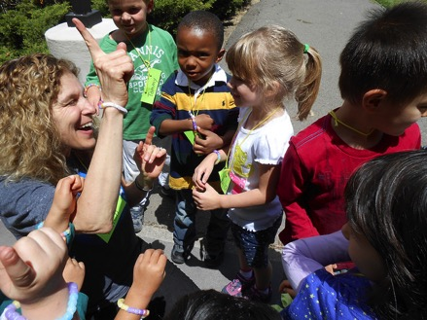
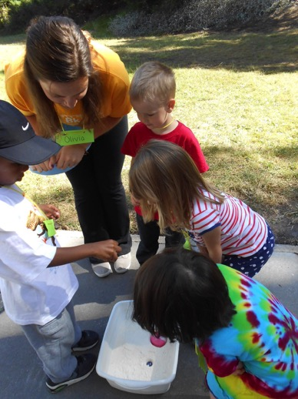
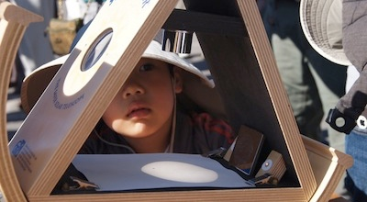
www.astrosociety.org/MySkyTonight
Notes:
We have created a set of research-based, hands-on astronomy activities that are rich in science practices and designed to be developmentally appropriate for pre-K children. We have also provided training for the informal educators who received these materials. All of the activities and supporting resources, including lesson plans and short instructional videos, are freely available online at astrosociety.org/MySkyTonight

Slide 47
Diary Study:
Conversations About Nature
Notes:
In addition to creating these materials and training, we have also advanced the knowledge base in early STEM learning through a series of studies. For example, one of our studies explored children’s natural interest in astronomy. We sent families home with a diary in which they could log their conversations about nature for a period of two weeks. When we received back their journals, we learned that 15-20% of their conversations were about the Sun, the Moon, the stars, planets - astronomy-related!

Slide 48
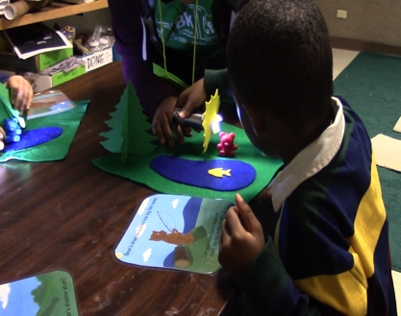

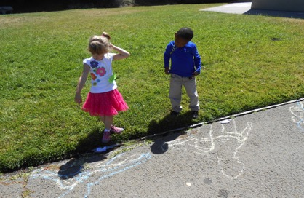
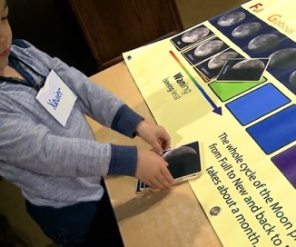
Notes:
Over 300 educators have participated in My Sky Tonight training workshops, and we distributed the activity toolkit to over 200 museums, parks, nature centers, and libraries across the U.S., reaching thousands of young children and their families. I brought along three example activities: Bear’s Shadow, Hide & Seek Moon, and Moon Phases Matching. Bear’s Shadow has been by far our most popular activity and is well-suited for a storytime activity in a library, although we have have had success offering all of these activities in library workshops for families with young children.

Slide 49
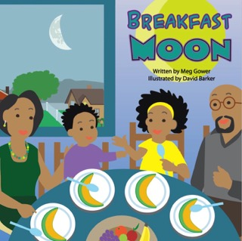
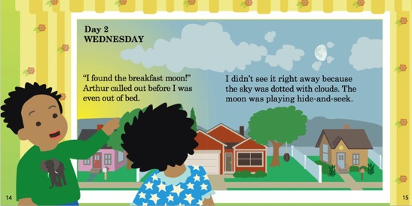
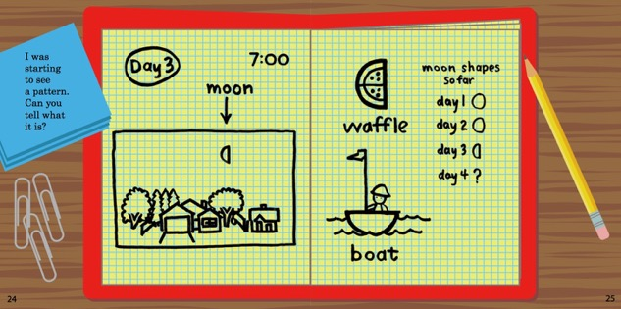
Notes:
Our work with educators and children has sparked our interest in further work. We are currently investigating the role of storybooks in supporting young children’s engagement in the practices of science. With supplemental funding from NSF, we created a children’s storybook, Breakfast Moon, which we are now publishing. It’s about a sister and brother who looks for the moon each morning and record their observations in a journal – so the characters are modeling science practices. We plan to create more stories, as books and in other formats, and materials to support families with young children observing the sky together at home noticing changes that occur over time – hours, days, or weeks.

Slide 50
A Program from the Astronomical Society of the Pacific
www.astrosociety.org/MySkyTonight
Anna Hurst: ahurst@astrosociety.org
My Sky Tonight is based upon work supported by the Division of Research On Learning (DRL) of the National Science Foundation under Grant no. AISL #1217441. Any opinions, findings, and conclusions or recommendations expressed in this material are those of the authors and do not necessarily reflect the views of the National Science Foundation.

Slide 51
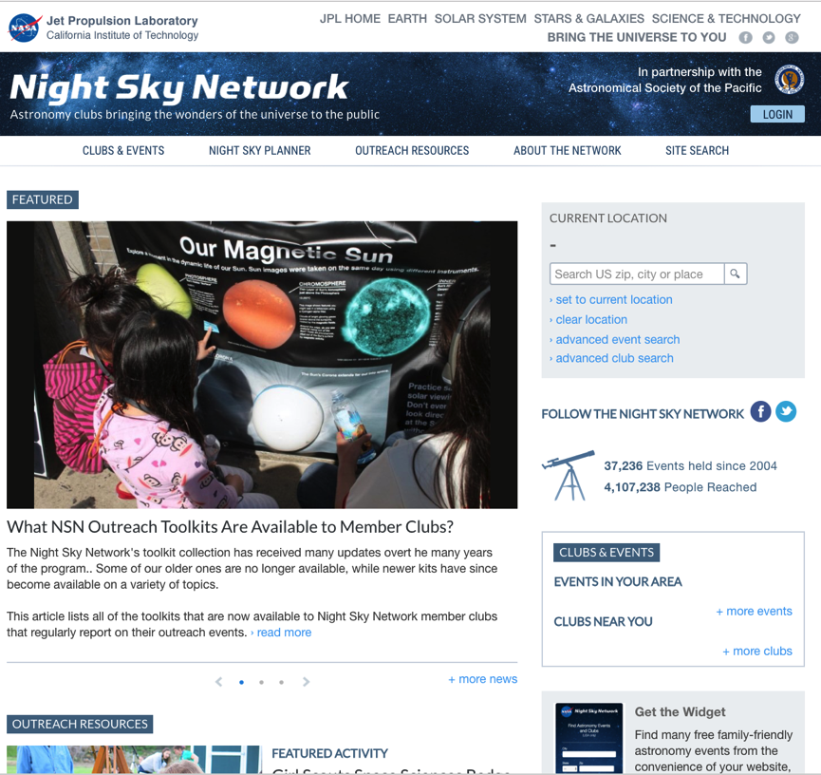


Slide 52
Jeannie Colton

Slide 53
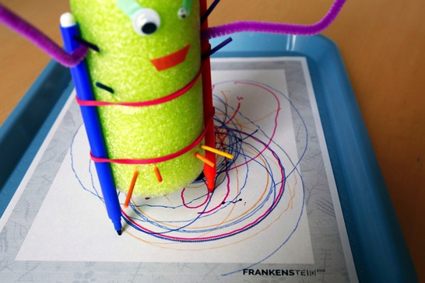


Jeannie Colton
Program Coordinator
Center for Innovation in Informal STEM Learning
Notes:
I am going to briefly share an example of programming that can be used in either a library or museum context or even in partnership with each other!

Slide 54



Flexible programming
Relevant content
Ease of use
Notes:
Flexible programming: We tested the activities in both settings, received feedback from librarians and patrons and museum educators and museum guests. We chose activities that are versatile and flexible so they can be offered as stand alone tabletops in a museum gallery, they can be facilitated tabletops, and even facilitated as workshops or in camps.
Relevant content: One reason this program works so well in libraries is because of the focus on the widely read and adapted story. The literature connection made it a no-brainer that the kit should be workable in a library setting. Much of the content also focuses on responsible innovation so there is a natural connection to STEM and STEAM programming that both libraries and museums can benefit from.
Ease of use: As with the other NISEnet kits, the Frankenstein200 kit is designed so that facilitators can them right out of the box. This is especially helpful to library staff who might not have much experience with informal engagement.

Slide 55


Examples from our partners
Sci-Port Discovery Center and Barnes & Noble
Maine Discovery Museum and Bangor Public Library
Kaleideum and Center for Women Writers
Notes:
Sci-Port is in Shreveport, Louisiana
Maine Discovery Museum is in Bangor, Maine
Kaleideum is in Winston-Salem, North Carolina
I won’t go into details about these events, as I wasn’t there. ☺ I’m sharing these partnership ideas to hopefully inspire you to think about how you can collaborate with libraries or even book stores, writing groups, or other literary outlets.

Slide 56




Book List
A recommended book list for various ages is available in the planning guide, which can be found on the NISE Network website:
http://www.nisenet.org/sites/default/files/frankenstein200_event_planning_guide_0.pdf

Slide 57
Download the Frankenstein200 resources
http://nisenet.org/frankensteinkit

Slide 58
THANK YOU!!!
Frankenstein200 is supported by the National Science Foundation under award number 1516684. Any opinions, findings, and conclusions or recommendations expressed in this presentation are those of the authors and do not necessarily reflect the views of the Foundation.

Slide 59
Darlene Cavalier

Slide 60


Darlene Cavalier
@ASU_SFIS
@SciStarter
SciStarter.org
Notes:
60

Slide 61



Libraries as Community Hubs for Citizen Science
.
Goal: Develop a field-tested, replicable, low-cost toolkit of citizen science resources for public libraries.
Develop and evaluate citizen science toolkits
Create associated resources to train, support, and communicate with librarians and citizen scientists
Work with stakeholders to create a plan to scale the model to interested libraries, statewide then nationally.
Notes:
61

Slide 62
Libraries as Community Hubs for Citizen Science
.
Considerations:
Capacity of libraries, librarians and staff
Interests/concerns of communities
Criteria for physical and digital tools, projects, and assets
Programming support
Web companion support
Scale (local vs regional vs national)
Notes:
62

Slide 63
Libraries as Community Hubs for Citizen Science
.
Timeline:
January – September 2018: Community Dialogues (STAR Net model)
October – December: Phase One kits in circulation
January-March: Phase Two kits in circulation
April: Activate promotions; Phase Three kits implemented in libraries
Ongoing evaluations through Sept. 2019
Notes:
63

Slide 64


Citizen Science Day:
April 13, 2019

Slide 65
Cheri Grinnell
(remote presentation)

Slide 66

Breaking Down Barriers
Notes:
[Let the video play.]
What you just watched is the breaking down of the blue block wall to open the Science in Play 2 Go exhibit at the Boyle County Public Library in Danville, KY.
The exhibit has been traveling the state for three month residencies at host libraries for almost two years and here in Boyle County we will break the 100,000 mark of visitors to the exhibit.
The goal of this exhibit is to reach those children that may never have the opportunity to visit the Kentucky Science Center or any Science Center, to show parents the value and learning in play and to empower those parents to keep that learning going, creating lifelong learners. Thanks to the generosity of PNC and Genentech, we were able to create a traveling version of the wildly successful Science in Play exhibit at the museum. The only question was venue.

Slide 67


Library
Community gathering place
Community resource
On the front lines of education
Notes:
In this digital age, there are many who think libraries are losing their relevance, but actually the reverse is true. They are more relevant than ever. So much more than books, libraries provide classes, programs, computers and maker spaces. They have strong relationships with schools and other community agencies putting them on the front lines of education at all levels. They are gathering places and their resources are free to all who enter.

Slide 68



Museum
Museum
Place of learning
Educational resource
On the front lines of education
Notes:
Museums, on the other hand, while they also have strong relationships with schools and other community agencies, must charge fees for their services. Also, unlike libraries, museums do not have branches in every county, but one flagship location. These two differences limit their influence and footprint. Many museums, such as the Kentucky Science Center, offer offsite programs and services, but struggle in getting those services to the ones who most need them. Communities are either unaware the resources exist or they simply do not have the funds to pay for them.

Slide 69

It’s a natural partnership
Notes:
That’s why partnering with libraries is a match made in heaven. Working with the Kentucky Department of Libraries and Archives we have created an application process for libraries across the state.
The exhibit provides a draw that brings people into the library that would not usually come, giving the library the opportunity to then show what they have to offer. The library provides the museum with access to their community contacts giving the museum a foot in the door of the community to then show what is available and possible.
After all, we share the same goals: ensuring children are ready to learn their very first day in school and giving them experiences that turn them into lifelong learners, to never stop asking questions and searching for answers.

Slide 70

3 month residencies in libraries across the state of Kentucky
Notes:
Science in Play 2Go is on a mission to travel the entire state of Kentucky through the library system. The reception for the exhibit has been overwhelmingly positive. I could give you pages of feedback showing just how amazing this collaboration has been for the libraries, the museum and the families and schools that have visited the exhibit. BUT, since I only have a few minutes, I have just included a few:

Slide 71

“This exhibit brought in many new families that I was able to speak with and let them know we have programs even after the exhibit is gone. Making that first contact with families is crucial to them returning to be consistent users of the library and this could not have easily happened for some of these families without the exhibit being here. “ Lenisa Jones, Branch Manager, Marshall County Library
“Science in Play 2Go helped me see the value in learning through play, recognize the science occurring with the simplest of materials and showed me I did not have to have all the answers to effectively facilitate the development of the skills needed for today’s world. In short, STEAM can be taught with a rock or a stick – it is the question that matters – it begins the journey….”
Janet Harris, Director, Muhlenberg County Library
“Science in Play 2Go has increased awareness of the Kentucky Science Center’s ability to provide science experiences for all ages in all corners of the state.” Mira Gentry-Johnson, Senior Manger of Visitor Experience, Kentucky Science Center
“I have taken my class on lots of field trips, but this has been the best. I just had to email you. It’s been several weeks and my students are still talking about it. It gave me a lot of ideas on how I could incorporate science in my classroom. Is it coming back?” Logan County Kindergarten Teacher
“We only have one car. I could never bring my children to the museum. This is so wonderful!”
Oldham County Mom

Slide 72
Questions
Resources
Discussion

Slide 73
Thank you

