Slide 1
NISE NETWORK
Rae Ostman
Arizona State University
Science Museum of Minnesota
www.nisenet.org

Slide 2
The Nanoscale Informal Science Education Network…
Notes:
10+ years of funding through NSF for nanoscale science, engineering, and technology.

Slide 3
… is now the National Informal STEM Education Network.
Notes:
Now have diversified our funding and the STEM topics we cover.
Leadership for the network: SMM (Paul Martin), MOS (Larry Bell), ASU (Rae Ostman)

Slide 4
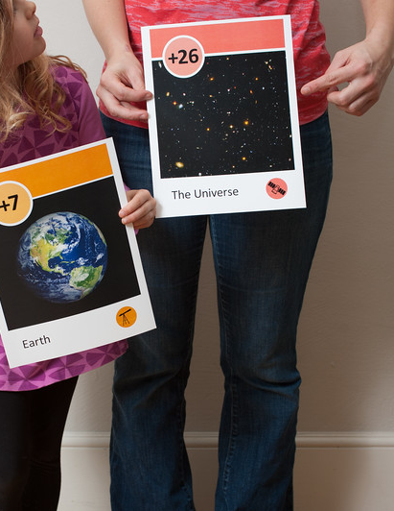
Network focus
Building relationships among individuals and organizations
Engaging the public in learning about STEM
Increasing capacity in the field
Notes:
Our primary areas of focus remain the same

Slide 5
NISE Net creates lasting relationships among individuals and organizations.
Notes:
Building collaborations.
“We built the network by doing work together.”

Slide 6
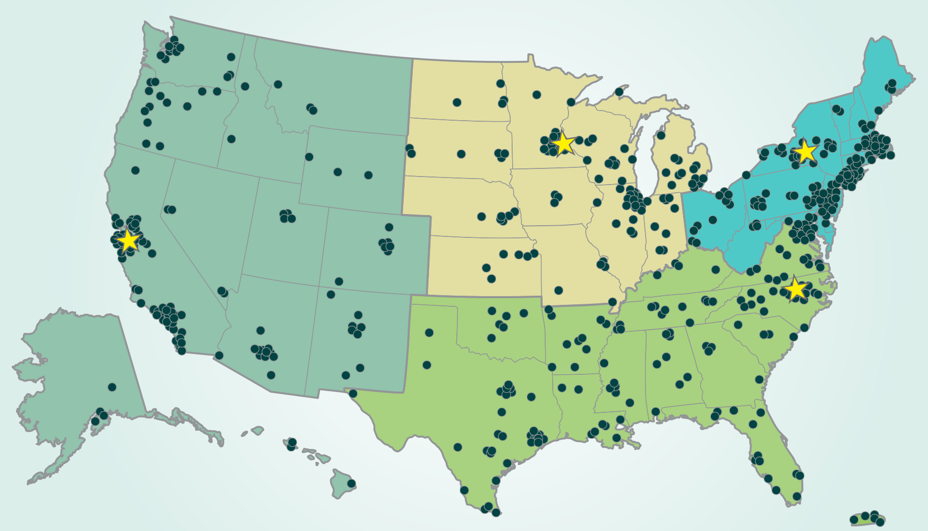
Over 600 organizations regularly participate in Network activities.
Notes:
~400 museums
~200 universities

Slide 7
NISE Net supports informal learning about STEM in communities across the United States.
Notes:
“New” network now includes all areas of STEM = science, technology, engineering, and math.

Slide 8
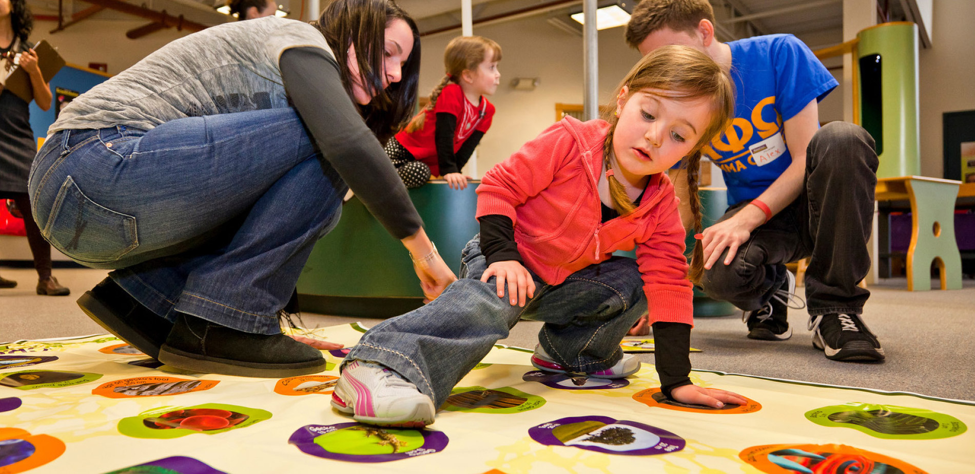
NISE Net engages all audiences in learning about STEM in ways that are fun and easy to understand.
Notes:
Engaging the public: accessible to and appropriate for multiple and diverse audiences

Slide 9
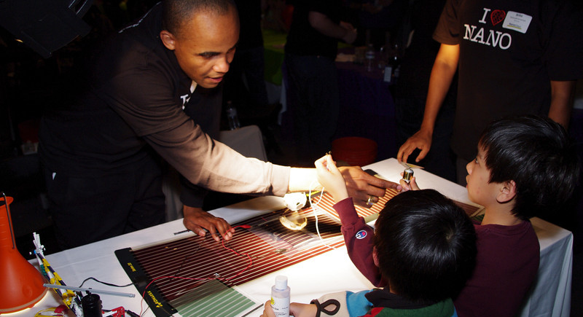
NISE Net improves the practices and skills of educators and scientists.
Notes:
Generating knowledge and providing resources that increase the capacity of the ISE field.

Slide 10
Together, Network partners reach millions of people each year!
Notes:
Impact
All 50 states and Puerto Rico

Slide 11
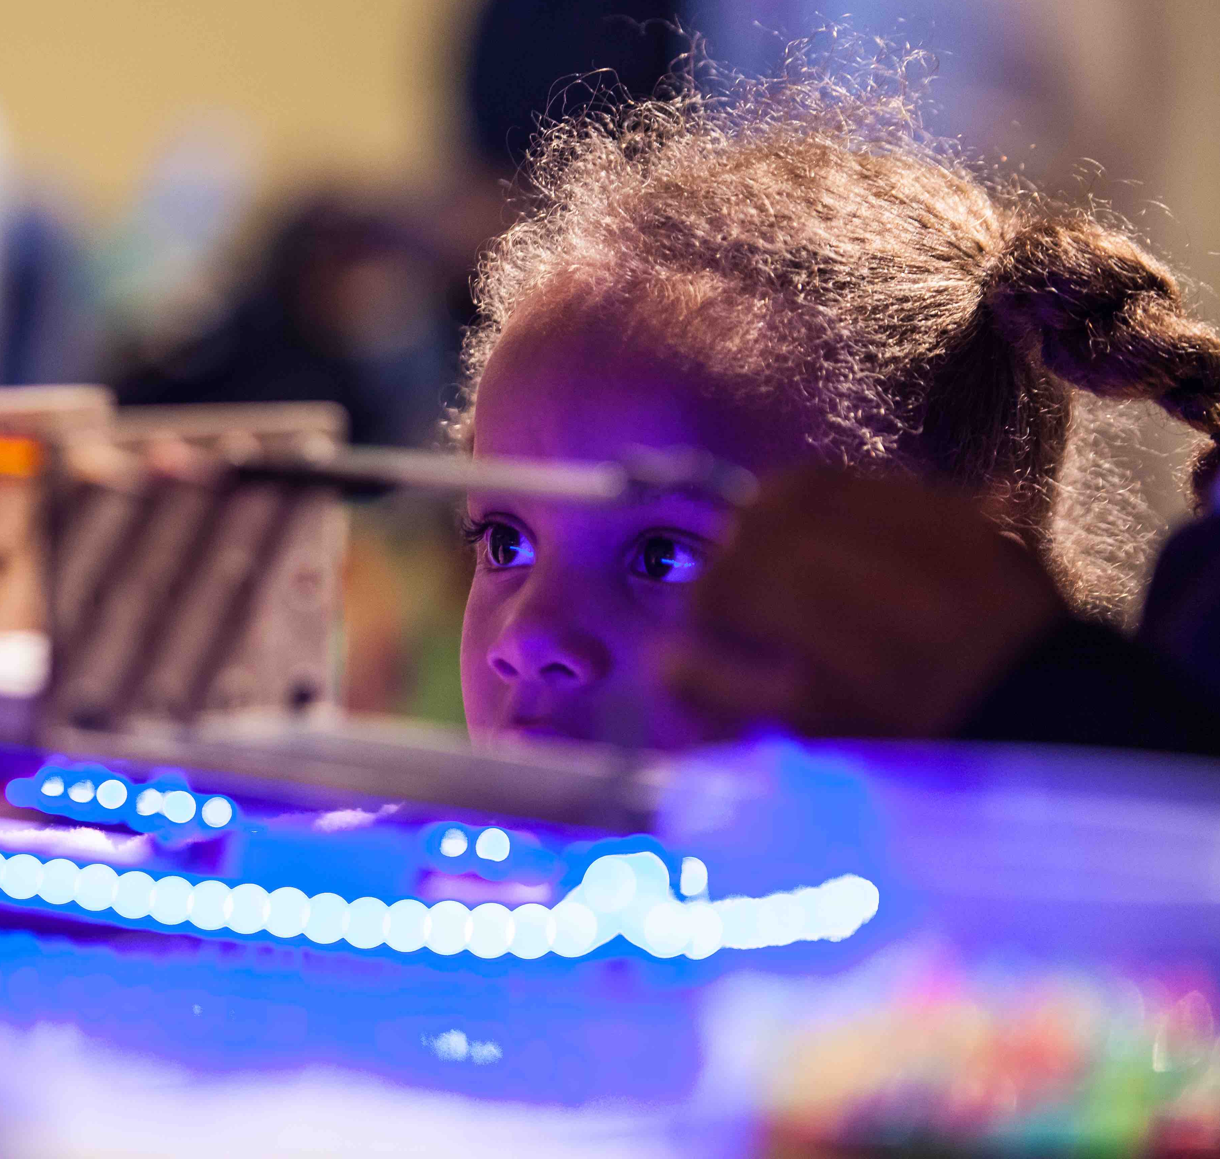
Resources and information
Website:
nisenet.org
Newsletter:
nisenet.org/newsletter
Social media:
nisenet.org/social
Notes:
Hundreds of products freely accessible on our website (ed materials, professional resources, reports)
To stay up to date on everything related to the network, be sure you’re on all our lists.

Slide 12
Thank you
The Nanoscale Informal Science Education Network is supported by the National Science Foundation under award numbers 0532536 and 0940143. Multi-Site Public Engagement in Science is supported by the National Science Foundation under award number 1421179. Transmedia Museum is supported by the National Science Foundation under award number 1516684. ChemAttitudes is supported by the National Science Foundation under award number 1612482. Any opinions, findings, and conclusions or recommendations expressed in this presentation are those of the authors and do not necessarily reflect the views of the Foundation.
Sustainability in Science Museums is supported by the Walton Sustainability Solutions Initiatives at Arizona State University (ASU) and is a collaboration with the Center for Engagement and Training in Science and Society at ASU.
Space and Earth Informal STEM Education is supported by NASA under cooperative agreement number NNX16AC67A. Any opinions, findings, and conclusions or recommendations expressed in this material are those of the author(s) and do not necessarily reflect the view of the National Aeronautics and Space Administration (NASA).

