Slide 1
Museums / Science Centers & the American Chemical Society A Summary for NISENet
Darcy J. Gentleman, Ph.D.
Office of Public Affairs
Collaboration Opportunities – NISENet Meeting June 3, 2015

Slide 2
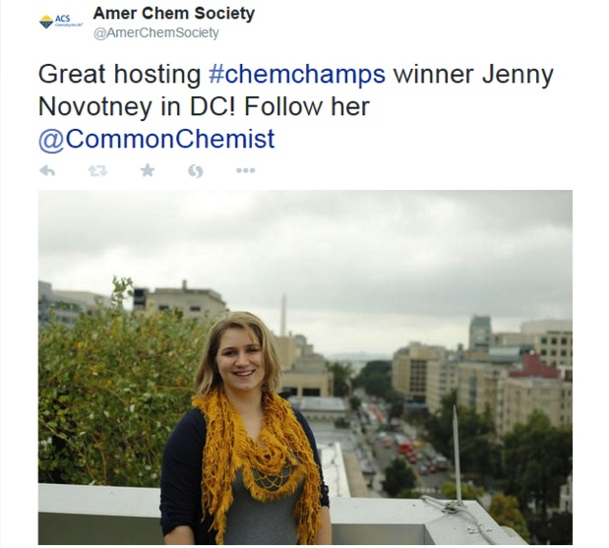

Slide 4
> 158,000
members

Slide 5
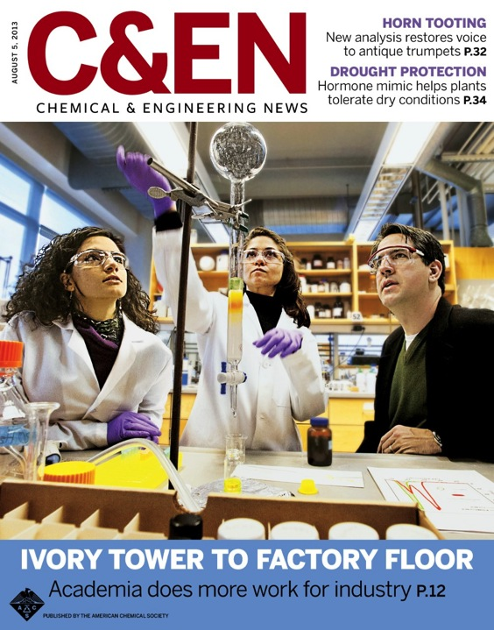

Slide 7
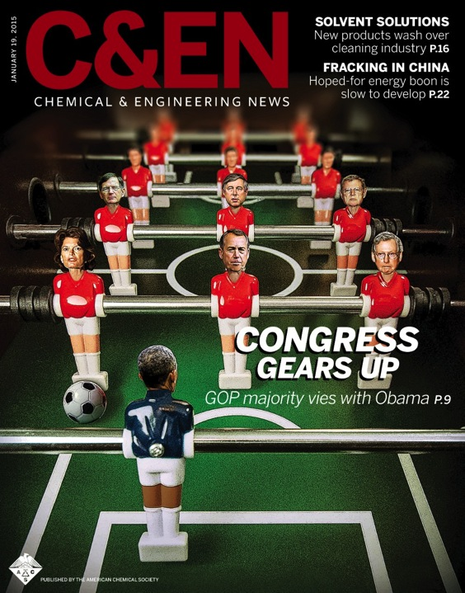

Slide 8
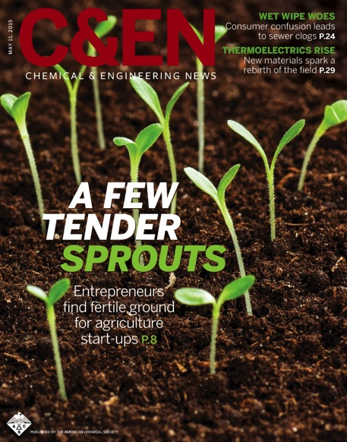

Slide 9
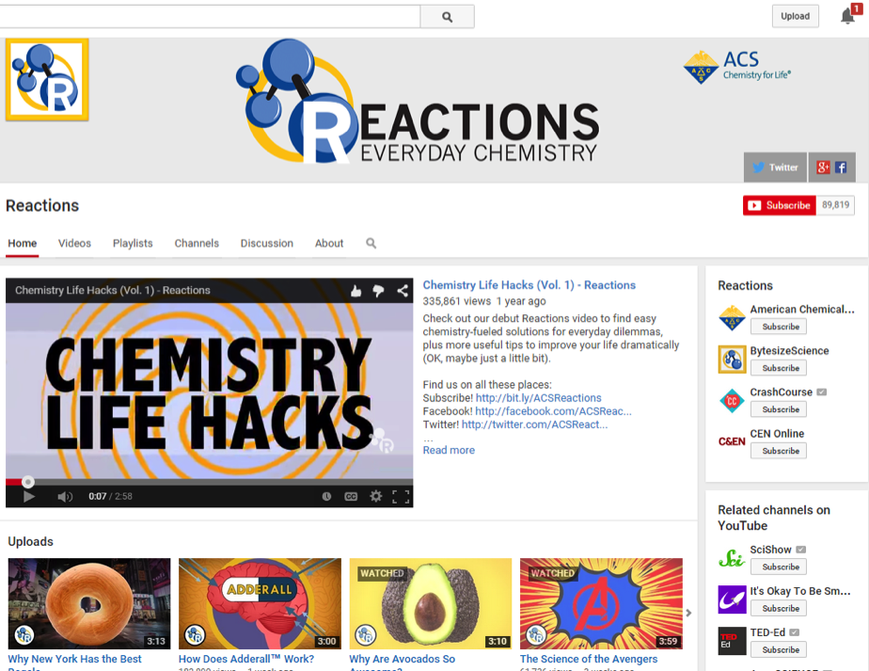
American Chemical Society

Slide 10
National Historic Chemical Landmarks (NHCL)
Commemorate seminal chemistry achievements with significant societal benefit
www.acs.org/landmarks
e.g. later in 2015, Polaroid at MIT Museum

Slide 11
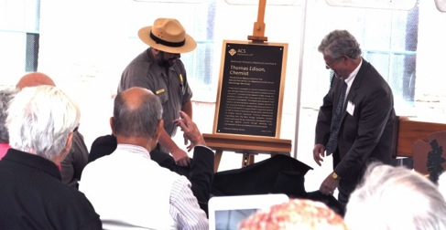
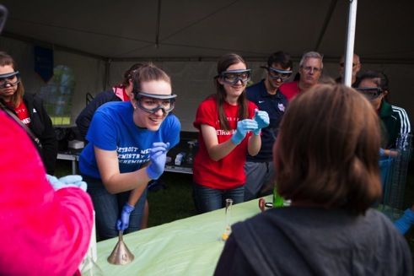
NHCL (2014) Thomas Edison, Chemist
Thomas Edison National Historical Park West Orange, NJ
The Henry Ford Greenfield Village,
Dearborn, MI

Slide 12
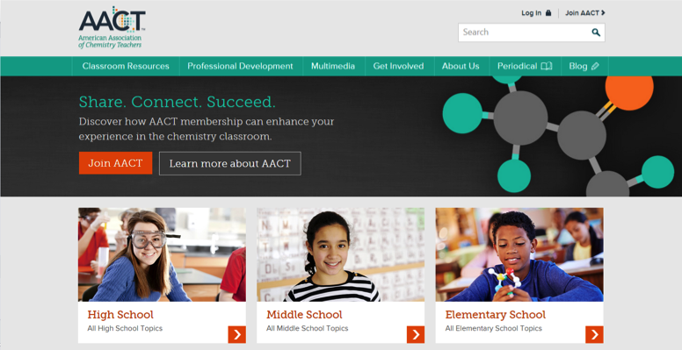
www.teachchemistry.org

Slide 13
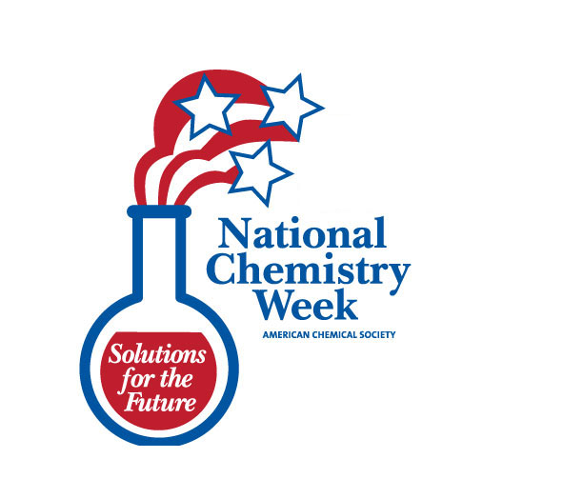

Slide 14
Fourth Week in October, YYYY

Slide 15
6:02 am
10/23/YY

Slide 16
Santa Ana Zoo, October 2014 - Candy

Slide 17
Hawai’i (in a mall) October 2014 - Candy

Slide 18
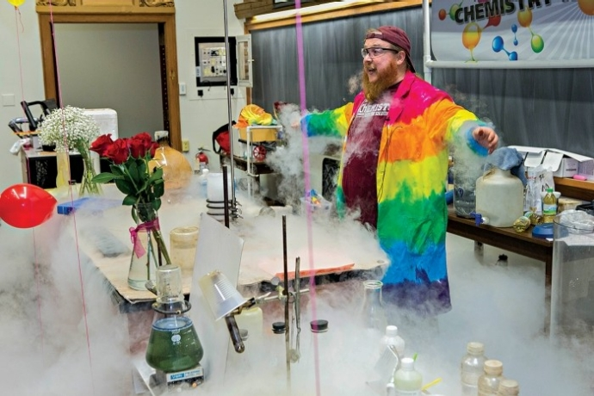
October 18-24, 2015 Colors
http://bit.ly/ACS-NCW

Slide 19
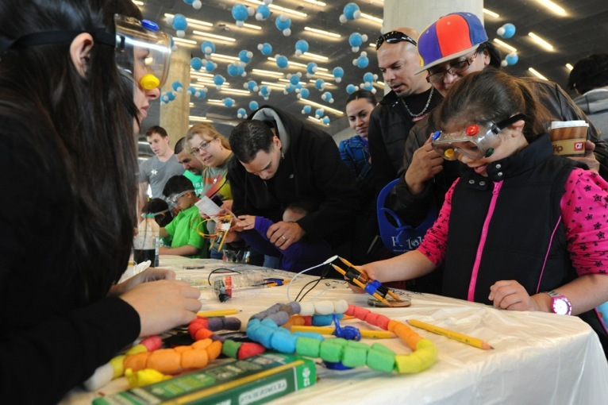
Annual National Meetings MARCH/April & AUGUST/September
Peter Cutts
Perot Museum of Nature and Science Dallas, March 2014

Slide 20
Annual National Meetings MARCH/April & AUGUST/September
K-6 target audience
Entertain, engage, educate & inform
Community outreach
2016: San Diego & Philadelphia
2017: San Francisco & Washington, DC
2018: New Orleans & Boston

Slide 21
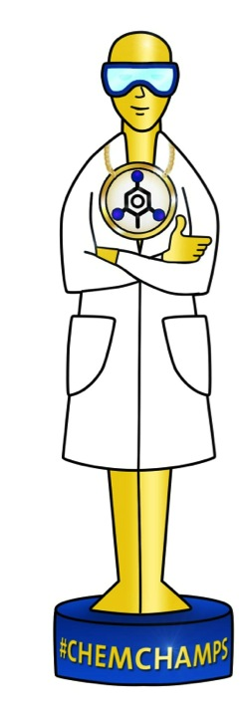
American Chemical Society

Slide 22
What?
Contest,
backboned off
social media.

Slide 23
Who?
Younger
ACS Members
(under 35)

Slide 24
Why?
EMPOWER
ENGAGE
ENHANCE

Slide 25
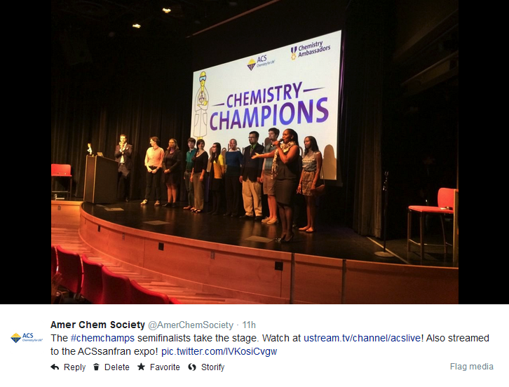

Slide 26
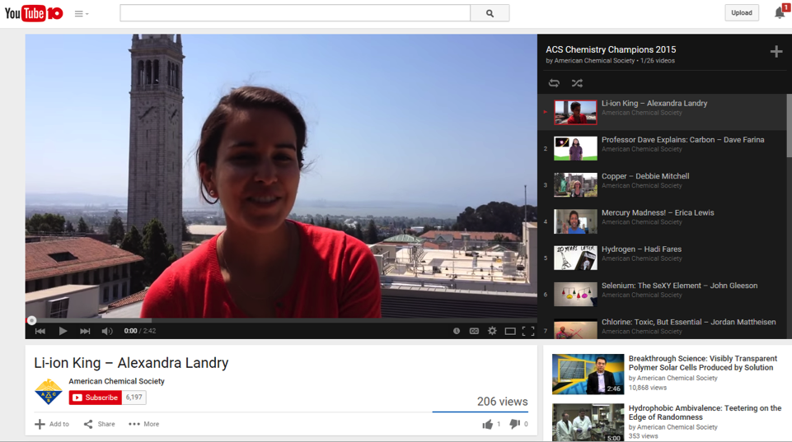
http://bit.ly/chemchamps2015
American Chemical Society

Slide 27
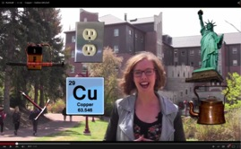
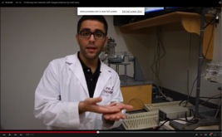
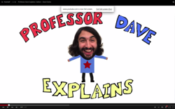
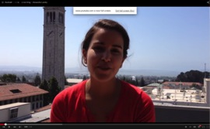
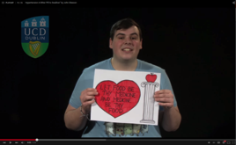
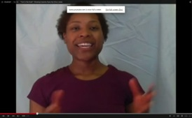
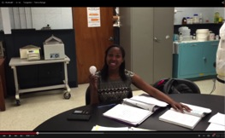
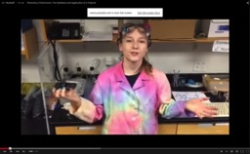
www.acs.org/chemchamps

Slide 29
Darcy J. Gentleman, Ph.D. Manager, Engagement & Science Communications Office of Public Affairs d_gentleman@acs.org

