Slide 1
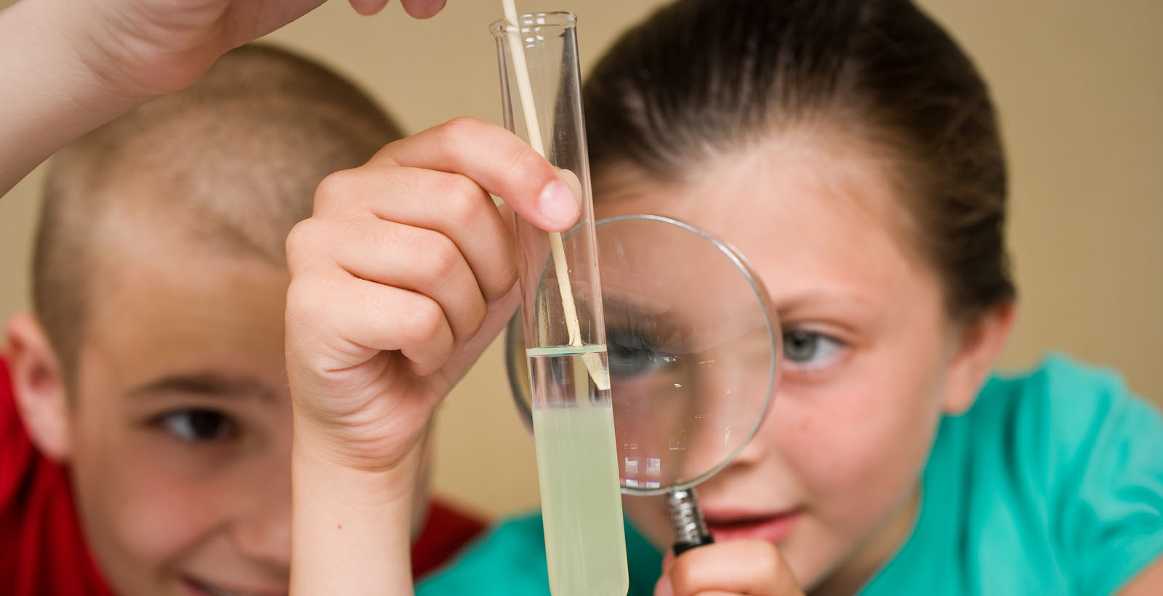
Training in Nano Content
www.nisenet.org

Slide 2
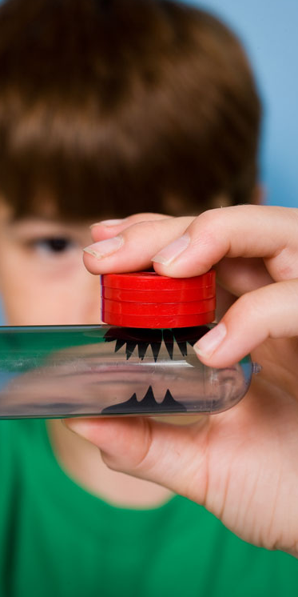
Session Presenters
Shari Hartshorn
Science Museum of Minnesota
Tifferney White
Lied Discovery Children’s Museum
Madlyn Runburg
Natural History Museum of Utah

Slide 3
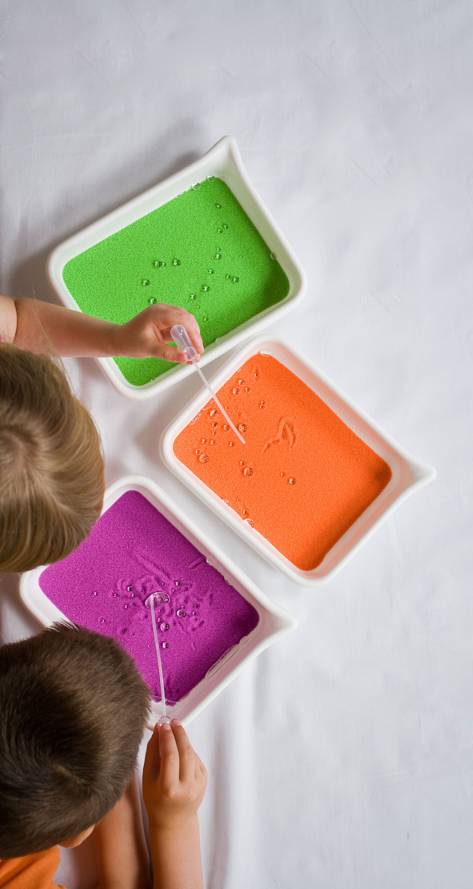
Session Overview
Warm Up
Training methods used at three museums
Successes and obstacles to training
Small Group/Large Group Discussion
Wrap-up

Slide 4
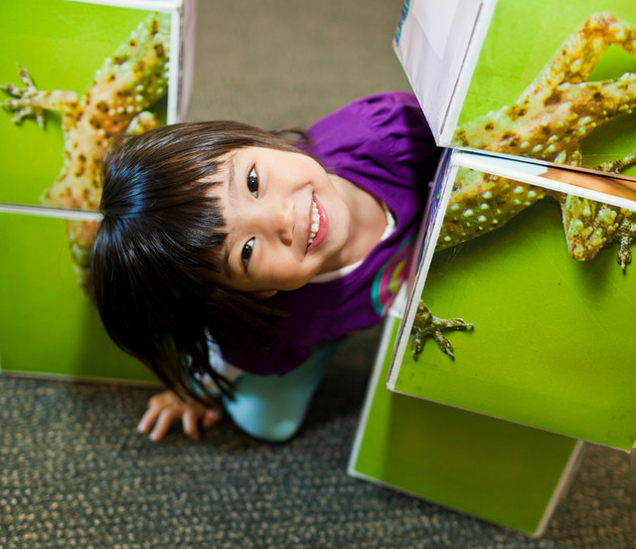
Warm Up

Slide 5
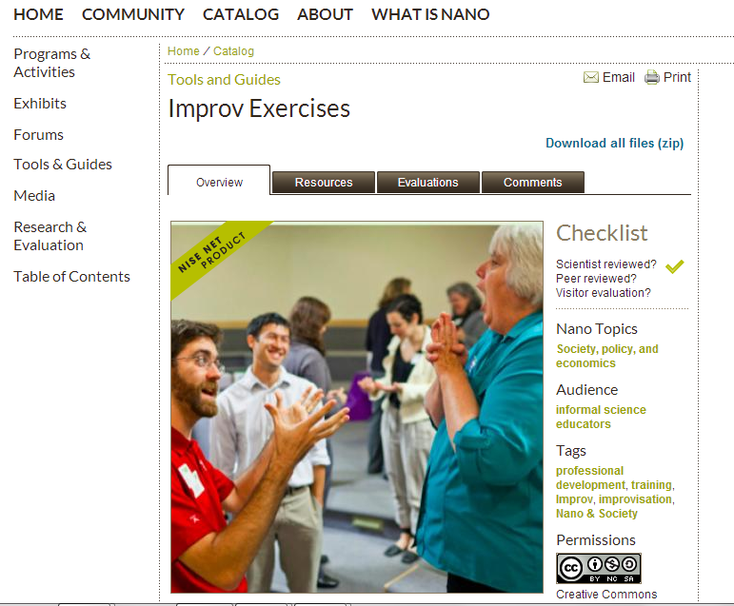

Slide 6
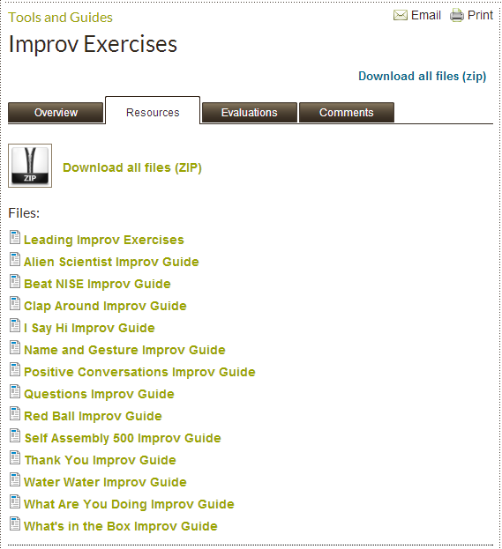

Slide 7
Youth Teaching Youth Summer Nano Institute
A collaboration between NHMU’s Youth Teaching Youth and the University of Utah’s Nano Institute

Slide 8
Collaboration Goals:
Increase capacity of NHMU staff and volunteers to deliver nanoscale science programming to the public
Provide graduate students with training to increase skills for communicating nanoscale science to public audiences
Create opportunities for YTY high school participants to work with near-peer mentors engaged in STEM research

Slide 9
Youth Teaching Youth Summer Nano Institute

Slide 10
Feedback from YTY Students:
Wanted more time in the labs!
Wanted more time for prototyping activities
Weren’t ready for the week to be over
“I thought it was going to be more like sitting down and talking all the time but it was really more doing and thinking.”
“I expected the program to be like the nano kits that we do but it was better. This was the best thing that we have ever done in YTY!”
“Expected: Boring Nano Project Reality: Everything, even the building, was off the hook!”

Slide 11
Feedback From Graduate Students:

Slide 12
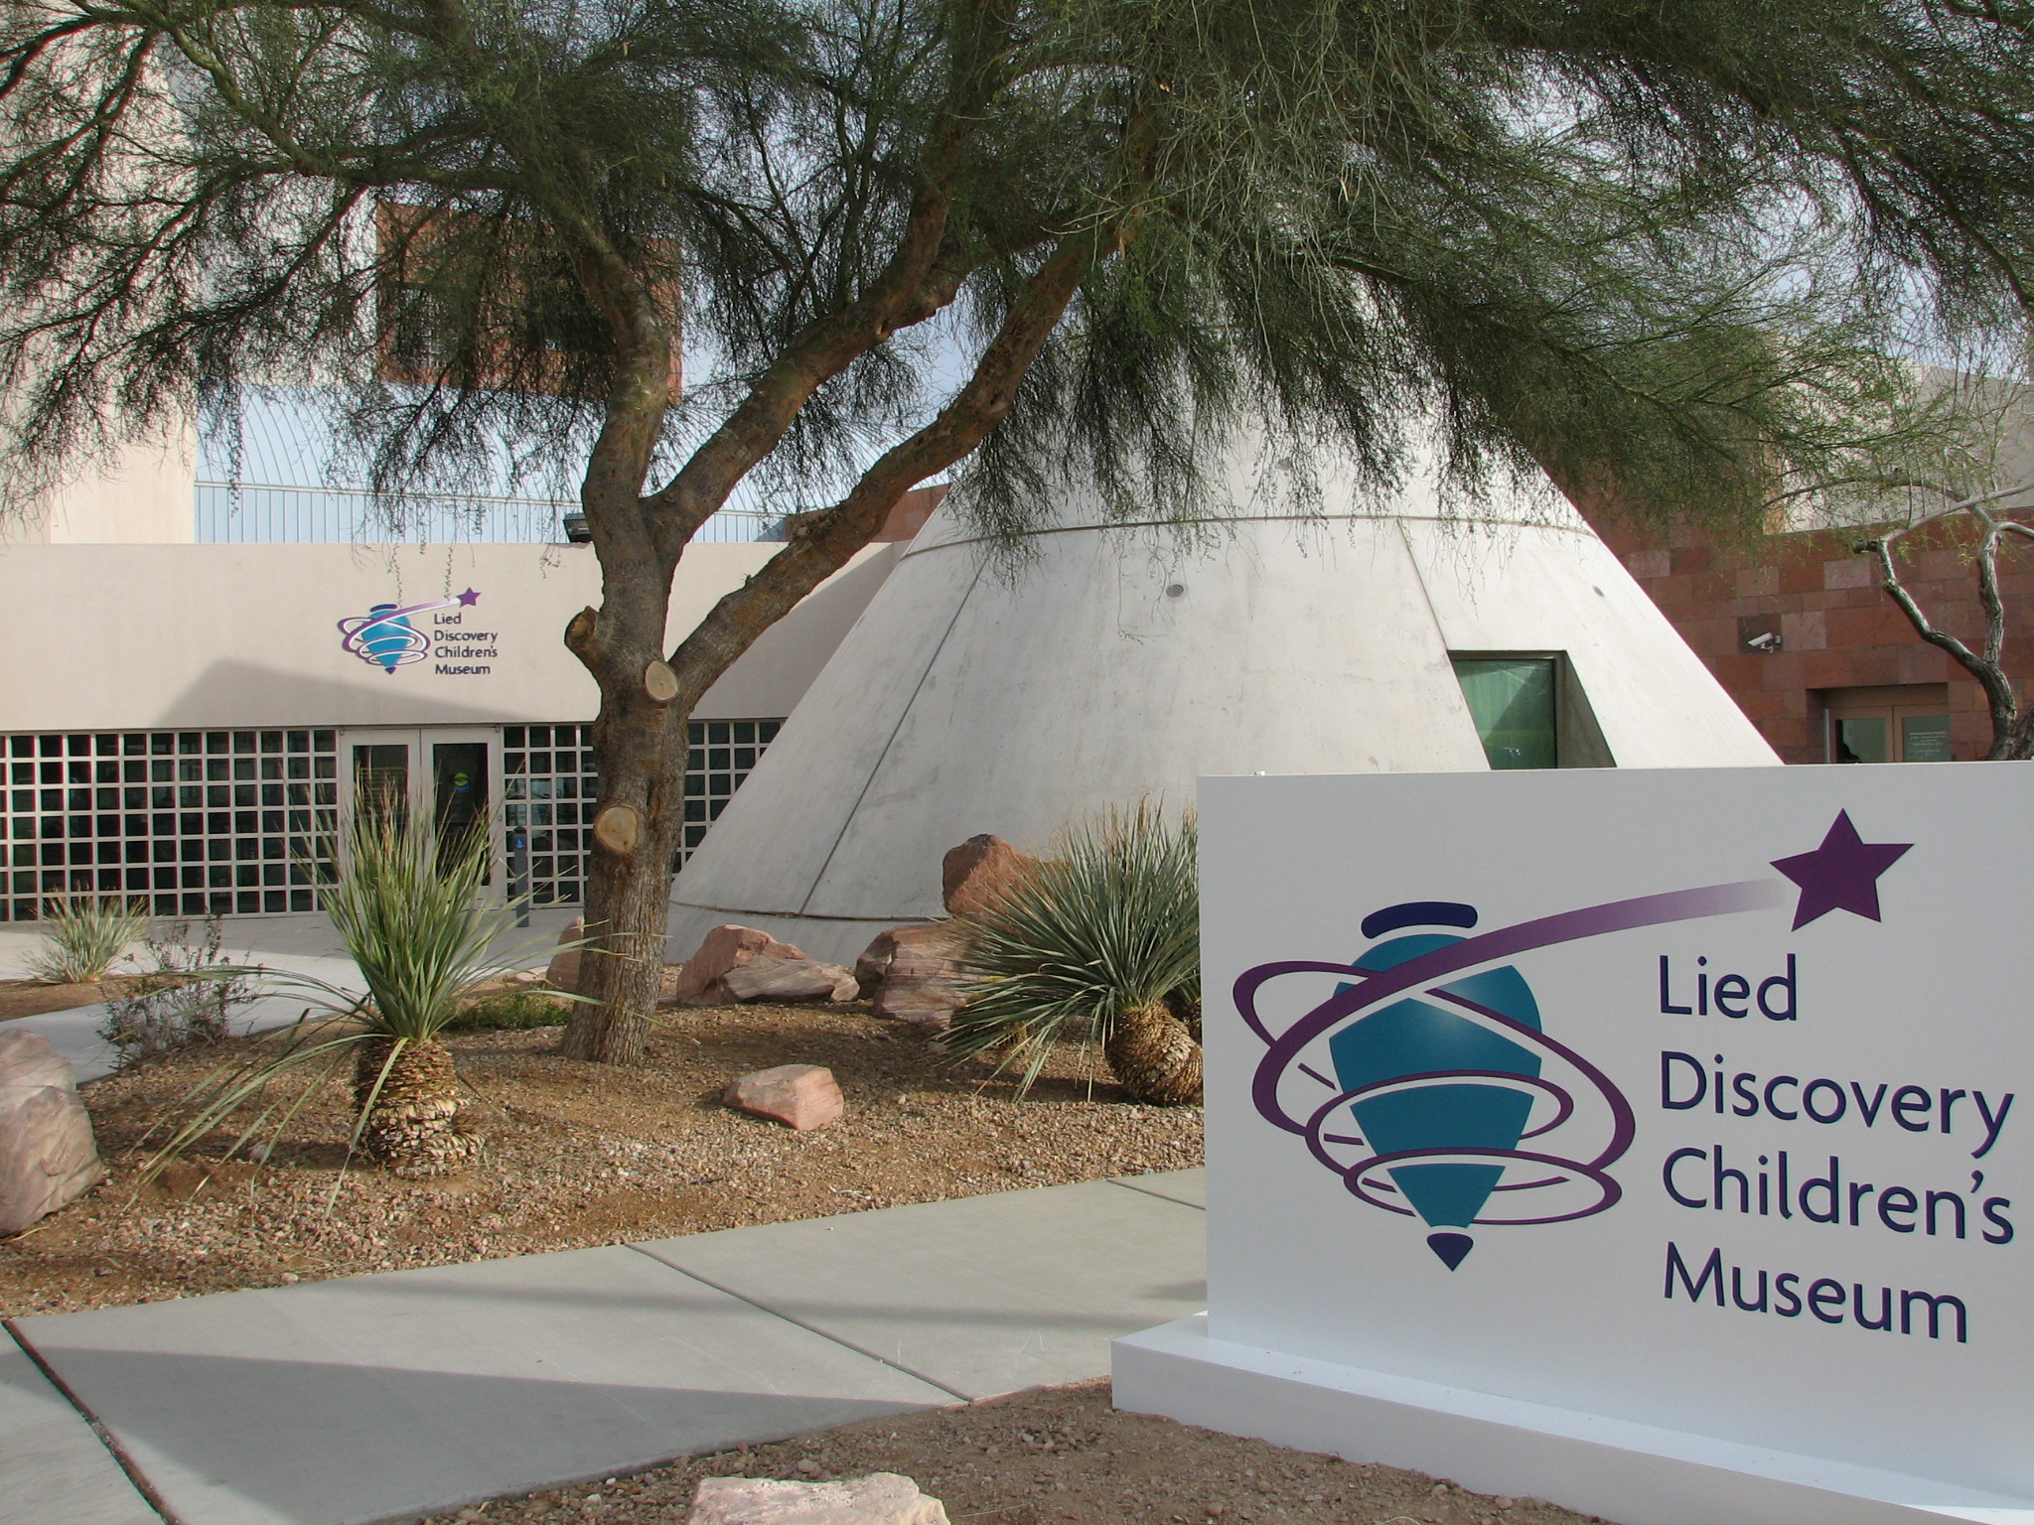
Las Vegas, Nevada
Target Audience: Children 0-12 and their families
Content Focus: Science & Nature and Arts & Humanities valuing Early Childhood education
Current Building: Two floors, 35,000 square feet
Staffing working with visitors:
Entry level, High School diploma, most with no college
YouthWorks (volunteers and interns)

Slide 13
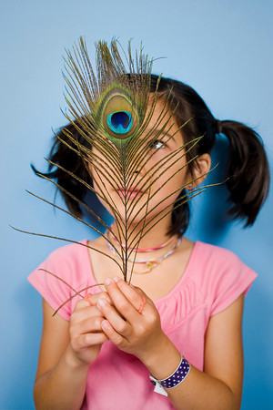
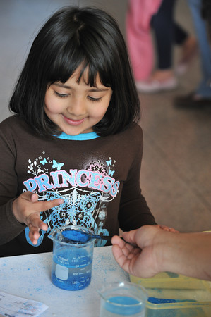
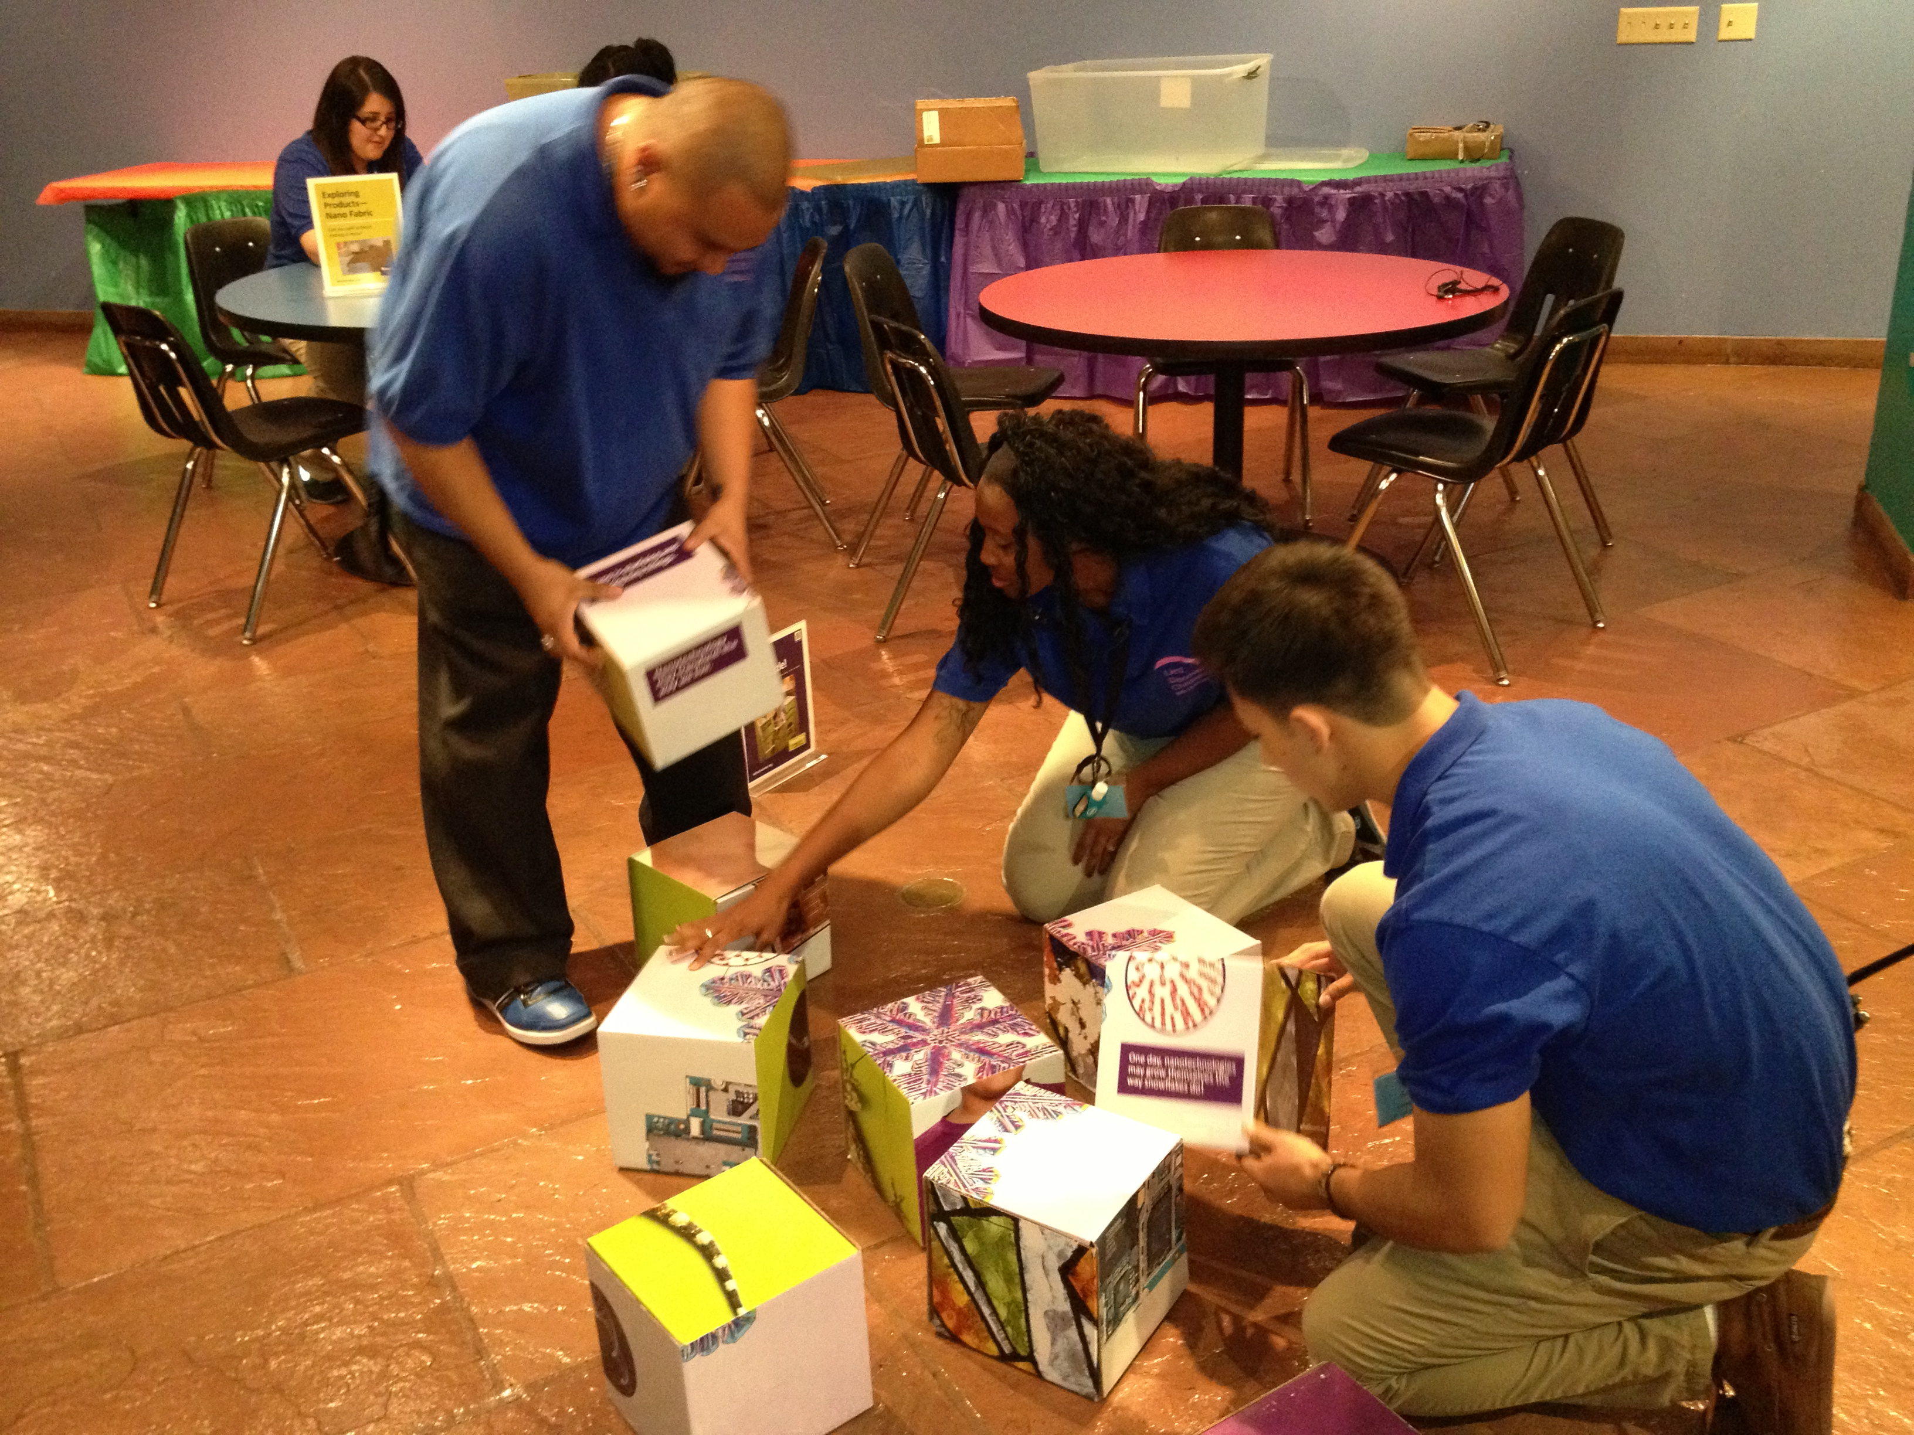
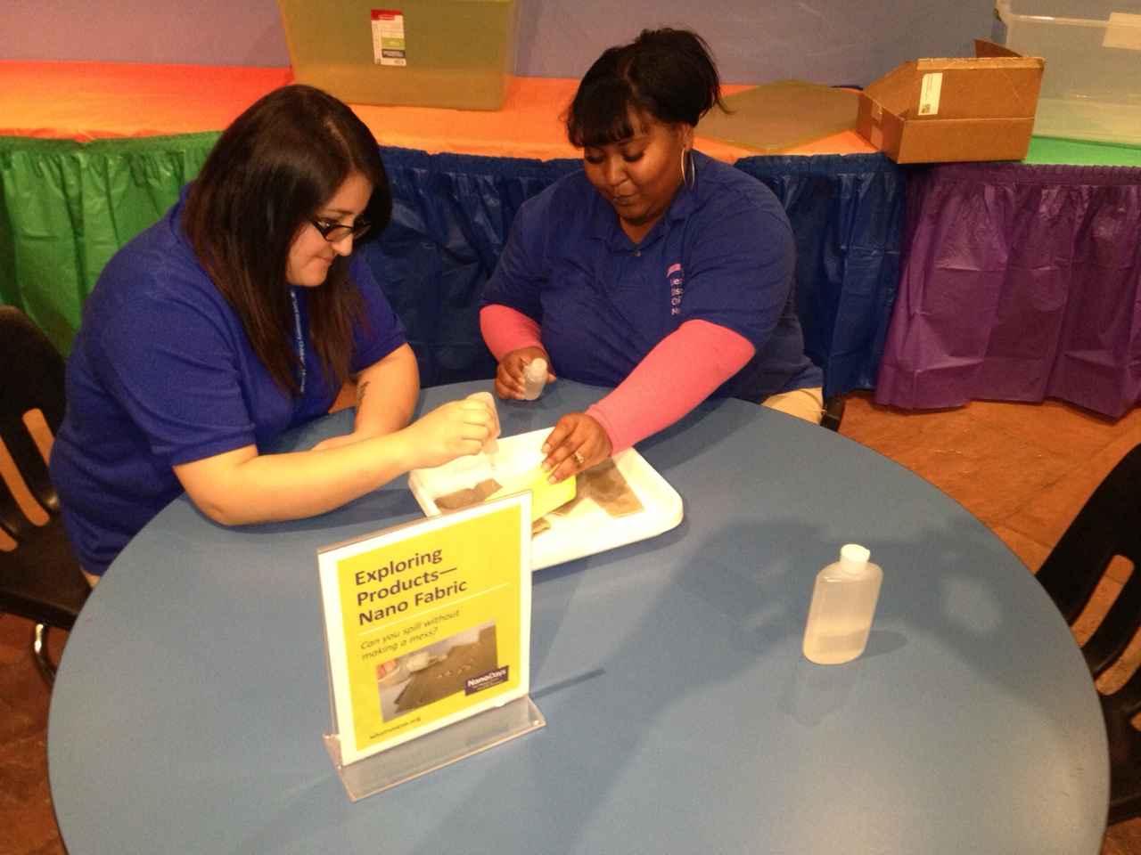
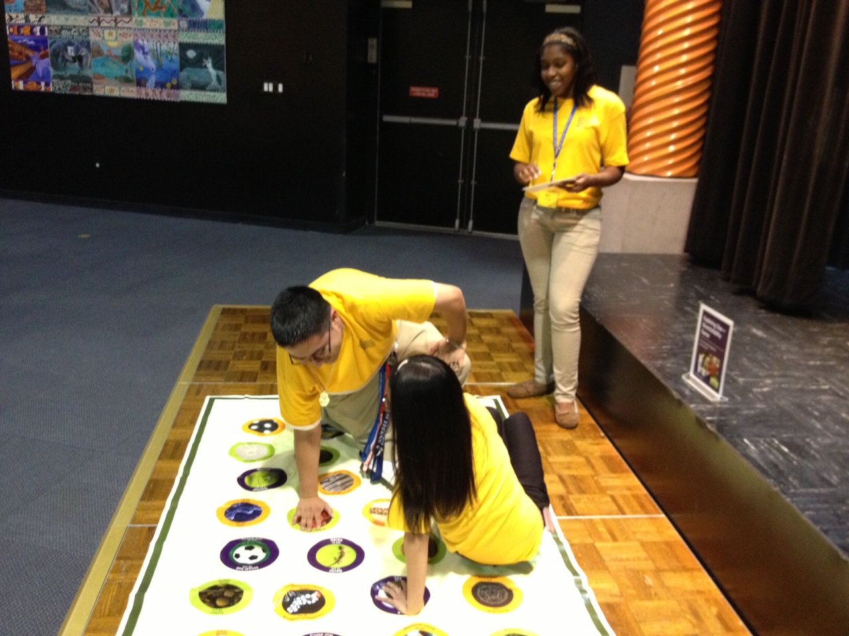
LDCM – Nano Training
Notes:
Evaluation Questions are not the same as survey or interview questions
Shy away from yes/no questions and why questions

Slide 14
LDCM Training Approach
3 Tiered:
Staff Training (general)
Trained by Tifferney
3.5 hours (Sunday morning)
Introduction to Nano and 3-5 activities in one session
Introduced as visitor, time to “play”, discussed background, present to each other (supervised practice) and supervised showtime (same day, on museum floor), observed again within two weeks.
Staff Training (early childhood)
Trained by Early Childhood Education Specialist
Nano with younger visitors (3-5 years old)
YouthWorks Interns
Trained by staff
Desire to do something unique

Slide 15
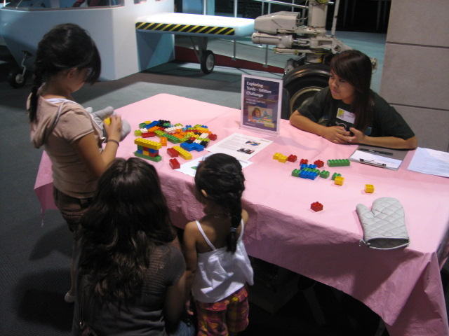
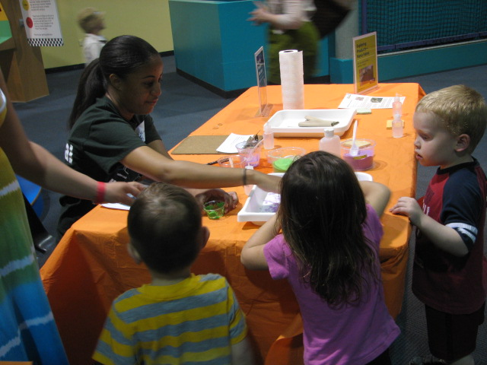
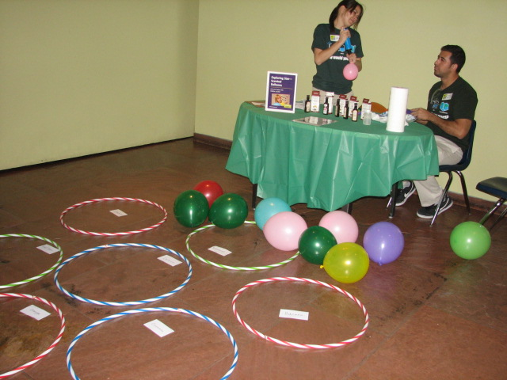
LDCM – Nano on Museum Floor

Slide 16
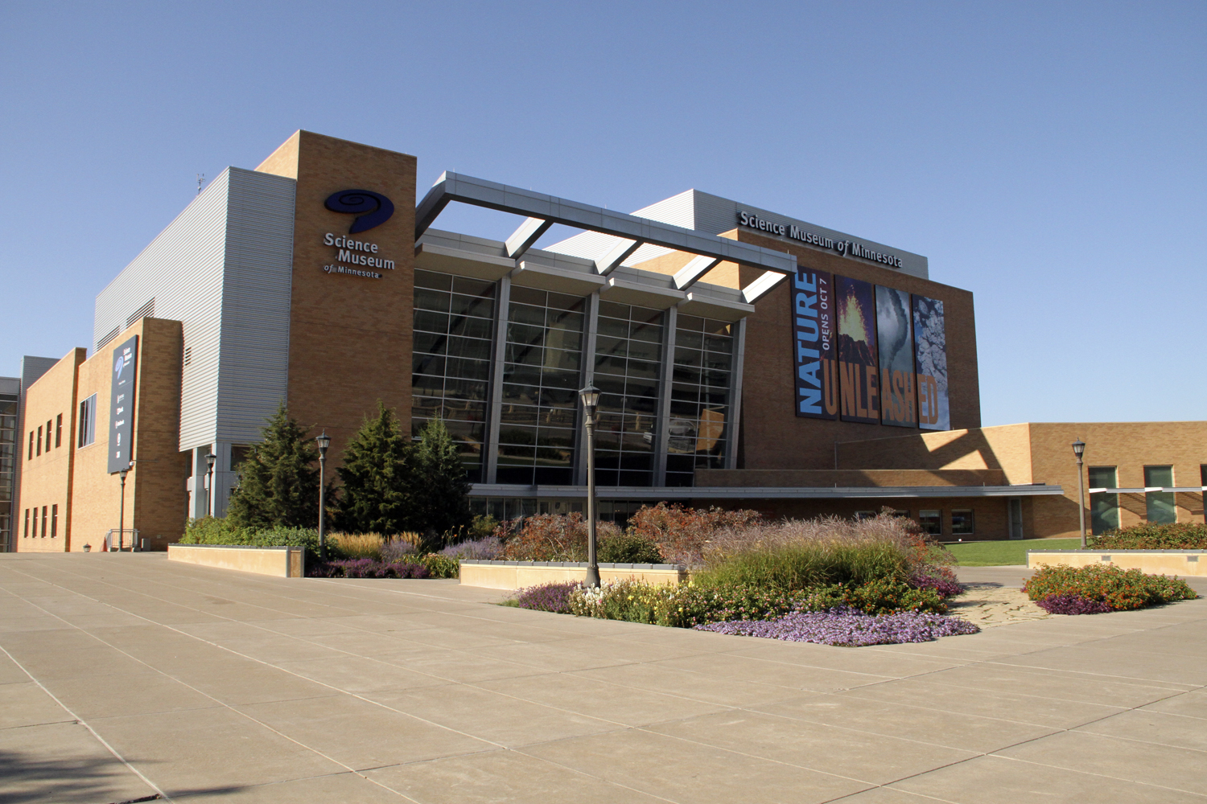

Slide 17
Training Staff and Volunteers
Early Activities
Typical Method
Be the visitor
Background
Presenter notes
Adapting (experiences)

Slide 18
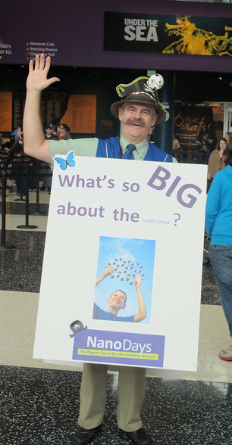
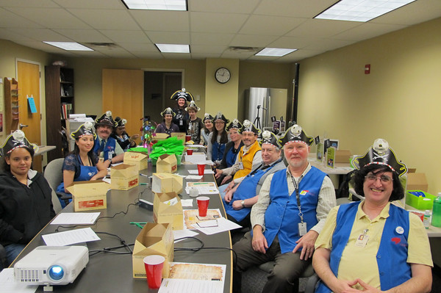
Training Staff and Volunteers
NanoDays – Multiple Attempts

Slide 19
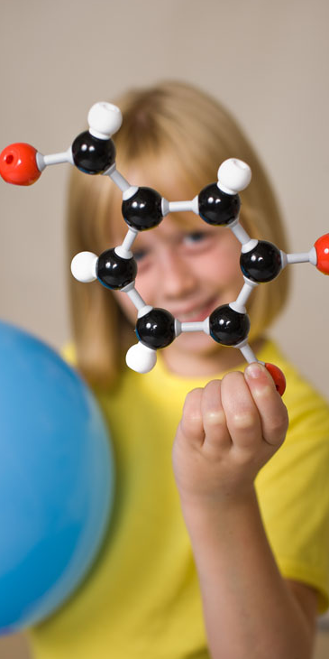
Training Successes & Obstacles

Slide 20
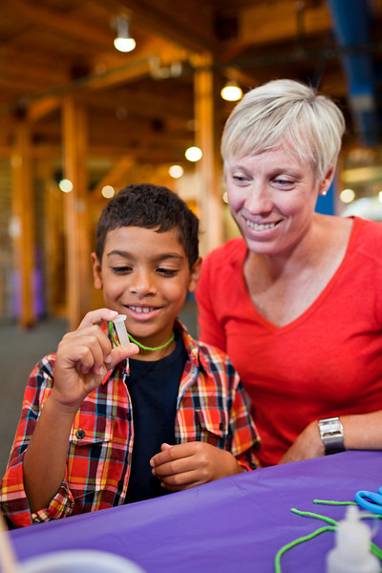
Contact Information Shari Hartshorn shartshorn@smm.org Tifferney White twhite@ldcm.org Madlyn Runburg mrunburg@nhmu.utah.edu

Slide 21
This presentation is based on work supported by the National Science Foundation under Grant No. 0940143.
Any opinions, findings, and conclusions or recommendations expressed in this presentation are those of the author(s) and do not necessarily reflect the views of the Foundation.

