Slide 1
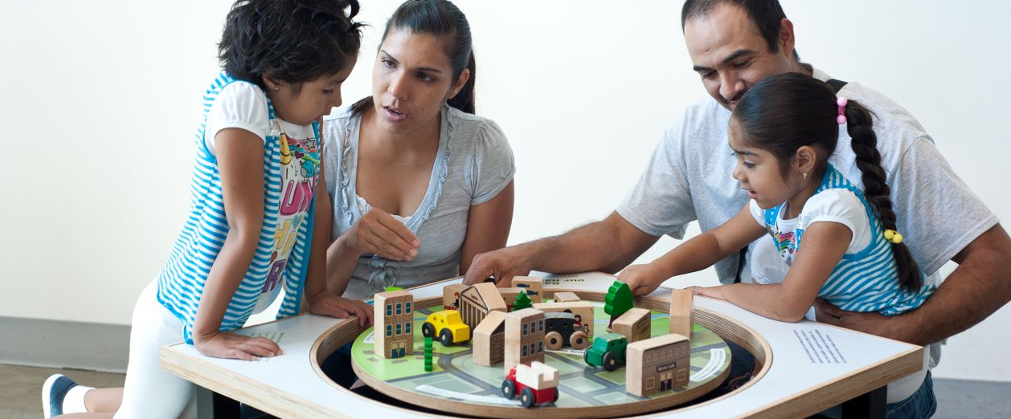
After the Bell Rings: Adapting Nano for After-School Programs and Libraries
Network-Wide Meeting
December 2012

Slide 2
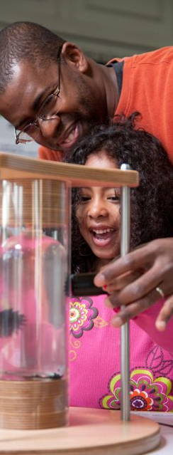
Presentation Overview
Lynn Cole, Queens Public Library, susanlynn.cole@queenslibrary.org
Joe Schwanebeck, Science Center of Iowa, joe.schwanebeck@sciowa.org
Mike Rathbun, Discovery Center Museum, michaelr@discoverycentermuseum.org
Bethany Thomas, Children’s Discovery Museum, bthomas@normal.org

Slide 3
Breakout Groups Led By:
Lynn Cole, Queens Public Library, susanlynn.cole@queenslibrary.org
Joe Schwanebeck, Science Center of Iowa, joe.schwanebeck@sciowa.org
Mike Rathbun, Discovery Center Museum, michaelr@discoverycentermuseum.org
Bethany Thomas, Children’s Discovery Museum, bthomas@normal.org

Slide 4
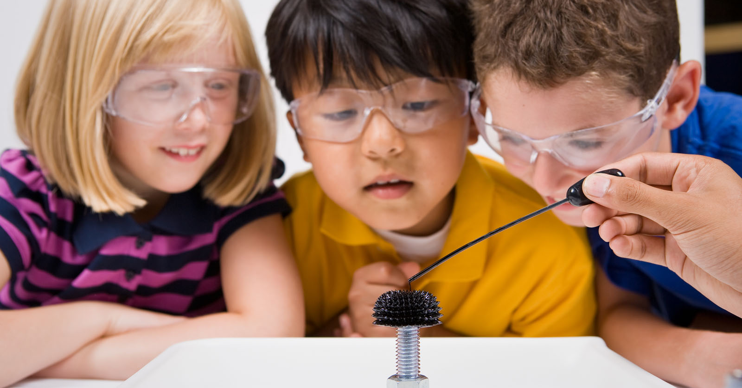
This presentation is based on work supported by the National Science Foundation under Grant No. 0940143.
Any opinions, findings, and conclusions or recommendations expressed in this presentation are those of the author(s) and do not necessarily reflect the views of the Foundation.
Notes:
And as always, thank you to NSF for supporting this project!

Slide 5
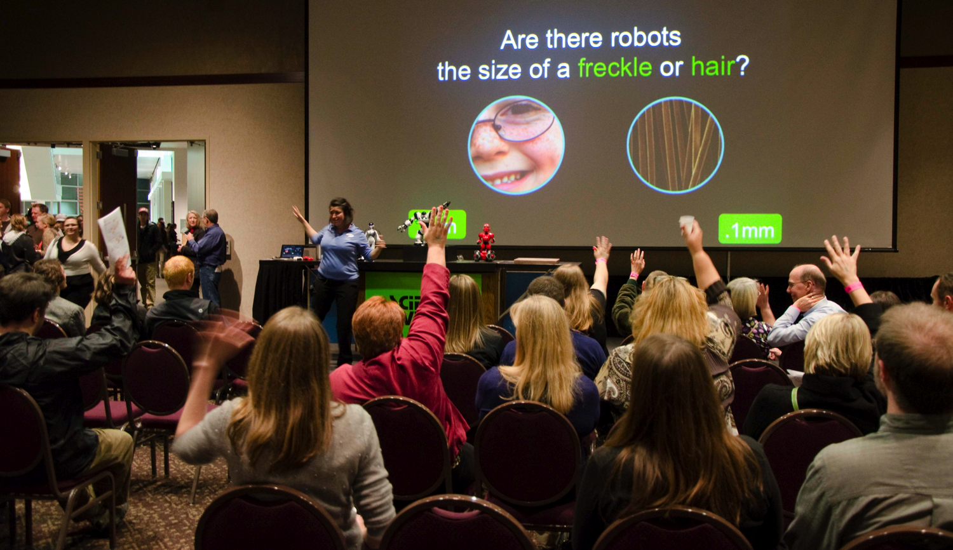
Questions and Discussion?

