Slide 1
Nano is for Everyone
Expanding Your Reach Through Partnerships
www.nisenet.org

Slide 2
Why Partner to Reach Underserved Communities?
Leverages partners’ existing, trusted relationships.
Partner organizations can serve as cultural brokers.
Increases impact and perceived value of ISEs in the community.
Leads to new opportunities for funding/revenue.

Slide 3
Changing Demographics in U.S.
U.S. Population 1960-2050
% of total
Source: Pew Research Center, US Population Projections, 2008
Notes:
The demographic population of the United States is changing; note the fast growth of Hispanic and Latino population.
Sources of information about local demographic changes.– Local United Ways, School District Planning and Evaluation (school population) Local Census Data. Find groups in your area that need to be included in NANO work.
Source:
Pew Research Center, US Population Projections, 2008
http://pewresearch.org/pubs/729/united-states-population-projections
http://pewhispanic.org/files/reports/85.pdf

Slide 4
Exploring Terms
Pair Share Activity:
Turn to the person on your right/left and take some time to define the following terms.
Equality/Equity

Slide 5
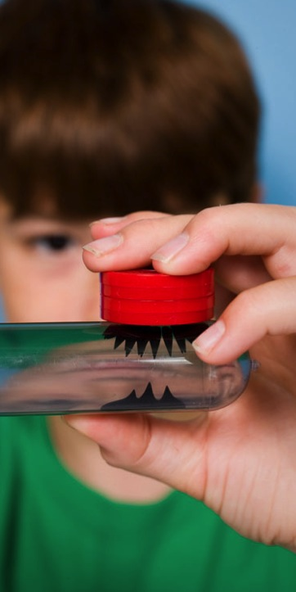
A Question of Equity
Acting Equitably implies taking actions
that differentiate needs and
that apply policies and practices according to the different needs of groups
Equity of Effort to reach underserved audiences
Notes:
Very important to talk about an equitable approach and fairness. It puts folks in an equity frame of mind. Equity of effort that your actions will be based on your effort.
Equity of Effort to reach underserved audiences– some groups are harder to reach than others and require more/different strategies/partnerships.

Slide 6
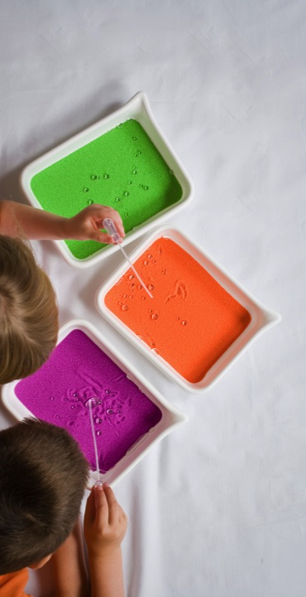
Building Partnerships

Slide 7
Characteristics of Successful Partnerships
Shared goals
Realistic expectations
Formalize & plan
Time commitment
Organic Relationships
Mutual respect
Perseverance
Notes:
Shared Goals: everyone understands the benefits. At the most basic level when thinking about partnering around nano content, ISEs benefit through access to new audiences and partnering organizations benefit by being able to offer new content to their audiences.
Realistic expectations: While the intention might be to have a long-standing relationship, being clear about what the boundaries/limitations of the “first step” is important in managing expectations and achieving outcomes.
Formalize and plan: Important to take time to move beyond verbal agreement to take action. Write up a short plan of action that outlines the intent of the partnership that both organizations sign as a commitment.
Time commitment: Both parties should have a clear understanding of the time and effort that will be required to implement the partnership. Both parties should also be able to commit to these requirements, and be willing to flex if more time is necessary.
Organic relationships: While it’s important to have shared goals, the partnership should also build on the existing assets of each party (i.e., what each already does). Don’t try and hammer a square peg into a round hole just for the sake of partnership.
Mutual respect: each organization will have its own mission/philosophy and way of working. Both parties need to acknowledge, respect, and be willing to work within these differences to shape a partnership. No one party has the “right way” of operating.
Perseverance: Success may take more time, effort and patience than initially thought. Remember that you learn by doing.

Slide 8
Challenges to Partnership
Forced partnership
High turnover
Exclusive self-interest
Difference in institutional cultures and assumptions
Lack of trust
Notes:
Forced partnership: not all matches are good matches. Remember that failure of one outreach effort does not mean partnership is not possible.
Turnover: many CBOs serving underserved populations have high staff turnover. Taking this into account from the outset is important. Establish 2 or more contact points to ensure continuity of effort.
Self interest: Must think less of your own needs and more of the overall objective of the partnership.
Institutional cultures and assumptions: Need to recognize that each partner will need time/opportunity to teach the other “how they do things.” One partner’s expertise doesn’t trump the other’s expertise or opinion on what may or may not work. Must find common ground or compatible strategies for success.
Lack of trust: many CBOs that serve underrepresented audiences have been pursued as the “token” effort by other organizations (or even your own). You must be willing to take the time to build that trust, even for a one-time event.

Slide 9
Exploring Strategies: Partnership Case Studies
Notes:
This is an overview of the presentation we are going to have this morning.

Slide 10
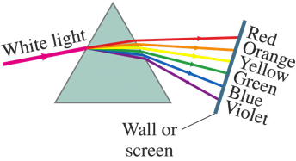
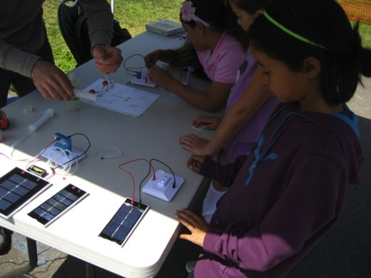
Project iLASER: Inspiring Future Problem-Solvers
Project iLASER:
investigations with
Light
And
Sustainable
Energy
Resources

Slide 11
International Year of Chemistry 2011

Slide 12
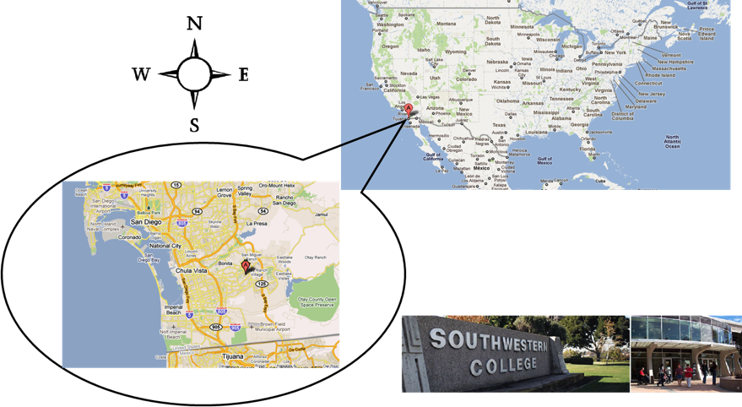
Location of Southwestern College

Slide 13
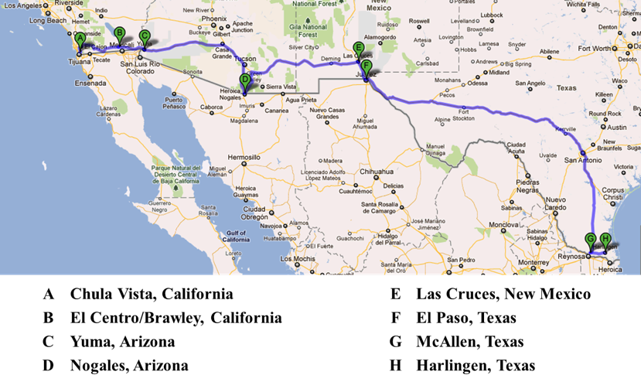
Project iLASER Route – Fall 2011

Slide 14
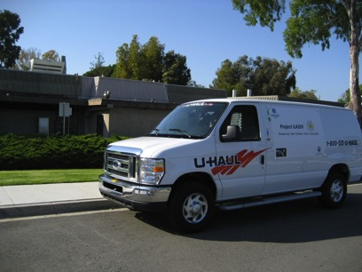
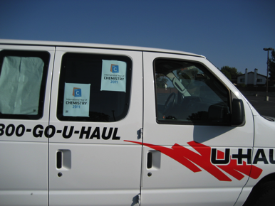
The Project iLASER Chariot – Fall 2011

Slide 15
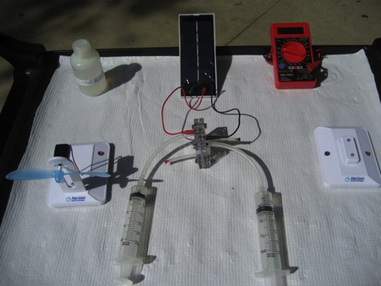
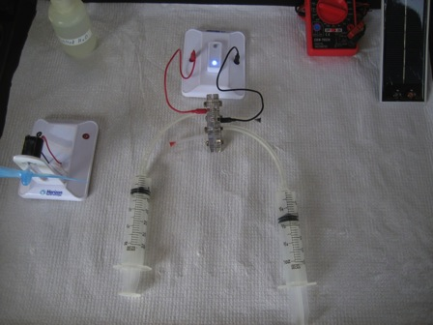
Storing and Utilizing Solar Energy
Text

Slide 16
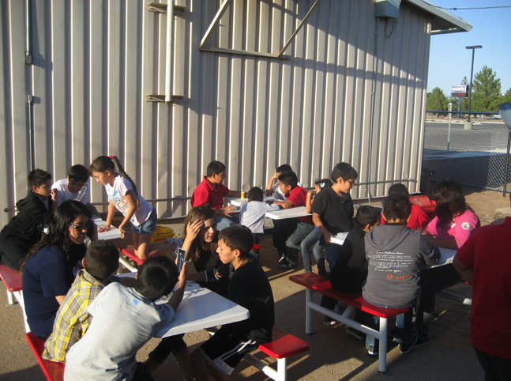
Solar Hydrogen Action Abounds

Slide 17
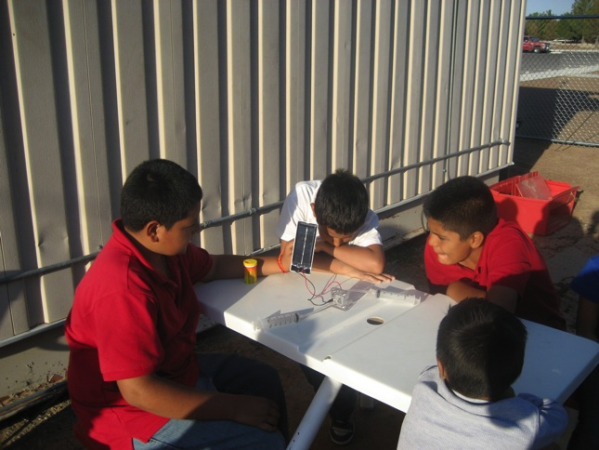
Storing Solar Energy as Hydrogen Fuel

Slide 18
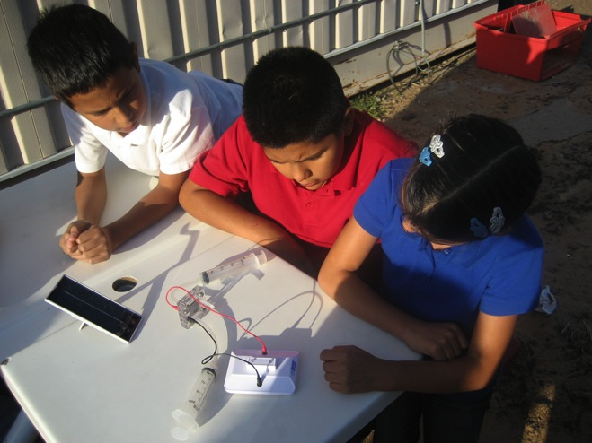
Converting Hydrogen Fuel to Electricity

Slide 19
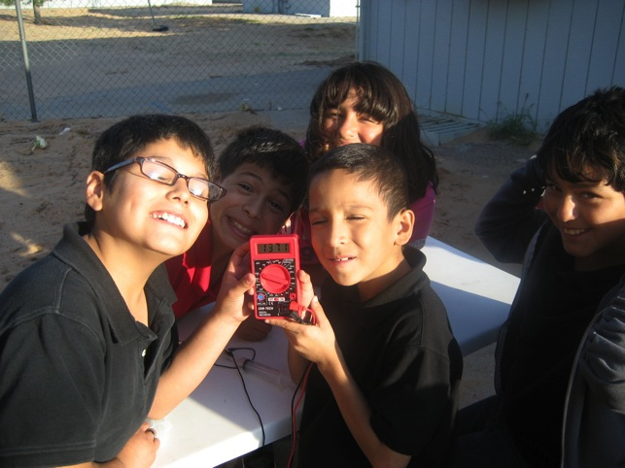
Quantitative Measurement of Electricity

Slide 20
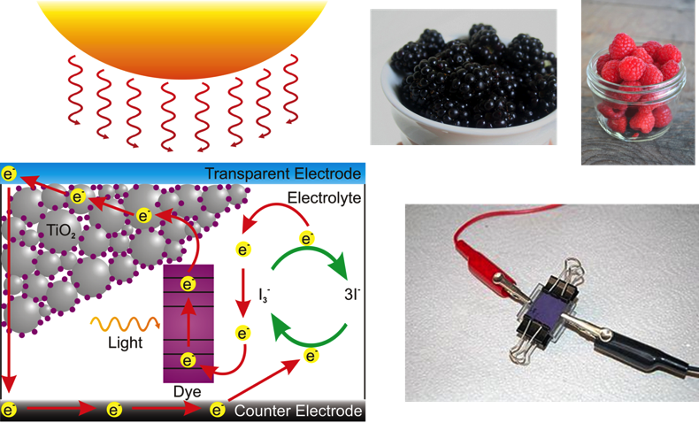
Building Dye-Sensitized Solar Cells

Slide 21
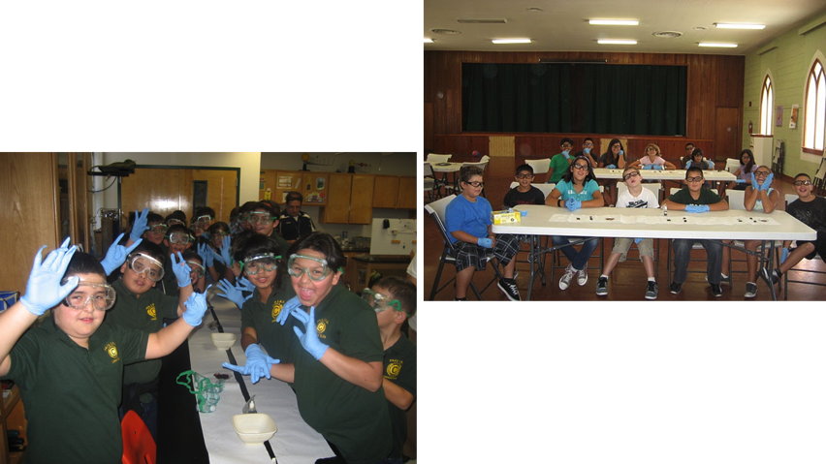
Building Dye-Sensitized Solar Cells

Slide 22
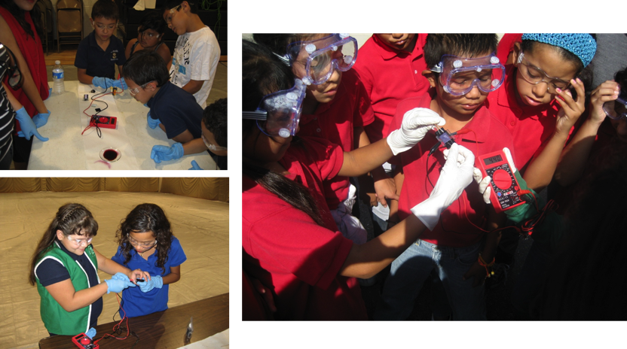
Testing the Dye-Sensitized Solar Cells

Slide 23
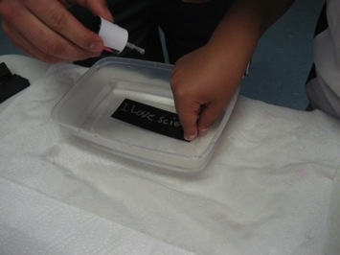
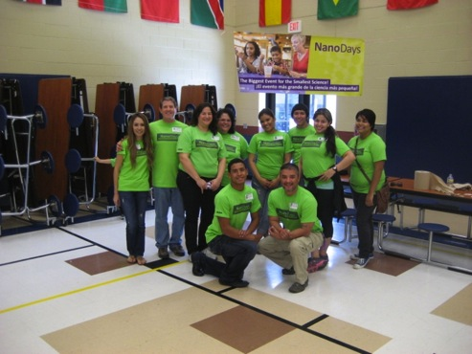
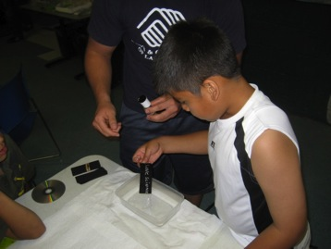
NanoDays 2012

Slide 24
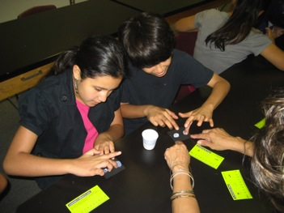
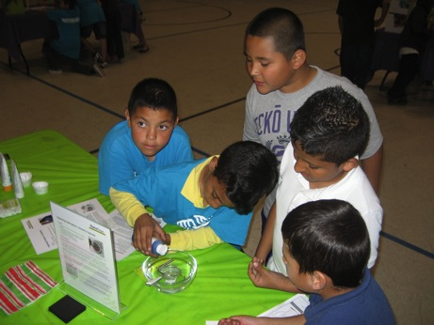
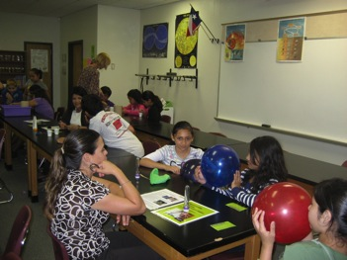
NanoDays 2012

Slide 25
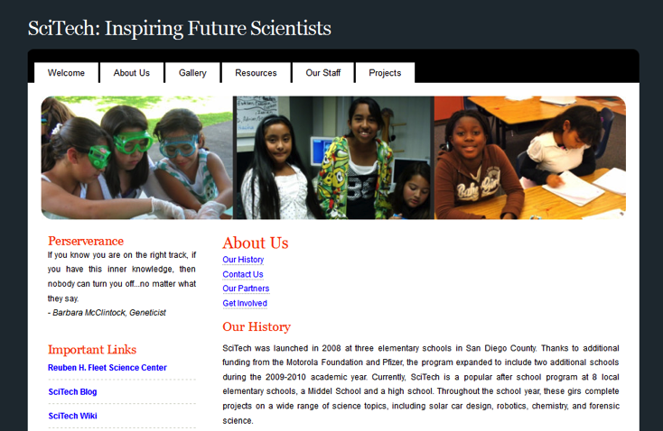
R.H. Fleet SciTech Program

Slide 26
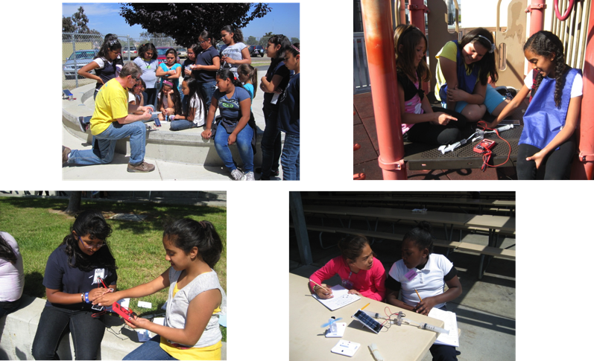
R.H. Fleet SciTech Program

Slide 27
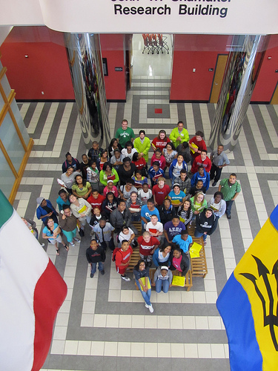
Kentucky Science Center
Day of Nano Lab Programming with Lincoln Foundation Whitney Young Scholars, the University of Louisville Micro/Nano Lab, and the Kentucky Science Center
March 17, 2012
Programming consisted of introduction to nano, gold nanoparticle reactions, and a MEMS cleanroom tour

Slide 28
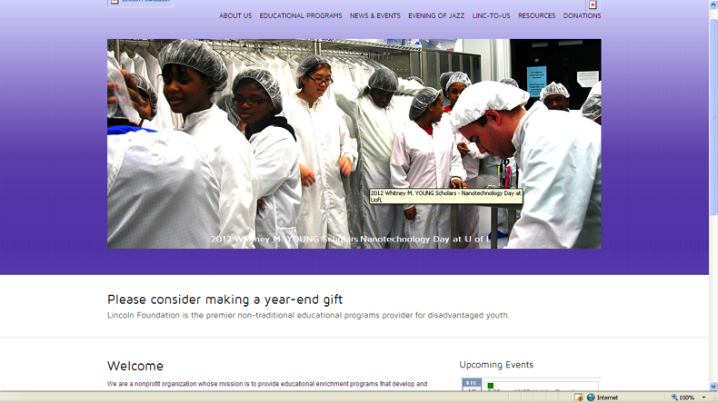
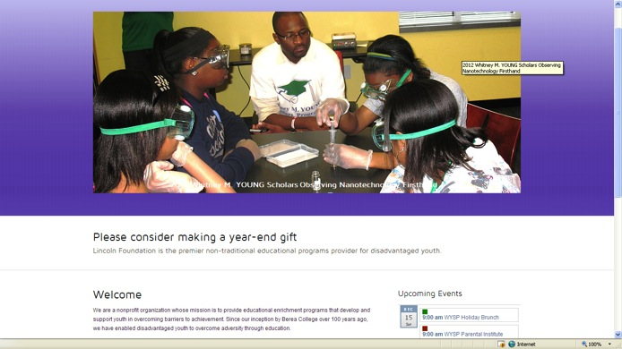
Our Lab Featured on lincolnfdn.org!

Slide 29
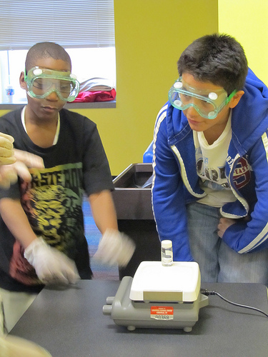
Key Project Points- Kentucky Science Center
To provide a genuine lab experience to an underserved curriculum.
Coming to the table with a well-defined proposal. Offering to supplement their program schedule with KSC-developed content. Avoiding ‘chicken-or-the-egg’ situations.
Drawing upon published & cutting-edge nano research to create not only this lab experience but also publically accessible labs. Content has since been utilized in our BioLab for ‘drop-in’ demonstrations and also at the Youth Science Summit— a day-long STEM event for area Middle and High School students.

Slide 30
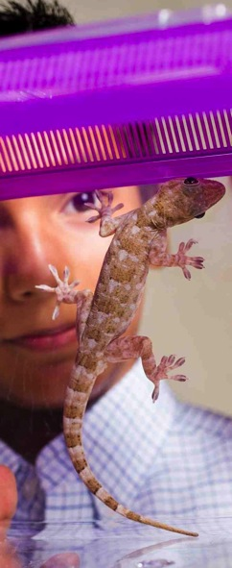
Context: NISE Net IA Partnership Work
Connection with Boys & Girls Clubs of America (BGCA) made in 2009
Three NISE Net Partners: OMSI, Museum of Life + Science, NYSci
Local BGCA sites/systems
Nine months duration
Notes:
Initial connection with BGCA came from their participation in the 2009 DEA workshop in Washington, D.C. Mary Grybeck, Director of Technology Programs and Training, provided the DEA working group with some background about the BGC, how the Clubs are structured, and some suggestions for partnering with local Clubs. Grybeck also suggested particular local Clubs to contact in the three communities where the pilot
projects were going to take place.

Slide 31
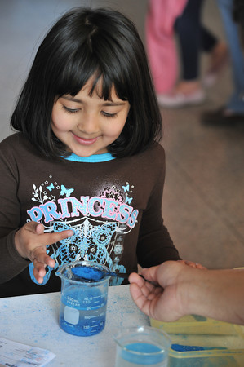
Lessons Learned
Consider multiple visits
Modify activities to match the environment
Keep groups small
Provide youth with take-aways
Notes:
Consider multiple visits
Repeat visits create added value in a number of ways. They communicate to the BGC that your institution has a long-term interest in partnership. The extended contact hours for youth to familiarize themselves with the visiting museum staff and begin to develop relationships. For NYSci, repeat visits also provided the opportunity for informal measurement of learning outcomes. Multiple visits may also be useful for recruitment. In
the case of OMSI, new youth were drawn to the programming at each successive visit.
Modify activities to match the environment
Given the active environment at Clubs, careful thought should be put into the program design to ensure a positive experience for your staff, youth participants, and BGC staff. Programs should be designed to allow each participant to have the same experience at the same time, so plan for modifications that support large group activity and longer engagement times. Consider opening and closing activities that “hook” youth, even if not nano-related.
Keep groups small
Although the ability to facilitate groups of youth may vary by educators, both OMSI and NYSci suggested keeping the size of the group small. NYSci felt 10 youth with two educators was an ideal number, while OMSI felt 15 youth was the maximum group size they could handle with one facilitator.
Provide youth with take-aways
A great way to get and keep kids engaged is to ensure that there is some kind of take-away for youth to bring home and remind them of their learning experience. Youth participating in both NYSci and OMSI programming were able to leave with at least one product from their experience. As was evident in OMSI’s experience, the youth were excited about having something to bring home and the paper buckyballs were in high demand.

Slide 32
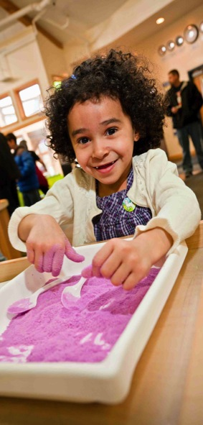
Lessons Learned
Be persistent in making the initial connection!
Explore what both sides can bring to the partnership
Visit the facility prior to program delivery
Deliver programming in pairs
Notes:
Be persistent in making a connection
As in many nonprofit organizations, BGC staffing can be very fluid. It may take months to find the right person in the organization to get a program established, but as in NYSci’s case, once it happens implementation can move along quickly. Took NCML+S more than 9 months to find appropriate contact.
Explore what both sides can bring to the partnership
Explore the strengths of each partner and the contributions they can make to partnership. It may be easy to assume in this type of endeavor that the science center or museum is providing most of the assets to the partnership, but do not discount the assets embodied by the potential partner. BGC often support youth that do not regularly visit science centers and museums, and present good opportunity to reach these children and their families. They may also have physical assets to bring to the table. While both OMSI and NYSci were able to provide free entrance to program participants, Clubs were able to provide transportation to and from the museum.
Visit the facility prior to program delivery
The physical layouts of Clubs vary widely, especially when it comes to classroom space. The BGC environment is very active, with youth participating in sports, arts & crafts, computer activities or just hanging out. Making time to visit the location will inform choice of activity and give you a feel for the amount of privacy you will have for your visit as well as the amount of BGC staff support your can expect on site.
Deliver programming in pairs
If possible, involve BGC staff as co-teachers. If BGC staff is not available to co-teach, it’s recommended to send teams of at least two people for program delivery. This allows for mutual support during activities and increased attention to youth. NYSci successfully
delivered their programming with two staff members, while OMSI ended up only able to send one person to their local Clubs. Although OMSI had success with their programming, they also had some challenges facilitating and managing the group with only one staff person.

Slide 33
Partnerships for Equity Resources
Process Evaluation of the Diversity, Equity, and Access Working Group’s Partnership Pilot Project : http://www.nisenet.org/catalog/tools_guides/process_evaluation_diversity_equity_access_working_groups_partnership_pilot_pro
Collaboration: Critical Criteria for Success: http://astc.org/pubs/browse_publications.htm

Slide 34
This presentation is based on work supported by the National Science Foundation under Grant No. 0940143. Any opinions, findings, and conclusions or recommendations expressed in this presentation are those of the authors and do not necessarily reflect the views of the Foundation.

