Slide 1
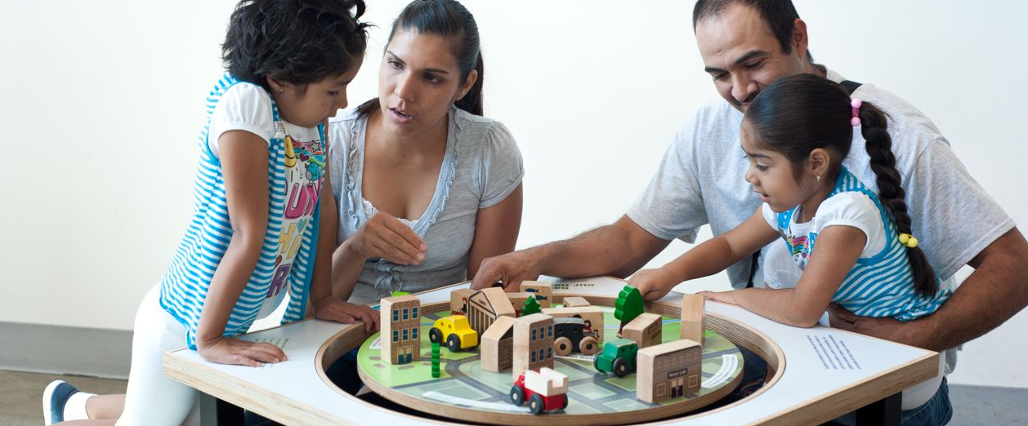
NISE Network Evaluation:
What We’ve Learned and Where We’re Headed
Network-Wide Meeting
December 2012

Slide 2
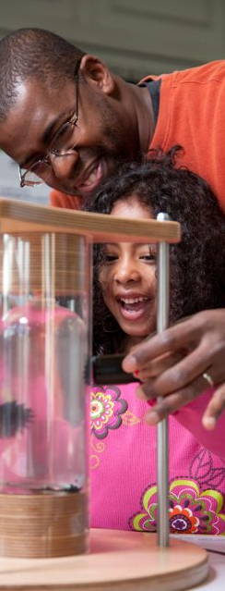
Presenters
Elizabeth Kunz Kollmann, Museum of Science, Boston, ekollmann@mos.org
Juli Goss, Museum of Science, Boston, jgoss@mos.org
Liz Rosino, Oregon Museum of Science and Industry, LRosino@omsi.edu
Gina Svarovsky, Science Museum of Minnesota, gsvarovsky@smm.org
Notes:
Many of you have probably heard about findings from some of our past studies, but you may not have heard about some of our more recent studies.
We are also currently working on a number of additional studies for the NISE Net, which have findings which may be applicable to your own work.
Today we’d like to talk with you about some of these studies.
Introduce who each person is
Liz Kollmann, head of the NISE Network evaluation team
Juli Goss leads the evaluation work looking to understand the impacts of the NISE Net on professionals
Liz Rosino leads up the work surrounding the Annual Partner survey and data mining for the evaluation team.
Gina Svarovsky heads up the evaluation work looking to understand the impacts of the NISE Net on the public

Slide 3
NISE Network Evaluation Team
Composed of evaluators from:
Museum of Science, Boston
Oregon Museum of Science and Industry
Science Museum of Minnesota
Notes:
The NISE Network evaluation team is made up of evaluators from three NISE Network institutions
The Museum of Science, Boston,
The Oregon Museum of Science and Industry, and
The Science Museum of Minnesota

Slide 4
Evaluation Team Structure
Summative Evaluation
Formative Evaluation
Public Impacts
Team-Based Inquiry
Professional Impacts
Annual Partner Survey / Data Mining
Notes:
Evaluators from these institutions have created cross-institutional teams in order to understand the impacts of the NISE Network
The teams continually work with each other in order to inform each other’s work and ensure that we are gathering data that can inform the Network’s work and understand the impact of this work on NISE Net’s core audiences
Professional impacts
The purpose of this team is to study the impact of the NISE Network on its professional audience.
This team addresses how NISE Net affects the capacities of those involved and how professionals’ practice may change as a result of participation in NISE Net.
Public Impacts
The purpose of this team is to study the impact of NISE Network products on the public.
This team is currently looking at the impacts of the mini-exhibit and plans to also study the impacts of NanoDays 2013.
Team-based Inquiry
The purpose of this team is to support funded partners and work groups in conducting studies of their practices and products as well as
Promote TBI among broader institutions.
The Network believes that by engaging in an ongoing cycle of inquiry, working collaboratively with evaluators to gather data and answer questions relevant to their work, and continuously reflecting on lessons learned, the work groups will improve their contribution to the Network.
Annual Partner Survey
The purpose of this team is to coordinate and implement the annual partner survey in order to inform the public and professional impacts teams as well as team-based inquiry.
Inform the Network more broadly
Supporting other groups as well
Today we want to talk to you about findings from two recent studies we’ve conducted
The Network Communication Study which looked at how messages, content, and products are communicated through the Network; and
The Mini-Exhibit study which looked at the impact of the mini-exhibit on visitors’ understandings of nanotechnology
We will also briefly touch on we’re the evaluation work is heading by letting you know a little about:
The longitudinal study we are currently conducting to understand the long-term impact of the NISE Net on ISE professionals,
How the Annual Partner Survey connects to this work, and
The NanoDays study which will look at the impact of 2013 NanoDays on members of the public.
After the presentation about the professional work and the public impact work, there will be a short amount of time for Q&A
We will also leave time for Q&A about all of the studies at the end of the session

Slide 5
Network Communication Study
www.nisenet.org

Slide 6
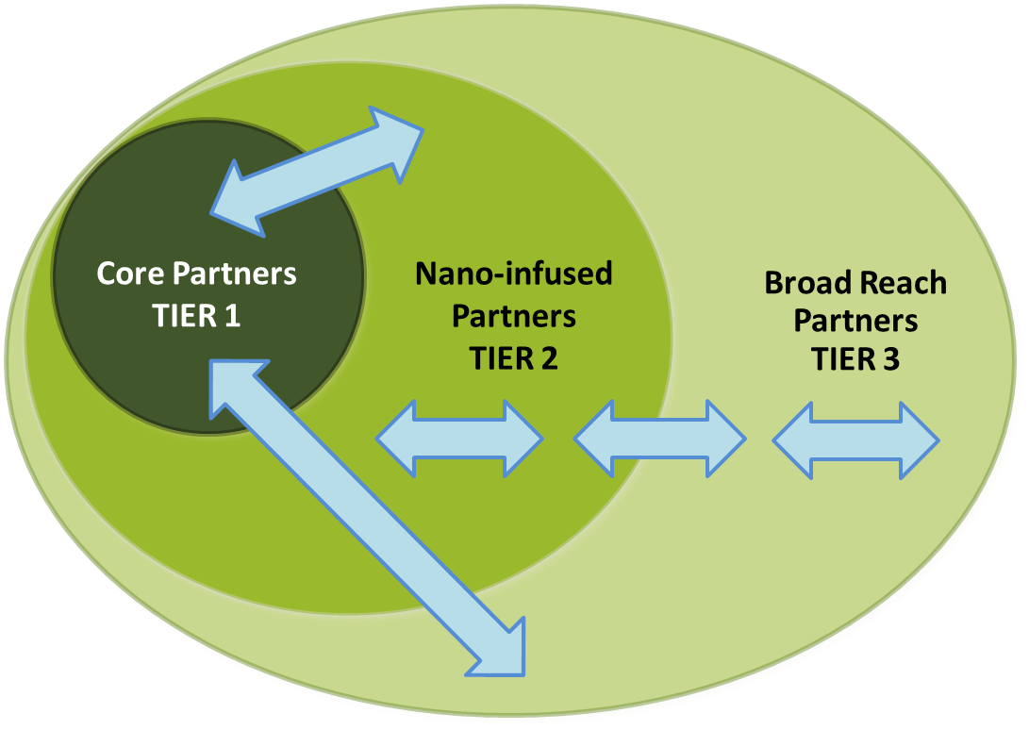
Study purpose and focus
A study of communication within and between the tiers…
Because this is a network, studying communication
highlights the ideas holding us all together.
6
Notes:
You might notice that this figure looks similar to Larry’s diagram in yesterday morning’s presentation.
This study helped inform that next version of the diagram and how we understand the network.
The purpose of this study was to look at how people in the Network are sharing and getting ideas. Realized that studying the key structures of the Network would allow us to see how people are understanding and developing ideas.
We looked at communication in all directions between directly funded partners and the broader network.

Slide 7
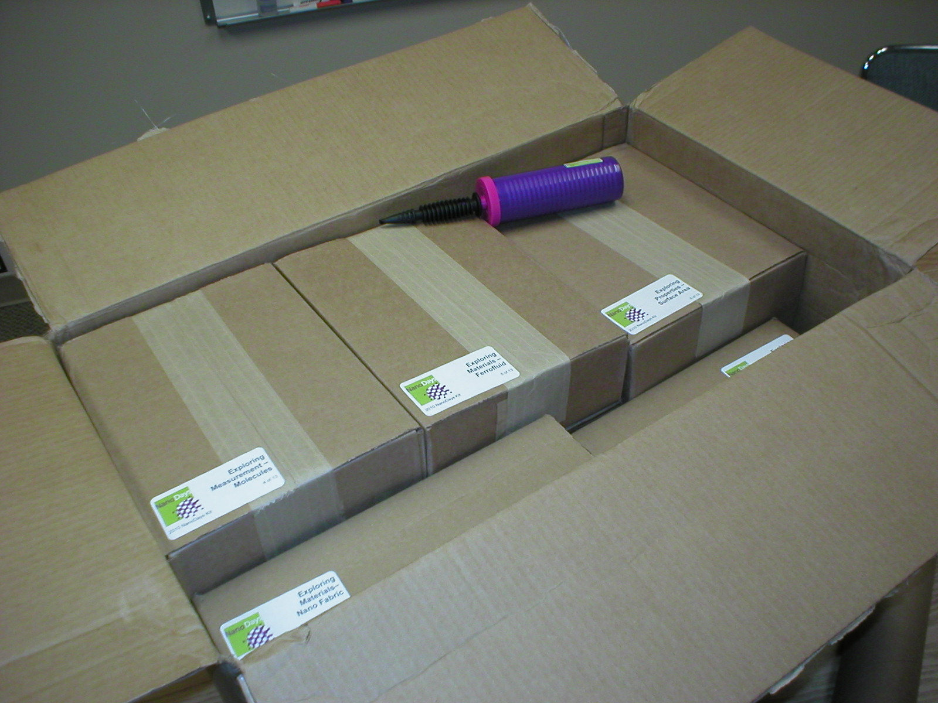
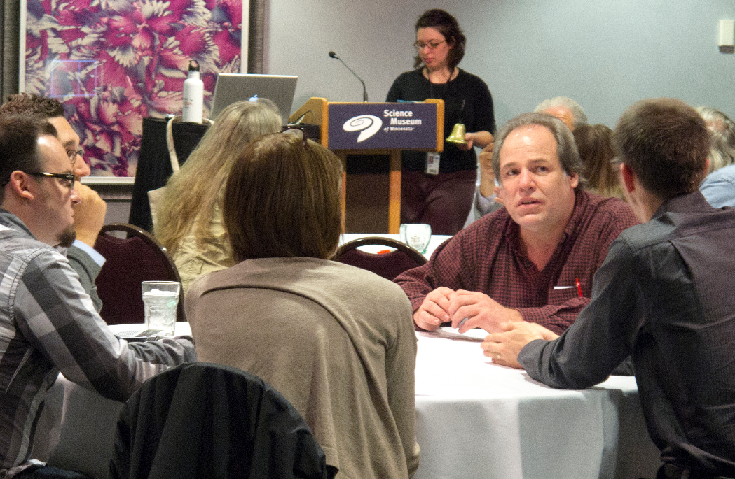
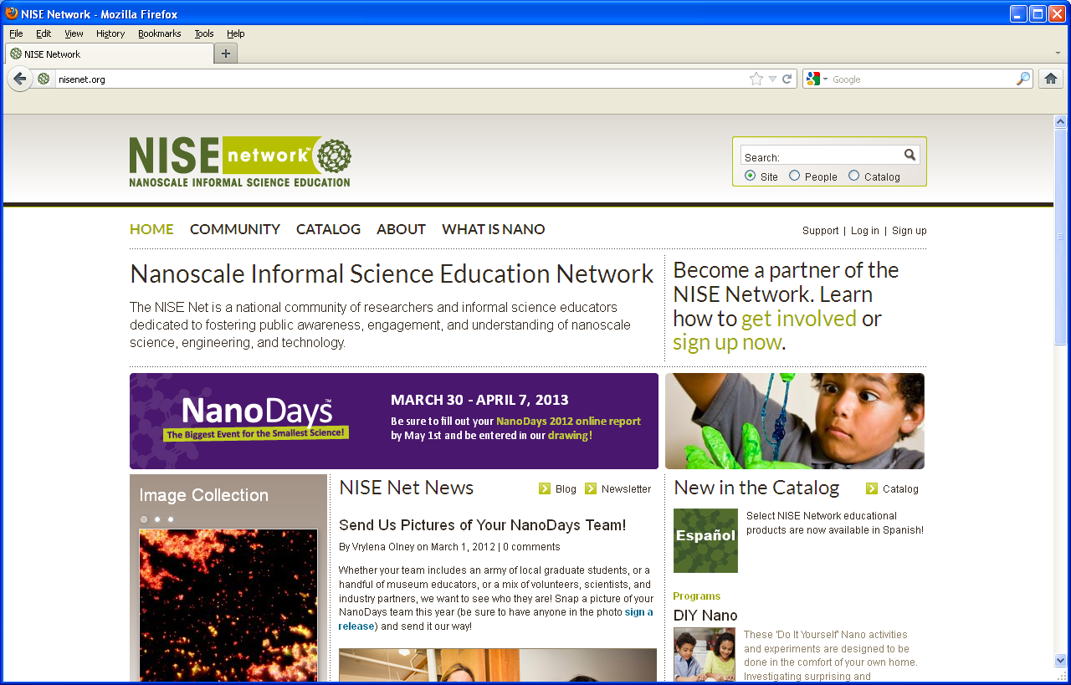
Study purpose and focus
4 primary communication components:
NanoDays
Regional hub structure
Face-to-face meetings
nisenet.org
Notes:
The 4 key structures we studied – you’re probably familiar with most of these.
NanoDays kits and events
Regional hub structure
Face-to-face meetings
The website – nisenet.org
Why now?
Study this now so that this information could tie into future studies of professional and public impact.
Also since it studies structures that were determined to be semi-fixed as of the beginning of Year 6, hope to provide Network Leadership with information for future decision making.

Slide 8
Methods
Tier 1
7 focus groups with 3-4 people each
Total of 24 professionals
Core Partners
TIER 1
Nano-infused Partners
TIER 2
Broad Reach Partners TIER 3
Notes:
Representation from all eligible working groups and 12 of 13 eligible institutions
Members of Network leadership and Evaluation work group were not eligible
Respondent rate = 24 of 44 eligible people (55%)

Slide 9
Methods
Tiers 2 & 3
39 individual interviews
All participants considered “actively engaged”
Various
museum types, sizes, and geographic region
Core Partners
TIER 1
Nano-infused Partners
TIER 2
Broad Reach Partners TIER 3
Notes:
Active engagement = institution has held NanoDays at least once in the past 3 years; someone from institution has participated in 1 or more professional development opportunities (meeting, workshop, site visit).
Evaluation determined eligible institutions and had regional hub leaders report the most involved individual per institution. Evaluation did not share final sample, but used hub leader input to determine individual characteristics that were the most up to date and could not always be determined by network databases.
Respondent rate = 39 of 87 (45%)

Slide 10
Findings
The communication that happens through various Network components
Notes:
The findings are organized by the communication that happens through each of the four primary communication components (NanoDays, face-to-face meetings, the regional hub structure, and nisenet.org) as well as through a couple of additional avenues as identified by study participants.

Slide 11
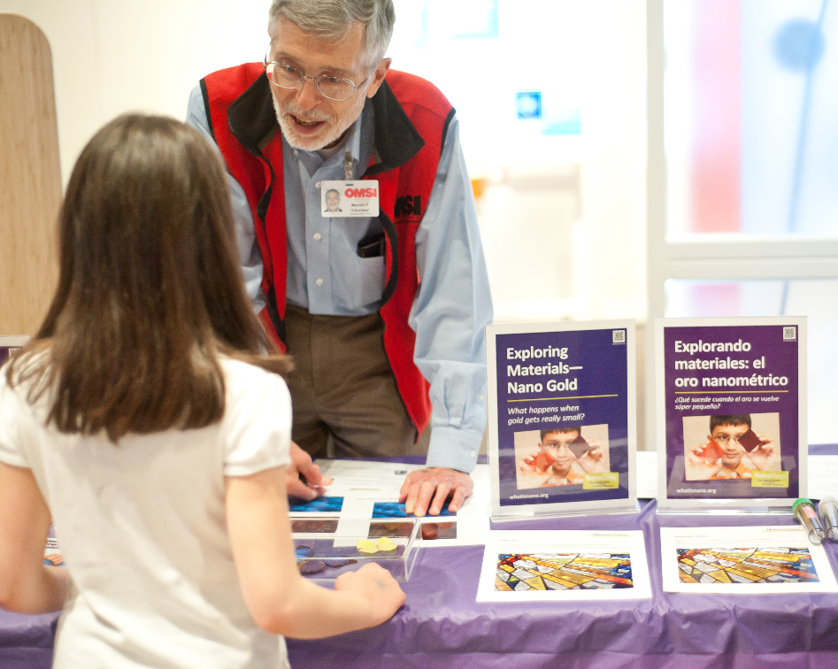
NanoDays says…
Notes:
During the focus groups and interviews, everyone was asked to identify the main messages and ideas they felt were communicated by NanoDays (particularly the NanoDays kit) to professionals (not the public…).

Slide 12
NanoDays says…
You can do Nano!
Notes:
You can do nano!
This study finds that the ease with which the kit activities can be implemented by museum professionals communicates that nanotechnology can be accessible and fun for everyone.
Kit conveys messages to professionals such as:
nano can be fun and exciting
anyone can do nano
NanoDays is a “common cause”

Slide 13
NanoDays says…
Nano is important!
You can do Nano!
Notes:
Nano is important!
Partners felt the high quality of the kit materials and activities conveyed that the Network:
believes nano education is important and worth doing
NISE Net is a professional and well-organized network
trustworthy source of information that respects and values its partners.

Slide 14
NanoDays says…
Nano is important!
You can do Nano!
Communication and dissemination of information is important!
Notes:
Communication and dissemination of information are important!
Through this component the Network both disseminates and gathers information.
A key communication aspect of NanoDays seems to take place in the form of the online NanoDays report. The funded partners involved in developing ND materials each year, emphasized that the report is the primary way in which they hear from partners and learn about the size, scope, and reach of NanoDays events each year. In addition, many partners indicated that this reporting form was the primary way in which they were able to communicate and provide feedback.

Slide 15
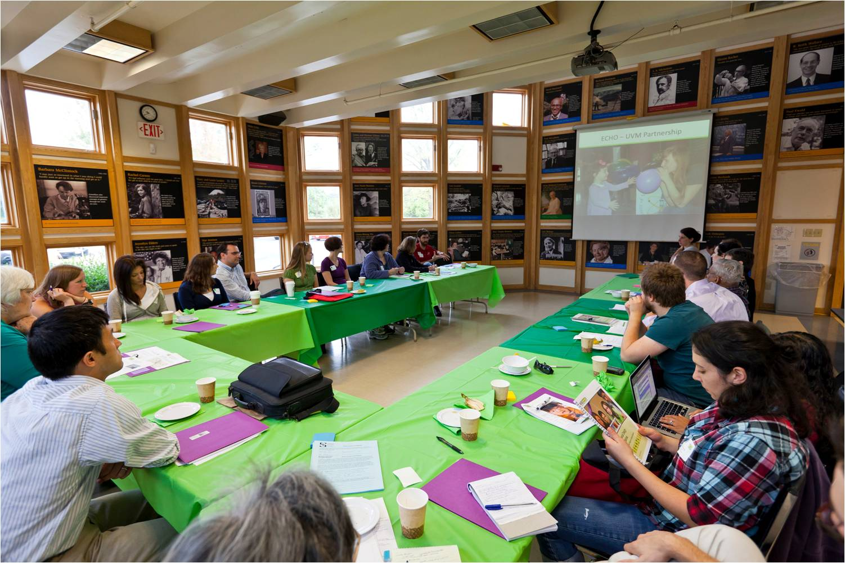
Face-t0-face meetings say…
Notes:
As you know, NISE Net partners have the opportunity to meet in-person each year at meetings, workshops, and partner site visits. Findings from this study indicate that meetings foster communication across and within all levels of Network involvement.

Slide 16
Face-t0-face meetings say…
We are here for you!
Notes:
We are here for you!
Partners feel that face-to-face meetings not only allow people to become better acquainted, but also provide a place for mentoring and encouraging deeper commitment to and involvement in nano education. People reported feeling that NISE Net is a supportive network that supports and values its partners.
Through these important face-to-face meetings, general information, updates, and focused training around complex topics is provided.

Slide 17
Face-t0-face meetings say…
You are part of a community!
We are here for you!
Notes:
You are part of a community!
Through face-to-face meetings the Network builds relationships and promotes deeper involvement in nano education. Face-to-face meetings were described as an essential communication mechanism that promotes community building within the Network.
Partners from all levels of involvement report to generally enjoy NISE Net meetings and feel they benefit primarily because they provide the opportunity to interact with their ISE colleagues who are also engaged in nano education.
Many of the conversations that partners reported having at meetings were about implementing products (particularly the NanoDays kit). For some partners, conversations at face-to-face meetings were often a catalyst for future discussions via phone and email.

Slide 18
Regional Hub Structure says…
Notes:
As you know, the Network is divided into seven geographically defined “regional hubs” that are overseen by a hub leader. Through this component hub leaders provide personalized support and information to the broader Network.

Slide 19
Regional Hub Structure says…
We are your go-to resource!
Notes:
We are your go-to resource!
It was found that through this structure information about the Network and its initiatives is disseminated, partners are directed to NISE Net resources, and is the structure that ensures that people have a personal Network contact.

Slide 20
Regional Hub Structure says…
We are your go-to resource!
You are also part of a local community!
Notes:
You are also part of a local community!
In addition to disseminating information, partners felt that the regional hub structure facilitates local connections and partnerships and cultivates a sense of community that helps people feel part of the Network.
Messages reportedly received through this structure include, “We’re part of a whole” and “We’re in this together.”

Slide 21
Regional Hub Structure says…
We are your go-to resource!
Please contact us!
You are also part of a local community!
Notes:
Please contact us!
Beyond interacting with hub leaders at regional meetings and submitting the NanoDays report, few partners reported actively seeking to communicate with their hub leader despite the structure being designed as a conduit of communication. Rather, most partners reported to receive updates and information from their hub leader, but they did not respond to this communication or otherwise initiate communication.
Those partners who did communicate with their hub leader shared their questions, feedback, requests for resources and additional supports, and updates about their institution’s nano programming.

Slide 22
Nisenet.org website says…
Notes:
During the focus groups and interviews, partners identified the main messages and ideas they felt were communicated by the nisenet.org website.

Slide 23
Nisenet.org website says…
You can do MORE nano!
Notes:
You can do MORE nano!
This study found that the website primarily communicates the extent of the Network’s resources including educational products and community efforts.
The massive amount of information on the website was perceived to be both a strength and a challenge. While it was felt that nisenet.org conveyed to website visitors the scope of the Network and that “there’s a community,” there was also worried that the amount of information available made it difficult for visitors to find what they were seeking.
Despite this concern, only 2 of the 39 partners interviewed indicated that they had difficulty finding the information they were seeking on the website, and several people expressed their enthusiasm about the site.

Slide 24
Nisenet.org website says…
You can do MORE nano!
Here is a wealth of Network info and resources!
Notes:
Here is a wealth of Network information and resources!
The study finds that the website is a mechanism that communicates information in a unilateral direction. The work of the funded partners outward to the rest of the Network. Although the website features a commenting function whereby partners can comment in the catalog as well as on the blog, few people have made use of it.
In interviews, few partners indicated that they updated their personal profile, accessed the site to connect to other Network partners, or shared the website with individuals not involved with NISE Net. In general, people seemed to view the website as a repository of information and resources and not a mechanism through which they can communicate with the Network.

Slide 25
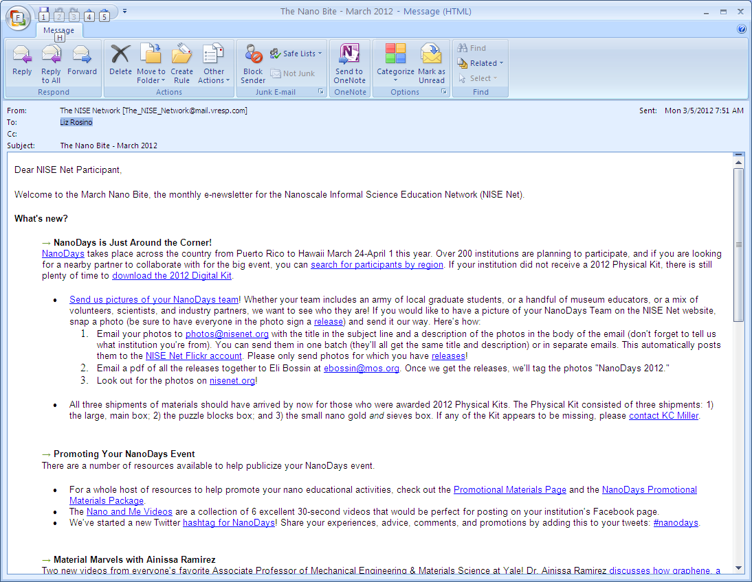
The Nano Bite and social networking says…
Notes:
When asked whether there were additional communication mechanisms that NISE Net employed beyond the four primary components, partners voluntarily referenced the Nano Bite monthly e-newsletter and social networking sites with reasonable frequency.

Slide 26
The Nano Bite and social networking says…
We have some interesting and timely information for you!
Notes:
We have some interesting and timely information for you!
Through the Nano Bite, funded partners say they share NISE Net updates, reinforce Network practices, and highlight the nano work of selected partners.
In line with this, about a quarter of partners who were interviewed indicated that they did receive general information and Network updates from the Nano Bite newsletter.
Similarly unprompted during interviews, a few partners also mentioned learning about NISE Net and receiving Network updates through social networking offerings such as the NISE Net Facebook and LinkedIn groups and via Twitter. Similar to the website, they primarily saw these sites as a way to gain instead of contribute information. So the few partners who did mention accessing Network information and updates through social networking sites usually did not use these mechanisms to communicate back to or outside of the Network or to individuals outside of the NISE Network.

Slide 27
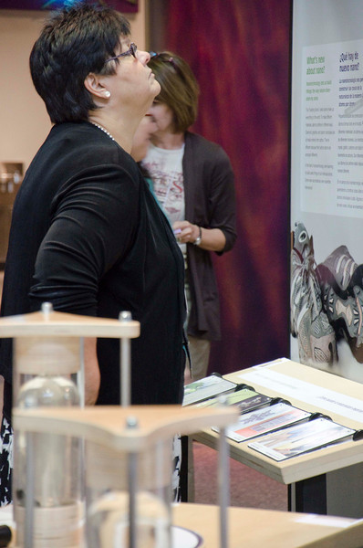
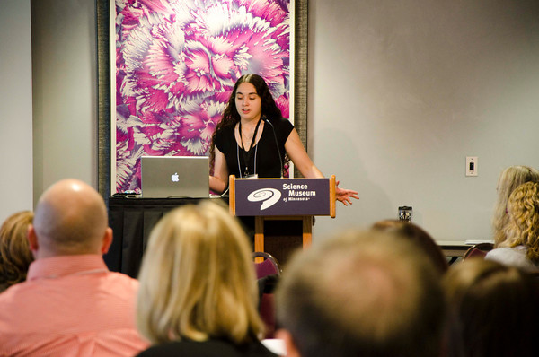
Communication that Network partners desire
Ideas, information, and practices that Network partners wished they heard more about.
Notes:
We not only looked into what people were hearing, we asked about what people wanted to learn more about.
Now I’ll shared the communication that Network partners desire

Slide 28
Desired Communication
I guess it’s the SEI stuff, the societal and ethical implication stuff… I think it’s a bigger question that the field is struggling with.
How do I convey challenging content?
What kind of information can we provide to the other partners to get them to feel comfortable with reaching out to diverse audiences?
Notes:
One big question that people had was how to convey challenging content. For example, an educational product developer mentioned how difficult it was to convey nano and society concepts – and how this could be difficult for anyone.
1st quote

Slide 29
Desired Communication
I would love to be able to know or gauge partners’ interest… have we created things that they really want to use?
One of the things that would be helpful for me, and I’m sure for other people, is to sort of have people’s experiences with these NanoDays kits and these activities somehow recorded.
How are partners engaging the public in nano?
Notes:
Across tiers, partners strongly desired to know more about the nano educational activities happening throughout the year at other organizations.
What are people doing outside of NanoDays?
What are people doing for NanoDays?
How are people modifying materials for their audience?

Slide 30
Desired Communication
I wish I knew more about the [NanoDays] evaluation, like what they’re finding out is more effective…. I’ve never heard them talk directly about the data that’s being collected.
I would just like to have more email, even if it’s just notices of new things coming out of whatever the national network is as well…maybe give me a menu of things to sign up for.
How can we communicate more?
Notes:
Not only do partners want to know how other partners are engaging the public – everyone wants to generally communicate more.
For example – 2nd quote

Slide 31
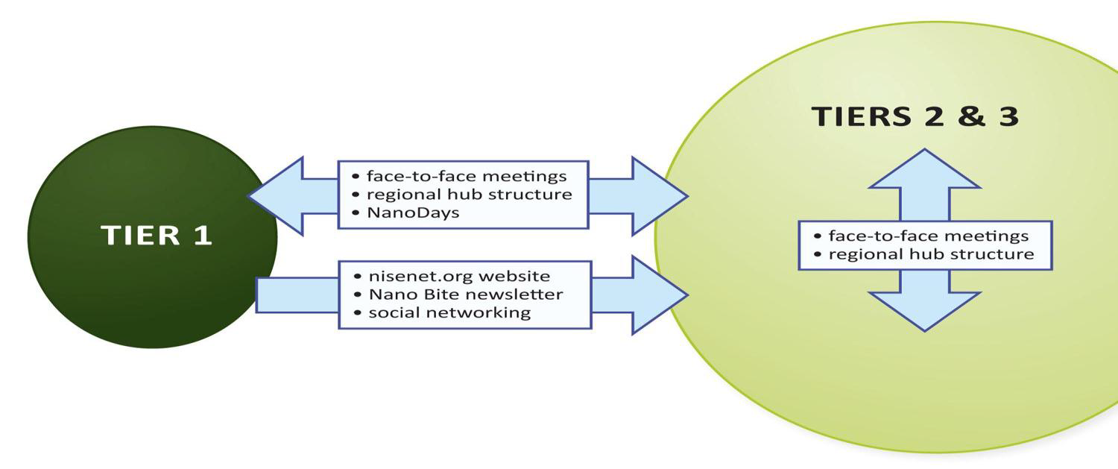
Reflections
Directionality of NISE Network communication components
Notes:
Partners most valued mechanisms that promoted multi directional communication – in particular, face to face meetings. Catalyst for partners’ deeper involvement in the Network. Unilateral components were effective in communicating information out from Tier 1. Tier 2 and 3 wanted these components (particularly the website) to allow for multidirectional communication. Multidirectional communication mechanisms more strongly communicated a sense of community (meetings, and RHS). Modify and create current communication components that allow for greater multidirectional communication in the Network.
NCS provided the groundwork future evaluation

Slide 32
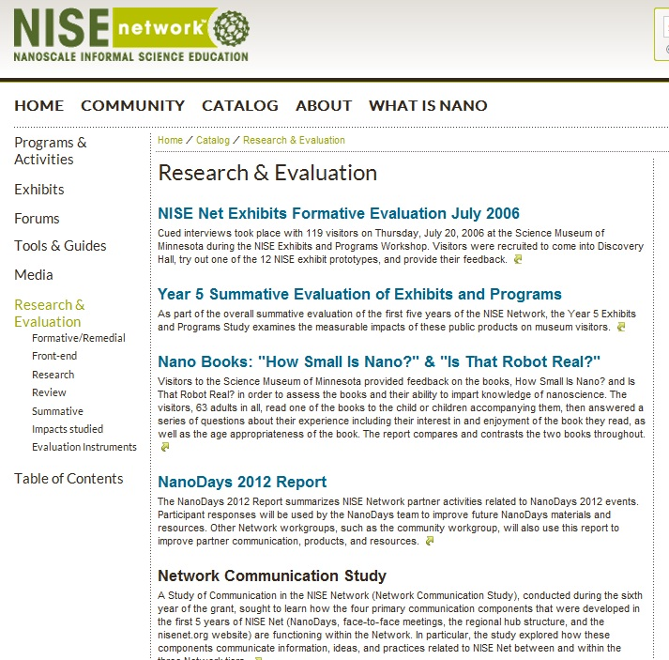
Learn more about evaluation
nisenet.org/catalog/eval
NanoDays reports
Educational product evaluation
Network Communication Study
Notes:
You can find most of our reports at this website
NanoDays reports – read about what other partners are doing!
Evaluation of products
All the big reports – like the Network Communication Study

Slide 33
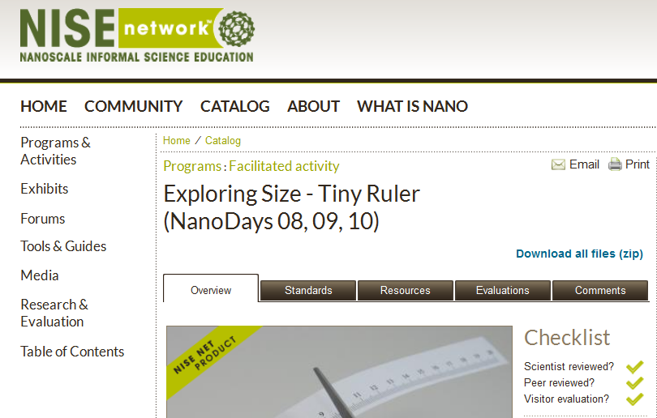
Learn more about evaluation
Evaluation of educational products
Notes:
The reports about educational products can also be found on a product’s page.
Look at the evaluation tab

Slide 34
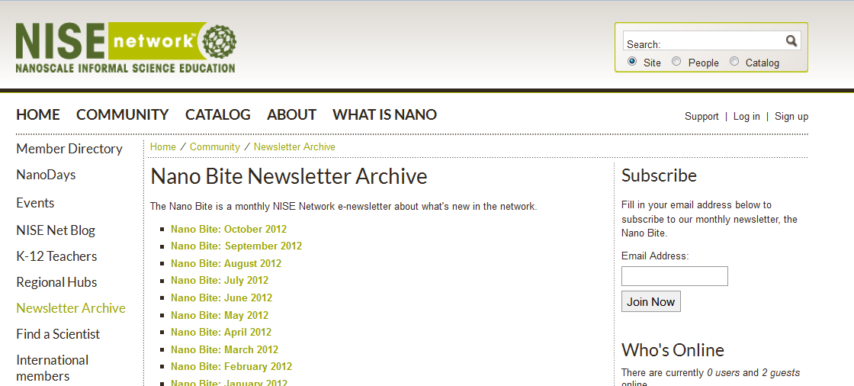
Learn more about the Network
The Nano Bite
nisenet.org/community/nanobite
Subscribe here!
Notes:
Big method of dissemination about network updates
Key findings from evaluation
Partner highlights
Subscribe here!
Archive of all past newsletters
Sign up and subscribe

Slide 35
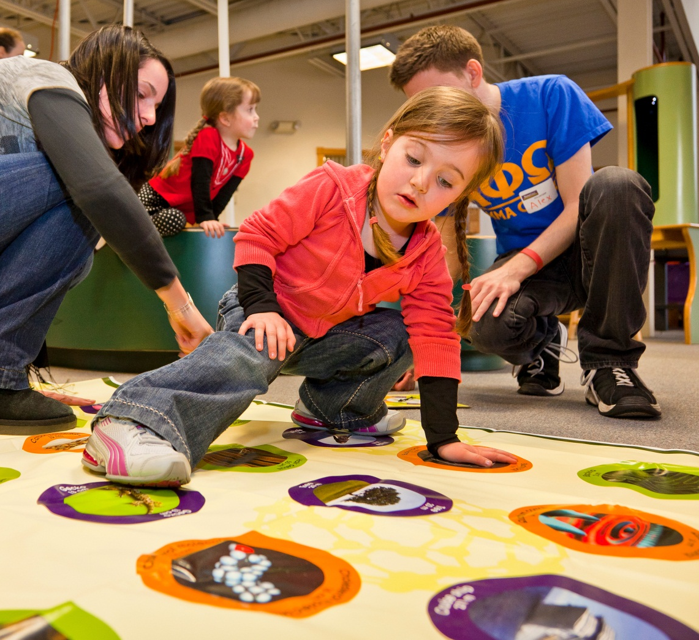
Learning more about the Network
Community
nisenet.org/community
Find your Regional Hub leader and talk to a real person!
Use the social networking links to connect with others in your region!

Slide 36
Annual Partner Survey
What was the purpose?
Consolidate requests for information about partners
Who did we want to hear from?
1,020 individuals considered ‘currently active’ in the Network
How did we collect the data?
Online survey in late October
Who responded?
296 individuals from 199 organizations
Notes:
A big Thank You to all of you who did complete the survey! Lucky 23 winners randomly selected to receive gift cards or set of nano educational materials.
What was the purpose?
Consolidate requests for information about partners. Look at the big picture to understand what’s happening but inform work moving forward. There were questions about the impacts of the Network on the individuals involved, use of products, how people are partnering and with who. It will not result in one big report, but instead disseminated through the reporting/work of these various individual studies. NanoBite?
Who did we want to hear from?
In total we invited 1,020 individuals considered ‘currently active’ in the Network from across 389 organizations. Multiple people from each organization, hoping to hear from everyone.
How did we collect the data?
Online survey in late October.
Who responded?
296 individuals from 199 organizations
Don’t have any findings to report, we just wanted to mention the Survey as one of the evaluation methods being used to collect data about the Network. So a reminder that your input is important and that you will be hearing from me again next Fall about the survey!

Slide 37
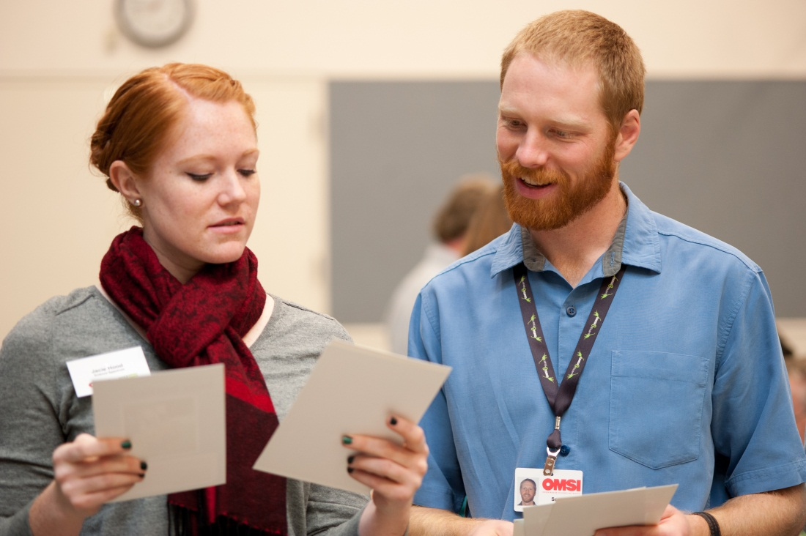
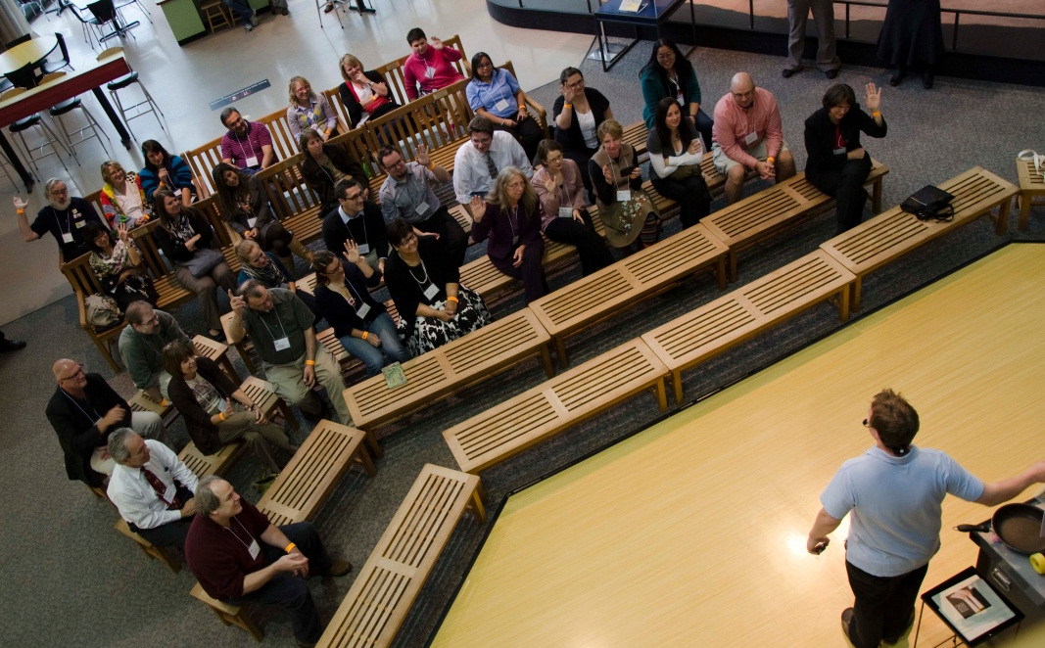
Professional Impacts
How does the Network impact professionals’…
Community
Learning
Use
3 years
Annual Partner Survey
Interviews

Slide 38
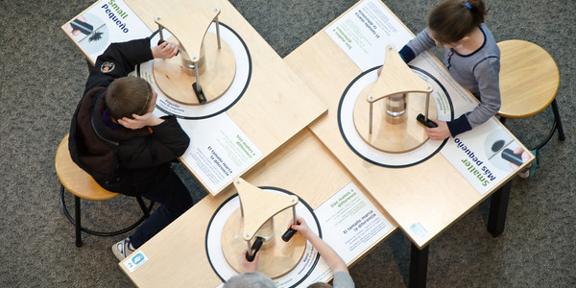
Public Impact of the Nano exhibition
www.nisenet.org

Slide 39
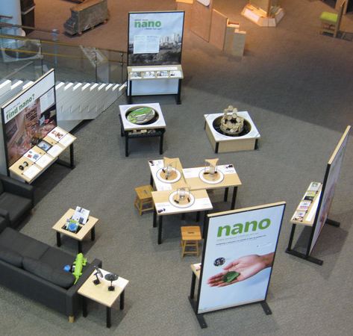
Nano mini-exhibition
400 sq. ft
Seven core components and seating area
70 identical copies going to Network Partners
Notes:
Originally designed to have a 400 sq. ft footprint
Seven core components (4 panels, the tippy table, small/smaller/nano, and build a carbon nanotube) and the seating area, which has reading material and is often next to the static beads table.
70 identical copies are going out to Network Partners; currently 43 have already shipped.

Slide 40
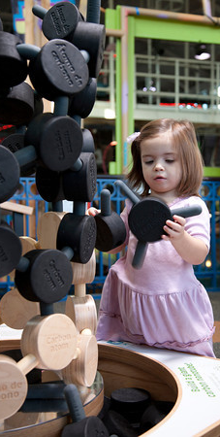
Evaluation of Nano
Formative Evaluation
main focus: provide feedback for improvement
Do individual pieces work for visitors?
Summative Evaluation
main focus: measure impact
What does the overall experience look like?
What does visitor learning look like?
Notes:
There have been two main stages of evaluation for the Nano mini-exhibition: the formative evaluation, which focused on providing feedback to improve the individual components of the mini-exhibition. The overall evaluation question for the formative evaluation was: Do these individual pieces work for visitors?
The second stage of evaluation is the Summative evaluation, which primarily focuses on measuring impact. The two main questions for the summative evaluation are: What does the overall visitor experience look like in the mini-exhibition? And what does visitor learning look like?
The rest of this talk will be about our summative work.

Slide 41
Summative evaluation: Context
Five sites, variety of installations
Science Museum of Minnesota
Duluth Children’s Museum
Science Spectrum (Lubbock, TX)
Oregon Museum of Science & Industry
Port Discovery (Baltimore, MD)
Data collected
observations
surveys and interviews
counting tallies
Notes:
The summative study took place at five partner institutions: the Science Museum of Minnesota, the Duluth Children’s Museum, Science Spectrum in Lubbock, TX, the Oregon Museum of Science and Industry, and Port Discovery in Baltimore, MD.
Variety of installations:
SMM, Duluth Children’s, and OMSI installed the exhibition out in the open. Science Spectrum had the exhibition installed outside of their birthday party space. Port Discovery installed in a room with other, additional exhibit components about nano which they themselves designed and fabricated in conjunction with the University of Maryland College Park MERSC.
The data we collected consisted of observations, surveys and interviews, and counting tallies that would be used to make visitor contact projections.

Slide 42
Data analysis
General Visitors
SMM (n=100)
Duluth (n=103)
Port Discovery (n=32)
OMSI (n=25)
Science Spectrum (n=16)
Spanish-Bilingual Visitors
OMSI (n=25)
Science Spectrum (n=22)
Visitors with Disabilities
Port Discovery
Museum of Science
Notes:
We focused most of our efforts on collecting general audience data, but we did do some data collection with Spanish bilingual visitors (at OMSI and Science Spectrum in Lubbock, TX). We are still working on collecting data from visitors with disabilities – we began that work at Port Discovery just last month and then will continue that work at MOS through January 2013.

Slide 43
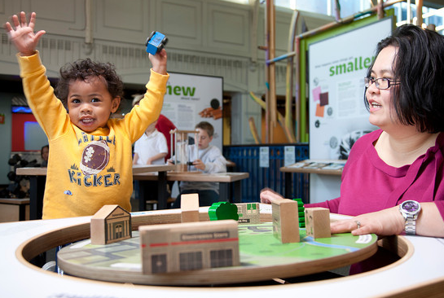
Early findings: Use
Notes:
So now, we’ll talk about some of our early findings, primarily around visitor use and learning. I need to say, though, that we are still working to finalize the numbers, and these findings are early and preliminary.
In early 2013, we should have some finalized and confirmed summaries of findings for you, which we’ll share through various network channels including posting on NISEnet.org.

Slide 44
Early findings: Use
Visitors dig it!
High visitor contact
High dwell times
Notes:
The good news: visitors dig it!
High visitor contact:
On average, about half of visitors who go into an institution with a mini-exhibition have contact with it. These estimates, based on counting tallies done at the five institutions, do vary:
Baltimore – about a third
OMSI – about half
SMM – about half
Lubbock – a little more than half
Duluth – almost all
High dwell times:
The exhibition is demonstrating quite a bit of holding power, with the overall mean dwell time of about six minutes for groups. Again we see variation across locations for average dwell time:
SMM – about five minutes
Duluth – almost six minutes
Lubbock – almost seven minutes
Baltimore – about seven and a half minutes
OMSI – almost eight minutes
These variations could be due to a range of factors, including the configuration of the exhibition, it’s location, and the characteristics of the groups observed in a particular location.

Slide 45
Early findings: Use
Visitors dig it!
High visitor contact
High dwell times
Visitor views of experience
Interesting and enjoyable
“interactive”, “family-friendly”, “Informative”
emphasis on connection of nano to daily life
Notes:
High levels of interest and enjoyment
Visitors report high levels of interest and enjoyment, both for themselves and their children.
For themselves: almost all report interesting/very interesting; enjoyable/very enjoyable
Adults were also asked to rate interest/enjoyment for the children in their group: more than three fourths of visitors said interesting/very interesting/enjoyable/very enjoyable. These are high levels if you consider that very, very young kids are included in these groups.
Why interesting? Why enjoyable?
content – most popular answer for both!
engaging for kids, welcoming, family friendly
general experience
Competitive with other experiences
Almost three fourths of visitors found it was as or more interesting than other things they’d seen at the museum that day.
emphasis on connection to nano -
when asked about what exhibit was about…
visitor responses identified “connection to nano” as most frequent theme. more common the general comments.

Slide 46
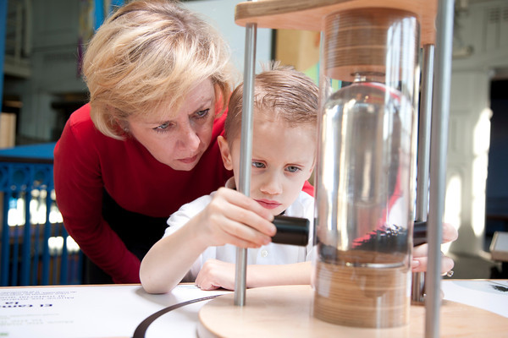
Early findings: Learning
Visitors are learning!
60% report increase in confidence
Similar proportions of increase across levels of prior nano knowledge
Notes:
The good news – visitors are learning!
Increases in confidence
One way we are measuring learning in the study is to ask visitors to report their confidence levels in doing a variety of things – like talk about nano, describe nano to a friend, identify one way nano can impact your life, etc – both before and after their experience on the exit interview. This is called a “retrospective pre” questioning approach, which can be particularly useful when examining outcomes related complex topics that people don’t know what they don’t know.
By looking at the difference in visitor confidence levels, we see that over half of visitors report an overall increase in confidence after having seen the mini-exhibition. That is very exciting!
Another interesting finding is that these levels of confidence seem consistent across different levels of prior nano knowledge. So we asked visitors in another question “Before now, how often have you heard about nano?” and they could choose from four responses, ranging from “I haven’t heard about it at all” to “I hear about it all the time”. Across these different levels, it still seems like the same proportion of people in each level are reporting increases in confidence. This suggests that the mini-ex is working as both an accessible entry point for people who aren’t familiar with nano as well as those who may have more experience with it.

Slide 47
Early findings: Learning
Visitors are learning!
60% report increase in confidence
Similar proportions of increase across levels of prior nano knowledge
NISE Net content map areas
Visitor responses touched on all four areas of the content map
Most common: connection to daily life
This specific answer was more common that general responses about nano or science
Notes:
Content map
We’re hitting all areas!
connection to nano is again most common

Slide 48
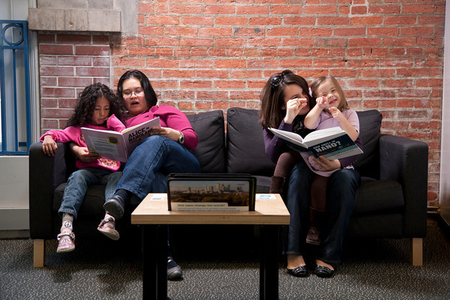
Institutional comparisons
Emerging differences
group dwell times/visitor contact
levels of interest & enjoyment
changes in confidence
Notes:
Already mentioned group dwell times across institutions earlier

Slide 49
Spanish bilingual audience
Spanish-bilingual comparisons
prior nano knolwedge
group dwell times
slightly different confidence gains
Notes:
lower levels of prior nano knowledge than general audience
group dwell times
on average – Spanish dwell time is almost ten minutes.
confidence gains may be larger than general audience.

Slide 50
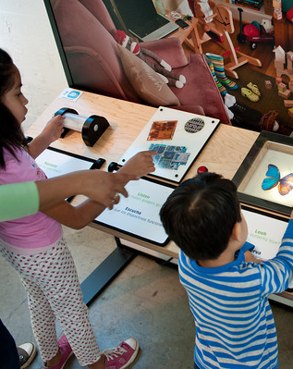
Further analysis and next steps
Exploring other relationships between use and learning; demographic data
Additional analysis of bilingual data
Analysis of data from visitors with disabilities
Additional estimates for number of visitors who come in contact with Nano
Next Public Impacts study: Focus on NanoDays

Slide 51
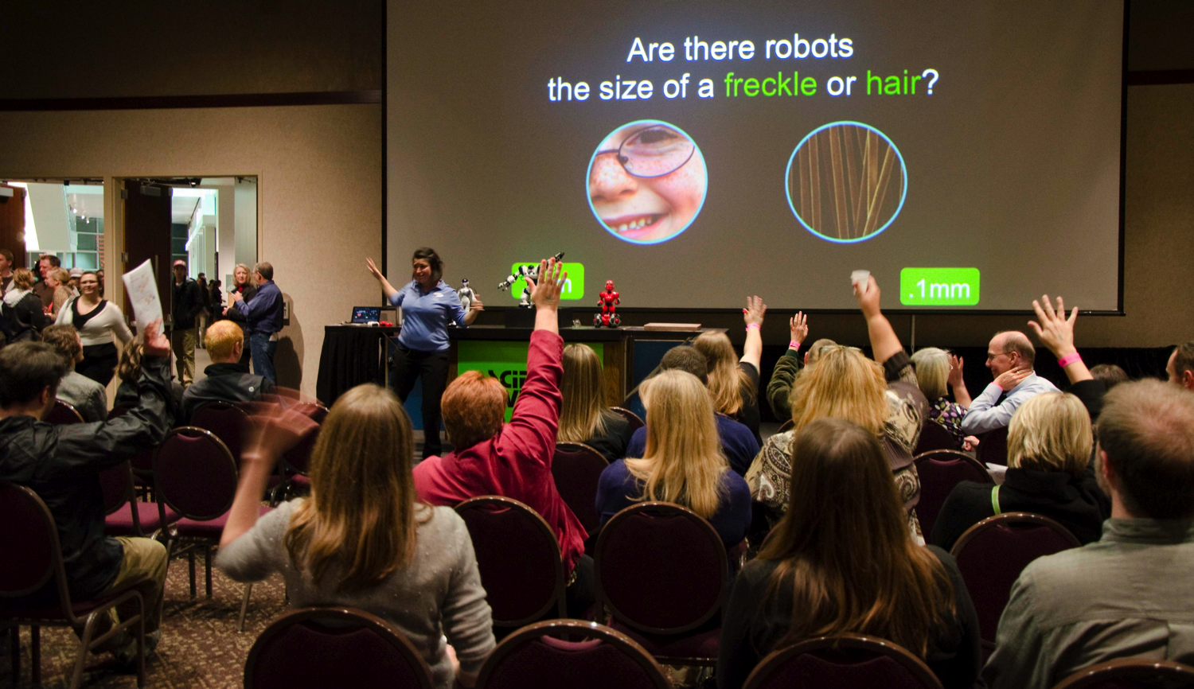
Questions and Discussion?

