Slide 1
NISE Grant Report
South Florida Science Museum

Slide 2
Our Project
Who we reached – 50 Palm Beach County at-risk students from Title 1 schools, grades 3-5
Provided an outreach program – Chemical Concoctions
Bused the students to the museum to explore our temporary exhibit “It’s a Nano-World” and experience another educational program – Nitromania
Main purpose – introduce nano-content in an engaging way

Slide 3
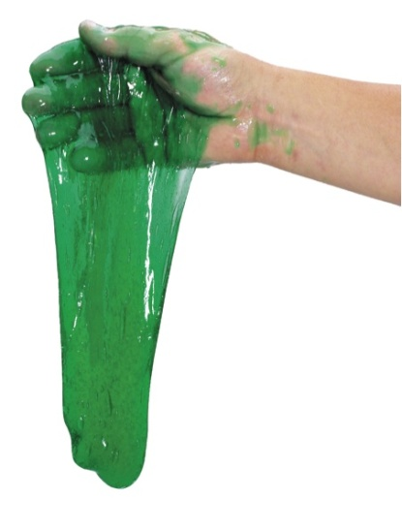
Integrating Nano-Content
Chemical Concoctions:
Understand the differences between the states of matter on an atomic level
Emphasize that to work on a nano-scale with atoms and molecules, scientists would have to work on things that they can’t even see!
Make their own polymer ‘flubber’ – borax, water, glue
Discuss material engineering & importance of nanotechnology in creating new products

Slide 4
Integrating Nano-Content
Nitromania:
Explore physical properties of water and nitrogen
Matter changes states right in front of their eyes as they learn the atomic and molecular behavior behind the phenomena
We can work on the nano-scale to improve material strength, change physical and electrical properties, and make things like superfast computer chips, water-repellent fabrics, and really good ice cream.
Make liquid nitrogen ice cream!
LN2 freezes ice cream so fast that the ice crystals that form are super small – down to the nano scale.
These super tiny crystals make the ice cream very smooth.

Slide 5
‘It’s a Nano-World’
Students enjoyed free exploration of the exhibit!
Blood drop ball pit – balls inside represented red and white blood cells
Measure how many nanometers tall you are
View highly magnified photos and guessed what they were
Look through microscopes and magnifiers to view shells, clothing, hair, skin.

Slide 6
Results
Students were given a pre and post test on the material covered in both classes
Average pre-test score – 50%
Average post-test score- 80%
83% of students showed improvement in content knowledge

