Slide 1
Large Scale Demonstrations of Nanoscale Science
Karen Dewhirst
Creative Discovery Museum,
Chattanooga, TN
Museum Experience Manager, Science/Exhibits

Slide 2
Types of Science Demonstrations at Creative Discovery Museum
General Admission Science Demonstrations
Special Event demonstrations
Science Demonstrations for School Groups

Slide 3
General Admission Science Demonstration
30 minute presentation in auditorium
Daily in high season; weekends in low season
Audience participation in experiments
Presented by Museum Educators
Topic changes every 3-4 months
Occasional school group tours

Slide 4
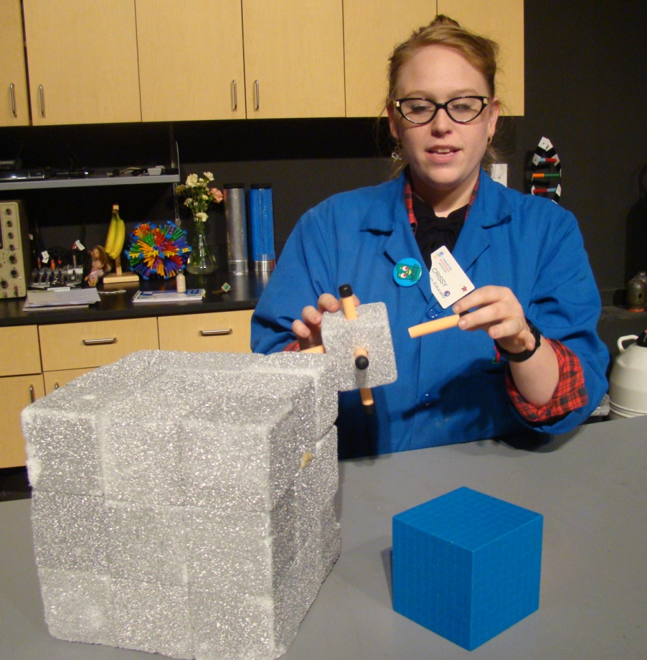
Surface Area Demonstration for General Admission Guests
Modified to increase length and audience participation – Spring 2012
Presented by Museum
Educators
Added PowerPoint
to facilitate presentation
of science content

Slide 5
Special Event - Attack of the Nano Scientist
Part of Nano Day 2011
and Nano Night 2012
festivities
Nano man pre-sells
presentation
Nano man - super hero
status/photo opportunities
Presentation provides
opportunity to wrap-up nano
activity content
Modifications increase
audience participation

Slide 6
Training Science Demonstrations
Written script with experiment details
Group training
Watch the demo
Do the experiments
Individual practice sessions
Check-off performance
Live performance
Peer review every month

Slide 7
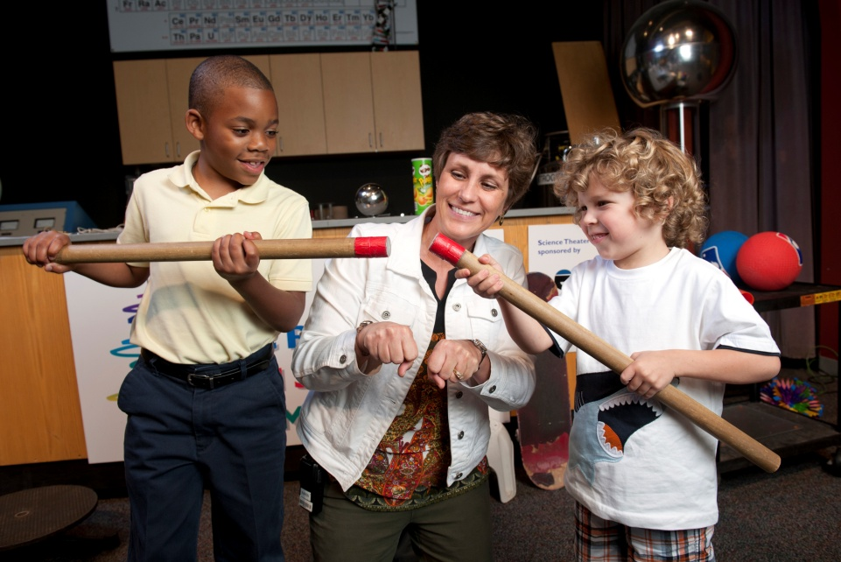
Science Demonstrations for School Groups
60 minute presentation by reservation only followed by a 60 minute hands-on workshop
Grade level specific (K-5)
Meets state science standards
Audience participation
Larger than life equipment
Engaging and animated presenter with science background (back-up presenters trained)

Slide 8
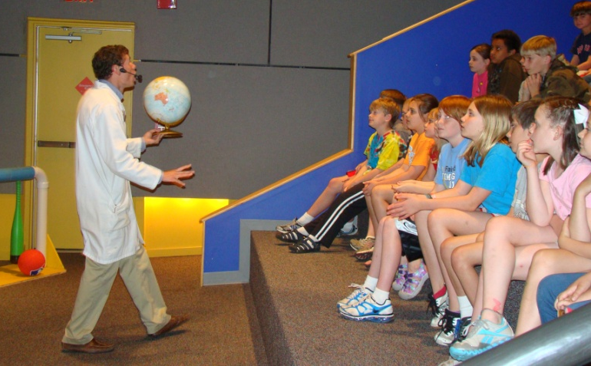
Next Steps
2013 mini-grant recipient
Expand museum audience
in age and geography
Develop nanoscale science
demonstration and workshop for middle school groups
Develop distance learning nanoscale science lesson with hands-on activities

