Slide 1

Museum Partner Workshop
October 19, 2017

Slide 2
Workshop goals
Introduce Frankenstein200 project elements
Review museum partner requirements and optional activities
Discuss the plotline and important themes of Mary Shelley’s Frankenstein
Develop confidence to facilitate Frankenstein200 kit activities
Develop confidence to train museum staff and volunteers
Discuss ideas for integrating Frankenstein200 activities into museum programming
Discuss strategies for adapting the activities for different audiences

Slide 3
Agenda
9:00am Welcome and introduction
10:00am Frankenstein200 kit
12:00pm Lunch and discussion
1:00pm Planning and implementation
1:45pm Wrap up
2:00pm Adjourn
Notes:
Welcome to our Frankenstein200 workshop!

Slide 4
MARY SHELLEY’S FRANKENSTEIN

Slide 5
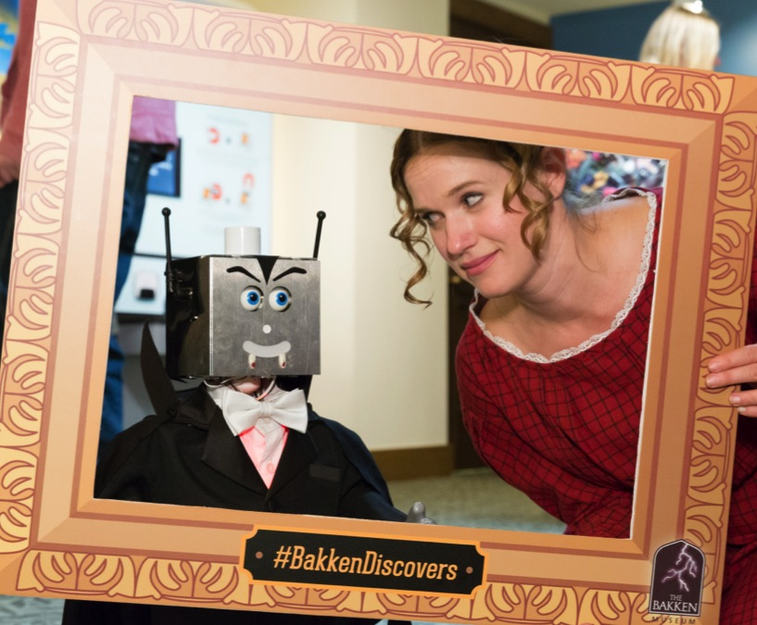
Welcome!
Introductions
Icebreaker
Main events in the Frankenstein story

Slide 6
FRANKENSTEIN200

Slide 7


Frankenstein200 project
Celebrating the 200th anniversary of Mary Shelley’s Frankenstein!
Over 50 museums, libraries, and other organizations across the United States are participating.
Notes:
Frankenstein200 is a national project that focuses on the bicentennial. Over 50 museums and other organizations across the United States are participating in this project, and many more are doing other activities related to the 200th anniversary of the Frankenstein story.

Slide 8
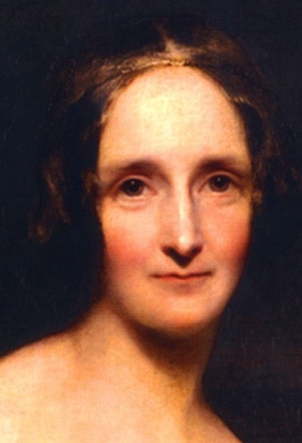
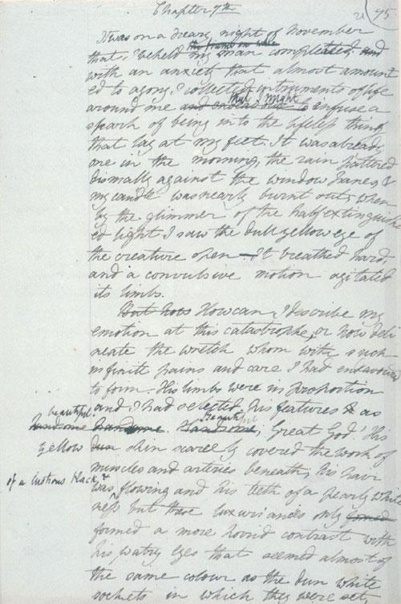
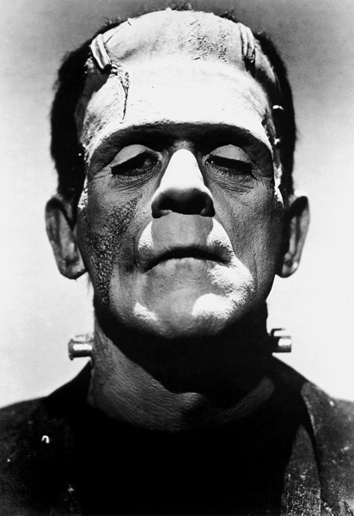
Mary Shelley’s Frankenstein
Mary Shelley
Draft of Frankenstein
Boris Karloff as Frankenstein’s creature
Notes:
Mary Shelley’s Frankenstein has endured in the popular imagination for two hundred years. Shelley got the idea for the novel following a ghost story competition among famous authors in 1816. Her novel was published on January 1, 1818, when she was only 20 years old. This thrilling tale of Victor Frankenstein and his stitched-together creature has never been out of print, and is currently the most-assigned novel in university courses. Its themes of innovation and its consequences remain relevant today.

Slide 9
Opportunities for learning
Practice 21st century skills such as creativity and collaboration
Explore emerging technologies such as artificial intelligence, robotics, synthetic biology, and human enhancement
Reflect on responsible innovation through questions that are easy to understand but hard to answer
Notes:
The Frankenstein200 project uses themes from Frankenstein to examine emerging technologies such as artificial intelligence, robotics, synthetic biology, and human enhancement. It promotes the development of 21st century skills related to creative collaboration and critical thinking, and gives participants a chance to think about important questions related to responsible innovation.

Slide 10
Key questions
What is life?
Why do we create?
What are our responsibilities as creators, scientists, and engineers?
Notes:
These important questions are easy to understand but hard to answer! People of all ages can explore these questions.

Slide 11
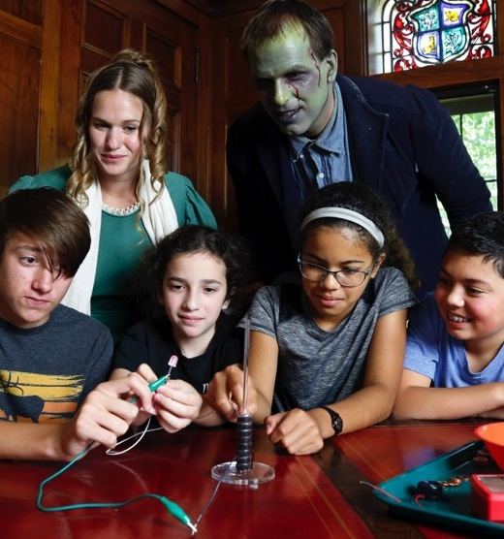
Transmedia project
Studying learning across:
Hands-on activities
Alternate reality game
DIY activities and contests
Notes:
Frankenstein200 is a transmedia project, which means “across media.” It is studying the learning that occurs when people participate in a combination of hands-on activities and immersive digital experiences. It also looks at learning that happens across settings (at home, at a museum, online).

Slide 12
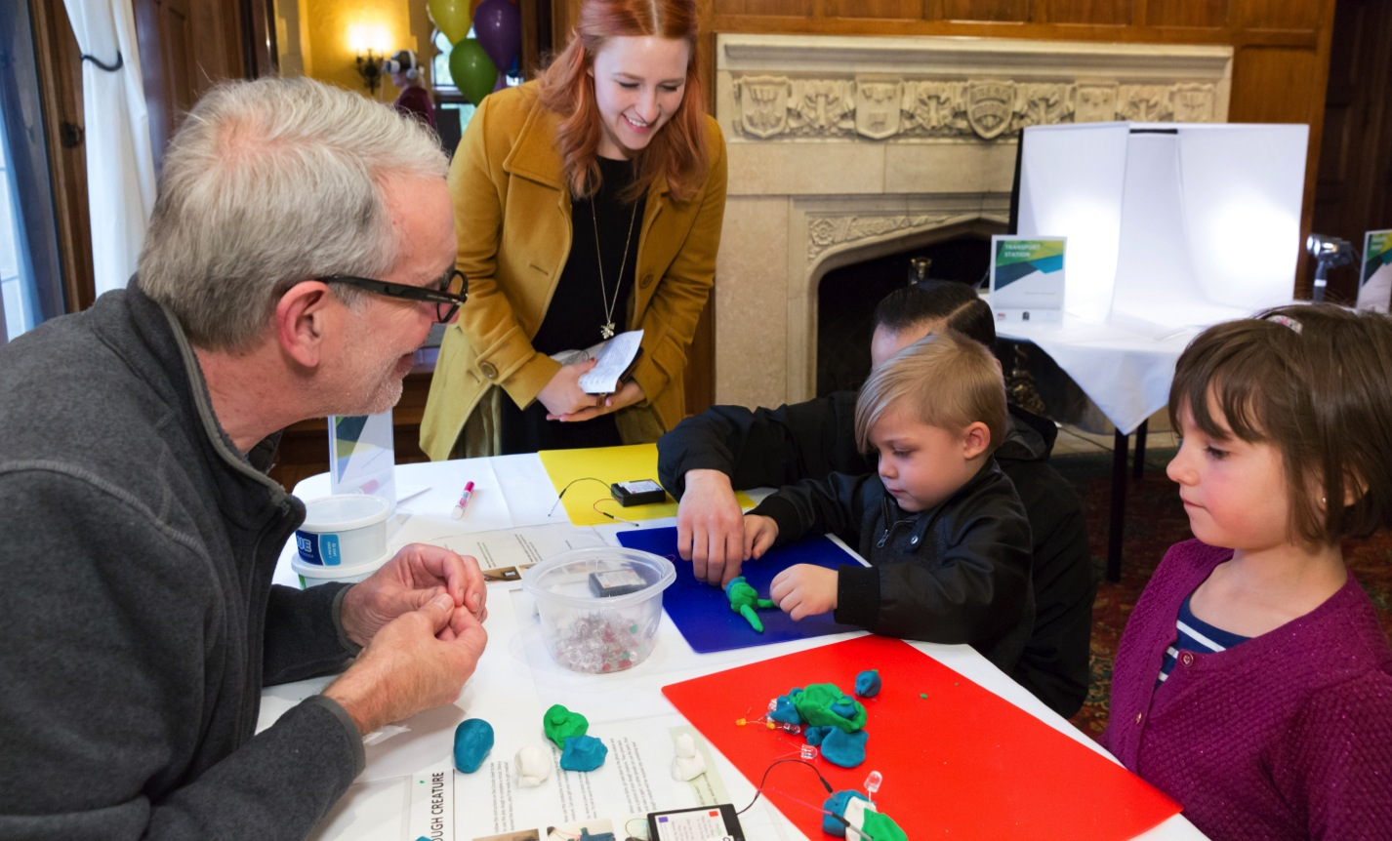
Museum programming

Slide 13
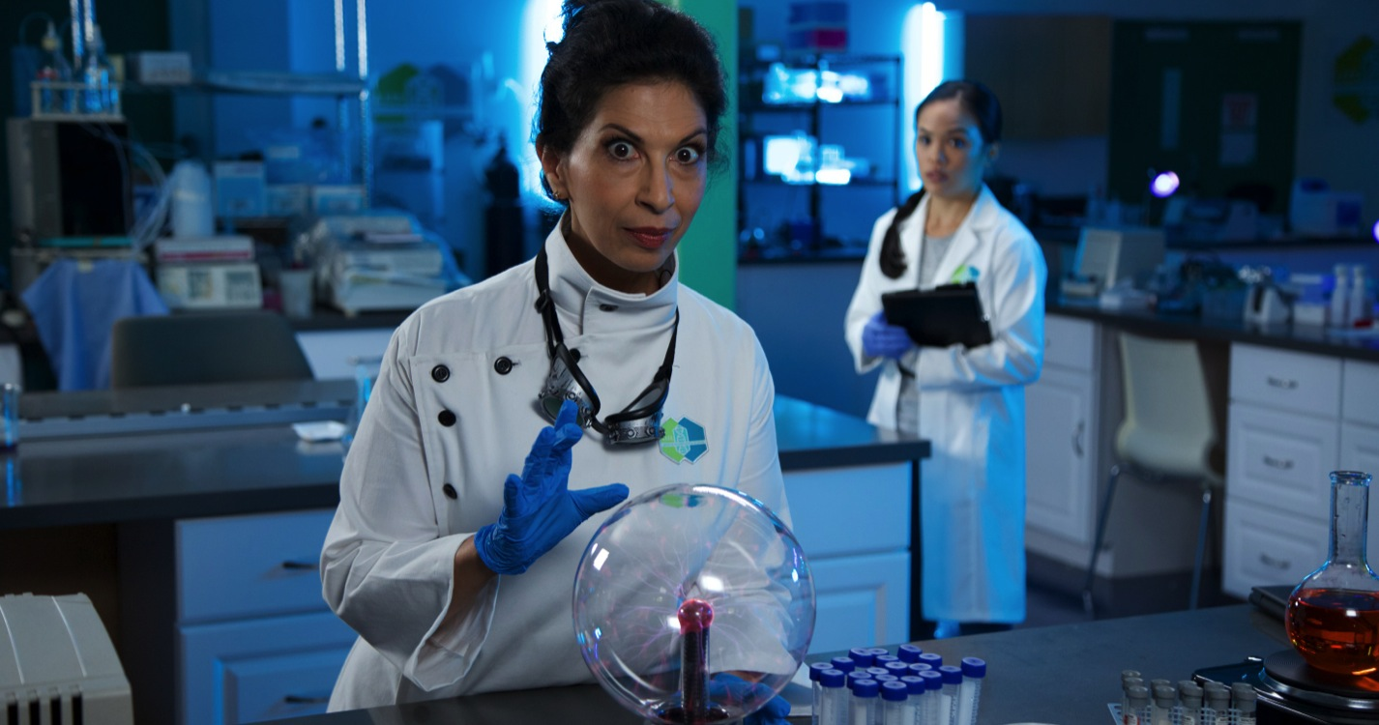
L.I.F.E.
A portal from real world museums to the the fictional world of Frankenstein

Slide 14
DIY activities
Instructables contest

Slide 15
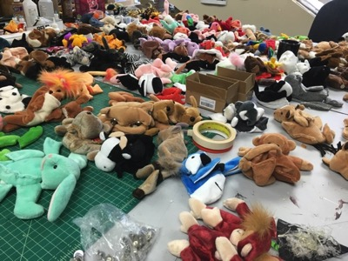
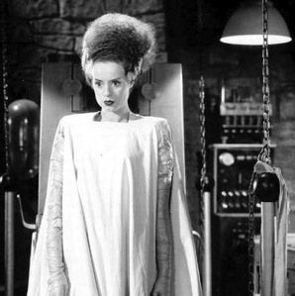
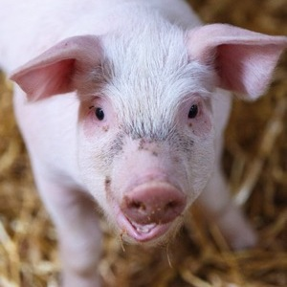
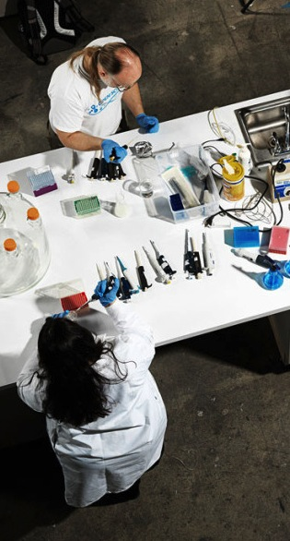
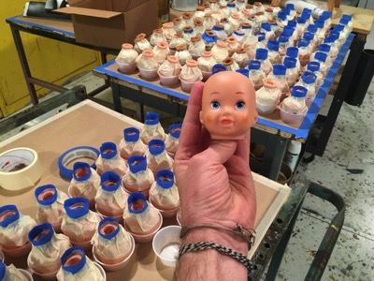
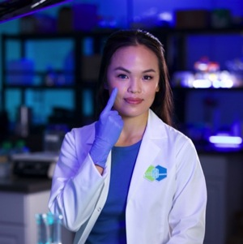
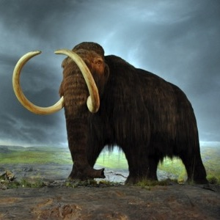
Transmedia connections
Notes:
Main areas of research highlighted in museum activities, ARG, and online activities are same as hands-on activities: AI/robotics and gen eng/syn bio.

Slide 16
ACTIVITY KIT

Slide 17
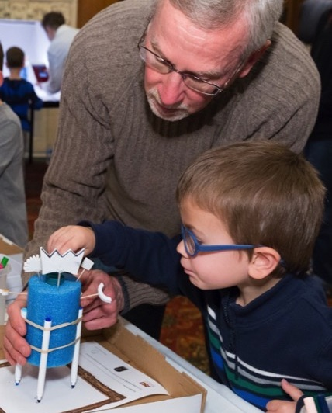
Frankenstein200 kits
Hands-on activities
Automata
Battery Stack
Dough Creature
Frankentoy
Monster Mask
Scribble Bot
Spark of Life
Notes:
The Frankenstein200 kits include seven hands-on activities. All of them encourage creativity and reflection about responsible innovation. Some also focus on the science that inspired Mary Shelley.

Slide 18
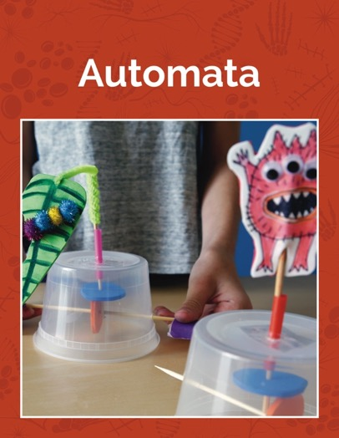
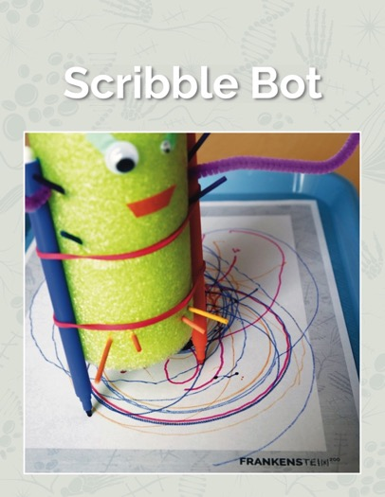
Creativity and responsible innovation
Artificial intelligence and robotics
Notes:
Two of the activities, Automata and Scribble Bot, make connections to research on robotics and artificial intelligence.

Slide 19
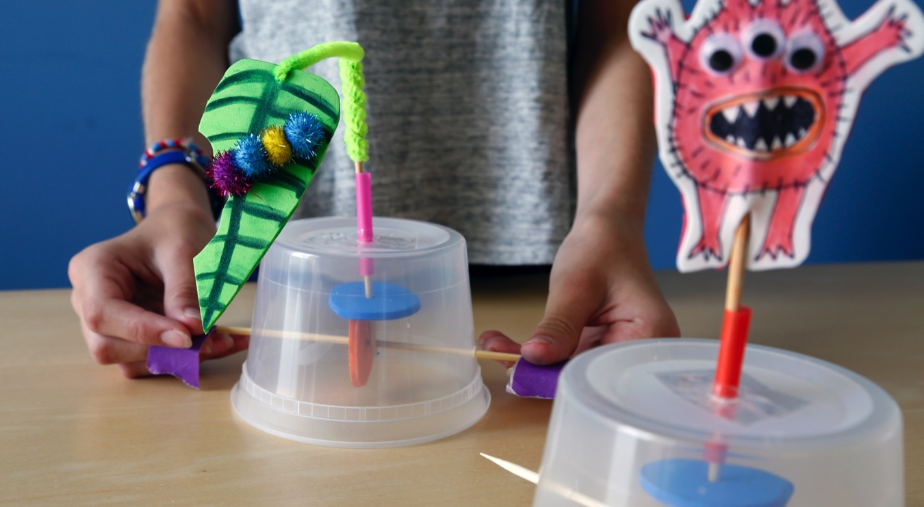
Automata
Notes:
In the Automata activity, learners make automata, which are moving mechanical devices that imitate the movement of a human, animal, or other living thing.

Slide 20
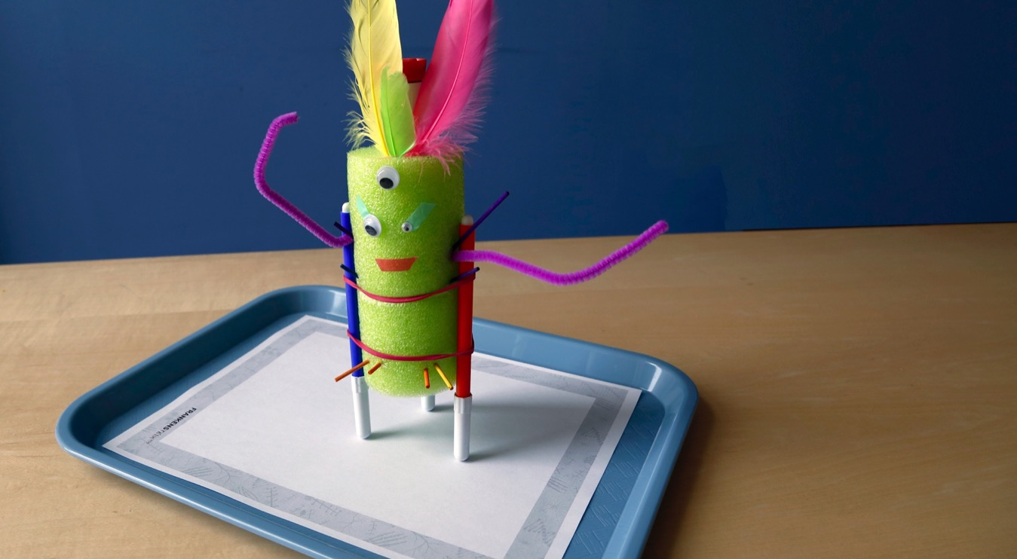
Scribble Bot
Notes:
In the Scribble Bot activity, learners make a toy bot with a surprising ability: it scribbles on a sheet of paper.

Slide 21
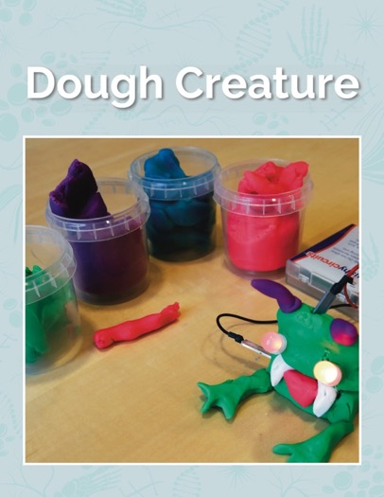
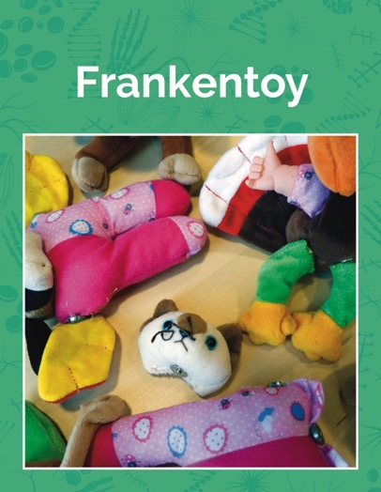
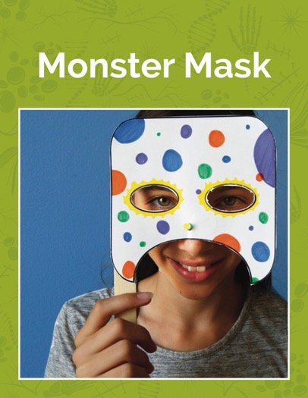
Creativity and responsible innovation
Genetic engineering and synthetic biology
Notes:
Dough Creature, Frankentoy, and “Monster Mask explore research in fields such as genetic engineering and synthetic biology.

Slide 22
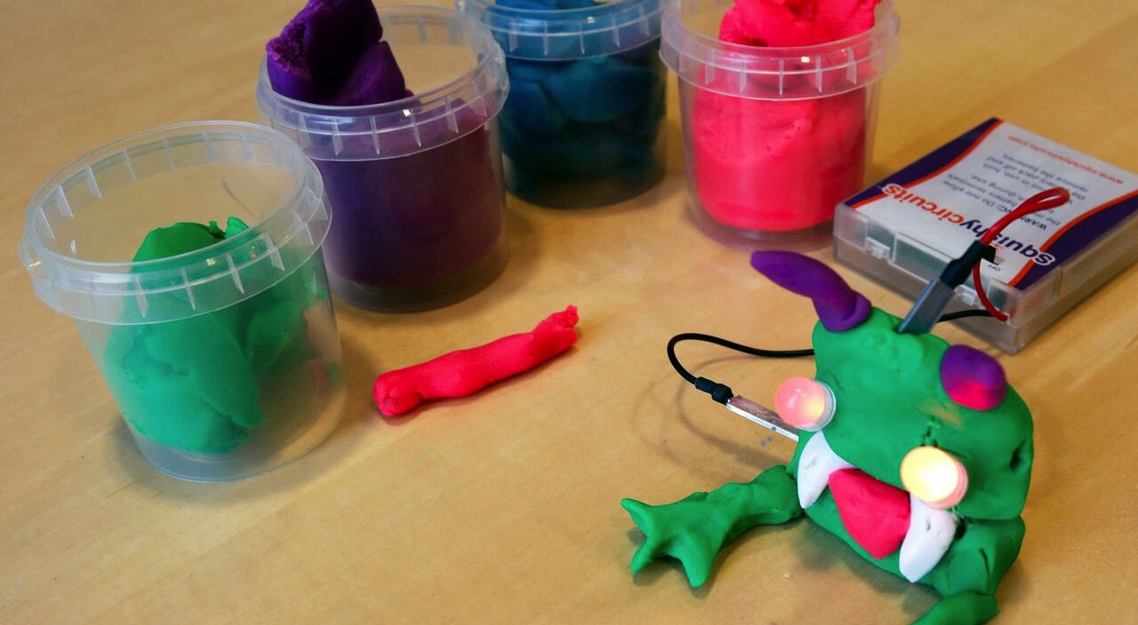
Dough Creature
Notes:
In Dough Creature, learners make a creature out of play dough and use it to create an electrical circuit.

Slide 23
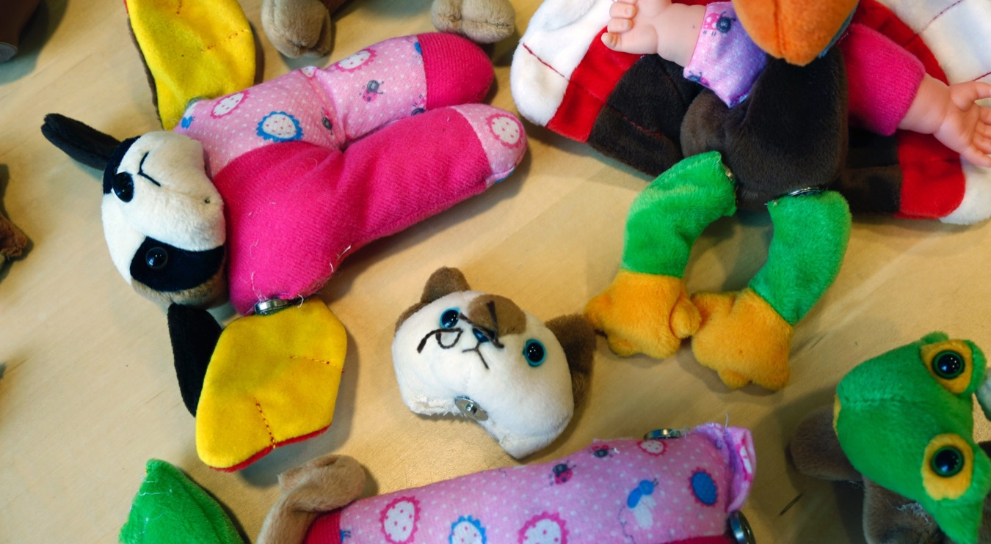
Frankentoy
Notes:
In the Frankentoy activity, learners make a “creature” by mixing and matching different parts of toys.

Slide 24
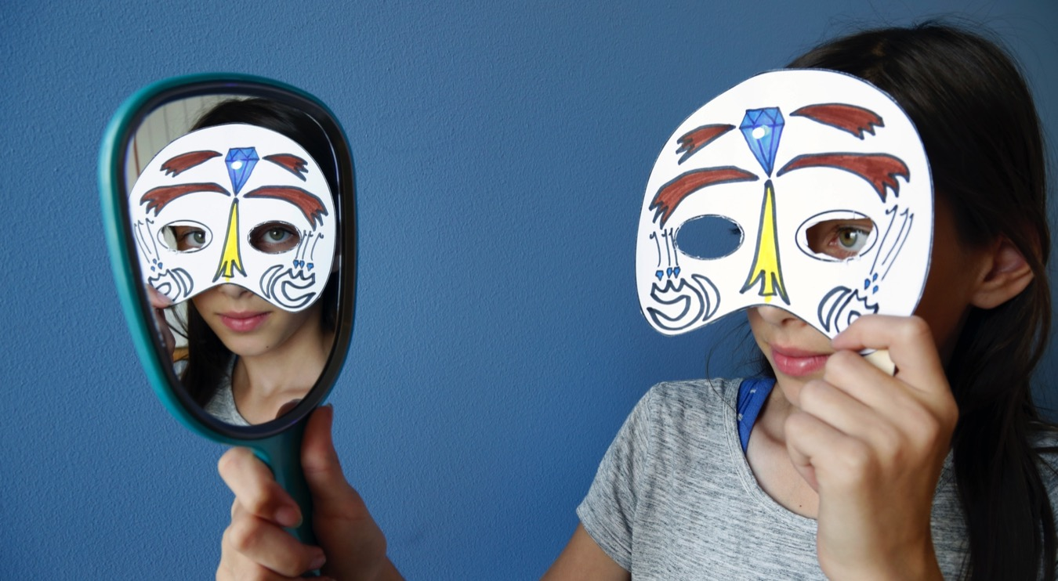
Monster Mask
Notes:
In Monster Mask, learners make a disguise with a special feature: an LED bulb that lights up.

Slide 25
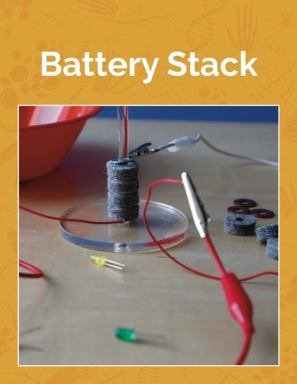
Scientific exploration and responsible innovation
Science of Mary Shelley’s time
Notes:
Battery Stack and Spark of Life explore the science of Mary Shelley’s time.

Slide 26
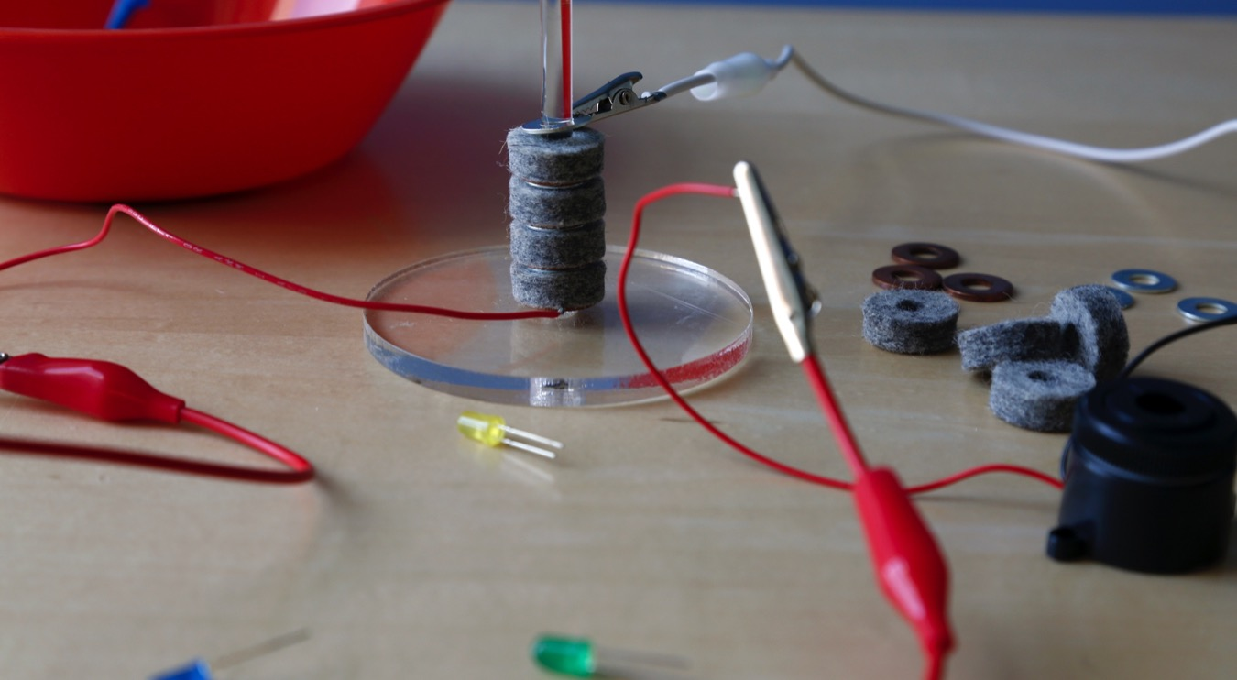
Battery Stack
Notes:
In the Battery Stack activity, learners make a voltaic pile, the first kind of battery.

Slide 27
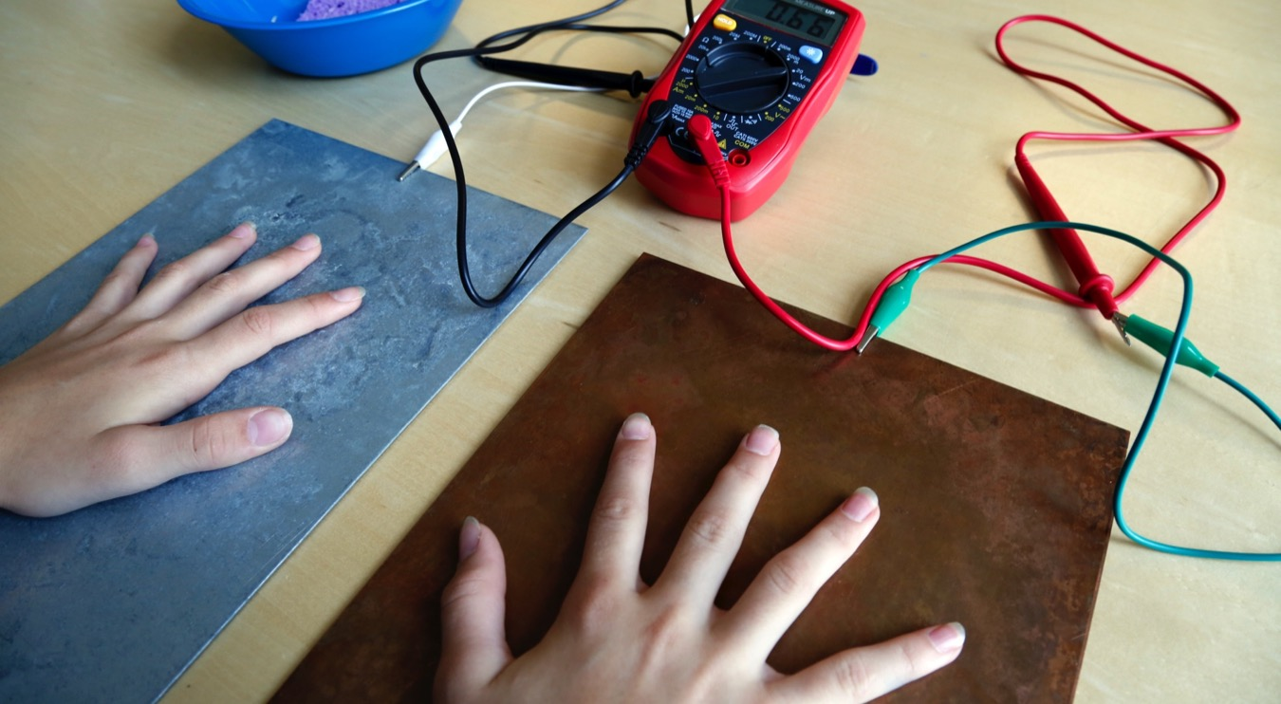
Spark of Life
Notes:
Finally, in the Spark of Life activity, learners create a battery from two kinds of metal and their own body! This activity also has an optional demonstration of a TENS unit (TENS stands for transcutaneous electrical nerve stimulation).

Slide 28
Hands-on activities
Facilitating the activities:
How to encourage creativity and exploration
How to relate the activities to themes in the novel
How to relate the activities to current STEM research and questions of responsible innovation
How to adapt the activities for different formats and audiences

Slide 29
Try the activities
10:15am Activity group 1
Automata
Scribble Bot
Dough Creature
Frankentoy
11:00am Break
11:15am Activity group 2
Monster Mask
Battery Stack
Spark of Life
12:00pm Lunch

Slide 30
Lunch
Discussion:
Integrating activities into different programming formats
Adapting activities for different audiences
12:45pm Each table reports two ideas

Slide 31
Alternate reality game
Notes:
The Frankenstein200 project has also created an online interactive educational experience.

Slide 32

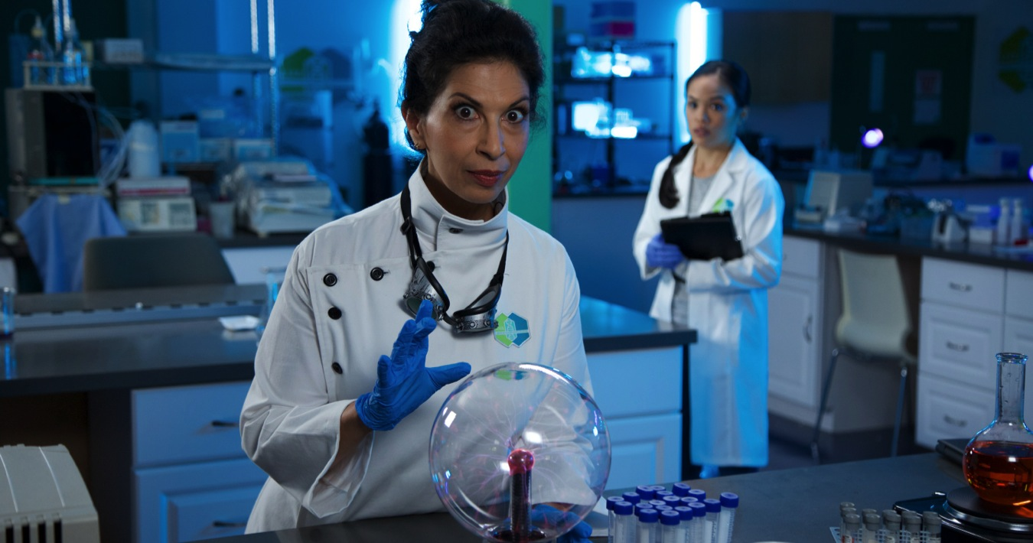
L.I.F.E.
The Laboratory for Innovation and Fantastical Exploration (L.I.F.E.)
was founded by Dr. Victoria “Tori” Frankenstein.
Notes:
The L.I.F.E. lab is fictional.

Slide 33
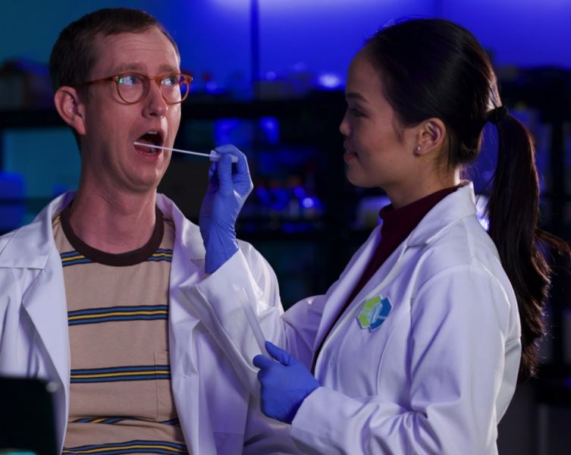
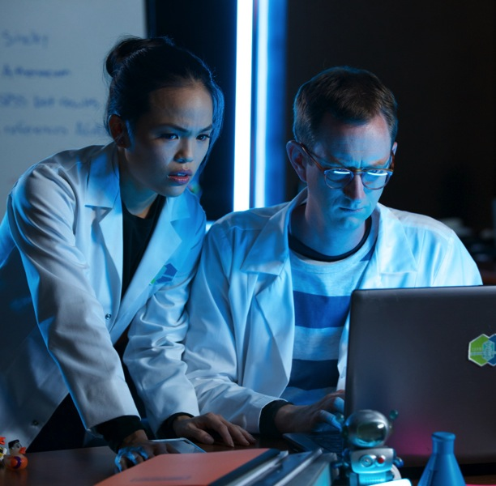
Research assistants
Mya
Genetics + Biochemistry
Xavier
Machine learning + Artificial intelligence

Slide 34
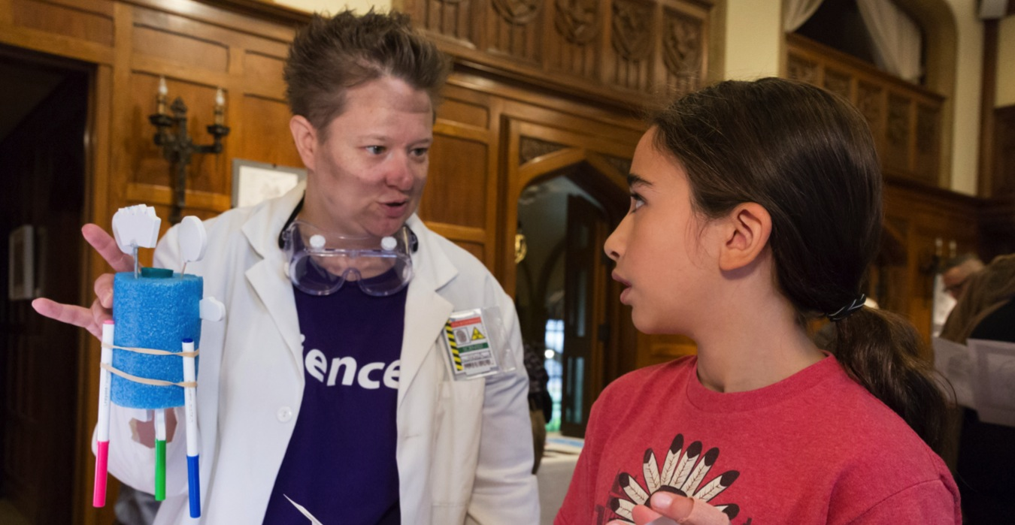
L.I.F.E. scouts are searching for new research assistants!

Slide 35
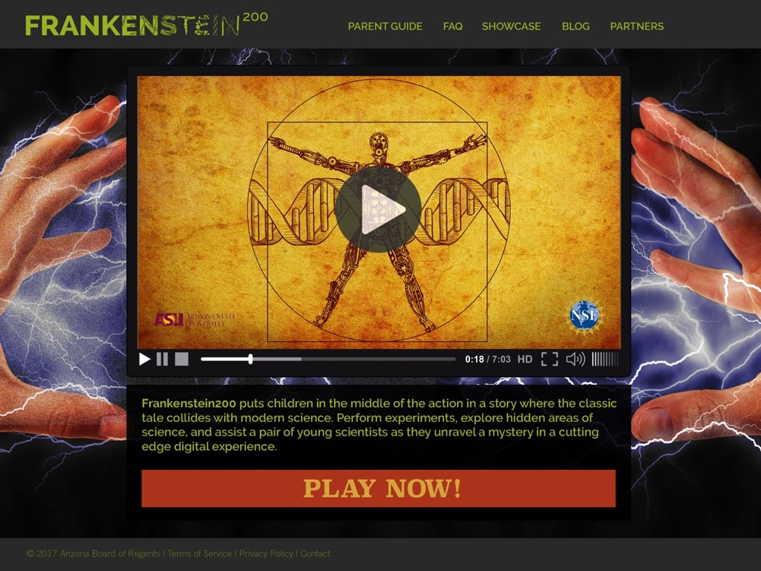
Frankenstein200.org
Notes:
PLAY TRAILER

Slide 36

Walk through L.I.F.E.
Create an account
Take a personality test and get placed in a lab
Every three days:
  Receive an invitation to explore
  Watch a video from Mya or Xavier
  Search L.I.F.E.’s research archives
  Play interactive content
  Do making activities at home
  Collaborate on knowledge building
  Earn achievements
The full experience is 10 episodes that take place over 30 days.

Slide 37
Sample episode
Episode 4
Player gets an email inviting them back to the lab
Once player logs in, they find a video from Xavier discussing human enhancement
Player searches the archives for relevant content
Xavier has created a chatbot and he needs you to help it learn
Player and Xavier chat in real time chat about whether or not a machine could ever become sophisticated enough to be creative
Player gets clues about the unfolding narrative
Player earns achievements based on level of completion
Notes:
Do glasses count as human enhancement? Does a pacemaker?
Where does humanity stop and technology begin?

Slide 38
WORKSHOP & INSTRUCTABLES

Slide 39
DIY activities
Instructables contest
30 additional activities
e.g. Handmade Hand
4 activities connect to the ARG
and generate an achievement code
Frankenstein
Tentatively scheduled for May, 2018

Slide 40
TRAINING MATERIALS

Slide 41
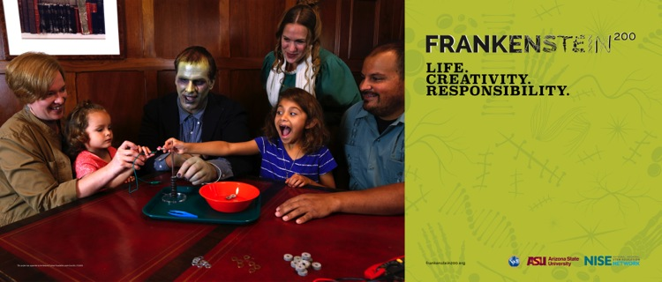
Program planning materials

Slide 42
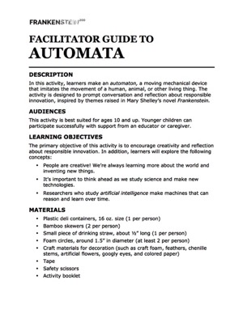
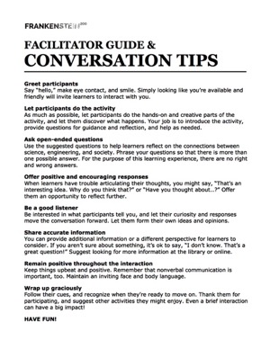
Training materials
Notes:
Training materials include a project and kit overview slide deck; general tips for facilitating hands-on activities; and a quick recap of Mary Shelley’s Frankenstein.
Each activity comes complete with all the materials and supplies you need. They’re all packaged together in one cardboard box. In the box, you’ll find two kinds of print materials: one kind that you can use and share with participants, and one kind with additional information for activity facilitators. There are also brief training videos for each activity.

Slide 43
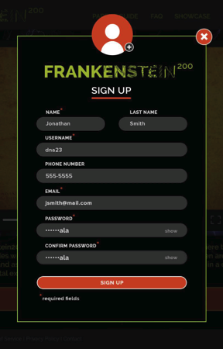
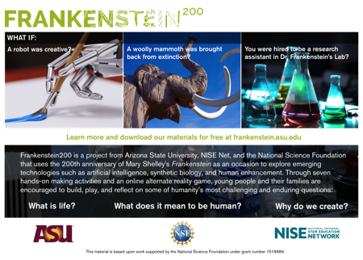
ARG promo materials

Slide 44
MUSEUM PARTNER ACTIVITIES

Slide 45
Requirements
Celebrate the 200th anniversary of Frankenstein
Host at least one dedicated event featuring Frankenstein200 activities with public audiences in January 2018. This programming should be specifically focused on Frankenstein, but you have a lot of flexibility in what you do.
Utilize materials in seasonal programming
Use Frankenstein200 materials in on-site or off-site public programming in October 2018. You can incorporate kit activities into “spooky science” or other programming your organization already offers.
Reach underserved audiences
Partner with a local library or community organization to reach underserved audiences. This requirement can be met as part of the October programming, and it can involve a new or existing partnership.
Notes:
For recipients of physical kits.

Slide 46
Requirements
Report on your activities
Submit an online report by March 1, 2018 describing your January program.
Participate in a brief phone interview with a member of the ASU team in November 2018 to discuss your October programming.

Slide 47
Timeline
Required activities
January 2018: Host required public event in conjunction with 200th anniversary of the publication of Frankenstein
March 1, 2018: Reports due online (template will be available for review in early 2018)
October 2018: Integrate kit activities into seasonal programming
November 2018: Participate in telephone interview with ASU team about incorporating kit activities into October programming

Slide 48
Optional opportunities
Attend professional development workshop
Thank you!
Promote and/or use the other project elements
Alternate reality game live in January, 2018 @ Frankenstein200.org
Workshop online in January, 2018 @ Frankenstein200.org
Instructables contest tentatively scheduled for May, 2018
Participate in research and evaluation
We will be in touch in early 2018 about the option to collect data at your organization

Slide 49
Transmedia learning
Investigating the interactions between the individual elements in the transmedia learning environment
Studying how the transmedia experience leads to increased efficacy and engagement in science-in-society issues

Slide 50
QUESTIONS?

Slide 51



Thank you
Copyright 2017, Arizona State University. Published under a Creative Commons Attribution-Noncommercial-ShareAlike license: http://creativecommons.org/licenses/by-nc-sa/3.0/us/
Distributed in collaboration with the National Informal STEM Education Network: nisenet.org
This project was supported by the National Science Foundation under Grant Number 1516684. Any opinions, findings, conclusions, or recommendations expressed in this program are those of the authors and do not necessarily reflect the views of the Foundation.

