Slide 1
Nano and Food
Nano: In Your Food, Around Your Food, In Your Home, and At Your Museum
Notes:
To DO: Add slides about NISE resources --
Pictures of gala and where these things can happen
Immersion circulator pics.

Slide 2
Helpful Links
Nano Consumer Databases
Woodrow Wilson Center: nanoproject.org
Nanotechnology in City Environments from ASU NICE.ASU.EDU
Advocacy Pages
Nano Supermarket: Nanosupermarket.org
As You Sow: asyousow.org/health_safety/gmosnano.shtml (Very Biased)

Slide 3
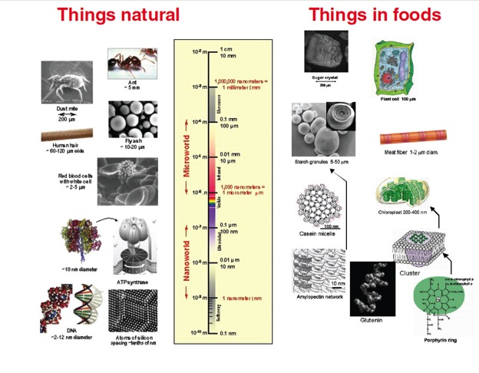
From Nanotechnology in Food Products: Image Courtesy of Dr. Jose Miguel Aguilera and the U.S. Department of Energy

Slide 4
WHERE??

Slide 5
A Bit More Specific Potential Nanotech
Zinc Oxide Alginate Nanofilms as a food preservative: Food film (alginate) with anti-microbial properties.
DNA Nano-Vaccines for Shrimp (white spot syndrome virus) with chitosan nanocapsules. Dispersed by ultrasound opening the capsules.
Starch Nanoparticle Latex Binder—EcoSphere Biolatex to bind paper and cardboard. (On the market at McD’s)
Nutraceuticals: For example, omega fatty acid delivery. Smaller size probably means more absorbsion and increase water solubility (instead of oils and fats)
Notes:
http://nice.asu.edu/nano/zinc-oxide-calcium-alginate-nanofilms-food-preservative
http://nice.asu.edu/nano/dna-nano-vaccines-cultured-shrimp
http://nice.asu.edu/nano/starch-nanoparticle-latex-binder%E2%80%94ecosphere-biolatex
http://nice.asu.edu/nano/nanoencapsulation-omega-fatty-acids-processed-food-products

Slide 6
Risks
Unanticipated Risks
Nanotoxicity?
Blood-brain barrier?
Nanotechnology in Food Products: Workshop Summary. National Acadamies Press, 2009
“The draft foods guidance [April 2012] alerts manufacturers to the potential impact of any significant manufacturing process change, including those involving nanotechnology, on the safety and regulatory status of food substances. This guidance describes the factors manufacturers should consider when determining whether a significant change in manufacturing process for a food substance already in the market:
Affects the identity of the food substance;
Affects the safety of the use of the food substance;
Affects the regulatory status of the use of the food substance; and
Warrants a regulatory submission to FDA.
The draft foods guidance also recommends manufacturers consult with FDA regarding a significant change in manufacturing process for a food substance already in the market. “
http://www.fda.gov/Food/GuidanceRegulation/GuidanceDocumentsRegulatoryInformation/IngredientsAdditivesGRASPackaging/ucm300914.htm
Notes:
Pubmed articles and loposomes! Especially if you’re doing stuff on quackery.

Slide 7
Spending
FDA Budget for Nanomaterials:
  FY 2012 Actual $13.6 million
  FY 2013 Estimated $16.5 million
  FY 2014 Proposed $16.8million
USDA/NIFA/ARS are also part of the NNI
  FY 2012 Actual $18.3 million
  FY 2013 Estimated $18.3 million
  FY 2014 Proposed $20.3 million
Department of State/OECD
Total Funding for NNI Health and Safety: $88, $102, $105 Million
From NNI Federal Budget Also, shout out to ASU and UCSB CNS
Notes:
NNI Federal Budget is 1.7 Billion
National Institute for Food and Agriculture
Agricultural Research Service
Organization for Economic Cooperation and Development

Slide 8
Quick Stats About Nano And Food

Slide 9
Quick Stats About Nano And Food

Slide 10
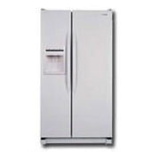

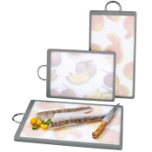
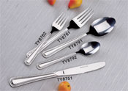
Nanosilver
The Majority of Cooking and Storage Products
Anti-Bacterial Properties
Food storage
Coatings on utensils – Silverware without much silver
Supplements

Slide 11
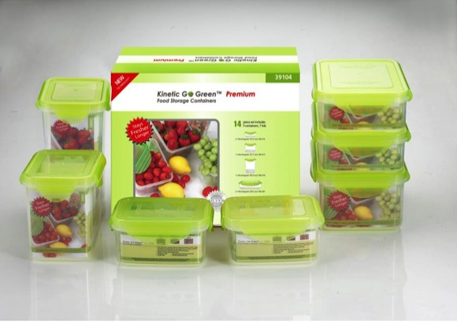
Nanosilver
Jello Test
Notes:
http://www.stevespanglerscience.com/product/1551

Slide 12
Why is Titanium Dioxide in Food?
We have been enslaved for control by future electromagnetic weapons and tasers. A solution of water and Titanium Dioxide will superheat in microseconds from directed energy weapons. Each human or animal is now a target!
But the real explanation may be political control. When one considers the military effectiveness of this chemical, one begins to realize that we are being "magnetized" for control by future electromagnetic weapons and tasers.
Since this is obviously outlandish, I just was to reassure everyone that this was for humor, but someone actually wrote this.
Notes:
THIS WAS THE FIRST RESULT WHEN SEARCHING ‘HISTORY OF TITANIUM DIOXIDE IN FOOD”

Slide 13
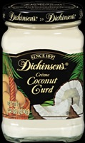
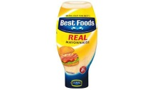
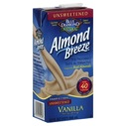
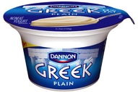
Titanium Dioxide in Food
Used as a whitener for almost a century
(1821 – Discovered – Industrial production -1916)
Indeterminate impact on human health when ingested:
Donuts, Candy, Mayonnaise, Cream Cheese
Notes:
http://www.epa.gov/nanoscience/files/NanoPaper2.pdf Notes that macro tio2 is bioinert.

Slide 14
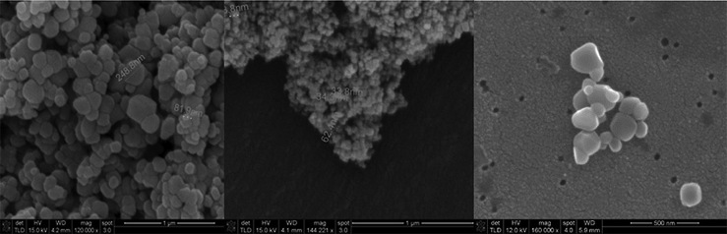
From: “Titanium Dioxide Nanoparticles in Food and Personal Care Products” Alex Weir, Paul Westerhoff, in Environmental Science and Technology (2012)

Slide 15
From: “Titanium Dioxide Nanoparticles in Food and Personal Care Products” Alex Weir, Paul Westerhoff, in Environmental Science and Technology (2012)

Slide 16
From: “Titanium Dioxide Nanoparticles in Food and Personal Care Products” Alex Weir, Paul Westerhoff, in Environmental Science and Technology (2012)

Slide 17
Making A Donut Solar Cell
http://www.youtube.com/watch?v=bVwzJEhMmD8

Slide 18
Let’s Make Food!
Make Your Own Gummy Worms
Dessert: Raw Egg on Toast
Sous Vide Egg
Nano Crumble

Slide 19
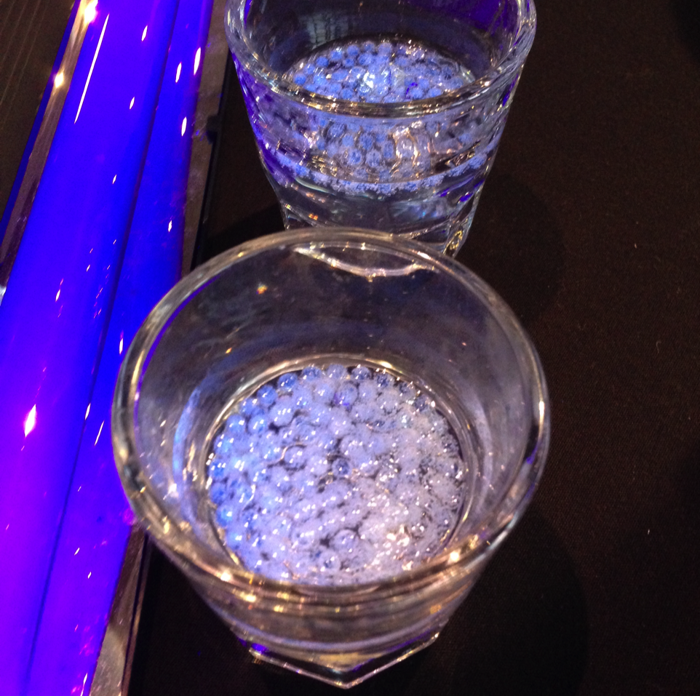
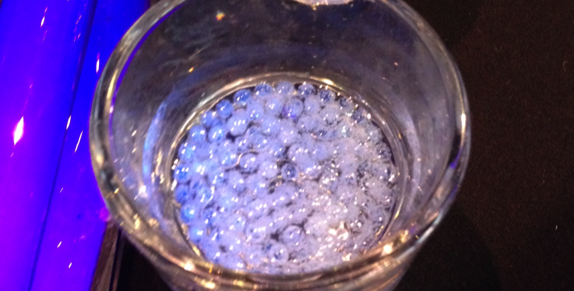
Fun with Sodium Alginate

Slide 20
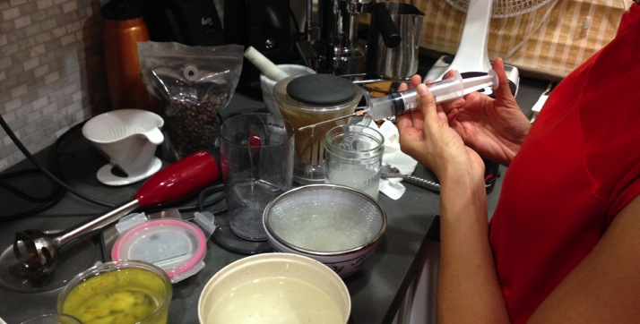
Fun with Sodium Alginate

Slide 21
Fun with Sodium Alginate
What can you put in it?
For Normal Spherification: Liquids or puree’s with no calcium
For Reverse Spherification: Liquids with Calcium (chocolates, milk products, etc)
NISE Net Write-Up: Sweet Self-Assembly by CMH
Great Resource for recipes:
http://www.molecularrecipes.com/spherification/
And http://chefsteps.com

Slide 22
Making Your Own Gummy Worms
What you need: (I can e-mail this to you if you want)
Materials | Equipment
For Gel
For Gel: Sodium Alginate – “Algin” (a powdered seaweed extract) 3 grams Distilled Water 400 grams Food Dye | Immersion Blender Scale Small ramekin or cup for measuring the powder A Cup (with more volume than 500ml) Flat bottom container no smaller than 3” diameter, at least 500ml, and has a screw on top. Funnel or syringe Squeeze Bottle with screw top and narrow nozzle
For Calcium Bath (page 2)
Warm Tap Water Calcium Gluconate 9-10 grams (Calcium chloride works, you can halve the amount of Calcium chloride) | 5” or bigger diameter Bowl (a white or clear bowl works best) Paper towels (be clean!) Small ramekin or cup for measuring powder(dry!) Spoon

Slide 23
A Raw Egg for Dessert
Not really! Mango puree with greek yogurt on pound cake.
250 g ( 8.8 oz) of water
1.3 g sodium citrate
1.8 g sodium alginate (0.36%) (I used 3g)
250 g mango puree
This takes practice!!!
Serve over coconut yogurt with honey and toasted brioche

Slide 24
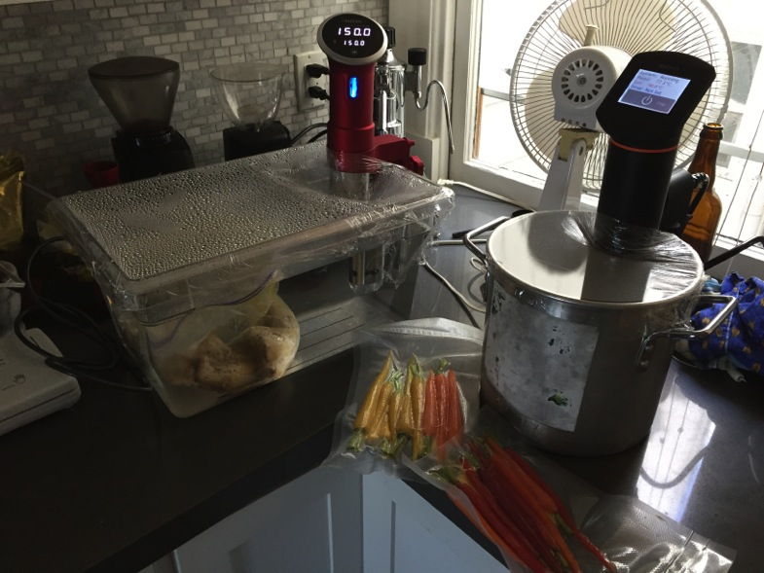
Controlling Variables
Notes:
In the Yolk: Protein15.86 g- Tryptophan0.177 g- Threonine0.687 g- Isoleucine0.866 g- Leucine1.399 g- Lysine1.217 g- Methionine0.378 g- Cystine0.264 g- Phenylalanine0.681 g- Tyrosine0.678 g- Valine0.949 g- Arginine1.099 g- Histidine0.416 g- Alanine0.836 g- Aspartic acid1.550 g- Glutamic acid0.595 g- Glycine0.488 g- Proline0.545 g- Serine1.326 g
http://ndb.nal.usda.gov/ndb/foods/show/152?fg=&man=&lfacet=&count=&max=25&sort=&qlookup=eggs&offset=&format=Full&new=&measureby=
40 different proteins

Slide 25
Proteins and Eggs
What’s nano about eggs?
At specific temperatures, the proteins in eggs do specific things.
Whites are 10% protein, 20% in yolk. (McGee’s Keys to Good Cooking)
Eggs contain 10 non-essential and 8 essential amino acids. (nbd.nal.usda.gov/ndb/)
40 different proteins in egg whites (Exploratorium.edu “Science of Eggs”)
Maintaining consistent temperatures and environments can be important in producing nano materials.
Notes:
In the Yolk: Protein15.86 g- Tryptophan0.177 g- Threonine0.687 g- Isoleucine0.866 g- Leucine1.399 g- Lysine1.217 g- Methionine0.378 g- Cystine0.264 g- Phenylalanine0.681 g- Tyrosine0.678 g- Valine0.949 g- Arginine1.099 g- Histidine0.416 g- Alanine0.836 g- Aspartic acid1.550 g- Glutamic acid0.595 g- Glycine0.488 g- Proline0.545 g- Serine1.326 g
http://ndb.nal.usda.gov/ndb/foods/show/152?fg=&man=&lfacet=&count=&max=25&sort=&qlookup=eggs&offset=&format=Full&new=&measureby=
40 different proteins

Slide 26
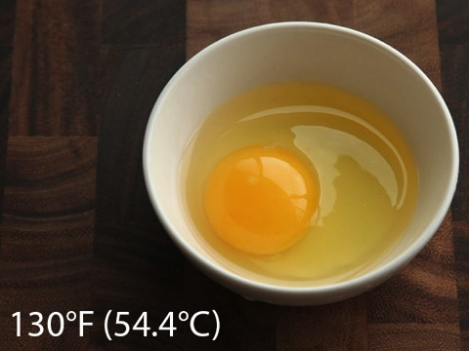
Eggs at Different Temps
www.seriouseats.com

Slide 27
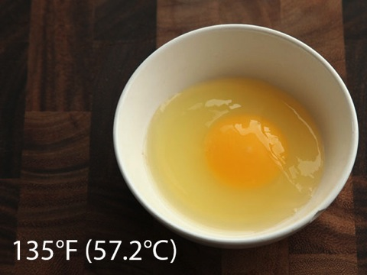
Eggs at Different Temps
www.seriouseats.com

Slide 28
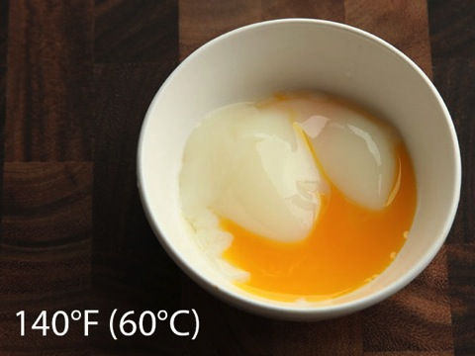
Eggs at Different Temps
www.seriouseats.com

Slide 29
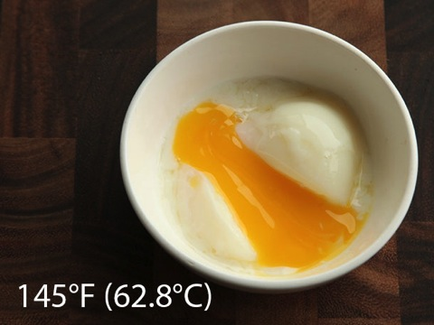
Eggs at Different Temps
www.seriouseats.com

Slide 30
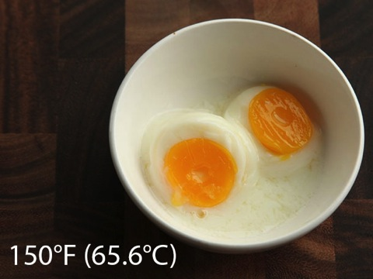
Eggs at Different Temps
www.seriouseats.com

Slide 31
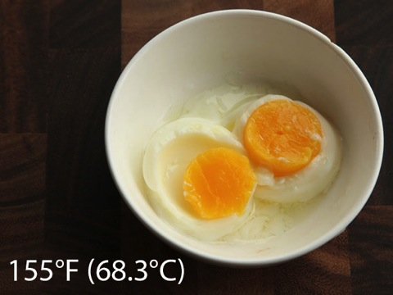
Eggs at Different Temps
www.seriouseats.com

Slide 32
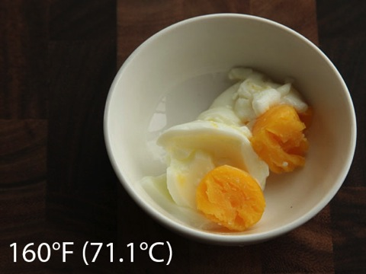
Eggs at Different Temps
www.seriouseats.com

Slide 33
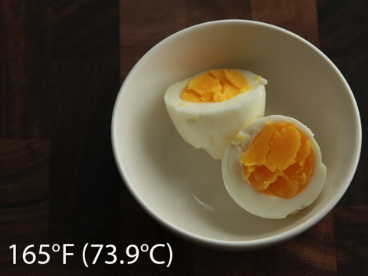
Eggs at Different Temps
www.seriouseats.com

Slide 34
Proteins and Eggs
Let’s see an egg at 147 F/63.8 C
And a Nano Crumble!
(Carrots and Perfect Yolk from Chefsteps.com)
Combine:
Chopped Nasturtium (substitute Arugula!) Handful-ish
Crumbled hazelnuts (freshly roasted if you can. 325 F for 15 minutes, cool a bit, then chop)
Teaspoon-ish of grade B maple syrup, teaspoon-ish of hazelnut oil, and a pinch of salt in a bowl.
Top with an Egg Yolk Sous Vide in oil at 147 F/63.8 C
Notes:
In the Yolk: Protein15.86 g- Tryptophan0.177 g- Threonine0.687 g- Isoleucine0.866 g- Leucine1.399 g- Lysine1.217 g- Methionine0.378 g- Cystine0.264 g- Phenylalanine0.681 g- Tyrosine0.678 g- Valine0.949 g- Arginine1.099 g- Histidine0.416 g- Alanine0.836 g- Aspartic acid1.550 g- Glutamic acid0.595 g- Glycine0.488 g- Proline0.545 g- Serine1.326 g
http://ndb.nal.usda.gov/ndb/foods/show/152?fg=&man=&lfacet=&count=&max=25&sort=&qlookup=eggs&offset=&format=Full&new=&measureby=
40 different proteins

Slide 35
Thank You!
Frank Kusiak: Frank_kusiak@berkeley.edu
Special thanks to:
Lizzie Hagar-Barnard for Jell-o experiments and general science knowledge help!

