Slide 1
Working with teachers and schools
to reach K-12 students
Kevin Dilley, Sciencenter, Ithaca, NY
Barbara McMillin, Children’s Museum in Oak Lawn, Oak Lawn, IL
Cheryl Glasford, Omaha Children’s Museum, Omaha, NE
Corrine Doron, Sony Wonder Technology Lab, New York, NY
Sarah Thomas, Explorit Science Center, Davis, CA
JUNE 2015
NETWORK-WIDE MEETING
NISENET.ORG

Slide 2
Children’s Museum in Oak Lawn
Barbara McMillin

Slide 3
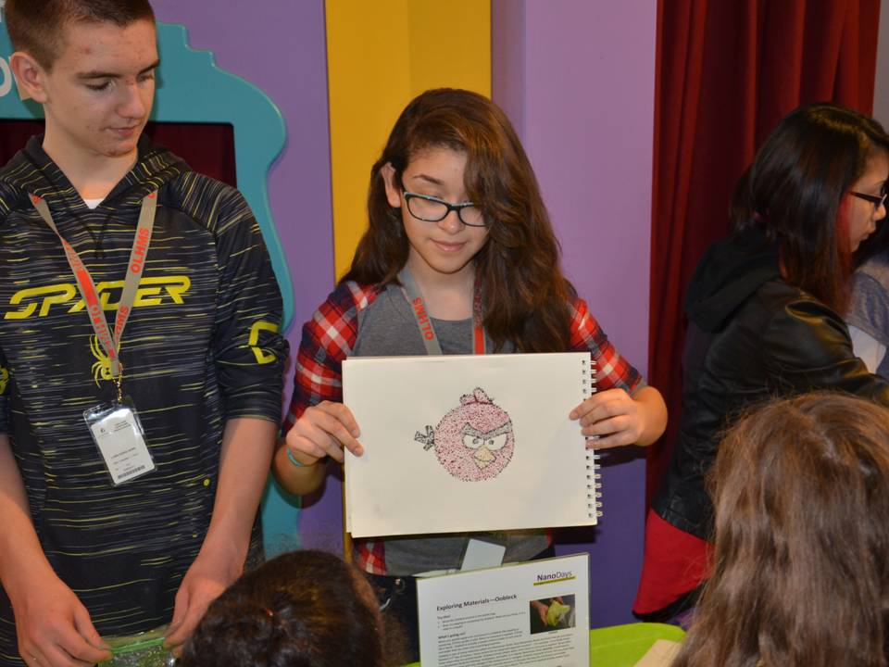
Children’s Museum at Oak Lawn

Slide 4
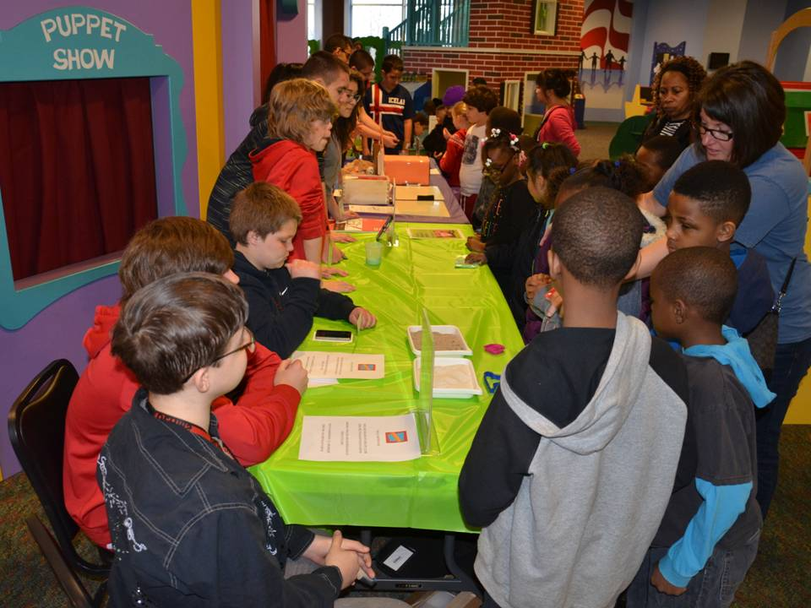
Children’s Museum at Oak Lawn

Slide 5
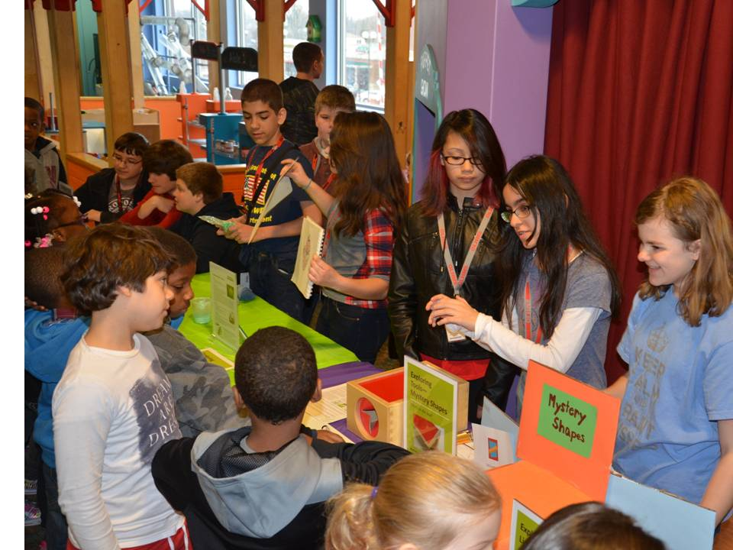
Children’s Museum at Oak Lawn

Slide 6
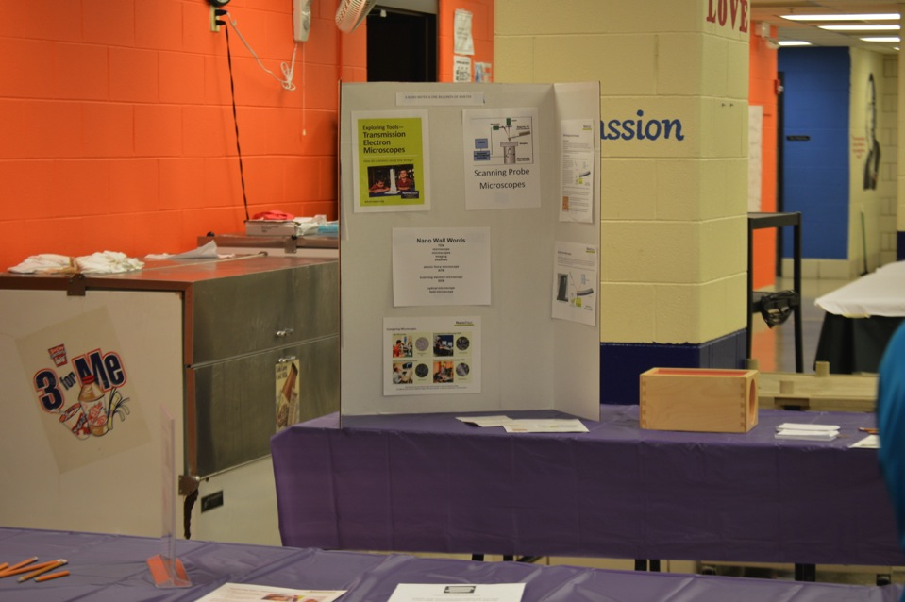
Children’s Museum at Oak Lawn

Slide 7
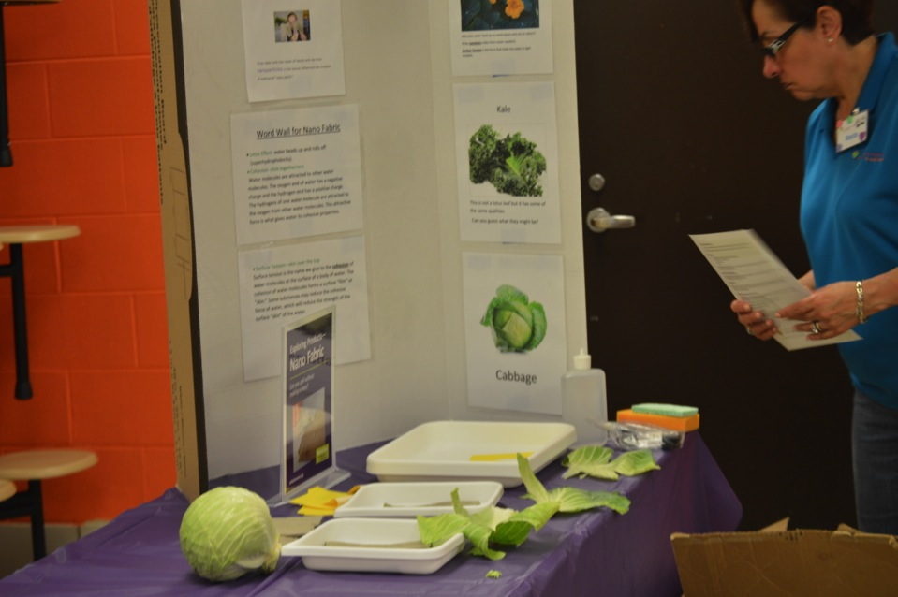
Children’s Museum at Oak Lawn

Slide 8
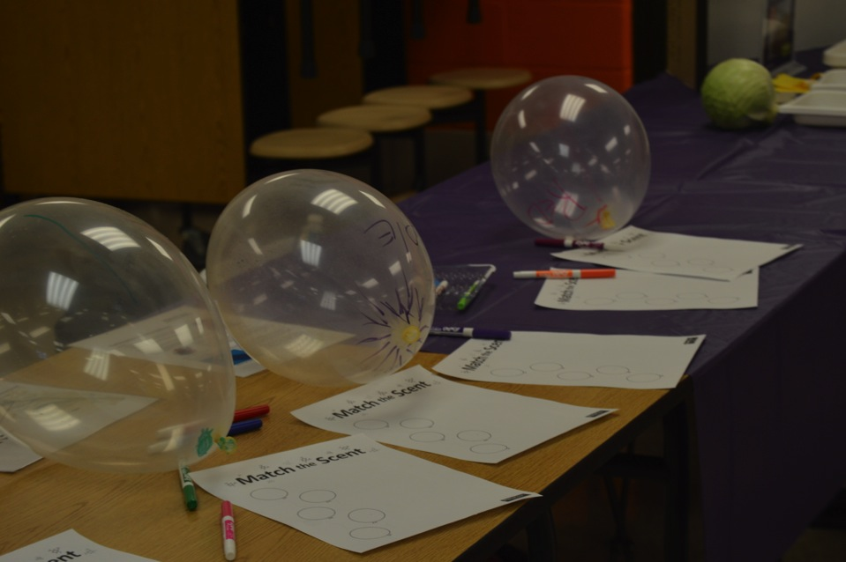
Children’s Museum at Oak Lawn

Slide 9
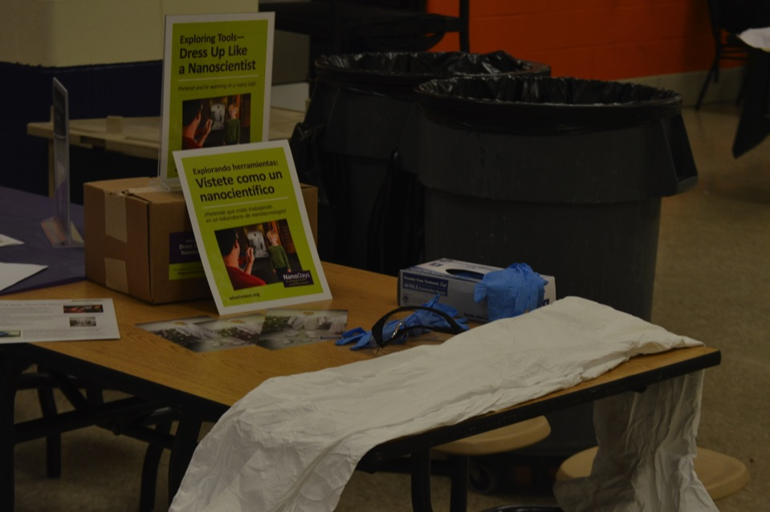
Children’s Museum at Oak Lawn

Slide 10
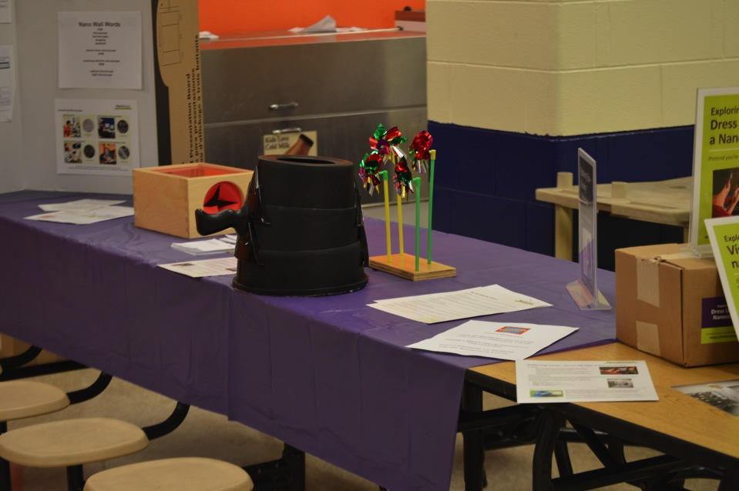
Children’s Museum at Oak Lawn

Slide 11
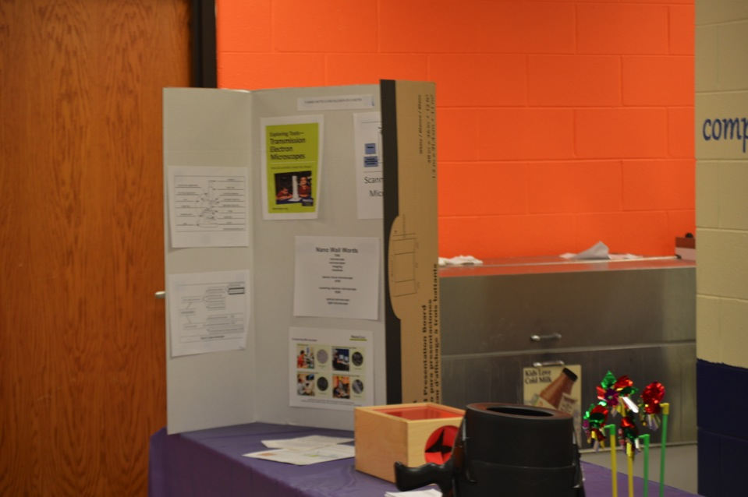
Children’s Museum at Oak Lawn

Slide 12
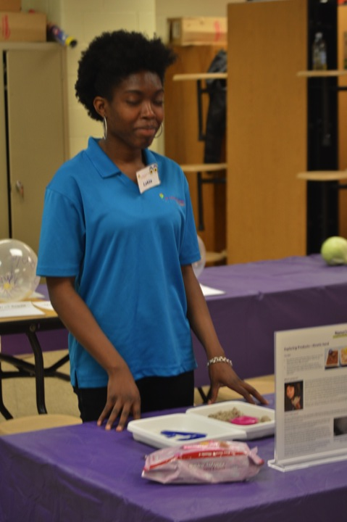

Slide 13
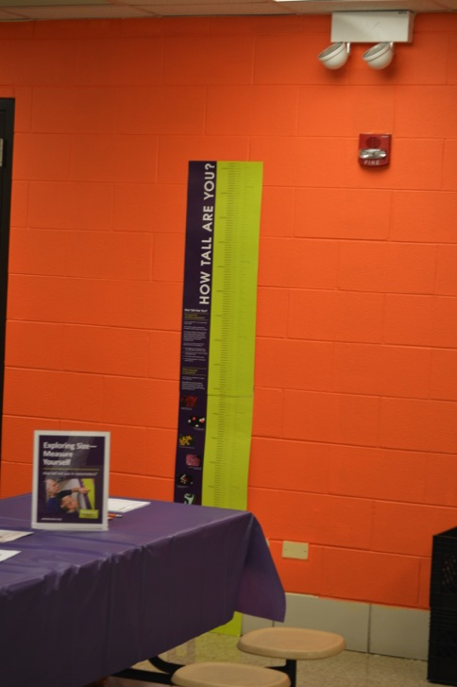

Slide 14
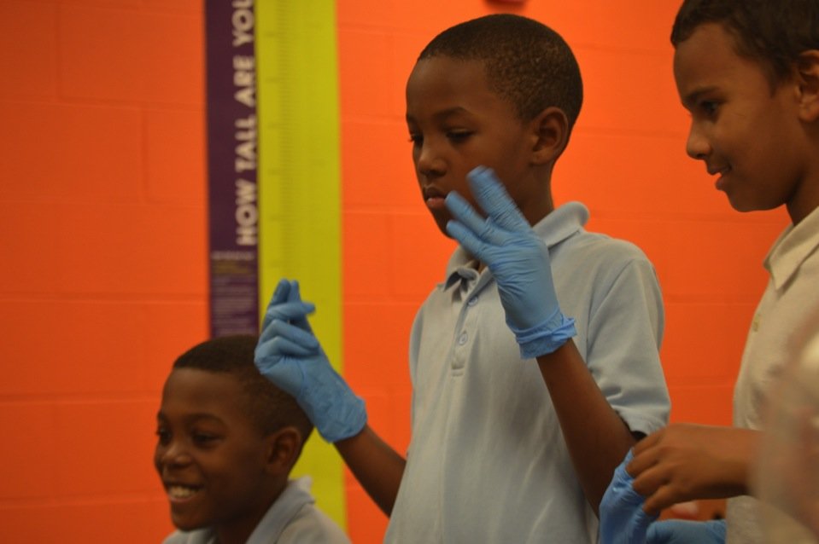
Children’s Museum at Oak Lawn

Slide 15
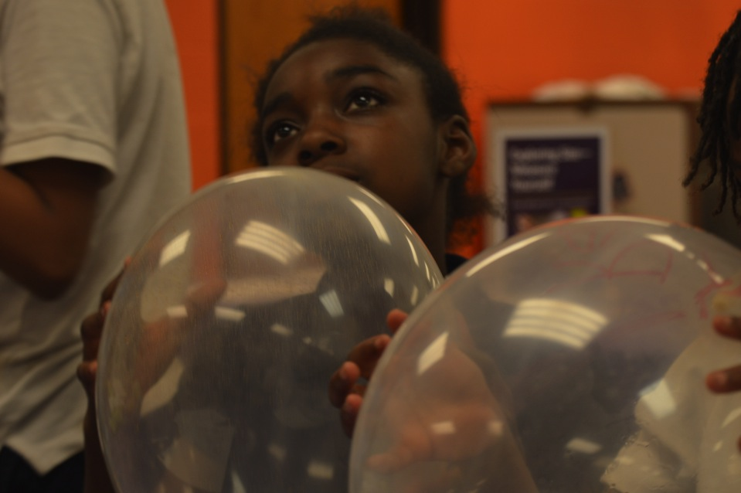
Children’s Museum at Oak Lawn

Slide 16
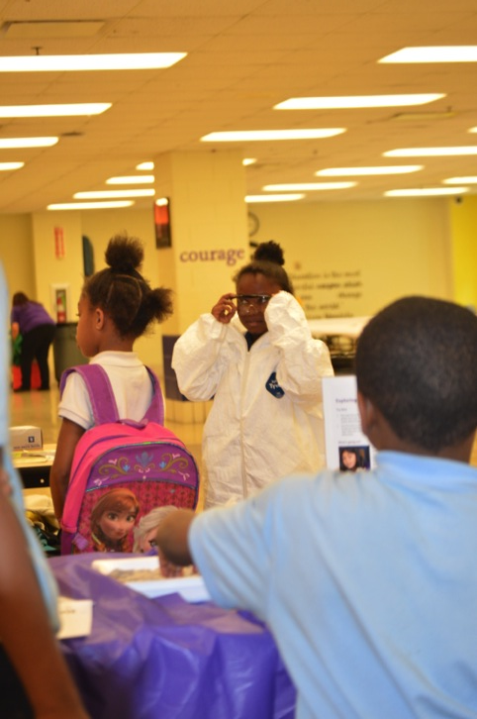

Slide 17
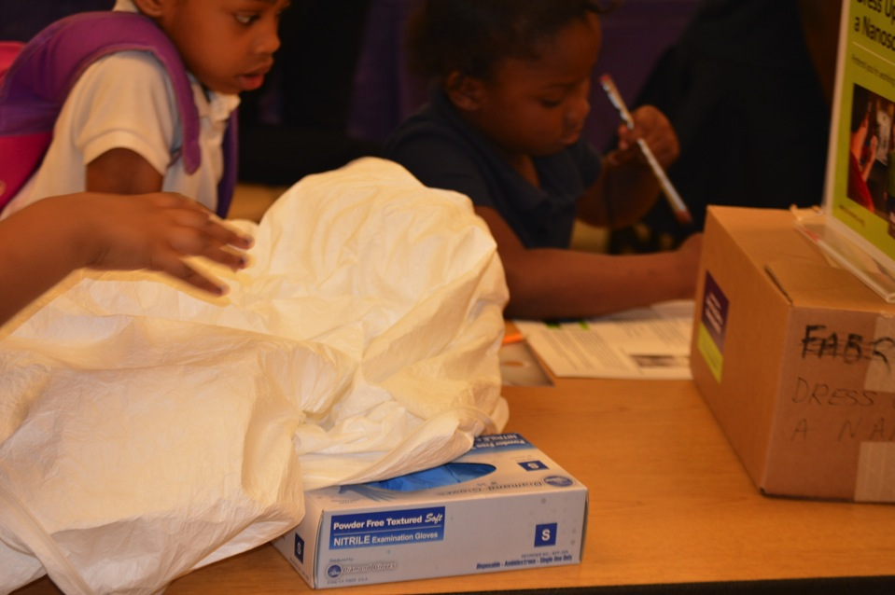
Children’s Museum at Oak Lawn

Slide 18
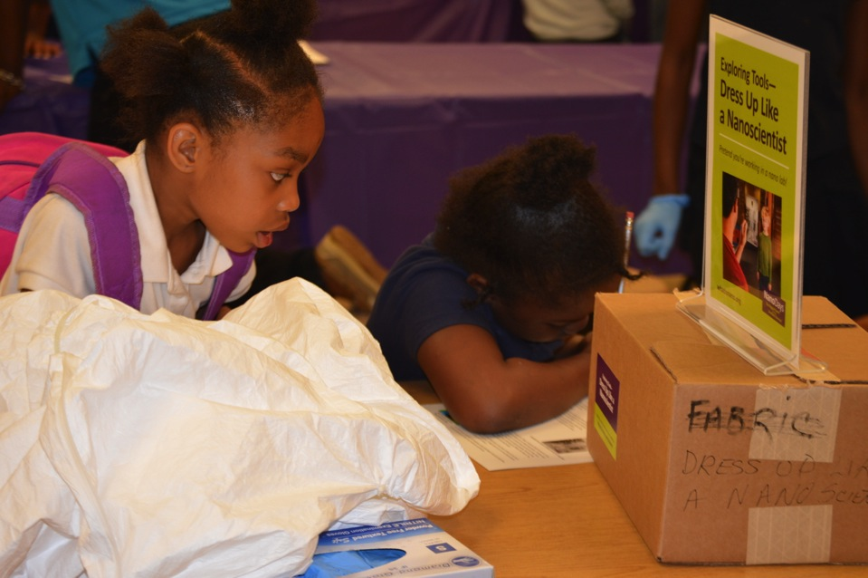
Children’s Museum at Oak Lawn

Slide 19
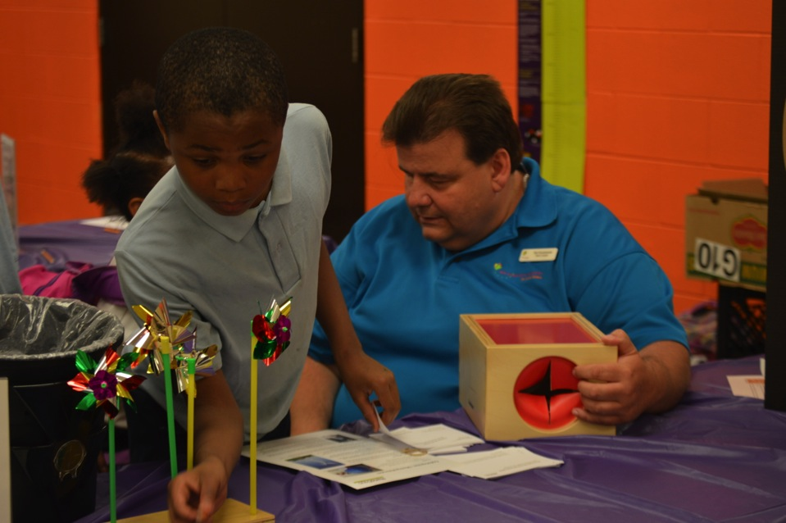
Children’s Museum at Oak Lawn

Slide 20
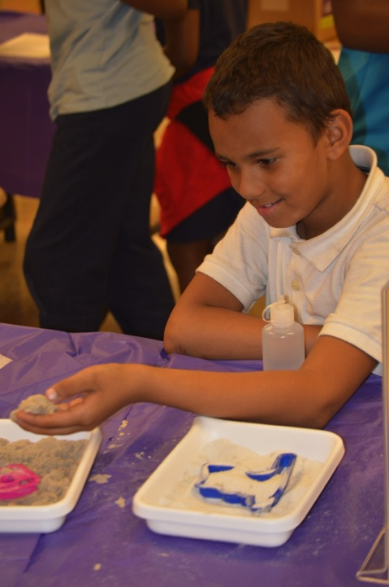

Slide 21
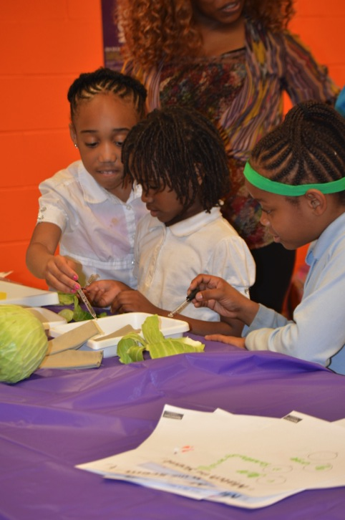

Slide 24
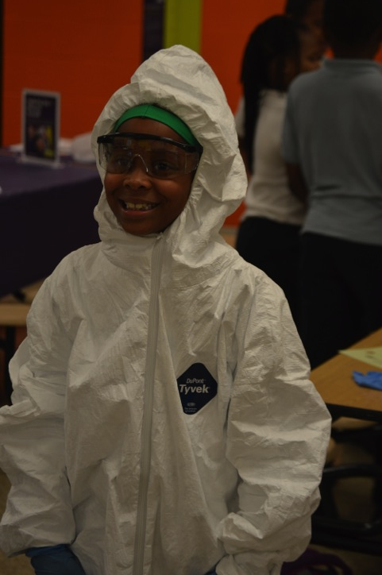

Slide 25
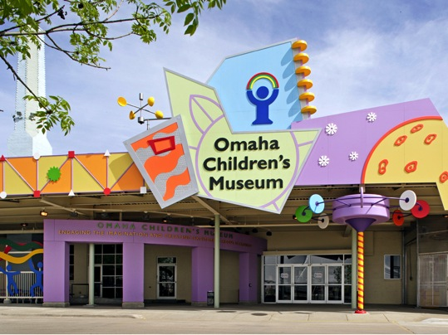
Omaha Children’s Museum
JUNE 2015
NETWORK-WIDE MEETING
NISENET.ORG
Notes:
Good morning

Slide 26
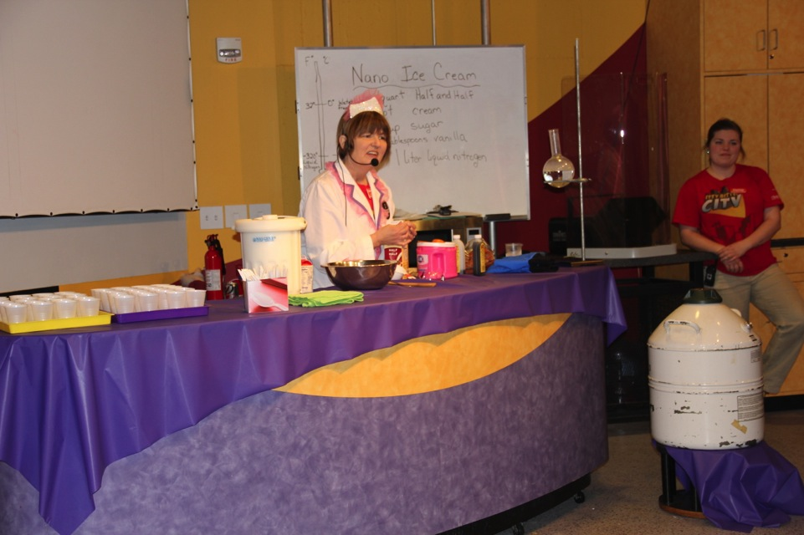

Slide 27
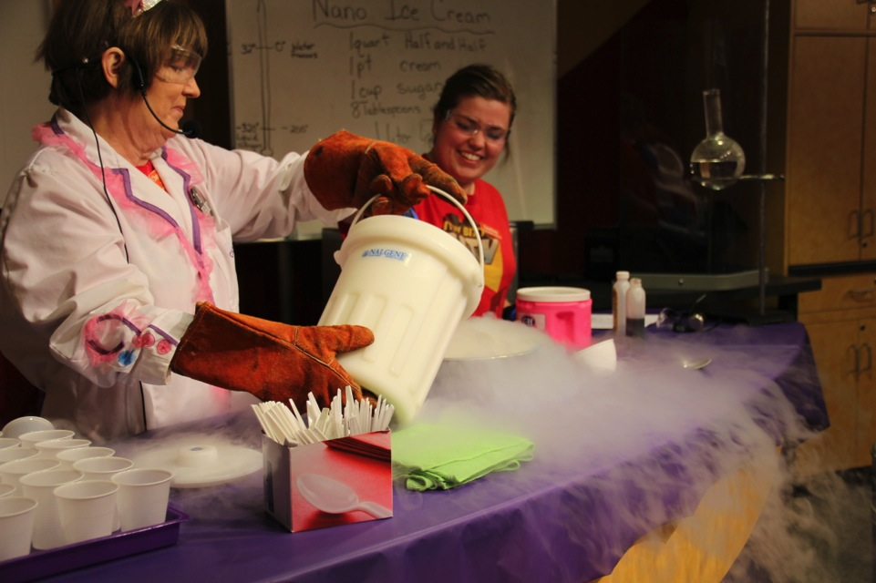

Slide 28
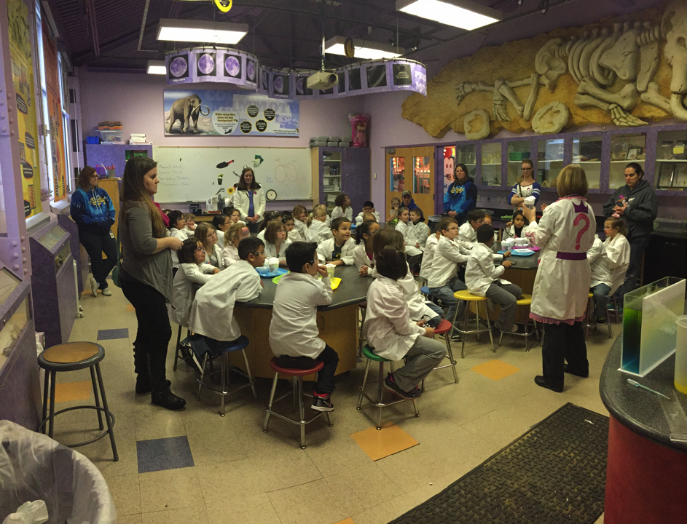

Slide 29
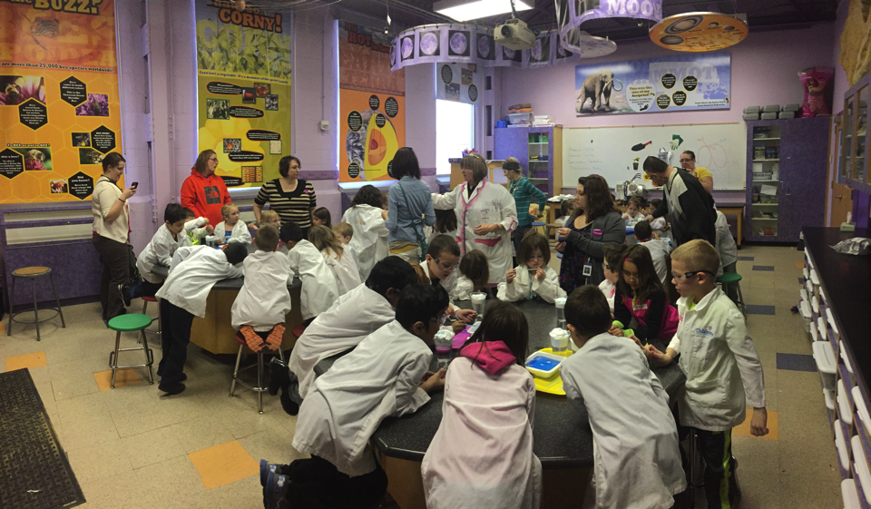

Slide 30
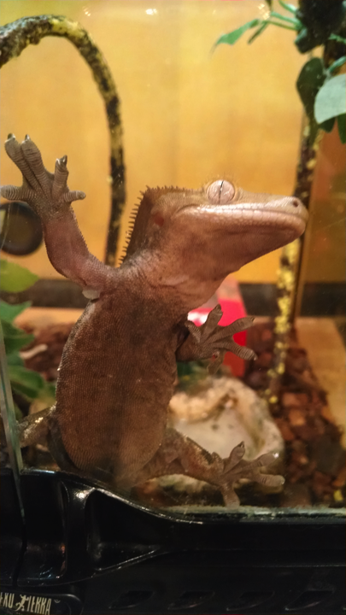

Slide 31
Thank you!
Cynthia Needham, ICAN Productions
This presentation is based on work supported by the National Science Foundation under Grant No. 0940143. Any opinions, findings, and conclusions or recommendations expressed in this presentation are those of the authors and do not necessarily reflect the views of the Foundation.

Slide 32
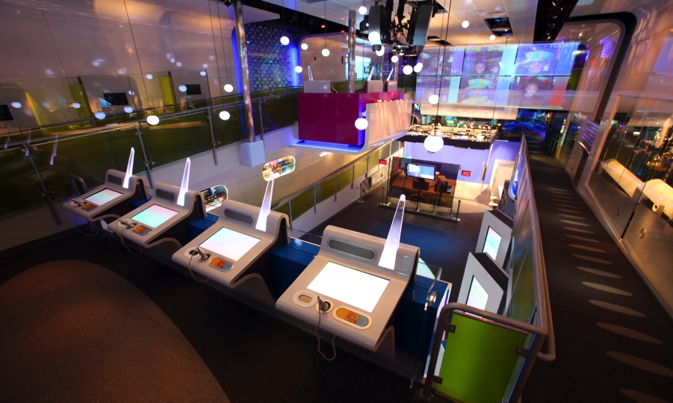
Sony Wonder Technology Lab
Midtown East, NYC
14,000 sq. ft. of exhibits
Annually 200,000 visitors
65% school/ camp groups

Slide 33
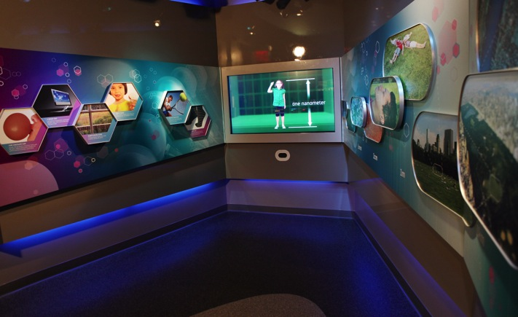
Sony Wonder Technology Lab
Our Nano Exhibit

Slide 34
Sony Wonder Technology Lab: Nano Exhibit Video

Slide 35
Sony Wonder Technology Lab
Our School Program
School Demos
How We Used the NISENet Resources
Staff Training
What Teachers Tell Us

Slide 36
Thank you!
Corrine Doron
Senior Manager of Programs
corrine_doron@sonyusa.com
SONYWONDERTECHLAB.COM
Cynthia Needham, ICAN Productions
This presentation is based on work supported by the National Science Foundation under Grant No. 0940143. Any opinions, findings, and conclusions or recommendations expressed in this presentation are those of the authors and do not necessarily reflect the views of the Foundation.

Slide 37
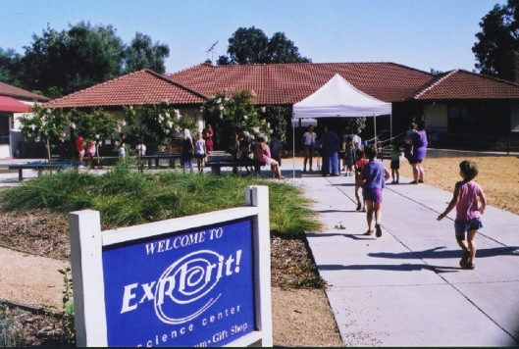
Beyond the Walls, Within the Community: Creating the Link.
Sarah Thomas, Explorit Science Center
Mission:
To ignite and foster curiosity about science and nature through inquiry and discovery.

Slide 38
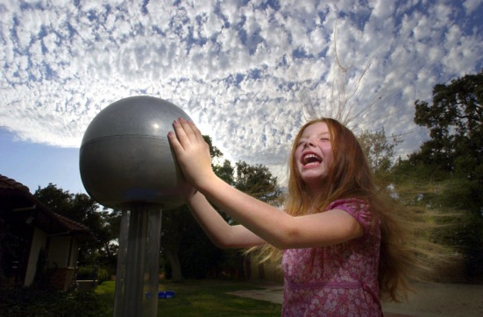
Explorit Science Center
Think it.
Try it.
Explorit.
Established 1982 by community educators
Independent non-profit

Slide 39
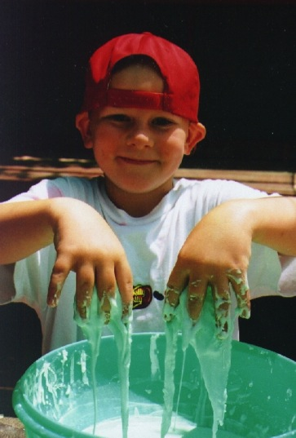
Explorit’s Style Hands-On…
Notes:
Hands-on
Informal
Accessible
Engaging

Slide 40
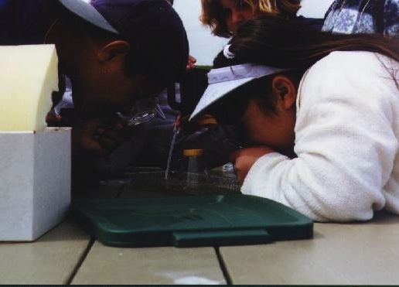
Minds-On…
Notes:
Hands-on
Informal
Accessible
Engaging

Slide 41
Target audience
Serving nearly 30,000 annually
Reaching rural, urban and underserved communities
Targeting K-6 children, families, and teachers

Slide 42
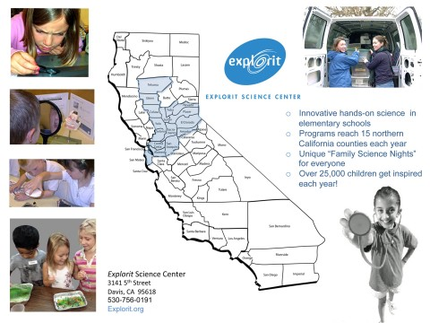
Program Reach: 15 Counties

Slide 43
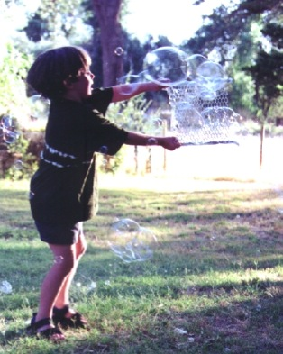
Programs and Services
Interactive Exhibits
Weekend Family Programs
School Outreach & Field Trips
Science & Health Nights
Classes & Camps for Kids
Teacher Workshops

Slide 44
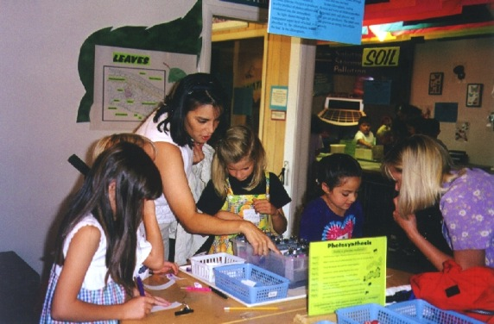
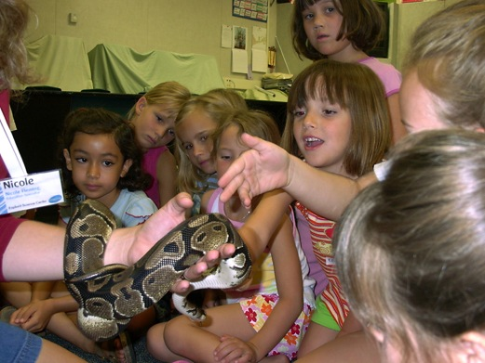
On Site Programs

Slide 45
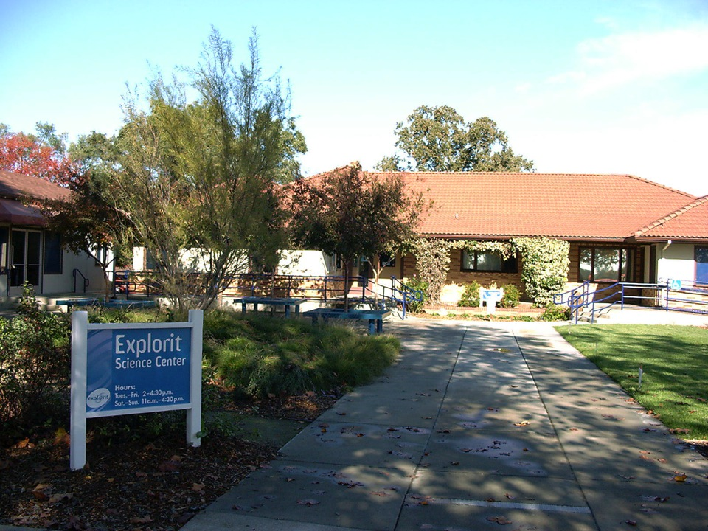
On Site Programs

Slide 46
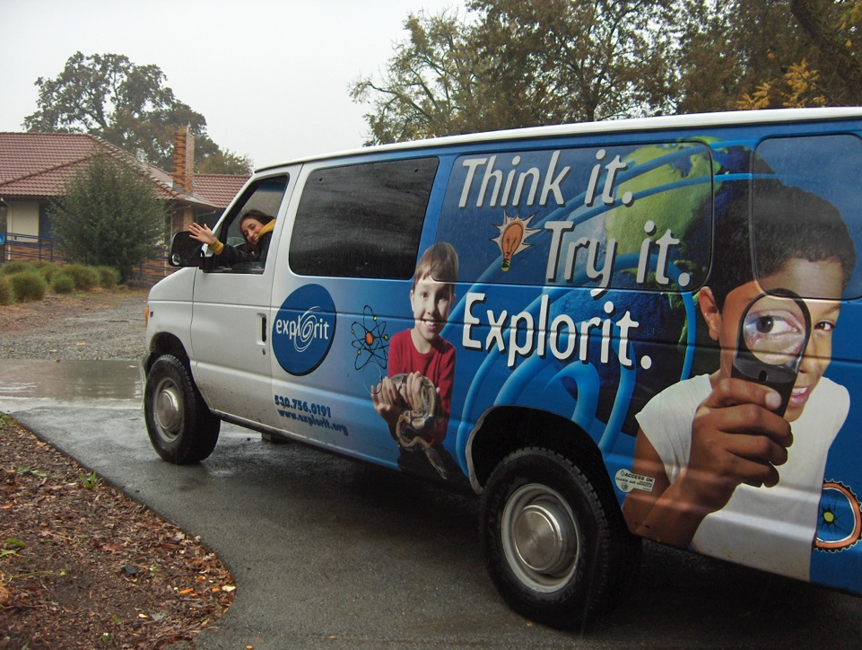
On Site Programs

Slide 47
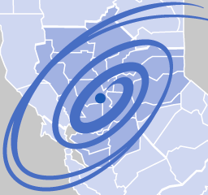
Traveling Programs
Over 60% of total audience reached with mobile programs throughout 15 counties

Slide 49
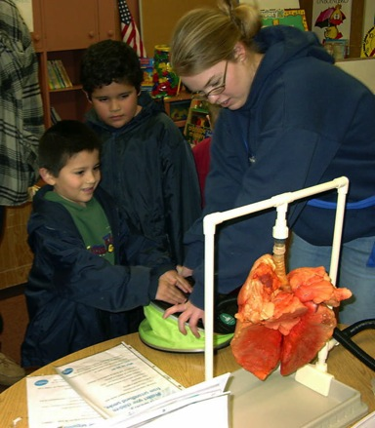
Classroom Adventure Programs
60 minute programs that take place in K-6 classrooms.
Developed to fulfill Explorit’s long term goal of increasing traveling outreach to underserved children and schools.
8 topics, 2 new for the 2014-15 school year.

Slide 50
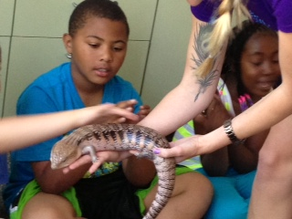
Classroom Adventure Topics
Amazing Animals (K - 4) Investigate animal traits, characteristics, and adaptations with specimens and live animals.

Slide 51
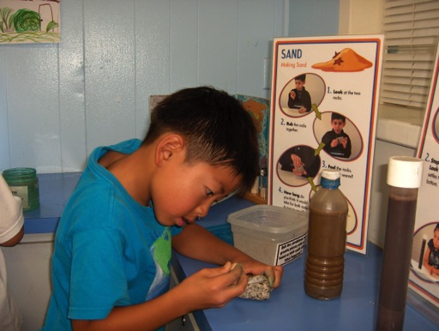
Classroom Adventure Topics
Earth’s Features (2 - 6) Explore the forces and characteristics of volcanoes, earthquakes, rocks, and mineral forms.

Slide 52
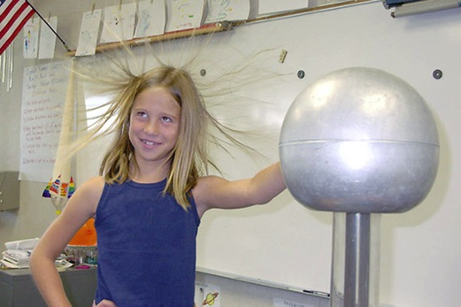
Classroom Adventure Topics
Explorations in Energy (3 - 6) Experiment with energy sources and how they can be converted into heat, light, and motion.

Slide 53
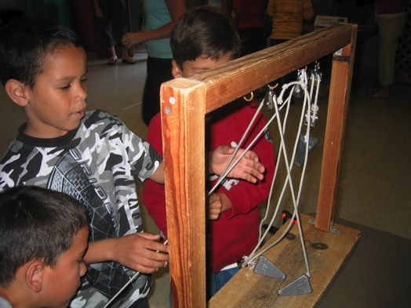
Classroom Adventure Topics
Simple Machines (K - 4) Explore the six main types of simple machines while experimenting with the forces of motion.

Slide 54
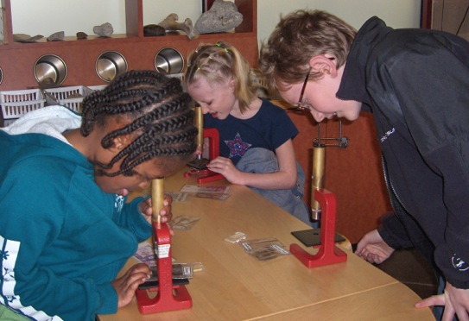
Classroom Adventure Topics
Microscopes and Magnifiers (3 - 6) learn about the microscope parts and reveal the minute wonders of pond water life.

Slide 55
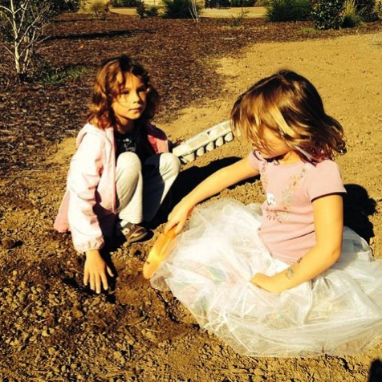
Classroom Adventure Topics
Neighborhood Ecosystems (K - 6) Explore the soil, plants, and animals in the schoolyard ecosystem.

Slide 56
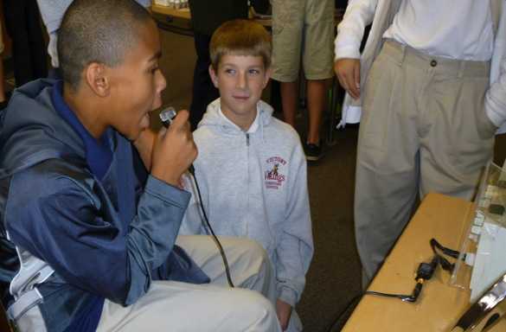
Classroom Adventure Topics- NEW 2015!
Light & Sound (1 - 5) Discover waves - see the sound waves of your voice or use vibrations to move objects.

Slide 57
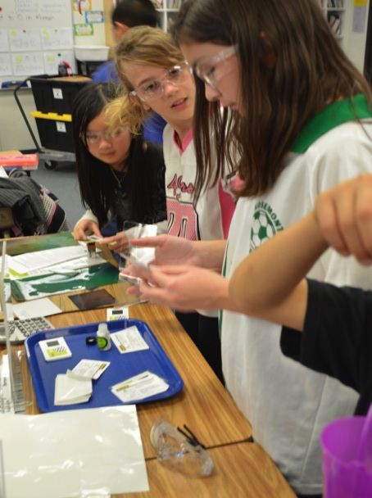
Classroom Adventure Topics- NEW 2015!
Nanotechnology (4 - 6) Investigate the nano technology in nature, health, energy, and the environment.

Slide 58
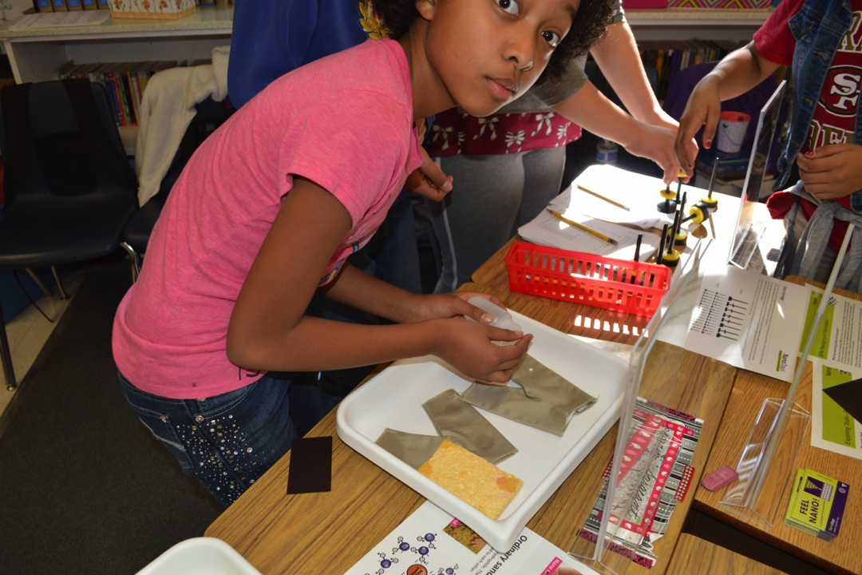
Nanotechnology Classroom Adventure was developed through a mini grant from NISE network.

Slide 59
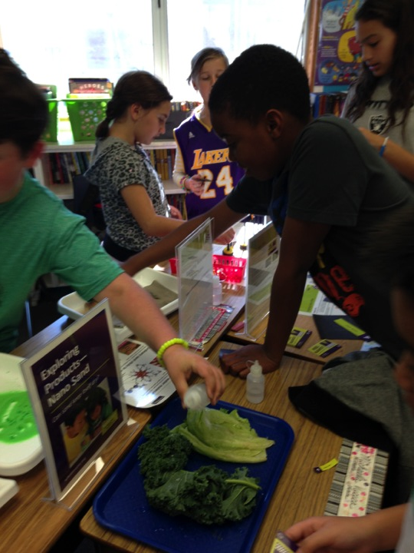

Slide 61
Challenges
Introducing new CA programs:
Teachers book programs they’re familiar with.
“Nano” doesn’t seem like it fits into NGSS.
“Nano” is an unfamiliar topic to many teachers.
Because of a lack of prior knowledge, the Nano CA requires more introduction background than our other CA programs.

Slide 62
TBI Survey
Question:
Does the current CA format meet the needs of our teachers?
Preliminary Findings (data still being collected and analyzed):
60 min. programs are preferable to longer programs.
A pre-requisite video would be a welcome addition.
The station/rotation format is preferred over a whole class participation project.

Slide 63
TBI SURVEY FINDINGS

Slide 64
2014-15 CA Programs
Bookings from September 2014-June 2015:

Slide 65
Faced with challenges, but also opportunities for growth…

Slide 66
Learning about the new NGSS

Slide 67
Trying new marketing strategies:
Offering discounts on new programs.
Piloting the programs for free.
Reaching out to PTO/PTA.
Teacher specific commercial (watch).

Slide 69
Questions & Discussion

Slide 70
Thank you!
Cynthia Needham, ICAN Productions
This presentation is based on work supported by the National Science Foundation under Grant No. 0940143. Any opinions, findings, and conclusions or recommendations expressed in this presentation are those of the authors and do not necessarily reflect the views of the Foundation.

