Slide 1

Let’s Do Chemistry
Event Overview and Training
Notes:
Welcome to our Explore Science: Let’s Do Chemistry event overview and training! In this presentation, we’re going to go through quite a bit of information related to the national Let’s DO Chemistry project, as well as the programming we are doing here. We’ll have time at the end for questions, but feel free to ask for clarification throughout. Throughout this presentation I’ll refer to the project and kit as Let’s Do Chemistry, which is the tagline for the kit materials and resources.

Slide 2



Overview
Let’s Do Chemistry kit and project
Content and learning goals
Event overview and safety
Leading the activities
Notes:
This training has four parts:
1. Quick introduction to the Let’s Do Chemistry activity kits and project
2. Overview of the chemistry content and activity learning goals
3. A section specifically on safety protocols and practices
4. Tips to help you successfully lead the activities

Slide 3

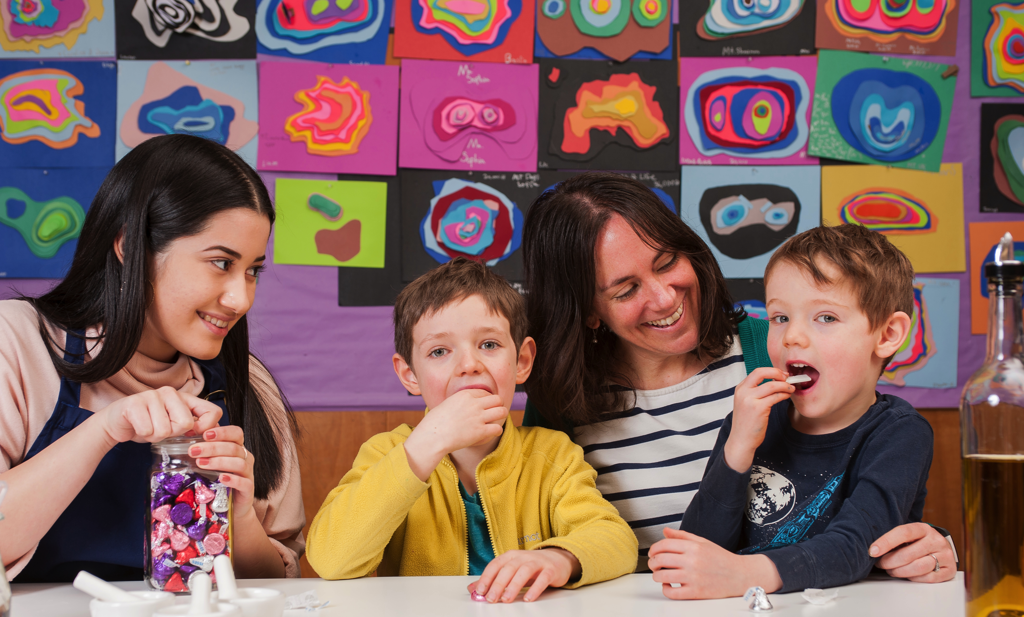
Gum & Chocolate
Notes:
First, let’s start by experiencing some chemistry in action! Together, we’re going to do a hands-on (mouths-on!) chemistry activity. This activity requires eating gum and chocolate, so please let me know now if you have any food sensitivities or allergies.
Refer to the training guide included in the Let’s Do Chemistry kit for instructions and tips. If a participant is unable to complete this activity due to food allergies or sensitivities to gum or chocolate, invite them to partner up with another participant to share observations.
***You can also share this activity with public audiences, but please remember to specifically be aware of food sensitivities and allergies. The gum and chocolate in this activity also present a choking hazard to children under 3.***

Slide 4

Notes:
The Let’s Do Chemistry projects represents an effort by the National Informal STEM Education Network (NISE Net) in collaboration with the American Chemical Society to encourage positive attitudes toward learning about chemistry through engaging, hands-on activities.
This year, 2018, the NISE Network has sent out 250 physical Explore Science: Let’s Do Chemistry kits. We are joining museums, science centers, other informal science education institutions, and American Chemical Society local sections and student chapters across the country to host events this fall and throughout the year.
The NISE Net team includes museum educators and researchers from the Museum of Science in Boston, the Science Museum of Minnesota, Arizona State University, and Sciencenter in Ithaca, New York. The ACS team includes chemists, science communicators, and educators from the association. Additional advice, expertise, and oversight are contributed by the ACS Committee on Chemical Safety, the ACS Committee on Community Activities, the Children’s Creativity Museum in San Francisco, the Children’s Museum of Houston, The Franklin Institute, The Lawrence Hall of Science at the University of California Berkeley, the Museum of Life and Science in Durham, North Carolina, and the University of Notre Dame.

Slide 5

Content and Learning Goals
Notes:
First we’ll jump into a quick overview of the content and learning goals.

Slide 6
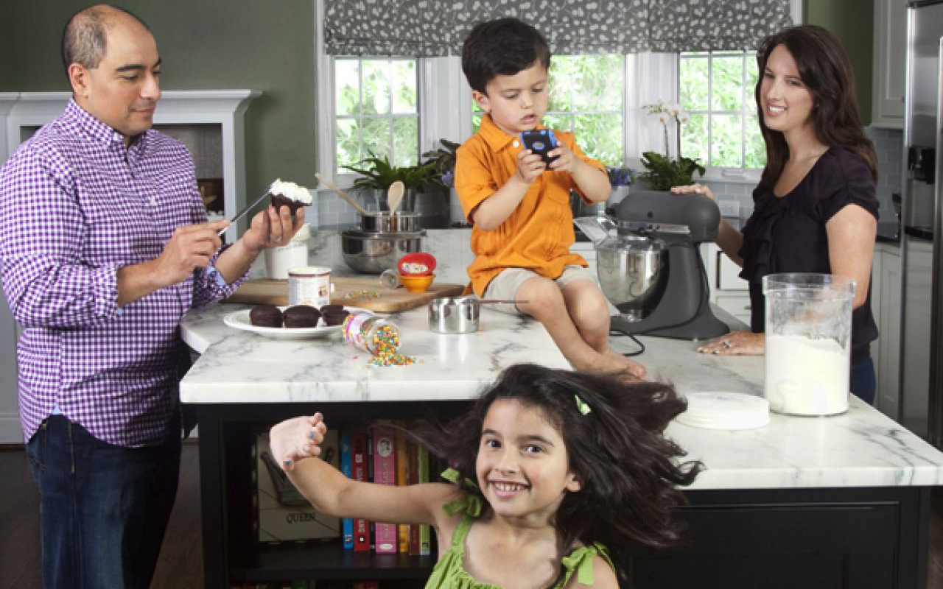
What is Chemistry?
Notes:
The big picture project goal is to develop positive attitudes towards chemistry and more specifically toward learning about chemistry. But what is chemistry? What could you say if this family asked you what chemistry is? Can you find some examples of chemistry here in this photo?
Hint: You’ve just done an activity that involves chemistry (gum and chocolate). Encourage participant trainees to offer ideas of their own before going onto the next slide.

Slide 7
Chemistry
Chemists are scientists that study
The elements that make up everything in this world
the way different materials behave and change
how materials interact with each other and combine to make new things
Chemistry can help us understand the world around us and solve problems.
Notes:
This definition isn’t precise, but it’s a good introduction that will be supported by the activities in the kit.
Chemistry can help us answer questions like:
What is air made of?
What makes slime stretchy?
What kind of fuel will launch a toy rocket?
What happens if you mix gum and chocolate?
How can we make sure our water is safe to drink?
What are stars made of?
Our Let’s Do Chemistry activities investigate some of these questions, and many more! And remember, you don’t have to be a chemist to learn, use, and talk about chemistry.

Slide 8
Learning Goals
Develop positive attitudes toward learning chemistry
  Interest: “Chemistry is interesting!”
  Relevance: “Chemistry is connected to my life!”
  Self-efficacy: “I can learn chemistry!”
Notes:
How do you create activities that influence public attitudes and not just teach them the content? The project team had that same question, so a large part of this project was focused on studying facilitated activities to learn best practices and methods of supporting indicators of positive attitudes. Defined as increased interest, relevance, and self-efficacy. One of the outcomes of that research are the activities in the Let’s Do Chemistry kit that we’ll be using during our event.
We’re going to (relatively quickly) explore what we mean by interest, relevance, and self-efficacy and provide you resources to support these goals. You can find more specific information about how these goals connect to specific activities in the written facilitator guides and training videos for each activity.

Slide 9
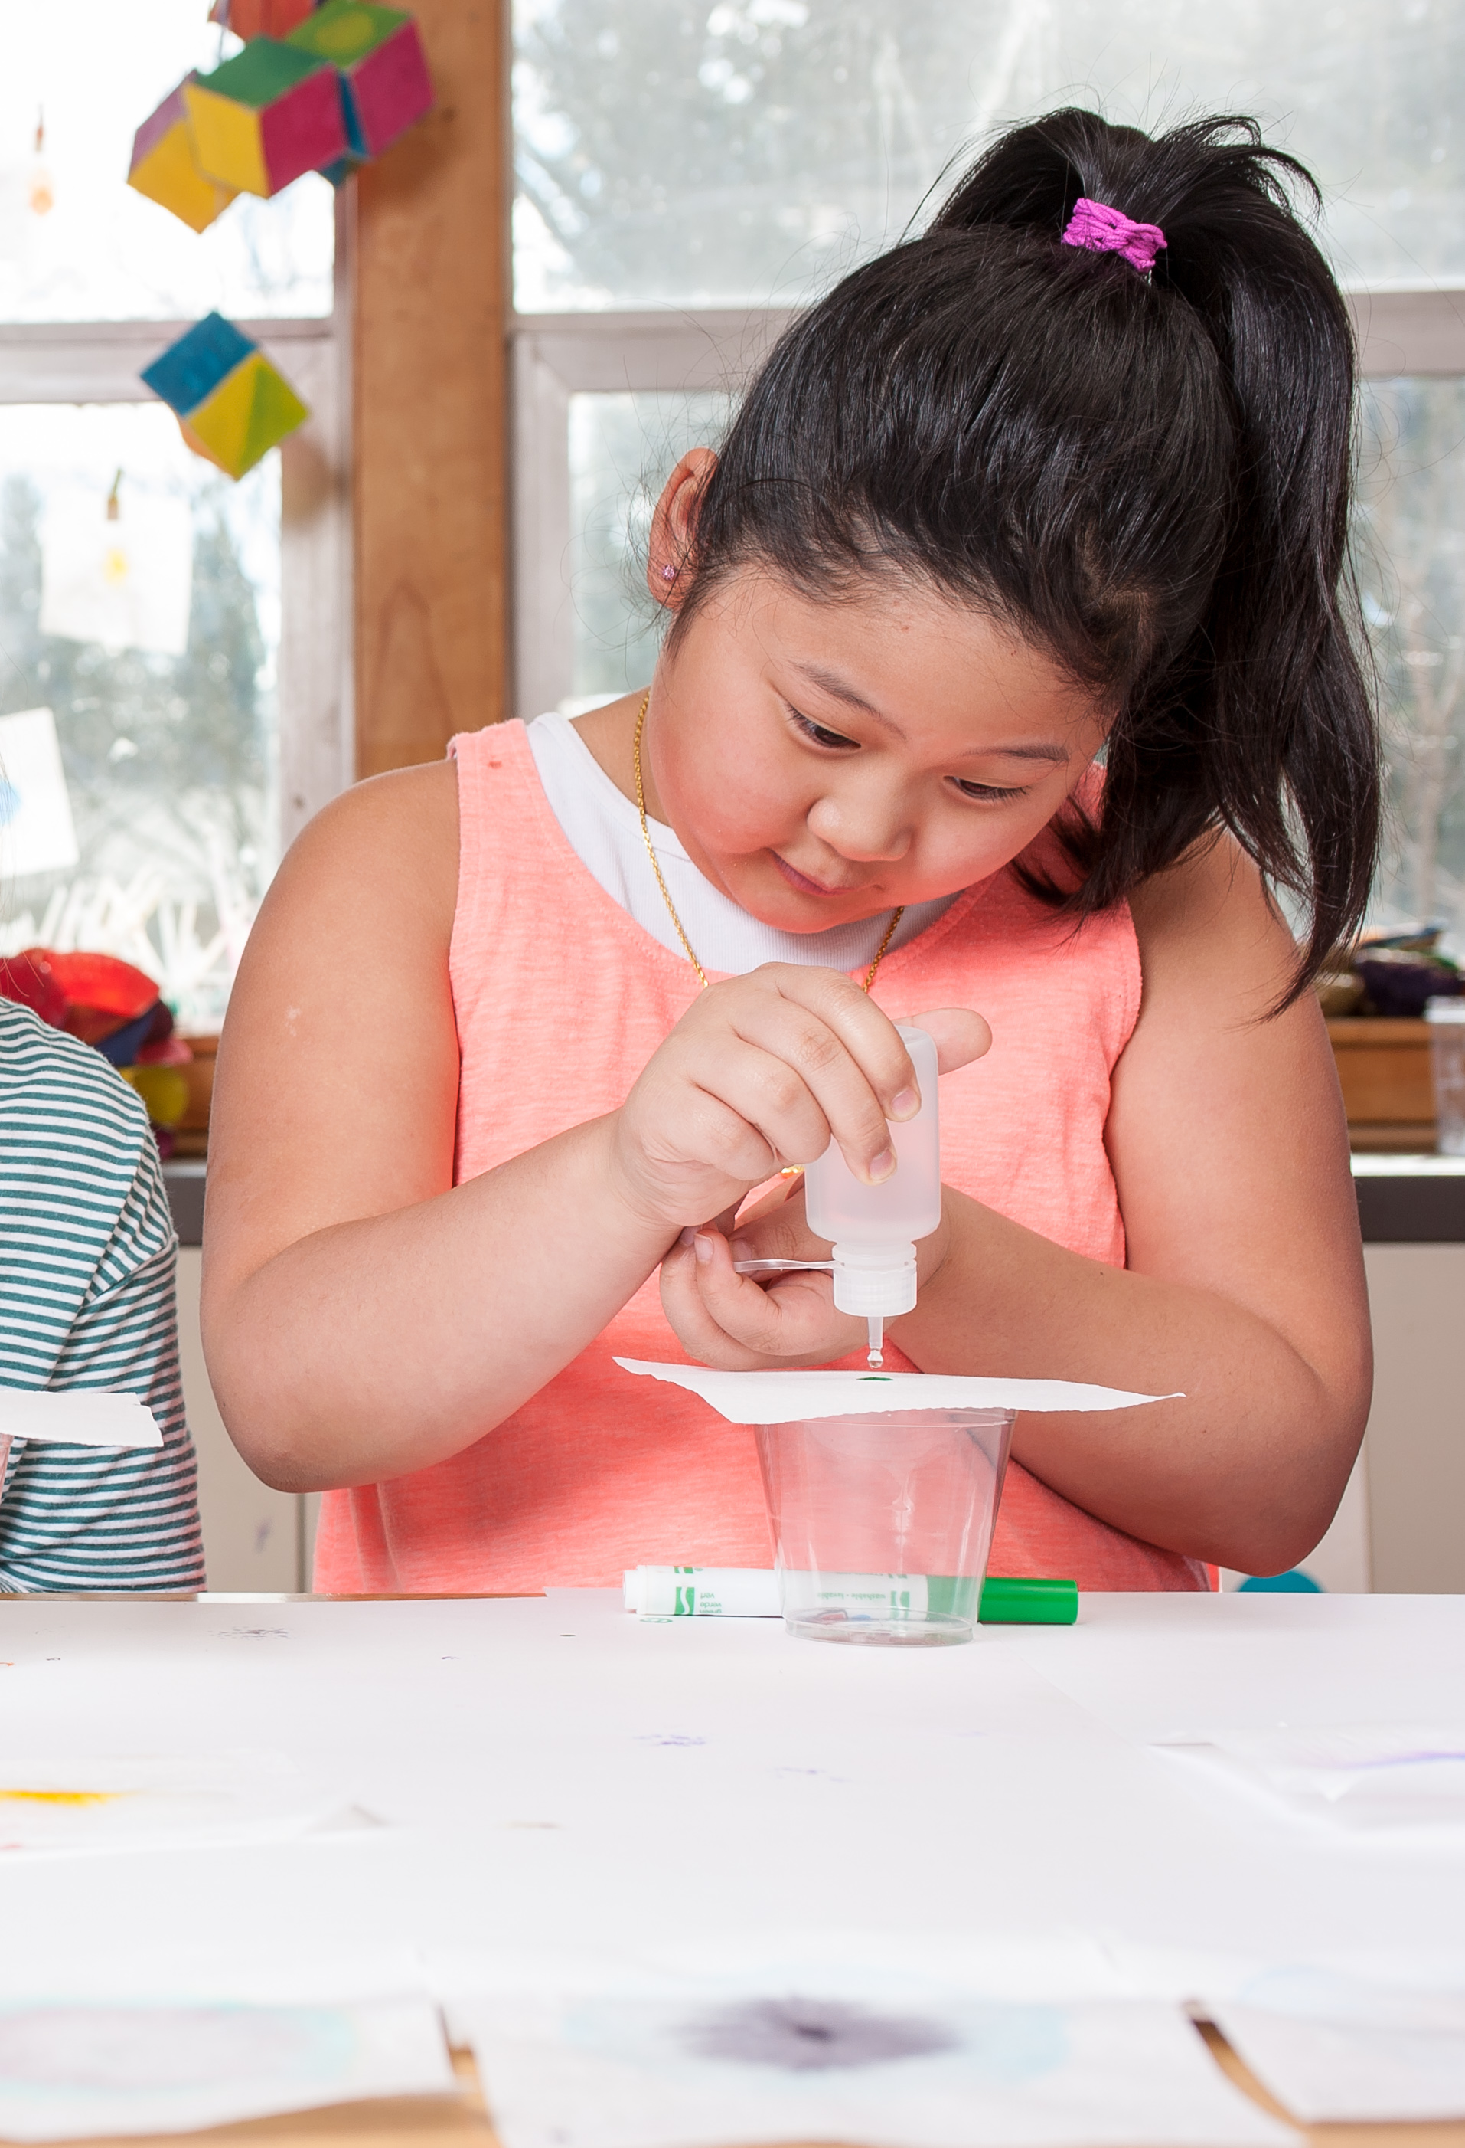
  Interest
  “Chemistry is interesting!”
Notes:
Interest is the feeling of having your attention, concern, or curiosity particularly engaged by something. Interest involves both feeling and thinking. It’s both affective and cognitive. Interest is encouraged by activities that are hands-on and allow for observation of phenomena
When doing a hands-on chemistry activity, interested learners may…
…try things out
...observe carefully
...ask you questions
…talk to each other
…want to do more
Thinking back to the Gum & Chocolate activity, what are some ways the activity supported increased interest?

Slide 10
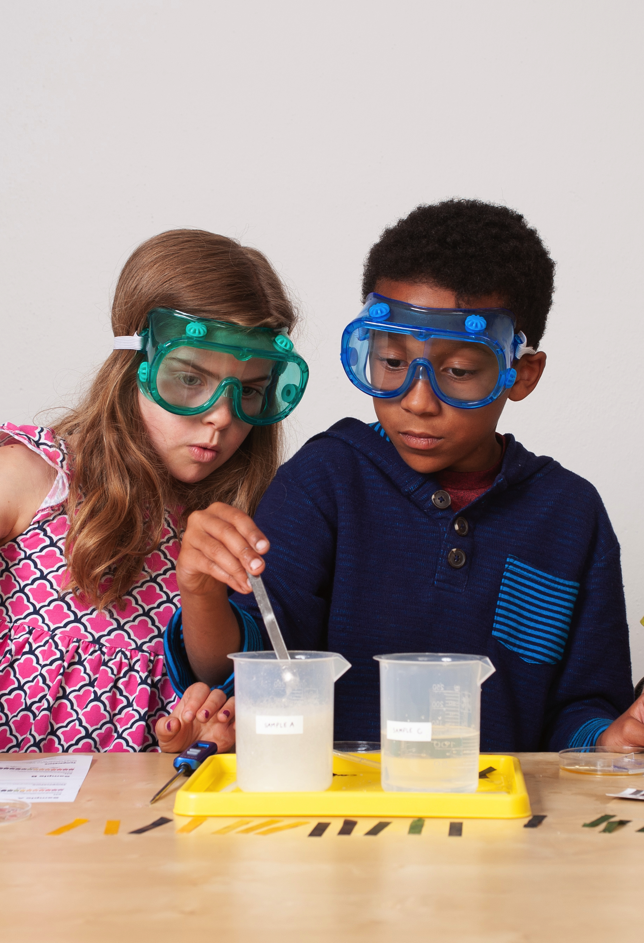
  Relevance
  “Chemistry is connected to my life!
Notes:
Relevance involves both personal experience and broader applications. Relevance involves making connections to familiar experiences, everyday life, and the ways that chemistry is used.
Learners who discover the relevance of chemistry may…
…notice uses and applications of chemistry
….remember things they’ve done before
...make connections to everyday life
…talk about how chemistry can solve (or create) problems or how chemistry relates to issues that are important to them
Thinking back to the Gum & Chocolate activity, what are some ways the activity supported increased relevance?

Slide 11
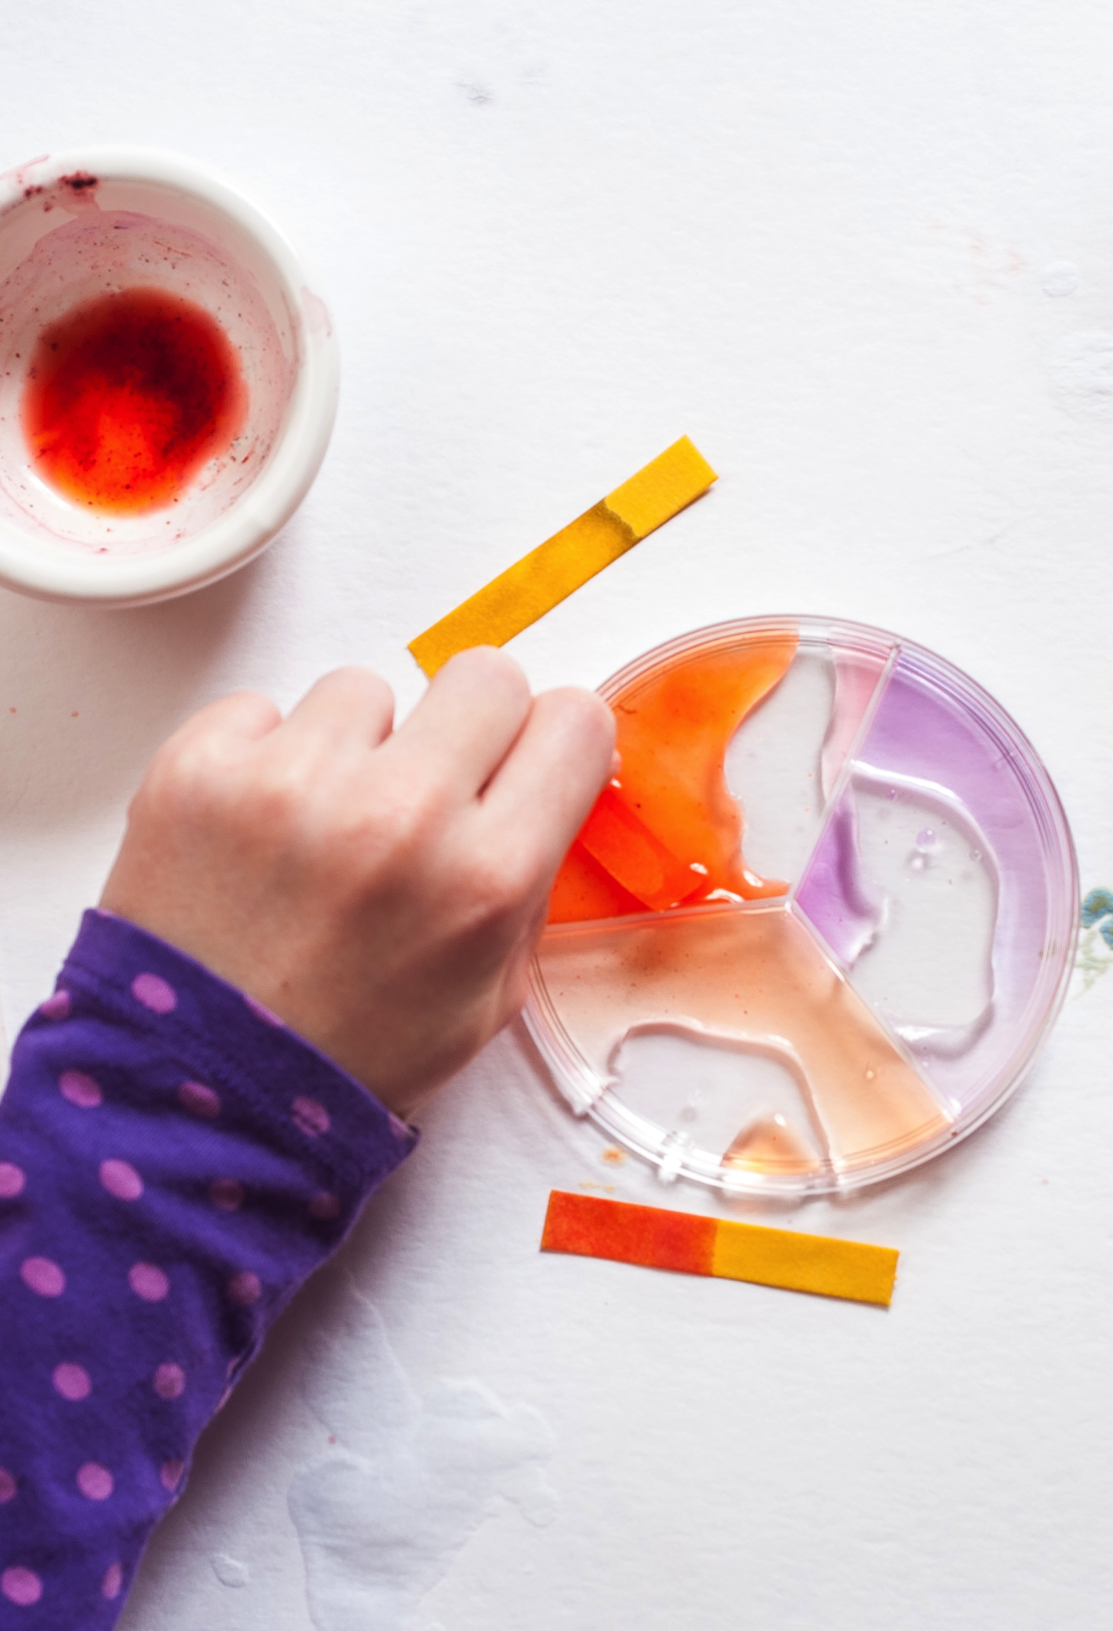
  Self-efficacy
  “I can learn chemistry!”
Notes:
Self-efficacy is feeling confident in the ability to learn, talk about, and use chemistry. Self-efficacy is encouraged by activities that are easy to do and understand and that are hands-on.
Learners who develop self-efficacy by doing hands-on chemistry may…
…feel confident about what they’re doing
...come up with things to try
...investigate their own questions
...figure things out on their own
…think of themselves as someone who can do chemistry
Thinking back to the Gum & Chocolate activity, what are some ways the activity supported increased self-efficacy?
Note, for this project, self-efficacy relates to a domain (like chemistry.) It is not a general sense of confidence.

Slide 12
Lifelong Learning
Positive attitudes about chemistry start here and will continue at other times and places:
Interest starts now but can carry into the future.
Relevance starts here but can connect to home, school, work, and our community.
Self-efficacy starts with specific activities but can extend to chemistry more generally.
Notes:
Supporting interest, relevance, and self-efficacy as tools to generate positive attitudes can translate beyond the activities we present as part of our event!

Slide 13
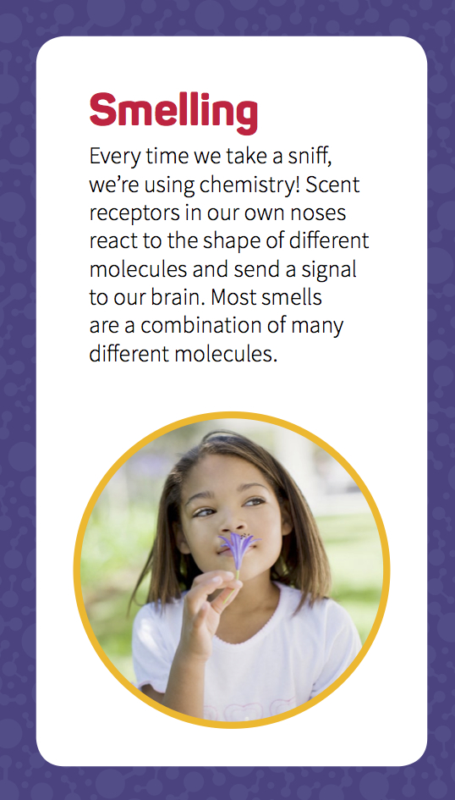
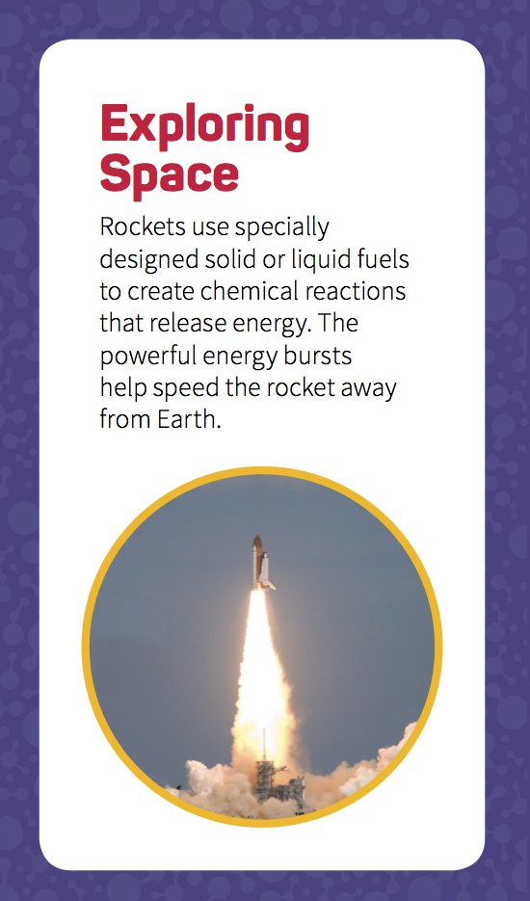
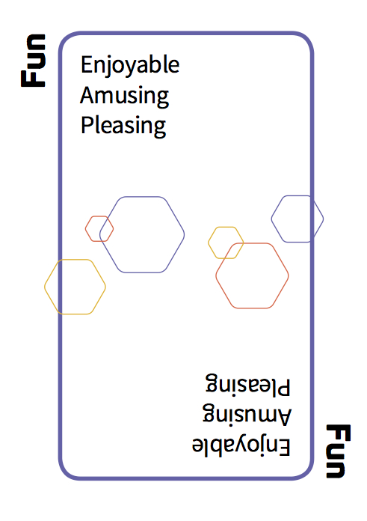
Atoms to Atoms
Notes:
***If your training schedule allows***
Playing the Atoms to Atoms game will help us develop a better sense of what chemistry is and what chemists do. These example might also help us broaden our definition of chemistry.
Play the Atoms to Atoms game with the participant trainees. Refer to the training guide included in the Let’s Do Chemistry kit for instructions and tips. You can also share this activity with public audiences.

Slide 14
Let’s Do Chemistry!
More about… Less about…
Fun Facts
Confidence Comprehensive knowledge
Excitement Equations
Concrete connections Abstract ideas
Exploring together Explaining to someone
Offering guidance Showing the right way
Asking questions Providing answers
But it’s still all about chemistry! And you have an important role as a guide.
Notes:
For educators: You can use many of the same strategies you use to create other fun learning experiences. You are not at a disadvantage if you don’t know lot of chemistry!
For chemists: Don’t worry about sharing everything you know about chemistry today! Relax and have fun with your participants and it will create a foundation for future learning.

Slide 15
Event Overview and Safety
Notes:
Now we’ll think focus on the specifics of our event, logistics, and, importantly, safety.

Slide 16
Event Overview
Background
Who’s here
Orientation
Policies
Schedule
Future events and dates
Notes:
In this section of the presentation, you can add in more information about your event and specific program, as well as information about your own institution.

Slide 17

Safety
Event safety might include…
…lost child protocol
...fire alarm protocol and knowing the nearest exit
...other ideas?
Notes:
Add information specific to your institution and setting here. Consultant other staff who may want to share specific information regarding event safety. Remember some of the volunteers at your event may be unfamiliar with your building and facilitates. The Let’s Do Chemistry Safety Guide includes additional links and resources to help you think broadly about event safety.

Slide 18

Safety
Safe practices might include…
…labels and SDS for all materials
….goggles or gloves (PPE)
...keeping chemistry materials away from mouth, eyes, skin
…disposing of materials properly
Notes:
Learning and using safe practices is an integral part of learning and doing hands-on chemistry. Safety should be a part of all stages of planning implementing the Let’s Do Chemistry activities and events.
Always follow and model prudent practices when doing chemistry activities. Think about:
What hazards exist and what associated risks may arise from these hazards?
How to minimize risks through protocols we have designed into the activities and training materials.
How safe practices and protocols should best be communicated with facilitators, participants, and other.
PPE stands for personal protective equipment. Most activities in the Let’s Do Chemistry kit do not require PPE. However, both Sublimation Bubbles and Rocket Reactions do require that everyone (participants and facilitators) wear full coverage goggles. We also suggest gloves for some activities.
Each activity kit also includes a labeling kit (water-resistant labels and permanent pens). Before doing the activity with the public be sure all tools and materials are correctly labeled.
Your institution may have special rules or protocols for chemistry related activities, so check with your facilities staff, safety committee, and/or others. The Let’s Do Chemistry Safety Guide included in the kit covers topics including suggestions for planning a safe event, specific tips, chemical safety guidelines, protocols, and precautions. Each activity facilitator guide and training video also offers specific information about safety.

Slide 19
Leading the Activities
Notes:
This section of today’s presentation focuses on some specific skills and strategies that will be useful in leading hands-on chemistry activities with public audiences.

Slide 20
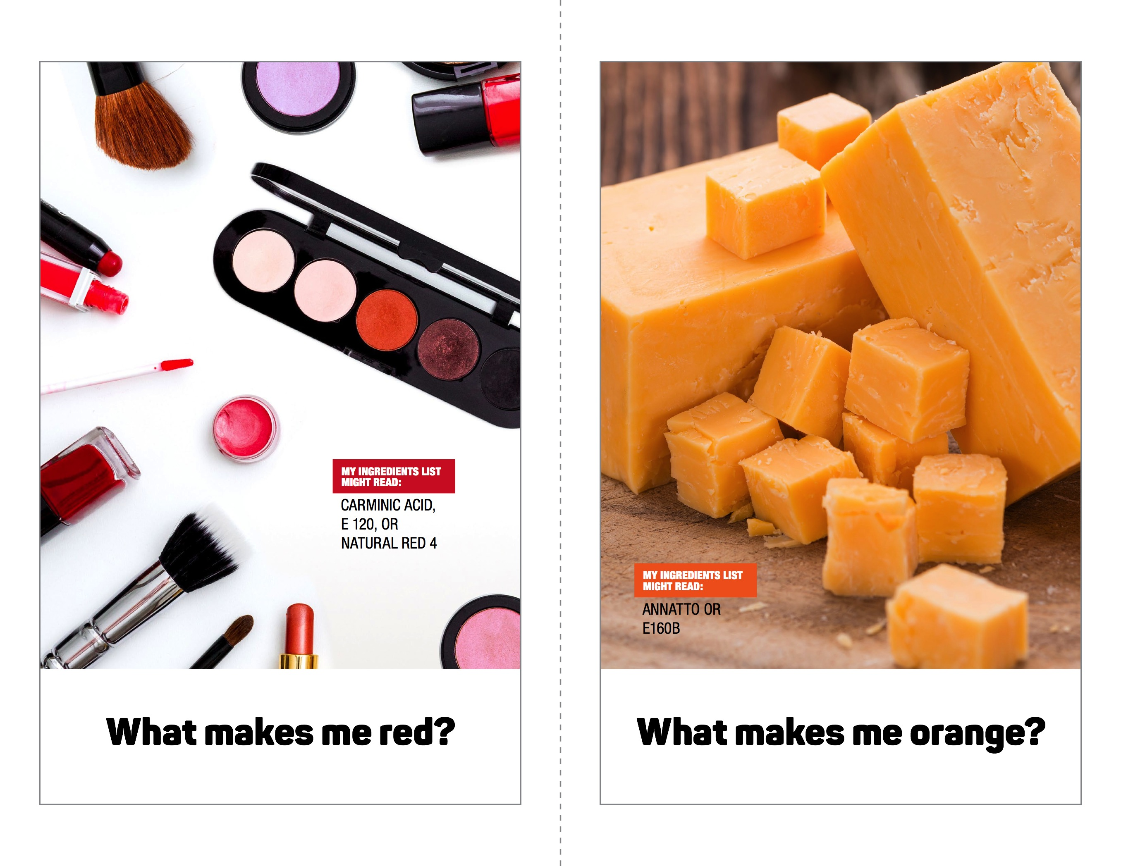
Activity Materials
Notes:
Each activity in the Let’s Do Chemistry kit comes complete with all the materials and supplies you need. They’re all packaged together in one cardboard box. In the box, you’ll find two kinds of print materials: one kind that you can use and share with participants, and one kind with extra information just for you, the activity facilitator. Each activity box also included the SDS (Safety Data Sheets) for any chemicals used in the activity. Those should be kept close-by. If your activity requires additional special safety equipment, be sure you’ve collected those from the event planner or coordinator. Those are not packaged inside the activity box because they’re so bulky!
There is a colorful activity guide with step-by-step illustrations and photos that will help (you and) participants do the activity. Some activities also include colorful information sheets or other graphic materials. All of these public facing materials are available in English and Spanish! There are also more plain-looking materials that provide extra information for you as activity facilitators. You should review these prior to doing the activity. Unlike the other materials, these are just for you and are not meant to be shared with participants.
Finally, please note that there is a training video for each activity, which you can watch to help you learn the activity before you do it with participants.
We encourage you to read the Let’s Do Chemistry Planning and Partnership Guide and the Safety Guide included in the kit well in advance of your event training. Become familiar with each of the activities and all of the safety information so that you can train staff and volunteers. We also suggest that you share the training video links for each activity ahead of time with facilitators, as well as digital copies of the written materials, so they can prepare in advance. These digital files can be found on the thumbdrive included in the physical kit and online at www.nisenet.org/chemistry-kit.

Slide 21
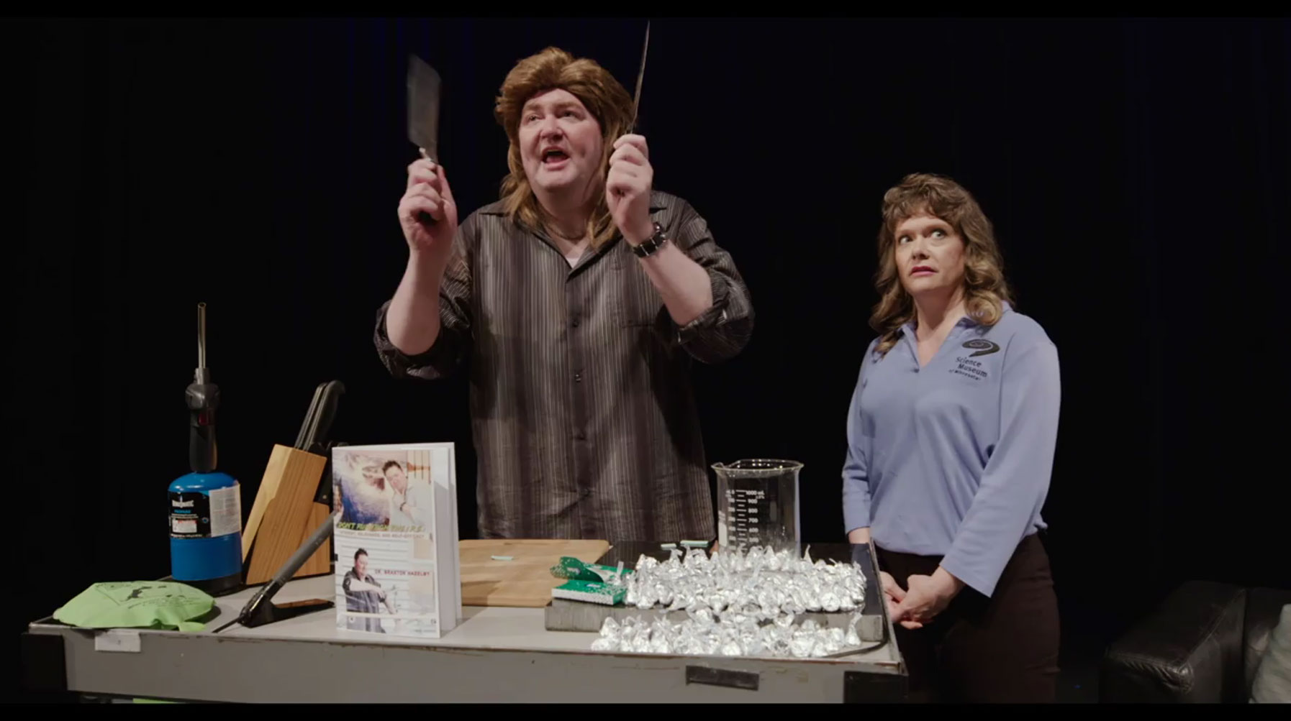
Chem-Attitudes
with Dr. Braxton Hazleby
Notes:
We’ll have a chance to become more familiar with our activities soon, but now we’re going to watch a short video together. This (hopefully) humorous video offers a general introduction to some key facilitation strategies you can use when doing the Let’s Do Chemistry activities with public audiences.
The purpose of the training video is to:
Introduce educators and volunteers to the goals of the project, especially helping participants develop positive attitudes toward chemistry.
Share some specific strategies you can use to help participants develop interest, relevance, and self-efficacy.
And, clarify that while all the activities are about chemistry, and visitors will certainly learn chemistry concepts, it’s most important that both you and the participants have fun and get excited about learning chemistry (not that they learn all the chemistry in the world right here, right now!)
Remember! There are also additional training for each of the Let’s Do Chemistry activities.
Play the Chem-Attitudes with Dr. Braxton Hazleby facilitation video now. The video is not imbedded in this presentation. The video is about 14 minutes long. You can download or stream the video here, https://vimeopro.com/nisenet/explore-science-lets-do-chemistry-training-films.

Slide 22
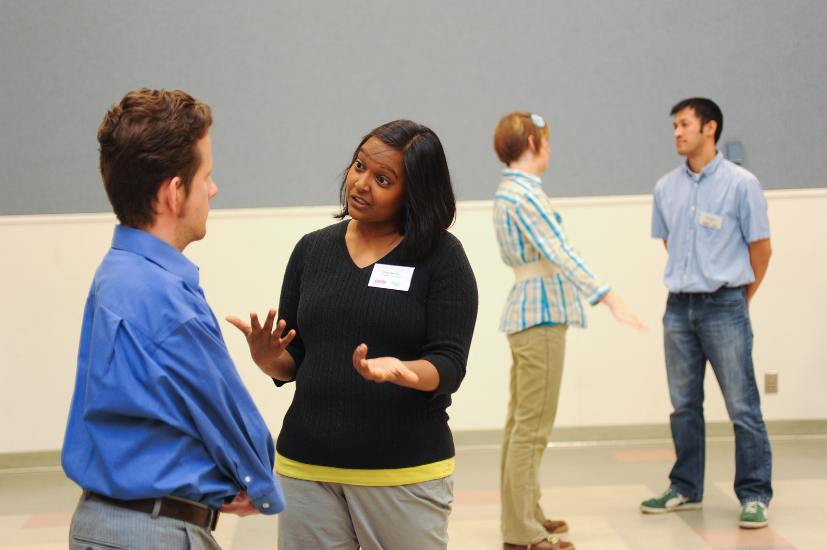
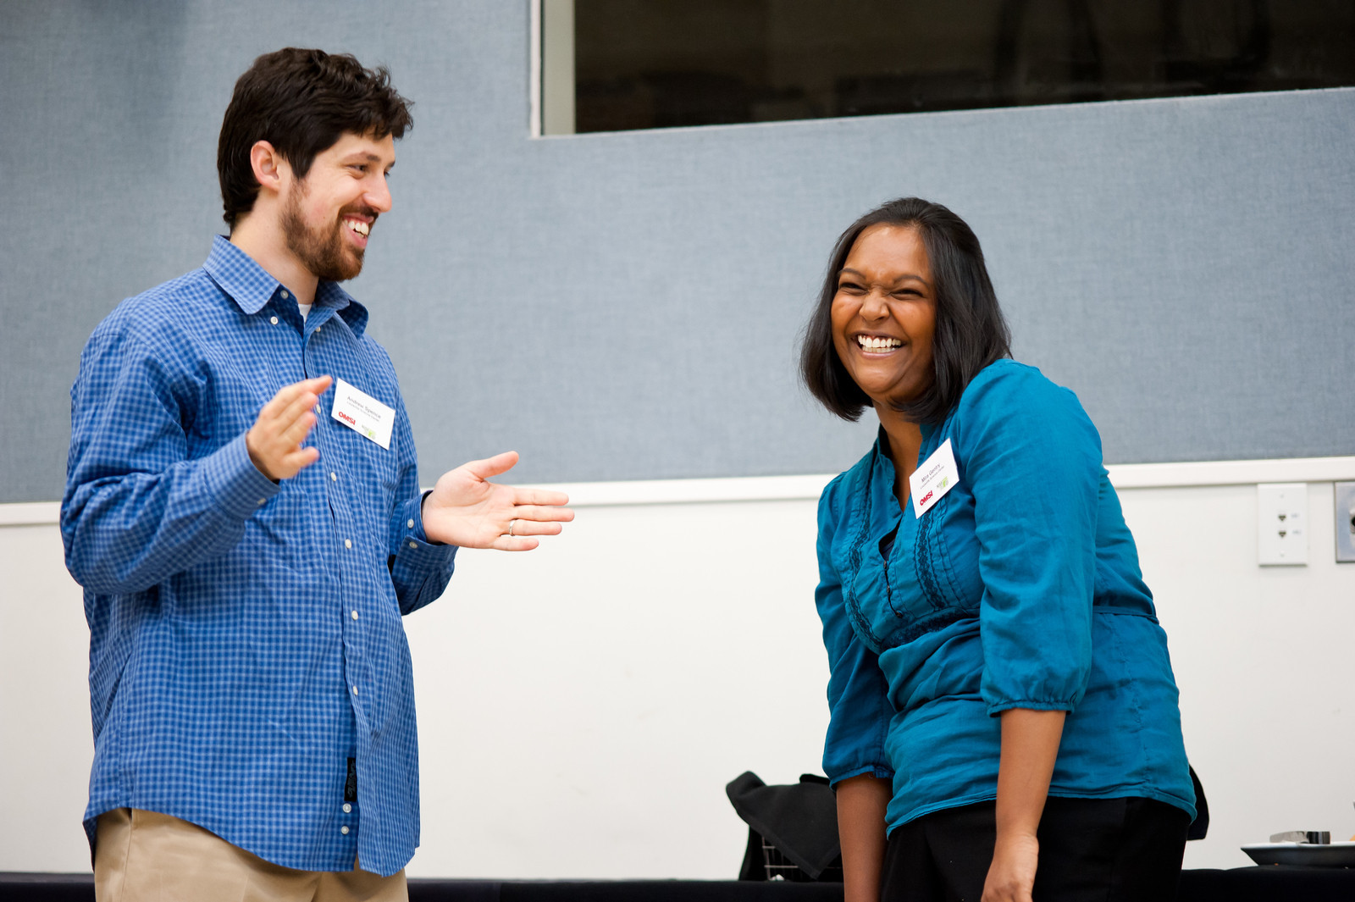
What’s in the box? Improv Game
Everyone find a buddy.
Person A walks up to person B holding a mimed box.
Person B steps forward and asks… “What’s in the box?
Person B opens the box and defines the content, with whatever they imagine.
Person A gives a specific reason for giving the gift to Person B. The reason should explain how the gift meets one of their partner’s needs.
Person B accepts the reason given by their partner and adds information to help support it.
Notes:
As we saw in the video, asking good questions and really listening to participants is a great way to engage visitors in these activities. We’re going to play a game together that will help us practice this idea in person.
Play the What’s in the Box? improv game with the participant trainees. You may wish to model one interaction with a volunteer before asking everyone to pair up. Refer to the training guide included in the Let’s Do Chemistry kit for instructions and tips.

Slide 23
What’s in the box? Debrief
Debrief questions
How did you know what was in the box? What did you do to figure out what was inside?
Who thought that the object in the box was something different than what their partner said?
How would you describe your experience in this exercise? What helped us be successful?
What techniques did you use to come up with a specific reason that the gifts were great?
How could you apply these techniques to engaging with participants? What is a specific example from your experience?
Notes:
Playing What’s in the box will help us remember and practice the importance of asking good questions, listening to participant responses, and building off those responses to develop a conversation. Questions are one of our most important tools as facilitators!
Good questions inspire confidence and encourage participants to think like a scientist. Ask questions that allow them to use their own experience, make observations, and test their own answers. What are some good questions you ask participants?
The types of questions you ask and the way you ask them can dramatically impact the way a visitor interacts with your activity. Think about how participants come up with an answer to your question.
Prior knowledge (there is a right answer that they have to know)
Their own ideas, opinions, or experiences (no one right answer)
Direct observation (if they don’t know, there is a way to figure it out together with the tools you have in front of you)
Avoid asking questions where you have the “right” answer in your head, and you’re expecting participants to guess what you’re thinking. If a question you’re asking isn’t working, try changing it up. Experiment with your questions!
Use the debrief questions outlined above and refer to the training guide included in the Let’s Do Chemistry kit for additional tips.

Slide 24
Tips for Leading Hands-On
Chemistry Activities
INVITE PARTICIPATION
Greet participants
Have fun!
SUPPORT EXPLORATION
Ask guiding questions & listen
Offer positive feedback
DEEPEN UNDERSTANDING
Make connections
Share what you know & acknowledge what you don’t
Notes:
Here are some examples of quick tips for leading these Let’s Do Chemistry activities. A one-page sheet of additional tips, that follow this general flow of invite participation, support exploration, and deepen understanding can be found in each activity box for easy reference.

Slide 25
Questions?
Notes:
You may choose to give facilitations some time now to read over their activity materials, practice, and become familiar with their activity before doing the activity with a public audience.

Slide 26
Thank You!

Slide 27



Copyright 2018 Sciencenter, Ithaca, NY. Available under a Creative Commons Attribution-Noncommercial-ShareAlike license.
Funded by the National Science Foundation under Award No. 1612482. Any opinions, findings, and conclusions or recommendations are those of the authors and do not necessarily reflect the views of the Foundation.

Slide 28
Notes:
Additional slide templates

Slide 29

Notes:
Additional slide templates

Slide 30
Notes:
Additional slide templates

Slide 31
Notes:
Additional slide templates

