Slide 1
Flying Cars and Food Pills
A journey into the Future

Slide 2
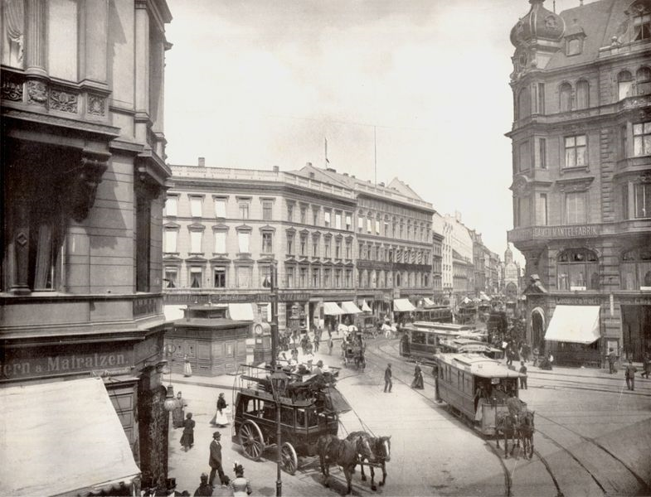

Slide 3
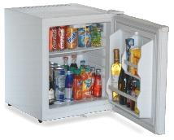
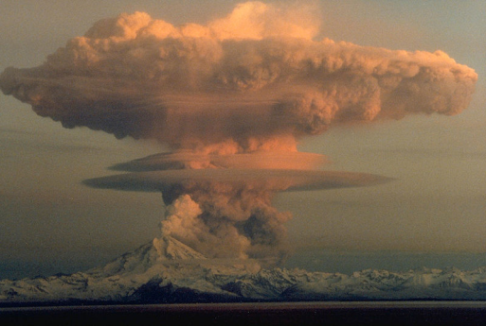
Which of these was NOT predicted in 1900?

Slide 4
Which of these was NOT predicted in 1900?
Notes:
Refrigerators
“Liquid air refrigerators will keep great quantities of food fresh for long intervals.”
Airplanes
Nuclear Bombs
“Giant guns will shoot twenty-five miles or more, and will hurl …shells exploding and destroying whole cities.”
Cell Phones
“…at some future date we may be able to carry apparatus on our persons which will enable us to communicate with another person …without the intervention of wires…” Edwin Reynolds, Milwaukie Sentinel, December 30, 1900.
“Shall not the wireless telephone and wireless telegraph, now a hope, become a reality?”

Slide 5
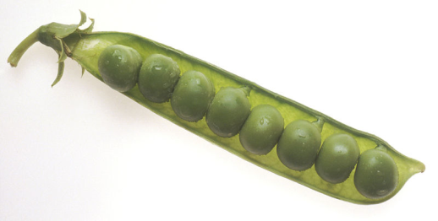
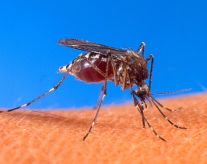
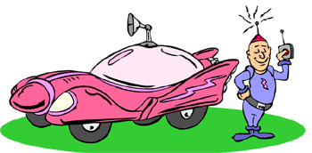
Which of these was NOT predicted in 1900?

Slide 6
Which of these was NOT predicted in 1900?
Notes:
Rats and mosquitoes extinct
“Insect screens will be unnecessary. Mosquitoes, house-flies and roaches will have been practically exterminated. Boards of health will have destroyed all mosquito haunts and breeding grounds, drained all stagnant pools, filled in all swamp lands, and chemically treated all still water streams.”
Peas the size of apples
“Strawberries as large as apples will be eaten by our great-great-grandchildren for their Christmas dinners a hundred years hence….Peas and beans will be as large as beets are to-day.”
Self driving cars
No X, C or Q.
“There will be No C, X or Q in our every-day alphabet. They will be abandoned because unnecessary. Spelling by sound will have been adopted, first by the newspapers.”

Slide 7
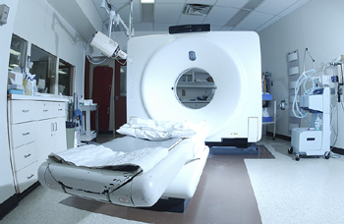
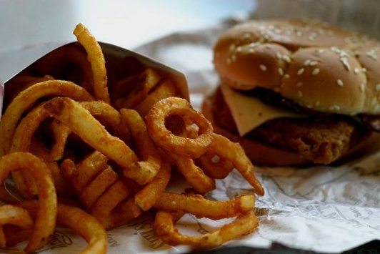
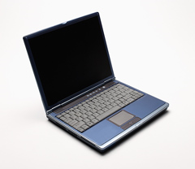
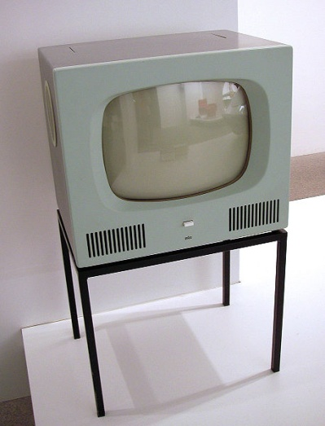
Which of these was NOT predicted in 1900?
Photo: Flickr user ebru

Slide 8
Which of these was NOT predicted in 1900?
Photo: Flickr user ebru
Notes:
CAT scans
“Microscopes will lay bare the vital organs, through the living flesh, of men and animals. The living body will to all medical purposes be transparent. …This work will be done with rays of invisible light.”
Fast Food
“Ready-cooked meals will be bought from establishments similar to our bakeries of today.”
“…foods may be prepared in quantities by inexpensive labor and thus make it possible to live… without the cost of maintaining a separate kitchen for every three or four persons.”
Laptop Computers
Television
“Persons and things of all kinds will be brought within the focus of cameras connected electrically with screens at opposite ends of circuits… the guns of a distant battle will be heard to boom when seen to blaze, and thus the lips of a remote actor or singer will be heard to utter words or music when seen to move.”

Slide 9
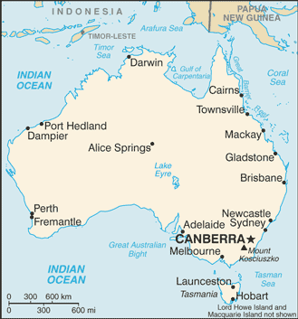
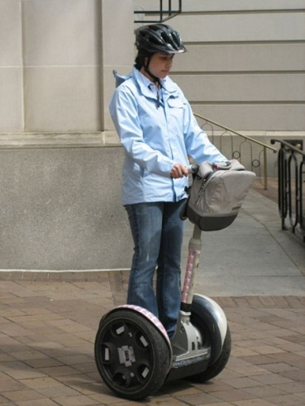
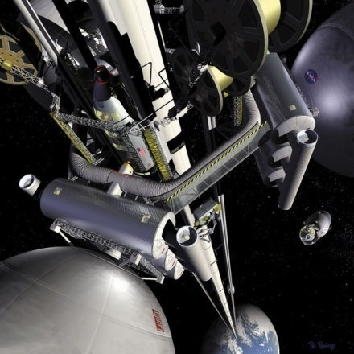
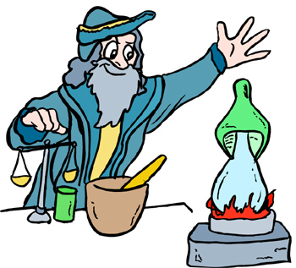
Which of these was NOT predicted in 1900?
Photo: Flickr user Richard from DC

Slide 10
Which of these was NOT predicted in 1900?
Photo: Flickr user Richard from DC
Notes:
Australia would be flooded and turned into a lake
“The greater portion of the central Australian desert, covering an area of fully 1,000,000 square miles, might be flooded. The island continent would then be converted into a gigantic oval dish, of which the depressed central portion would be covered with water, and only the “rim” inhabited.”
We would ride around on electric scooters
We would have an elevator into space
We would have the power to turn lead into gold
“Shall the mystery of transmutation not be solved? Shall the master of the anathor not bring us gleaming gold from the dullest dross?”

Slide 11
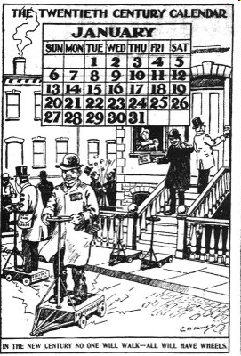

Slide 12
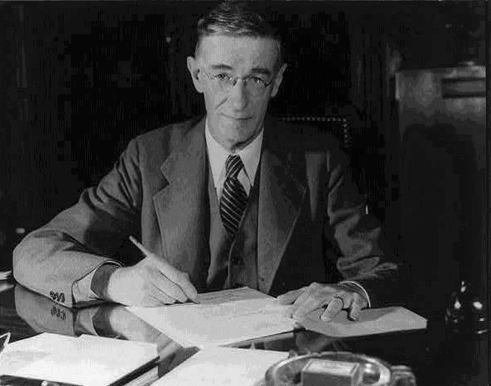
Vannevar Bush made predictions in 1945.
Vannevar Bush circa 1940, Office for Emergency Management, United States Federal Government, public domain

Slide 13
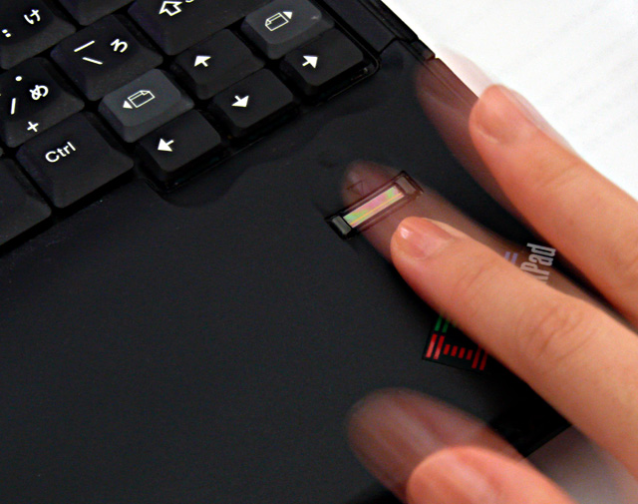
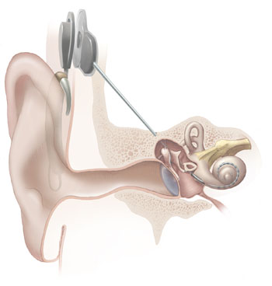
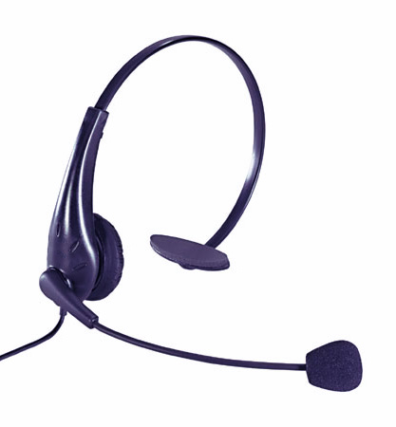
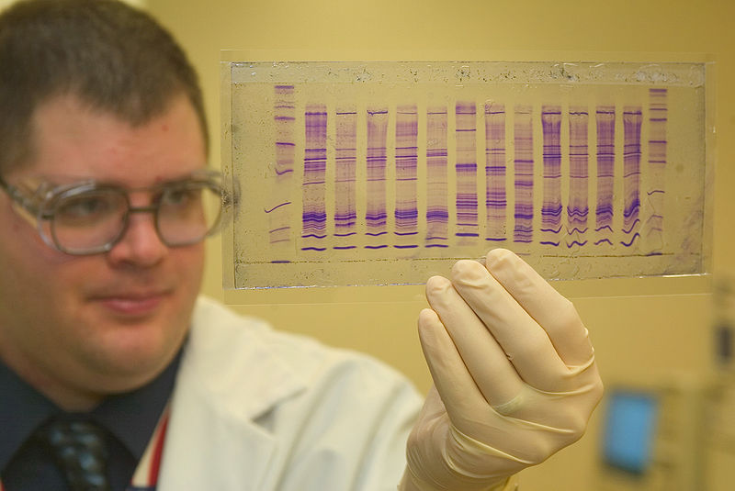
Which of these was NOT predicted in 1945?
Notes:
Cochlear implants
Fingerprint scanners
Voice recognition
DNA testing

Slide 14
Which of these was NOT predicted in 1945?
Notes:
Cochlear implants
By bone conduction we already introduce sounds into the nerve channels of the deaf in order that they may hear. Is it not possible that we may learn to introduce them without the present cumbersomeness of first transforming electrical vibrations to mechanical ones, which the human mechanism promptly transforms back to the electrical form?
Fingerprint scanners
…when it comes, for example, to matching a set of fingerprints with one of five millions on file. Selection devices of this sort will soon be speeded up from their present rate of reviewing data at a few hundred a minute. By the use of photocells and microfilm they will survey items at the rate of thousands a second, and will print out duplicates of those selected.
DNA testing
Voice recognition
will the author of the future cease writing by hand or typewriter and talk directly to the record? …the result is a machine which types when talked to.
DNA testing

Slide 15
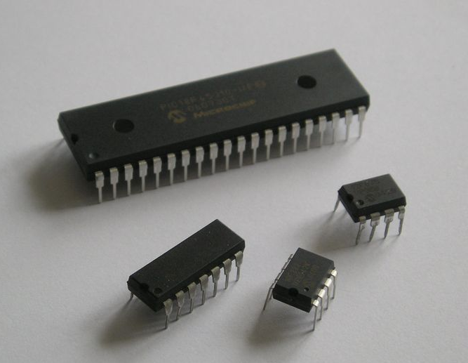
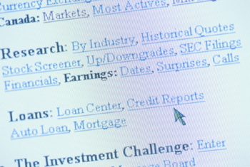
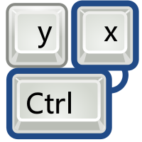
Which of these was NOT predicted in 1945?
Notes:
Math software
Hyperlinks
Keyboard shortcuts
Computer chips

Slide 16
Which of these was NOT predicted in 1945?
Notes:
Computer chips
Hyperlinks
associative indexing, the basic idea of which is a provision whereby any item may be caused at will to select immediately
and automatically another.
Keyboard shortcuts
Frequently-used codes are mnemonic, so that he seldom consults his code book; but when he does, a single tap of a key
projects it for his use.
Math software
The advanced arithmetical machines of the future will be electrical in nature, and they will perform at 100 times present speeds, or more. …they will select their own data and manipulate it in accordance with the instructions thus inserted, they will perform complex arithmetical computations at exceedingly high speeds, and they will record results in such form as to be readily available for distribution or for later further manipulation.

Slide 17
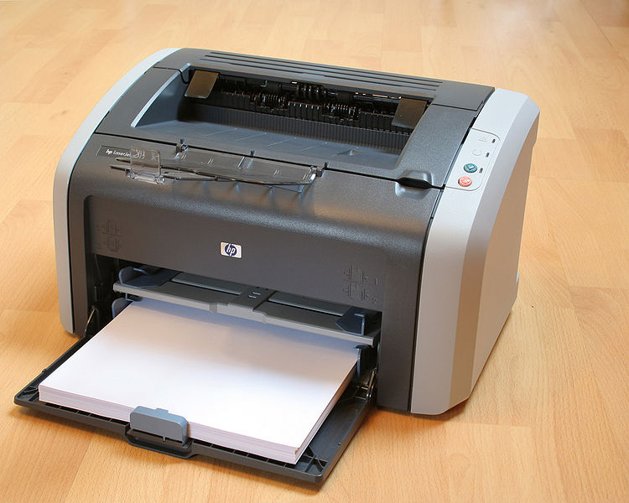
Which of these was NOT predicted in 1945?
Notes:
Universal translator
Laser printer
Wikipedia
Post-It notes

Slide 18
Which of these was NOT predicted in 1945?
Notes:
Post-It Notes
Wikipedia
Wholly new forms of encyclopedias will appear, ready-made with a mesh of associative trails running through them…
Universal translator
It is strange that the inventors of universal languages have not seized upon the idea of producing one which better fitted the technique for transmitting and recording speech.
Laser printer
…a rapid camera for dry photography…in which the picture is finished as soon as it is taken…the record is made by a moving beam of electrons rather than a moving pointer, for the reason that an electron beam can sweep across the picture very rapidly indeed.

Slide 19
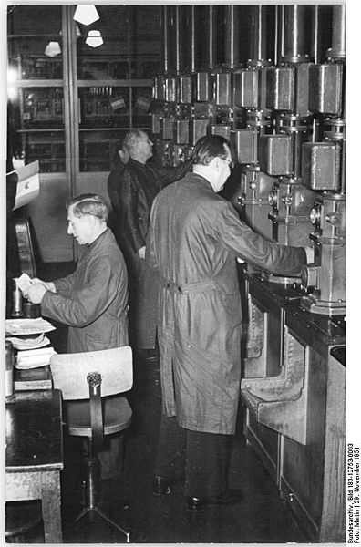
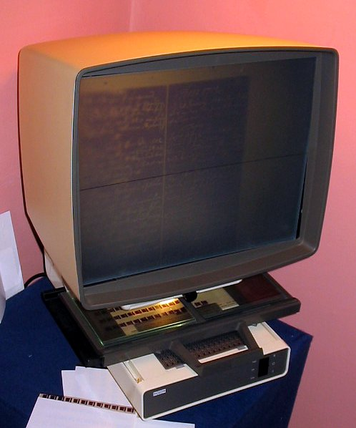
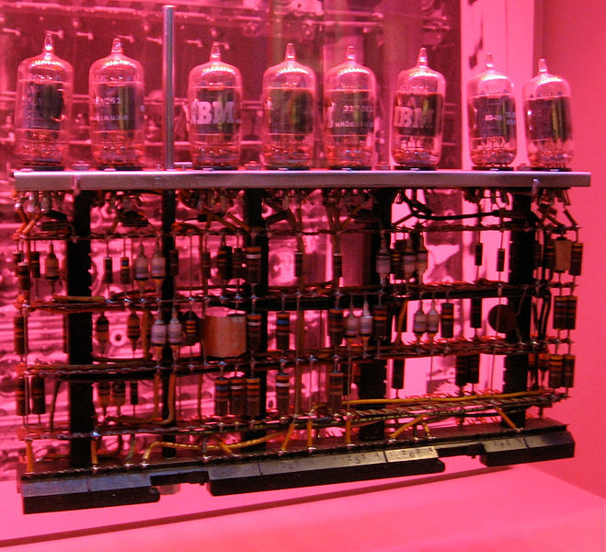
Bush thought it would all be on paper.
Notes:
One of them will take instructions and data from a roomful of girls armed with simple keyboard punches, and will deliver sheets of
computed results every few minutes.
The cards may be in miniature, so that they occupy little space. They must move quickly. They need not be transferred far, but merely into position so that the photocell and recorder can operate on them. Positional dots can enter the data. At the end of the month a machine can readily be made to read these and to print an ordinary bill. With tube selection, in which no mechanical parts are involved in the switches, little time need be occupied in bringing the correct card into use - a second should suffice for the entire operation. The whole record on the card may be made by magnetic dots on a steel sheet if desired, instead of dots to be observed optically, following the scheme by which Poulsen long ago put speech on a magnetic wire. This method has the advantage of simplicity and ease of erasure. By using photography, however, one can arrange to project the record in enlarged form, and at a distance by using the process common in television equipment.
2 years before the transistor, he says:
Technical difficulties of all sorts have been ignored, certainly, but also ignored are means as yet unknown which may come any day to accelerate technical progress as violently as did the advent of the thermionic tube.

Slide 20
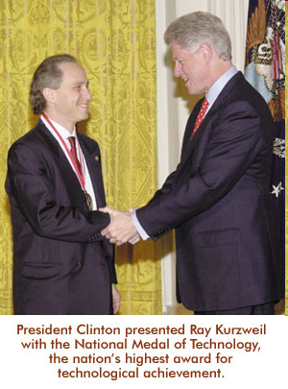
Ray Kurzweil made predictions in 1999.

Slide 21
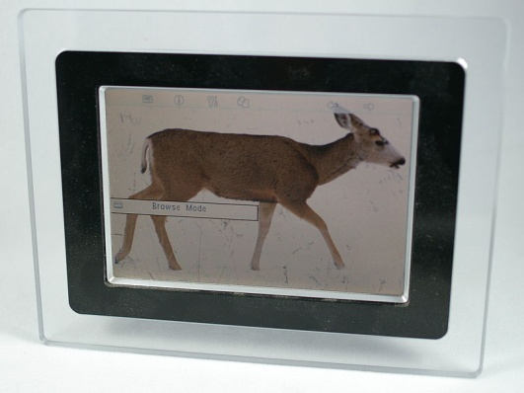
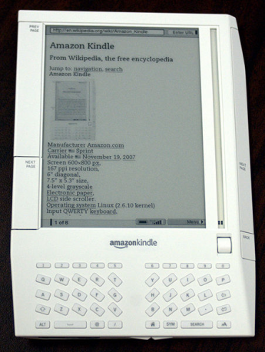
Which of these was NOT predicted in 1999?
Photo: Wikpedia user Hustvedt
Photo: Wikpedia user ShakataGaNai

Slide 22
Which of these was NOT predicted in 1999?
Photo: Wikpedia user Hustvedt
Photo: Wikpedia user ShakataGaNai
Notes:
Digital picture frames
“Virtual paintings--high-resolution wall-hung displays--have become popular. Rather than always displaying the same work of art, …these virtual paintings can change the displayed work … or can cycle through collections of art.”
Wireless Internet
“Computers routinely include wireless technology to plug into the ever-present worldwide network, providing reliable, instantly available, very-high-bandwidth communication.“
Electronic Books
“Books, magazines, and newspapers are now routinely read on displays that are the size of, well, small books.”
Wikipedia

Slide 23
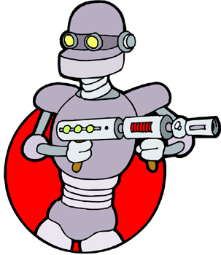
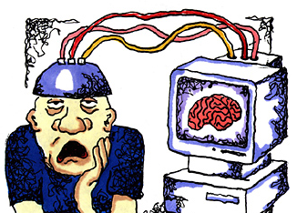
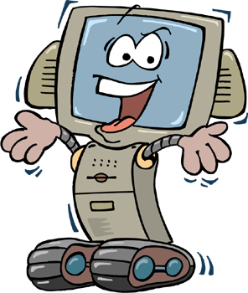
Which of these was NOT predicted in 1999?

Slide 24
Which of these was NOT predicted in 1999?
Notes:
Doctors examining their patients over the internet
“Telemedicine is widely used. Physicians can examine patients using visual, auditory, and haptic examination from a distance.”
Armies of fighting robots
“Humans are generally far removed from the scene of battle. Warfare is dominated by unmanned intelligent airborne devices.”
Copying human brains into computers
“Research has been initiated on reverse engineering the human brain through… destructive scans of the brains of recently deceased persons”
Artificial Intelligence

Slide 25
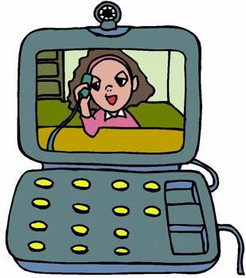
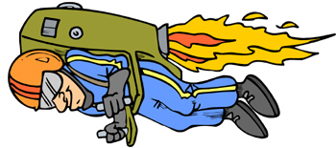
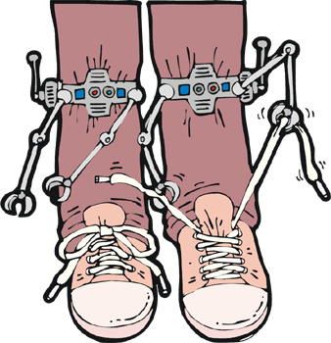
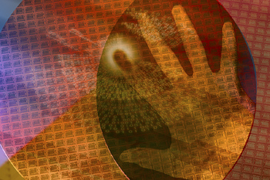
Which science fiction object from movies does NOT already exist?

Slide 26
Which science fiction object from movies does NOT already exist?
Notes:
Jetpack
Videophone
Self-tying shoes
Fingerprint scanner

Slide 27
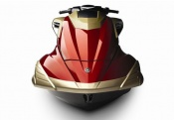
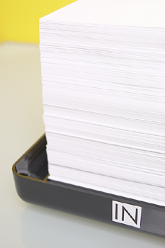
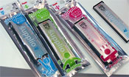
What nanotechnology does NOT already exist?

Slide 28
What nanotechnology does NOT already exist?
Notes:
Superlight Jetski
Nonstick aluminum foil
Dust repellent paper
Aromatherapy pencils

Slide 29
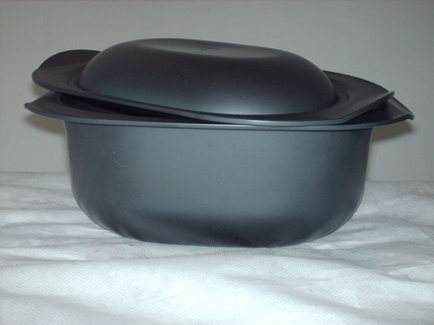
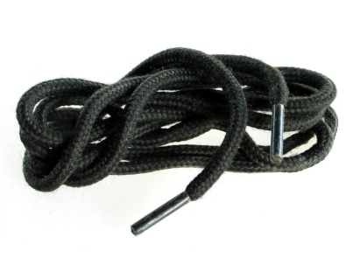
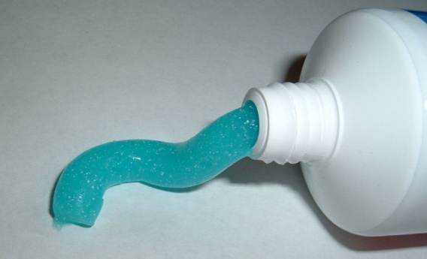
What nanotechnology does NOT already exist?
Photo: Wikipedia user Fiertel91

Slide 30
What nanotechnology does NOT already exist?
Photo: Wikipedia user Fiertel91
Notes:
Antibacterial curling iron
Antibacterial doorknob
Antibacterial tupperware
Antibacterial shoelaces
Antibacterial teddy bear
Antibacterial toothpaste

Slide 31
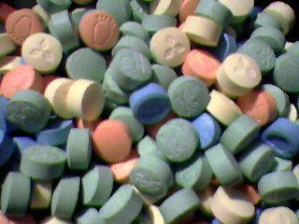
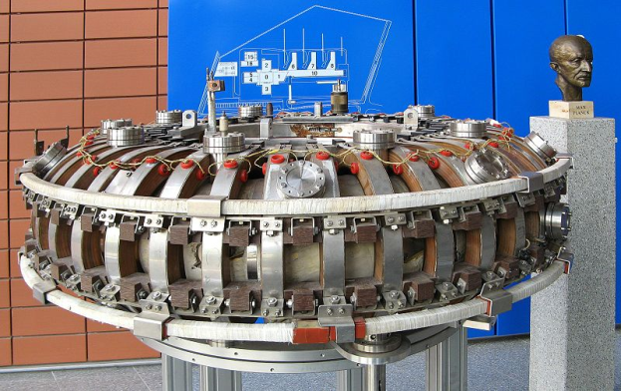
What thing are nanoscientists NOT predicting for 50 years in the future?
Photo: Wikipedia user Berndt vdB
Notes:
Kurzweil is predicting the Matrix. Is he a nanoscientist? How about just “scientists”?

Slide 32
What thing are nanoscientists NOT predicting for 50 years in the future?
Photo: Wikipedia user Berndt vdB
Notes:
Cure for cancer
Elevator into space
Household fusion power
Stainfree pants

Slide 33
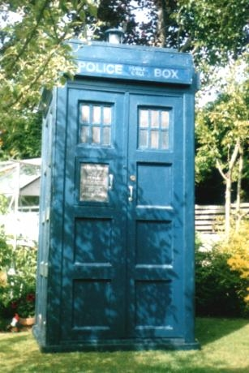
What thing are nanoscientists NOT predicting for 50 years in the future?

Slide 34
What thing are nanoscientists NOT predicting for 50 years in the future?
Notes:
The Matrix
“There is widespread use of all-encompassing visual, auditory, and tactile communication using direct neural connections, allowing virtual reality to take place without having to be in a "total touch enclosure.“”
Time travel
Replacing teachers with computers
“Paper books or documents are rarely used and most learning is conducted through intelligent, simulated software-based teachers.”
Paint that dries into a TV
Technically, one insane group predicts time travel for 2075. But they’re nuts.
http://www.btplc.com/Innovation/News/timeline/TechnologyTimeline.pdf
They predict self-assembling liquid screens by 2050.

Slide 35
What do YOU think will happen in 50 years?
Photo: Wikipedia user Berndt vdB

Slide 36
Previous Audiences think:

