Slide 1
Welcome! We’re warming up with professional-style introductions.
Sharing Science Workshop & Practicum
(Pretend you’re at a science conference networking session)
Meet and greet others, as if for the first time.
Learn a bit about their research interests -
- and share some of your own.
Work your way around the room!
Notes:
Arrival Time Activity: Meet & Greet Role-Play [slide 1]
Participants have been told that the Sharing Science Workshop begins with a role-play the moment they walk into the workshop room. They have been asked to prepare and to practice aloud in advance a 15-30 second introduction, targeted for people they might meet at an interdisciplinary conference - individuals with some background in science but no particular experience in their own area of expertise. Welcome new arrivals warmly and invite them to stash their belongings, take some refreshments, and begin the role-play. Gently nudge them to meet as many of the other participants as they can. Join in if you'd like!

Slide 2
SHARING SCIENCE Workshop & Practicum [DATE]
Your hosts:
[Facilitator Names]
Notes:
Introduction to the Sharing Science Workshop & Practicum [Slide 2]
Use a gentle bell or chime to invite the group to have a seat. Have a white board or easel and pad handy for the interactive part of the discussion.
Facilitator Narrative:
Hello again and welcome. We're delighted to have you here today, and we think you'll probably have a pretty good time. Sharing Science turns out to be a fairly rewarding activity. You seemed pretty at ease with these conversations and indeed, many of you noted in your pre-Workshop survey that [you have more confidence speaking about your research to other scientists than you do to non-scientists]. Today we're going to work together on stretching your capacity to have good conversations about science with people who may be less comfortable and familiar with the world of research. Then we're going to give you an opportunity to engage [families, young people, museum visitors] in science with conversation and hands-on activities here at the [Museum, school, festival, etc.].

Slide 3
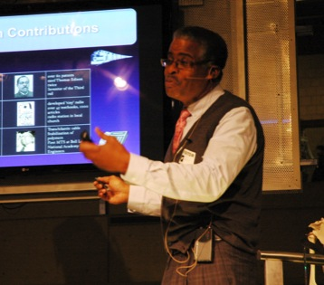
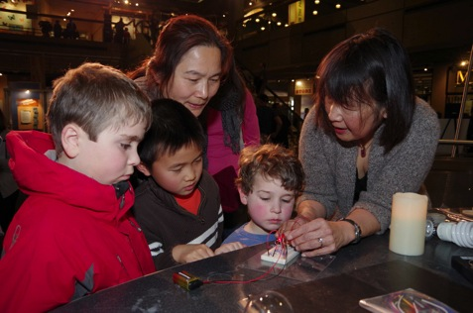
What’s different about sharing science with broader audiences?
Notes:
White Board (or Easel Pad) Discussion [slide 3]
What's Different About Sharing Science with Broader Audiences?
So, what's different about sharing science with broader audiences, like [museum visitors, science cafe participants, kids]? All of you have had some experience talking about science or about your own research with family members or with friends who don't necessarily have the same science background that you do. What are some of the common problems you typically encounter?
Facilitation Note: Encourage the group to respond - you can jot down key issues on a white board or easel pad. You also have the option here to share (anonymously) any relevant comments that emerged from the pre-workshop survey. Common issues that typically arise:
Too much to explain.
Hard to know what they do and don't know.
Slipping into jargon.
Making the TMI (too much information) mistake.
Trouble finding analogies.
Being afraid of boring them.
Not wanting to seem too 'nerdy.'
Now, what are some of the strategies you have already come up with to deal with some of these issues?
Again, encourage the group to respond and share ideas with each other. Jot some of these down on the whiteboard.

Slide 4
Take them on a journey from a place they already are… to an interesting new place.
HERE…
There
Notes:
[Slide 4] One way to think about this is to that you are trying to take your audience on a journey from a place they already are... to a new place they may have never been. You can't drag them there; you can't force them to want to go. You'd be better off enticing them there. Or giving them an incentive to go ahead and explore the place on their own, providing a little signposting along the way.

Slide 5
Consider Your Audience:
Who are they?
What prior experience do they have?
What might they find intriguing?
What might they care about?
How much time & attention do they likely
have to spend with you at this moment?
Notes:
[Slide 5It may help to spend a moment reflecting on the following questions:
Who are they?
What prior experience might they have?
What might they find intriguing?
What might they care about?
And, how much time and attention are they likely to have to spend with you at this particular moment?
The answers to these questions will provide you with clues as to how you might best scaffold your interaction with this particular audience based on their needs, more than your own. And, as a result, the experience is likely to prove more rewarding for you both.
Once you figure out who your audience is, you can figure out what it might take to begin to engage their interest in the topic. You might ask an intriguing question. You might give them a hands-on opportunity to explore an interesting phenomenon. You might adjust your use of language and the kinds of explanations you provide. Remember that there is always a little lingering question in the mind of every listener: “why should I care?” Inotherwords, "why should I expend time and energy to try to stay with you and follow where you're going?" It helps for there to be a reward, an 'aha' moment, an intriguing insight that helps capture the imagination and cast the world around us in new perspective.

Slide 6
What’s the potential significance?
Engineer: What important challenge are you hoping to address?
Scientist: What intriguing mystery are you hoping to solve?
Why will it matter?
Notes:
[Slide 6] One of the most powerful things you can do, in talking about your research with teen and adult audiences, is to address the significance of the work - the 'So What?' of it. For an engineer it might be about a solution to a problem or an important challenge you are trying to overcome. For a scientist it might be about an intriguing mystery are you hoping to solve. Quite likely, there's a little of both involved. The key thing is to address "why will it matter?" in a way your audience will find relevant. Next, I'm going to play for you a couple of examples where researchers take this approach in speaking to broader audiences.

Slide 7
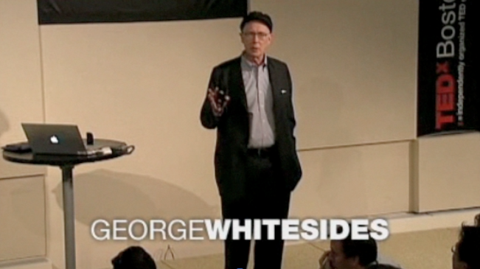
Notes:
[Slide 7] First we'll hear a one-minute excerpt from chemist and Harvard professor George Whitesides, as he begins one of his TED Talks. He starts with a very grand idea.
Click to next slide and video will play automatically.

Slide 8
INSERT FILM HERE
Notes:
[Slide 8] Insert video found at https://vimeo.com/164456850 so it rolls automatically during presentation.

Slide 9
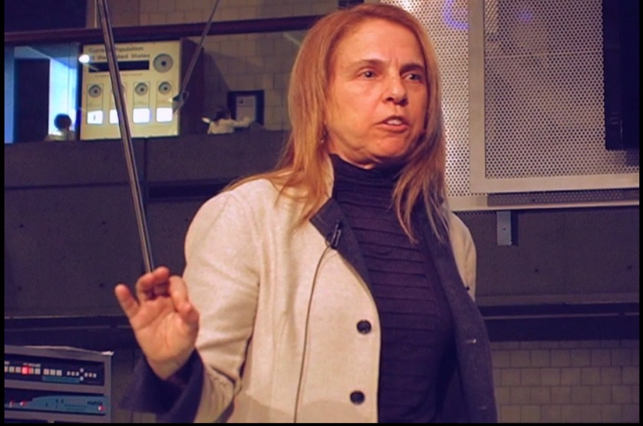
Pam Silver
Notes:
[Slide 9] Now, let's listen to a one-minute excerpt from Professor Pamela Silver, a bioengineer at Harvard Medical School, speaking to an audience at the Museum of Science, Boston. Like George Whitesides, she begins with the challenge she'd like to solve. Notice also how she makes frequent eye contact with her audience and connects her biological tools and chemical compounds with pictures of things familiar to her audience.
Click to next slide and video will play automatically.

Slide 10
Pam Silver
INSERT FILM HERE
Notes:
[Slide 10] Insert video found at https://vimeo.com/164456849 so it rolls automatically during presentation.

Slide 11
Introducing Yourself and Your Work to Broader Audiences
Notes:
[slide 11] Facilitator Narrative: One thing you might have noticed about the two video excerpts we just saw is that they would probably both work well with a high school audience, and maybe even a middle school audience. And that is something we want to aim for here. If a smart 12-year old can grasp what you're saying, then probably so can adults who haven't attended a science or math class for perhaps decades. Let's focus on that next.
[Leave this slide up during intro to the activity]
Facilitator Narrative: We're going to do a rapid prototyping exercise now. We'd like each of you to take a few minutes to work out how you will take the professional networking introduction you brought here this morning, and transform it into the kind of introduction that might engage a bunch of smart (and polite) 12-year olds in the research that you do. Think back to when YOU were around that age, and what you would have found interesting and what content and vocabulary you would have been familiar with. You may begin any way you want - with an appeal to the imagination, a description of an important problem that should be solved, a 'suppose' kind of question, or with a story. But the whole thing should take less than a minute, and your goal is to get it to the point where your listeners want to ask you more about your project. After you have a chance to work on a first draft of this for a couple of minutes, we're going to get into small groups and try it out. Then, if there's time, we'll give you a chance to revise these drafts and try them again.

Slide 12
Rapid Prototyping Introducing yourself and your work to smart twelve-year-olds. (1st draft)
Length: Up to one minute long.
Engagement: How will you grab their attention or capture
their imagination? What analogies can you make?
Relevance: How can you relate the topic to something they
already know or care about?
Language: What words and concepts can you use?
Open ending: How can you encourage their curiousity?
Notes:
[Slide 12] Here are your drafting instructions. I'll let you know when it's time to form into groups.

Slide 13
Rapid Prototyping Try out the 1st draft!
Structure: Groups of 3-5, rotate speaker and smart 12-year-old roles.
Timing: Appoint a timer. Each speaker has up to one minute, and then may engage in up to two minutes of discussion with listeners.
Feedback/Suggestions: Each listener provides up to 1 minute of
helpful feedback to each speaker, if the speaker requests feedback.
Rotate: Switch roles. About 5-6 minutes total for each person.
When finished: Begin work on Draft Two.
Notes:
[Slide 13] Facilitation Notes: Facilitator gives instructions for small group work, as summarized on this slide. Have each group assign a timer, to ensure that everyone gets their turn. (Countdown timers on smartphones are readily available and work well for this.) It helps keep the energy flowing if people stand in their small groups in different areas of the room.
Facilitator Narrative: Before you begin, I'd like to encourage you to listen carefully to each other and do your best to help by offering constructive feedback. What is constructive feedback? Think about content, style, approach, presence. Is the speaker's strategy working? Why or why not? Should they make more eye contact, slow down, or smile more? Are they using words that were too technical or concepts too advanced? Are they trying to cram too much in? Do you have an idea for an analogy they might use or a thought-provoking question they could ask? Many people are shy about giving feedback, or they only want to mention what was good and not what could be improved. And yet, we find most participants in these workshops would really rather receive constructive feedback in an environment like this, before they’re put on the spot in a much higher stakes setting. So I encourage each of you to give your colleagues permission to give you their valuable feedback and to provide thoughtful feedback to them as well. Then, when everyone in your small group has had their turn, sit down and begin your second draft. Go ahead and begin.
Facilitation Notes: Continue to monitor the time, and give cues when the groups should have reached their second, third speakers, etc. Stop by each group to see if they have any questions. Participants always enjoy doing two rounds of this activity, and it gives them a chance to apply the feedback they receive. In between rounds, give them a few minutes to revise their introduction. Mix up the groups for the second round by having each group send one (if in groups of three) or two (if in groups of four or more) on to the next group (you may also code these rotations on their nametags in advance). That way there will be some “fresh ears” as well as others who will understand how the introductions have improved since the prior draft. The length of this activity is entirely dependent on the number of people in each group and the size of the groups. You may accelerate draft two by giving them less time to revise, and less time in small groups for feedback.

Slide 14
Rapid Prototyping, Round Two Introducing yourself and your work to smart 12-year-olds! (2nd draft)
Length: Up to one minute long.
Engagement: How will you grab their attention or capture
their imagination? What analogies can you make?
Relevance: How can you relate the topic to something they
already know or care about?
Language: What words and concepts can you use?
Open ending: How can you encourage their curiousity?
Notes:
[Slide 14] (Round 2 - 2nd draft)

Slide 15
Rapid Prototyping Try out the 2nd draft
Structure: Groups of 3-5, rotate speaker and smart 12-year-old roles.
Timing: Appoint a timer. Each speaker has up to one minute, and then may engage in up to two minutes of discussion with listeners.
Feedback/Suggestions: Each listener provides up to 1 minute of
feedback to each speaker, if the speaker requests feedback.
Rotate: Switch roles. About 4-5 minutes total for each person.
When finished: Go around again if other groups are still working,
or congratulate each other and sit down.
Notes:
[Slide 15] (Round 2 - Sharing and feedback)

Slide 16
What did you learn from the Rapid Prototyping Exercise?
Notes:
[Slide 16] What did you learn from the Rapid Prototyping Exercise?
Now, let's discuss what we learned from the rapid prototyping exercise.
Facilitation Notes: Take a few moments to prompt the group to reflect on their experiences and what they learned during this rapid prototyping exercise. Reinforce the characteristics of effective introductions and the value of drafting different versions and trying them on various people until they have versions that work well in situations. Encourage them to develop several different types of introductions suitable for use in a variety of social and professional situations. Above all, tell, them, none of this comes easily, and the best idea to take away from the exercise is that...

Slide 17
What did you learn from the Rapid Prototyping Exercise?
It takes
practice!
Notes:
[Slide 17] It takes practice. But with practice, especially practice aloud and with others, these types of introductions will soon just roll off the tongue. You can prepare a few different varieties, for use in different types of situations, and be prepared no matter where you are.
We're going to take a ten-minute break now, and when we resume, we're going to stretch you even further.

Slide 18
Next, something completely different….
Kids!
(and their
accompanying adults)
Notes:
[Slide 18] Next, something completely different... engaging kids, and their accompanying adults.

Slide 19
Time for a brief break!
Notes:
Break. [Slide 19] Set-up the room for hands-on activities. Recruit volunteers for the skit!

Slide 20
Sharing Science with Hands-On Activities
Notes:
[Slide 20] Introduction to Sharing Science with Hands-On Activities
Facilitator narrative: Today, we’re going to explore hands-on demo activities where visitors get to interact one-on-one with a person – YOU – as they explore a new idea or phenomenon. We’ll discuss inquiry-based learning and strategies for creating a really positive visitor experience. Now, most kids will engage with you if you are friendly and welcoming and have something interesting to show them, or better yet, something interesting and fun for them to do.

Slide 21
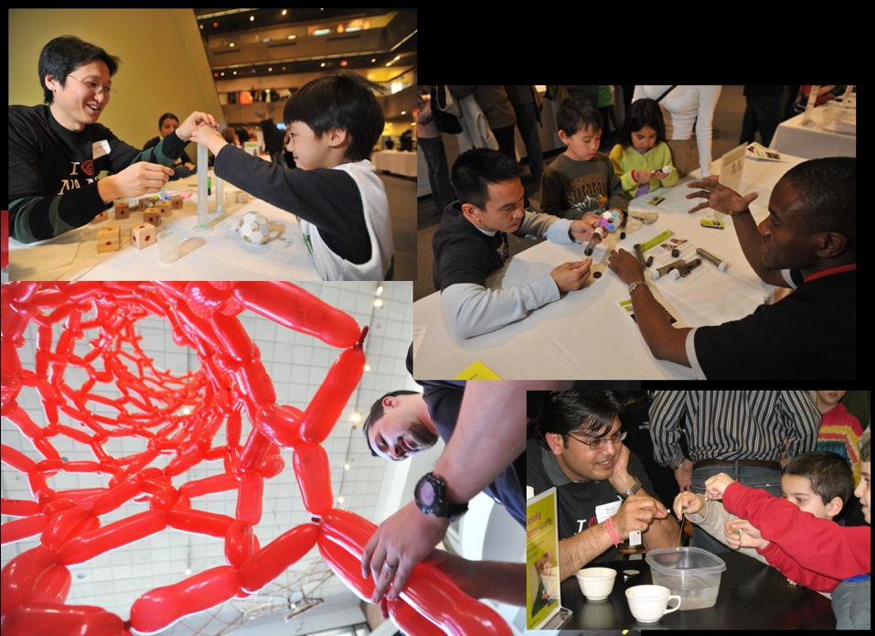
“I did an experiment!”
Hands-on, Minds-on Engagement
“I saw it happen!”
“Their faces just lit up.”
“We had such GREAT
conversations with people!”
“I figured out
the answer
myself!”
“Exploring stuff is
way more fun than
being told stuff.”
Notes:
[Slide 21] So, in science museums and other informal learning environments, we like to provide hands-on activities that get our guests acting like scientists and investigators themselves. A well-designed hands-on activity will give them a wow! moment and stimulate their curiosity. So...

Slide 22
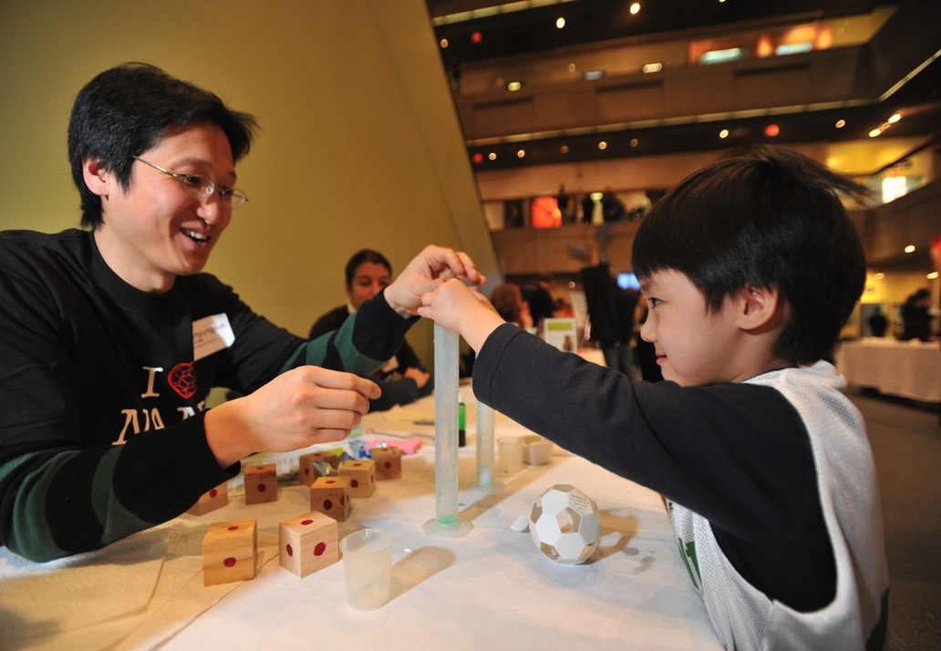
What makes for a good
hands-on demo
experience?
Notes:
[Slide 22] What makes for a good hands-on demo experience? Well, let's try one, and see what you think. We'll call it a "demonstration demo" or a "demo demo." I'll show you one way of facilitating a hands-on activity with a pair of visitors and then we can share our thoughts about it. First I’ll need a couple of volunteers...
[The Demo Demo skit…and debrief…]
Facilitator Narrative: Well that was pretty bad, wasn't it? But what’s important here is to tease out exactly what were the elements that made it so very bad? Because therein lie all the clues as to what can makes a hands-on activity facilitation very good. [I’d like you to pair off with a neighbor and come up with a few specific things that this demonstrator did wrong in this scenario. Take three minutes to do this.]
So, what made this experience so terrible? Perhaps we should hear from our brave volunteers first...
[Take comments from the audience and underscore the critical points. If comments peter out, remind the group of any important faux pas not yet mentioned.]
OK, we’ve identified what was bad. Now let’s see if we can identify – by contrast – some good ways to facilitating a hands-on learning experience.

Slide 23
Lauren Tests her Prototype
Notes:
[Slide 23] Facilitator Narrative: Now, let's see what you think of this interaction. Lauren Zarzar was a Harvard graduate student researching hydrogels when she devised a hands-on activity that would allow museum visitors to explore their amazing liquid absorption capacity. This little two-and-a-half minute hand-held video catches Lauren testing her demo prototype activity with a mother and child pair during her internship at the Museum of Science in Boston. See if you can pick out what's working well and what might be improved the next time she tries it. And, notice how the boy's mother is able to provide additional context and meaning for him. Often you will find yourself being assisted by the adult companions of children.
[Video will roll automatically from next slide.]

Slide 24
INSERT FILM HERE
Notes:
[Slide 24] Insert video found at https://vimeo.com/164456851 so it rolls automatically during presentation.
Debrief Questions: What strategies did Lauren use to engage her 'customer?' What worked well? What might be improved next time? What role did the parent play in the interaction?
Facilitator Narrative after debrief discussion: By the way, after more prototyping, Lauren's activity proved so successful that it was adopted into the catalog of demos maintained online by the Nanoscale Informal Science Education Network, at nisenet.org.

Slide 25
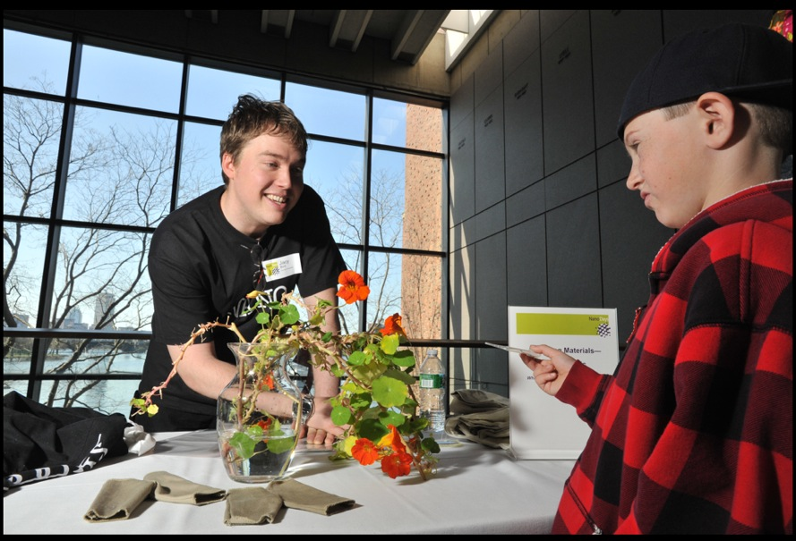
The Hands-On Activity Facilitator’s Guide
Notes:
[Slide 25] Facilitator Narrative: In just a minute, you're going to get your hands on some hands-on demos. But first, I'm handing out a 10-point "Hands-On Activity Facilitator's Guide that will prompt you to think about key elements of successful hands-on activities and facilitation styles. These 10 queries will remind you that our goal is not to cram people's brains with facts, but to guide them in exploring and questioning for themselves. And now, it's time to get our own hands on...

Slide 26
Inside the Box
Demo materials
Activity guides & background info
Notes:
[Slide 26] When you get to your station, you will find a box. Inside the box you will find all the materials you need to run one [NanoDays or other] hands-on activity. Each activity has a “guide” with information you need about the activity.
[The following is true for NanoDays activity guides:
The front of the guide is divided into three sections:
“Try This!” which gives the instructions for doing the activity.
"What’s going on?” which explains what the visitor observed.
“How is this nano?” which explains the nanoscale science and/or technology background for the activity
Many guides also have a back side, including:
Learning objectives – tells you what visitors will hopefully learn from participating in the activity.
Materials – Check that you have all the materials needed for the activity.
Notes to the presenter – These may help give you some helpful hints to make the activity more successful.
Some of the activities also include Extensions – which are extra activities that can be added on.]
Read over the guide, review the other materials in your box, and then craft an approach for facilitating this activity with visitors. Refer to the Hands-On Activity Facilitator's Guide for coaching. Practice it with your partners, and figure out how to improve it.

Slide 27
Take 20 min
to learn your demo
(Make use of the Hands-on Activity
Facilitator’s Guide)
Notes:
[Slide 27] We have about 20 minutes.

Slide 28
Rotation 1
20 minutes
Facilitators: Do your best to engage visitors in your activity. Try different strategies.
Visitors: Experience the demos as though you were a young science museum visitor. Afterwards, offer constructive feedback.
Notes:
[Slide 28] 1st Rotation - Practice facilitating and experiencing hands-on demos.
We have about 20 minutes.
Facilitation Notes: Instruct half the pairs (or trios) to leave their demos and go to visit one of the other demo stations, role-playing being 'visitors.' In 20 minutes, they should make it to at least two demo stations. You may want to sound a chime after 10 minutes, when the group should rotate stations. Advise the facilitators to try testing out two different strategies. Advise the role-playing visitors to offer some feedback after the interaction.

Slide 29
SWITCH!
Notes:
[Slide 29] Switch!

Slide 30
Rotation 2
20 minutes
Facilitators: Do your best to engage visitors in your activity. Try different strategies.
Visitors: Experience the demos as though you were a young science museum visitor. Afterwards, offer constructive feedback.
Notes:
[Slide 30] 2nd Rotation - Practice facilitating and experiencing hands-on demos.
Facilitators and visitors switch roles.
Again, we have about 20 minutes.

Slide 31
Debrief and discussion
Notes:
[Slide 31] Debrief and discussion and perhaps lunch break.
Facilitation Notes: Boxed lunches or a lunch buffet will help save time. The group can stay in the room and continue to discuss what they learned from the practice rotations and brainstorm new approaches. If you are breaking the training into two separate days, this would be the conclusion of the Workshop portion.

Slide 32
Practicum:
Putting it all to practice…
Notes:
[Slide 32] Afternoon Practicum: Putting it all to Practice
Facilitation Notes: Brief the group on what will happen during the Practicum with actual visitors. Advise them that they may have an opportunity to use the 30-second introductions they worked on earlier in the day if they get asked about their research. Review any important policies/expectations for volunteers working with visitors, and what to do in the event of an emergency.
Some last minute advice!
Kids will probably approach you right away, even before you're all set up. Just smile and tell them you’re setting up and invite them to return in a few minutes.
Once you're set up, be very welcoming and attentive. You may want to introduce yourself and ask your young visitors their names. Welcome their adults too!
Say little; instead encourage activity, thinking, exploration, and conversation.
Have a closing ready – thank them for doing a great job and suggest another activity.
Keep track of your materials. It helps to keep a clean demo space – just the sign and the materials you need to do the demo. Stash extra materials behind you and make sure a trashcan is handy.

Slide 33
Debrief & Discussion
Q1 What did you like best about working with visitors?
Q2 What proved more difficult than expected?
Q3 What strategies worked best?
Q4 Any surprises – or ‘aha’ moments?
Q5 Any ideas for improvements?
(in the activity or the approach)
Notes:
[Slide 33] Debrief & Discussion
Facilitation Notes: Facilitating hands-on activities can be exhausting! Hopefully you'll have some refreshments handy for your participants. You may want to write the five questions for reflection as headings atop five columns on a whiteboard or easels or on large poster-size post-it notes stuck to a wall:
Q1 What did you like best about working with visitors?
Q2 What aha moments – or surprises - did you have?
Q3 What was more difficult than you expected?
Q4 What strategies worked best for you?
Q5 Ideas for improvement (demo or approach)?
Congratulate your Practicum participants on a job well done. Facilitate a discussion soliciting comments under each of these topic headings and encourage the group to share their experiences. You may invite people to contribute thoughts on post-it notes under each of these headings, or you can scribe them on the board as they come up in discussion. You may also ask if any in the group have started thinking about hands-on activities that they could design in relation to their own research area.

Slide 34
Congratulations!
Sharing Science Workshop & Practicum
© Museum of Science Contact: nano@mos.org
Notes:
[Slide 34] Congratulations!
You are now graduates of the Sharing Science Workshop & Practicum.
Facilitator Notes: Hand out the resource list if you have photocopied it. Hand out the post-session surveys if you are administering them on paper; or, ask your participants to respond to the survey link they will soon receive by email. If you are inviting the participants to help out at an upcoming outreach event, like NanoDays, brief them on the date, time, and logistics [see sample next: Slide 35]. Otherwise, discuss how participants can continue their practice and involvement.

Slide 35
[Date]
[Time]
Notes:
[Slide 35] Sample invite to come help out at the next big outreach event…

