Slide 1
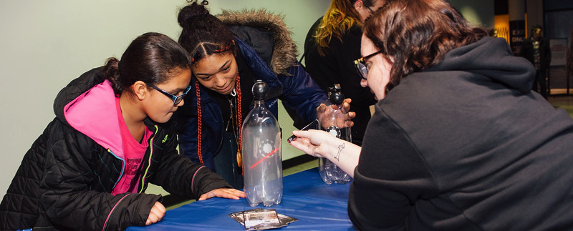

From Thin Mints to Thin Films: Museum Partnerships Engaging
Girl Scouts in STEM Education
www.nisenet.org
ASTC Conference, October 2018, Hartford, CT
Notes:
Photo credit: Science Museum of Minnesota for NISE Network

Slide 2
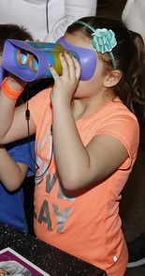
Presenters
Pamela Harman, SETI Institute
Reaching For The Stars: NASA Science for Girl Scouts
pharman@seti.org
Catherine McCarthy, NISE Network
Science Museum of Minnesota
cmccarthy@smm.org
Joelle Adolfi,
Rochester Museum & Science Center
jadolfi@rmsc.org
Kristen Martin,
The Tech Museum of Innovation
kmartin@thetech.org

Slide 3
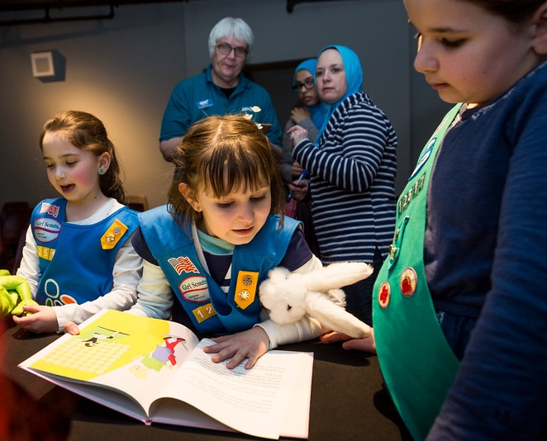
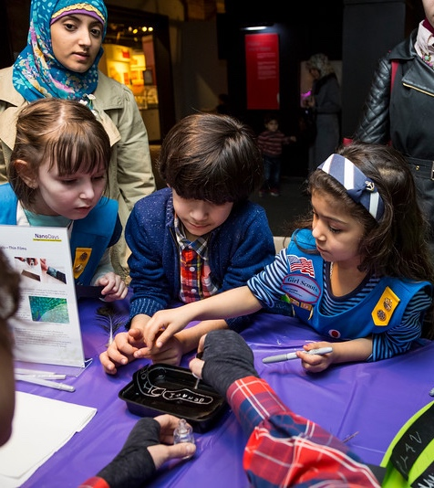
Overview
Girl Scout badges, STEM outcomes
NISE Network’s
Explore Science: Earth & Space Toolkits Overview and Badge Connections
Museums partnering with
local Girl Scouts
  Ongoing programming,
  Skill building workshops
  Overnights, special events
  Collaboration tips
Discussion, Q/A
Notes:
Photos from the MOST in Syracuse, NY courtesy of NISE Network
Thin Films activities from our kits in Syracuse NY- I reallyl should have brought Thin Mints cookies!

Slide 4
Pamela Harman
SETI Institute
Reaching For The Stars: NASA Science for Girl Scouts pharman@seti.org

Slide 5




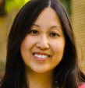
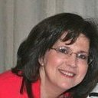

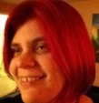


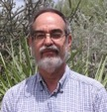



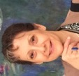



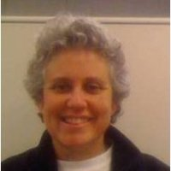




Reaching for the Stars: NASA Science for Girl Scouts
(Girl Scout Stars, GS Stars)

Slide 6

Girl Scouts of the USA
SLIDES FOR MARCOM PRESENTATION
JUNE
Jennifer Allebach, Girl Experience Executive
Girl Scouts’ STEM Initiative
Notes:
Test sound

Slide 7

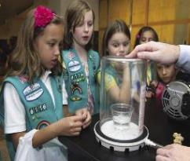
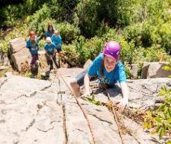
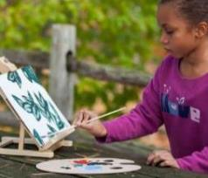
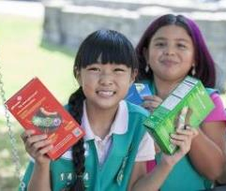
National Program Outcomes
Take Action to Change the World
SENSE OF SELF
POSITIVE VALUES
CHALLENGE SEEKING
STEM
Outdoor
HEALTHY RELATIONSHIPS
COMMUNITY PROBLEM SOLVING
Life Skills
Entrepreneurship
Girl Scout Leadership Experience
7

Slide 8
STEM Vision and Strategy
❖ Offer all girls high-quality, multi-year and progressive STEM program
❖ Increase girls’ interest, confidence, competency in STEM, as well as their understanding of STEM’s value to people and society
❖ Reach more underserved girls with STEM program
❖ Support Girl Scout councils to implement program, build local partnerships and share best practices in STEM
❖ Increase the number of women pursuing STEM degrees and careers
Notes:
Our goal is to offer all Girl Scouts high-quality, progressive STEM program. In fact because of our national reach, we currently serve 456K girls in underserved communities and we plan to reach more.
We plan to show :
increased STEM interest, confidence and competency among girls; and frankly increased satisfaction with Girl Scouts among girls, parents and volunteers.
That will translate to more women in STEM, helping to close the digital divide and reduce economic disparities.

Slide 9
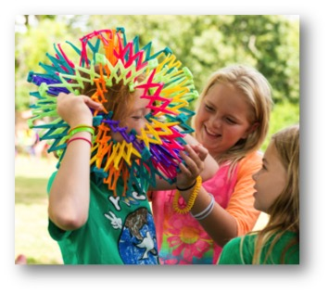
Opportunity for Impact
2nd - 3rd grade
75%
1.4 million
Notes:
Most children develop their STEM identity in 2nd or 3rd grade.
75% of Girl Scouts are in grades K – 5.
We reach 1.4 million girls at the very moment in their lives when they are deciding "STEM is fun and I am good at it" or "STEM is not for me."
That. Is. Impact.

Slide 10
STEM Outcomes
STEM Interest
STEM Confidence
Value of STEM to People & Society
STEM Competence (Knowledge)
Notes:
This will include a survey that councils can use to measure the impact of their own local program as well as the national STEM program. The national STEM outcomes are: STEM interest, STEM confidence, understanding the value of stem to people and society and STEM competence. We are currently testing the measures that will be associated with the outcomes.
o A girl who is interested in STEM, identifies STEM subjects as something she likes, wants to learn more about and wants to pursue further.
o A girl who is confident in STEM feels that she has the skills and abilities to successfully engage in STEM programs and activities.
o A girl who understands the value of STEM to people and society believes that STEM knowledge and pursuits are important and relevant to real life, and that these can be used to address personal and/or societal problems.
o A girl who is competent in STEM has learned the intended domain-specific skills and/or content knowledge of the program. This may be through specific national program (such as engineering) or through local STEM program or a combination of both.
In June, we plan to provide councils with more detailed information about the outcomes and measures and a plan for resource roll-out (surveys, webinars, supporting documentation, etc.) The outcome measures that we will be releasing are being provided as a resource to help the movement (GSUSA and councils) assess STEM program consistently and to help program align to national standards known to increase girls interest and engagement in STEM.

Slide 11
Strategic Program Focus
Engineering
Outdoor STEM
Computer Science
Notes:
So where do we start?
STEM covers a very wide range of topics and disciplines, so we’re starting with a focus on just three: Engineering, Outdoor STEM, and Computer Science.
These focus areas were chosen based on girl interest, council requests, funders’ needs, current organization relationships (Society of Women Engineers or SWE, National Center for Women in Information and Technology or NCWIT, FIRST Robotics). Outdoor STEM also supports another key initiative for the Movement.

Slide 12
Strategic Partners
Councils & Volunteers
Funders
STEM Organizations
Notes:
So where do we start?
STEM covers a very wide range of topics and disciplines, so we’re starting with a focus on just three: Engineering, Outdoor STEM, and Computer Science.
These focus areas were chosen based on girl interest, council requests, funders’ needs, current organization relationships (Society of Women Engineers or SWE, National Center for Women in Information and Technology or NCWIT, FIRST Robotics). Outdoor STEM also supports another key initiative for the Movement.

Slide 13
Partnering with Girl Scouts
Local Partnerships
Contact the Girl Scout council in your area (ask for the program lead or the STEM program lead)
  Go to http://www.girlscouts.org/.
  Click on “find a council.”
  See graphic on next slide.
Possibilities to explore: workshops/events that align with national and/or council programs, career exploration, etc.
Share your certificate of compliance
Check with local council about Girl Scouts’ Safety Activity Checkpoints
Notes:
So where do we start?
STEM covers a very wide range of topics and disciplines, so we’re starting with a focus on just three: Engineering, Outdoor STEM, and Computer Science.
These focus areas were chosen based on girl interest, council requests, funders’ needs, current organization relationships (Society of Women Engineers or SWE, National Center for Women in Information and Technology or NCWIT, FIRST Robotics). Outdoor STEM also supports another key initiative for the Movement.

Slide 14
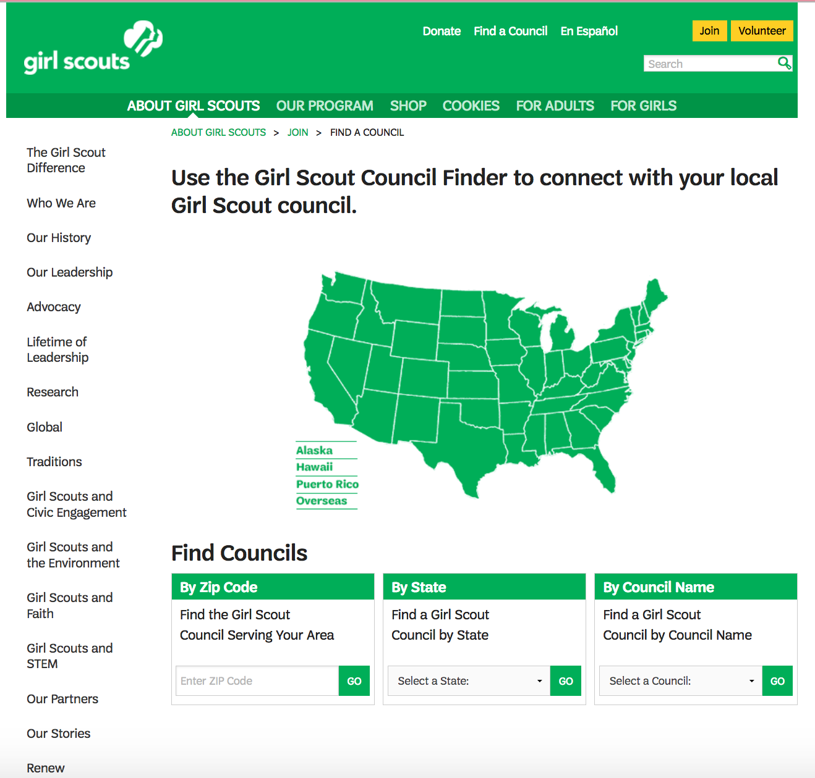

Slide 15

Notes:
Workshops that tie to national and/or local program

Slide 16

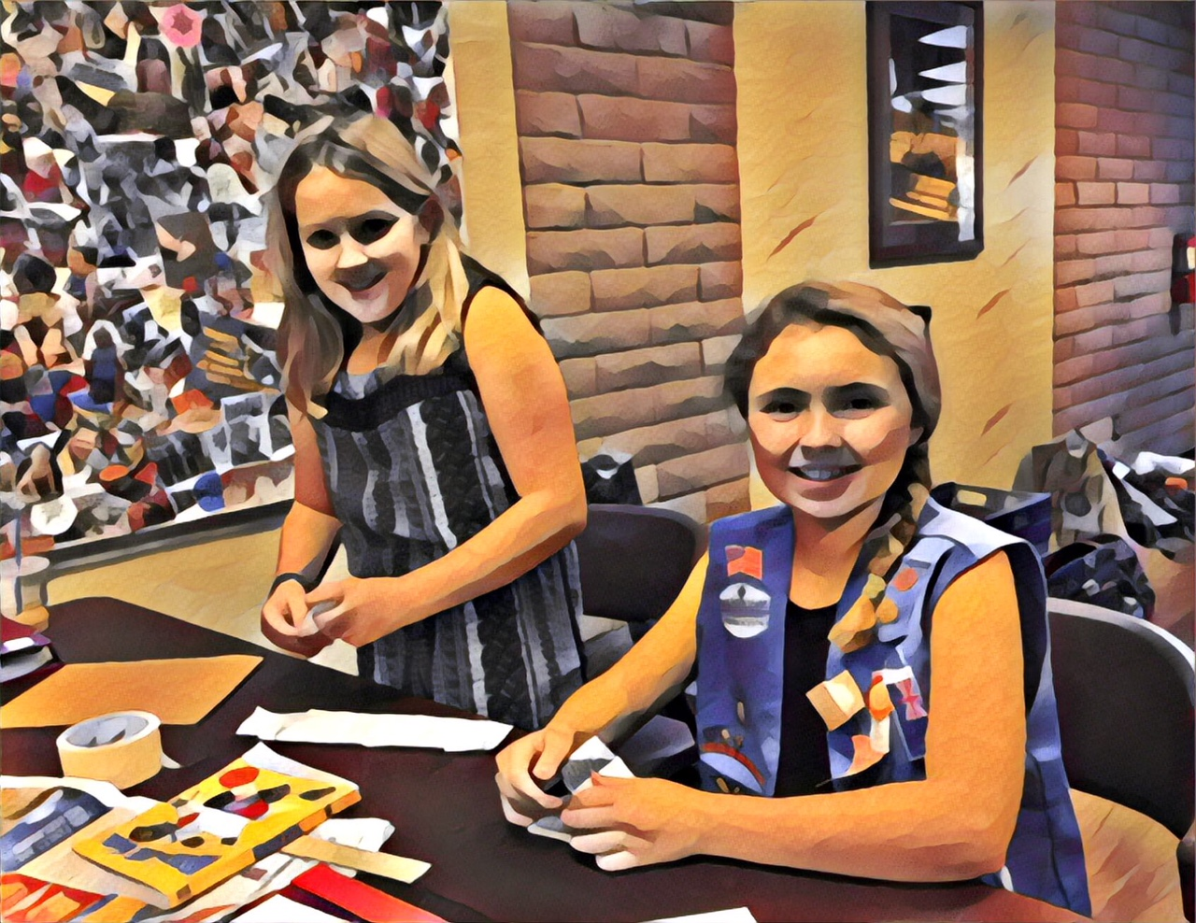
NEW STEM Journeys and Badges
NEW STEM Journey and Badges
Journeys: STEM + Leadership
✻ Hands-on challenges — how to solve problems like engineers, programmers
and scientists.
✻ Take Action project — girls use what they’ve learned to address a problem.
✻ This connects STEM to helping people in the real world.
Badges: STEM + Skills
✻ Hands-on activities teach girls specific STEM skills.
✻Building STEM skills builds STEM confidence
Notes:
The new STEM Journey teach girls a way of thinking. That’s why they’re called Think Like an Engineer, Think Like a Programmer, and Think Like a Citizen Scientist.
Engineering teaches design thinking. That’s how engineers solve problems.
Computer Science teaches computational thinking. That’s how programmers solve problems.
Outdoor STEM teaches the scientific method. That’s how citizen scientists make observations in nature, then collect and analyze their data.
These ways of thinking will help girls when they do any STEM program, including national badges, service unit events, and council programs.
The Journeys, of course, also include a Take Action project. Girls can use what they’ve learned about how engineers, programmers and scientists solve problems and use that to address a problem in their community.
Research shows that girls are more interested in STEM when they understand how it helps people. The combination of STEM and Take Action is a powerful way to make that connection for girls.
The badges focus in on specific skills. For example, girls learn how to build a robot, design a video game, create a wireframe, run a trace route map, or make paper prototypes of an engineering invention.
Building STEM skills builds STEM confidence – one of our 4 STEM outcomes and a very important one for girls!

Slide 17



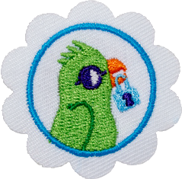
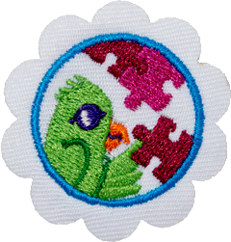
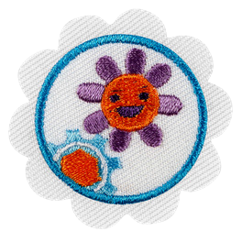

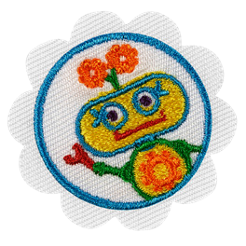
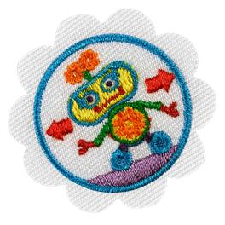
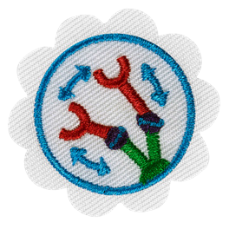
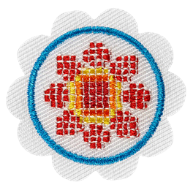
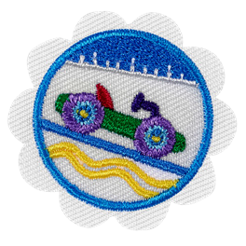

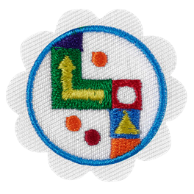
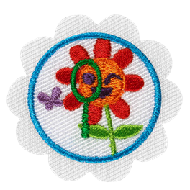
STEM for Girl Scout Daisies
JOURNEY AWARDS
Engineering Journey
BADGES
Space Science
Cybersecurity
Space Science Explorer
Cybersecurity Basics
Cybersecurity Safeguards
Cybersecurity Investigator
Think Like an Engineer
Take Action
Robotics
Computer Science Journey
What Robots Do
How Robots Move
Design a Robot
Think Like a Programmer
Take Action
Mechanical Engineering
Outdoor STEM Journey
Model Car Design Challenge
Roller Coaster Design Challenge
Board Game Design Challenge
Think Like a Citizen Scientist
Take Action
2018

Slide 18

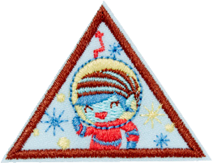
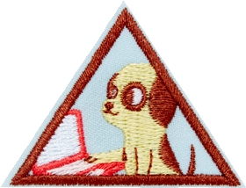

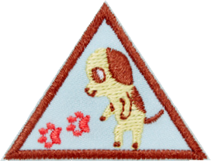
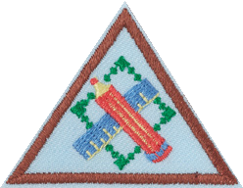

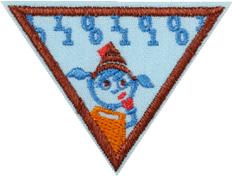
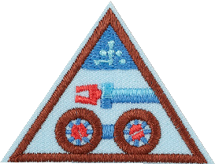
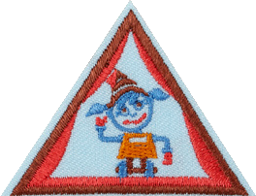

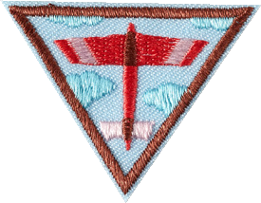

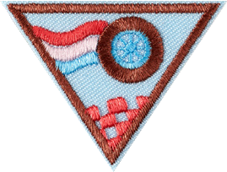

STEM for Girl Scout Brownies
BADGES
JOURNEY AWARDS
Engineering Journey
Space Science
Cybersecurity
Space Science Adventurer
Cybersecurity Basics
Cybersecurity Safeguards
Cybersecurity Investigator
Think Like an Engineer
Take Action
Robotics
Computer Science Journey
Programming Robots
Designing Robots
Showcasing Robots
Think Like a Programmer
Take Action
Mechanical Engineering
Outdoor STEM Journey
Fling Flyer Design Challenge
Leap Bot Design Challenge
Race Car Design Challenge
Think Like a Citizen Scientist
Take Action
2018

Slide 19




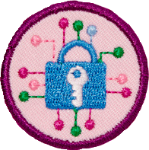
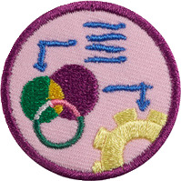

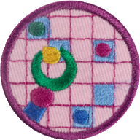
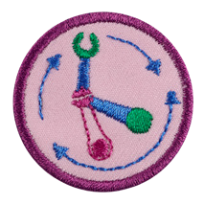

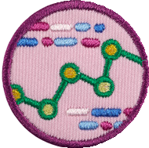



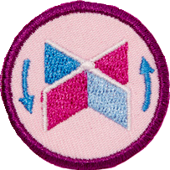


STEM for Girl Scout Juniors
BADGES
JOURNEY AWARDS
Engineering Journey
Space Science
Cybersecurity
Space Science Investigator
Cybersecurity
Basics
Cybersecurity
Safeguards
Cybersecurity Investigator
Think Like an Engineer
Take Action
Robotics
Computer Science Journey
Programming Robots
Designing Robots
Showcasing
Robots
Think Like a Programmer
Take Action
Mechanical Engineering
Outdoor STEM Journey
Balloon Car
Design Challenge
Crane Design
Design Challenge
Paddle Boat Design Challenge
Think Like a Citizen Scientist
Take Action
2018

Slide 20

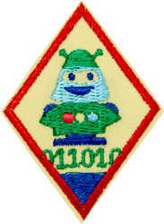
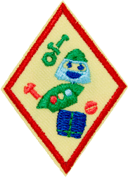
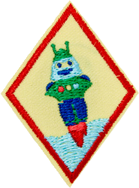
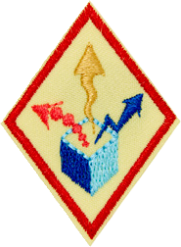


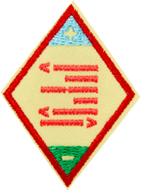

STEM for Girl Scout Cadettes
BADGES
Robotics
JOURNEY AWARDS
Engineering Journey
Programming Robots
Designing Robots
Showcasing
Robots
Think Like an Engineer
Take Action
Leader in Action
Computer Science Journey
Think Like a Programmer
Take Action
Leader in Action
2018

Slide 21

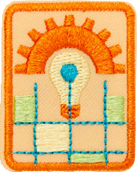

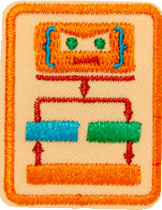
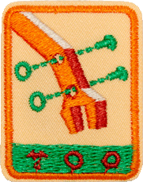



STEM for Girl Scout Seniors
BADGES
JOURNEY AWARDS
Engineering Journey
Robotics
Think Like an Engineer
Take Action
Programming Robots
Designing Robots
Showcasing Robots
Computer Science Journey
Think Like a Programmer
Take Action
2018

Slide 22







WHAT’S NEW
STEM for Girl Scout Ambassadors
BADGES
Robotics
JOURNEY AWARDS
Engineering Journey
Think Like an Engineer
Take Action
Programming Robots
Designing Robots
Showcasing Robots
Computer Science Journey
Think Like a Programmer
Take Action
2018

Slide 23


3 steps
2 choices

Slide 24


5 steps
3 choices

Slide 25


5 steps
3 choices

Slide 27
Catherine McCarthy
NISE Network
Science Museum of Minnesota, Saint Paul, MN cmccarthy@smm.org

Slide 28


WHAT IS THE
NISE NETWORK?

Slide 29

The National Informal STEM Education Network is dedicated to supporting learning about science, technology, engineering, and math (STEM).
NISE Net
includes
informal educators and scientists.

Slide 30

NISE Net supports informal learning about STEM in communities across the United States.
Our activities are
fun and accessible
for everyone.

Slide 31

Together we reach millions of people each year!
NISE Net
brings together diverse people to share and learn from each other.

Slide 32



WHAT WE CREATE
Educational products
kits of hands-on activities
for use in museums (and similar settings)
exhibits for museums
Professional development tools
training videos
online workshops
written guides
planning resources

Slide 33


KIT CONTENTS
Each kit includes:
hands-on activities
posters, media, and graphics
event planning materials
training videos
All resources are available for free download at nisenet.org

Slide 34


KIT CONTENTS
Each activity includes:
all necessary materials
step-by-step instructions
facilitator guide & background info
activity sign
All resources are available for free download at nisenet.org

Slide 35


Explore Science: Earth and Space Toolkits
Description
  STEM educational resources, including hands-on activities, videos, and media
  Professional resources for planning, implementation, and staff training
  All necessary materials to build partnerships, provide professional development, and engage the public
2019 Toolkit Application
  350 copies distributed in early 2019
  Applications due November 1, 2018
    http://www.nisenet.org/earthspacekit-apply

Slide 36

Toolkit Eligibility
The physical toolkit is designed for informal science education public events and outreach. To be eligible to receive a physical toolkit, organizations must be:
  Located in the United States
  Public informal science outreach and education institutions such as:
    science museums and science centers,
    children’s museums,
    natural history museums,
    public planetariums and observatories, and
    NASA visitor centers
Please note that K-12 schools, afterschool programs, libraries, parks, and astronomy clubs are not eligible to receive physical toolkits. Consider downloading a digital toolkit if your organization does not meet eligibility criteria. Digital toolkits will be available for download in February 2019 at nisenet.org/earthspacekit
Notes:
The physical toolkit is designed for informal science education public events and outreach. To be eligible to receive a physical toolkit, you must be located in the United States and be a public informal science outreach and education institution. Some examples of those include science museums and science centers, children’s museums, natural history museums, public planetariums and observatories, and NASA visitor centers.
Please note that K-12 schools, afterschool programs, libraries, parks and astronomy clubs are not eligible to receive a physical toolkit but these organizations would be able to access and download a digital toolkit. If you have questions about your eligibility feel free to ask now in the chat box or consider contacting your regional hub coordinator, again that info can be found on the Contact Us page on nisenet.org.

Slide 37
Partner Expectations
Recipients must:
  Use the toolkit for at least one event between March and May
  Meet data reporting requirements – due June 2018
Recipients may:
  Attend professional development online workshops
  Collaborate with local experts
  Collaborate locally to reach underserved audiences

Slide 38

Using Your Toolkit All Year Long
Celestial events: Meteor showers, lunar eclipses, full moons, planetary events, and more
Earth and space science events:
  World Water Day, March 22, 2019
  Earth Hour, March 30, 2019
  Global Astronomy Month, April
  Yuri's Night, April 12, 2019
  Earth Day, April 22, 2019
  National Environmental Education Week, week of Earth Day
  Astronomy Day (Spring), May 11, 2019
  Astronomy Week (Spring), May 6-12, 2019
  World Oceans Day, June 8, 2019
  Asteroid Day, June 30, 2017
  International Observe the Moon Night, October 20, 2018; TBD 2019
  Astronomy Day (Fall), October 5, 2019
  Astronomy Week (Fall), September 30-October 6, 2019
  World Space Week, October 4-10, 2019
  Earth Science Week, October 14-20, 2019
Notes:
Again, as I mentioned earlier, you must host at least one event between March and May but we encourage you to think about how you can use you toolkit throughout the year. As you can see here, we’ve listed out several options for adding the activities in the toolkit to an existing STEM event. Again, all of these can be found in the overview document.

Slide 39

Toolkits & Girl Scout Badges
Activities from the NISE Network’s Explore Science: Earth and Space toolkits can supplement, and in some cases satisfy some of the requirements for a Girl Scout to earn a Space Science badge.
Digital versions of the 2017 & 2018 Earth & Space toolkits are available for download
2017 Explore Science: Earth & Space toolkit: www.nisenet.org/earthspacekit-2017
2018 Explore Science: Earth & Space toolkit: www.nisenet.org/earthspacekit-2018

Slide 40
Badge NISE Network
Step Earth & Space toolkit activity
Daisy Space Science Explorer Badge (grades K-1)
Explore the Sun Exploring Earth: Bear’s Shadow
Observe the Moon Exploring the Solar System: Hide and Seek Moon
Meet the Stars Exploring the Universe: Filtered Light
Brownie Space Science Adventurer Badge (grades 2-3)
Meet the Neighbors Exploring the Solar System: Pocket Solar System
Investigate the Moon Exploring the Solar System: Solar Eclipse & Exploring the Solar System: Craters
Junior Space Science Investigator Badge (grades 4-5)
Model the Solar System Exploring the Universe: Objects in Motion
Circle the Sun Exploring the Universe: Orbiting Objects
Use Tools to Explore Exploring the Solar System: Mars Rovers
Notes:
Please see handouts with resource and more details.

Slide 41



Applications Now Open!
Explore Science: Earth & Space 2019 toolkit applications
are due November 1, 2018
http://www.nisenet.org/earthspacekit-apply
Notes:
The National Informal STEM Education Network (NISE Net) is pleased to offer 350 free Explore Science: Earth & Space 2019 toolkits to new and existing eligible partners in the United States. In collaboration with NASA, the NISE Network has assembled a new set of engaging, hands-on Earth and space science experiences with connections to science, technology, and society.

Slide 42





Thank You
This material is based upon work supported by NASA under cooperative agreement award numbers NNX16AC67A and 80NSSC18M0061.
Any opinions, findings, and conclusions or recommendations expressed in this material are those of the author(s) and do not necessarily reflect the view of the National Aeronautics and Space Administration (NASA).

Slide 43
Joelle Adolfi
Rochester Museum & Science Center, Rochester, NY jadolfi@rmsc.org

Slide 44

Girl Scouting at the Rochester Museum and Science Center
What we offer…
At the RMSC we offer a variety of Girl Scout badges for Brownies through Seniors.
Our programs are on “demand” now
As well as customized overnights.
Notes:
At the Rochester Museum and Science Center, we have been offering Girl Scout Badge Programs for approximately 20 years. By utilizing our resources of the Museum, Strasenburgh Planetarium and Cumming Nature Center, we are able to offer a variety of programs in the STE(A)M fields. It really allows us to focus on programming that we excel at. This year we have developed some new programming with the new Girl Scout Outdoor Programs and the NISE Net Earth and Space Kits.

Slide 45

Girl Scouts at RMSC
Brownie Home Scientist with Nano Kits
Notes:
Over the past several years we have been integrating the NISEnet kits into our existing scout programs. Our most popular classes include Brownie Home Scientist where we explore electricity using the Exploring Forces Static Electricity kit and plasma balls, explore density with liquid layers, explore acids and bases with mini-rockets and balloon blow up, explore matter by making slime and oobleck and then tie many of these concepts together by making liquid nitrogen ice cream.

Slide 46


New GSA badges and NISEnet kits
Space Science Badge-
Daisy: Space Science Explorer
Brownie: Space Science Adventurer
Junior: Space Science Investigator
Robotics-
Daisy: All three badges in one class
Brownie: Programming badge and Design badge
Junior: Programming badge and Design badge
* All have the opportunity to use what they learned from the program toward their Showcasing badge.
Notes:
My colleague Stephanie Hildreth works as a Scout leader for the Girl Scouts of America she was able utilize the relationship with GSA to receive drafts requirement guides of the Space Science badges and Robotics badge, which allowed us to create curriculum for those badge programs in time for our 2018-2019 scout program season. Building into the use of the NISEnet Exploring Science; Earth and Space kits components into the curriculum.
Space Science Badges:
Daisy Space Science Explorer badge uses Hide and Seek Moon activity and Bear Shadow activity.
Brownie Space Science Adventurer badge uses Pocket Solar System activity
Junior Space Science Investigator badge uses Mars Rover
*We also offer a planetarium as an add on, as we cover the entire badge in the program session.
Robotics Badges:
Daisy Programming, Design and Showcasing Badge are completed in one program session
Brownie: Programming and Design badge are covered in one program session
Junior: Programming and Design badge are covered in one program session
*Both Brownie and Juniors have the opportunity to use what they learned from the RMSC Scout program toward their Showcasing Badge.
These badges use kit activities from both Frankenstein 200 (Scribble bots) and Exploring Science; Earth and Space (Mars Rover)

Slide 47


Tips and Challenges
Tips!
Fun- should not seem like school!
Unique experience-only at the RMSC.
Hands on, project based- they are learning through doing.
Inquiry based learning- asking questions, not giving answers.
Completing badge requirements within a 3 hour class.
Cost effective- Admission to the RMSC included with Scout Program.
Class is in the Instructor’s hands.
Organized bin of materials are ready for instructors.
Challenges
Getting the word out!
Creating quality programming that we can excel at.
Finding quality instructors.
Classroom space, technology, supplies and materials!
Weekend programming
Scheduled programs vs. Program that ran
Knowing Girl Scout Council Boundaries
Who to contact at Girl Scouts
Notes:
Through providing Girl Scout programming, we have learned what works and what doesn’t work for us.
Tips:
One of the most important things we have learned is that Girl Scout Programming should not seem like school! Programming should be fun.
We want the Girl Scouts to have a unique experience at the Rochester Museum and Science center, the contents of the program should be something that they would be able to replicate completely on their own. For example- Liquid Nitrogen ice cream, utilizing exhibits, live animals, or special demonstrations and experiments.
Learning is hands on and project based, the instructor introduces a topic and gives any direction needed to help facilitate the activities where the Girl Scouts are learning through doing. For example, in Brownie home scientist, the Girl Scouts play with Plasma Balls to learn about conductors and insulators, make their own slime to learn about phases of matter and blow up a balloon using vinegar and baking soda to learn about acids and bases.
We use the Inquiry process for all of our classes. Instructors aren’t talking at the Scouts; we are engaging them with questions. For example, instead of telling Scouts what an insulator or conductor is, I ask them to tell me about a time that they have given or received a static shock. Through their stories, they have now told me several different conductors of electricity.
One of the most helpful things we do is provide a complete badge program for the Scouts within the timeframe of three hours or less. At the end of class we can tell the Scouts: You have earned ___badge. As a Girl Scout leader, I know it often takes me 4-5 meetings to complete an entire badge.
We know Scouts have to spend their money wisely. We try to keep Scout classes cost effective at $15-$20 per Scout depending on the level of program. Before their badge class begins or after their badge class is complete, the Girls participating have admission to the RMSC and are able to explore on their own.
Our Girl Scout programming is completed by a trained, professional instructors teaching within areas of their expertise with the help of an assistant. This means that the class is in the instructor’s hands and Leaders and parents can sit back and relax or join in the fun.
We make the class as easy as possible for the instructors by having all of the materials for their program together for them in a prepared bin.
Challenges:
Marketing and Letting Scouts know what we offer for them is a challenge. Information appears on our website, the Girl Scouts of Western New York website and is often featured in the Council Information Sheet. Most often, Scouts know about our programming because they have attended a Scout program previously.
Creating programming that our Museum can excel at teaching. Not every STEM badge that Girl Scouts comes out with will be something that we will be able to offer. We have tried offering several badges that aren’t quite in our areas of expertise or that we do not have all of the equipment for and have not succeeded, especially if there is another community resource that is able to create a better program for that topic. Know what you are good at and stick to it.
Scout classes are taught on weekends and we mainly utilize part-time, per –diem staff. Finding strong staff to commit to changing hours is challenging. We do have a core group of reliable, committed part-time staff who truly enjoy teaching at the RMSC on their weekends.
At the RMSC we are lucky enough to have plentiful classroom spaces; however, many of the classroom spaces are lacking technological updates or lab spaces. Scout classes also often need a plethora of supplies, everything from basic craft supplies, to food supplies, to chemicals and lab equipment.

Slide 48


Partnering with Girl Scouts of Western New York
Partnering up for Science Events
Troop Facilitation
Using resources from the RMSC to help facilitate troop activities.
STEM-A-Palooza, a Girl Scouts of
Western New York event
Notes:
We have begun to partner with Girl Scouts of Western New York for Science Programming. We recently tabled at STEM-A-Palooza. I also use our RMSC kits to facilitate Girl Scout Troops.

Slide 49
Kristen Martin
The Tech Museum of Innovation, San Jose, CA kmartin@thetech.org

Slide 50
Girl Scouts
@ The Tech

Slide 51




Partnership history
Originated 2009-2010 with two Junior programs :
  Math Whiz
  Make it Matter
Big changes for 2012
  GS badging program changed
  Switched Junior programs:
    Detective
    Entertainment Technology
  Greater demand - offering 15-20 sessions
Present day
  Programs for Daisies through Seniors
  48 session dates FY19
Notes:
*2009 - 2013 only ran 6-8 sessions per year

Slide 52









2018-2019 Program Offerings
*Schedule for year is set in advance; sessions may be added if demand is high
Program | Age/Level | GSUSA Badge | Cost | Includes | # Sessions offered
Robo-Designer | Daisy K-1st | What Robots Do Design a Robot | $40 | Both robotics badges + Tech fun patch Museum Admission; IMAX film | 3
Home Scientist | Brownie 2nd-3rd | Home Scientist | $35 | Program badge + Tech fun patch Museum Admission | 19
Robo-Designer |  | Designing Robots | $40 | Program badge + Tech fun patch Museum Admission; IMAX film | 3
Amusement Innovator | Junior 4-5th | Entertainment Technology | $30 | Tech fun patch; Museum Admission | 6
Tech Detective |  | Detective | $30 | Tech fun patch: Museum Admission | 6
Robo-Designer |  | Designing Robots | $40 | Program badge + Tech fun patch Museum Admission; IMAX film | 3
Special Agent | Cadette 6-8th | Special Agent | $30 | Tech fun patch: Museum Admission | 4
Change Makers | Senior 9-10th | Social Innovator | $65 | Program badge + Tech fun patch Museum Admission; lunch | 4

Slide 53


Benefits of VIP Partnership
Programs featured in council’s annual Program Guide
Marketing through multiple channels: Facebook features, direct e-news to members, lobby flyers, lobby monitor ads, cross promotion to other STEM program attendees
Invitations to table at special council events (Bridging, STEM Career events)

Slide 54



Challenges
Successes
Some programming is difficult to fill (age-level related)
Competing events and programs (no programs during cookie sales)
Meeting demand
Negotiating what success looks like (Tech vs. GSNorCal - primarily regarding attendance)
Huge program growth
  from 2 to 8 programs
  from 6 to 48 sessions
Girls in STEM initiative
  Served roughly 4,000 girls in GS programs over the last 8 years
Advertising partnership
Revenue

Slide 55



Tips for Other Museums
Make it fun!
Match badge programs to existing experiences/activities or adopt badge programming that match your center’s programming themes
Start small and grow with demand
Work with your local council to determine needs

Slide 56
Discussion and
Questions

Slide 57

Discussion
How can I learn more about the new badges?

Slide 58

Discussion
Practical suggestions for making overnights successful?

Slide 59

Discussion
Suggestions for connecting with local troops?

Slide 60
Discussion
Other
Questions?

Slide 61

Discussion
Other
Questions?

Slide 62

This material is based upon work supported by NASA under cooperative agreement award numbers NNX16AC67A and 80NSSC18M0061.
Any opinions, findings, and conclusions or recommendations expressed in this material are those of the author(s) and do not necessarily reflect the view of the National Aeronautics and Space Administration (NASA).

